Slide 1
Disclaimer: The information in the following slides are a guide to assist in the Sales Tax Registration Process. At the end of the registration process, there will be a submit button. Once submit is clicked, the business has registered with the state and is obligated to the state filing frequencies and, if any, fees and penalties. Businesses should contact Sales Tax and More before hitting submit if questions arise. Unfortunately, your registration process will need to start over as states typically have a timeout period. There is a fee associated with the assistance of the registration. If the slides show information that is not consistent with what is shown on the website, please contact us, and we will correct this information as quickly as possible. Call Sales Tax and More at (972) 737-4559 or email info@salestaxandmore.com

Slide 2
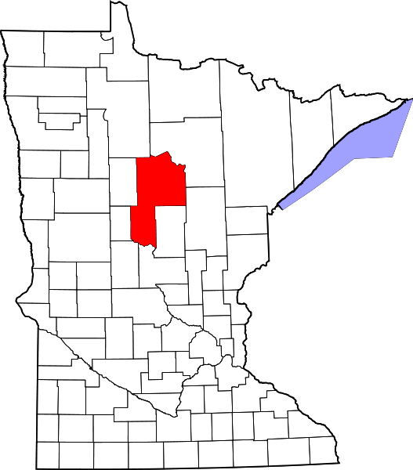


Minnesota Sales Tax Registration Instructions
https://www.mndor.state.mn.us/tp/eservices/_/
Tax Type:
Sales & Use Tax
https://www.salestaxandmore.com/

Slide 3
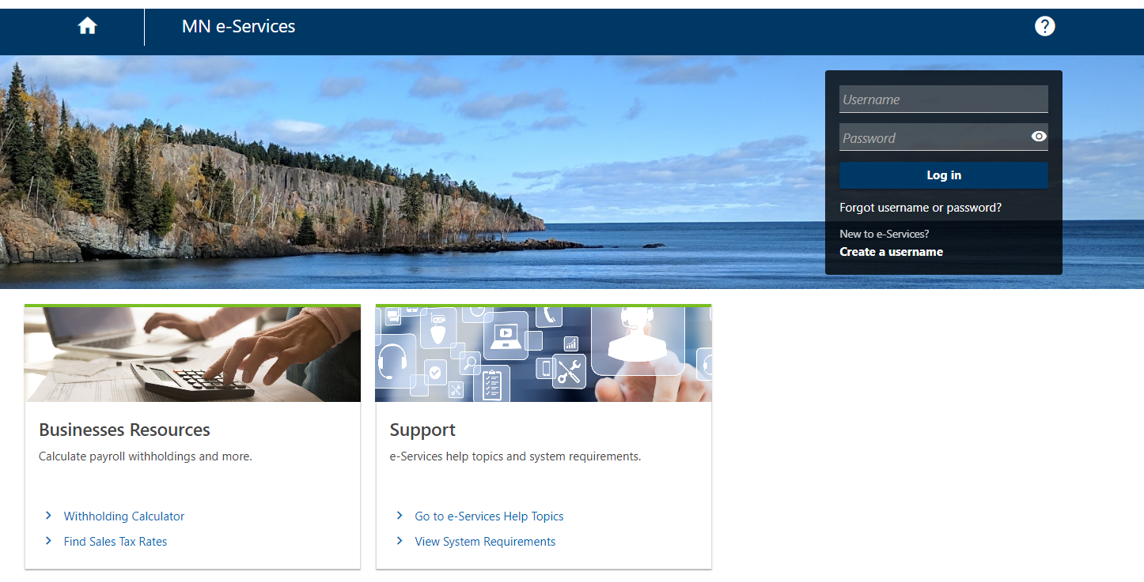
Sales Tax and More - MN Registration
Step 1
Click - Create Username
https://www.salestaxandmore.com/

Slide 4
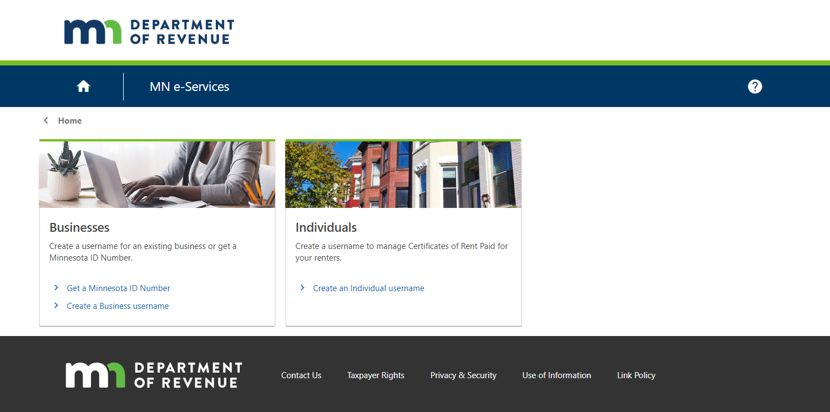
Sales Tax and More - MN Registration
Step 2
Click- Get a Minnesota ID Number
https://www.salestaxandmore.com/

Slide 5
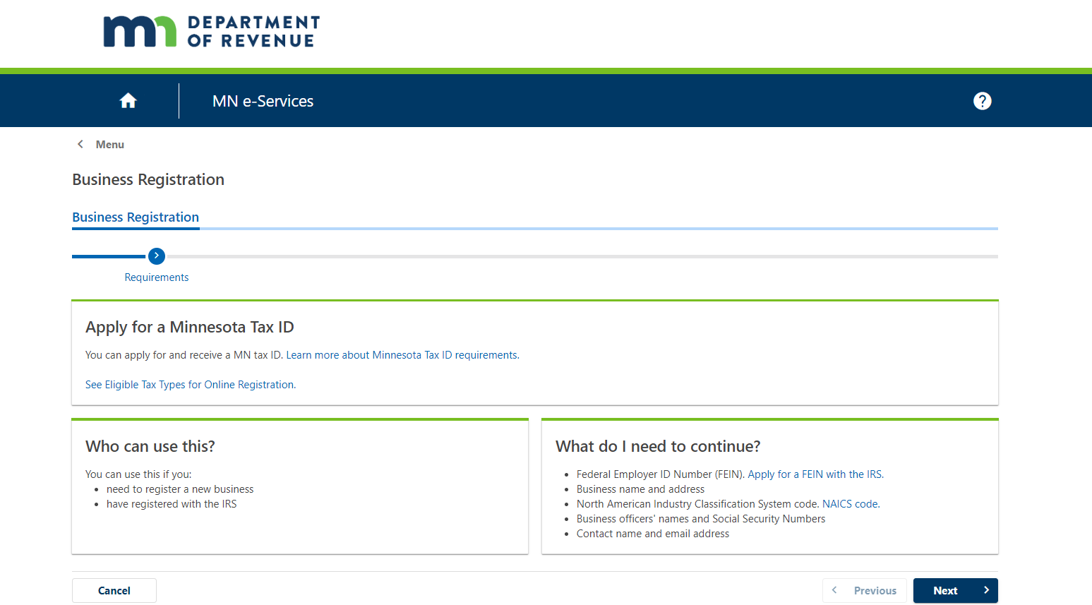
Sales Tax and More - MN Registration
Step3
Click - Just click Next
https://www.salestaxandmore.com/

Slide 6
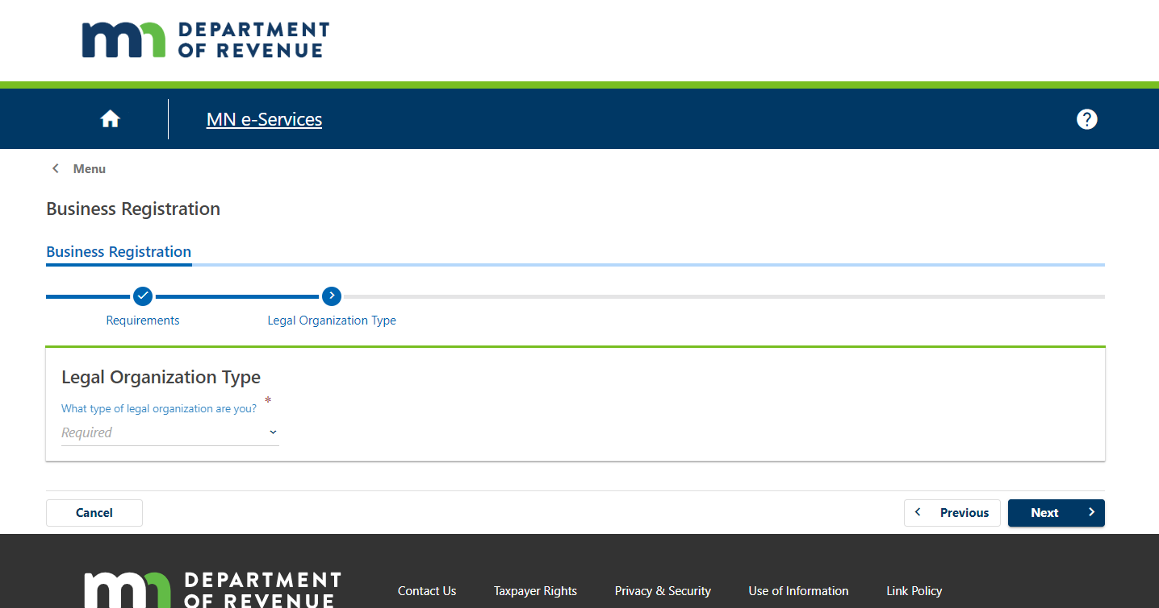
Sales Tax and More - MN Registration
Step 3
Drop down menu - Type of organization
https://www.salestaxandmore.com/

Slide 7
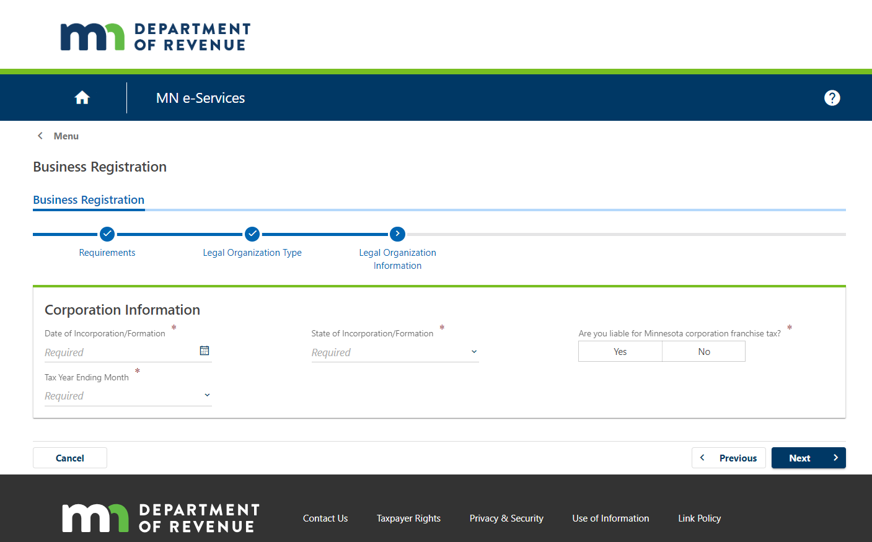
Sales Tax and More - MN Registration
Step 4
Date of Incorporation/formation
State of formation
Are you liable for Minnesota corporation franchise tax? NO
Tax Year Ending Month
Click NEXT
https://www.salestaxandmore.com/

Slide 8
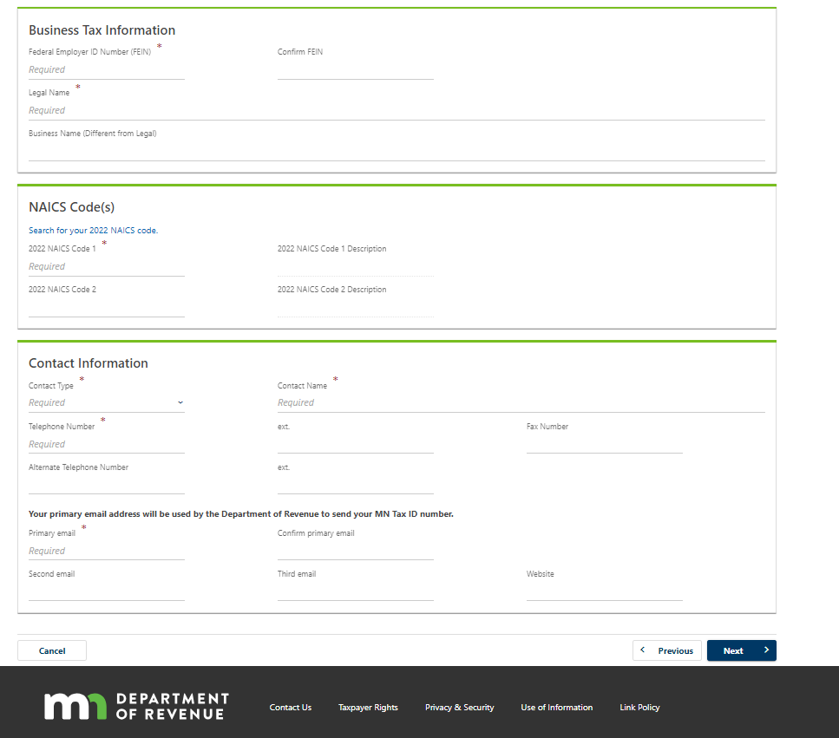
Sales Tax and More - MN Registration
Step 5
Business Tax Information- Type in FEIN and then type it in again under Confirm FEIN
Legal Name- Type in Legal Name
Business Name (Different from Legal)- Type in DBA
NAICS Code(s): Click on Search for your 2022 NAICS code and choose the appropriate code
Contact Information: Choose Contact Type from the drop down; Type in Contact Name; and Contact Telephone Number
Your primary email address will be used by the Department of Revenue to send your MN Tax ID number: Type in primary email address and then type it in again under Confirm primary email address
Click NEXT
https://www.salestaxandmore.com/

Slide 9
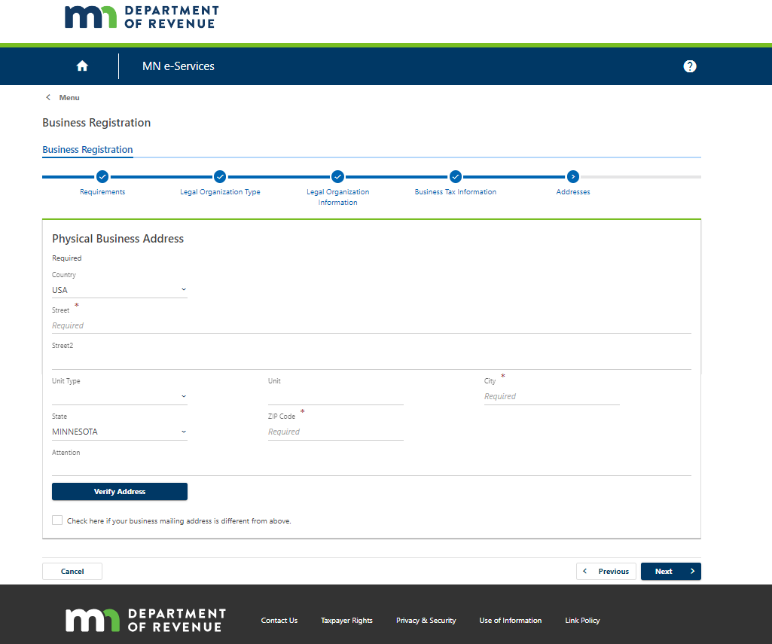
Sales Tax and More - MN Registration
Step 6 Type in Physical Business Address; Click Verify Address
Check the Box if your business mailing address is different from above. If you do choose to list a different mailing address then the page will drop down and just type in the mailing address and don’t forget to Click Verify Address
Click NEXT
https://www.salestaxandmore.com/

Slide 10
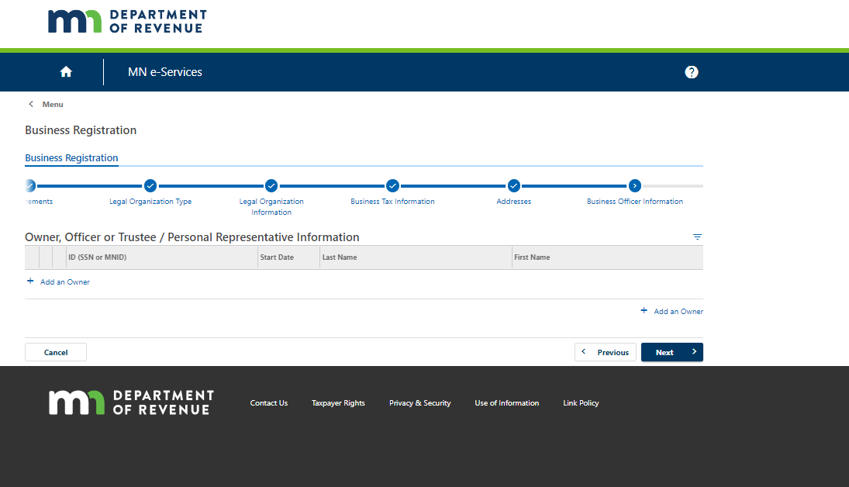
Sales Tax and More - MN Registration
Step 7
Owner, Officer or Trustee / Personal Representative Information: Click the +Add
https://www.salestaxandmore.com/

Slide 11
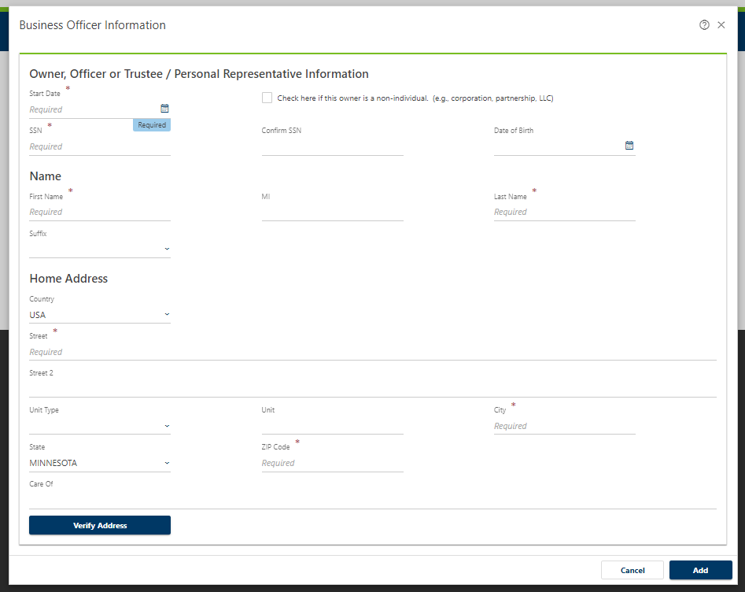
Sales Tax and More - MN Registration
Step 8: Owner, Officer or Trustee / Personal Representative Information:
A)Choose start date from the calendar B)Type in SSN and re type in SSN under confirm SSN
C)Type in Date of Birth D)Type in First and Last name
E) Type in home address and verify address
Click ADD
https://www.salestaxandmore.com/

Slide 12
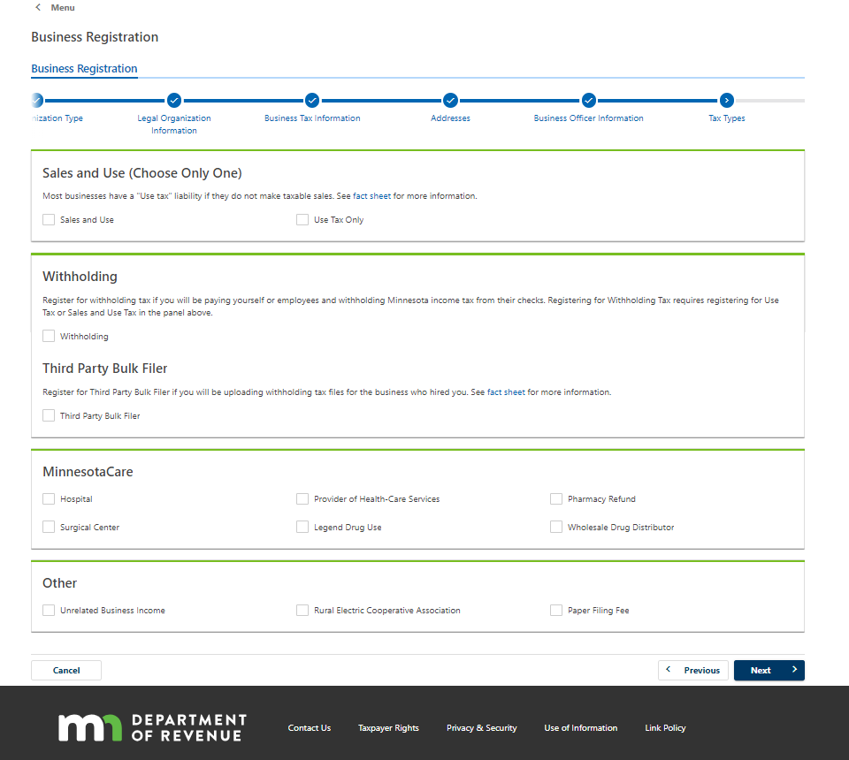
Sales Tax and More - MN Registration
Step 9 Choose Sales and Use Tax only and Click NEXT
https://www.salestaxandmore.com/

Slide 13
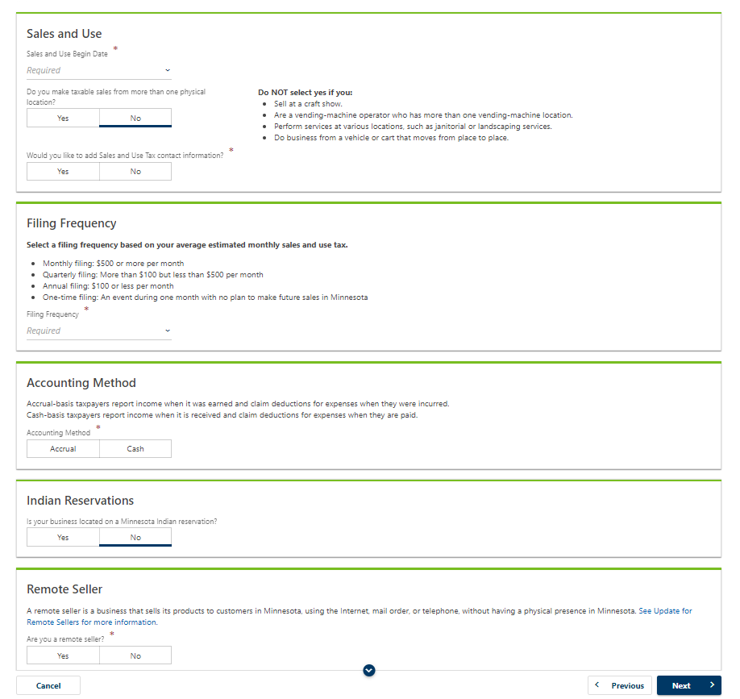
Sales Tax and More - MN Registration
Step 10
Sales and Use
Sales and Use Begin Date: Choose Month and Year
Do you make taxable sales from more than one physical location? NO
Would you like to add Sales and Use Tax contact information? Choose Yes or No
Filing Frequency
Choose the applicable filing frequency based on your average estimated monthly sales and use tax.
Accounting Method: Choose Accural
Indian Reservations
Is your business located on a Minnesota Indian reservation?NO
Remote Seller
Are you a remote seller? YES
Begin Date: should auto populate and will match the date above that was chosen previously
Click NEXT
https://www.salestaxandmore.com/

Slide 14
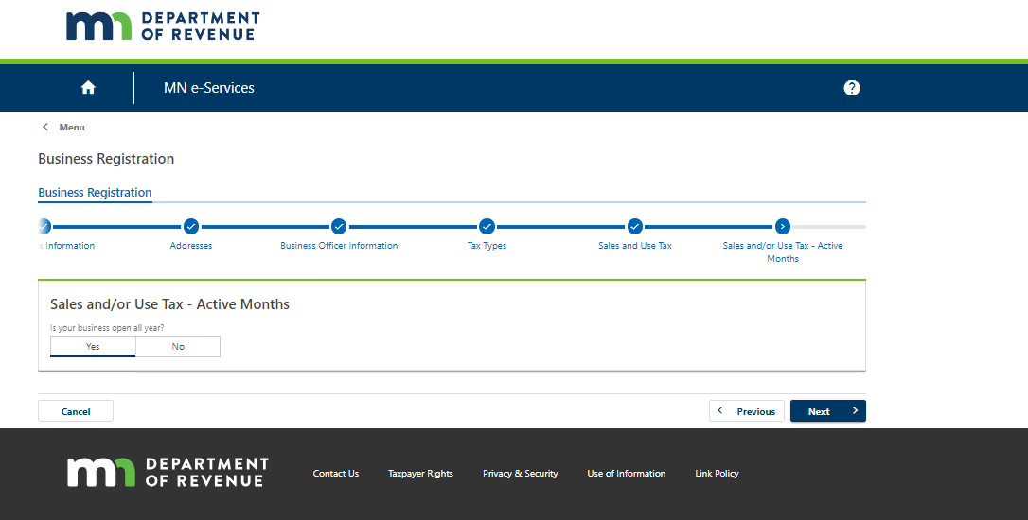
Sales Tax and More - MN Registration
Step 11: Sales and/or Use Tax - Active Months
Is your business open all year? Should Auto populate answer: YES
Click NEXT
https://www.salestaxandmore.com/

Slide 15
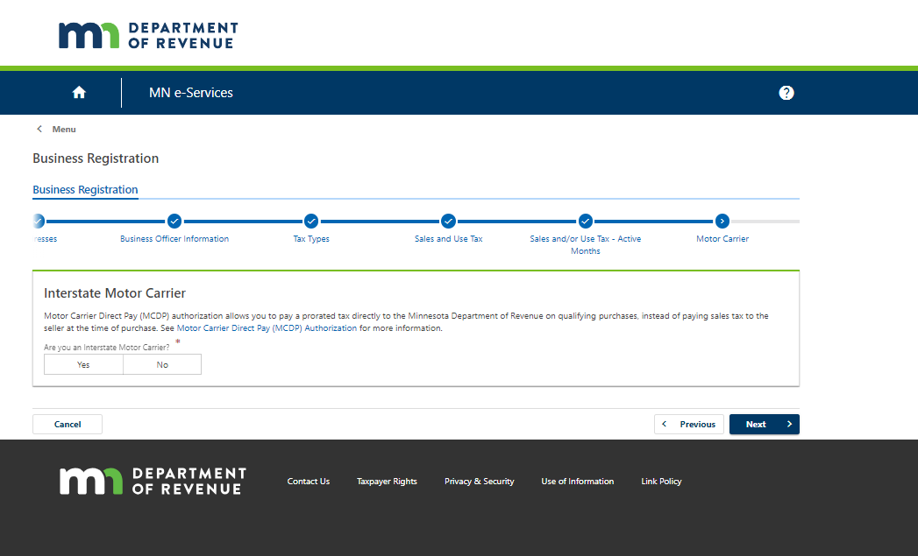
Sales Tax and More - MN Registration
Step 12: Interstate Motor Carrier
Are you an Interstate Motor Carrier? NO
Click NEXT
https://www.salestaxandmore.com/

Slide 16
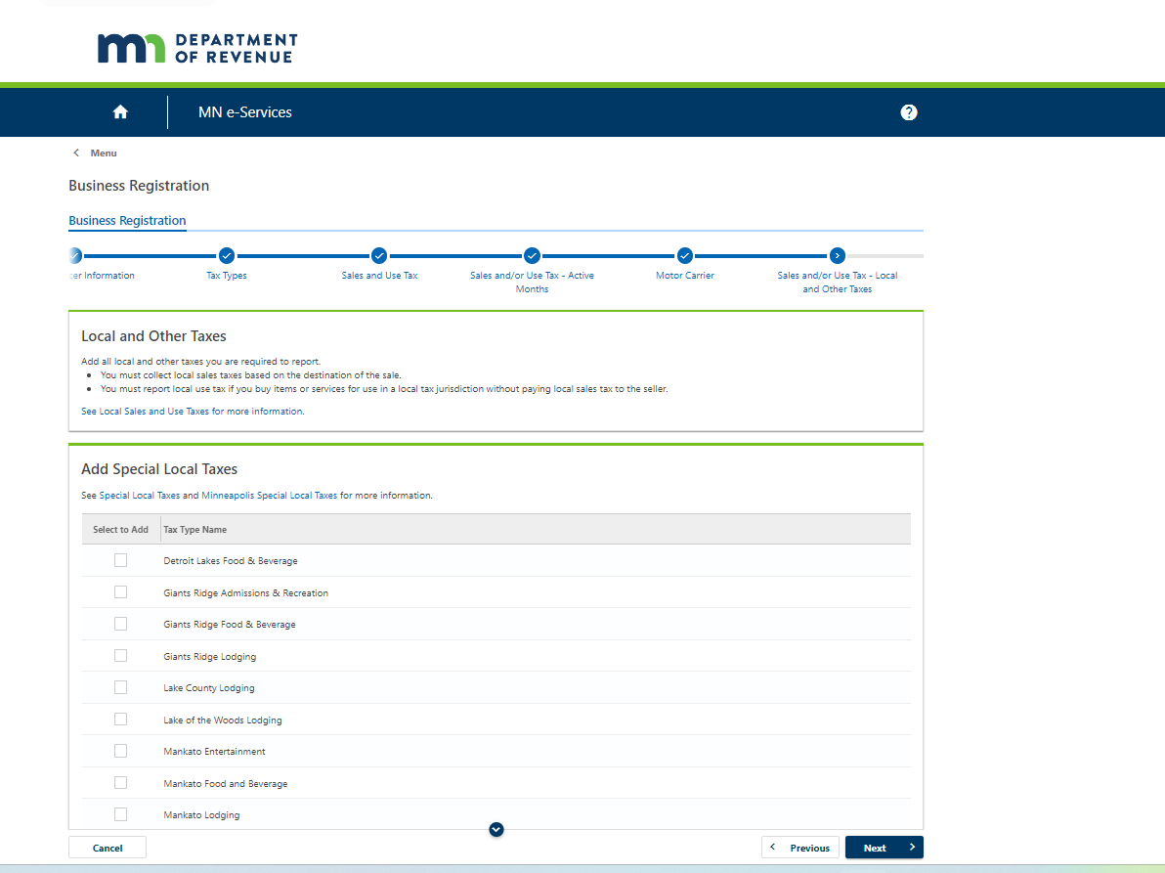
Sales Tax and More - MN Registration
Step 13: Skip and Just Click NEXT
https://www.salestaxandmore.com/

Slide 17
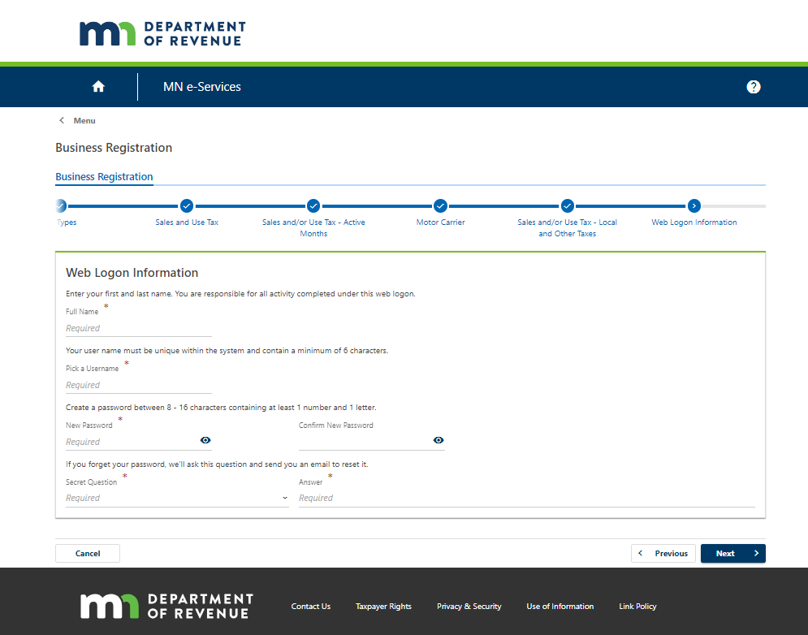
Sales Tax and More - MN Registration
Step 14
Type - Web login information, name, pick username, password (2x’s), secret question, secret answer (write down)
Click - Next
https://www.salestaxandmore.com/

Slide 18
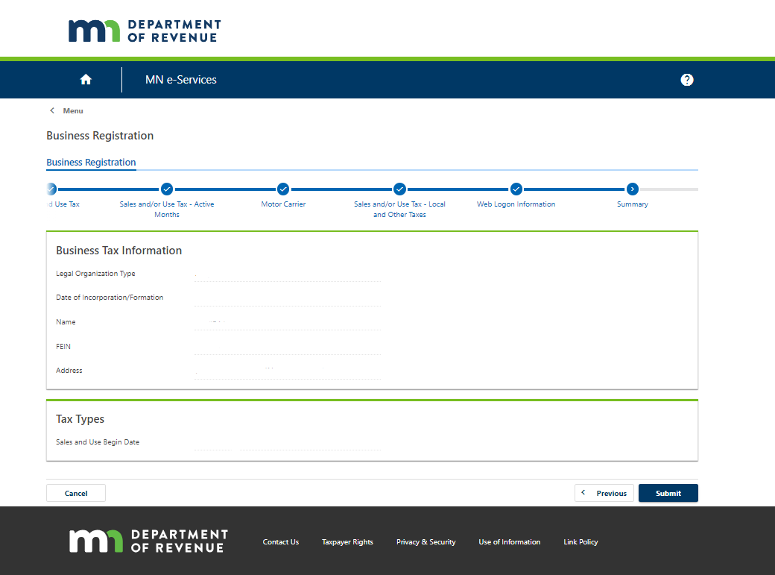
Sales Tax and More - MN Registration
Step 15: Review information: Business Tax Information
Legal Organization Type
Date of Incorporation/Formation
Name
FEIN
Address
Tax Types
Sales and Use Begin Date:
Once Reviewed Click SUBMIT
https://www.salestaxandmore.com/

Slide 19
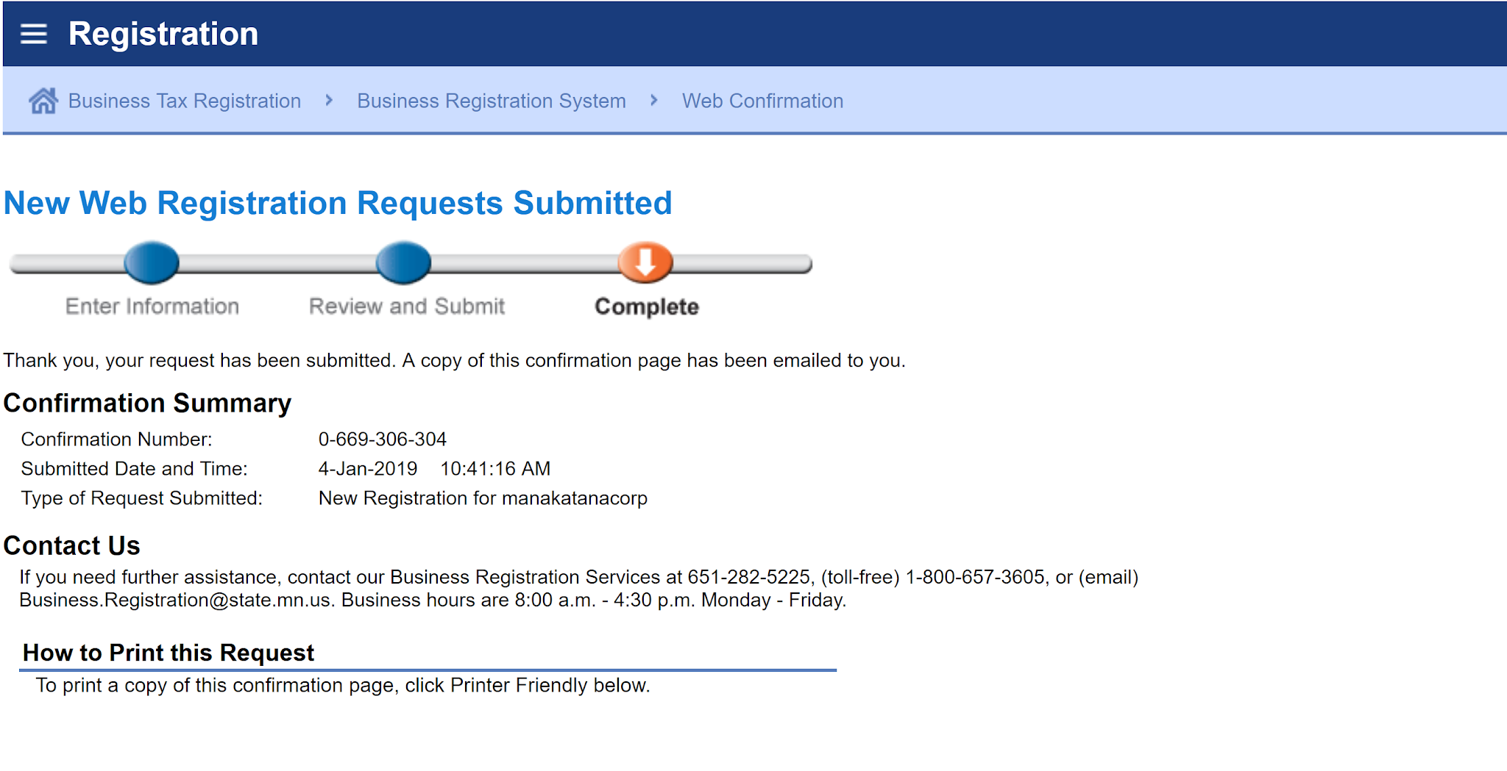
Sales Tax and More - MN Registration
Check your Email, may take 24 - 48 hours (next slide)
Registration Complete.
https://www.salestaxandmore.com/

Slide 20
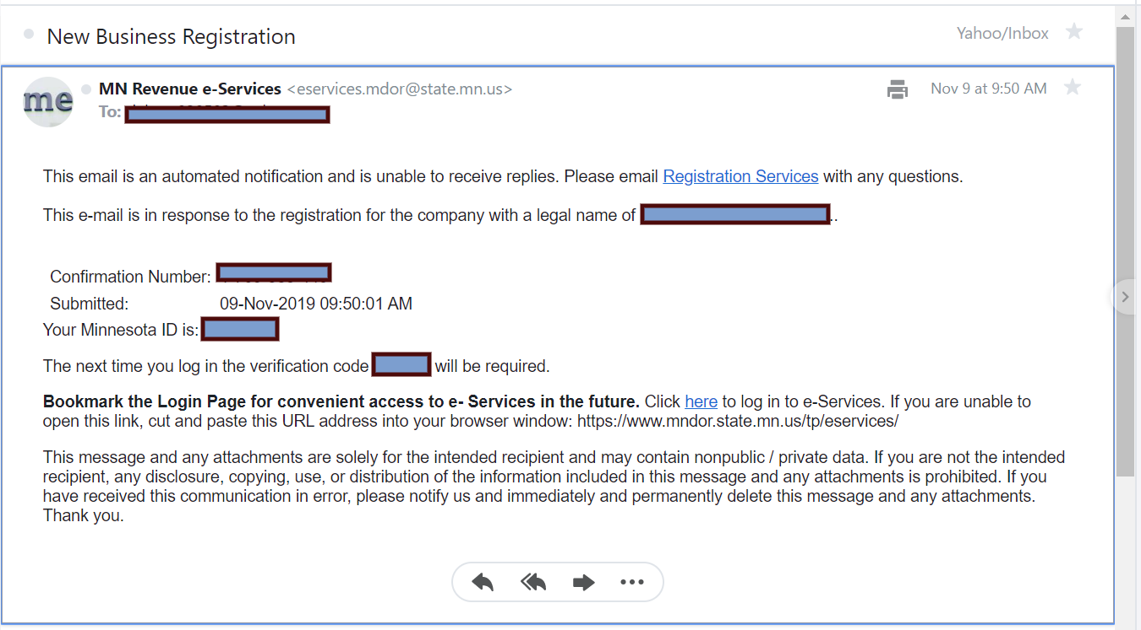
Sales Tax and More - MN Registration
Keep your MN ID, this is your permit #.
Keep your verification code, this will be needed when you log into the MN Revenue online. You are now set up with a MN online revenue account.
https://www.salestaxandmore.com/

Slide 21
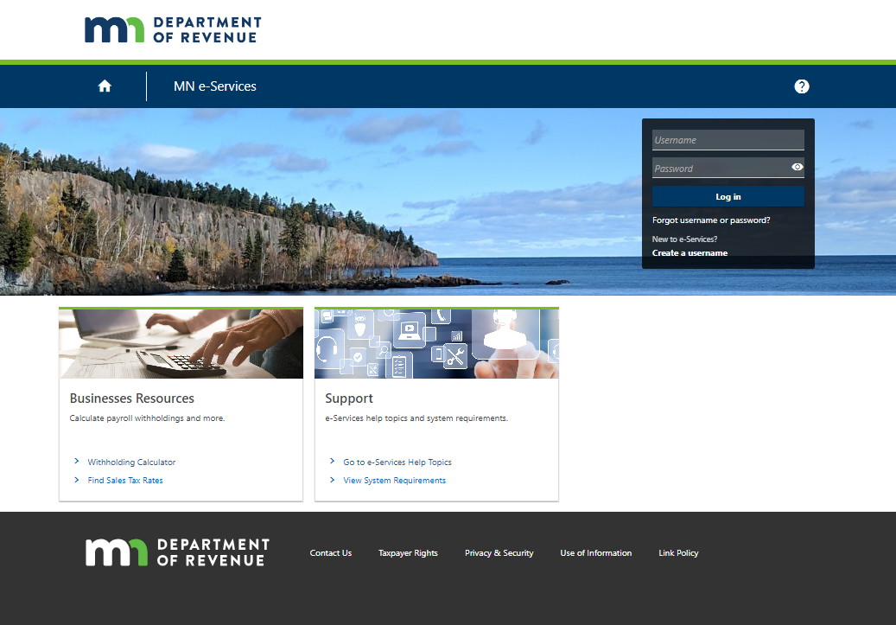
Sales Tax and More - MN Registration
https://www.mndor.state.mn.us/tp/eservices/_/
Type - User name created earlier
Type - Password created earlier
Click - Log in
On the next page will need to enter verification code
https://www.salestaxandmore.com/

