Slide 1






Reliance Trading Co.,Ltd.
ZhangZhou Subang Plastic Products Co., Ltd.
CATALOG
Website
Videos
Facebook
Wechat
WhatsApp

Slide 2

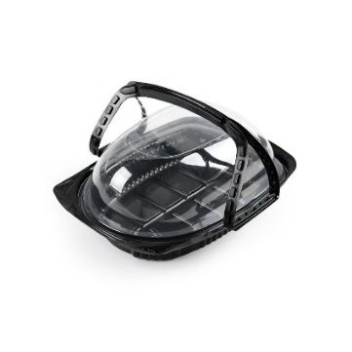
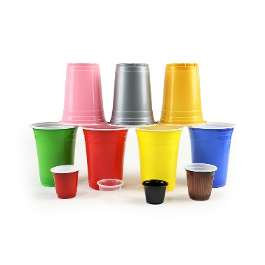
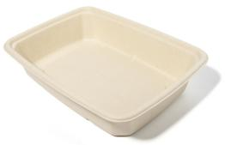
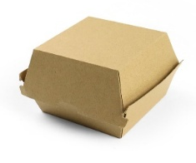
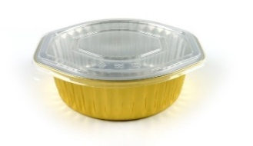
Reliance Trading Co.,Ltd. is a leading provider of eco-friendly and innovative packaging solutions, headquartered in Mainland China. With three companies and two advanced manufacturing facilities, we deliver high-quality, sustainable packaging options to clients across the globe.
Our vertically integrated structure allows us to control every aspect of production from raw material sourcing to final delivery – ensuring consistent quality, cost efficiency, and fast turnaround times. With a dedicated team of professionals and cutting-edge technology, we specialize in creating tailored packaging solutions for industries such as food, retail, and electronics.
PART 1
COMPANY
P03 ~ 04
PART 2
PRODUCTS
P05 ~ 102
PART 3
CONTACT
P103

Slide 3
PRODUCTS CATALOG
PET Tray
P05~17
PP Sauce Cup
P75~76
PET New Tray
P18~20
PP Bowl
P77~78
PET Clamshell
P21~26
PP Food Container
P79
PET Food Container
P27~29
Paper Box
P80~83
PET Clamshell for Plant
P30~32
Paper Bag
P84~85
PET Cup
P33~44
Paper Tray
P86~87
PP Cup
P45
Sugarcane / Bagasse
P88~98
Paper Cup
P46~47
Aluminum
P99
PP Tray
P48~53
Paper Straw
P100
PP Insert Tray
P54~58
Other Straw
P101
PP Tray for Top Sealing
P59
Others
P102
Take Away Container
P60~74

Slide 4
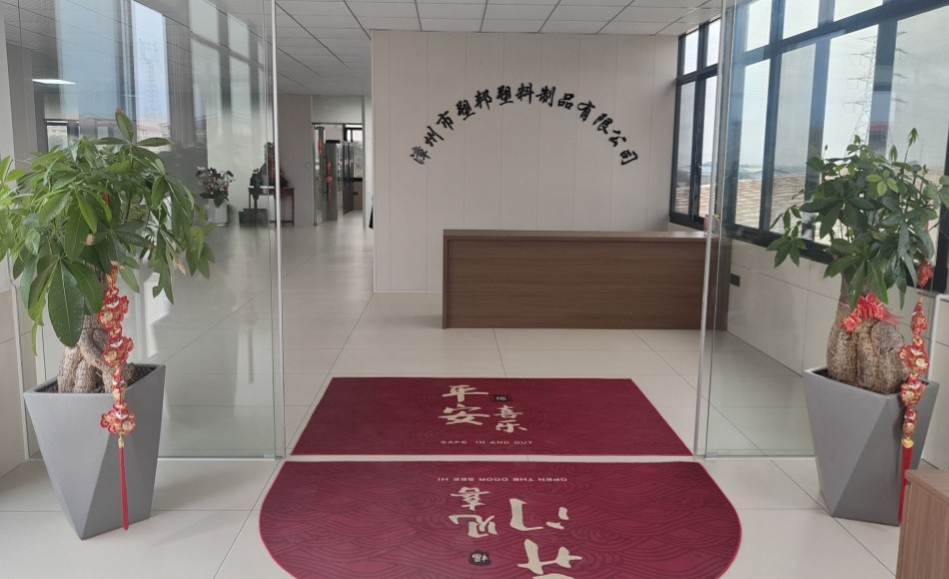
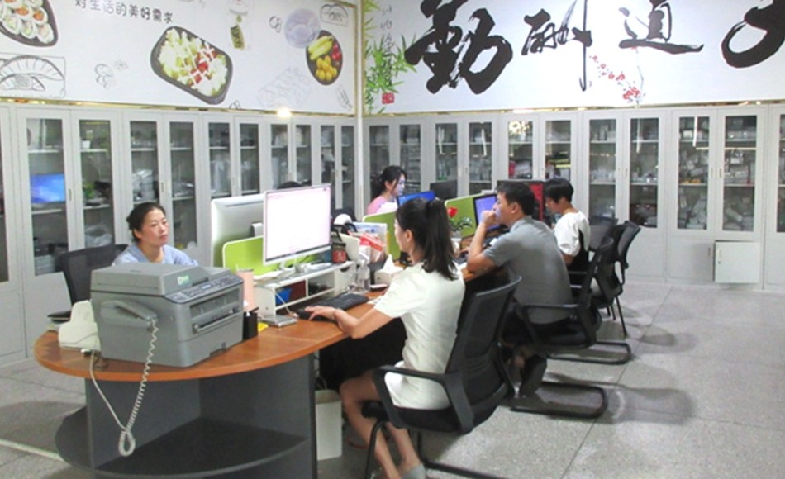
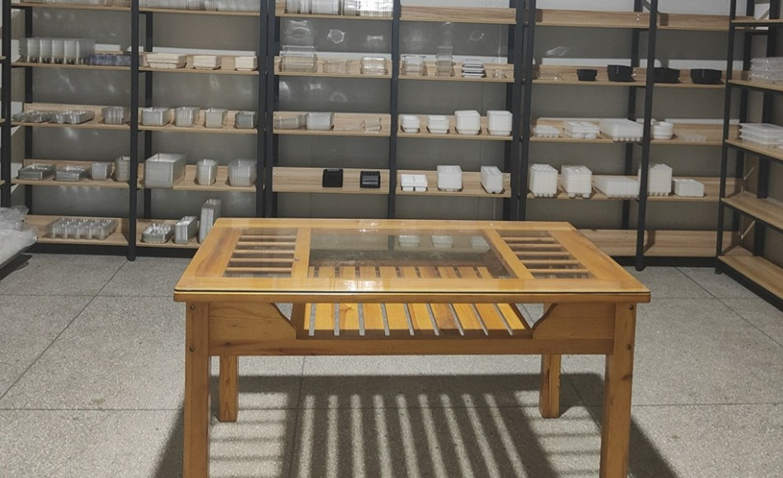
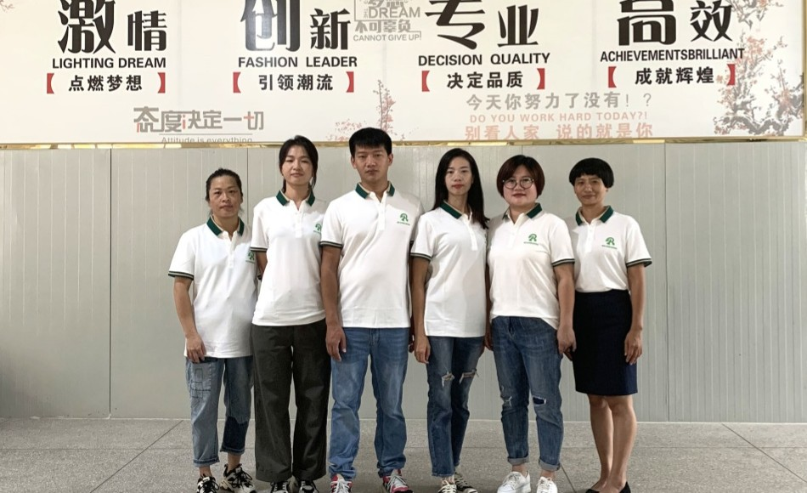
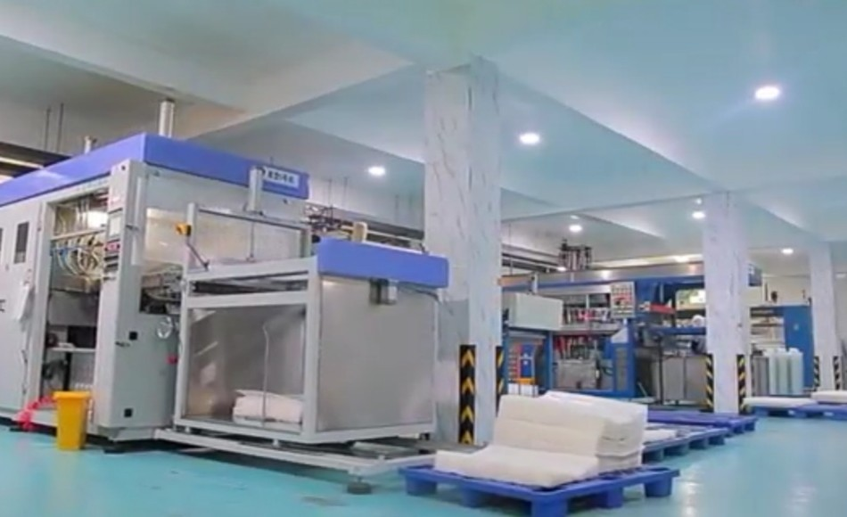
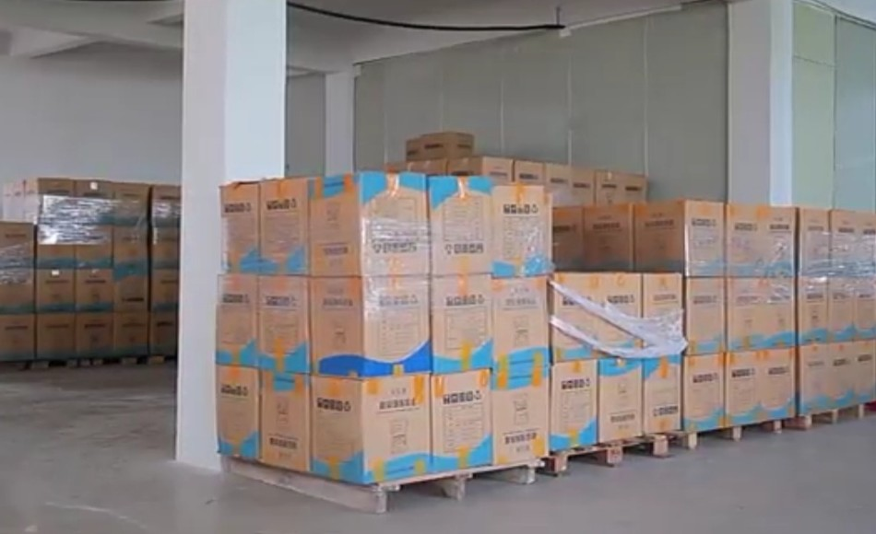
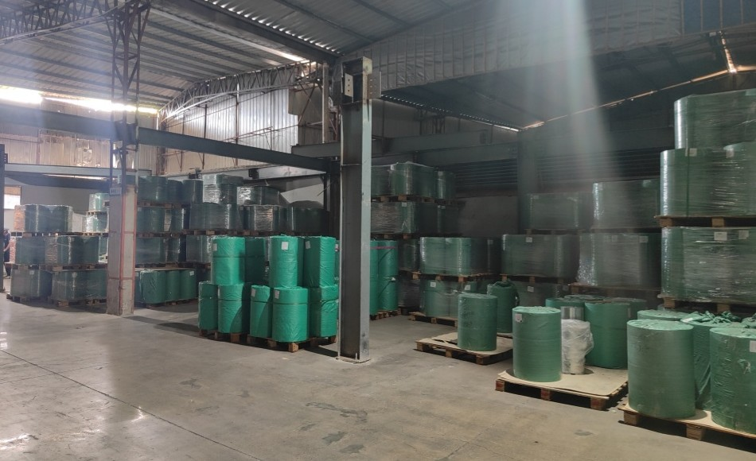
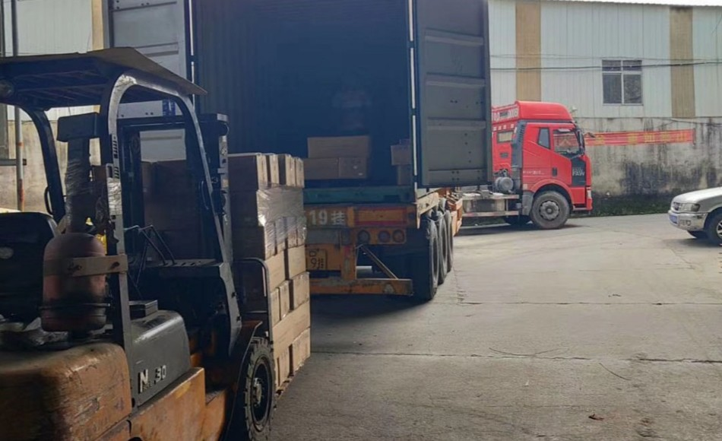
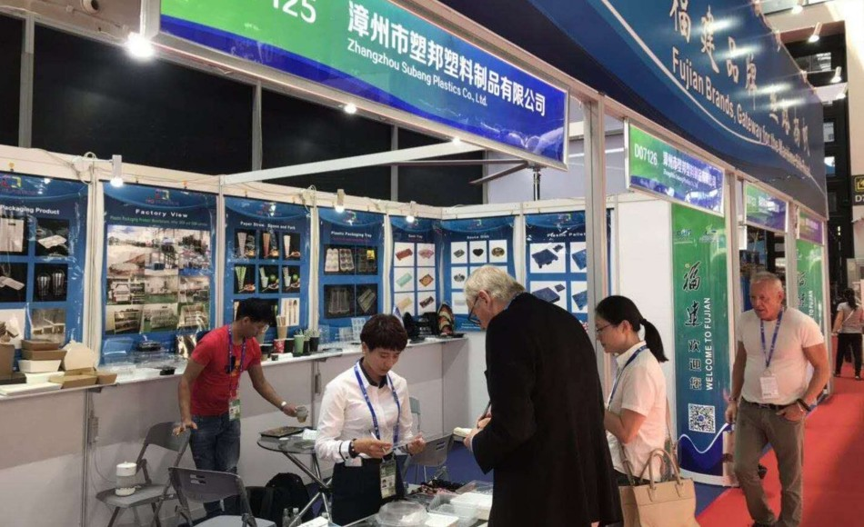
Office
Office
Sample Room
Sales Team
Workshop
Warehouse
Rawmaterial Warehouse
Delivery
Exhibition

Slide 5
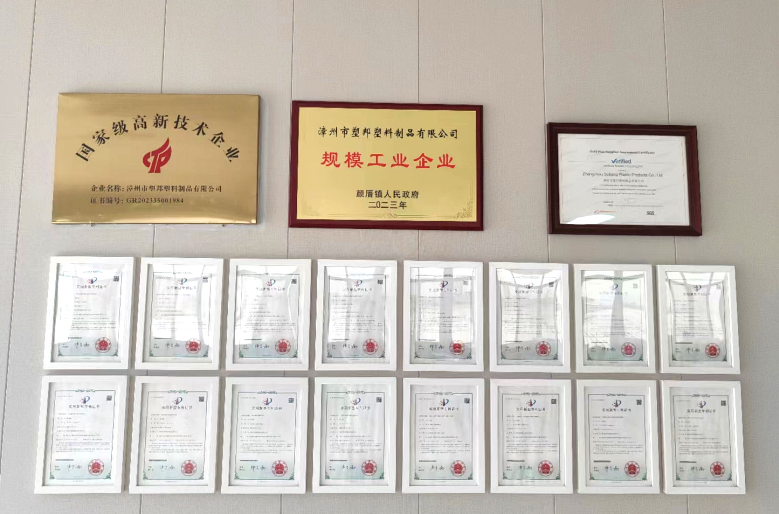
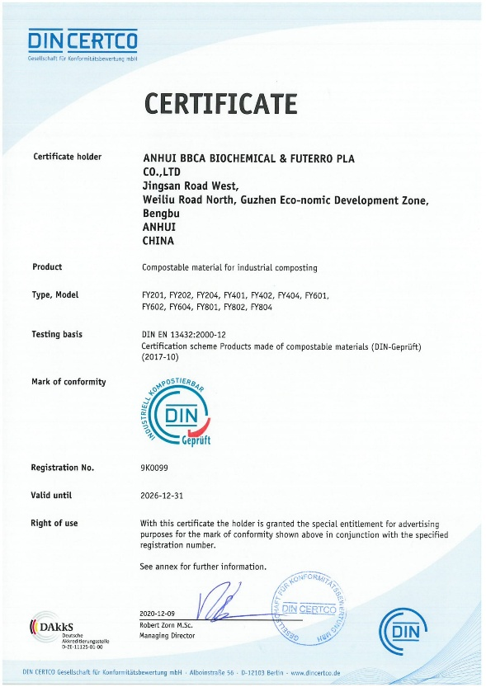
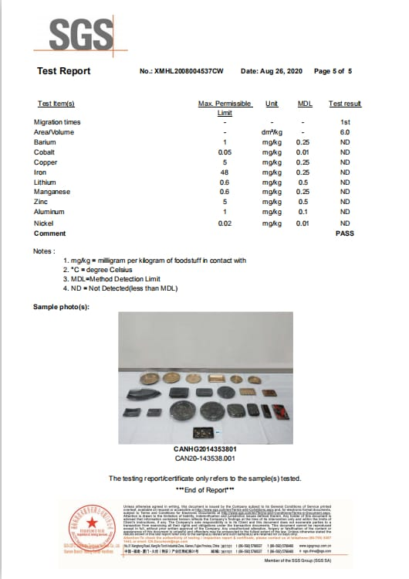

Slide 6
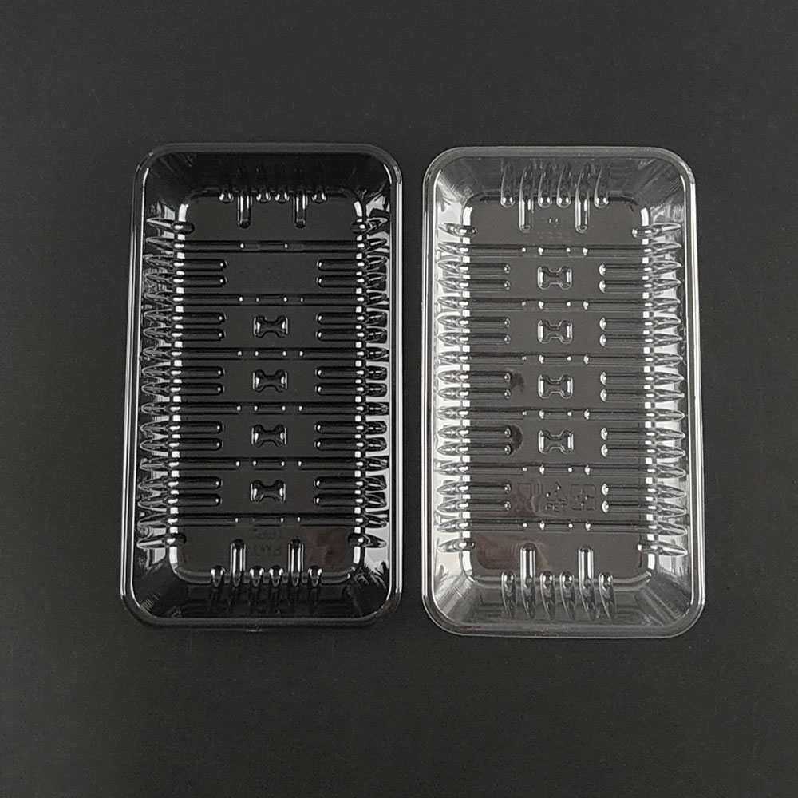
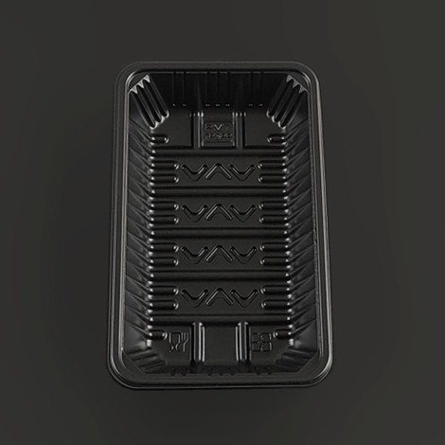
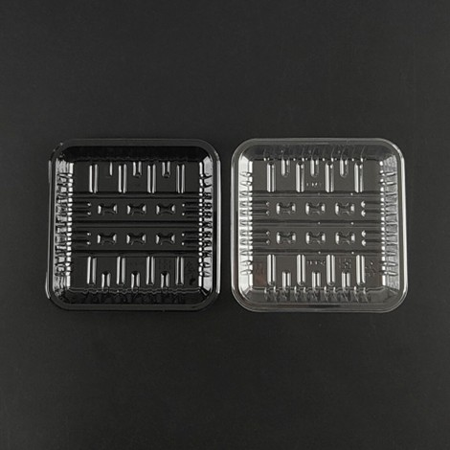
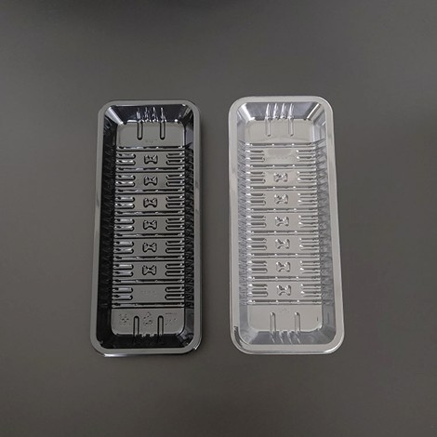
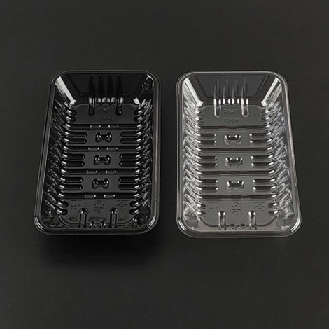
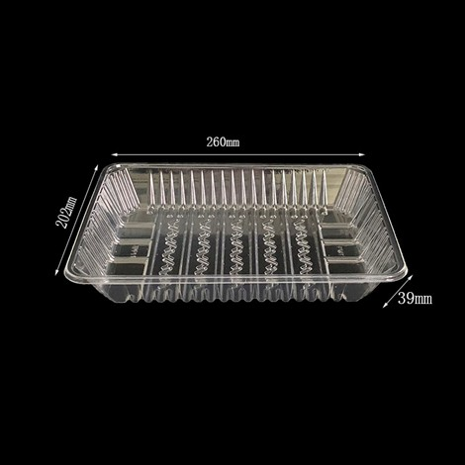
PET Tray
Item No. | TPP2
Size | 194*109*22mm
Material | PET Black/Transparent
Weight | 8.5g
Thickness | 0.30mm
Item No. | TPP3PP
Size | 195*118*35mm
Material | PP
Weight | 9.5g
Thickness | 0.30mm
Item No. | TPP4
Size | 130*130*18.8mm
Material | PET
Weight | 7g
Thickness | 0.30mm
Item No. | TPP5
Size | 247*101*21.3mm
Material | PET
Weight | 10g
Thickness | 0.30mm
Item No. | TPP6
Size | 158*91*22mm
Material | PET
Weight | 6.6g
Thickness | 0.30mm
Item No. | TPP11
Size | 260*202*39mm
Material | PET
Weight | 24g
Thickness | 0.30mm

Slide 7
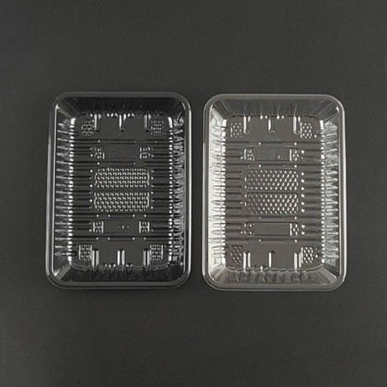
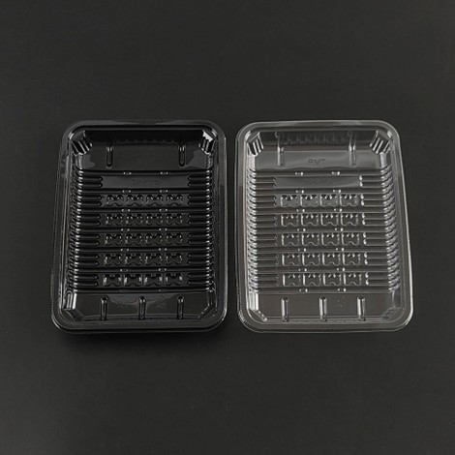
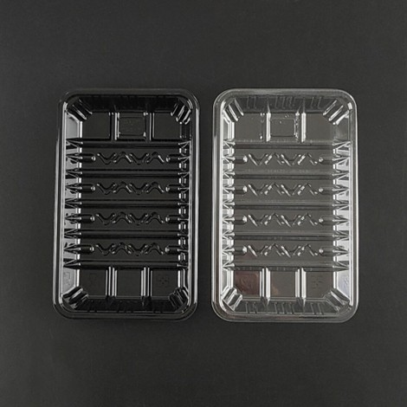
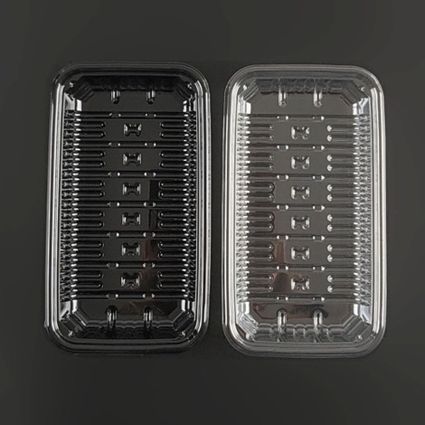
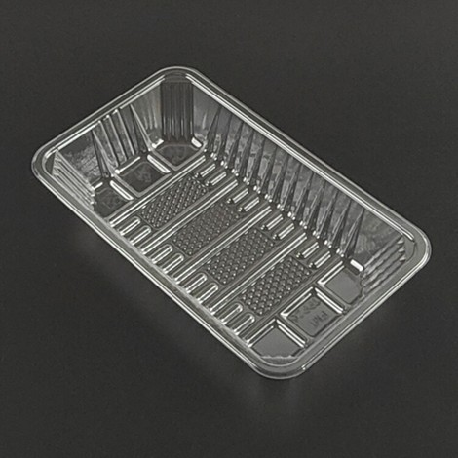
PET Trays
Item No. | TPP14
Size | 190*120*22mm
Material | PET
Weight | 10g
Thickness | 0.30mm
Item No. | TPP15
Size | 197*150*25mm
Material | PET
Weight | 11.8g
Thickness | 0.30mm
Item No. | TPP17
Size | 195*118*25mm
Material | PET
Weight | 9g
Thickness | 0.30mm
Item No. | TPP22
Size | 194*109*22mm
Material | PET
Weight | 10g
Thickness | 0.30mm
Item No. | TPP26
Size | 220*132*40mm
Material | PET
Weight | 12g
Thickness | 0.30mm
Item No. | TPP28
Size | 180*130*19mm
Material | PET
Weight | 9g
Thickness | 0.28mm

Slide 8
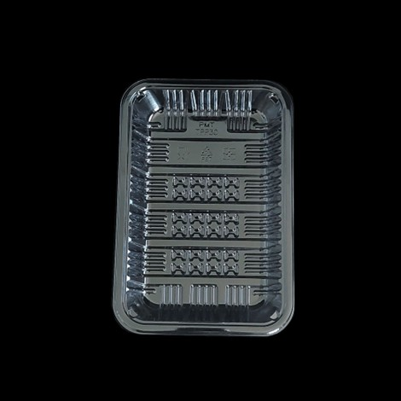
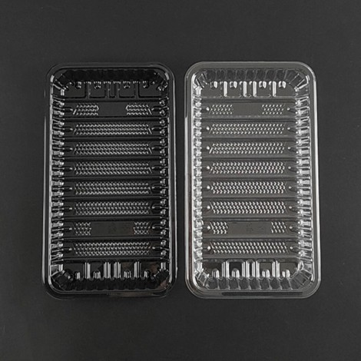
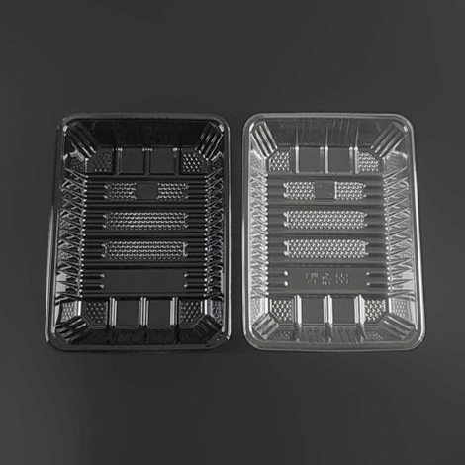
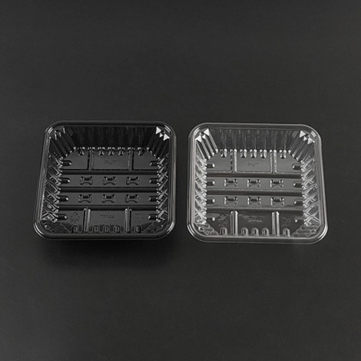
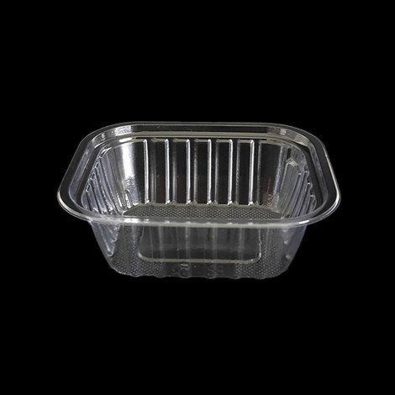
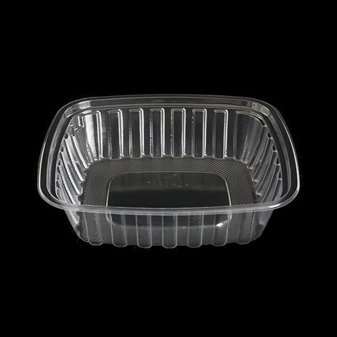
PET Trays
Item No. | TPP30
Size | 215*145*22mm
Material | PET
Weight | 13g
Thickness | 0.30mm
Item No. | TPP33
Size | 250*140*25mm
Material | PET
Weight | 14.5g
Thickness | 0.30mm
Item No. | TPP38
Size | 220*161*40mm
Material | PET
Weight | 14.5g
Thickness | 0.30mm
Item No. | TPP44
Size | 142*142*30mm
Material | PET
Weight | 10g
Thickness | 0.35mm
Item No. | TPPD-12
Size | 145*120*50mm
Material | PET
Weight | 7.3g
Thickness | 0.35mm
Item No. | TPPD-24
Size | 190*160*50mm
Material | PET
Weight | 13.5g
Thickness | 0.35mm

Slide 9
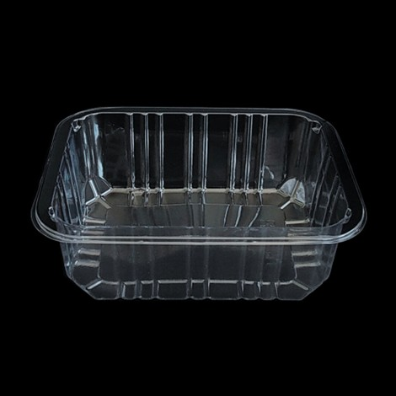
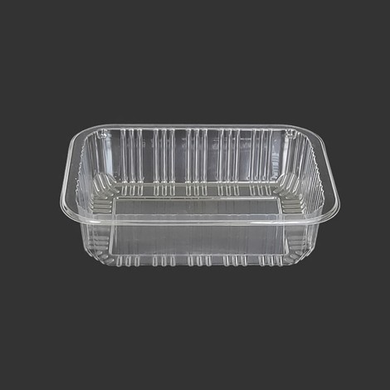
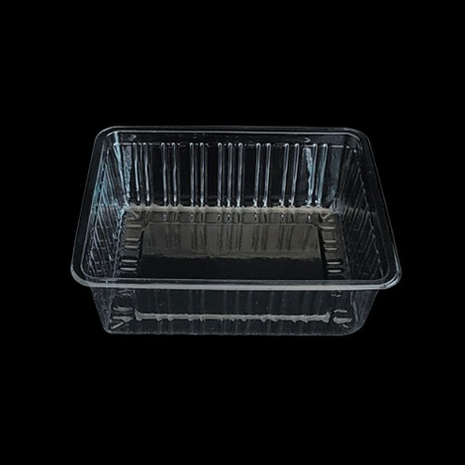
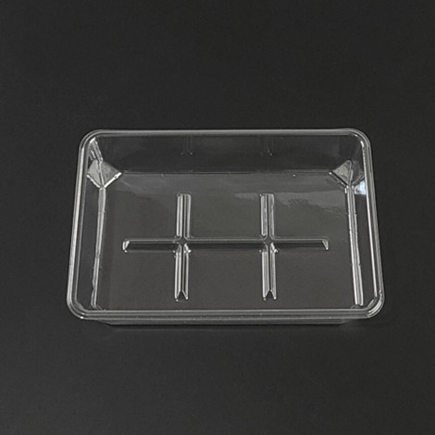
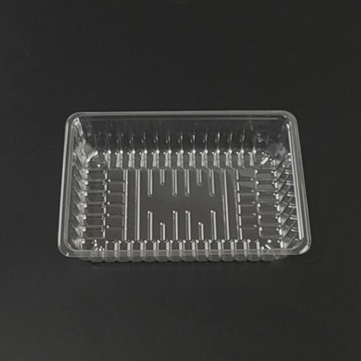
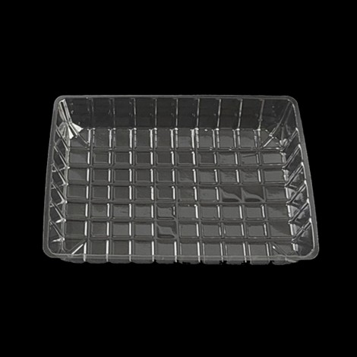
PET Trays
Item No. | TPPD-60
Size | 130*178*60mm
Material | PET
Weight | 15g
Thickness | 0.45mm
Item No. | TPPD-45NPP
Size | 178x130x45mm
Material | PP
Weight | 14g
Thickness | -
Item No. | Mushroom Tray
Size | 155*120*55cm
Material | PET
Weight | 11.5g
Thickness | 0.47mm
Item No. | 6 Compartments Cake Tray
Size | 180*120*40mm
Material | PET
Weight | 13.5g
Thickness | 0.45mm
Item No. | 1218-45
Size | 180*120*48mm
Material | PET
Weight | 10g
Thickness | 0.35mm
Item No. | JY39
Size | 202*140*38mm
Material | PET
Weight | 15g
Thickness | 0.35mm

Slide 10
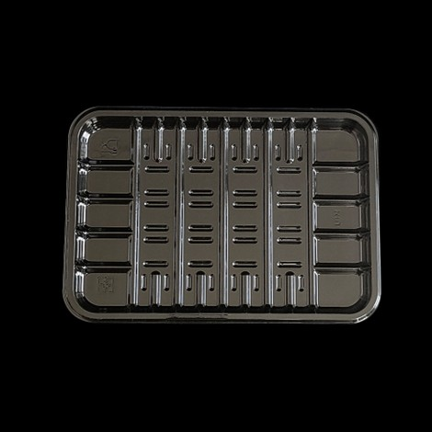
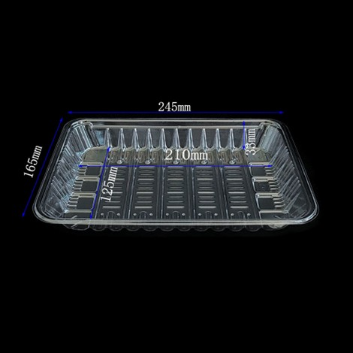
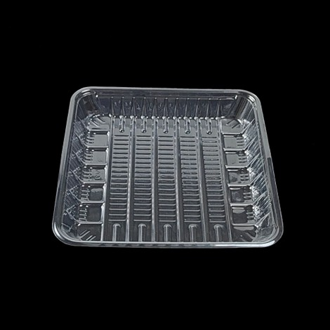
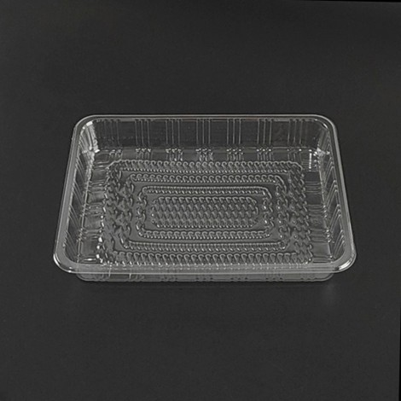
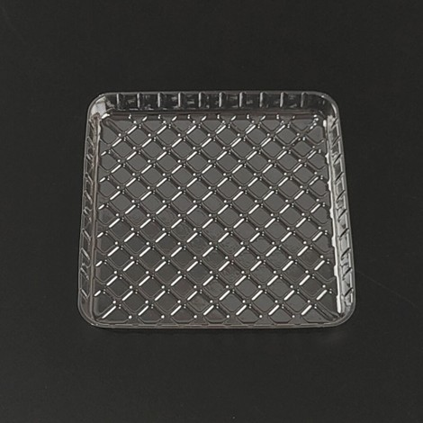
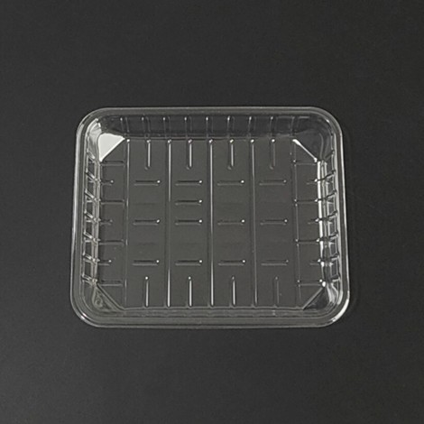
PET Trays
Item No. | R01
Size | 177*125*15mm
Material | PET
Weight | 8.7g
Thickness | 0.30mm
Item No. | JY21
Size | 245*163*35mm
Material | PET
Weight | 12g
Thickness | 0.22mm
Item No. | JY31
Size | 220*220*30mm
Material | PET
Weight | -
Thickness | -
Item No. | 0622
Size | 212x160x30mm
Material | PET
Weight | -
Thickness | -
Item No. | PETTRAY-1
Size | 11*12*1.3CM
Material | PET
Weight | 3.5g
Thickness | 0.19mm
Item No. | PETTRAY-2
Size | 14*11.5*2.5cm
Material | PET
Weight | 5.8g
Thickness | 0.28mm

Slide 11
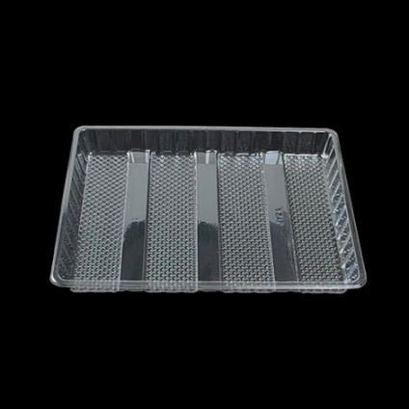
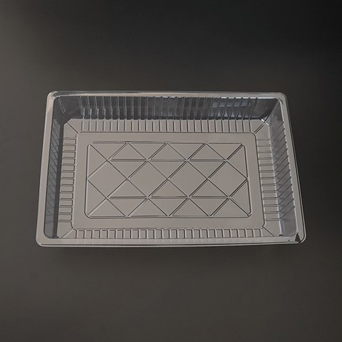
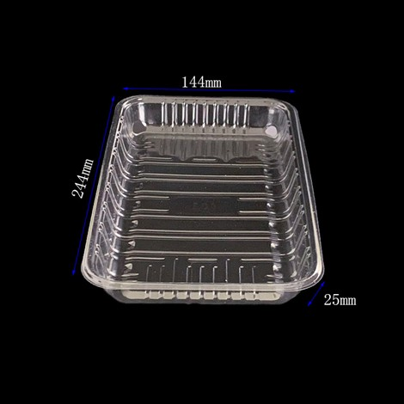
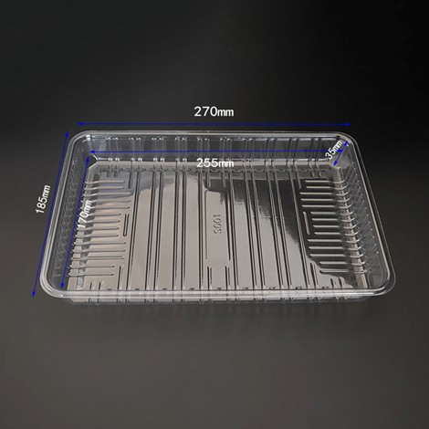

PET Trays
Item No. | JY24
Size | 250*182*28mm
Material | PET
Weight | 22.5g
Thickness | 0.36mm
Item No. | JY15
Size | 290*190*45mm
Material | PET
Weight | 27g
Thickness | 0.36mm
Item No. | S01
Size | 244*144*25mm
Material | PET
Weight | 12g
Thickness | 0.25mm
Item No. | S001
Size | 270*185*35mm
Material | PET
Weight | 23g
Thickness | 0.35mm
Item No. | MM
Size | 314*248*28mm
Material | PET
Weight | 27g
Thickness | 0.26mm
Item No. | Y01
Size | 337*240*25mm
Material | PET
Weight | 29.5g
Thickness | 0.28mm

Slide 12






PET Trays
Item No. | B11
Size | 240*199*26mm
Material | PET
Weight | 19g
Thickness | 0.29mm
Item No. | JY27
Size | 205*165*30mm
Material | PET
Weight | 30.4g
Thickness | 0.70mm
Item No. | 32103
Size | 320mm*100mm*28mm
Material | PET
Weight | 8g
Thickness | 0.18mm
Item No. | JY38
Size | 225*100*48mm
Material | PET
Weight | 12.5g
Thickness | 0.40mm
Item No. | JY46
Size | 180*110*20mm
Material | PET
Weight | 5.8g
Thickness | 0.20mm
Item No. | BISCUITS-1
Size | 295*140*58mm
Material | PET
Weight | -
Thickness | -

Slide 13






PET Trays
Item No. | PETT-1
Size | 220*150*30mm
Material | PET
Weight | -
Thickness | -
Item No. | PETT-15
Size | 183*122*40mm
Material | PET
Weight | -
Thickness | -
Item No. | FCB-1
Size | 195*195*22mm(Dia:180mm)
Material | PET
Weight | 13g
Thickness | 0.26mm
Item No. | FCB-2
Size | 190*190*25mm(Dia:165mm)
Material | PET
Weight | 13g
Thickness | 0.26mm
Item No. | PETT-2
Size | 180*180*30mm
Material | PET
Weight | -
Thickness | -
Item No. | PETT-4
Size | 220*150*29mm
Material | PET
Weight | 8.7g
Thickness | -

Slide 14





PET Trays
Item No. | PETT-5
Size | 240*200*20mm
Material | PET
Weight | 15g
Thickness | -
Item No. | PETT-6
Size | 183*120*40mm
Material | PET
Weight | 16.5g
Thickness | -
Item No. | PETT-7
Size | 183*150*27mm
Material | PET
Weight | -
Thickness | -
Item No. | PETT-8
Size | 210*160*30
Material | PET
Weight | 19g
Thickness | -
Item No. | B13
Size | 220*108*37mm
Material | PET
Weight | 13.4g
Thickness | -
Item No. | 6 Compartment Tray
Size | 184*121*29mm
Material | PET
Weight | 7.9g
Thickness | -

Slide 15






PET Trays
Item No. | PETT-9
Size | -
Material | PET
Weight | -
Thickness | -
Item No. | PETT-10
Size | 194*145*60mm
Material | PET
Weight | -
Thickness | -
Item No. | PETT-11
Size | 211*146*40mm
Material | PET
Weight | 15g
Thickness | -
Item No. | PETT-12
Size | 250x120x52mm
Material | PET
Weight | -
Thickness | -
Item No. | PETT-13
Size | 228*150*31mm
Material | PET
Weight | 14g
Thickness | -
Item No. | PETT-14
Size | -
Material | PET
Weight | -
Thickness | -

Slide 16






PET Trays
Item No. | 6 Compartment Seafood Tray
Size | -
Material | PET
Weight | -
Thickness | -
Item No. | 8 Compartment Seafood Tray
Size | -
Material | PET
Weight | -
Thickness | -
Item No. | SC02
Size | 180*105*40mm
Material | CPET
Weight | -
Thickness | -
Item No. | QB-04
Size | 170*170*28mm
Material | PET
Weight | -
Thickness | -
Item No. | TPP15-Blue
Size | 195*145*25mm
Material | PET
Weight | -
Thickness | -
Item No. | PETSAUSETRAY
Size | 140*50*25mm
Material | PET
Weight | -
Thickness | -

Slide 17






PET Trays
Item No. | VG-0413-rr
Size | 290*178*38mm
Material | PET
Weight | -
Thickness | -
Item No. | VG-0415-rr
Size | 235*185*27mm
Material | PET
Weight | -
Thickness | -
Item No. | VG-0777-rr
Size | 363*200*38mm
Material | PET
Weight | -
Thickness | -
Item No. | VG-1219-rr
Size | 260*202*34mm
Material | PET
Weight | -
Thickness | -
Item No. | VG-1971-rr
Size | 206*157*34mm
Material | PET
Weight | -
Thickness | -
Item No. | 14IT
Size | 335*243*30mm
Material | PET
Weight | -
Thickness | -

Slide 18





PET Trays
Item No. | C3
Size | 278*278*63mm
Material | PET
Weight | -
Thickness | -
Item No. | HH-06
Size | 337*187*60mm
Material | PET
Weight | -
Thickness | -
Item No. | PETT-16
Size | 170*95*35mm
Material | CPET
Weight | -
Thickness | -
Item No. | PETT-17
Size | 170*95*35mm
Material | CPET
Weight | -
Thickness | -
Item No. | SP01
Size | 7*70*25mm
Material | PET
Weight | -
Thickness | -

Slide 19






PET New Tray for Meat
Item No. | WX2013-S
Size | 192*130*22mm
Material | PET
Weight | 12g
Thickness | -
Item No. | WX2013-GB
Size | 192*130*22mm
Material | PET
Weight | 12g
Thickness | -
Item No. | WX2013-GS
Size | 192*130*22mm
Material | PET
Weight | 12g
Thickness | -
Item No. | WX2015-XS
Size | 195*145*20mm
Material | PET
Weight | -
Thickness | -
Item No. | WX2015-GB
Size | 195*145*25mm
Material | PET
Weight | 15.4g
Thickness | -
Item No. | WX2015-GS
Size | 195*145*25mm
Material | PET
Weight | -
Thickness | -

Slide 20






PET New Tray for Meat
Item No. | WX2212-XS with Lid
Size | 220*115*40mm
Material | PET
Weight | 30.2g
Thickness | -
Item No. | WX2212-XS-GB
Size | 220*115*40mm
Material | PET
Weight | 15.6g
Thickness | -
Item No. | WX2118-GS
Size | 205*180*25mm
Material | PET
Weight | 15g
Thickness | -
Item No. | WX2118-S
Size | 205*180*25mm
Material | PET
Weight | 18g
Thickness | -
Item No. | WX2515-XS-GB with Lid
Size | 210*180*25mm
Material | PET
Weight | 16g/11g
Thickness | -
Item No. | WX2515-XS -GS
Size | 210*180*25mm
Material | PET
Weight | 16g
Thickness | -

Slide 21





PET New Tray for Meat
Item No. | WX2514-S
Size | 243*140*20mm
Material | PET
Weight | 16.7g
Thickness | -
Item No. | WX2514-GS
Size | 243*140*20mm
Material | PET
Weight | 16.7g
Thickness | -
Item No. | WX2518-XS
Size | 250*180*25mm
Material | PET
Weight | 21g
Thickness | -
Item No. | WX1616-GB
Size | 160*160*15mm
Material | PET
Weight | 13.6g
Thickness | -
Item No. | GOLDTRAY-1
Size | 210*210*25mm
Material | PET
Weight | -
Thickness | -

Slide 22






PET Clamshell
Item No. | TPPCS-3
Size | 245*163*35mm
Material | PET
Weight | 12g
Thickness | 0.22mm
Item No. | JY15
Size | 290*190*45mm
Material | PET
Weight | 27g
Thickness | 0.36mm
Item No. | PETC-1
Size | 155*120*55cm
Material | PET
Weight | 11.5g
Thickness | 0.47mm
Item No. | PETC-2
Size | -
Material | PET
Weight | -
Thickness | -
Item No. | S-003
Size | 190*156*45mm
Material | PET
Weight | -
Thickness | -
Item No. | S-001
Size | 190*156*45mm
Material | PET
Weight | -
Thickness | -

Slide 23






PET Clamshell
Item No. | PETC-5
Size | -
Material | PET
Weight | -
Thickness | -
Item No. | PETC-6
Size | -
Material | PET
Weight | -
Thickness | -
Item No. | TPPCS-4
Size | 127*112*70mm
Material | PET
Weight | 17g
Thickness | 0.45mm
Item No. | 18119
Size | 185*110*90mm
Material | PET
Weight | -
Thickness | -
Item No. | RC-01
Size | 203*158*125mm
Material | PET
Weight | -
Thickness | -
Item No. | 3LB-H127
Size | 190*185*125mm
Material | PET
Weight | -
Thickness | -

Slide 24






PET Clamshell
Item No. | K-301
Size | 100*110*95mm
Material | PET
Weight | -
Thickness | -
Item No. | K-302
Size | 170*100*90mm
Material | PET
Weight | -
Thickness | -
Item No. | MX-04
Size | 170*170*95mm
Material | PET
Weight | -
Thickness | -
Item No. | MX-12
Size | 315*255*95mm
Material | PET
Weight | -
Thickness | -
Item No. | MX-24
Size | 440*325*90mm
Material | PET
Weight | -
Thickness | -
Item No. | MX-06
Size | 250*180*100mm
Material | PET
Weight | -
Thickness | -

Slide 25






PET Clamshell
Item No. | STL-4D
Size | 205*205*100mm
Material | PET
Weight | -
Thickness | -
Item No. | STL-6D
Size | 280*190*100mm
Material | PET
Weight | -
Thickness | -
Item No. | XT101206
Size | 165*165*85mm
Material | PET
Weight | -
Thickness | -
Item No. | XT200005
Size | 190*190*80mm
Material | PET
Weight | -
Thickness | -
Item No. | XT230003
Size | 190*190*85mm
Material | PET
Weight | -
Thickness | -
Item No. | RE20105
Size | 200*105*85mm
Material | PET
Weight | -
Thickness | -

Slide 26






PET Clamshell
Item No. | STL-1D
Size | 120*115*95mm
Material | PET
Weight | -
Thickness | -
Item No. | XT150721
Size | 230*230*100mm
Material | PET
Weight | -
Thickness | -
Item No. | SGL-250A
Size | 150*125*50mm
Material | PET
Weight | -
Thickness | -
Item No. | SGL-280A
Size | 145*120*65mm
Material | PET
Weight | -
Thickness | -
Item No. | PET-CLAMSHELL-1
Size | 185*120*80mm
Material | PET
Weight | -
Thickness | -
Item No. | SZ2-500A
Size | 180*140*80mm
Material | PET
Weight | -
Thickness | -

Slide 27






PET Clamshell
Item No. | TPL-1
Size | 190*190*130mm
Material | PET
Weight | -
Thickness | -
Item No. | XT-400A
Size | 160*120*70mm
Material | PET
Weight | -
Thickness | -
Item No. | XT-500M1
Size | 180*135*75mm
Material | PET
Weight | -
Thickness | -
Item No. | XT151123
Size | 175*175*85mm
Material | PET
Weight | -
Thickness | -
Item No. | XT220003
Size | 195*195*120mm
Material | PET
Weight | -
Thickness | -
Item No. | S-205
Size | 155*150*75mm
Material | PET
Weight | -
Thickness | -

Slide 28






PET Food Container
Item No. | TPD-16
Size | 180*130*35mm
Material | PS
Weight | -
Thickness | -
Item No. | JY15
Size | 290*190*45mm
Material | PET
Weight | 27g
Thickness | 0.36mm
Item No. | TPPD-24
Size | 190*160*50mm
Material | PET
Weight | -
Thickness | -
Item No. | TPPD-12
Size | 145*120*50mm
Material | PET
Weight | -
Thickness | -
Item No. | PETFC-1
Size | 160*120*57mm
Material | PET
Weight | -
Thickness | -
Item No. | S-204
Size | 160*135*75mm
Material | PET
Weight | -
Thickness | -

Slide 29






PET Food Container
Item No. | R02
Size | 125X125X50mm
Material | PET
Weight | -
Thickness | -
Item No. | HT077APB
Size | 313*230*112mm
Material | PET
Weight | -
Thickness | -
Item No. | ELP-09097
Size | 97*105*70mm
Material | PET
Weight | 15g
- | 10g + 5g
Item No. | FR-001
Size | 250*250*100mm
Material | PET
Weight | -
Thickness | -
Item No. | LS-DM-047B
Size | 220*220*70mm
Material | PET
Weight | -
Thickness | -
Item No. | LS-DM-048B
Size | 190*190*80mm
Material | PET
Weight | -
Thickness | -

Slide 30






PET Food Container
Item No. | LS-DM-129B-8
Size | 260*260*100mm
Material | PET
Weight | -
Thickness | -
Item No. | G-2013
Size | 280*280*30mm
Material | PET
Weight | -
Thickness | -
Item No. | G-2105
Size | 250*250*30mm
Material | PET
Weight | -
Thickness | -
Item No. | G-2103
Size | 280*280*30mm
Material | PET
Weight | -
Thickness | -
Item No. | G-2120
Size | 195*195*20mm
Material | PET
Weight | -
Thickness | -
Item No. | KARYO-1303
Size | 220*220*30mm
Material | PET
Weight | -
Thickness | -

Slide 31



PET Clamshell for Plant Packaging
Item No. | B1
Size | 330*165*120mm
Material | PET
Weight | 45g
Thickness | 0.30mm
Item No. | B2
Size | 328*190*165mm
Material | PET
Weight | 77.5g
Thickness | 0.45mm
Item No. | JY50
Size | 348*93*57mm
Material | PET
Weight | 26g
Thickness | 0.29mm

Slide 32



PET Clamshell for Plant Packaging
Item No. | B3
Size | 400*90*60mm
Material | PET
Weight | 33g
Thickness | 0.35mm
Item No. | B4
Size | Customize
Material | PET
Weight | 27g
Thickness | 0.31mm
Item No. | JY50-02
Size | 350*90*60mm
Material | PET
Weight | 25g
Thickness | 0.29mm

Slide 33



PET Clamshell for Plant Packaging
Item No. | JY51
Size | 340*110*90mm
Material | PET
Weight | 34g
Thickness | 0.35mm
Item No. | JY52
Size | 250*110*90mm
Material | PET
Weight | 24g
Thickness | 0.33mm
Item No. | 35
Size | 350*135*110mm
Material | PET
Weight | 50g
Thickness | 0.36mm

Slide 34




PET / PLA Cup
Item No. | 78-8oz
Size | 78*49*86mm
Material | PET / PLA
Weight | 7g
Thickness | -
Item No. | 78-Arch Lid
Size | -
Material | PET / PLA
Weight | 2.6g
Thickness | -
Item No. | 78-9oz
Size | 78*48*98mm
Material | PET / PLA
Weight | 7.5g
Thickness | -
Item No. | 78-Flat Lid
Size | -
Material | PET / PLA
Weight | 2g
Thickness | -
Item No. | 78-10oz
Size | 78*50*107mm
Material | PET / PLA
Weight | 8g
Thickness | -

Slide 35






PET / PLA Cup
Item No. | 90-12oz-A
Size | 90*55*116mm
Material | PET / PLA
Weight | 10.5g
Thickness | -
Item No. | 90-16oz
Size | 90*55*136mm
Material | PET / PLA
Weight | 13g
Thickness | -
Item No. | 90-12oz-B
Size | 90*57*107mm
Material | PET / PLA
Weight | 11g
Thickness | -
Item No. | 90-20oz
Size | 90*55*158mm
Material | PET / PLA
Weight | 14g
Thickness | -
Item No. | 90-14oz
Size | 90*55*116mm
Material | PET / PLA
Weight | 11g
Thickness | -
Item No. | 90-360U
Size | 90*46*91mm
Material | PET / PLA
Weight | 11g
Thickness | -

Slide 36




PET / PLA Cup
Item No. | 90-500U
Size | 90*40*118mm
Material | PET / PLA
Weight | 13.5g
Thickness | -
Item No. | 90-Arch Lid
Size | -
Material | PET / PLA
Weight | 3.5g
Capacity | -
Item No. | 78-Flat Lid
Size | -
Material | PET / PLA
Weight | 2.5g
Capacity | -
Item No. | 78-Sip Lid
Size | -
Material | PET / PLA
Weight | 4g
Capacity | -

Slide 37



PET / PLA Cup
Item No. | 92-9oz
Size | 92*55*71mm
Material | PET / PLA
Weight | 8g
Capacity | 260ml
Item No. | 92-12oz
Size | 92*60*106mm
Material | PET / PLA
Weight | 11g
Capacity | 410ml
Item No. | 92-420
Size | 92*61*106mm
Material | PET / PLA
Weight | 11.5g
Capacity | 420ml
Item No. | 92-Arch Lid
Size | -
Material | PET / PLA
Weight | 3.6g
Capacity | -
Item No. | 92-Flat Lid
Size | -
Material | PET / PLA
Weight | 2.6g
Capacity | -

Slide 38

PET / PLA Cup
Item No. | 95-16oz
Size | 95*56*126mm
Material | PET / PLA
Weight | 12g
Capacity | 490ml
Item No. | 95-Arch Lid
Size | -
Material | PET / PLA
Weight | 4g
Capacity | -
Item No. | 95-Flat Lid
Size | -
Material | PET / PLA
Weight | 2.7g
Capacity | -
Item No. | 95-Sip Lid
Size | -
Material | PET / PLA
Weight | 4g
Capacity | -

Slide 39






PET / PLA Cup
Item No. | 98-12oz
Size | 98*58*89mm
Material | PET / PLA
Weight | 11g
Capacity | 340ml
Item No. | 98-14oz
Size | 98*58*108mm
Material | PET / PLA
Weight | 11.5g
Capacity | 430ml
Item No. | 98-16oz-A
Size | 98*63*122mm
Material | PET / PLA
Weight | 13.5g
Capacity | 500ml
Item No. | 98-16oz-B
Size | 98*62*127mm
Material | PET / PLA
Weight | 13.5g
Capacity | 500ml
Item No. | 98-16oz-C
Size | 98*62*127mm
Material | PET / PLA
Weight | 13.5g
Capacity | 540ml
Item No. | 98-18
Size | 98*75*98mm
Material | PET / PLA
Weight | 13.5g
Capacity | 510ml

Slide 40





PET / PLA Cup
Item No. | 98-20oz
Size | 98*62*135mm
Material | PET / PLA
Weight | 15.5g
Capacity | 600ml
Item No. | 98-24oz-A
Size | 98*59*153mm
Material | PET / PLA
Weight | 16.5g
Capacity | 660ml
Item No. | 98-24oz-B
Size | 98*62*159mm
Material | PET / PLA
Weight | 16.8g
Capacity | 720ml
Item No. | 98-400
Size | 98*61*82mm
Material | PET / PLA
Weight | 13.5g
Capacity | 400ml
Item No. | 98-Tall Lid
Size | -
Material | PET / PLA
Weight | 3.6g
Capacity | -
Item No. | 98-Arch Lid
Size | -
Material | PET / PLA
Weight | 4g
Capacity | -

Slide 41
PET / PLA Cup
Item No. | 98-Flat Lid
Size | -
Material | PET / PLA
Weight | 2.8g
Capacity | -
Item No. | 98-Sip Lid
Size | -
Material | PET / PLA
Weight | 4.5g
Capacity | -

Slide 42


PET / PLA Cup
Item No. | 107-32oz
Size | 107*72*176mm
Material | PET / PLA
Weight | 20g
Capacity | 1000ml
Item No. | 107-Flat Lid
Size | -
Material | PET / PLA
Weight | 4g
Capacity | -

Slide 43






PET / PLA Cup
Item No. | 117-8oz
Size | 117*98*42mm
Material | PET / PLA
Weight | 11g
Capacity | 350ml
Item No. | 117-12oz
Size | 117*88*54mm
Material | PET / PLA
Weight | 14g
Capacity | 430ml
Item No. | 117-16oz
Size | 117*82*78mm
Material | PET / PLA
Weight | 16g
Capacity | 580ml
Item No. | 117-24oz
Size | 117*77*105mm
Material | PET / PLA
Weight | 21g
Capacity | 750ml
Item No. | 117-32oz
Size | 117*71*145mm
Material | PET / PLA
Weight | 24g
Capacity | 1000ml
Item No. | 117-Tall Lid
Size | -
Material | PET / PLA
Weight | 6g
Capacity | -

Slide 44


PET / PLA Cup
Item No. | 117-Arch Lid
Size | -
Material | PET / PLA
Weight | 6.5g
Capacity | -
Item No. | 117-Flat Lid
Size | -
Material | PET / PLA
Weight | 6g
Capacity | -

Slide 45

PET Cup
Item No. | Football Texture
Size | 190*65mm
Material | PET
Weight | -
Capacity | -

Slide 46





PP Cup
Item No. | 2OZ Coffe Cup
Size | 56*33*52mm
Material | PP
Weight | 1.7g
Thickness | -
Item No. | 2oz Coffe Cup
Size | 56*33*52mm
Material | PP
Weight | 1.7g
Thickness | -
Item No. | 98-16OZ Party Cup
Size | 98*62*117mm
Material | PP
Weight | 9g
Thickness | -
Item No. | PARTYCUP-Red
Size | 50*32*50mm
Material | PP
Weight | -
Thickness | -
Item No. | PPCUP-1
Size | 70*42*70mm
Material | PP
Weight | -
Thickness | -

Slide 47






Paper Cup
Item No. | FRENCHFRY
Size | Customized
Material | Kraft Paper
Weight | -
Thickness | -
Item No. | Corrugated-1
Size | 87*60*110mm/80*56*90mm
Material | Corrugated Paper
Weight | -
Thickness | -
Item No. | PAPERCUP-2
Size | 60*43*60mm
Material | Kraft Paper
Weight | -
Thickness | -
Item No. | Corrugated-2
Size | Customized
Material | Corrugated Paper
Weight | -
Thickness | -
Item No. | Top Lid-Free
Size | 10oz, 14oz, 16oz
Material | Paper
Weight | -
Thickness | -
Item No. | White Paper Cup
Size | 8oz, 10oz, 12oz, 16oz
Material | Paper
Weight | -
Thickness | -

Slide 48
Paper Cup
Item No. | FRENCHFRY
Size | Customized
Material | Kraft Paper
Weight | -
Thickness | -
Item No. | Corrugated-1
Size | 87*60*110mm/80*56*90mm
Material | Corrugated Paper
Weight | -
Thickness | -
Item No. | PAPERCUP-2
Size | 60*43*60mm
Material | Kraft Paper
Weight | -
Thickness | -
Item No. | Corrugated-2
Size | Customized
Material | Corrugated Paper
Weight | -
Thickness | -
Item No. | Top Lid-Free
Size | 10oz, 14oz, 16oz
Material | Paper
Weight | -
Thickness | -
Item No. | White Paper Cup
Size | 8oz, 10oz, 12oz, 16oz
Material | Paper
Weight | -
Thickness | -

Slide 49






PP Tray
Item No. | 2014
Size | 200*137*40mm
Material | PP
Weight | 14g
Thickness | 0.60mm
Item No. | 2111
Size | 190*135*40
Material | PP
Weight | 16.5g
Thickness | 0.65mm
Item No. | 12125
Size | 120*120*50mm
Material | PP
Weight | 12g
Thickness | 0.90mm
Item No. | 19135
Size | 190*135*50
Material | PP
Weight | 16.5g
Thickness | 0.65mm
Item No. | TPPD-45NPP
Size | 178x130x45mm
Material | PP
Weight | 16g
Thickness | 0.7mm
Item No. | RYTP
Size | 190*115*39mm
Material | PP
Weight | 13g
Thickness | -

Slide 50






PP Tray
Item No. | TOFU Tray
Size | 140*140*35mm
Material | PP
Weight | -
Thickness | -
Item No. | Tofu Tray
Size | 190*110*40mm
Material | PP
Weight | 9g
Thickness | Customize
Item No. | PPT-1
Size | 385*270*33mm
Material | PP
Weight | -
Thickness | -
Item No. | XRB-240
Size | -
Material | PP
Weight | -
Thickness | -
Item No. | XRB-500
Size | 195*118*30mm
Material | PP
Weight | -
Thickness | -
Item No. | 12184
Size | 120*180*40mm
Material | PP
Weight | 16g
Thickness | 0.7mm

Slide 51






PP Tray
Item No. | 17143
Size | 170*140*30mm
Material | PP
Weight | -
Thickness | -
Item No. | AB101015
Size | 100*100*15mm
Material | PP
Weight | -
Thickness | -
Item No. | ATQ-10103
Size | 100*100*30mm
Material | PP
Weight | -
Thickness | -
Item No. | ATQ-10104
Size | 100*100*40mm
Material | PP
Weight | -
Thickness | -
Item No. | B10
Size | 165*115*30mm
Material | PP
Weight | -
Thickness | -
Item No. | B12
Size | 150*100*16mm
Material | PP
Weight | -
Thickness | -

Slide 52






PP Tray
Item No. | DY-30-600
Size | 238*134*30mm
Material | PP
Weight | 10.5g
Thickness | -
Item No. | DY-25-700
Size | 240*160*25mm
Material | PP
Weight | -
Thickness | -
Item No. | XKM
Size | 205*134*10mm
Material | PP
Weight | 7g
Thickness | -
Item No. | PPT-2
Size | 205*110*25mm
Material | PP
Weight | -
Thickness | -
Item No. | SUB-2619H25
Size | 260*188*25mm
Material | PP
Weight | -
Thickness | -
Item No. | 2SAUSE-PP
Size | 120*73*25mm
Material | PP
Weight | -
Thickness | -

Slide 53






PP Tray
Item No. | TPD-23
Size | 235*235*45mm
Material | PP
Weight | -
Thickness | -
Item No. | TPD-23-HOLE
Size | 235*235*45mm
Material | PP
Weight | -
Thickness | -
Item No. | R800 Tray
Size | 174*120*58mm
Material | PP
Weight | -
Thickness | -
Item No. | 19155
Size | 190*150*50mm
Material | PP
Weight | -
Thickness | -
Item No. | Lyophilization Mold Tray
Size | Customize
Material | Customize
Weight | Customize
Thickness | Customize
Item No. | YTL-18-13-H55
Size | 183*133*53mm
Material | PP
Weight | 14.6g
Thickness | -

Slide 54




PP Tray
Item No. | YTL2014H55
Size | 222*142*55mm
Material | PP
Weight | 16.2g
Thickness | -
Item No. | BT-2213H30
Size | 223*135*32mm
Material | PP
Weight | -
Thickness | -
Item No. | YTL2014H35
Size | 222*142*55mm
Material | PP
Weight | -
Thickness | -
Item No. | ATQ-19004A
Size | 195*155*40mm
Material | PP
Weight | 20.5g
Thickness | -

Slide 55






PP Insert Tray
Item No. | 8 Compartments
Size | 270*140*48mm
Material | PP
Weight | -
Thickness | -
Item No. | 10 Compartments
Size | 216*211*36
Material | PP
Weight | -
Thickness | -
Item No. | 14 Compartments
Size | 242*142*37mm
Material | PP
Weight | -
Thickness | -
Item No. | 12 Compartments
Size | -
Material | PP
Weight | -
Thickness | -
Item No. | 12 Compartments
Size | 235*180*38mm
Material | pp
Weight | 25g
Thickness | 0.60mm
Item No. | 12 Compartments New
Size | 250*153*32mm
Material | pp
Weight | 17g
Thickness | 0.47mm

Slide 56






PP Insert Tray
Item No. | YJ-12
Size | 224*153*28mm
Material | PP
Weight | 16g
Thickness | 0.48mm
Item No. | 15-Dumpling Tray
Size | 237*180*34mm
Material | pp
Weight | 25g
Thickness | 0.60mm
Item No. | 20-Dumpling Tray
Size | 300*200*38mm
Material | pp
Weight | 39g
Thickness | 0.65mm
Item No. | LYJ-12
Size | 205*153*32mm
Material | pp
Weight | 15g
Thickness | 0.48mm
Item No. | 12-Dumpling Tray
Size | 233*166*38mm
Material | pp
Weight | 25g/18g
Thickness | 0.65mm/0.45mm
Item No. | SM-12
Size | 270*153*36mm
Material | PP
Weight | 20g
Thickness | 0.48mm

Slide 57






PP Insert Tray
Item No. | 6 Comaprtments Tray
Size | 255*170*50mm
Material | PP
Weight | 20g
Thickness | 0.45mm
Item No. | YPJ-6
Size | 272*178*35mm
Material | PP
Weight | -
Thickness | -
Item No. | ATQ-25174-6A
Size | 250*170*43mm
Material | PP
Weight | 25g
Thickness | 0.60
Item No. | 6-Shrimp Ball Tray
Size | 254*107*37mm
Material | PP
Weight | -
Thickness | -
Item No. | 4-Siomai Tray
Size
Material | PP
Weight | -
Thickness | -
Item No. | 24-Sesame Ball Tray
Size | 223*153*34mm
Material | PP
Weight | -
Thickness | -

Slide 58






PP Insert Tray
Item No. | 12 Comparements
Size | -
Material | PP
Weight | -
Thickness | -
Item No. | 12 Compartmens
Size | -
Material | PP
Weight | -
Thickness | -
Item No. | 15 Compartments
Size | -
Material | PP
Weight | -
Thickness | -
Item No. | 18 Compartments
Size | 203*104*21mm
Material | PP
Weight | -
Thickness | -
Item No. | 20 Compartments
Size | 223*151*26mm
Material | PP
Weight | -
Thickness | -
Item No. | 24 Compartments
Size | 200*128*25mm
Material | PP
Weight | -
Thickness | -

Slide 59






PP Insert Tray
Item No. | 40-Dumpling Tray
Size | 263*214*27mm
Material | PP
Weight | 26g
Thickness | *
Item No. | 10-Shrimp Roll Tray
Size | 234*140*26mm
Material | PP
Weight | 17g
Thickness | *
Item No. | 6-Mochi Tray
Size
Material | PP
Weight | *
Thickness | *
Item No. | Spring Roll 20g*14Rolls
Size | 195*160*20mm
Material | PP
Weight | *
Thickness | *
Item No. | Spring Roll 40g*20Rolls
Size | 323*202*30mm
Material | PP
Weight | 23g
Thickness | *
Item No. | PP-INSERTTRAY-1
Size | 155*140*30
Material | PP
Weight | *
Thickness | *

Slide 60






PP Tray for Top Sealing
Item No. | ATQ12154
Size | 150*120*40mm
Material | PP
Weight | 12g
Thickness | 0.70mm
Item No. | ATQ12155
Size | 150*120*50mm
Material | PP
Weight | 15g
Thickness | 0.80mm
Item No. | 12184
Size | 180*120*40mm
Material | PP
Weight | 16g
Thickness | 0.70mm
Item No. | TP400
Size | 180*130*35mm
Material | PP
Weight | 18g
Thickness | 0.70mm
Item No. | TPSP-1BPP
Size | 215*155*45mm
Material | PP with PE film Coating
Weight | 34g
Thickness | -
Item No. | TPP38PP
Size | 220*161*40mm
Material | PP
Weight | 14g
Thickness | 0.4mm

Slide 61






PP Take Away Food Container
Item No. | HS-1000-Black
Size | 225*15*55mm
Material | PP
Weight | 41.8g
Thickness | -
Item No. | HS-1000-White
Size | 225*15*55mm
Material | PP
Weight | 33.2g
Thickness | -
Item No. | PP-21
Size | 210*115*52mm
Material | PP
Weight | 26.5g
Thickness | -
Item No. | R800
Size
Material | PP
Weight | 26.5g
Thickness | -
Item No. | 19154
Size | 190*150*40mm
Material | PP
Weight | 31g
Thickness | -
Item No. | 500ml
Size | 169*116*33mm
Material | PP
Weight | 17.1g
Thickness | -

Slide 62






PP Take Away Food Container
Item No. | 650ml
Size | 169*116*41.5mm
Material | PP
Weight | 19g
Thickness | -
Item No. | 750ml
Size | 169*116*48.5mm
Material | PP
Weight | 18.3g
Thickness | -
Item No. | 1000ml
Size | 169*116*63mm
Material | PP
Weight | 24.7g
Thickness | -
Item No. | AS-350ml
Size | 141*97*37mm
Material | PP
Weight | 15g
Thickness | -
Item No. | AS-450ml
Size | 141*97*48mm
Material | PP
Weight | 17g
Thickness | -
Item No. | AS-588ml
Size | 222.7*151.7*27mm
Material | PP
Weight | 29.3g
Thickness | -

Slide 63






PP Take Away Food Container
Item No. | AS-750ml
Size | 223*152*39mm
Material | PP
Weight | 18.1g
Thickness | -
Item No. | AS-B-750ml
Size | 216*145*33mm
Material | PP
Weight | 20g
Thickness | -
Item No. | AS-1000ml
Size | 223*152*52mm
Material | PP
Weight | 21.3g
Thickness | -
Item No. | AS-B-1000ml
Size | 216*145*43mm
Material | PP
Weight | 20.1g
Thickness | -
Item No. | AS-1250ml
Size | 244*158*49mm
Material | PP
Weight | 37.2g
Thickness | -
Item No. | AS-B-1250ml
Size | 244*158*41mm
Material | PP
Weight | 37.5g
Thickness | -

Slide 64






PP Take Away Food Container
Item No. | AS-1500ml
Size | 244*158*55mm
Material | PP
Weight | 39.5g
Thickness | -
Item No. | AS-2000ml
Size | 244*158*71mm
Material | PP
Weight | 46.1g
Thickness | -
Item No. | 320ml
Size | 120*120*36mm
Material | PP
Weight | 14.8g
Thickness | -
Item No. | 420ml
Size | 120*120*48mm
Material | PP
Weight | 15.6g
Thickness | -
Item No. | 520ml
Size | 120*120*58mm
Material | PP
Weight | 16.8g
Thickness | -
Item No. | 620ml
Size | 152*1522*41mm
Material | PP
Weight | 25g
Thickness | -

Slide 65






PP Take Away Food Container
Item No. | 820ml
Size | 152*152*56mm
Material | PP
Weight | 26.5g
Thickness | -
Item No. | 1020ml
Size | 152*152*70mm
Material | PP
Weight | 31.8g
Thickness | -
Item No. | 1220ml
Size | 180*180*56mm
Material | PP
Weight | 36.8g
Thickness | -
Item No. | 1520ml
Size | 180*180*69mm
Material | PP
Weight | 39g
Thickness | -
Item No. | 12185-2A with Lid
Size | 120*180*50mm
Material | PP
Weight | 25g
Thickness | -
Item No. | ATQ-12185-2A
Size | 120*180*50mm
Material | PP
Weight | 16.5g
Thickness | 0.80mm

Slide 66






PP Take Away Food Container
Item No. | 2-Compartment
Size | 219*118mm
Material | PP
Weight | 34.3g
Thickness | -
Item No. | 2-Compartment-B
Size | 219*118mm
Material | PP
Weight | 31g
Thickness | -
Item No. | 3-Compartment
Size | 220*160mm
Material | PP
Weight | 21.2g
Thickness | -
Item No. | 4-Compartment
Size | 220*167mm
Material | PP
Weight | 25.3g
Thickness | -
Item No. | 4-Compartment-B
Size | 207*180mm
Material | PP
Weight | 20g
Thickness | -
Item No. | 5-Compartment
Size | 220*190mm
Material | PP
Weight | 29.2g
Thickness | -

Slide 67






PP Take Away Food Container
Item No. | 3-Compartment-Round
Size | 215*174*43mm
Material | PP
Weight | 22.7g
Thickness | -
Item No. | 4-Compartment-Round
Size | 234*200*50mm
Material | PP
Weight | 27.9g
Thickness | -
Item No. | Clamshell-3-Compartment
Size | 396*221*35mm
Material | PP
Weight | 44.3g
Thickness | -
Item No. | C-4-Compartment
Size | 396*194*35mm
Material | PP
Weight | 41.9g
Thickness | -
Item No. | C-5-Compartment
Size | 396*194*35mm
Material | PP
Weight | 54.3g
Thickness | -
Item No. | 5 Compartment
Size | 240*193*40mm
Material | PP
Weight | -
Thickness | -

Slide 68






PP Take Away Food Container
Item No. | 19155-3A with Lid
Size | 190*150*50mm
Material | PP
Weight | 34.6g
Thickness | -
Item No. | 19154-2A with Lid
Size | 190*150*40mm
Material | PP
Weight | 31.8g
Thickness | -
Item No. | 19153-3A
Size | 200*150*30mm
Material | PP
Weight | 19g
Thickness | 0.65mm
Item No. | 3800ml
Size | 418*173*69mm
Material | PP
Weight | 101.6g
Thickness | -
Item No. | 1350ml
Size | 300*150*38mm
Material | PP
Weight | 46.8g
Thickness | -
Item No. | 2000ml
Size | 300*150*55mm
Material | PP
Weight | 49.8g
Thickness | -

Slide 69






PP Take Away Food Container
Item No. | 300ml-1
Size | 118*84*46mm
Material | PP
Weight | 11.6g
Thickness | -
Item No. | 300ml-2
Size | 120*84*49mm
Material | PP
Weight | -
Thickness | -
Item No. | 360ml-1
Size | 118*98*47mm
Material | PP
Weight | 11.5g
Thickness | -
Item No. | 360ml-2
Size | 118*84*49mm
Material | PP
Weight | -
Thickness | -
Item No. | 450ml-1
Size | 118*94*61mm
Material | PP
Weight | 11.8g
Thickness | -
Item No. | 450ml-2
Size | 117*72*54mm
Material | PP
Weight | 11.2g
Thickness | -

Slide 70






PP Take Away Food Container
Item No. | 450ml-3
Size | 120*94*60mm
Material | PP
Weight | 18.3g
Thickness | -
Item No. | 458ml-1
Size | 118*88*60mm
Material | PP
Weight | 12.7g
Thickness | -
Item No. | 458ml-2
Size | 120*88*63mm
Material | PP
Weight | -
Thickness | -
Item No. | 500ml-1
Size | 118*79*85mm
Material | PP
Weight | 15.2g
Thickness | -
Item No. | 500ml-2
Size | 118*79*85mm
Material | PP
Weight | -
Thickness | -
Item No. | 625ml-1
Size | 147*110*53mm
Material | PP
Weight | 17.8g
Thickness | -

Slide 71






PP Take Away Food Container
Item No. | 625ml-2
Size | 147*110*45mm
Material | PP
Weight | 16.6g
Thickness | -
Item No. | 750ml
Size | 147*110*63mm
Material | PP
Weight | 19.4g
Thickness | -
Item No. | 800ml
Size | 147*100*72mm
Material | PP
Weight | 20.1g
Thickness | -
Item No. | 1000ml-1
Size | 147*103*88mm
Material | PP
Weight | 20.7g
Thickness | -
Item No. | 1000ml-2
Size | 147*97*83mm
Material | PP
Weight | 22.5g
Thickness | -
Item No. | 1250ml-1
Size | 175*132*81mm
Material | PP
Weight | 32.1g
Thickness | -

Slide 72






PP Take Away Food Container
Item No. | 1250ml-2
Size | 176*120*73mm
Material | PP
Weight | 28.6g
Thickness | -
Item No. | 1500ml
Size | 175*125*97mm
Material | PP
Weight | 32.8g
Thickness | -
Item No. | 1750ml
Size | 175*125*117mm
Material | PP
Weight | 36.9g
Thickness | -
Item No. | 1500ml
Size | 240*205*46mm
Material | PP
Weight | 47.8g
Thickness | -
Item No. | 2000ml
Size | 240*198*62mm
Material | PP
Weight | 53.9g
Thickness | -
Item No. | 2500ml
Size | 240*196*78mm
Material | PP
Weight | 59.4g
Thickness | -

Slide 73






PP Take Away Food Container
Item No. | 3000ml
Size | 240*193*95mm
Material | PP
Weight | 73.4g
Thickness | -
Item No. | 3500ml
Size | 240*186*113mm
Material | PP
Weight | 71.1g
Thickness | -
Item No. | 3588ml
Size | 295*246*62mm
Material | PP
Weight | 82g
Thickness | -
Item No. | 4088ml
Size | 295*246*87mm
Material | PP
Weight | 95g
Thickness | -
Item No. | 4888ml
Size | 295*239*105mm
Material | PP
Weight | 102g
Thickness | -
Item No. | 700ml
Size | 140*106*60mm
Material | PP
Weight | 18.1g
Thickness | -

Slide 74






PP Take Away Food Container
Item No. | 850ml
Size | 140*106*72mm
Material | PP
Weight | 20g
Thickness | -
Item No. | 999ml
Size | 140*109*83mm
Material | PP
Weight | 21.8g
Thickness | -
Item No. | Y-350ml
Size | 151*100*32mm
Material | PP
Weight | 16.9g
Thickness | -
Item No. | Y-450ml
Size | 151*100*40mm
Material | PP
Weight | 11.8g
Thickness | -
Item No. | Y-550ml
Size | 151*100*50mm
Material | PP
Weight | 19.3g
Thickness | -
Item No. | Y-750ml
Size | 177*136*45mm
Material | PP
Weight | 19.4g
Thickness | -

Slide 75






PP Take Away Food Container
Item No. | Y-1000ml
Size | 177*137*54mm
Material | PP
Weight | 27.6g
Thickness | -
Item No. | Y-1100ml
Size | 177*133*72mm
Material | PP
Weight | 31.7g
Thickness | -
Item No. | Y-1200ml
Size | 177*128*80mm
Material | PP
Weight | 33.5g
Thickness | -
Item No. | Y-1350ml
Size | 177*127*90mm
Material | PP
Weight | 35.1g
Thickness | -
Item No. | Food Dish
Size | 162mm
Material | PP
Weight | 11.8g
Thickness | -
Item No. | JX-1C
Size | 240*200*68mm
Material | PP
Weight | 44.1g
Thickness | -

Slide 76


PP Take Away Food Container
Item No. | JX-2C
Size | 240*200*68mm
Material | PP
Weight | 43.6g
Thickness | -
Item No. | JX-3C
Size | 240*200*68mm
Material | PP
Weight | 48.3g
Thickness | -

Slide 77






PP Sauce Cup
Item No. | 1oz
Size | 40*30*33mm
Material | PP
Weight | 2g
Thickness | -
Item No. | 1.1oz
Size | 48*35*24mm
Material | PP
Weight | 2.5g
Thickness | -
Item No. | 1.5oz
Size | 54*41*25mm
Material | PP
Weight | 2.9g
Thickness | -
Item No. | 2oz
Size | 66*51*26mm
Material | PP
Weight | 4.2g
Thickness | -
Item No. | 2.5oz
Size | 70*56*29mm
Material | PP
Weight | 4.4g
Thickness | -
Item No. | 3oz
Size | 76*63*26mm
Material | PP
Weight | 5.5g
Thickness | -

Slide 78



PP Sauce Cup
Item No. | 3.5oz
Size | 77*62*29mm
Material | PP
Weight | 5.6g
Thickness | -
Item No. | 4oz
Size | 81*64*34mm
Material | PP
Weight | 6g
Thickness | -
Item No. | 5oz
Size | 85*67*31mm
Material | PP
Weight | 7.3g
Thickness | -

Slide 79






PP Bowl
Item No. | ATQ08604
Size | 86*40mm
Material | PP
Weight | -
Thickness | -
Item No. | TK-11004
Size | 110*40mm
Material | PP
Weight | -
Thickness | -
Item No. | TRS-130055
Size | 135*55mm
Material | PP
Weight | -
Thickness | -
Item No. | Sauce Cup
Size | 65*35mm
Material | PP
Weight | 2.6g
Thickness | -
Item No. | OVAL01
Size | 193*138*42mm
Material | PP
Weight | -
Thickness | -
Item No. | MB-19005
Size | 195*135*55mm
Material | PP
Weight | -
Thickness | -

Slide 80





PP Bowl
Item No. | BOWL-PP-1
Size | 118*70*40mm
Material | PP
Weight | -
Thickness | -
Item No. | TK-11004
Size | 110*40mm
Material | PP
Weight | -
Thickness | -
Item No. | ATQ-13004
Size | 130*130*40mm
Material | PP
Weight | -
Thickness | -
Item No. | ATQ-13006
Size | 130*130*65mm
Material | PP
Weight | -
Thickness | -
Item No. | Deli-Box
Size | 8oz, 12oz, 16oz, 24oz, 32oz
Material | PP
Weight | -
Thickness | -
Item No. | Induction Heating
Size 1 | 195*172*65mm
Size 2 | 185*160*65mm
Weight | -
Material | Kraft Paper

Slide 81






PP Food Container
Item No. | CTA-5
Size | 215*145*80mm
Material | PP
Weight | -
Thickness | -
Item No. | ZH04
Size | 220*185*45mm
Material | PP
Weight | -
Thickness | -
Item No. | ZH04-2
Size | 220*185*45mm
Material | PP
Weight | -
Thickness | -
Item No. | SANDWICH-PP-1
Size | 220*185*45mm
Material | PP
Weight | -
Thickness | -
Item No. | SANDWICH-PP-2
Size | 70*172*75mm
Material | PP
Weight | -
Thickness | -
Item No. | PB2
Size | 215*145*80
Material | PP
Weight | -
Thickness | -

Slide 82






Paper Box
Item No. | PAPER-CAKE-1
Size | 160*160*75mm
Material | White Craft Paper
Weight | -
Thickness | -
Item No. | PAPER-CAKE-2
Size | 250*320*92mm
Material | White Craft Paper
Weight | -
Thickness | -
Item No. | RE-6
Size | 260*260*125mm
Material | White Craft Paper
Weight | -
Thickness | -
Item No. | PB2513
Size | 350*255*130mm
Material | White Craft Paper
Weight | -
Thickness | -
Item No. | RE-02C
Size | 170*117*43mm
Material | Kraft Paper
Weight | -
Thickness | -
Item No. | BIGCAKE
Size | 310*310*205mm
Material | White Craft Paper
Weight | -
Thickness | -

Slide 83






Paper Box
Item No. | HAMBURGER
Size | 140*130*80mm
Material | Kraft Paper
Weight | -
Thickness | -
Item No. | GRAPE
Size | 240*130*110mm
Material | Kraft Paper
Weight | -
Thickness | -
Item No. | SANDWICH
Size | 70*130*130mm
Material | Kraft Paper
Weight | -
Thickness | -
Item No. | FRUIT
Size | 135*100*45
Material | Kraft Paper
Weight | -
Thickness | -
Item No. | PB-08
Size | 350*350*50mm
Material | Kraft Paper
Weight | -
Thickness | -
Item No. | RE-W08
Size | 250*200*115mm
Material | Kraft Paper
Weight | -
Thickness | -

Slide 84






Paper Box
Item No. | RE-WB0
Size | 300*210*60mm
Material | White Craft Paper
Weight | -
Thickness | -
Item No. | PC15
Size | 93*153*72mm
Material | White Craft Paper
Weight | -
Thickness | -
Item No. | BOWL-PAPER-1
Size 1 | 183*183*67mm
Size 2 | 158*158*75mm
Size 3 | 130*130*50mm
Material | Kraft Paper
Item No. | BOWL-PAPER-2
Size | Customized
Material | Kraft Paper
Weight | *
Thickness | *
Item No. | BOWL-PAPER-4
Size | 115*90*115mm
Material | Kraft Paper
Weight | -
Thickness | -
Item No. | PC
Size | Customized
Material | Kraft Paper
Weight | -
Thickness | -

Slide 85


Paper Box
Item No. | WT1818-4
Size | 175*175*55mm
Material | Paper + PET
Weight | -
Thickness | -
Item No. | WT1827-6
Size | 265*178*65mm
Material | Paper + PET
Weight | -
Thickness | -

Slide 86






Paper Bag
Item No. | PAPER-BAG-1
Size | 300*150*300mm
Material | Kraft Paper
Weight | -
Thickness | -
Item No. | PAPER-BAG-2
Size | 280*150*150mm
Material | Kraft Paper
Weight | -
Thickness | -
Item No. | PAPER-BREAD-1
Size 1 | 220*130*240mm
Size 2 | 160*125*240mm
Size 3 | 125*90*250mm
Material | Kraft Paper
Item No. | PAPER-DRINK
Size | 137*200*160mm
Material | Kraft Paper
Weight | -
Thickness | -
Item No. | PAPER-BREAD-2
Size | 210*210*25mm
Material | Kraft Paper
Weight | -
Thickness | -
Item No. | PAPER-BREAD-3
Size 1 | 120*115*250mm
Size 2 | 160*130*240mm
Size 3 | 225*110*260mm
Material | Kraft Paper

Slide 87


Paper Bag
Item No. | PAPER-BREAD-4
Size | 140*100*278mm
Material | Kraft Paper
Weight | -
Thickness | -
Item No. | PAPER-BREAD-5
Size | 130*92*280mm
Material | Kraft Paper
Weight | -
Thickness | -

Slide 88






Paper Tray
Item No. | FRUIT-1
Size | 195*110*35mm
Material | Kraft Paper
Weight | -
Thickness | -
Item No. | FRUIT-2
Size | 145*110*40
Material | Kraft Paper
Weight | -
Thickness | -
Item No. | FRUIT-3
Size | 200*105*45mm
Material | Kraft Paper
Weight | -
Thickness | -
Item No. | FRUIT-4
Size | 205*125*50mm
Material | Kraft Paper
Weight | -
Thickness | -
Item No. | FRUIT-5
Size | 200*110*45mm
Material | Kraft Paper
Weight | -
Thickness | -
Item No. | FRUIT-6
Size | 210*150*50mm
Material | Kraft Paper
Weight | -
Thickness | -

Slide 89






Paper Tray
Item No. | 1103
Size | 160*115*15mm
Material | Kraft Paper
Weight | -
Thickness | -
Item No. | 1105
Size | 185*130*15mm
Material | Kraft Paper
Weight | -
Thickness | -
Item No. | RE-1100
Size | 135*80*15mm
Material | Kraft Paper
Weight | -
Thickness | -
Item No. | RE-1100-B
Size | 135*80*15mm
Material | Kraft Paper
Weight | -
Thickness | -
Item No. | RE-1103
Size | 160*115*15mm
Material | Kraft Paper
Weight | -
Thickness | -
Item No. | RE-1105
Size | Customize
Material | Kraft Paper
Weight | -
Thickness | -

Slide 90


Sugarcane / Bagasse
Item No. | MP-008
Size | 155*15mm
Material | Sugarcane
Weight | 7g
Color | Natural / White
Item No. | MP-009
Size | 180*18mm
Material | Sugarcane
Weight | 8g
Thickness | Natural / White
Item No. | MP-037
Size | 225*19.6 mm
Material | Sugarcane
Weight | 13g
Thickness | Natural / White
Item No. | MP-010
Size | 230*20mm
Material | Sugarcane
Weight | 15g
Thickness | Natural / White
Item No. | MP-011
Size | 259*20mm
Material | Sugarcane
Weight | 20g
Thickness | Natural / White
Item No. | MP-012
Size | 260*20mm
Material | Sugarcane
Weight | 20g
Thickness | Natural / White

Slide 91




Sugarcane / Bagasse
Item No. | MP-001
Size | 318*254*24.5mm
Material | Sugarcane
Weight | 27g
Color | Natural / White
Item No. | MP-014
Size | 160*160*13mm
Material | Sugarcane
Weight | 12g
Thickness | Natural / White
Item No. | MP-004
Size | 203*203*20.5 mm
Material | Sugarcane
Weight | 17g
Thickness | Natural / White
Item No. | MP-015
Size | 260*260*20.5mm
Material | Sugarcane
Weight | 28g
Thickness | Natural / White
Item No. | MP-038
Size | 350*250*25mm
Material | Sugarcane
Weight | 43g
Thickness | Natural / White
Item No. | MP-049
Size | 260*210*25mm
Material | Sugarcane
Weight | 22.5g
Thickness | Natural / White

Slide 92





Sugarcane / Bagasse
Item No. | MW-005
Size | 160*37 mm
Material | Sugarcane
Weight | 10g
Color | Natural / White
Item No. | MW-069-L-PET
Size | 155*30 mm
Material | PET
Weight | 11.5g
Color | -
Item No. | MW-068
Size | 155*40mm
Material | Sugarcane
Weight | 9g
Color | Natural / White
Item No. | MW-068/069-L
Size | 152*10mm
Material | Sugarcane
Weight | 9.5g
Color | Natural / White
Item No. | MW-069
Size | 150*54mm
Material | Sugarcane
Weight | 12g
Color | Natural / White
Item No. | MW-070
Size | 175*53 mm
Material | Sugarcane
Weight | 16g
Color | Natural / White

Slide 93
Sugarcane / Bagasse
Item No. | MW-071
Size | 175*70 mm
Material | Sugarcane
Weight | 18g
Color | Natural / White
Item No. | MW- 070/071-L
Size | 182*10mm
Material | Sugarcane
Weight | 12.5g
Color | Natural / White
Item No. | MW-071-L- PET
Size | 182*30mm
Material | PET
Weight | 15.5g
Color | -
Item No. | MW-073
Size | 210 *75mm
Material | Sugarcane
Weight | 24g
Color | Natural / White
Item No. | MW-073-L
Size | 217*10mm
Material | Sugarcane
Weight | 18g
Color | Natural / White
Item No. | MW-073-L- PET
Size | 217*30mm
Material | PET
Weight | 19g
Color | -

Slide 94






Sugarcane / Bagasse
Item No. | MW-074
Size | 18*111mm
Material | Sugarcane
Weight | 28g
Color | Natural / White
Item No. | MW-074-L
Size | 192*12mm
Material | PET
Weight | 14g
Color | -
Item No. | MW-077
Size | 204*42mm
Material | PET
Weight | 23g
Color | -
Item No. | MW-077-L
Size | 215*33mm
Material | PET
Weight | 19.5g
Color | -
Item No. | MW-076
Size | 208*60mm
Material | Sugarcane
Weight | 24g
Color | Natural / White
Item No. | MW-080
Size | 208*82mm
Material | Sugarcane
Weight | 29g
Color | Natural / White

Slide 95




Sugarcane / Bagasse
Item No. | MW- 076/080-L
Size | 217*33mm
Material | PET
Weight | 20g
Color | -
Item No. | MW-078
Size | 228*166*31mm
Material | Sugarcane
Weight | 21g
Color | Natural / White
Item No. | MW-075
Size | 228*166*47mm
Material | Sugarcane
Weight | 23.5g
Color | Natural / White
Item No. | MW-079
Size | 228*166*56mm
Material | Sugarcane
Weight | 25g
Color | Natural / White
Item No. | MW- 078/075/079- L
Size | 235*172*27mm
Material | PET
Weight | 23g
Color | -
Item No. | MH-119
Size | 212*183*82mm
Material | Sugarcane
Weight | 41g
Color | Natural / White

Slide 96




Sugarcane / Bagasse
Item No. | MH-113
Size | 152*152*76mm
Material | Sugarcane
Weight | 20g
Color | Natural / White
Item No. | MH-010
Size | 192*205*76mm
Material | Sugarcane
Weight | 21g
Color | Natural / White
Item No. | MH-013
Size | 203*221*76mm
Material | Sugarcane
Weight | 37g
Color | Natural / White
Item No. | MH-002
Size | 203*221*76mm
Material | Sugarcane
Weight | 37g
Color | Natural / White
Item No. | MH-014
Size | 231*231*79mm
Material | Sugarcane
Weight | 42g
Color | Natural / White
Item No. | MH-015
Size | 231*231*79mm
Material | Sugarcane
Weight | 42g
Color | Natural / White

Slide 97






Sugarcane / Bagasse
Item No. | MH-008
Size | 182*136*65mm
Material | Sugarcane
Weight | 20g
Color | Natural / White
Item No. | MH-016
Size | 230*157*83mm
Material | Sugarcane
Weight | 30g
Color | Natural / White
Item No. | MH-126
Size | 318*156*70mm
Material | Sugarcane
Weight | 47g
Color | Natural / White
Item No. | MB-002
Size | 62*62*31mm
Material | Sugarcane
Weight | 3g
Color | Natural / White
Item No. | MG-002
Size | 65*65*7mm
Material | Sugarcane
Weight | 2g
Color | Natural / White
Item No. | MB-001
Size | 76*76*49mm
Material | Sugarcane
Weight | 4.2g
Color | Natural / White

Slide 98






Sugarcane / Bagasse
Item No. | MG-001
Size | 81*81*8mm
Material | Sugarcane
Weight | 3g
Color | Natural / White
Item No. | HL-00
Size | 135*75*20mm
Material | Sugarcane
Weight | -
Color | Natural / White
Item No. | HL-01
Size | 155*90*20mm
Material | Sugarcane
Weight | -
Color | Natural / White
Item No. | HL-02
Size | 220*90*20mm
Material | Sugarcane
Weight | -
Color | Natural / White
Item No. | HL-03
Size | 165*115*20mm
Material | Sugarcane
Weight | -
Color | Natural / White
Item No. | HL-05
Size | 185*130*20mm
Material | Sugarcane
Weight | -
Color | Natural / White

Slide 99






Sugarcane / Bagasse
Item No. | HL-09
Size | 240*150*20mm
Material | Sugarcane
Weight | -
Color | Natural / White
Item No. | HL-11
Size | 255*185*20mm
Material | Sugarcane
Weight | -
Color | Natural / White
Item No. | ABSORBENT
Size 1 | 270*175*40mm
Size 2 | 227*172*25mm
Size 3 | 220*135*25mm
Material | Sugarcane
Item No. | HAMBURGER-1
Size | 155*150*80mm
Material | Sugarcane
Weight | -
Thickness | -
Item No. | CUTLERY-1
Size | Customize
Material | Sugarcane
Weight | -
Color | Natural / White
Item No. | CUTLERY-2
Size | Customize
Material | Sugarcane
Weight | -
Thickness | Natural / White

Slide 100




Sugarcane / Bagasse
Item No. | Coffee Carrier-4-1
Size | 215*215*45mm
Material | Sugarcane
Weight | -
Color | Natural
Item No. | Coffee Carrier-2-1
Size | 215*110*45mm
Material | Sugarcane
Weight | -
Color | Natural
Item No. | Coffee Carrier-2-2
Size | 220*110*45mm
Material | Sugarcane
Weight | -
Color | Natural
Item No. | Coffee Carrier-4-2
Size | 190*190*45mm
Material | Sugarcane
Weight | -
Color | Natural

Slide 101






Aluminum
Item No. | ALUMINUM-1
Size | Customize
Material | Aluminum
Weight | -
Thickness | -
Item No. | ALUMINUM-2
Size | 195*205*60mm
Material | Aluminum
Weight | -
Thickness | -
Item No. | AL-200
Size | 165*65*30mm
Material | Aluminum
Weight | -
Thickness | -
Item No. | ALUMINUM-3
Size | 85*85*36mm
Material | Aluminum
Weight | -
Thickness | -
Item No. | ALUMINUM-4
Size | 85*85*36mm
Material | Aluminum
Weight | -
Thickness | -
Item No. | ALUMINUM-5
Size | 85*85*28mm
Material | Aluminum
Weight | -
Thickness | -

Slide 102





Paper Straw
Item No. | Paper-Straw-1
Size | Customize
Material | Paper
Weight | -
Thickness | -
Item No. | Paper-Straw-2
Size | Customize
Material | Paper
Weight | -
Thickness | -
Item No. | Paper-Straw-3
Size | Customize
Material | Paper
Weight | -
Thickness | -
Item No. | Paper-Straw-4
Size | Customize
Material | Paper
Weight | -
Thickness | -
Item No. | Paper-Straw-5
Size | Customize
Material | Paper
Weight | -
Thickness | -

Slide 103





Straw
Item No. | Coffee Grounds Straw-2
Size | 200mm
Material | Coffee Grounds
Weight | -
Thickness | -
Item No. | Bamboo Fiber Straw
Size | 205mm
Material | Bamboo
Weight | -
Thickness | -
Item No. | Coffee Grounds Straw-1
Size | 230mm
Material | Coffee Grounds
Weight | -
Thickness | -
Item No. | Three Hole Coffee Stirrers Sticks
Size | 215mm
Material | PLA
Weight | -
Thickness | -
Item No. | Plastic Straws
Size | 260mm
Material | PP
Weight | -
Thickness | -

Slide 104



Others
Item No. | WB01
Size | 150*85*253mm
Material | HDPE
Weight | -
Thickness | -
Item No. | COFFEE-1
Size | Customize
Material | PET/PA/AL/CPP
Weight | -
Thickness | -
Item No. | CP01
Size | 130*85mm
Material | PE
Weight | -
Thickness | -

Slide 105





CONTACT US
+86-13960005663
admin@bereliance.com
No.708 Tianzhi Village,
Yancuo Town, Longhai District,
Zhangzhou, Fujian Province,
China
Website
Videos
Facebook
Wechat
WhatsApp
02

