Slide 1
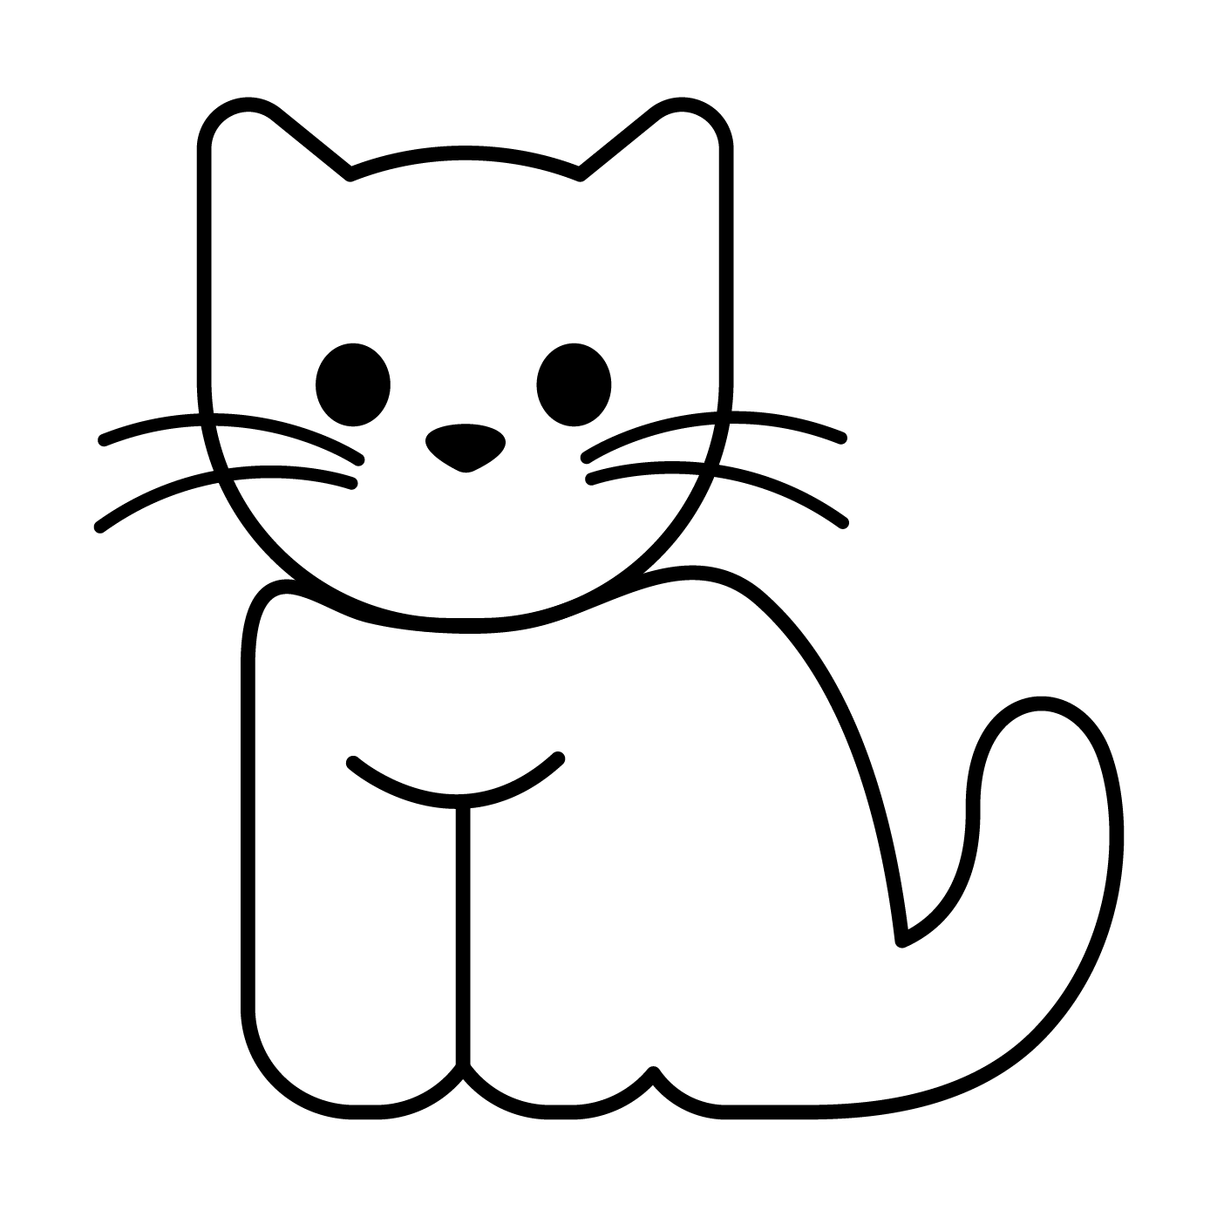


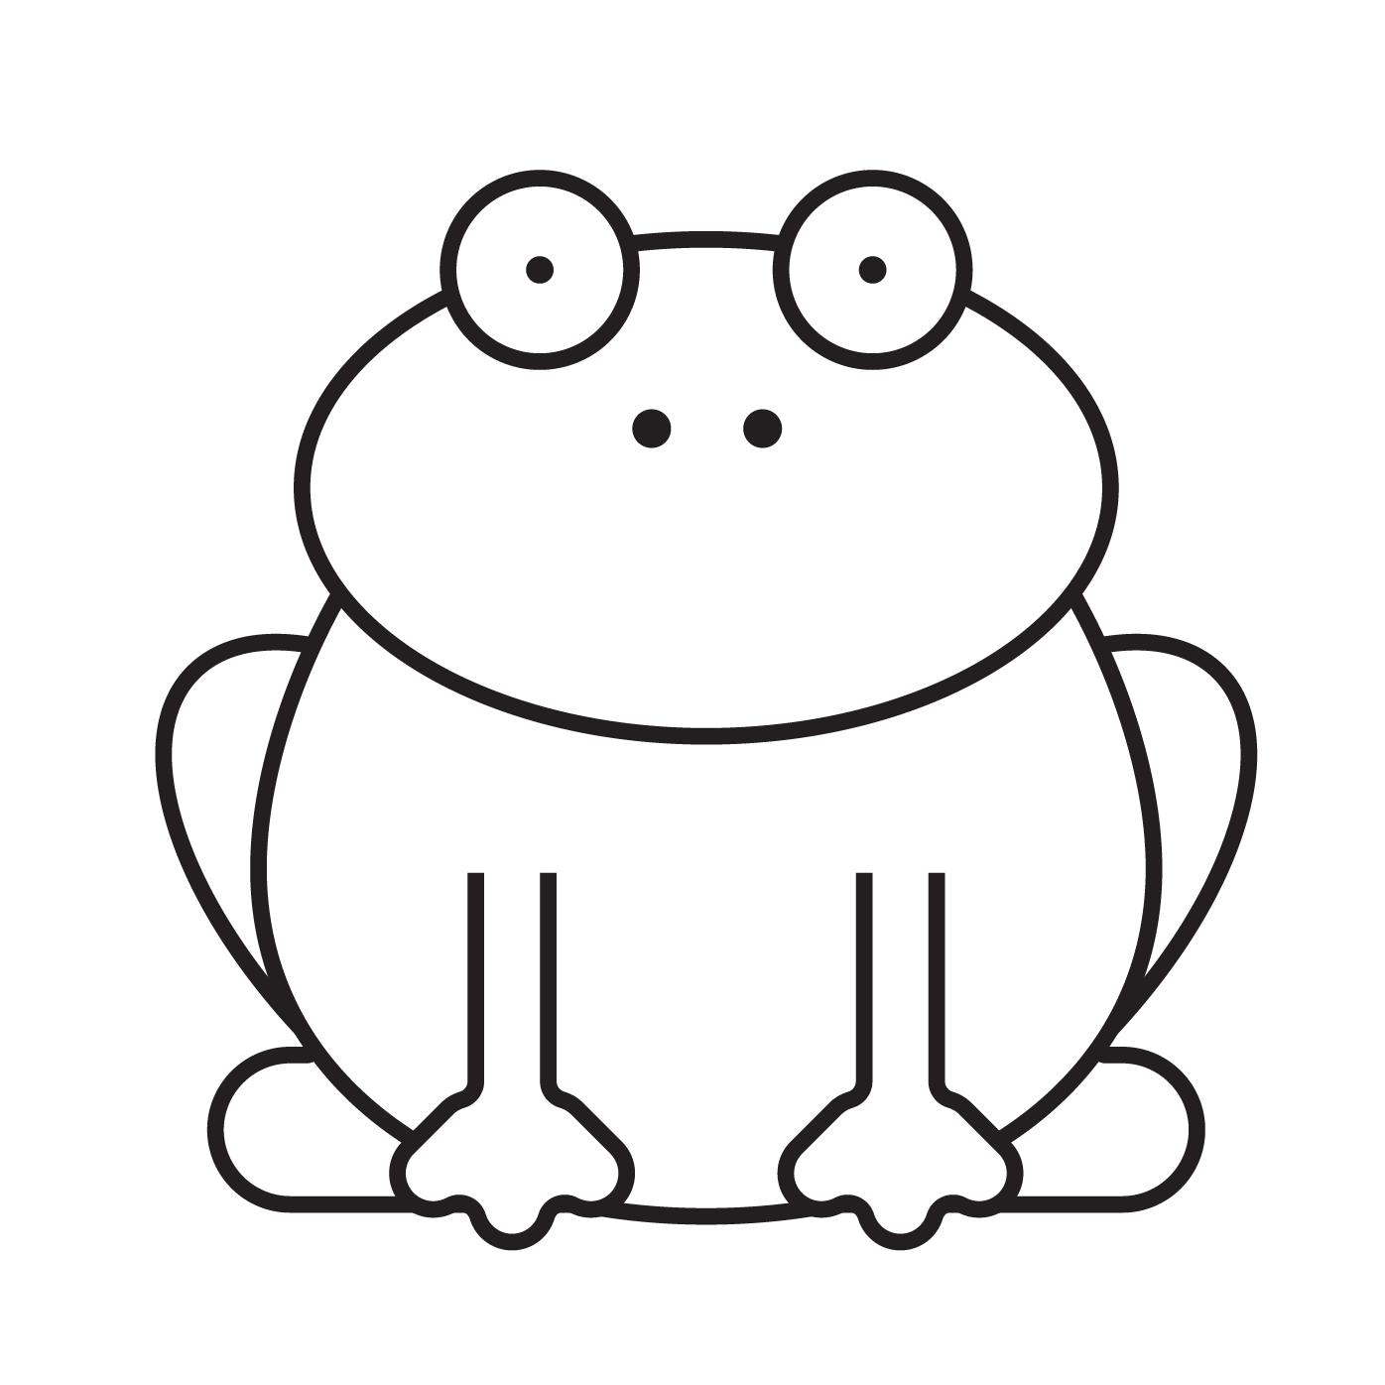

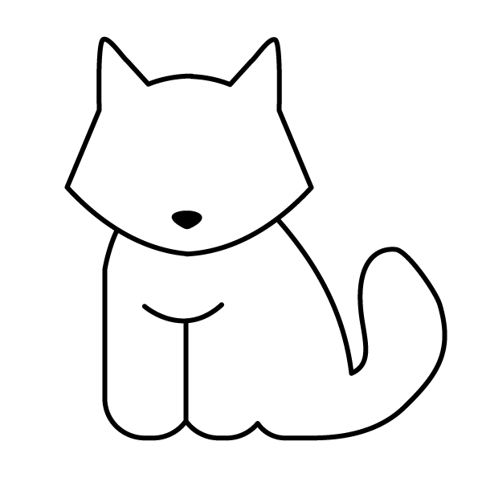

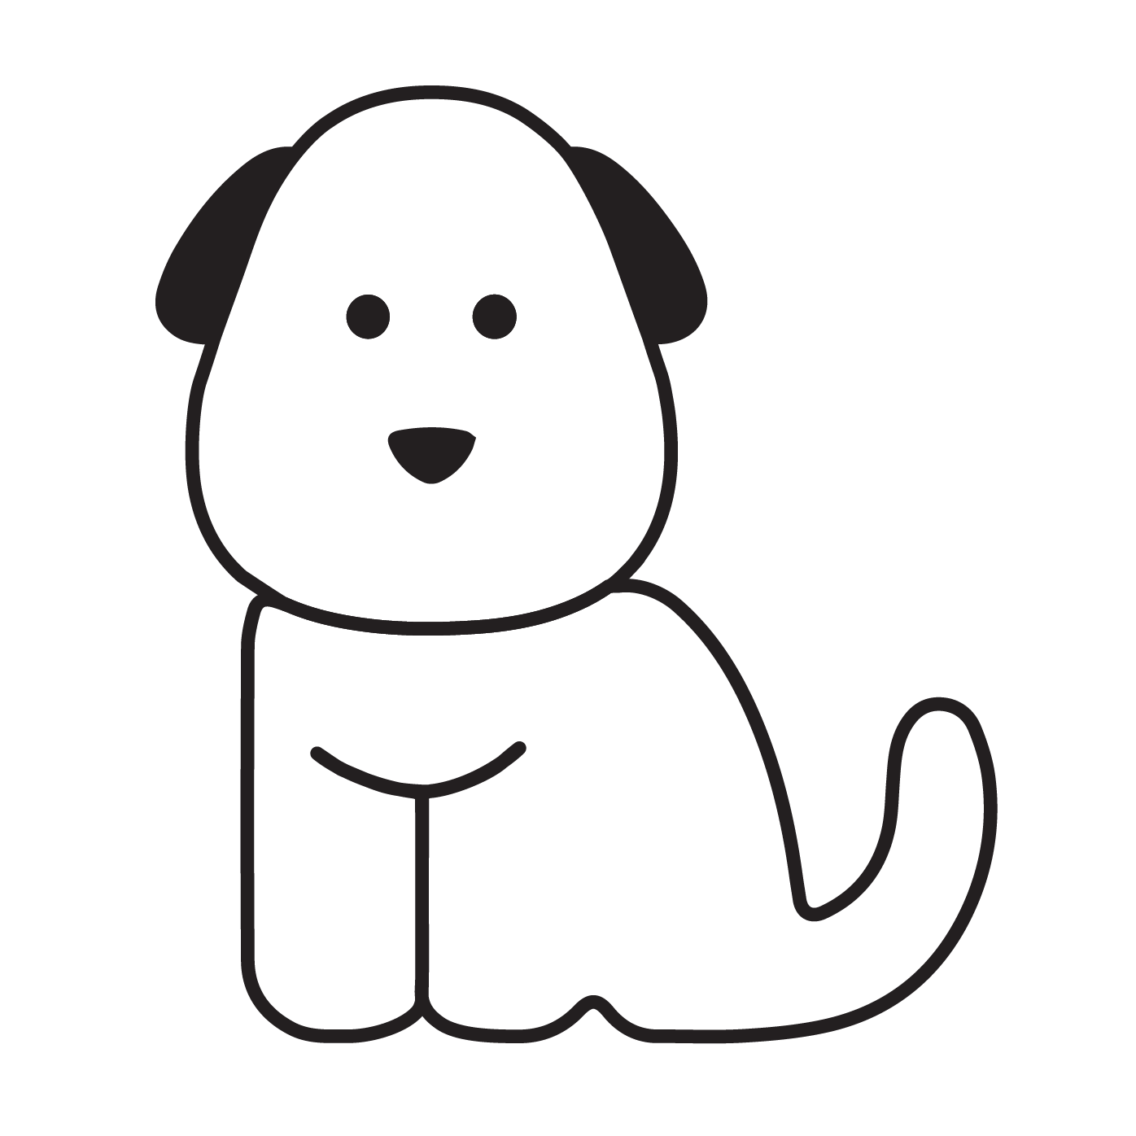


Let’s play – Rhyming words memory
Cut out the cards. Spread them out and turn them face down. Flip two at a time to match a pair of rhyming words. Play the game with a partner.
cat
box
bear
frog
hat
fox
chair
dog
© State of New South Wales (Department of Education), 2022. Except for the Department of Education logo, other logos and trademark-protected material, this resource is licensed under the Creative Commons Attribution 4.0 International Licence
Notes:
H5P Interactive - Offline Option
6. Memory
**There should be 2 of every icon**
Images:
Cat - https://drive.google.com/file/d/1EYh_hrBkoTkF5COIT6_qY-rrsr8gs5f0/view?usp=share_link
Pig - https://drive.google.com/file/d/1A_Gme3J-s89TBubsxdZlBq-LL1zyaIhf/view?usp=share_link
Net - https://drive.google.com/file/d/1G0q6IyLBUFosUYVXO9zmP1_6Vu1OVRgW/view?usp=share_link
Frog - https://drive.google.com/file/d/1_4jLHPvEGft9whsbgagvuBe2OMmCn6ai/view?usp=share_link
Hat - https://drive.google.com/file/d/1xF4P76_E0wLd4LnC0Jq17hkUP7TrZxpt/view?usp=share_link
Fox - https://drive.google.com/file/d/1cpqisAVt6OBLw7c1nOcJTYCiDQ9swKie/view?usp=share_link
Wet - https://drive.google.com/file/d/1aURBX6-fiIHkLsKJZSp7cH6YrGN8mREz/view?usp=share_link
Dog - https://drive.google.com/file/d/1YERJttP3vifBqdLvaF-i4sgRS0GNyTfj/view?usp=share_link

