Slide 1











Culture
FREE PRESENTATION TEMPLATE

Slide 2


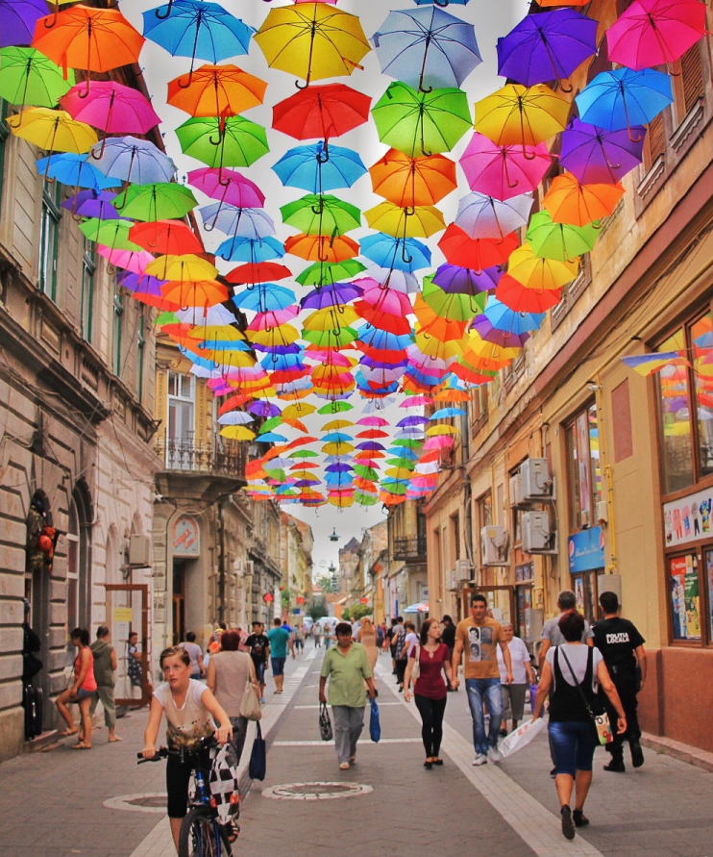

Welcome
Welcome to the world of fantasy! Join us on a journey to explore the mystical creatures, enchanted lands, and magical wonders that exist beyond our reality. Discover the wonders and secrets of this exciting realm and unlock the power of imagination.

Slide 3





01
Introduction
The Extraordinary Realm
Table of Contents
02
Encounters
Unicorn Sightings
03
Wonders
Wishes Granted
04
Magic
Spellcasting

Slide 4



The Realm of the Extraordinary
Welcome to the Fantasy World, a realm of wonder and enchantment where anything is possible. Here, dragons breathe fire, unicorns prance through meadows, and rainbows shine brightly. This world is a place where wishes come true, where potions can be cursed and spells are cast. It's a place of treasure and adventure, where the impossible becomes possible. But the greatest treasure of all is the one that lies within.
The world of fantasy is a reflection of our deepest desires, our fondest dreams, and our wildest imaginations. It's a place where we can let go of the constraints of reality and explore the boundless possibilities of the human mind. In this introduction, we will delve into the mysteries of this realm, uncovering the magic and wonder that lies within. So come with us and let's embark on a journey through the Fantasy World.

Slide 5
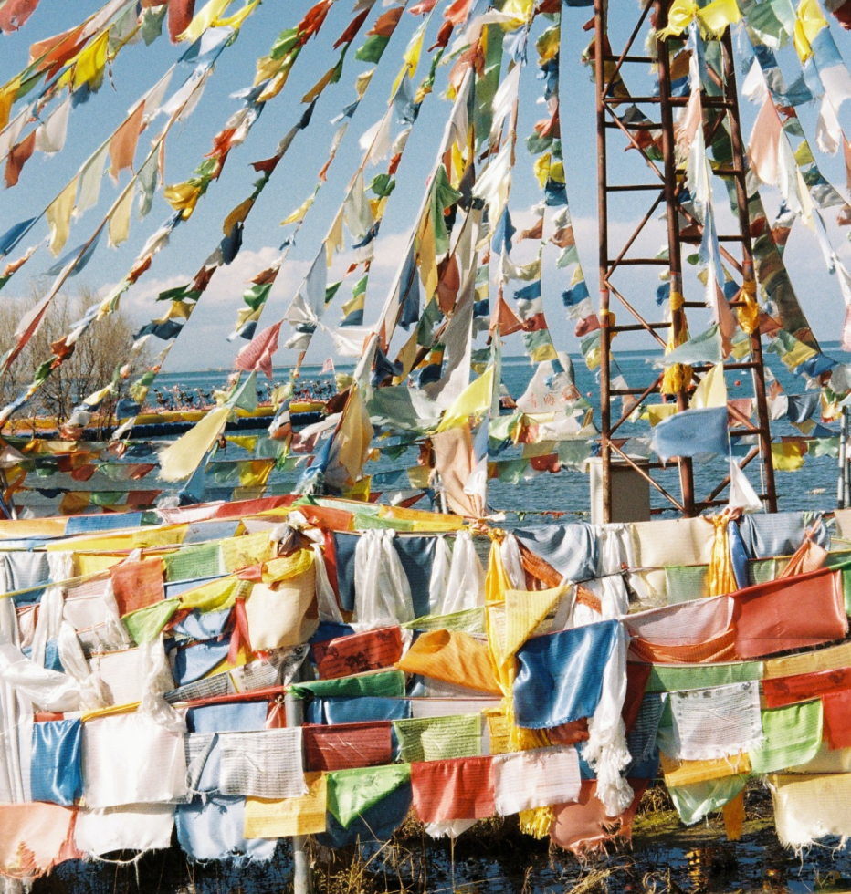



Unicorn Sightings
A record of the number of unicorns spotted in the fantasy realm and the beauty and mystery that surrounds these enchanting creatures.
Dragon Taming
A closer look at the art of taming dragons and the brave adventurers who dare to take on these fearsome creatures.

Slide 6




Fantasy is the gateway to the impossible, the land where the ordinary becomes extraordinary, and the impossible becomes possible. It is the realm of the imagination, where anything can happen and everything is possible.
The Dream Weaver

Slide 7



The Magic of Dragons: A Research
Unicorn
Sighting
Dragon
Taming
Rainbow
Seeing
"The Art of Archery": Discover the intricacies of the Art of Archery .
"The Music of the Elves": Immerse yourself in the enchanting music.
"The Life of an Elf": Learn about the customs and daily life of the elves.

Slide 8



S
W
O
T
Eclipse
Obtain
War
Invasion
Rare event causes unpredictable magic.
Humans acquire Crystal
Kingdoms clash in conflict.
Kingdom attacked by monsters.
Quest
Foundation
Transformation
Betrayal
Adventurers seek immortal artifact.
Shimmering City established
Peasant discovers magical powers.
Queen's advisor revealed as spy.

Slide 9


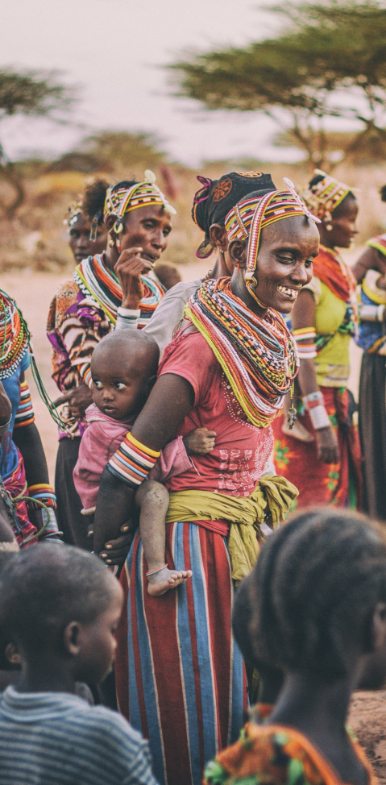
Some Data
Enchanted Creatures
75%
possess the ability to cast spells.
Magic-Wielding Individuals
60%
practice the art of illusions.
Spells Cast
90%
are dark magic, foretelling danger.

Slide 10
234,567
UNICORN SIGHTINGS
A tally of the number of unicorns spotted in the fantasy realm.

Slide 11





Some Graph
100
90
80
70
60
50
34.574
40
Total
30
20
10
0
1
2
3
4
5
6
7
8
Spellcasting Progress
Treasure Found
A record of the number of spells cast per year
A record of the amount of treasure found per month

Slide 12

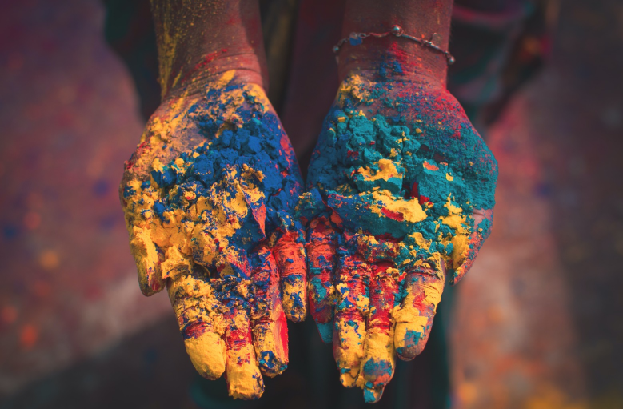
Portal to Adventure
A web application
A web application designed for discovering the world of fantasy

Slide 13


The Future of Fantasy
An mobile app
An app designed for exploring and experiencing the enchanting realm of fantasy
Explore a magical world
Experience fantasy firsthand
Immerse in a realm of magic
Discover untold wonders
Live your fantasy dreams

Slide 14


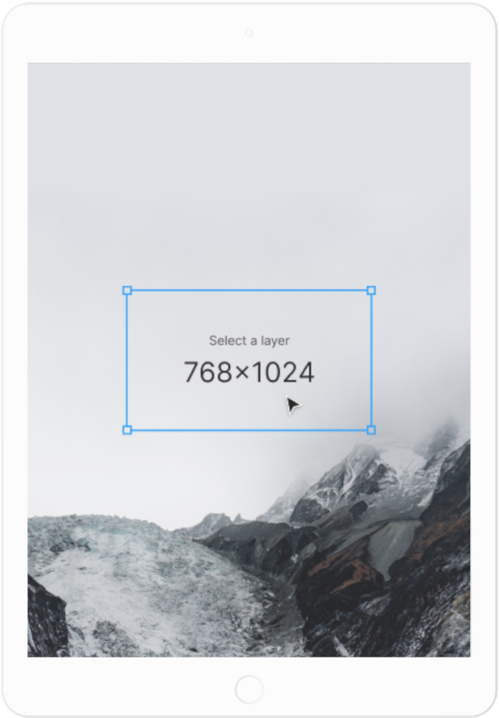
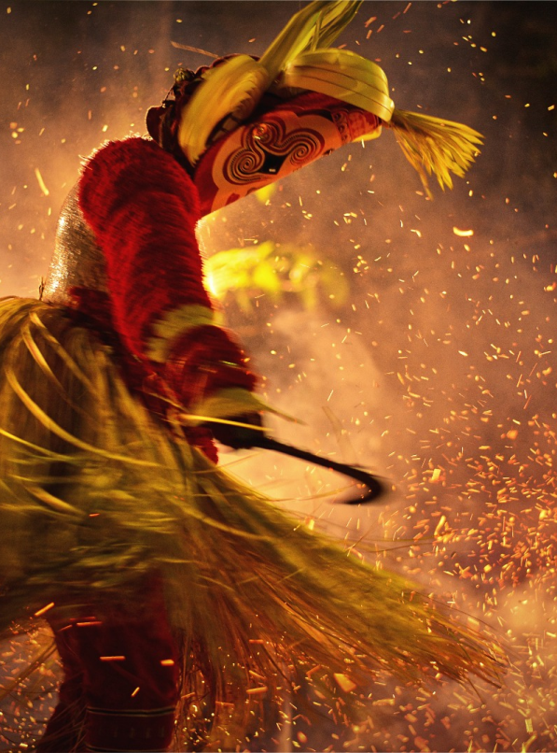

A Gateway to a World of Fantasy and Wonder
Immerse yourself in the world of magic and mystery
Explore uncharted territories and fantastical lands
Meet mythical creatures and legendary beings
Uncover hidden treasures and secret treasures
A web application
A web application designed for discovering the world of fantasy

Slide 15
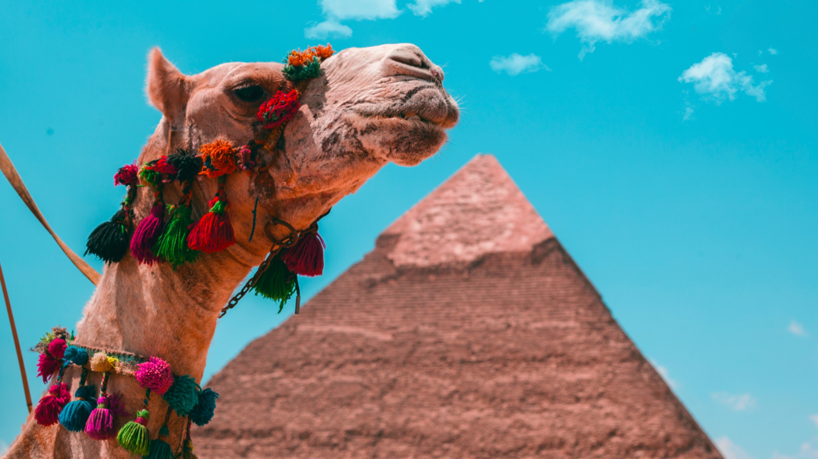
A Magic Picture

Slide 16



Discover the secrets
Find your own path
1
2
Explore the lush, vibrant forest and uncover the mysteries that lie within.
Choose your own path through the forest, and see where it takes you.
Meet the creatures
Uncover the magic
3
4
Encounter the mythical creatures that call the forest home, from talking animals to fairies.
Learn about the powerful magic that pervades the forest and how it affects all who enter.

Slide 17

The Enchanted Forest
Fantasy Realm at a Glance
A magical forest filled with talking animals and enchanted creatures.
The Crystal Caves
A network of underground caves filled with precious gems and crystals.
The Dragon's Lair
A dangerous and mysterious place where dragons reside.

Slide 18



The Information
Spellcasting
Competition
Treasure
Hunt
Great
Adventure
A significant event in the history of the fantasy realm, in which the greatest spellcasters of the realm.
A significant event in the history of the fantasy realm, in which a massive and awesome treasure hunt was organized.
A notable year in the history of the fantasy realm, in which a large number of adventurers set out to explore.

Slide 19




Our Team
Eldruin
Lunaria
The Fire Mage
The Moon Priestess
Elementalen
Eldruin
The Guardian
The Fire Mage

Slide 20












The Organization
Chloe Ng
The Mage
Valtorin
Aurielle
Theronis
Dariana
The Assassin
The Priestess
The Warrior
The Shaman
Lyrisa
Lucian
Elvina
Kaelen
The Dreamer
The Conjurer
The Oracle
The Sentinel
Cedric
Seraphina
The Timekeeper
The Lightbringer
To download more editable chart, click here

Slide 21


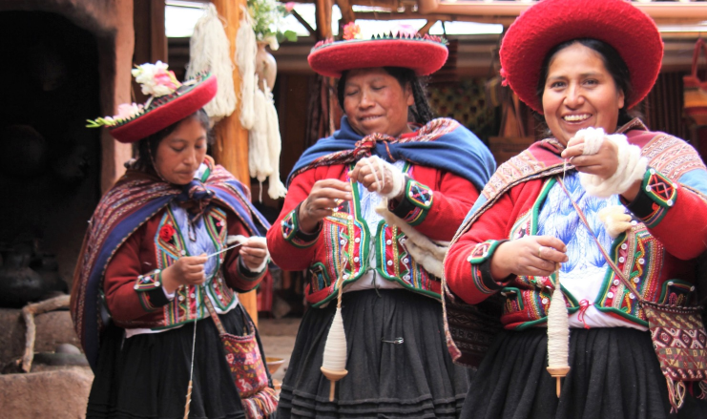

Thank you for choosing EaTemp
We offer free and high-quality slides templates for your presentations. We appreciate you choosing us and hope our templates have been helpful.
As a new website, we rely on your support to grow, so please help us by sharing our site with your friends and colleagues.
Credit | Image: Unsplash

