Slide 1
Water and soils
1
NOTE: Slides for each module are numbered for easier cross-referencing with class notes
NOTE: My slides have TONS of animations and building graphics. These do not translate well to D2L, so it is best to download the power point to work through the logic behind the animations

Slide 2
Water balance: internal balances
2
Energy
Precipitation
Evaporation
Interception
Throughfall
Sublimation
Snowpack
Snowmelt
Energy
(latent heat)
Evapotranspiration
Surface detention
Evaporation
Infiltration
Overland flow
Transpiration
Soil water
Percolation
Understanding the controls of the water balance is inseparable from understanding of the energy balance.
Groundwater
Stream flow generation
Evaporation
Streams and lakes
Watershed
Runoff

Slide 3
Soil water: topics covered
3
Water in unsaturated porous substrate: extending the fundamental vocabulary and concepts of subsurface waters to cover unsaturated conditions
Measuring water content: example of the gravimetric technique and an overview of other techniques
Capillarity and negative pressure head: the concepts necessary to quantify the ability of pores to create negative pressure heads that hold water against gravity or move water against gravity
Direction of soil water movement: examples of how to calculate total head in unsaturated conditions and infer the direction of hydraulic gradients
Soil water flux: extending Darcy’s Law to be able to predict the flux of water through a porous substrate under unsaturated conditions
Predicting infiltration rates: a simpler perspective on predicting infiltration rates based on Green-Ampt theory

Slide 4
Soil water: topics covered
4
Water in unsaturated porous substrate: extending the fundamental vocabulary and concepts of subsurface waters to cover unsaturated conditions
Measuring water content: example of the gravimetric technique and an overview of other techniques
Capillarity and negative pressure head: the concepts necessary to quantify the ability of pores to create negative pressure heads that hold water against gravity or move water against gravity
Direction of soil water movement: examples of how to calculate total head in unsaturated conditions and infer the direction of hydraulic gradients
Soil water flux: extending Darcy’s Law to be able to predict the flux of water through a porous substrate under unsaturated conditions
Predicting infiltration rates: a simpler perspective on predicting infiltration rates based on Green-Ampt theory

Slide 5
Soil physics: analogy with snow
5
Accumulation and warming phase
T < 0 °C
Ripening phase
T = 0 °C (isothermal)
Output phase
T = 0 °C (isothermal)
Snow (ice) particles
Liquid water

Slide 6
Soil physics: critical hydraulic thresholds
6
No transpiration
Yes transpiration
Yes transpiration
Wilting
point
Field
capacity
No infiltration by gravity
No infiltration by gravity
Yes infiltration by gravity
Soil (solid) particles
Liquid water

Slide 7

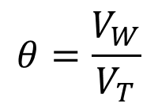


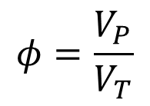
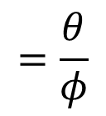
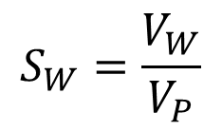







Water in porous media: the basics
7
Total volume is sum of
solid, water, and air volumes
Dimensionless ratios [1]
Porosity
$$V_{T}=$$
$$V_{S}$$
$${+V}_{W}$$
$${+V}_{A}$$
$$φ=\frac{V_{P}}{V_{T}}$$
Water content (volumetric)
$$θ=\frac{V_{W}}{V_{T}}$$
$$V_{A}$$
$$V_{P}$$
Pore volume
$$V_{S}$$
Saturation
$$V_{P}=V_{T}−V_{S}$$
Soil (solid) particles
$$S_{W}=\frac{V_{W}}{V_{P}}$$
$$=\frac{θ}{φ}$$
$$V_{W}$$
$$=V_{A}+V_{W}^{∗}$$
Liquid water
*if water is the only liquid in pores

Slide 8
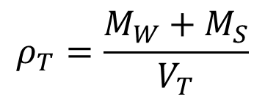


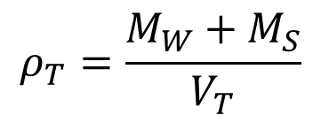
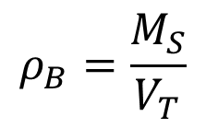
Soil physics: volumes [L³] of three phases
8
Density [M L⁻³]
Dimensionless ratios [1]
Bulk density
(“dry”)
$$ρ_{B}=\frac{M_{S}}{V_{T}}$$
Porosity
$$φ=\frac{V_{P}}{V_{T}}$$
Wet (or total) bulk density
$$ρ_{T}=\frac{M_{W}+M_{S}}{V_{T}}$$
Water content (volumetric)
$$θ=\frac{V_{W}}{V_{T}}$$
$ρ_{T}=\left(1−φ\right)ρ_{S}+$ $θρ_{W}$
$$V_{A}$$
$$V_{P}$$
Pore volume
$$V_{S}$$
Saturation
$$V_{P}=V_{T}−V_{S}$$
Soil (solid) particles
$$S_{W}=\frac{V_{W}}{V_{P}}$$
$$=\frac{θ}{φ}$$
$$V_{W}$$
$$=V_{A}+V_{W}$$
Liquid water
*if water is the only liquid in pores

Slide 9
Soil water: topics covered
9
Water in unsaturated porous substrate: extending the fundamental vocabulary and concepts of subsurface waters to cover unsaturated conditions
Measuring water content: example of the gravimetric technique and an overview of other techniques
Capillarity and negative pressure head: the concepts necessary to quantify the ability of pores to create negative pressure heads that hold water against gravity or move water against gravity
Direction of soil water movement: examples of how to calculate total head in unsaturated conditions and infer the direction of hydraulic gradients
Soil water flux: extending Darcy’s Law to be able to predict the flux of water through a porous substrate under unsaturated conditions
Predicting infiltration rates: a simpler perspective on predicting infiltration rates based on Green-Ampt theory

Slide 10
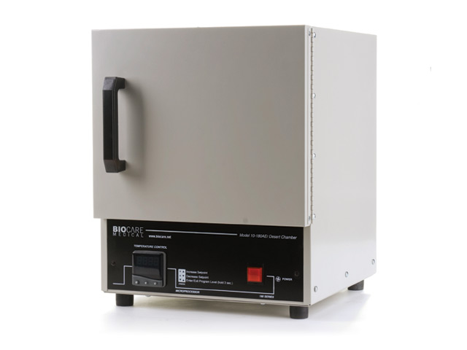
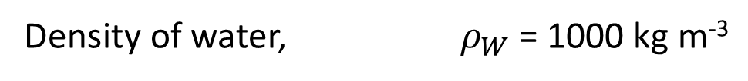

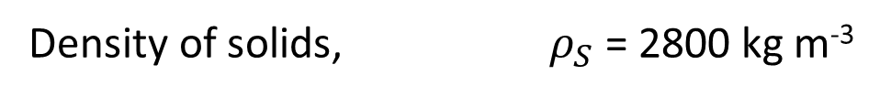
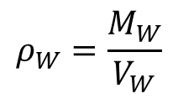
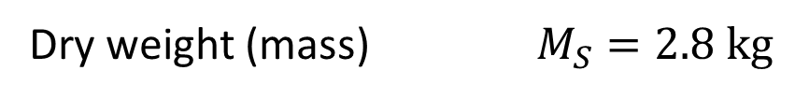
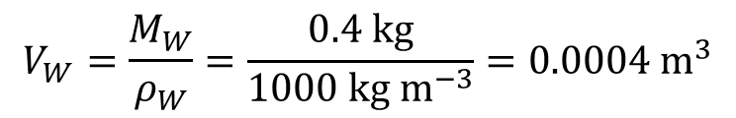
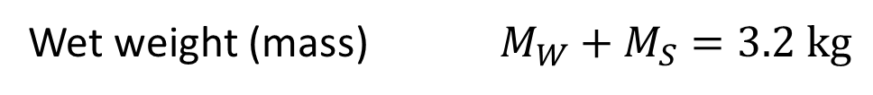
Soil water: water content measurement
10
Density of solids, $ρ_{S}$ = 2800 kg m⁻³
Density of water, $ρ_{W}$ = 1000 kg m⁻³
Intact soil core, $V_{T}$ = 1500 cm³ = 0.0015 m³
Wet weight (mass) $M_{W}+M_{S}=3.2 kg$
Wet bulk density (mass) $ρ_{T}=\frac{M_{W}+M_{S}}{V_{T}}=\frac{3.2 kg}{0.0015 m^{3}}=2133 kg m^{−3}$
By weight (in lab):
1. Sample a known soil volume
2. Weigh wet bulk sample
3. Dry sample in oven
4. Weigh dried sample
Dry weight (mass) $M_{S}=2.8 kg$
Water weight (mass) $M_{W}=\left(M_{W}+M_{S}\right)−M_{S}$
$$=0.4 kg$$
$$ρ_{W}=\frac{M_{W}}{V_{W}}$$
$$V_{W}=\frac{M_{W}}{ρ_{W}}=\frac{0.4 kg}{1000 kg m^{−3}}=0.0004 m^{3}$$
Water volume

Slide 11
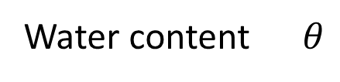
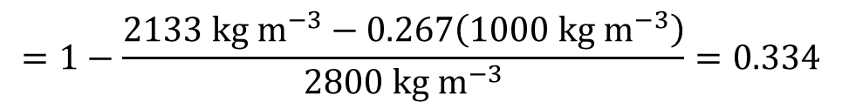


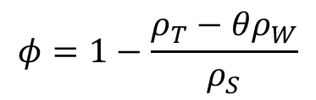
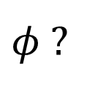


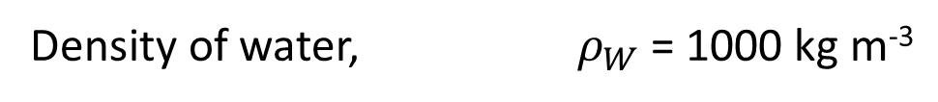
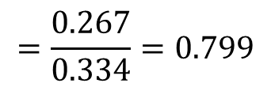
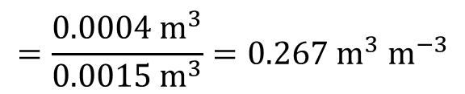
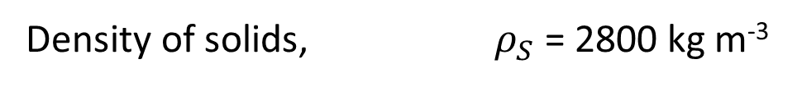

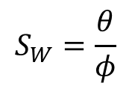
Soil water: water content measurement
11
Density of solids, $ρ_{S}$ = 2800 kg m⁻³
Density of water, $ρ_{W}$ = 1000 kg m⁻³
$$V_{T}=0.0015{ m}^{3}$$
$$ρ_{T}=2133 kg m^{−3}$$
$$V_{W}=0.0004 m^{3}$$
$$=\frac{V_{W}}{V_{T}}$$
$$=\frac{0.0004{ m}^{3}}{0.0015{ m}^{3}}=0.267{ m}^{3}{ m}^{−3}$$
Water content $θ$
By weight (in lab):
1. Sample a known soil volume
2. Weigh bulk sample
3. Dry sample in oven
4. Weigh dried sample
$φ$ ?
$ρ_{T}=\left(1−φ\right)ρ_{S}+$ $θρ_{W}$
$$φ=1−\frac{ρ_{T}−θρ_{W}}{ρ_{S}}$$
$$=1−\frac{2133 kg m^{−3}−0.267\left(1000 kg m^{−3}\right)}{2800 kg m^{−3}}=0.334$$
$$S_{W}=\frac{θ}{φ}$$
$$=\frac{0.267}{0.334}=0.799$$

Slide 12
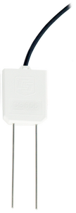
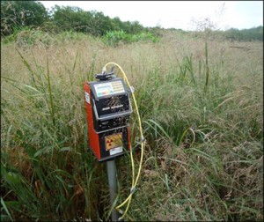
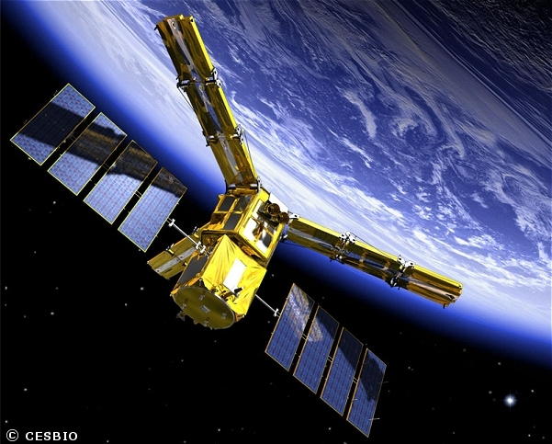
Soil water: water content measurement
12
By weight (in lab):
1. Sample a known soil volume
2. Weigh bulk sample
3. Dry sample in oven
4. Weigh dried sample
Neutron probe
(in field):
1. Emits “fast” neutrons
2. Return of “slow” neutrons determined by hydrogen atoms
3. Infer water content from hydrogen atoms
Electrical properties
(in field):
1. Electrical conductivity or resistivity
2. Electrical permittivity (e.g. measured by Time Domain Reflectometry (TDR))
Emission of radiation
(remote sensing):
1. Microwaves

Slide 13


Soil physics: critical hydraulic thresholds
13
$$θ_{wp}$$
$$θ_{fc}$$
No transpiration
Yes transpiration
Yes transpiration
Wilting
point
Field
capacity
No infiltration by gravity
No infiltration by gravity
Yes infiltration by gravity
Soil (solid) particles
Liquid water

Slide 14
Soil water: topics covered
14
Water in unsaturated porous substrate: extending the fundamental vocabulary and concepts of subsurface waters to cover unsaturated conditions
Measuring water content: example of the gravimetric technique and an overview of other techniques
Capillarity and negative pressure head: the concepts necessary to quantify the ability of pores to create negative pressure heads that hold water against gravity or move water against gravity
Direction of soil water movement: examples of how to calculate total head in unsaturated conditions and infer the direction of hydraulic gradients
Soil water flux: extending Darcy’s Law to be able to predict the flux of water through a porous substrate under unsaturated conditions
Predicting infiltration rates: a simpler perspective on predicting infiltration rates based on Green-Ampt theory

Slide 15
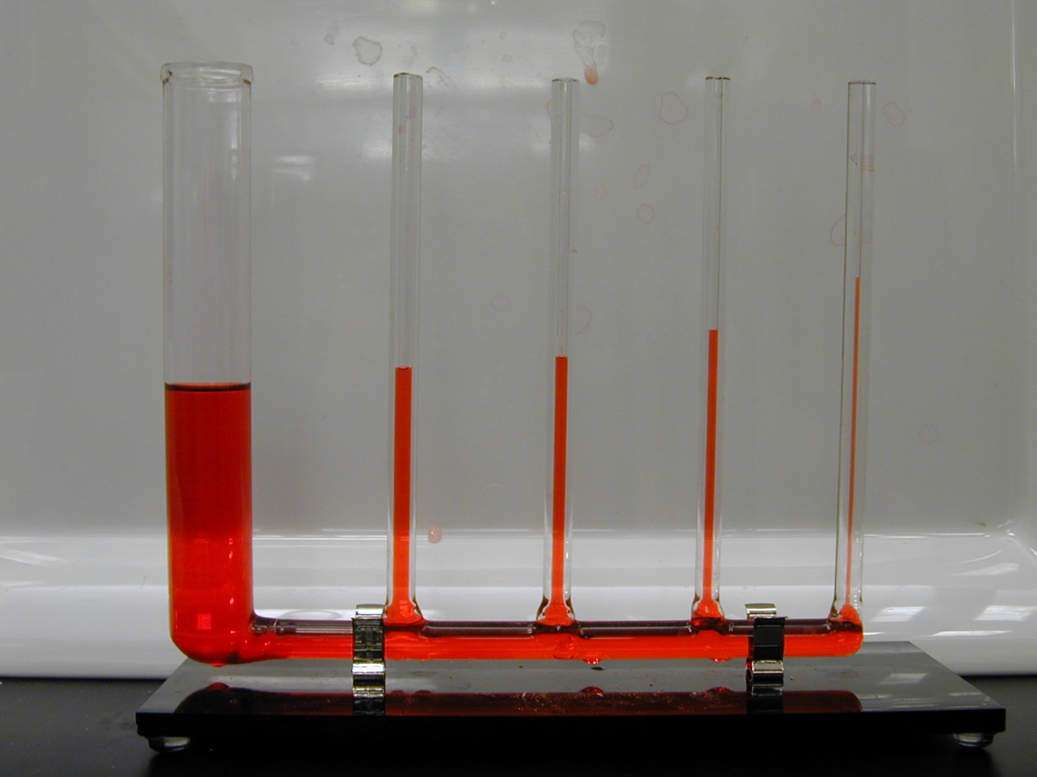
Soil physics: surface tension and capillarity
15
Hydrogen bonding results in high internal tension
Surface tension of water (20 °C) = 73 mN m⁻¹
Surface tension of ethanol = 22 mN m⁻¹
http://web.mit.edu/nnf/education/wettability/gravity.html

Slide 16
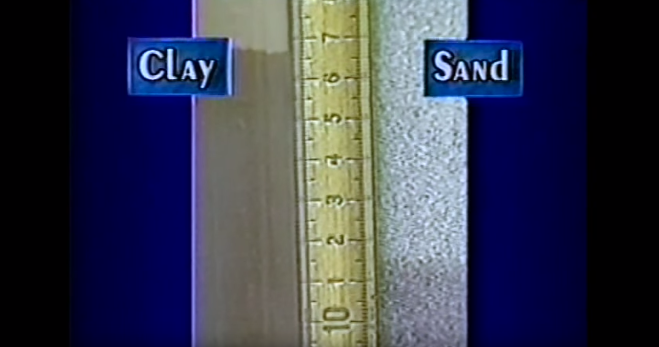
16
https://youtu.be/Ph-7tQuIbz4?t=292
Clay is finer than sand
Sand is coarser than clay
Capillary forces in finer sediments can lift water higher than in coarser sediments
For the same water content, tension tends to be higher in soils with smaller pores
Source of water (water table) is at bottom of columns

Slide 17
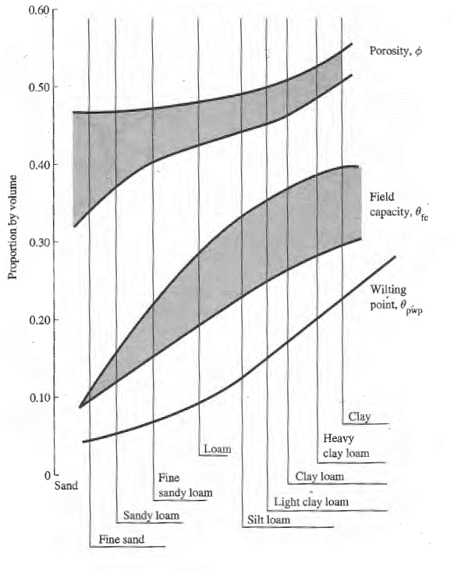

Soil physics: critical thresholds
17
COARSER
FINER
NOT
permeability
porosity > field capacity > wilting point
$$φ>θ_{fc}>θ_{wp}$$
The ability of soil to hold water against
gravity is called capillarity
Capillarity is caused by cohesive and adhesive forces creating tension on water molecules
Capillarity (or tension) increases as sediment/pore size decreases
Figure 7.6 in Dingman text

Slide 18
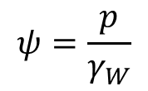
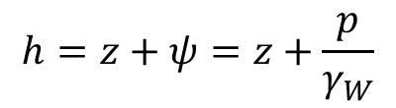


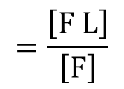


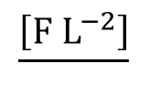
18
Soil physics: revisit hydraulic gradient and head
Hydraulic gradient – change in hydraulic head per unit length of flow path
Hydraulic head – potential mechanical energy of water per unit weight
$$\frac{\left[E\right]}{\left[F\right]}$$
$$=\frac{\left[F L\right]}{\left[F\right]}$$
$$=\left[L\right]$$
Elevation head ($z$) – potential mechanical energy due to gravity
(gravitational head)
Pressure head ($ψ$) – potential mechanical energy due to compression/tension
(+)
(-)
pressure
$$ψ=\frac{p}{γ_{W}}$$
$$\frac{\left[F L^{−2}\right]}{}$$
$$=\left[L\right]$$
weight density
$$\left[F L^{−3}\right]$$
(negative pressure head: matric potential, moisture tension, soil water potential, suction head)
Total hydraulic head (hydrostatic):
$$h=z+ψ=z+\frac{p}{γ_{W}}$$

Slide 19
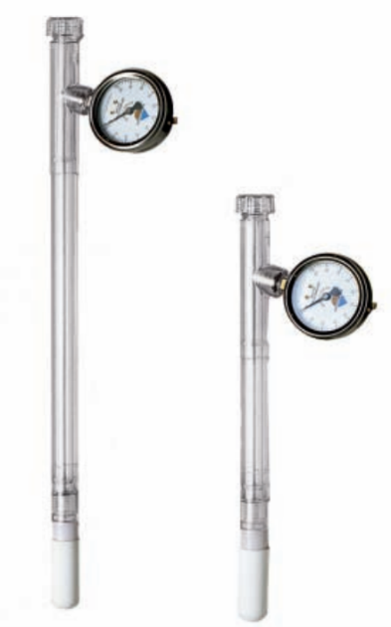
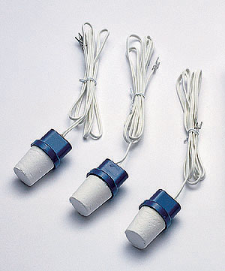
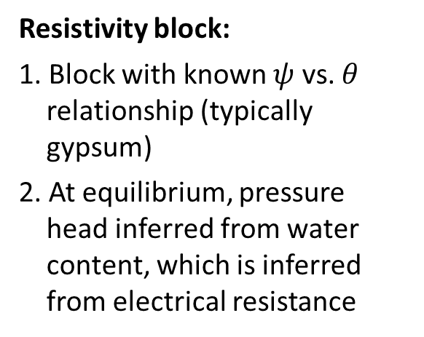
Soil water: water potential measurement
19
Gauge
Water filled chamber
Ceramic porous cup
Tensiometer:
1. Sealed water-filled chamber with pressure gauge connected to soil by porous cup
2. At equilibrium, pressure in chamber is equal to pressure head in soil
Resistivity block:
1. Block with known $ψ$ vs. $θ$ relationship (typically gypsum)
2. At equilibrium, pressure head inferred from water content, which is inferred from electrical resistance

Slide 20
Soil water: topics covered
20
Water in unsaturated porous substrate: extending the fundamental vocabulary and concepts of subsurface waters to cover unsaturated conditions
Measuring water content: example of the gravimetric technique and an overview of other techniques
Capillarity and negative pressure head: the concepts necessary to quantify the ability of pores to create negative pressure heads that hold water against gravity or move water against gravity
Direction of soil water movement: examples of how to calculate total head in unsaturated conditions and infer the direction of hydraulic gradients
Soil water flux: extending Darcy’s Law to be able to predict the flux of water through a porous substrate under unsaturated conditions
Predicting infiltration rates: a simpler perspective on predicting infiltration rates based on Green-Ampt theory

Slide 21












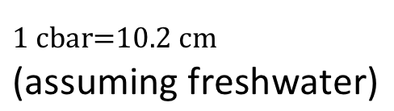



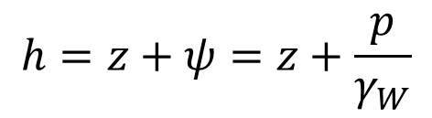







21
Redistribution: direction of water movement
$$h=z+ψ=z+\frac{p}{γ_{W}}$$
$$1 cbar=10.2 cm$$
(assuming freshwater)
A
B
$$z_{A}=$$
$$−20 cm$$
$$p_{A}=$$
$$−40 cbar$$
$$ψ_{A}=$$
$$−408 cm$$
Datum
$$h_{A}=$$
$$−20 cm$$
$$+\left(−408 cm\right)$$
$$=−428 cm$$
Soil
20 cm
$$z_{B}=$$
$$−50 cm$$
$$p_{B}=$$
$$−15 cbar$$
$$ψ_{B}=$$
$$−153 cm$$
50 cm
$$h_{B}=$$
$$−50 cm$$
$$+\left(−153 cm\right)$$
$$=−203 cm$$
In what direction does water want to move?
Water wants to move upward because the hydraulic head at depth A (-408 cm) is less than the hydraulic head at depth B (-203 cm).
But water may not move if the soil is too dry!

Slide 22
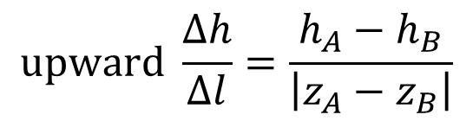
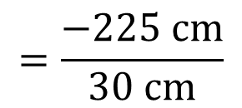
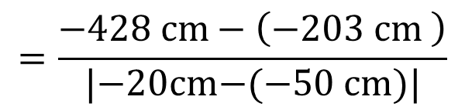
22
Redistribution: direction of water movement
$$h=z+ψ=z+\frac{p}{γ_{W}}$$
$$1 cbar=10.2 cm$$
(assuming freshwater)
A
B
$$z_{A}=$$
$$−20 cm$$
$$p_{A}=$$
$$−40 cbar$$
$$ψ_{A}=$$
$$−408 cm$$
Datum
$$h_{A}=$$
$$−20 cm$$
$$+\left(−408 cm\right)$$
$$=−428 cm$$
Soil
20 cm
$$z_{B}=$$
$$−50 cm$$
$$p_{B}=$$
$$−15 cbar$$
$$ψ_{B}=$$
$$−153 cm$$
50 cm
$$h_{B}=$$
$$−50 cm$$
$$+\left(−153 cm\right)$$
$$=−203 cm$$
In what direction does water want to move?
Alternate method using the sign of the hydraulic gradient:
$$upward \frac{Δh}{Δl}=\frac{h_{A}−h_{B}}{\left|z_{A}−z_{B}\right|}$$
$$=\frac{−428 cm−\left(−203 cm \right)}{|\text{−20}\text{cm}\text{−(−50 }\text{cm}\text{)}|}$$
$$=\frac{−225 cm}{30 cm}$$

Slide 23
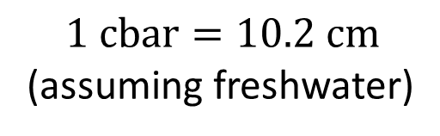




23
Redistribution: direction of water movement
$$h=z+ψ=z+\frac{p}{γ_{W}}$$
$$1 cbar=10.2 cm$$
(assuming freshwater)
A
B
$$z_{A}=$$
$$−20 cm$$
$$p_{A}=$$
$$−18 cbar$$
$$ψ_{A}=$$
$$−183 cm$$
Datum
$$h_{A}=$$
$$−20 cm$$
$$+\left(−183 cm\right)$$
$$=−203 cm$$
Soil
20 cm
$$z_{B}=$$
$$−50 cm$$
$$p_{B}=$$
$$−15 cbar$$
$$ψ_{B}=$$
$$−153 cm$$
50 cm
$$h_{B}=$$
$$−50 cm$$
$$+\left(−153 cm\right)$$
$$=−203 cm$$
What would the pressure head at A need to prevent water movement?

Slide 24
Soil water: topics covered
24
Water in unsaturated porous substrate: extending the fundamental vocabulary and concepts of subsurface waters to cover unsaturated conditions
Measuring water content: example of the gravimetric technique and an overview of other techniques
Capillarity and negative pressure head: the concepts necessary to quantify the ability of pores to create negative pressure heads that hold water against gravity or move water against gravity
Direction of soil water movement: examples of how to calculate total head in unsaturated conditions and infer the direction of hydraulic gradients
Soil water flux: extending Darcy’s Law to be able to predict the flux of water through a porous substrate under unsaturated conditions
Predicting infiltration rates: a simpler perspective on predicting infiltration rates based on Green-Ampt theory

Slide 25
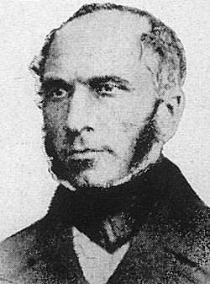
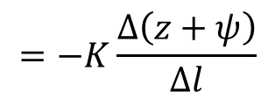
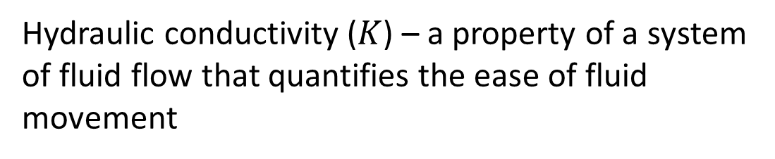
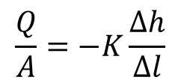



25
Groundwater movement: Darcy’s law
$h=z+ψ=z+\frac{p}{γ_{W}}$
Positive water flux is proportional to a
negative hydraulic gradient (for laminar flow through pores)
$$\frac{Q}{A}$$
$$=−K\frac{Δ\left(z+ψ\right)}{Δl}$$
[L T⁻¹]
(Darcian flux)
$$\frac{Q}{A}=−K\frac{Δh}{Δl}$$
$$\frac{Δh}{Δl}$$
[1]
Hydraulic conductivity ($K$) – a property of a system of fluid flow that quantifies the ease of fluid movement
Henry Darcy
French Engineer
mid-1800s
[L T⁻¹]
Hydraulic conductivity is strongly controlled by the size and connectivity of pores (and viscosity of the fluid)
This is permeability (not porosity)

Slide 26
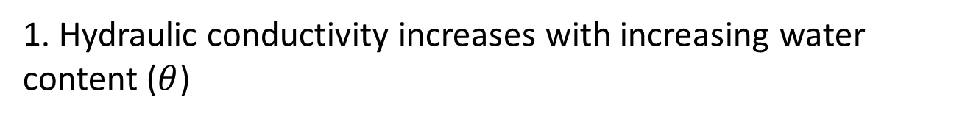
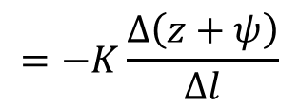
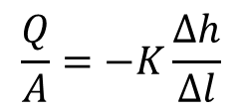
26
Soil physics: Darcy’s law in unsaturated conditions
$$\frac{Q}{A}=−K\frac{Δh}{Δl}$$
$$=−K\frac{Δ\left(z+ψ\right)}{Δl}$$
1. Hydraulic conductivity increases with increasing water content ($θ$)
Henry Darcy
French Engineer
mid-1800s

Slide 27
27
Soil physics: Darcy’s law in unsaturated conditions
$$\frac{Q}{A}=−K\frac{Δh}{Δl}$$
$$=−K\frac{Δ\left(z+ψ\right)}{Δl}$$
1. Hydraulic conductivity increases with increasing water content ($θ$)
2. Pressure head is negative in unsaturated conditions
Henry Darcy
French Engineer
mid-1800s

Slide 28

28
Soil physics: Darcy’s law in unsaturated conditions
$$\frac{Q}{A}=−K\frac{Δh}{Δl}$$
$$=−K\frac{Δ\left(z+ψ\right)}{Δl}$$
1. Hydraulic conductivity increases with increasing water content ($θ$)
2. Pressure head is negative in unsaturated conditions
3. Pressure head gets more negative with decreasing water content ($θ$)
Henry Darcy
French Engineer
mid-1800s

Slide 29



29
Soil physics: Darcy’s law in unsaturated conditions
$$\frac{Q}{A}=−K\frac{Δh}{Δl}$$
$$=−K\frac{Δ\left(z+ψ\right)}{Δl}$$
1. Hydraulic conductivity increases with increasing water content ($θ$)
2. Pressure head is negative in unsaturated conditions
3. Pressure head gets more negative with decreasing water content ($θ$)
$$\frac{Q}{A}=−K_{θ}\frac{Δh_{θ}}{Δl}$$
$$=−K_{θ}\frac{Δ\left[z+ψ_{θ}\right]}{Δl}$$
Henry Darcy
French Engineer
mid-1800s

Slide 30

30
Soil physics: Darcy’s law in unsaturated conditions
1. Hydraulic conductivity increases with increasing water content ($θ$)
2. Pressure head is negative in unsaturated conditions
3. Pressure head gets more negative with decreasing water content ($θ$)
Henry Darcy
French Engineer
mid-1800s

Slide 31



Soil physics: application to irrigation
31
3. Pressure head is a function of water content ($θ$)
Plant available water
$$θ_{pa}=\frac{θ−θ_{wp}}{θ_{fc}−θ_{wp}}$$
From the National Engineering Handbook, 201-VI

Slide 32

32
https://www.youtube.com/watch?v=Ph-7tQuIbz4

Slide 33




Soil physics: infiltration capacity
33
Infiltration capacity is a critical partitioning mechanism in the watershed, determining how rain water or snow melt is partitioned between:
1. Soil storage and transport
2. Overland flow
What do we need to know about soil to understand mechanisms of infiltration?
$$\frac{Q}{A}=−K_{θ}\frac{Δ\left[z+ψ_{θ}\right]}{Δl}$$
1. Characteristics of $K$ vs. $θ$
Horton RE. 1933. The role of infiltration in the hydrologic cycle.
Transactions, American Geophysical Union 14: 446–460.
2. Characteristics of $ψ$ vs. $θ$

Slide 34




Infiltration: controlling pressure head
34
Pressure plate
How do we calculate $K$ and $ψ$ as a function of $θ$?
Not easy to know $K\left(θ\right)$ and $ψ\left(θ\right)$:
1. Not easy to control $ψ$ at large scales
2. Not easy to scale to watersheds
Rien Van Genuchten
(> 22000 citations)

Slide 35







Infiltration: Richard’s equation
35
$$\frac{∂θ}{∂t}=$$
$$−\frac{∂q_{z}}{∂z′}$$
Inputs minus outputs due to change in flux with depth
$$\frac{ΔS}{Δt}$$
$$q_{z}=\frac{Q_{z}}{A_{Z}}$$
If flux is increasing with depth, then water content must decrease (soil is draining faster than filling)
Lorenzo A. Richards
$$θ$$
Soil at $z$

Slide 36
Infiltration: Richard’s equation
36
$$\frac{∂θ}{∂t}=$$
$$−\frac{∂q_{z}}{∂z′}$$
Inputs minus outputs due to change in flux with depth
$$\frac{ΔS}{Δt}$$
$$q_{z}=\frac{Q_{z}}{A_{Z}}$$
If flux is decreasing with depth, then water content must increase (soil is filling faster than draining)
Lorenzo A. Richards
$$θ$$
Soil at $z$

Slide 37





Infiltration: Richard’s equation
37
$$\frac{∂θ}{∂t}=$$
$$−\frac{∂q_{z}}{∂z′}$$
Inputs minus outputs due to change in flux with depth
$$\frac{ΔS}{Δt}$$
$$q_{z}=\frac{Q_{z}}{A_{Z}}$$
$$=−K_{θ}\frac{∂\left[z+ψ_{θ}\right]}{∂z′}$$
Lorenzo A. Richards
$$\frac{∂θ}{∂t}$$
$$=−\frac{∂K_{θ}}{∂z′}$$
$$+\frac{∂}{∂z′}\left[K_{θ}\frac{∂ψ_{θ}}{∂z′}\right]$$
Two practical problems:
1. Not easy to solve with arbitrary boundary conditions
2. Not easy to know $K\left(θ\right)$ and $ψ\left(θ\right)$
Inputs minus outputs due to elevation head
Inputs minus outputs due to pressure head
$$\frac{ΔS}{Δt}$$

Slide 38
Soil water: topics covered
38
Water in unsaturated porous substrate: extending the fundamental vocabulary and concepts of subsurface waters to cover unsaturated conditions
Measuring water content: example of the gravimetric technique and an overview of other techniques
Capillarity and negative pressure head: the concepts necessary to quantify the ability of pores to create negative pressure heads that hold water against gravity or move water against gravity
Direction of soil water movement: examples of how to calculate total head in unsaturated conditions and infer the direction of hydraulic gradients
Soil water flux: extending Darcy’s Law to be able to predict the flux of water through a porous substrate under unsaturated conditions
Predicting infiltration rates: a simpler perspective on predicting infiltration rates based on Green-Ampt theory

Slide 39
39
https://www.youtube.com/watch?v=Ph-7tQuIbz4

Slide 40

40
Infiltration is at its MAXIMUM early
Infiltration is at its MINIMUM late
Nearly saturated, gradient in elevation head (gravitational head) dominates movement
Unsaturated, gradient in pressure head (capillary forces, tension, etc.) dominates movement
Unsaturated, gradient in pressure head (capillary forces, tension, etc.) dominates movement
After ~2 minutes
After ~14 minutes
https://www.youtube.com/watch?v=Ph-7tQuIbz4

Slide 41





Infiltration: wetting fronts and Green-Ampt
41
When rainfall is
LESS THAN minimum infiltration capacity
Increasing water content ($θ$) [L³ L⁻³]
0
Ground surface
$$w=rainfall$$
[L T⁻¹]
$$w≈K_{θ_{w}}$$
$$w<K_{S}$$
Increasing depth [L]
Figure 8.20 from Dingman

Slide 42



Infiltration: wetting fronts and Green-Ampt
42
When rainfall is
LESS THAN minimum infiltration capacity
Increasing water content ($θ$) [L³ L⁻³]
0
Ground surface
$$w=rainfall$$
[L T⁻¹]
$$w≈K_{θ_{w}}$$
$$w<K_{S}$$
Increasing depth [L]
Infiltration is
limited by
rainfall
$$f\left(t\right)=w$$
Figure 8.20 from Dingman

Slide 43







Infiltration: wetting fronts and Green-Ampt
43
When rainfall is
GREATER THAN minimum infiltration capacity
Increasing water content ($θ$) [L³ L⁻³]
Before “ponding” time ($t_{p}$), infiltration is limited by rainfall
$$f\left(t\right)=w$$
0
Ground surface
$$−\frac{∆h}{∆l}$$
$${w>K}_{S}$$
Infiltration ($f\left(t\right)$) is
limited by
saturated hydraulic
conductivity ($K_{S}$)
Increasing depth [L]
and hydraulic gradient
at the wetting front
Hydraulic gradient
at the wetting front
determined by $\left|ψ_{f}\right|$, or pressure head just below the front
Figure 8.21 from Dingman

Slide 44



Infiltration: wetting fronts and Green-Ampt
44
When rainfall is
GREATER THAN minimum infiltration capacity
Increasing water content ($θ$) [L³ L⁻³]
Before “ponding” time ($t_{p}$), infiltration is limited by rainfall
$$f\left(t\right)=w$$
0
Ground surface
$$−\frac{∆h}{∆l}$$
$${w≥K}_{S}$$
At the time of ponding $\left|ψ_{f}\right|$ will be close the surface, and f(t) will be at it’s MAXIMUM
Increasing depth [L]
Figure 8.21 from Dingman

Slide 45


Infiltration: wetting fronts and Green-Ampt
45
When rainfall is
GREATER THAN minimum infiltration capacity
Increasing water content ($θ$) [L³ L⁻³]
Before “ponding” time ($t_{p}$), infiltration is limited by rainfall
$$f\left(t\right)=w$$
0
Ground surface
$${w≥K}_{S}$$
At the time of ponding $\left|ψ_{f}\right|$ will be close the surface, and f(t) will be at it’s MAXIMUM
Increasing depth [L]
$$−\frac{∆h}{∆l}$$
After water has infiltrated for a while, $\left|ψ_{f}\right|$ will be far from the surface, and f(t) will be its MINIMUM (approaching K_{S})
Figure 8.21 from Dingman

Slide 46














Infiltration: Green – Ampt, when rain > infiltration
46
$$f\left(t\right)=K_{s}\left(1+\frac{\left|ψ_{f}\right|Δθ}{F\left(t\right)}\right)$$
$f\left(t\right)$ is the rate of infiltration [L T⁻¹] at time $t$
$$K_{s}$$
$f\left(t\right)$
$K_{s}$ is the saturated hydraulic conductivity [L T⁻¹]
$\left|ψ_{f}\right|$ is the absolute value of the effective pressure
head at the wetting front [L]
$$\left|ψ_{f}\right|$$
$f\left(t\right)$
$Δθ$ is the difference between initial water content and saturated water content ($φ−θ_{0}$) [1]
$$Δθ$$
$f\left(t\right)$
Antecedent conditions matter! (i.e. initial water content)
$F\left(t\right)$ is the total cumulative amount of water that has infiltrated up until time $t$ [L]
$F\left(t\right)$
$f\left(t\right)$

Slide 47



Infiltration: Green – Ampt, when rain > infiltration
47
$$f\left(t\right)=K_{s}\left(1+\frac{\left|ψ_{f}\right|Δθ}{F\left(t\right)}\right)$$
$f\left(t\right)$ is the rate of infiltration [L T⁻¹] at time $t$
$F\left(t\right)$ is the total cumulative amount of water that has infiltrated up until time $t$ [L]
$F\left(t\right)$
$f\left(t\right)$
The effect of $\left|ψ_{f}\right|Δθ$ decreases
over time
The relative effect of pressure
gradient decreases over time
$F\left(t\right)$
and the infiltration rate decreases over time to a minimum value of $K_{S}$
The relative effect of gravitational
gradient increases over time

Slide 48

48
Infiltration is at its MAXIMUM early
Infiltration is at its MINIMUM late
Nearly saturated, gradient in elevation head (gravitational head) dominates movement
Unsaturated, gradient in pressure head (capillary forces, tension, etc.) dominates movement
$$f\left(t\right)=K_{s}\left(1+\frac{\left|ψ_{f}\right|Δθ}{F\left(t\right)}\right)$$
Unsaturated, gradient in pressure head (capillary forces, tension, etc.) dominates movement
After ~2 minutes
After ~14 minutes
https://www.youtube.com/watch?v=Ph-7tQuIbz4

Slide 49

49
Coarse sediment inhibits flow when pressure head gradient dominates
https://youtu.be/Ph-7tQuIbz4?t=914

Slide 50

50
Coarse sediment facilitates flow when gravitational head gradient dominates
https://youtu.be/Ph-7tQuIbz4?t=914

Slide 51




Infiltration: Green – Ampt, when rain > infiltration
51
$$f\left(t\right)=K_{s}\left(1+\frac{\left|ψ_{f}\right|Δθ}{F\left(t\right)}\right)$$
$f\left(t\right)$ is calculated from of $F\left(t\right)$
$F\left(t\right)$ is the cumulative effect of $f(t)$
$$F\left(t\right)=\int_{τ=t_{0}}^{t}{f\left(τ\right)dτ}$$
$$\frac{dF\left(t\right)}{dt}=f\left(t\right)$$
“Implicit” equation, must be solved by iterative technique (trial and error)

Slide 52




Infiltration: Green – Ampt, putting it together
52
Time of ponding
$$f\left(t\right)=$$
$$w$$
Infiltration excess
$$f\left(t\right)=K_{S}\left(1+\frac{\left|ψ_{f}\right|Δθ}{F\left(t\right)}\right)$$
$$K_{S}$$
Stored in soil
$$t_{p}=\frac{K_{S}\left|ψ_{f}\right|Δθ}{w\left(w−K_{S}\right)}$$

Slide 53

Soil physics: infiltration capacity
53
Infiltration capacity is a critical partitioning mechanism in the watershed, determining how rain water or snow melt is partitioned between
1. Soil storage and transport
2. Overland flow
Antecedent conditions
$$f\left(t\right)=K_{s}\left(1+\frac{\left|ψ_{f}\right|Δθ}{F\left(t\right)}\right)$$
Permeability
Horton RE. 1933. The role of infiltration in the hydrologic cycle.
Transactions, American Geophysical Union 14: 446–460.

Slide 54

Soil physics: macroporosity
54
Infiltration capacity influences rate of
downward water movement
through macropores

Slide 55
Soil water: topics covered
55
Water in unsaturated porous substrate: extending the fundamental vocabulary and concepts of subsurface waters to cover unsaturated conditions
Measuring water content: example of the gravimetric technique and an overview of other techniques
Capillarity and negative pressure head: the concepts necessary to quantify the ability of pores to create negative pressure heads that hold water against gravity or move water against gravity
Direction of soil water movement: examples of how to calculate total head in unsaturated conditions and infer the direction of hydraulic gradients
Soil water flux: extending Darcy’s Law to be able to predict the flux of water through a porous substrate under unsaturated conditions
Predicting infiltration rates: a simpler perspective on predicting infiltration rates based on Green-Ampt theory

