Slide 1
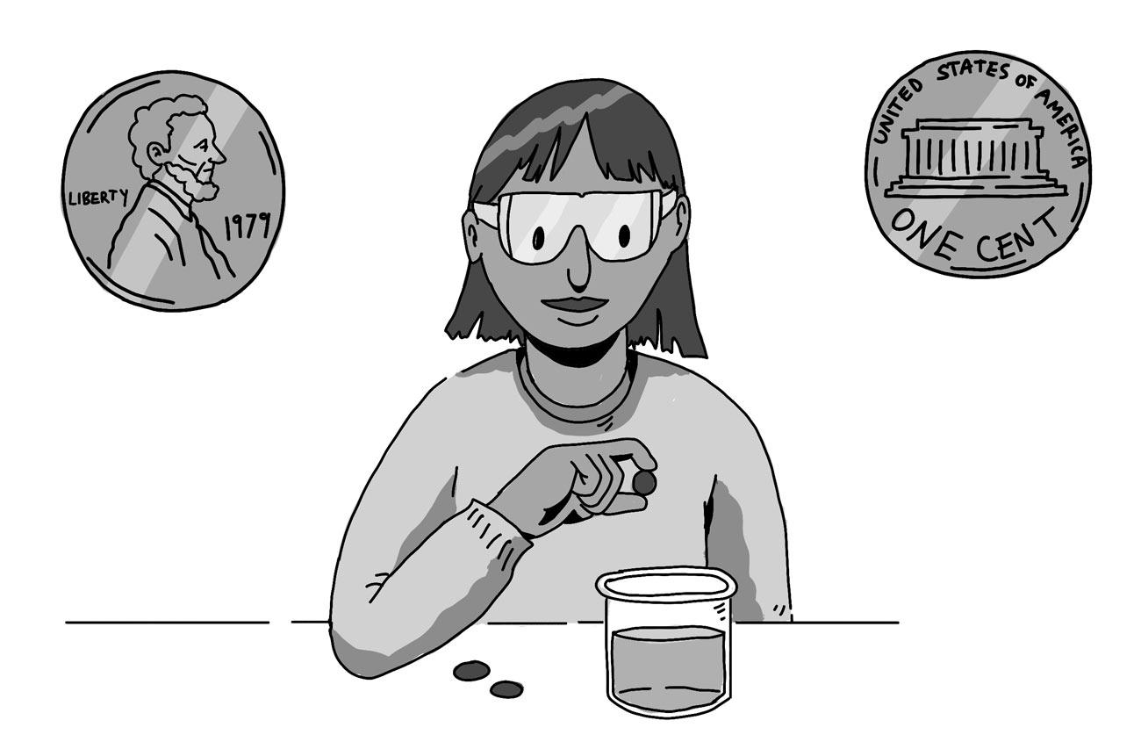
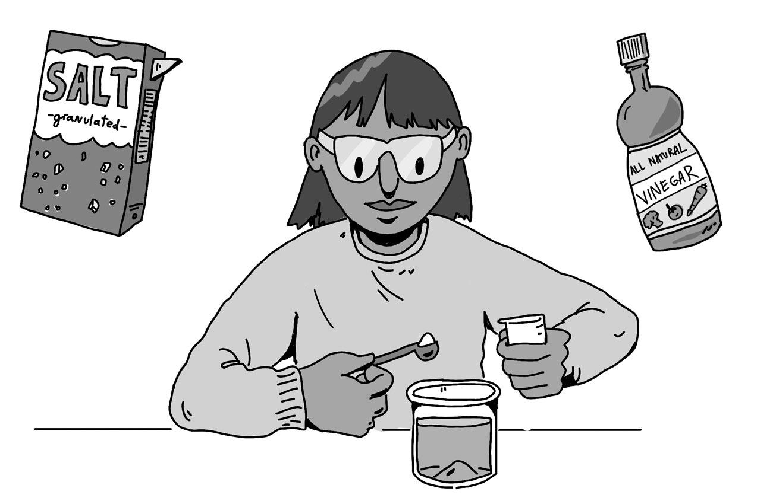

Lesson: Are magic potions real?
Extension Activity
Disappearing Penny
Try this experiment with a US penny made after 1982. These coins have a center made of zinc, a silvery metal that reacts with vinegar and salt.
Materials Needed:
Pennies minted after 1982
Sandpaper
Salt
Vinegar
A clear container
Instructions:
Rub the penny’s edge with sandpaper until you see silvery zinc. Do the same on the other side of the penny.
Mix 1-½ tablespoons of salt and ½ cup of vinegar in a clear container.
Drop in the penny and watch!
Discussion:
What do you notice? Leave the penny in the mixture overnight.
In our experiment, the center of the penny dissolved leaving behind a thin shell of copper. What happened in your experiment?
Are magic potions real?
1

