Slide 1


LOGO
HOSPITAL OPERATION
Presentation Template
www.freepptbackgrounds.net

Slide 2
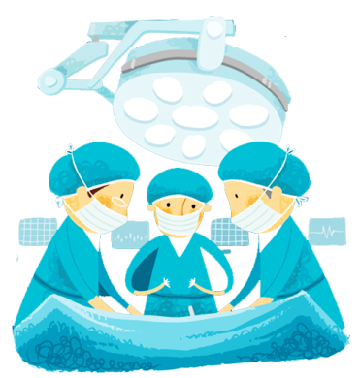

Contents
01
About us
02
Forum
03
Services
04
Timeline

Slide 3

PART 01
ABOUT US

Slide 4

TITLE HERE
We use well-known development methodologies to create a customized approach for each of the projects. This allows us to achieve high quality outcomes and full transparency towards.

Slide 5
95%
TITLE HERE
We hope that this template will return to you as a time, money and reputation.
68%
TITLE HERE
We hope that this template will return to you as a time, money and reputation.
51%
39%
24%

Slide 6

NOTE HERE
We use well-known development methodologies to create a customized approach for each of the projects. This allows us to achieve high quality outcomes and full transparency towards.
NOTE HERE
We use well-known development methodologies to create a customized approach for each of the projects. This allows us to achieve high quality outcomes and full transparency towards.
NOTE HERE
We use well-known development methodologies to create a customized approach for each of the projects. This allows us to achieve high quality outcomes and full transparency towards.

Slide 7

30%
A complex idea can be conveyed with just a single still image, namely making
70%
A complex idea can be conveyed with just a single still image, namely making

Slide 8

NOTE HERE
01
We hope that this template will return to you as a time, money and reputation.

NOTE HERE
We hope that this template will return to you as a time, money and reputation.
02
04
NOTE HERE

NOTE HERE
We hope that this template will return to you as a time, money and reputation.

NOTE HERE
We hope that this template will return to you as a time, money and reputation.
03

Slide 9
DESCRIPTION HERE
DESCRIPTION HERE
DESCRIPTION HERE
DESCRIPTION HERE

Slide 10
PART 02
FORUM

Slide 11
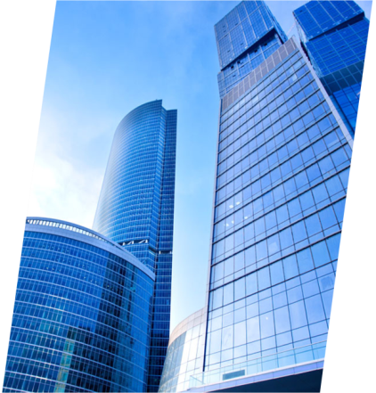
DESCRIPTION HERE
A complex idea can be conveyed with just a single still image, namely making it possible to absorb large amounts of data quickly.
OPTION
OPTION
OPTION
DESCRIPTION HERE
A complex idea can be conveyed with just a single still image, namely making it possible to absorb large amounts of data quickly.
DESCRIPTION HERE
A complex idea can be conveyed with just a single still image, namely making it possible to absorb large amounts of data quickly.

Slide 12

STEP HERE
We hope that this template will return to you as a time, money and reputation.
STEP HERE
We hope that this template will return to you as a time, money and reputation.
STEP HERE
We hope that this template will return to you as a time, money and reputation.

Slide 13
39%
56%
45%
26%
39%
26%
45%
26%
56%
26%
NOTE HERE
NOTE HERE
NOTE HERE
NOTE HERE
NOTE HERE
NOTE HERE
NOTE HERE
NOTE HERE
NOTE HERE
NOTE HERE
NOTE HERE
We use well-known development methodologies to create a customized approach for each of the projects. This allows us to achieve high quality outcomes and full transparency towards.
We use well-known development methodologies to create a customized approach for each of the projects. This allows us to achieve high quality outcomes and full transparency towards.

Slide 14



NOTE HERE
A complex idea can be conveyed with just a single still image, namely making it possible to absorb large amounts of data quickly.

Slide 15

CLICK TO ADD CAPTION TEXT
We use well-known development methodologies to create a customized approach for each of the projects. This allows us to achieve high quality outcomes and full transparency towards.

Slide 16
PART 03
SERVICES

Slide 17
80%
96%
45%
55%

Slide 18
NOTE
We hope that this template will return to you as a time, money and reputation.
NOTE HERE
NOTE HERE
NOTE
We hope that this template will return to you as a time, money and reputation.
NOTE
We hope that this template will return to you as a time, money and reputation.

Slide 19



NOTE HERE
We hope that this template will return to you as a time, money and reputation.
NOTE HERE
We hope that this template will return to you as a time, money and reputation.
NOTE HERE
NOTE HERE
NOTE HERE

Slide 20
STEP HERE
A complex idea can be conveyed with just a single still image, namely making it possible to absorb large amounts of data quickly.
STEP HERE
STEP HERE
STEP HERE
A complex idea can be conveyed with just a single still image, namely making it possible to absorb large amounts of data quickly.
STEP HERE
STEP HERE
A complex idea can be conveyed with just a single still image, namely making it possible to absorb large amounts of data quickly.处添加

Slide 21
NOTE HERE
We use well-known development methodologies to create a customized approach for each of the projects. This allows us to achieve high quality outcomes and full transparency towards.
NOTE HERE
NOTE
HERE
NOTE
HERE

Slide 22
PART 04
TIMELINE

Slide 23



NOTE HERE
A complex idea can be conveyed with just a single still image, namely making it possible to absorb large amounts of data quickly.
NOTE HERE
A complex idea can be conveyed with just a single still image, namely making it possible to absorb large amounts of data quickly.
NOTE HERE
A complex idea can be conveyed with just a single still image, namely making it possible to absorb large amounts of data quickly.

Slide 24



We hope that this template will return
to you as a time, money and reputation.
We hope that this template will return
to you as a time, money and reputation.
STAGE HERE
STAGE HERE
STAGE HERE
We hope that this template will return
to you as a time, money and reputation.

Slide 25
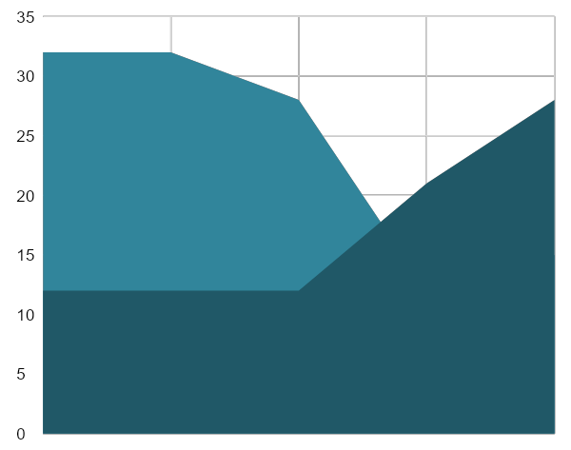
01 STEP HERE
We hope that this template will return
to you as a time, money and reputation.
02 STEP HERE
We hope that this template will return
to you as a time, money and reputation.

Slide 26
STEP HERE
STEP HERE
75%
97%
58%
41%
65%

Slide 27
STEP HERE
Go ahead and replace it with your own text.
04
03
STEP HERE
Go ahead and replace it with your own text.
02
01
STEP HERE
Go ahead and replace it with your own text.

Slide 28
LOGO
THANK YOU !
Hospital Operation Report Template
www.freepptbackgrounds.net

