Slide 1


WORLD ORGANIZATIONS

Slide 2

In this chapter we will study
• Establishment of UNO • Objectives of UNO
• Organs of UNO • Achievements of UNO
• Agencies of UNO • Regional Co-operation

Slide 3
● 20th century was witness to the World wars. After the end of first world war league of nations was founded
● The demand for peace also stronger.
● The word "United Nations" was proposed by Roosevelt of USA

Slide 4
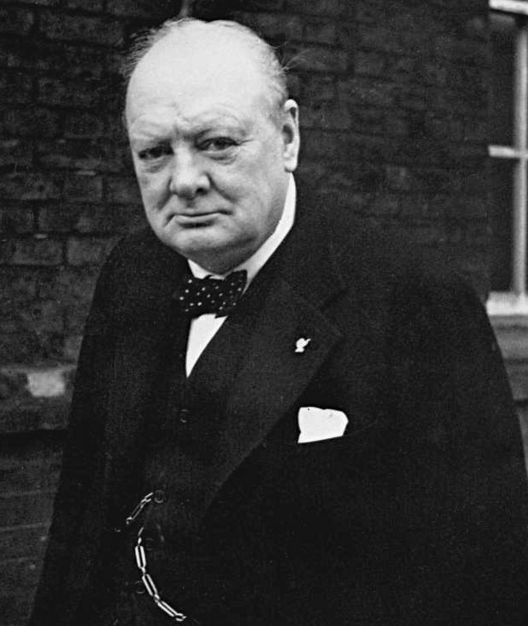
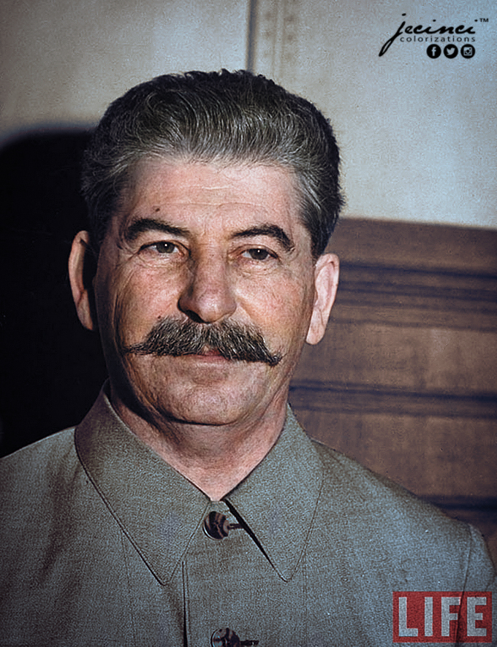
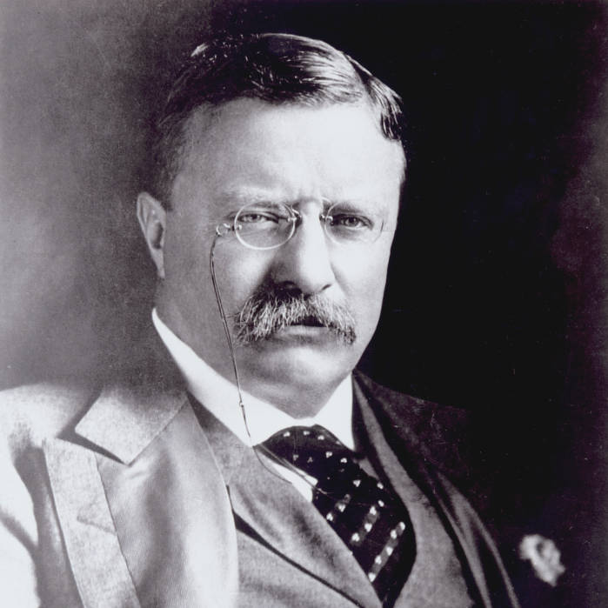
● At global level Winston Churchill of UK Joseph Stalin of USSR and Franklin D.Roosevelt of USA attempted to establish International organization

Slide 5
● on June 26th 1945 , 51 nation sign at the conference of UNO in San Francisco
● UN officially founded on October 24 1945
● At present 193 out of 195 countries have become the members of UNO

Slide 6
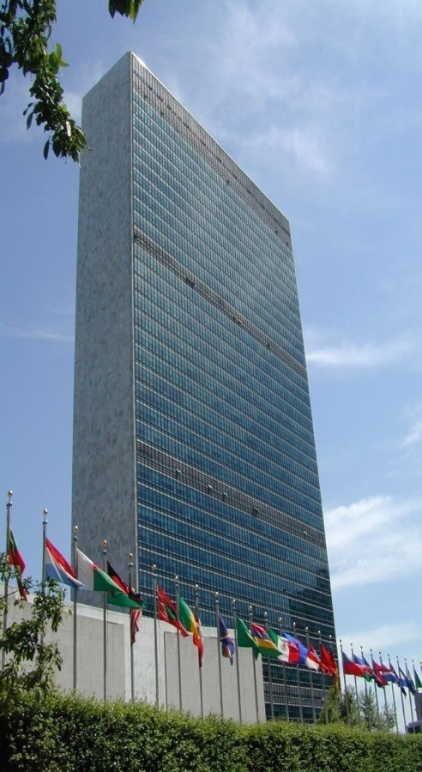
Aims of UNO
1. Safeguarding international peace and security
2. Cooperation among Nations
3. Improving the face in human rights
4. Exploring solutions to various economic sociological cultural problems
5. Providing recognition to international agreements
6. Striving to build mutual trust

Slide 7
UN affiliated bodies
General Assembly
Trusteeship Council
Secretariat
International Court of Justice
Security Council
Economics and Social Council

Slide 8
General assembly
● The body consisting of representatives from all the member States
● Every country send five representatives to this body
There are 7 vice presidents 17 chairperson and 7 permanent committees
● general assembly meetings begins around September

Slide 9
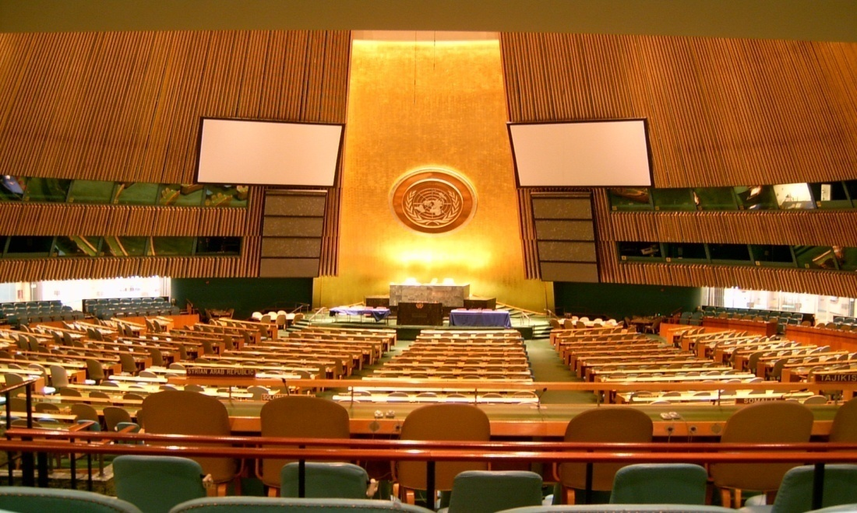
● For every important matters of approval a two third majority is mandatory
● General budget is approved in the general assembly
● It act like a global parliament to discuss world issues

Slide 10
Security council
● It is like a cabinet of UNO it has 15 members Nations among them USA UK France Russia China. These are the permanent members
● The remaining 10 members are elected by general assembly for a period of 2 years these are non permanent

Slide 11

● Every member has on vote to exercise. Veto power the right to reject a resolution
● solve Global problems peacefully it employees peacekeeping force to maintain peace
● select the judge of International court of justice and nominates secretary general for UN

Slide 12
Economic and social committee
● conducting studies on economic social cultural education and health issues
● Issues like refugee problem women status residence and many other issues
● Recommends on issues of human rights
● Organizing conferences on human resource culture education
● Coordinating the functions of UN agencies ILO FAO IMF

Slide 13
Trusteeship council
This Council actually works as an auxiliary or assisting organ of the General Assembly.
As the number of Trust territories and administrating nations has decreased, The Council had become smaller.
It has to look after the small territories. Having no statehood as such.

Slide 14
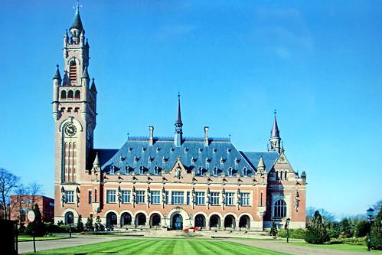
International court of justice
● This court has 15 judges for the term of 9 years
● It is located in Hague Netherland
● Giving judgment and providing legal consultations
● This court is important from ethical and rational prospectus

Slide 15
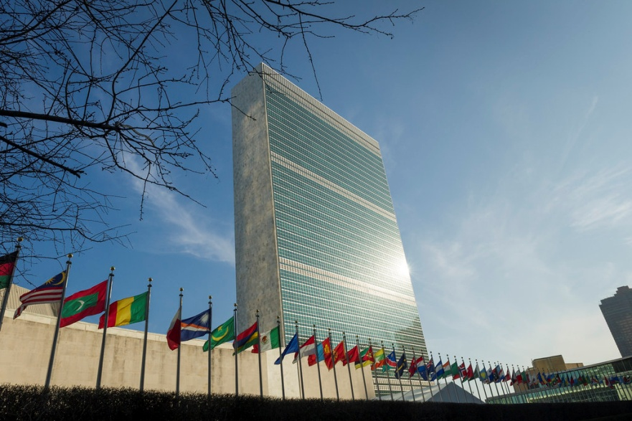
Secretariat
● It is the head of the executive body
● Secretary is elected by general assembly for a period of 5 years
● Its head office is in New York
● Day to day administration of the UNO and institutional functions are run by secretariat

Slide 16
Achievements of UNO
It resolved Korean conflicts, Swiss canal crisis and Vietnam problem
Solution of Kashmir and Palestine-Israel dispute.
making efforts towards the goal of disarmament
Trying to solve economic, financial and international trade related problems

Slide 17
trying to eradicate communicable and non-communicable diseases through World Health Organization (W.H.O.)
declaration of Universal Human Rights seeking their implementation world wide
Making efforts to end apartheid, imperialism and colonialism.
Striving to prevent ill effects of global warming

Slide 18

Various organization under UNO
FAO
it was born in 1945 to fight against poverty, malnutrition and hunger
❖ Its head office is in Rome
❖ It aims to develop agriculture, food supply, Hunger and reforming the life of rural people

Slide 19

WHO:
it was founded in 1948 with the aim of improving the health of the world community.
It has tried to eradicate diseases like Cholera, malaria, AIDS,COVID-19 and smallpox. The organization is trying to address issues like population growth, hunger, and malnutrition. Its head office is in Geneva Switzerland

Slide 20
UNESCO:
it was founded in the year 1946. It's head office in Paris.
• “Since wars begin in the minds of men, it is in the minds that the defenses of peace must be constructed” preamble of UNESCO

Slide 21
functions of UNESCO
• Aims to improve the science education culture of the world. And preserving the world heritage
• It aims at the development of technical education, information technology, creative mental, cultural and environment studies

Slide 22

UNICEF:
it was founded in 1946 for the benefit of the children.
The aim of this organization is to create a conducive environment for the development of children and women.
It received Nobel award in the year 1965.
❖ It sells greeting cards to generate funds to expend its various functions
❖ popular humanitarian organization

Slide 23

IMF
• It was founded in 1945 its head offices in New York.
• It tries to resolve international economic crisis.
• It plays the role of a facilitator between developed countries and undeveloped countries

Slide 24
IBRD:
it was founded in the year 1947 it is also called as World Bank its head office is in Washington
❖ This has been established with the aim of economic rejuvenation of the world after the Second World War

Slide 25
❖ This Bank provides funds in large sum to promote the growth in agriculture infrastructure transport communication
❖ It helps to balance the world trade and the development of the countries

Slide 26

International labor organization
its head office is in Geneva Switzerland. It works for the welfare of the workers health facilities life quality.
initiated by ILO for labor welfare
● maternity benefits
● minimum wages
● housing schemes for labours
● It's striving to protect the welfare of workers of the world

Slide 27

WTO:
it was founded on January 1st 1995 according to the general agreement on trade and tariff.
This tries to resolve various conflicts arising out international trade and Commerce.
It is considered as third important pillar of the World Trade along with IMF and World Bank

Slide 28

Regional Cooperation

Slide 29
Commonwealth Nations
● It is founded in the year 1926 the king of Indian remains the nominal head of this organization
● There are 54 member states and its head office is in London
● the main aim of this organization is to upholding the values of democracy freedom, elevation of poverty and securing world peace

Slide 30

SAARC: South Asian Association of Regional cooperation
● It was founded in 1985 its head office is in Nepal, Katmandu
● There are 8 States namely India Pakistan Sri Lanka Nepal Bangladesh Maldives Bhutan and Afghanistan

Slide 31
The main objectives of SAARC
promotions of economic growth, social progress and cultural development through mutual cooperation
workshops and training programs have been taken place for the representatives of these countries on various topics like science and technology agriculture on regular basis

Slide 32

● mutual distrust and a number of disputes among the member states stood as the stumbling blocks on the path of the progress
● The ‘Unanimity’ rule which means the acceptance of all the Member states for any decision proved to be a handicap of SAARC

Slide 33

European union
It is an institution of 27 European countries founded in 1992 by the Treaty of European Union in Maastricht.
● It provides for common market, common currency and common agriculture and trade policy
● The founders asserted for international peace and democracy in the world
● This union is the continuation of earlier European economic community

Slide 34

Association of Southeast Asian nations
● It was founded in 1967 the membership countries are Singapore Malaysia Indonesia Philippines and Thailand
● its main aim is to foster mutual corporation adding social and economic ties achieving progress in cultural technological scientific administrative fields
● It represents totally 9% of the world total population

Slide 35
The organization of African Unity
● It was founded in 1963
● It stands for the principles of self-determination of all the independent African States
● It aims to establish equality, freedom and Unity among all the African Nations and
● It upholds freedom, equality, justice and solidarity of African countries.

Slide 36
The member states of OAU expressed their determination “to fight against neo-colonialism in all its forms”.
This organisation renamed as African Union (AU) in 2002
● In 2023 G-20 Summit of New Delhi African Union Members were given its permanent membership.

Slide 37

Thank you
Prepared by:
Praveen Banakar

