Slide 1
Call Center Solution
Document Version - November 2021

Slide 2
Introduction
Key Features
Comparison
Value Propositions
Interface
Integration
Why B3Networks?
More Resources

Slide 3


Introduction
Our all-in-one Contact Center solution delivers the features of a complete professional call center that enables clients to select the most convenient mode of communication with your brand.
With this solution, you can monitor and control performance indicators to maximize work productivity and empower your organization so your workforce can communicate anywhere, anytime.

Slide 4
Key Features
INBOUND VOICE CALLS
ROUTING
OUTBOUND VOICE CALLS
Call Waiting / Call Transfer / Call Pickup
Call Spy / Whisper / Barge / Force hang-up
Interactive Voice Response (IVR)
Voicemail-to-Email
Virtual queue with Callback
Unlimited number of customized queues
Popup Script and Note
Call Conferencing
Call Recording
Ring All / Round Robin / Skill-based Routing
Multi-Line Hunting
Sticky Agent (Personal Routing for Repeat Callers)
Outbound campaigns with automatic call distributor (ACD)
Preview / Progressive dialing mode
Consent Management (Blacklist, Whitelist)
Real-time DNC Checking for Outbound calls
Call Masking
Call Recording
REPORTING & ANALYTICS
Supervisor real-time actionable Dashboard
User-friendly self-service portal
INTEGRATION
DEVICES
NUMBERS
Interoperability with Legacy PBX/Analog Lines via Gateway
Mobile/Desktop App to handle calls
Hot desking for IP Phone
International DIDs, toll-free, landline, golden numbers
Caller ID Retention

Slide 5










Value Propositions
Limited Maintenance & Admin Requirements
Unrestricted Scalability
Easily manage operations with a minimum technical obligation.
Easily customize the service anytime according to the business size no matter how big or small your company is.
Comprehensive Insight
Cost Savings
All data, including SLA, abandoned rate, average wait time, average call duration, are gathered to give you a rich source of customer intelligence.
Cut overall cost by spending less on devices, device management, and support.
Data Access Management
Greater Work Efficiency
Different account roles are available for you in order to limit access to statistics and data to only authorized individuals.
Pop-up with answer script and notes taking section for better customer interaction and task handling.
Improved Performance
Mobility & Geographical Flexibility
Performance statistics are available for all levels, whether agent, team or company.
Able to connect anywhere and anytime on our Mobile/Desktop Application.
Compliance
Seamless Integration
All calls are recorded for regulation and compliance purposes.
One-of-a-kind auto Do-Not-Call Numbers filtering, CRM integration tools, and DID numbers in 70+ countries give you the automation and insight that truly drive your productivity.

Slide 6

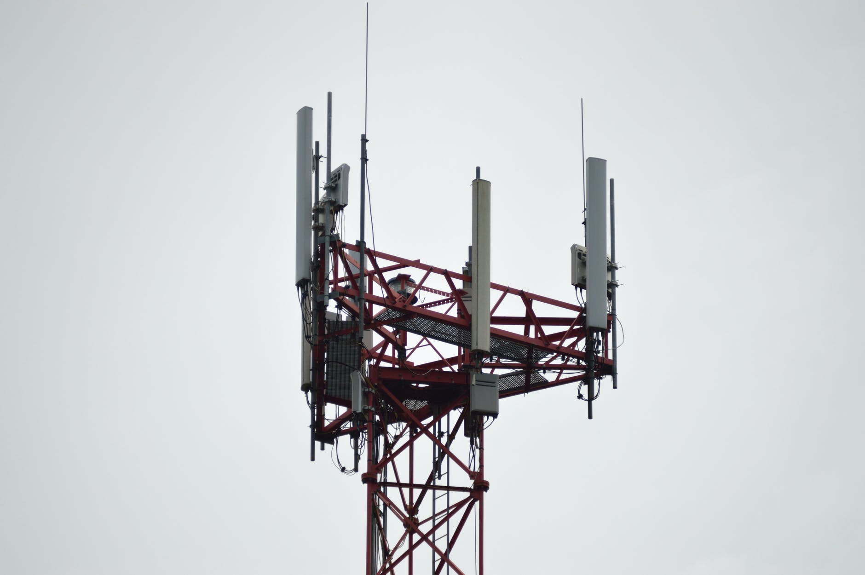


Use Cases
Information Technology
Telecommunication
Financial Institution
Retail Industry
Notes:
Healthcare
Car Retail
Education
Real Estate / Insurance Agency
Restaurant Reservation Group

Slide 7





Use Cases
Information Technology
“Thank you for calling the ABC Service Desk. Please select the reason for your call from the following options.”
1
2
3
4
Ext. Group 1
Ext. Group 2
Ext. Group 3
Ext. Group 4
Account Unlock/ Password Reset
Endpoint Security
VPN/VDI Issues
Office 365 Issues
Manage end users’ incidents and requests within the service level agreement by creating queues specific to affected applications for timely resolution, and to allow outbound calling to attend to tickets submitted through e-mail and the self-service portal.
Web-submit tickets from a third-party tool.
Outbound Agents
(Extensions)
End users

Slide 8
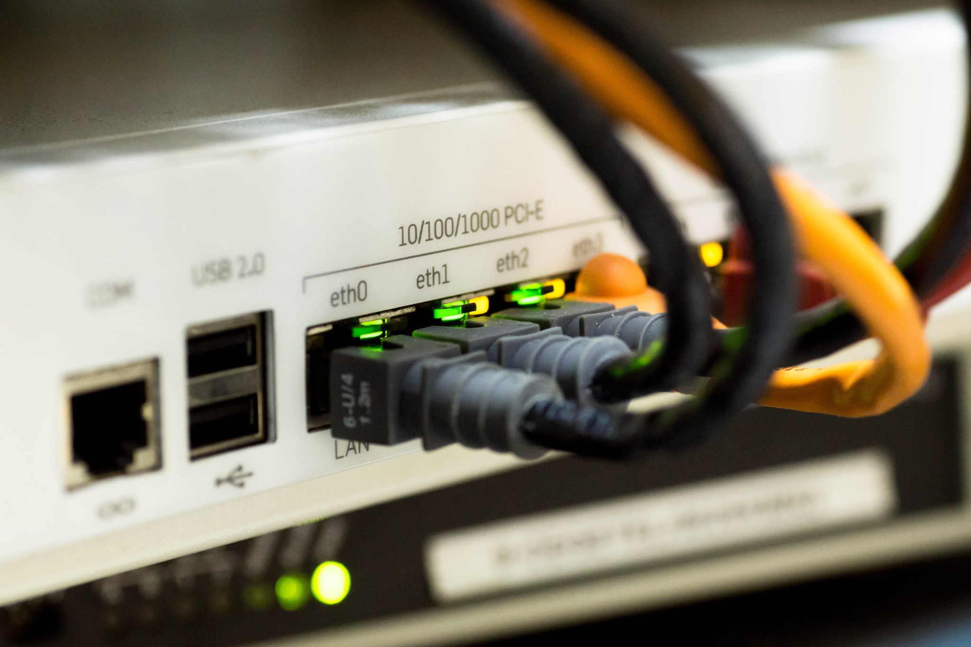

Use Cases
Telecommunication
“Thank you for calling XYZ Company. Please select from the following menu options.”
1
2
Non-XYZ Internet Subscriber
XYZ Internet Subscriber
8am-5pm
Otherwise
1
2
3
4
Customer Care
Billing
Retention
Technical Support
Attend to your prospects and existing customers’ queries by directing them to the appropriate account specialists. Require the agents to categorise calls (Disposition Code) and take notes for quality and reporting & analysis purposes.
Ext. Group 2
Ext. Group 3
Ext. Group 4
Ext. Group 5
Sales Hotline
Send online application link via SMS
Ext. Group 1
Pop-up window for Disposition Code and notes
Sends post-call survey to the customer

Slide 9








Use Cases
Financial Institution
Webhook verifies data
Plays “Approved” OR “Not approved” message
1
With Loan or Credit Card Application
Plays “Pending application result” message
Input Application Reference #
Plays “Reference number not found, please try again” message
“Thank you for calling Best Bank. Please select from the following menu options.”
8am-5pm
Sales Hotline
Ext. Group 1
Prospective Customer
2
Send Online Shop URL via SMS
Otherwise
1
Credit Card
Ext. Group 2
2
Savings/ Account
Ext. Group 3
Make all transactions secure by creating separate queues for new and existing customers, and by requiring them to input their reference number or account number – which will be verified by the system.
Webhook verifies data
3
Account Holder
3
Loans
Ext. Group 3
Input Account #
4
Investment/ Insurance
Ext. Group 4
Distributes the calls and shows customers’ details on a pop-up window

Slide 10







Use Cases
Retail Industry
Auto-dials customers’ numbers and assigns to call center queue
Agent 1
Agent 2
Agent 3
Drive business results by calling customers to offer discounts and new products. With note configuration, you can get an insight on what your customers feel about the purpose of the call.
Agents answer pre-determined questions, ex: Did the customer agree to renew or not?
Notes:
outbound call center
campaign - call retail store customers with expiring membership card, offer to renew now to get 5% discount on the membership fee and to receive a gift

Slide 11
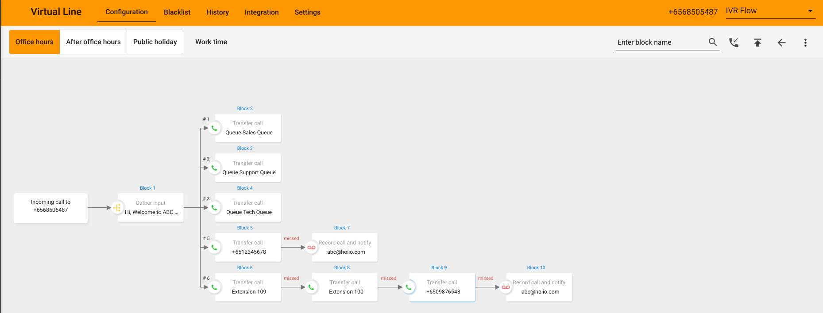
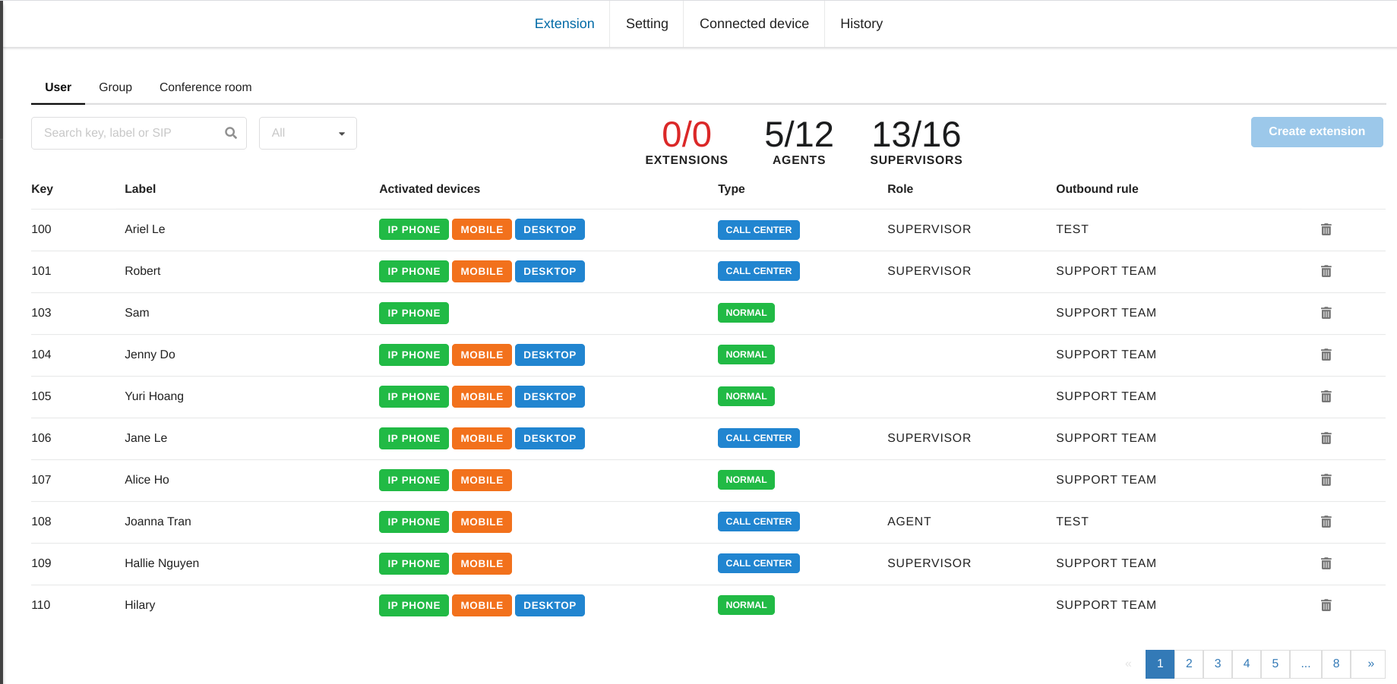

Interface Of Included Applications
VIRTUAL LINE
Interactive voice response system.
Enable easy routing of different team phone calls to the individuals, queues, groups.
Work-shift scheduler.
BIZPHONE
For internal/external calling.
Supports call transfer, call hold, call into group and call into conference (max 8 parties).

Slide 12
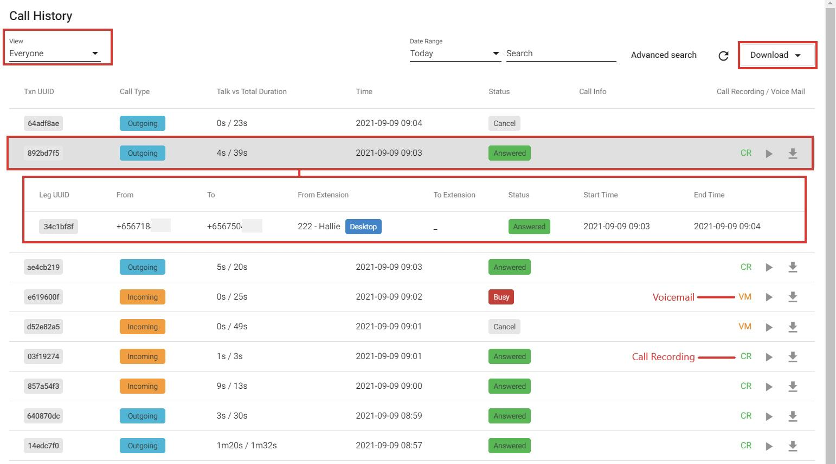
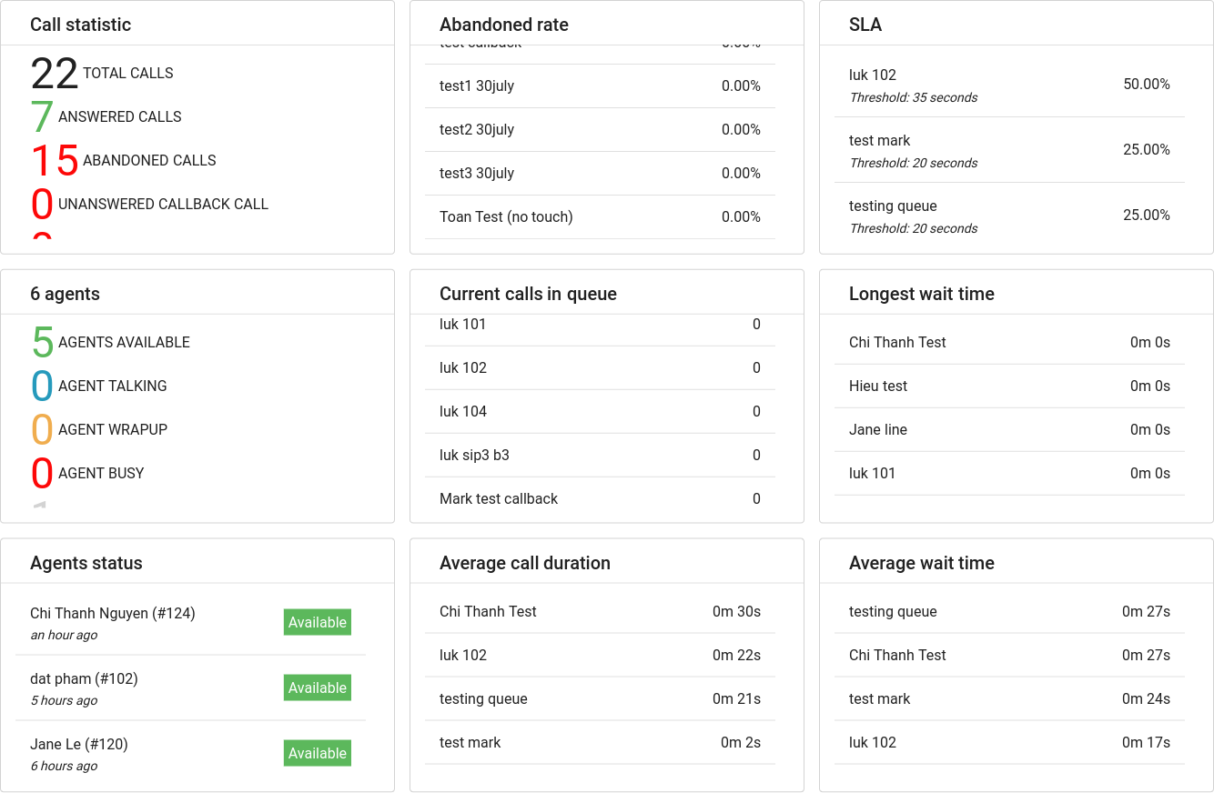
Interface Of Included Applications
CALL RECORDING
Record all incoming and outgoing calls.
Secure CR logs by encrypted data or SFTP.
WALLBOARD
Outbound/Inbound call center management.
Workforce management.
Call queue with music on hold.
Automatic call distribution.
Post call survey.

Slide 13








Integration
Inbound Call Center
Virtual Line will receive inbound calls and distribute them to call center queues in Wallboard, which are then received by agents in Bizphone accordingly. And the possibility of third-party Integrations just completes the overall solution.
It is a great way of managing the number of calls against the available agents. Added ability to analyse call data, listen to both inbound and outbound calls, monitor agent activities, and read customer survey responses are for business improvement.
Onshore
Offshore

Slide 14

Integration
Outbound Call Center
To establish an Outbound Call Center solution, the following applications are involved:
Wallboard will act as an auto-dialer and carry out automated call campaigns by automatically assigning calls to the chosen call center queue which are handled by agents in Bizphone.

