Slide 1


CONCISE
HIGH TECH
INNOVATION
HIGH TECHNOLOGY
Presentation Template
www.freepptbackgrounds.net

Slide 2

CONTENTS
1
#
Employ
2
#
Encourage
3
#
Equipment
OUR
MISSION
innovation
high-tech
company

Slide 3

EMPLOY

Slide 4


Employ
Explanation
A complex idea can be conveyed with just a single still image, namely making it possible to absorb large amounts of data quickly.
Fix
Fund
Improve
I hope and I believe that this Template will your
Hearing
Easy to change colors, photos and Text.
Goal
Get a modern PowerPoint Presentation
Growth
I hope and I believe that this Template will your

Slide 5

Employ
You will get a copy of this document on your Google Drive and will be able to edit, add or delete slides.
Click on the button under the presentation preview that says "Use as Google Slides Theme.
2
4
1
3
Click on the button under the presentation preview that says "Use as Google Slides Theme.
You will get a copy of this document on your Google Drive and will be able to edit, add or delete slides.

Slide 6

Employ
1
Fix
Add or delete slides. You have to be signed in to your Google account. in PowerPoint. Remember to download and install the fonts used in this presentation (you’ll find the links to the font files needed in the Presentation design slide)
2
Feedback
Facilities
Is the color of gold, butter and ripe lemons. In the spectrum of visible light, yellow is found between green and orange.
We press play on your digital story. Using conceptual, digital design, we work with you to build experiences that feel 'right' for your users. We create a solid user-product relationship, one that's long and fruitful.

Slide 7


CONCISE
Employ
HIGH TECH
INNOVATION
Fund
Moving from creative ideas to solid strategy and execution, we help your target market resonate fully with your brand. When you get them, they will get you, quicker. We leverage digital tools, design and words, to become even more relevant.
2012
We align with your users need to build and evolve a flowing shopping interface
2015
2010
Simple & Smooth, exactly how purchasing experiences should be.
Simple & Smooth, exactly how purchasing experiences should be.
2008
We align with your users need to build and evolve a flowing shopping interface

Slide 8

Employ
Goal
Your audience relate and absorb information on different sensory levels. We know visual stories are amplified with the right words. Sometimes it's easier to go old school, our copywriters prefer a good ball.
90%Growth
75%Hearing
The user can demonstrate on a projector or computer, or print the presentation and make it into a film to be used in a wider field. Using PowerPoint
The user can demonstrate on a projector or computer, or print the presentation and make it into a film to be used in a wider field. Using PowerPoint

Slide 9
ENCOURAGE

Slide 10
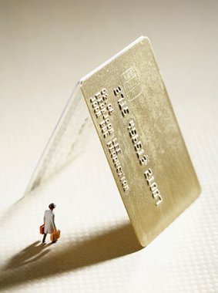
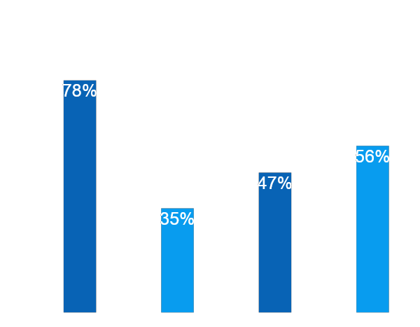

Encourage
Improve
The user can make a presentation on a projector or computer, or print out the presentation to make a film. The user can make a presentation on a projector or computer, and can also make a presentation.
Increase
Enter the comprehensive description of the above chart here
Enter the comprehensive description of the above chart here

Slide 11

Encourage
Industry
01
Inform
We cannot help ourselves. We live at home, quiet, confined, and our feelings prey upon us. You are forced on exertion.
It is a very sad thing that nowadays there is so little useless information.
02
Install
75%Invoice
We certainly do not forget you as soon as you forget us. It is, perhaps, our fate rather than our merit.
84%Join
03
Inventory
90%Knowledge
It is a very sad thing that nowadays there is so little useless information.
04
Instructions
We certainly do not forget you as soon as you forget us. It is, perhaps, our fate rather than our merit.

Slide 12

Encourage
You have always a profession, pursuits, business of some sort or other, to take you back into the world immediately
45%
30%
65%
50%
Tech
Startup
Public
NGO
Genius hath electric power which earth can never tame.
I believe that people would be alive today if there were a death
Genius hath electric power which earth can never tame.
I believe that people would be alive today if there were a death

Slide 13
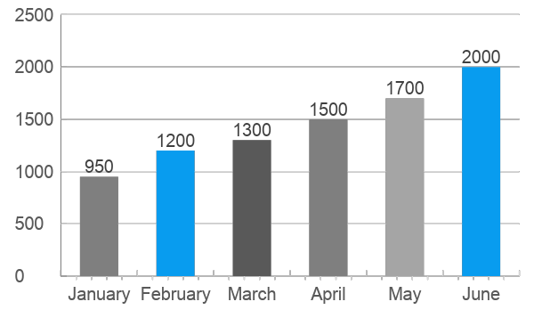
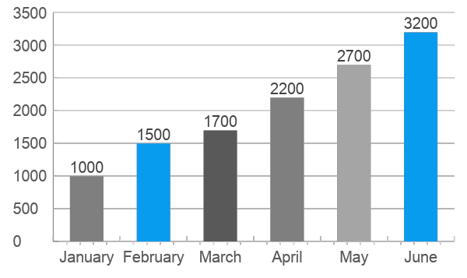
Encourage
VS
FINANCE
EDUCATION
A large income is the best recipe for happiness I ever heard of. Mansfield Park
I feel very strongly that change is good because it stirs up the system. Ann Richards

Slide 14
Encourage
Slider
Content
Ads
CULTURE
FASHION
01
02
God sometimes removes people from your life to protect you. Do not run after them.
Be an encourager, the world has enough critics already.

Slide 15
Encourage
REAL
ESTATE
03
04
Enjoy the little things in life, because one day you will look back and realize they were the big things.
Everyone wants, happiness. No one wants pain. But you can’t have a rainbow without a little rain.

Slide 16
EQUIPMENT

Slide 17
Equipment
1
Energy
Do you wonder what the difference between ignorance and genius is? A Genius has limits but an ignorant doesn’t have any.
03
2
01
E-commerce
Enjoy the little things in life, because one day you will look back and realize they were the big things.
02
3
Briefing
Everyone wants, happiness. No one wants pain. But you can’t have a rainbow without a little rain.

Slide 18






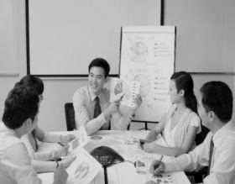
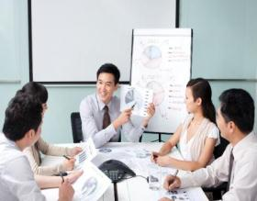
Equipment
Implementation
Design
Workshops
Evaluation
Do you wonder what the difference between ignorance and genius is? A Genius has limits but an ignorant doesn’t have any.
Enjoy the little things in life, because one day you will look back and realize they were the big things.
Do you wonder what the difference between ignorance and genius is? A Genius has limits but an ignorant doesn’t have any.
Enjoy the little things in life, because one day you will look back and realize they were the big things.

Slide 19





Equipment
Quality
Everybody has three chars ; the one is come out ,the one is owned ,the one is thought to have.
Assurance
You can’t change what’s going on around you until you start changing
Service
People who touch your heart are always with you.
Powerpoint
You can’t change what’s going on around you until you start changing

Slide 20
CONCISE
HIGH TECH
INNOVATION
THANK YOU !
High Technology Reseacrh Slides
www.freepptbackgrounds.net

