Slide 1
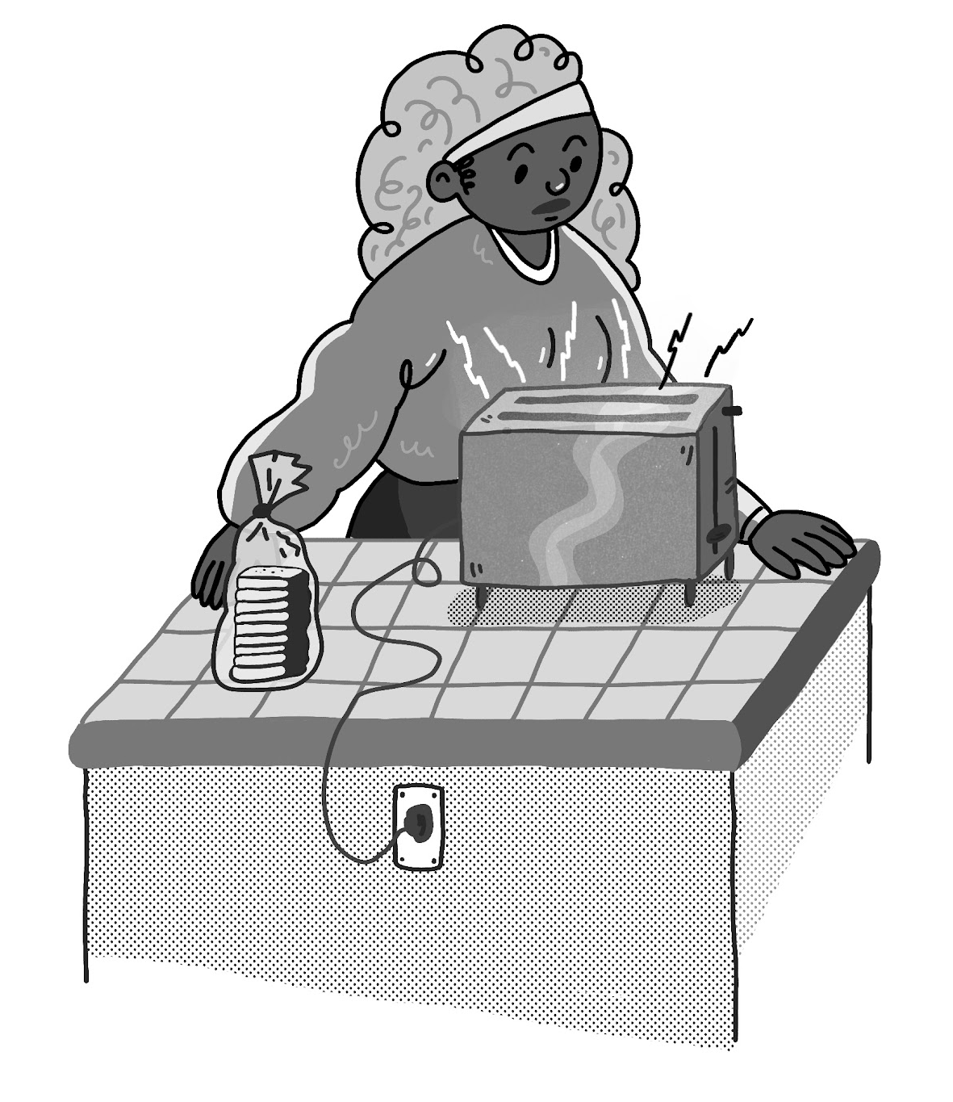
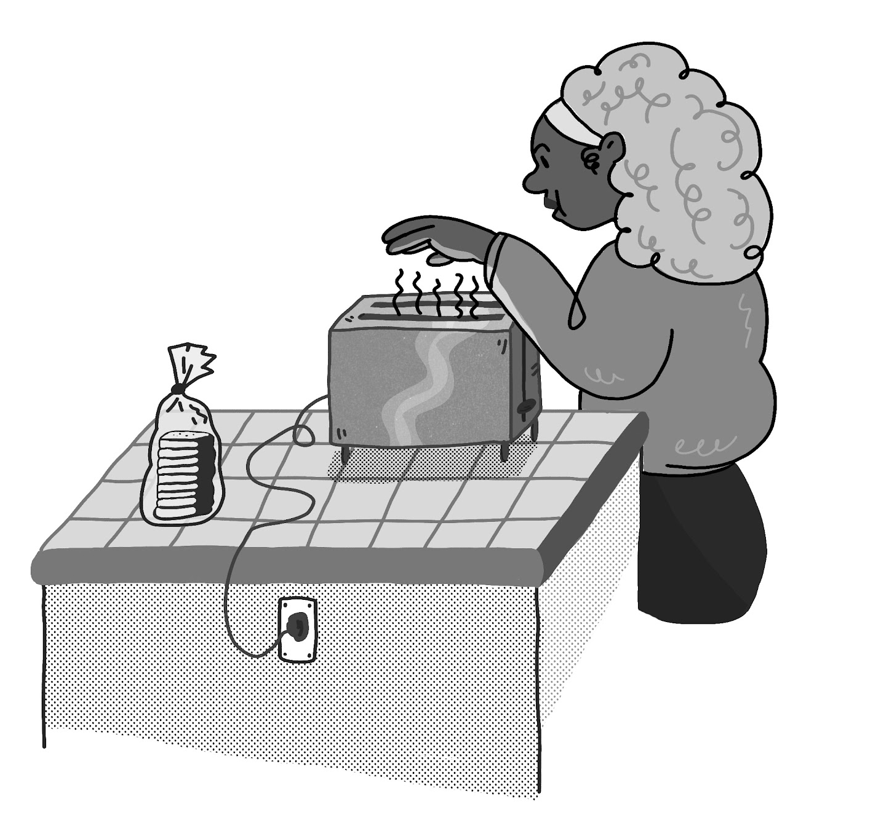
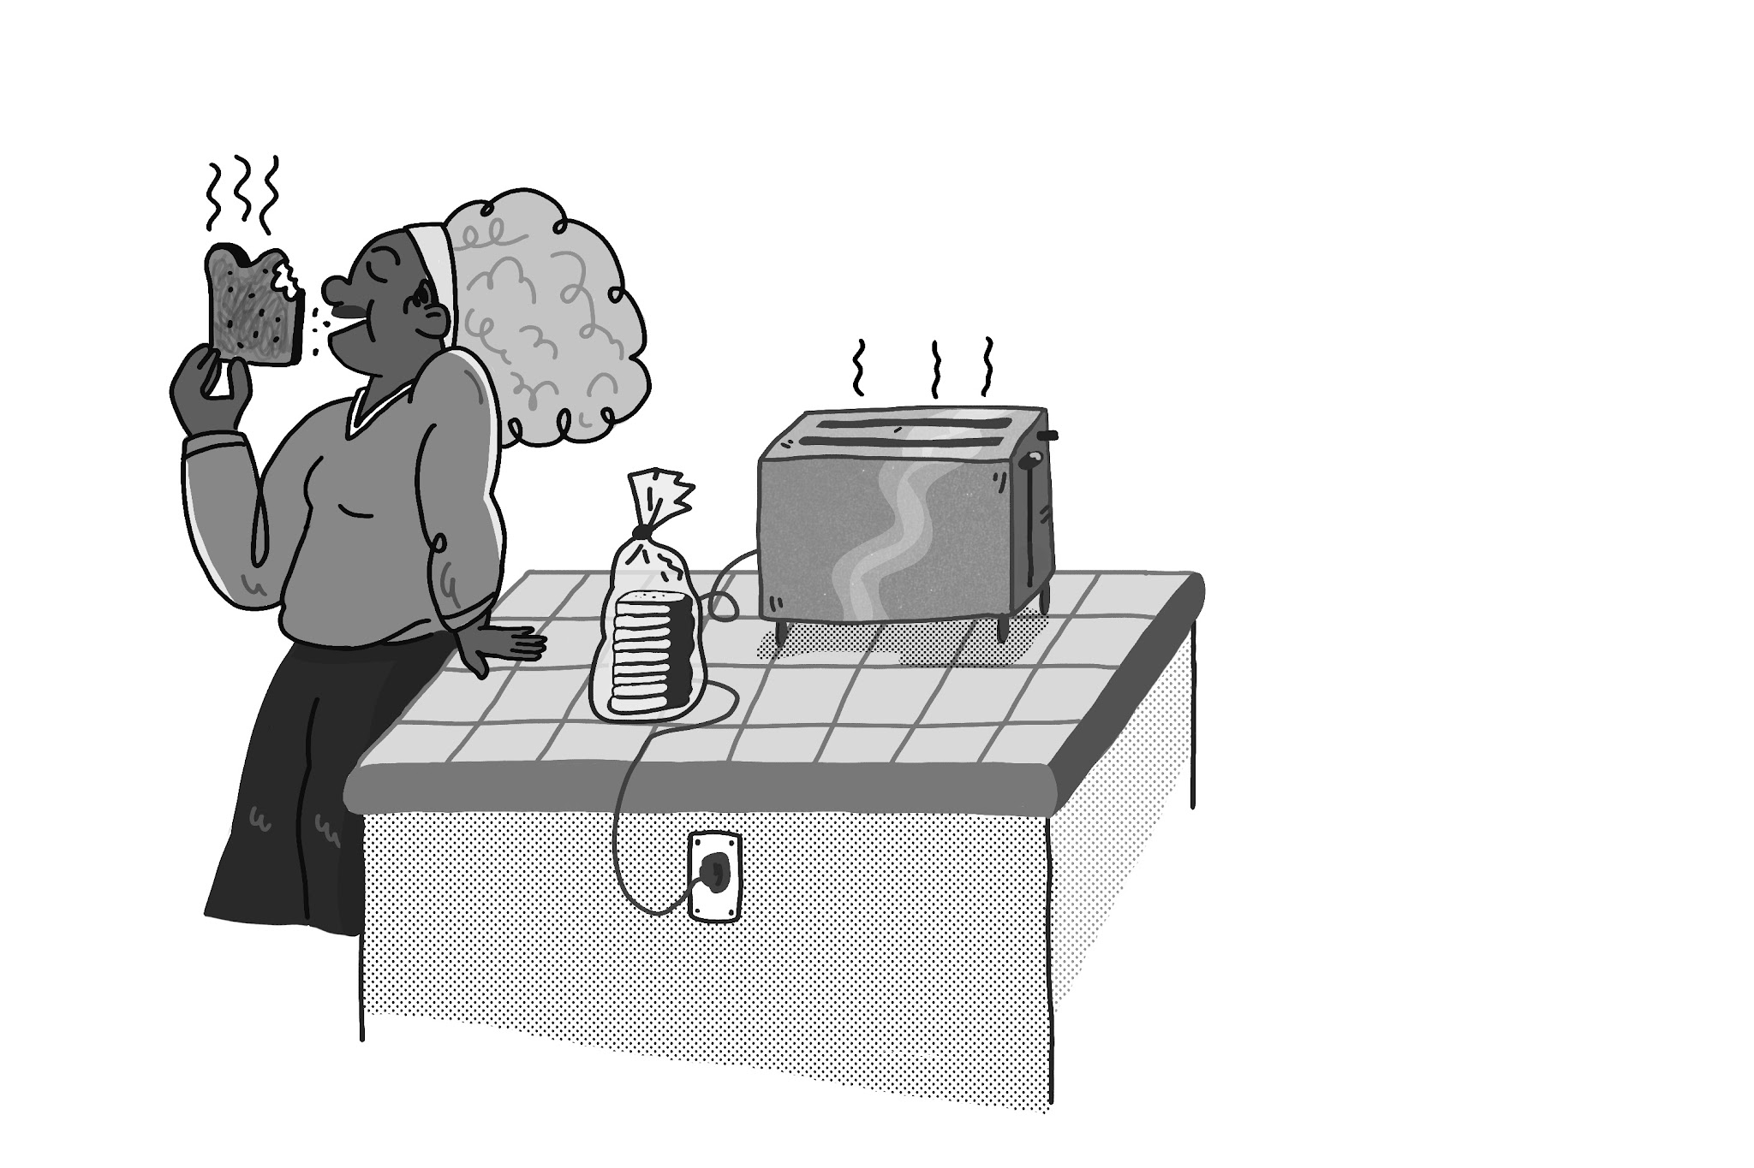
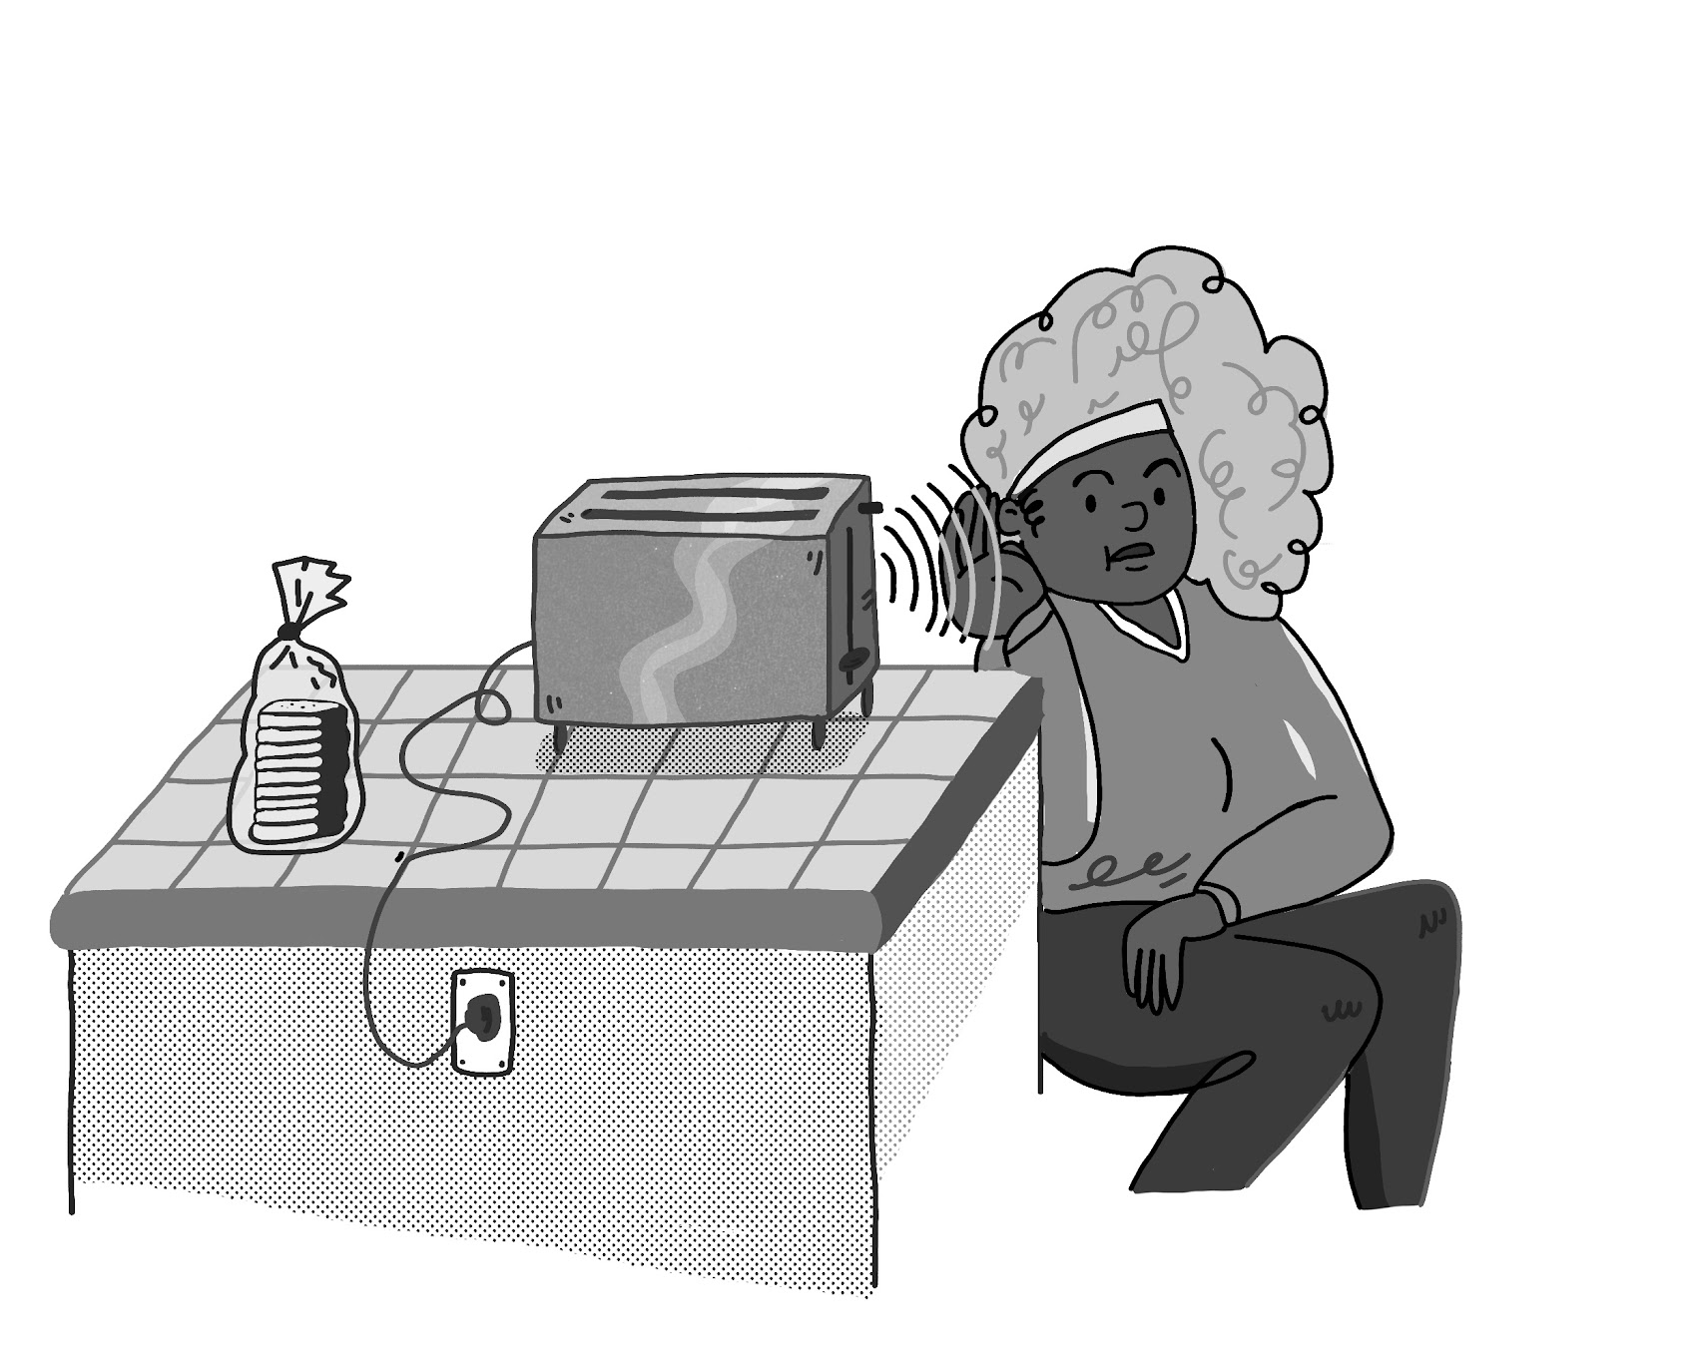

Electricity, Light, & Heat
Name: ___________________
Date: ___________________
Unit Assessment
1. Padma makes toast for breakfast. She puts bread into the toaster, plugs the toaster into the electrical outlet, and pushes the button to start the machine. As the toaster works, Padma makes several observations. Which of Padma’s observations provides evidence that energy has been transferred from the electrical outlet to another place?
Circle True or False for each sentence.
True False
True False
True False
True False
Padma looks down and observes that the coils inside the toaster are glowing red. Light is a form of energy. This is evidence that electrical energy from the outlet has been transferred to the toaster.
Padma feels that the air above the toaster is warm. Heat is a form of energy. This is evidence that electrical energy from the outlet has been transferred to the toaster.
Padma eats the toast and it tastes delicious. Taste is a form of energy. This is evidence that electrical energy from the outlet has been transferred to the toaster.
Padma listens closely and hears that the toaster is making a soft buzzing sound. Sound is a form of energy. This is evidence that electrical energy from the outlet has been transferred to the toaster.
Electricity, Light, & Heat | Unit Assessment
1

Slide 2
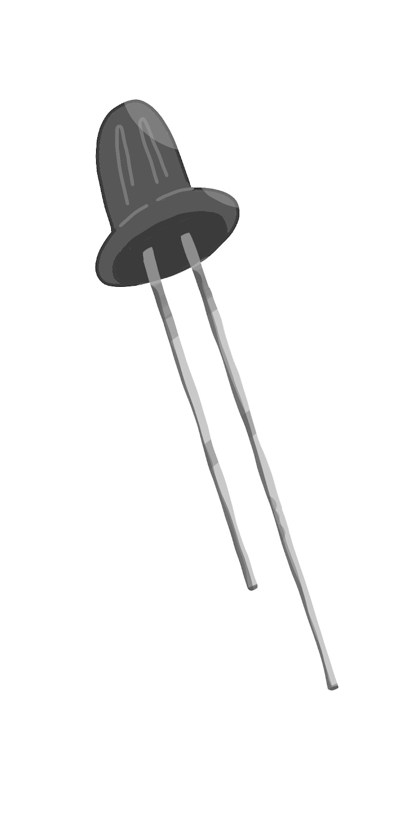
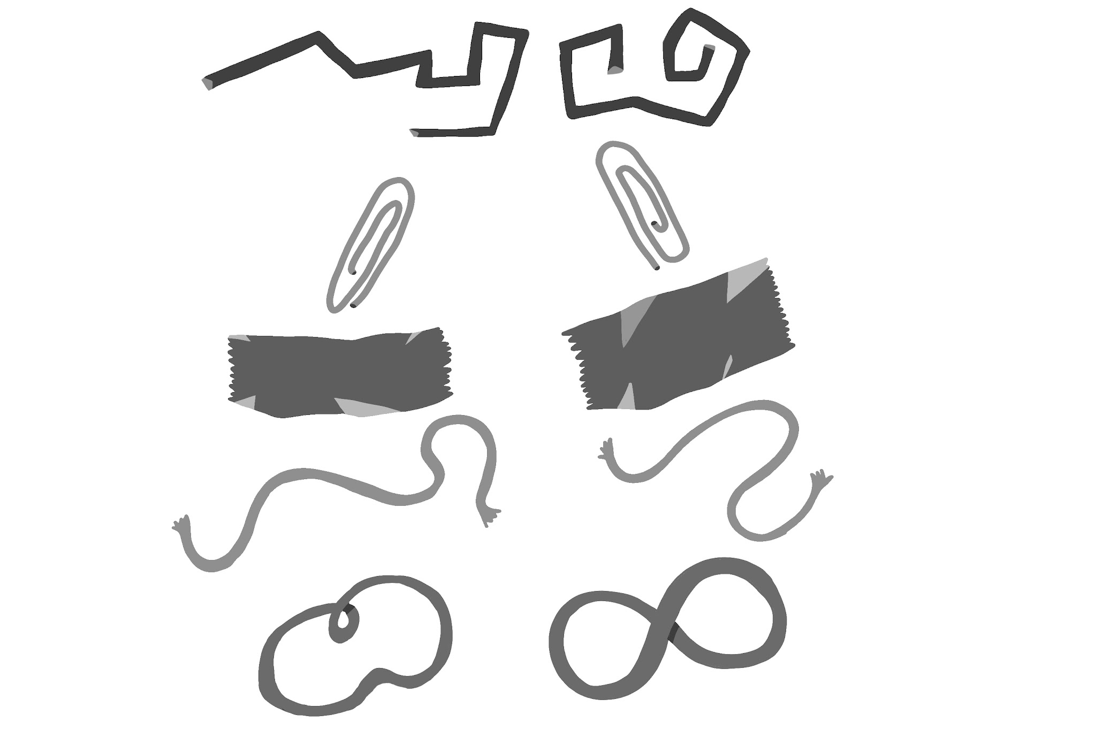
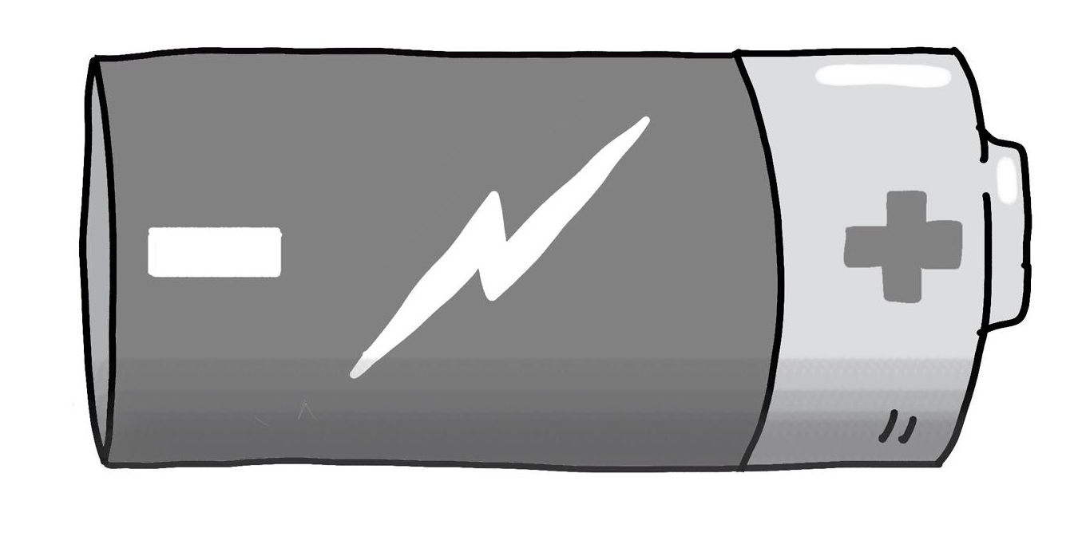
2. Maya wants to build a tiny flashlight by connecting a battery to an LED bulb. There are three rules that Maya needs to follow to get her flashlight to work:
The electrical energy must follow a path.
The path must be made using a conducting material.
Energy can only flow along the path in the direction of negative (-) to positive (+).
Maya has the following materials available:
COPPER WIRE
PAPER CLIPS
ALUMINUM FOIL
STRING
RUBBER BANDS
+
-
LED
BATTERY
Using the materials above, make a drawing of how Maya could connect them so that the LED bulb will light up. Make sure to add labels to your drawing.
3. Maya wants to figure out if paper clips or copper wire work better for her flashlight. What could Maya do to test which of these two materials works better?
Maya can use paper clips to connect the battery to the LED bulb. If it lights up, this is evidence that paper clips are a better material than copper wire.
Maya can use copper wire to connect the battery to the LED bulb. If it lights up, this is evidence that copper wire is a better material than paper clips.
Maya can first test the flashlight using paper clips. Then, she can test the flashlight using copper wire. If the LED bulb glows brighter with the copper wire compared to the paper clips, this is evidence that copper wire is a better material to use.
Electricity, Light, & Heat | Unit Assessment
2

Slide 3
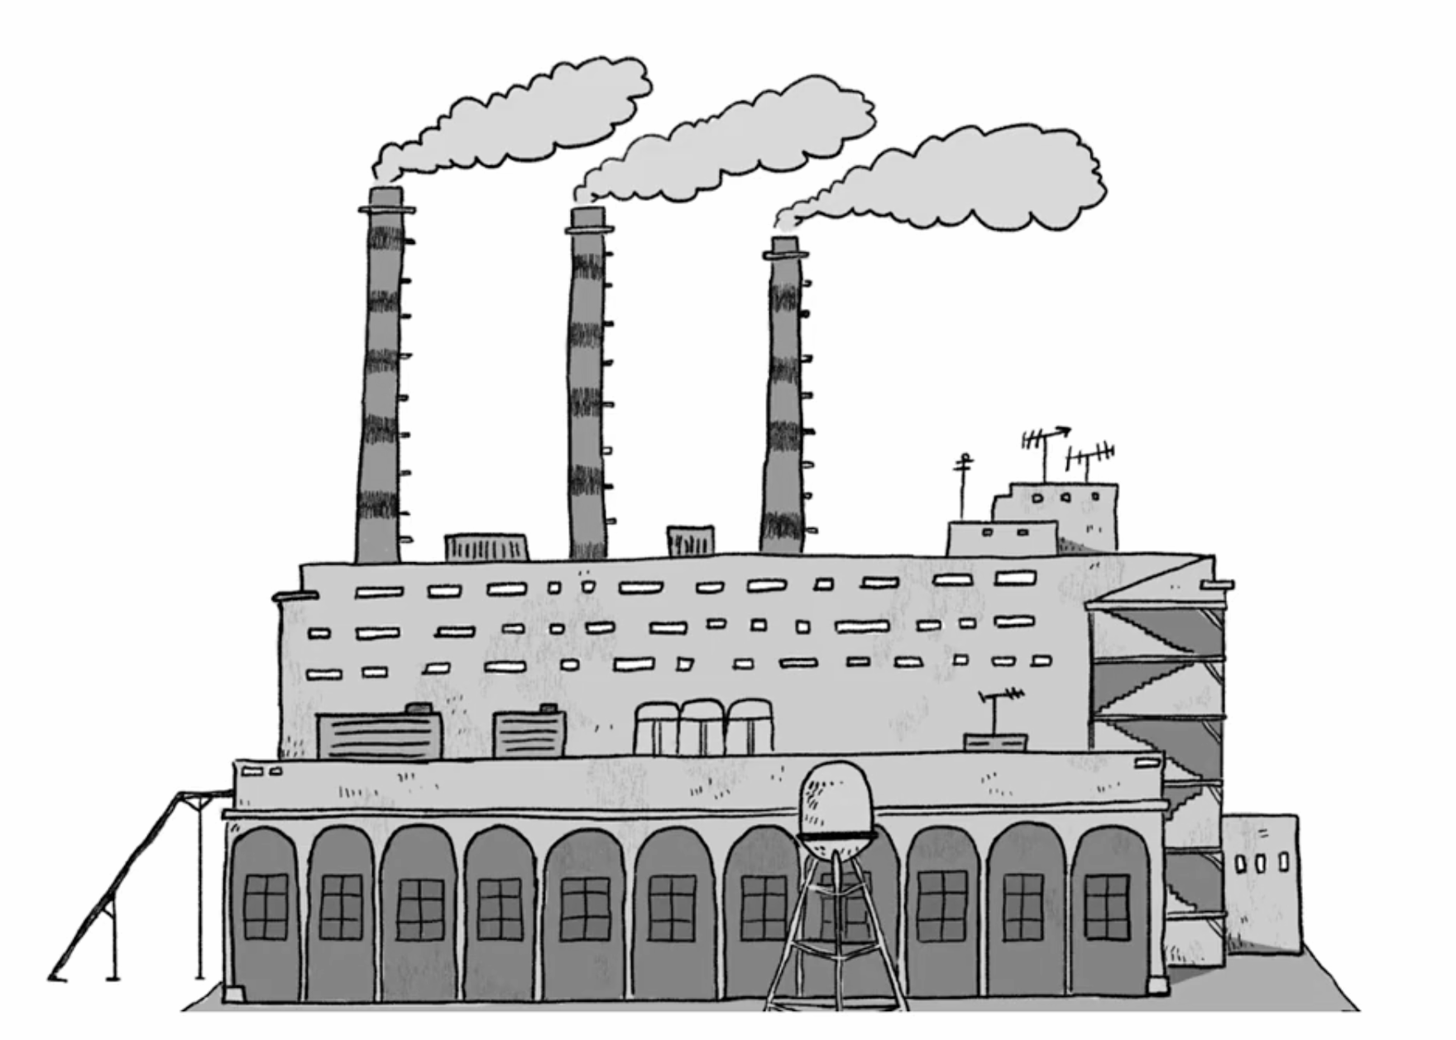
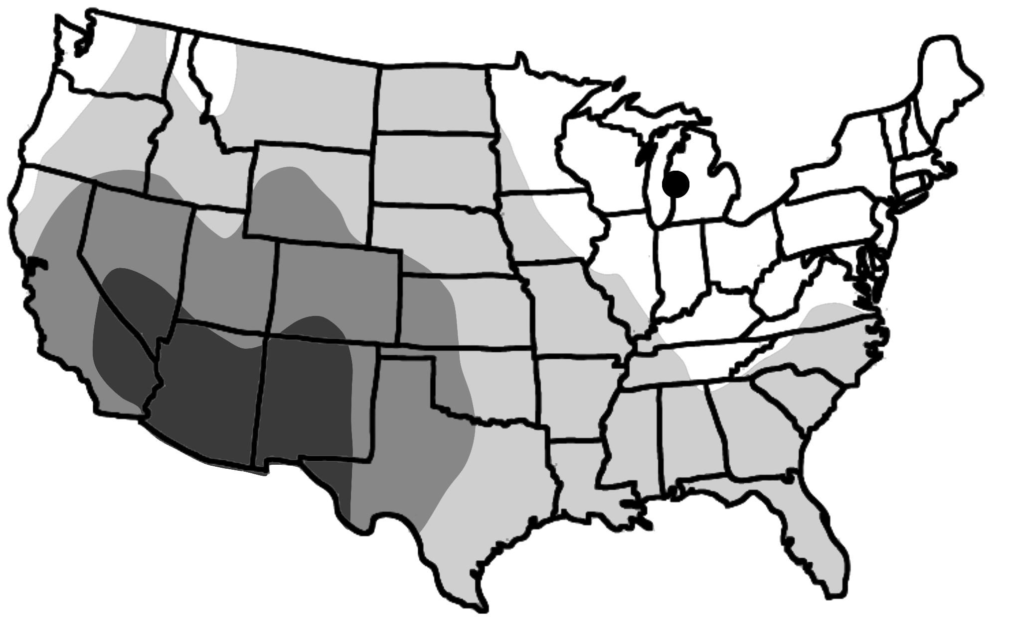


The people who live in the town of Smogville have noticed that the air is smoky throughout the year. Many people in the town have trouble breathing during the smoky days. Some think the smoky air is caused by the town’s power plant, which is shown to the right. The power plant burns fossil fuels to provide the town with energy. But when the fossil fuels are burned, smoke goes into the air.
The people of Smogville think that using renewable energy to power the town could solve the town’s air problem. Smogville isn’t near a river, so they cannot use water energy. The renewable energy sources the town can choose from are solar energy and wind energy.
4. In order for Smogville to use solar energy, there must be at least 250 sunny days each year. Look at the map shown to the right. Can Smogville use solar energy?
Yes, Smogville can use solar energy.
No, Smogville can’t use solar energy.
There is no way to tell if Smogville can use solar energy or not.
Number of Sunny Days in a Year in Different Areas
Smogville
Less than 200 days
About 200 days
About 250 days
About 300 days
5. In order for Smogville to use wind energy, the wind needs to blow at a speed of over 15 miles per hour. Look at the chart to the right. Can Smogville use wind energy? Why or why not?
Yes, Smogville can use wind energy because the wind blows over 15 miles per hour most days.
Yes, Smogville can use wind energy because the wind blows less than 15 miles per hour most days.
No, Smogville can’t use wind energy because the wind blows over 15 miles per hour most days.
No, Smogville can’t use wind energy because the wind blows less than 15 miles per hour most days.
Average Wind Speed in Smogville Every Year
Days in a year with no wind
Days in a year with wind speeds of 10-15 miles per hour
Days in a year with wind speeds of over 15 miles per hour
Electricity, Light, & Heat | Unit Assessment
3

Slide 4
6. Smogville tried using renewable energy to power the town. The town stopped running the power plant for a year. The graph below shows how many smoky air days the town had during a year when they used the fossil fuel power plant. It also shows the number of smoky days the town had during the year when they used renewable energy. What does the graph show you about the cause of the smoky air problem in Smogville?
Smoky Days in Smogville
160
140
120
100
80
60
40
20
0
Number of Smoky Days per Year
Power Plant
Renewable Energy
The power plant was the only cause of the smoky air problem. Using renewable energy has completely solved the problem of smoky days in Smogville.
The power plant was not the cause of the smoky air problem. Using renewable energy has not helped to solve the problem of smoky days in Smogville.
The power plant was one cause of the smoky air problem. Using renewable energy has partially solved the problem of smoky days in Smogville. There are fewer smoky days than when the town used the power plant.
7. Why did you choose your answer to Question 6? Explain what you notice from the graph to provide evidence about the cause of the smoky air in Smogville.
__________________________________________________________________________________________________________________________________________________________________________________________
______________________________________________________________
______________________________________________________________
______________________________________________________________
Electricity, Light, & Heat | Unit Assessment
4

