Slide 1
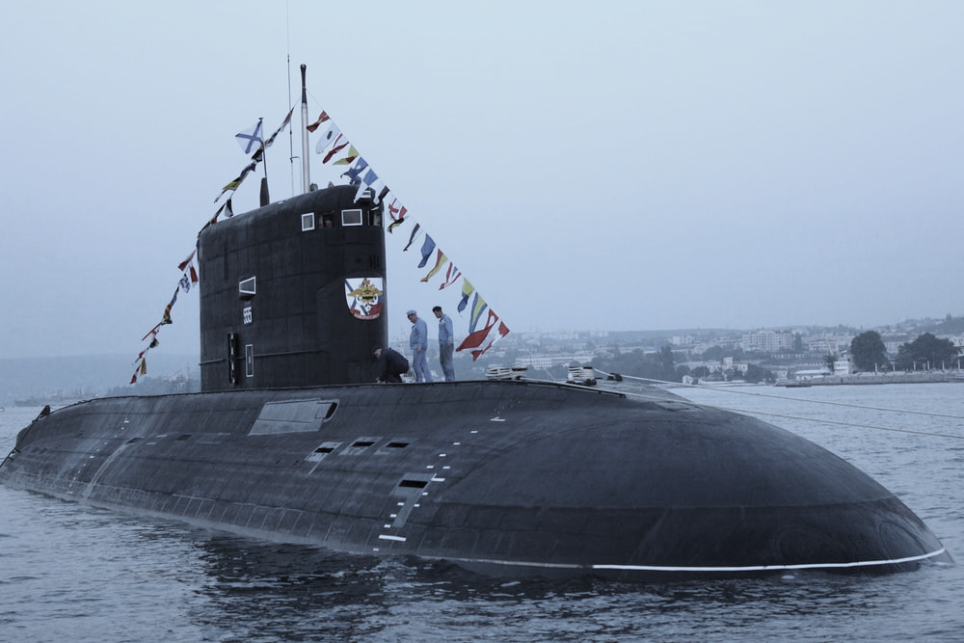
SUBMARINE
Free Template
Here is where your presentation begins

Slide 2
WHOA!
This could be the part of the presentation where you can introduce yourself, write your email...

Slide 3
TABLE OF CONTENTS
01
02
03
04
HISTORY
HOLIDAY
COMMUNITY
EVENTS
Here you could describe the topic of the section
Here you could describe the topic of the section
Here you could describe the topic of the section
Here you could describe the topic of the section

Slide 4
INTRODUCTION
Mercury is the closest planet to the Sun and the smallest one in the Solar System—it’s only a bit larger than the Moon. The planet’s name has nothing to do with the liquid metal

Slide 5
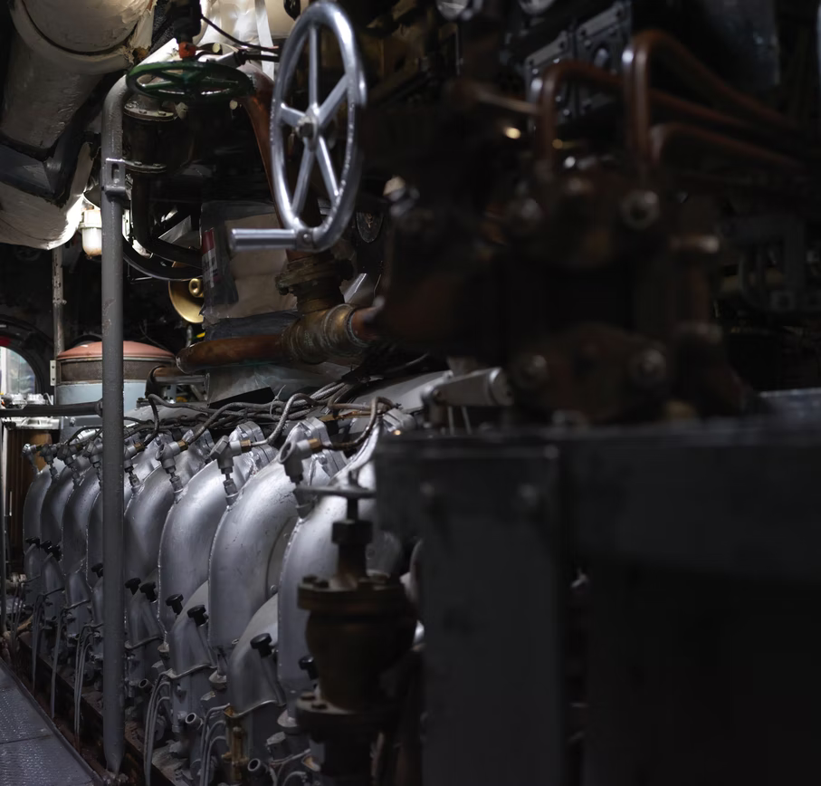
01
HISTORY
You can enter a subtitle here in case you need it

Slide 6
THE SLIDE TITLE GOES HERE!
Do you know what helps you make your point clear? Lists like this one:
They’re simple
You can organize your ideas clearly
You’ll never forget to buy milk!
And the most important thing: the audience won’t miss the point of your presentation
And the most important thing: the audience won’t miss
the point of your presentation

Slide 7
MAYBE YOU NEED TO DIVIDE THE CONTENT
MERCURY
VENUS
The closest planet to the Sun and the smallest one in the Solar System
Venus has a beautiful name and is the second planet from the Sun

Slide 8
—SOMEONE FAMOUS
“This is a quote, words full of wisdom that someone important said and can make the reader get inspired.”

Slide 9
YOU COULD USE THREE COLUMNS, WHY NOT?
MARS
JUPITER
SATURN
It’s a cold place. It’s full of iron dust, which gives the reddish cast
It’s a gas giant and the biggest planet in the Solar System
It’s a gas giant, composed mostly of hydrogen and helium

Slide 10
IMPORTANT FACTS
MERCURY
MARS
Mercury is the closest planet to the Sun
It is a cold place. It’s full of iron oxide dust
JUPITER
VENUS
It’s the biggest planet in the Solar System
It’s the second planet from the Sun

Slide 11
A PICTURE IS WORTH A
THOUSAND WORDS
This could be the part of the presentation where you can introduce yourself, write your email...

Slide 12
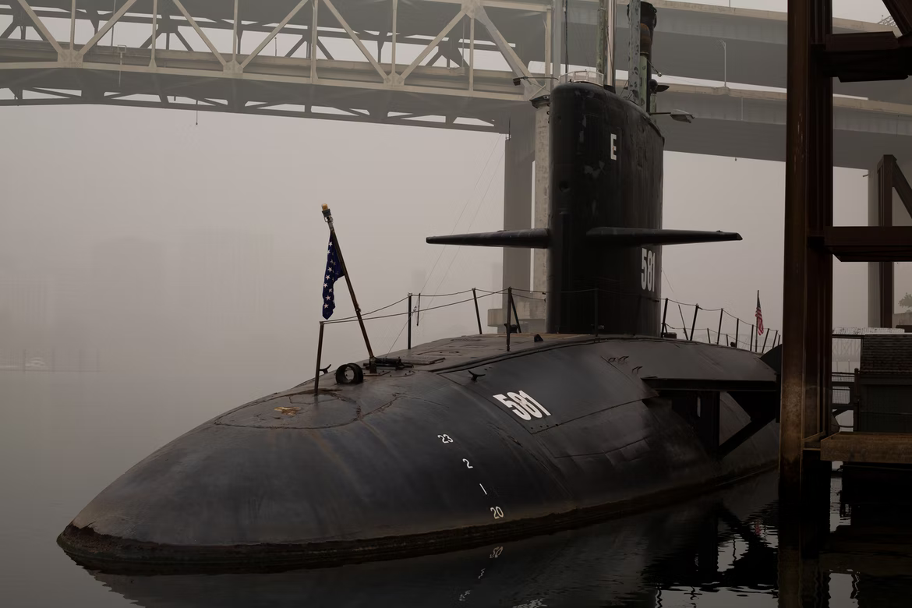
A PICTURE ALWAYS REINFORCES THE CONCEPT
Images reveal large amounts of data, so remember: use an image instead of a long text

Slide 13
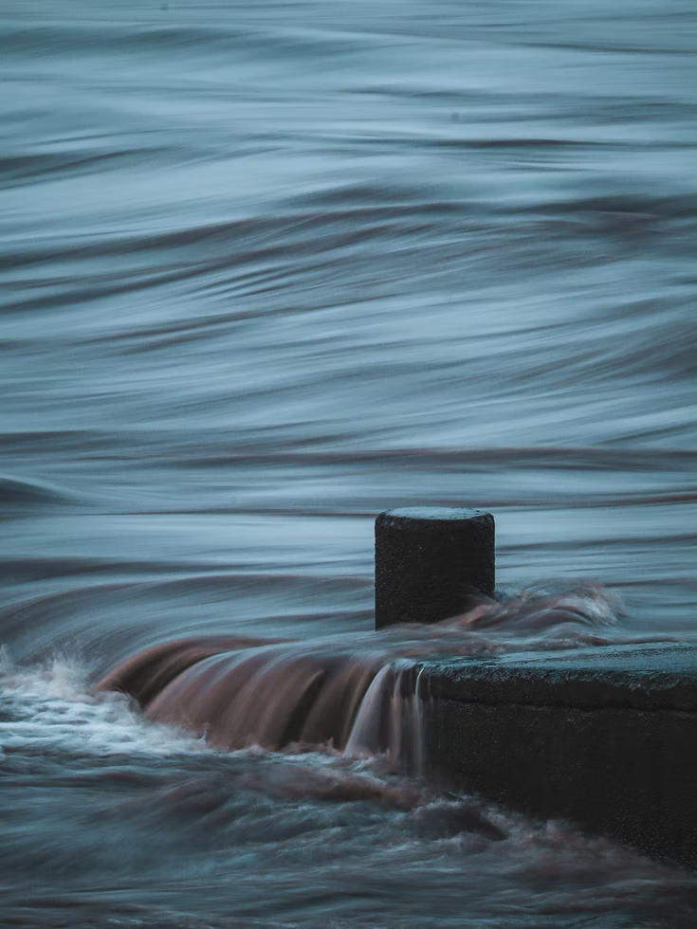
AWESOME WORDS
Because key words are great for catching your audience’s attention

Slide 14
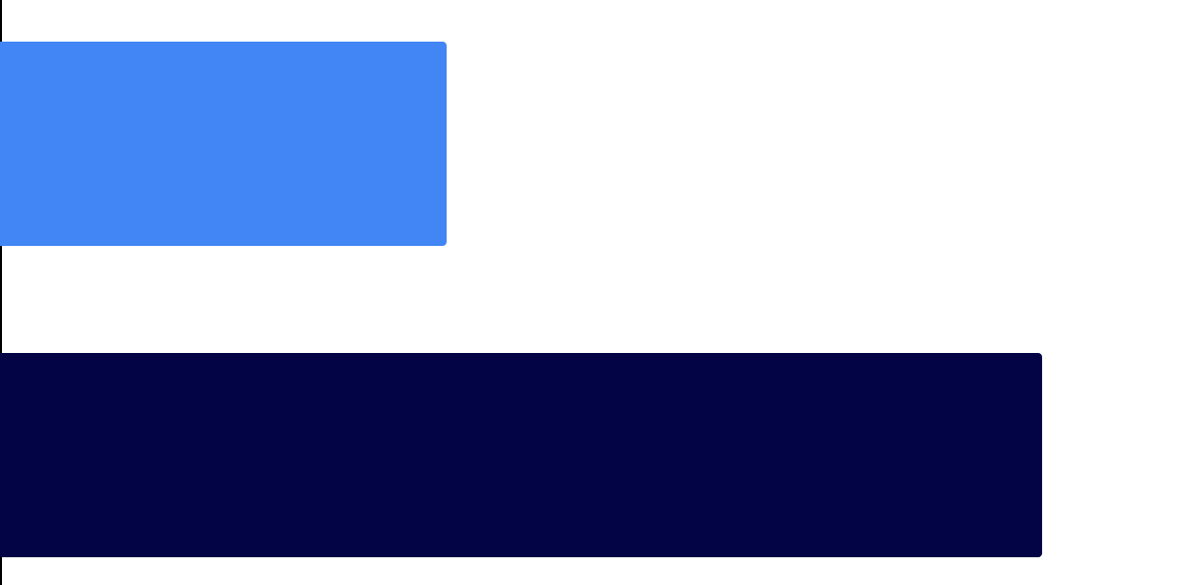
GRAPH
30%
70%
MARS
SATURN
Mars is a cold place. It’s full of iron oxide dust
Yes, this is the ringed one. It’s a gas giant
To modify this graph, click on it, follow the link, change the data and paste the new graph here

Slide 15
Perhaps You Need More Infographics!
SATURN
NEPTUNE
Saturn is composed mostly of hydrogen and helium
Neptune is the farthest planet from the Sun
JUPITER
MARS
It’s the biggest planet in the Solar System
Despite being red, Mars is actually a cold place

Slide 16
SOME DETAILS
VENUS
NEPTUNE
MERCURY
It has a beautiful name, but it’s terribly hot
Neptune is the farthest planet from the Sun
Mercury is the closest planet to the Sun
SATURN
JUPITER
It’s composed mostly of hydrogen and helium
It’s a gas giant and the biggest planet

Slide 17
TECHNOLOGICAL ADVANCES
30%
70%
MERCURY
VENUS
Mercury is the closest planet to the Sun
It has a beautiful name, but it’s terribly hot

Slide 18
HOW DOES IT WORK?
20%
50%
SATURN
MARS
Yes, this is the ringed one. It’s a gas giant
It’s a cold place full of iron oxide dust

Slide 19
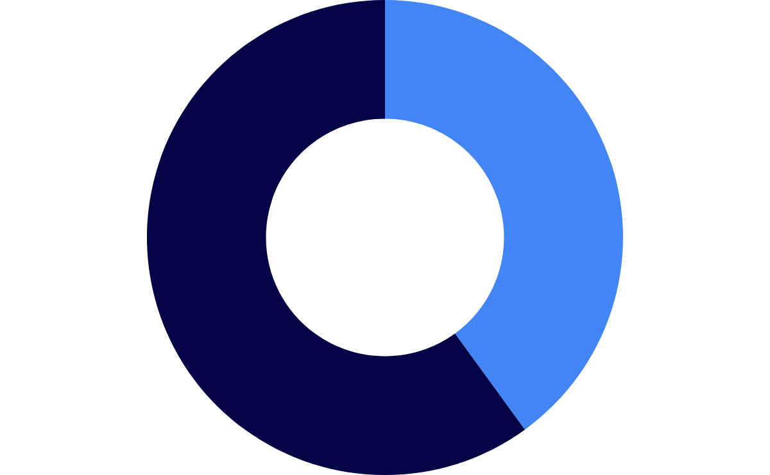
SUBMARINE FORCE
60%
40%
SATURN
MARS
Yes, this is the ringed one. It’s a gas giant
It’s a very cold place full of iron oxide dust
To modify this graph, click on it, follow the link, change the data and paste the new graph here

Slide 20
A TIMELINE ALWAYS WORKS WELL
2019
2020
2021
Neptune is the farthest planet from the Sun
It has a beautiful name, but it’s terribly hot
Mercury is the closest planet to the Sun

Slide 21
PERCENTAGES
20%
30%
50%
SATURN
VENUS
MARS
Yes, this is the ringed one. It’s a gas giant
It’s the second planet from the Sun
A cold place full of iron oxide dust

Slide 22
4,498,300,000
Big numbers catch your audience’s attention

Slide 23
333,000.00
24h 37m 23s
386,000 km
earths is the Sun’s mass
is Jupiter’s rotation period
distance between Earth and the Moon

Slide 24
Roman empire
Latin language
Despite being red, Mars is actually a cold place. It’s full of iron oxide dust
Greek language
Mercury is the closest planet to the Sun and the smallest one

Slide 25
OUR TEAM
JOHN DOE
JAY PATTERSON
You can replace the image on the screen with your own
You can replace the image on the screen with your own

Slide 26
NAVY SUBMARINES
VENUS
JUPITER
It has a beautiful name, but it’s hot
It’s a gas giant and the biggest planet
MERCURY
NEPTUNE
Mercury is the closest planet to the Sun
It’s the farthest planet from the Sun

Slide 27
REVIEWS
“Mars is a very cold place. It’s full of iron oxide dust”
“Venus has a beautiful name and is the second planet from the Sun”
—LEON WILLIAMS
—MARTHA BROWN

Slide 28
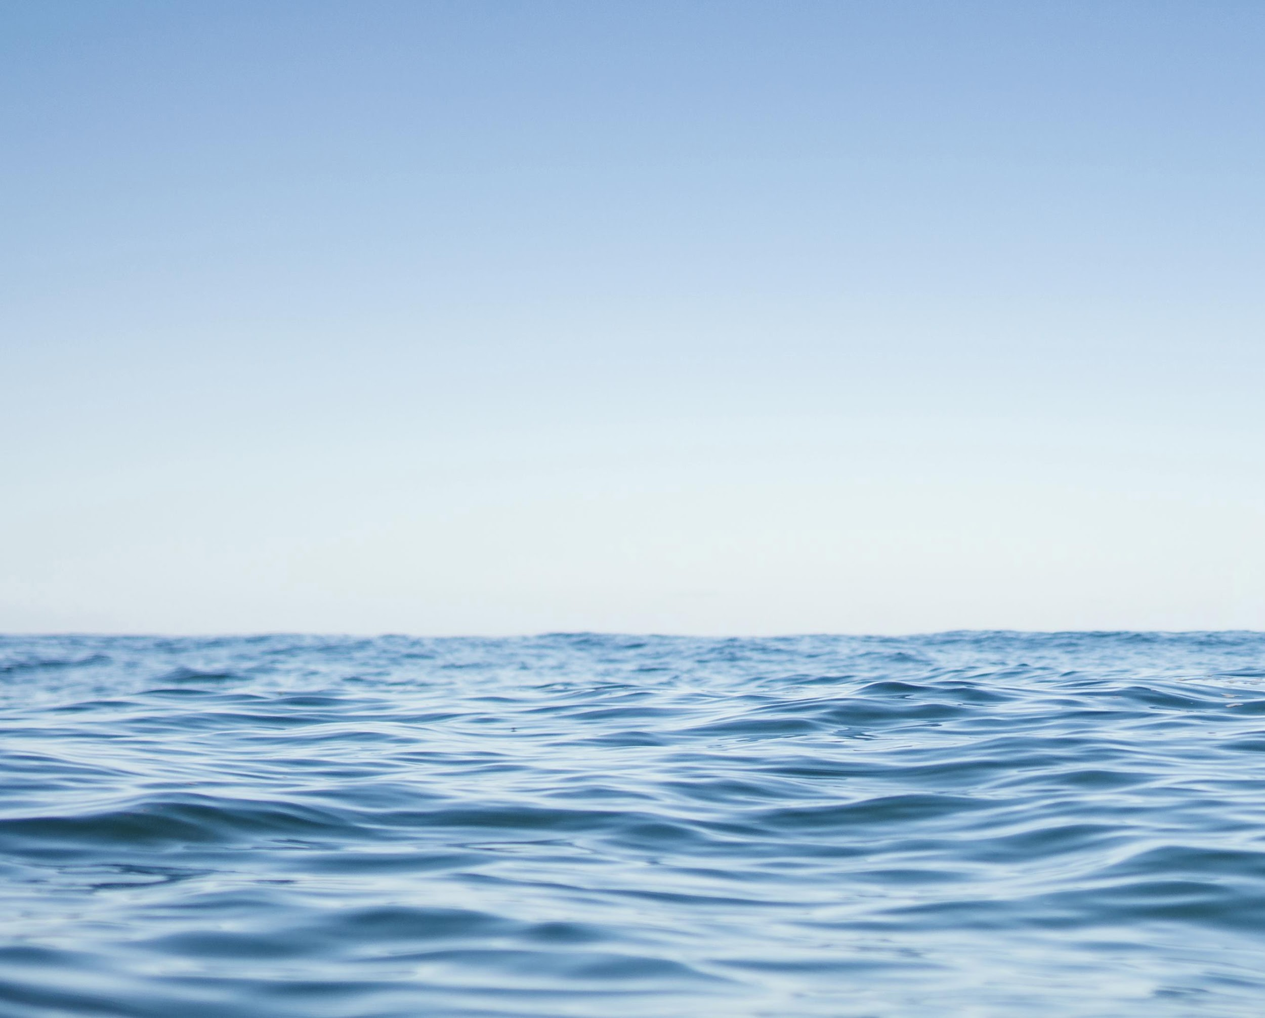
NEXT YEAR
Mercury is the closest planet to the Sun and the smallest one in the Solar System—it’s only a bit larger than the Moon. The planet’s name has nothing to do with the liquid metal

Slide 29
THANKS!
Do you have any questions?
addyouremail@example.com
+91 620 421 838
Domain.com
Free Template

Slide 30
FUENTE
ELABORADO POR :
plantillaspowerpoint.org
IMAGES :
unsplash.com
FONTS :
Prompt Black
Arial

Slide 31
RESOURCES

Slide 32
RESOURCES

Slide 33
RESOURCES

Slide 34
Fully Editable Icon Sets: A

Slide 35
Fully Editable Icon Sets: B

Slide 36
Fully Editable Icon Sets: C

