Slide 1
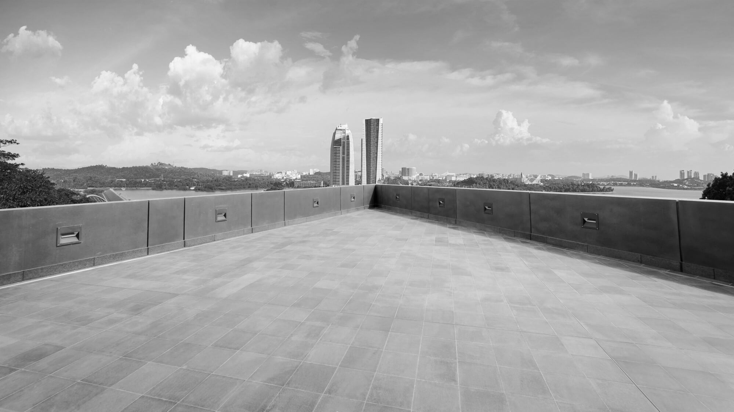
BUSINESS
STUDIO
PRESENTATION
TEMPLATE

Slide 2
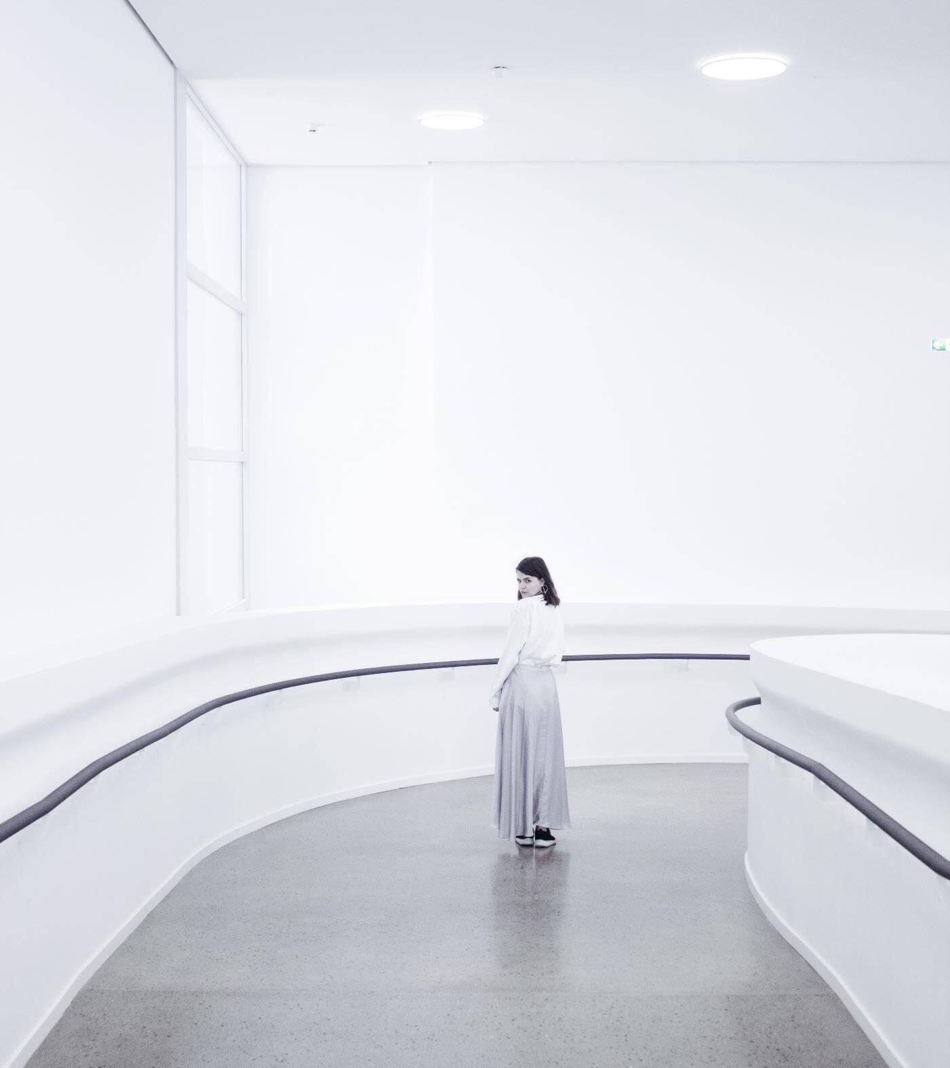
CONTENTS
ONE
TWO
THREE
FOUR
FIVE
SIX

Slide 3
TITLE HERE
We hope that this template will return to you as a time, money and reputation.
We use well-known development methodologies to create a customized approach for each of the projects. This allows us to achieve high quality outcomes and full transparency towards.
View more
More title text here

Slide 4

STEP HERE
STEP HERE
We hope that this template will return to you as a time, money and reputation.
We hope that this template will return to you as a time, money and reputation.
STEP HERE
STEP HERE
We hope that this template will return to you as a time, money and reputation.
We hope that this template will return to you as a time, money and reputation.

Slide 5

01
STAGE HERE
We use well-known development methodologies to create a customized approach for each of the projects. This allows us to achieve high quality outcomes and full transparency towards.

Slide 6


02
OPTION HERE
We use well-known development methodologies to create a customized approach for each of the projects. This allows us to achieve high quality outcomes and full transparency towards.

Slide 7



TITLE HERE
We use well-known development methodologies to create a customized approach for each of the projects. This allows us to achieve high quality outcomes and full transparency towards.
250K
TITLE HERE
TITLE HERE
More title text here
A complex idea can be conveyed with just a single still image, namely making it possible to absorb large amounts of data quickly.

Slide 8

STEP HERE
STEP HERE
STEP HERE
STEP HERE
STEP HERE
STEP HERE
We hope that this template will return to you as a time, money and reputation.
We use well-known development methodologies to create a customized approach for each of the projects. This allows us to achieve high quality outcomes and full transparency towards.
STEP HERE
More title text here

Slide 9
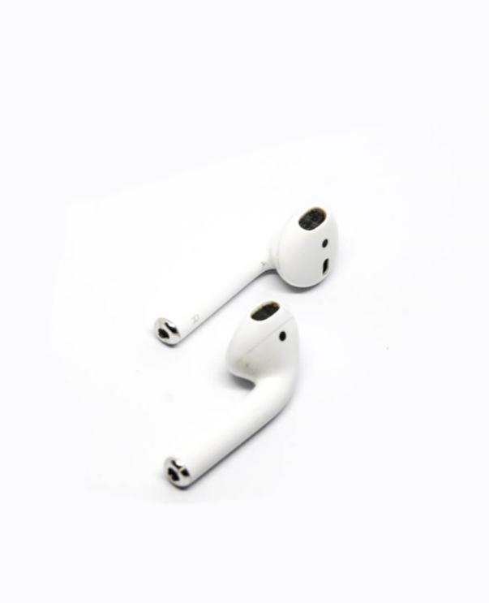
STAGE HERE
A complex idea can be conveyed with just a single still image, namely making it possible to absorb large amounts of data quickly.
STAGE HERE
STAGE HERE

Slide 10

OPTION HERE

Slide 11
TITLE HERE
TITLE HERE
TITLE HERE
We hope that this template will return to you as a time, money and reputation.
We hope that this template will return to you as a time, money and reputation.
2019
TITLE HERE
TITLE HERE
We hope that this template will return to you as a time, money and reputation.
We hope that this template will return to you as a time, money and reputation.

Slide 12
STEP HERE
STEP HERE
We hope that this template will return to you as a time, money and reputation.
We hope that this template will return to you as a time, money and reputation.
STEP HERE
We use well-known development methodologies to create a customized approach for each of the projects. This allows us to achieve high quality outcomes and full transparency towards.
2016
2017
2019
2019
STEP HERE
STEP HERE
STEP HERE
We hope that this template will return to you as a time, money and reputation.
We hope that this template will return to you as a time, money and reputation.

Slide 13
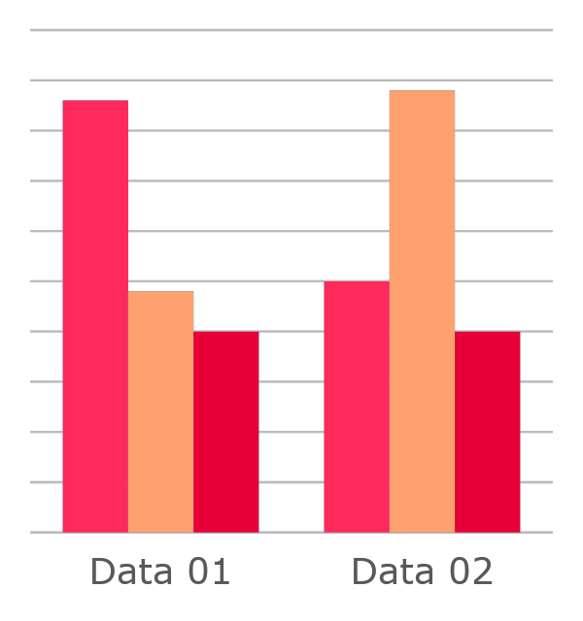
STAGE HERE
We use well-known development methodologies to create a customized approach for each of the projects. This allows us to achieve high quality outcomes and full transparency towards.
STAGE HERE
We hope that this template will return to you as a time, money and reputation.
We hope that this template will return to you as a time, money and reputation.

Slide 14
OPTION HERE
74%
74%
We use well-known development methodologies to create a customized approach for each of the projects. This allows us to achieve high quality outcomes and full transparency towards.
2019 – 75%
We hope that this template will return to you as a time, money and reputation.

Slide 15


TITLE HERE
We hope that this template will return to you as a time, money and reputation.
75%
52%
69%
55%
We hope that this template will return to you as a time, money and reputation.
We hope that this template will return to you as a time, money and reputation.
We hope that this template will return.
We hope that this template will return to you as a time, money and reputation.
JAN 1
JAN 2
JAN 3
JAN 4
JAN 5
JAN 6
JAN 7
JAN 8
JAN 9
JAN 10
JAN 11

Slide 16

STEP HERE
A complex idea can be conveyed with just a single still image, namely making it possible to absorb large amounts of data quickly.
STEP HERE
More title text here

Slide 17

STAGE HERE
A complex idea can be conveyed with just a single still image, namely making it possible to absorb large amounts of data quickly.
STAGE HERE
More title text here

Slide 18

OPTION HERE
A complex idea can be conveyed with just a single still image, namely making it possible to absorb large amounts of data quickly.
OPTION HERE
More title text here

Slide 19

TITLE HERE
A complex idea can be conveyed with just a single still image, namely making it possible to absorb large amounts of data quickly.
View more
More title text here

Slide 20



STEP HERE
2017
2019
20XX
STEP HERE
STEP HERE
STEP HERE
We hope that this template will return to you as a time, money and reputation.
We hope that this template will return to you as a time, money and reputation.
We hope that this template will return to you as a time, money and reputation.

Slide 21




STAGE HERE
STAGE HERE
STAGE HERE
CEO, Founder
Senior Graphic Designer
STAGE HERE
STAGE HERE
@Domnall Ridwan
Content Writer
@Valko Lon
Marketing
@Dalibor Sassa
@Rhianna Hercules

Slide 22

OPTION HERE
We use well-known development methodologies to create a customized approach for each of the projects. This allows us to achieve high quality outcomes and full transparency towards.
Company address 1234, SF
+022 4422 XXXX XXX
mail@companysite.com
www.companysite.com

Slide 23

TITLE HERE
A complex idea can be conveyed with just a single still image, namely making it possible to absorb large amounts of data quickly.
TITLE HERE
We use well-known development methodologies to create a customized approach for each of the projects. This allows us to achieve high quality outcomes and full transparency towards.
TITLE HERE
TITLE HERE

Slide 24
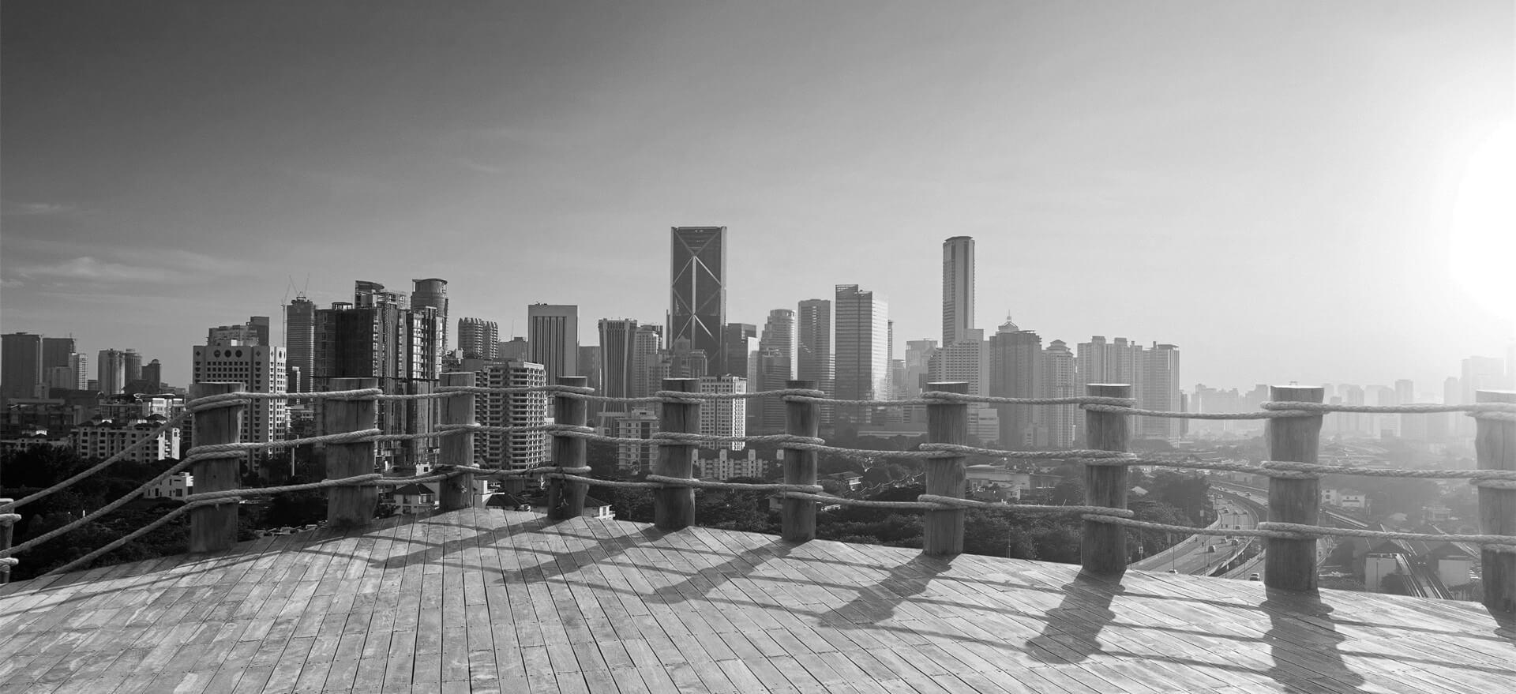
STEP HERE
STEP HERE
A complex idea can be conveyed with just a single still image, namely making it possible to absorb large amounts of data quickly.
STEP HERE
STEP HERE
STEP HERE
STEP HERE
STEP HERE
STEP HERE

Slide 25


20XX
THANK YOU!
Powered by GoogleSlides.org

