Slide 1


Scratch Challenge
Template de Slides Carnival
Beginner
RÉCIT document made available, with exception, according to the terms of the Creative Commons 4.0 License.

Slide 2

Scratch Challenge
Present at least one concrete action you can take to achieve a sustainable development goal.

Slide 3
Get informed !
01

Slide 4
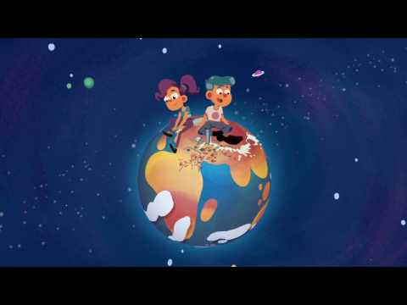

What is sustainable development?
What is sustainable development? - (3 m. 40 s.)

Slide 5
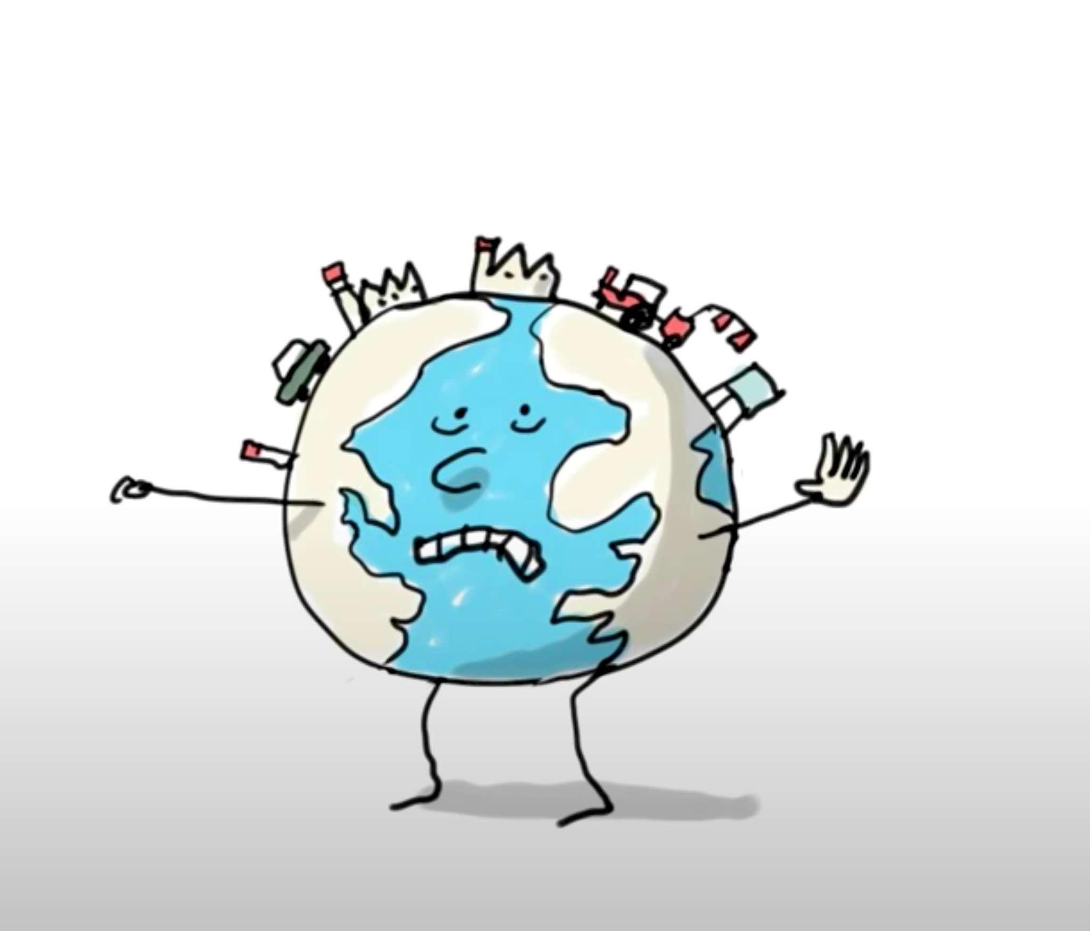
Respectful interactions between humans and the Earth
What suggestions were presented in the video?
Can you think of any more?

Slide 6

What is sustainable development?
1
Meet current needs without harming future generations.
Reflect on the consequences of all of our daily actions.
Make choices with great respect for humans and the Earth.
2
3

Slide 7





Sustainable Development
Environmental Protection
Economic
Viability
Social
Equity

Slide 8

Sustainable Development Goals
Notes:
https://en.wikipedia.org/wiki/Sustainable_Development_Goals#/media/File:Sustainable_Development_Goals.svg

Slide 9
Get inspired !
02

Slide 10
Scratch Challenge
Present at least one concrete action you can take to achieve a sustainable development goal.

Slide 11

Sustainable Goal #11 :
Notes:
Sustainable goal chosen for this challenge: Sustainable cities and communities
Note to teacher: A video explaining the 17 sustainable development goals defined by the UN.

Slide 12
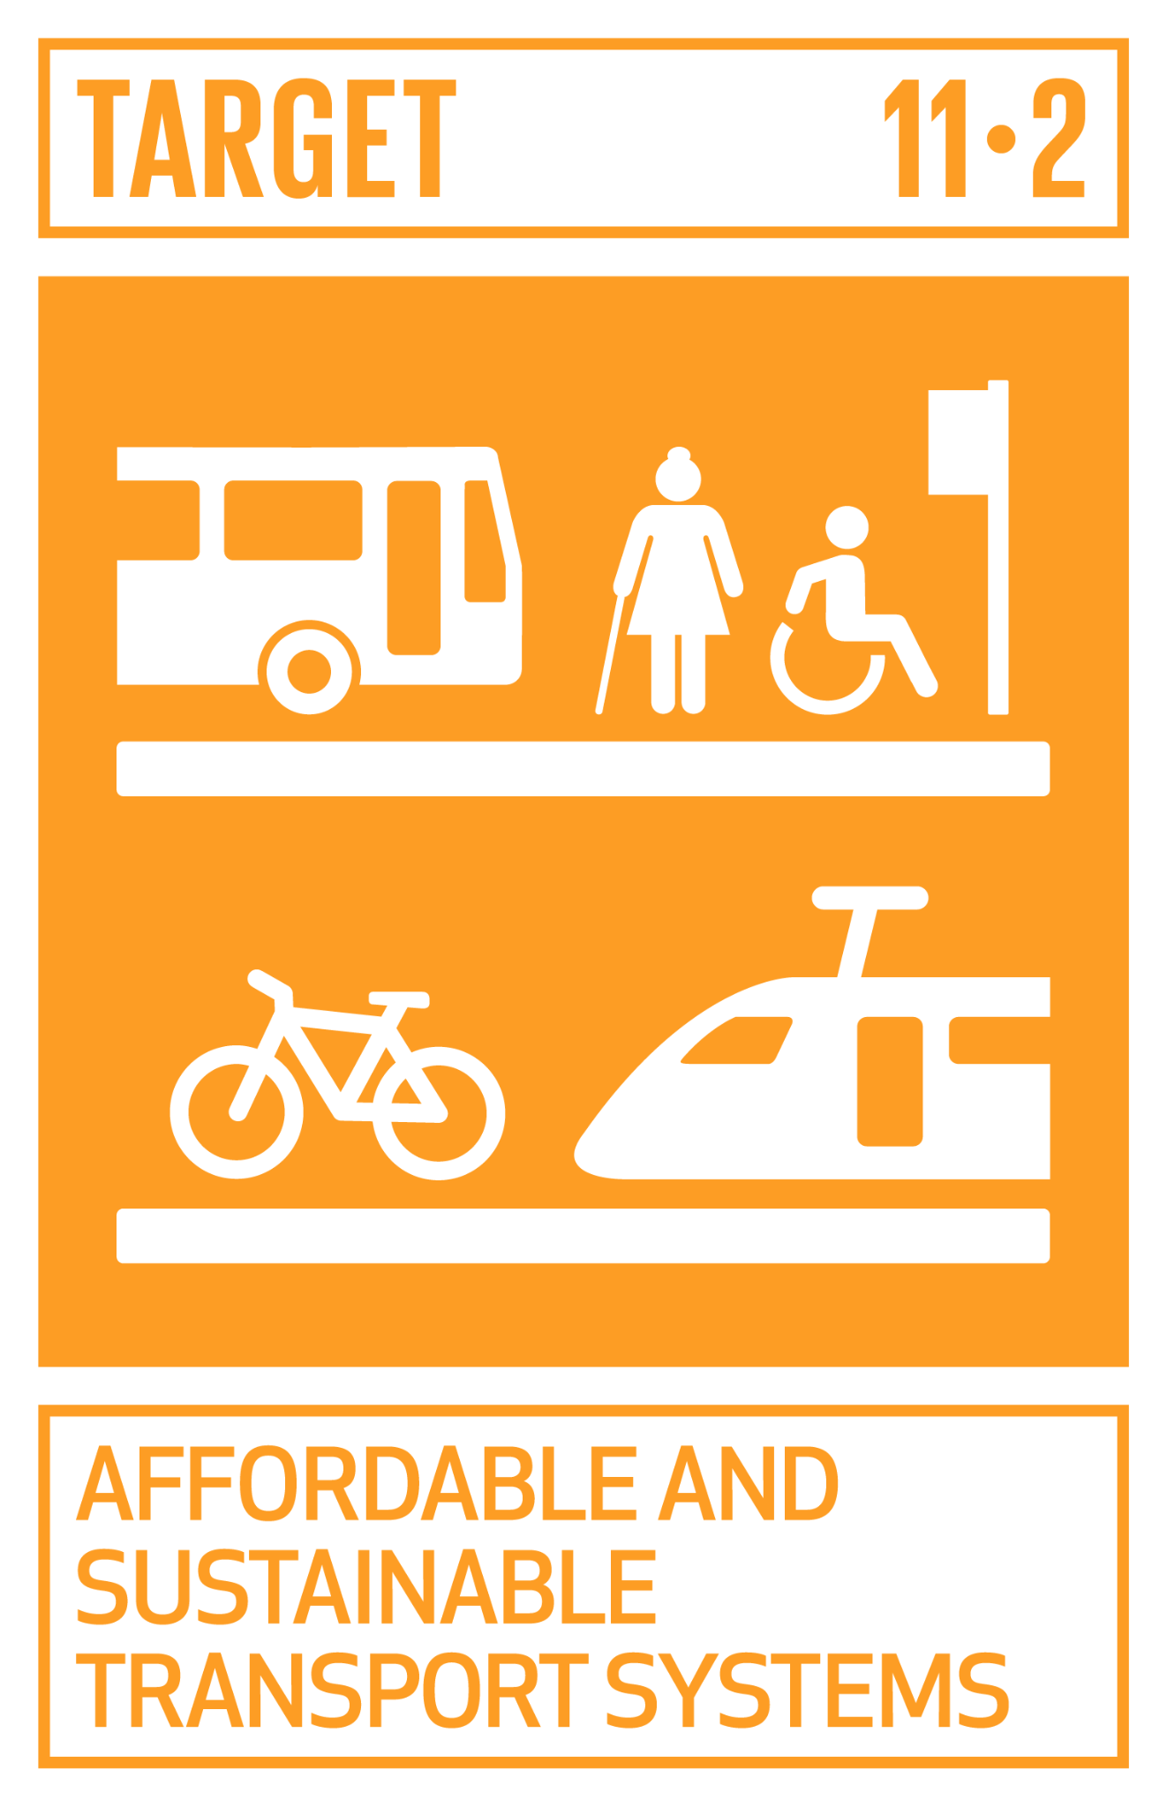
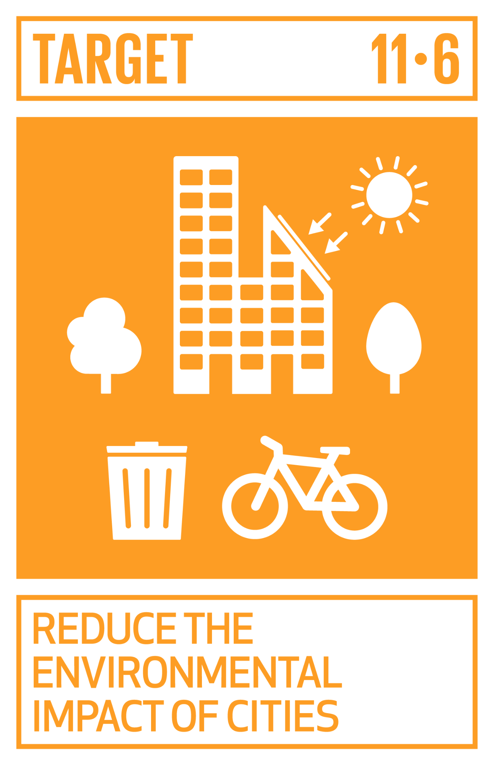
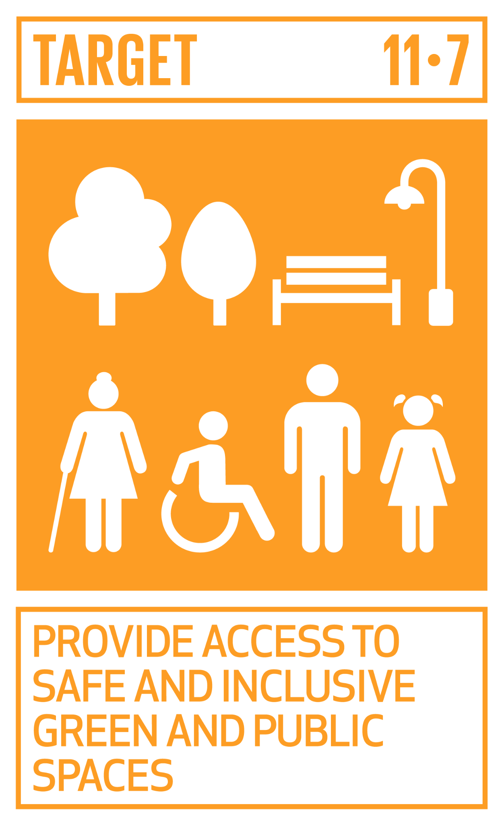
Look at and discuss the LOGOS
Notes:
These logos represent various issues. Have students describe what they see in each logo.
Have students discuss potential actions that could be taken or actions they are already taking.Have students discuss what actions that could be taken or that they are already taking.

Slide 13
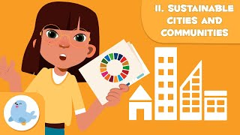
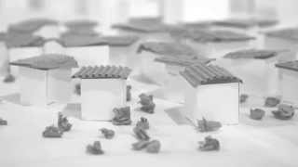
Other video suggestions
Sustainable Cities and Communities
Paper City: An Urban Story
Notes:
Suggestions
Food waste https://youtu.be/ishA6kry8nc or https://www.youtube.com/watch?v=0eqxgvZNn0I
Waste reduction: https://youtu.be/TPG6E4nxtSw or https://www.youtube.com/watch?v=EGzg77rx7Uo

Slide 14
Planning my work !
03

Slide 15
Scratch Challenge
Present at least one concrete action you can take to achieve a sustainable development goal.

Slide 16
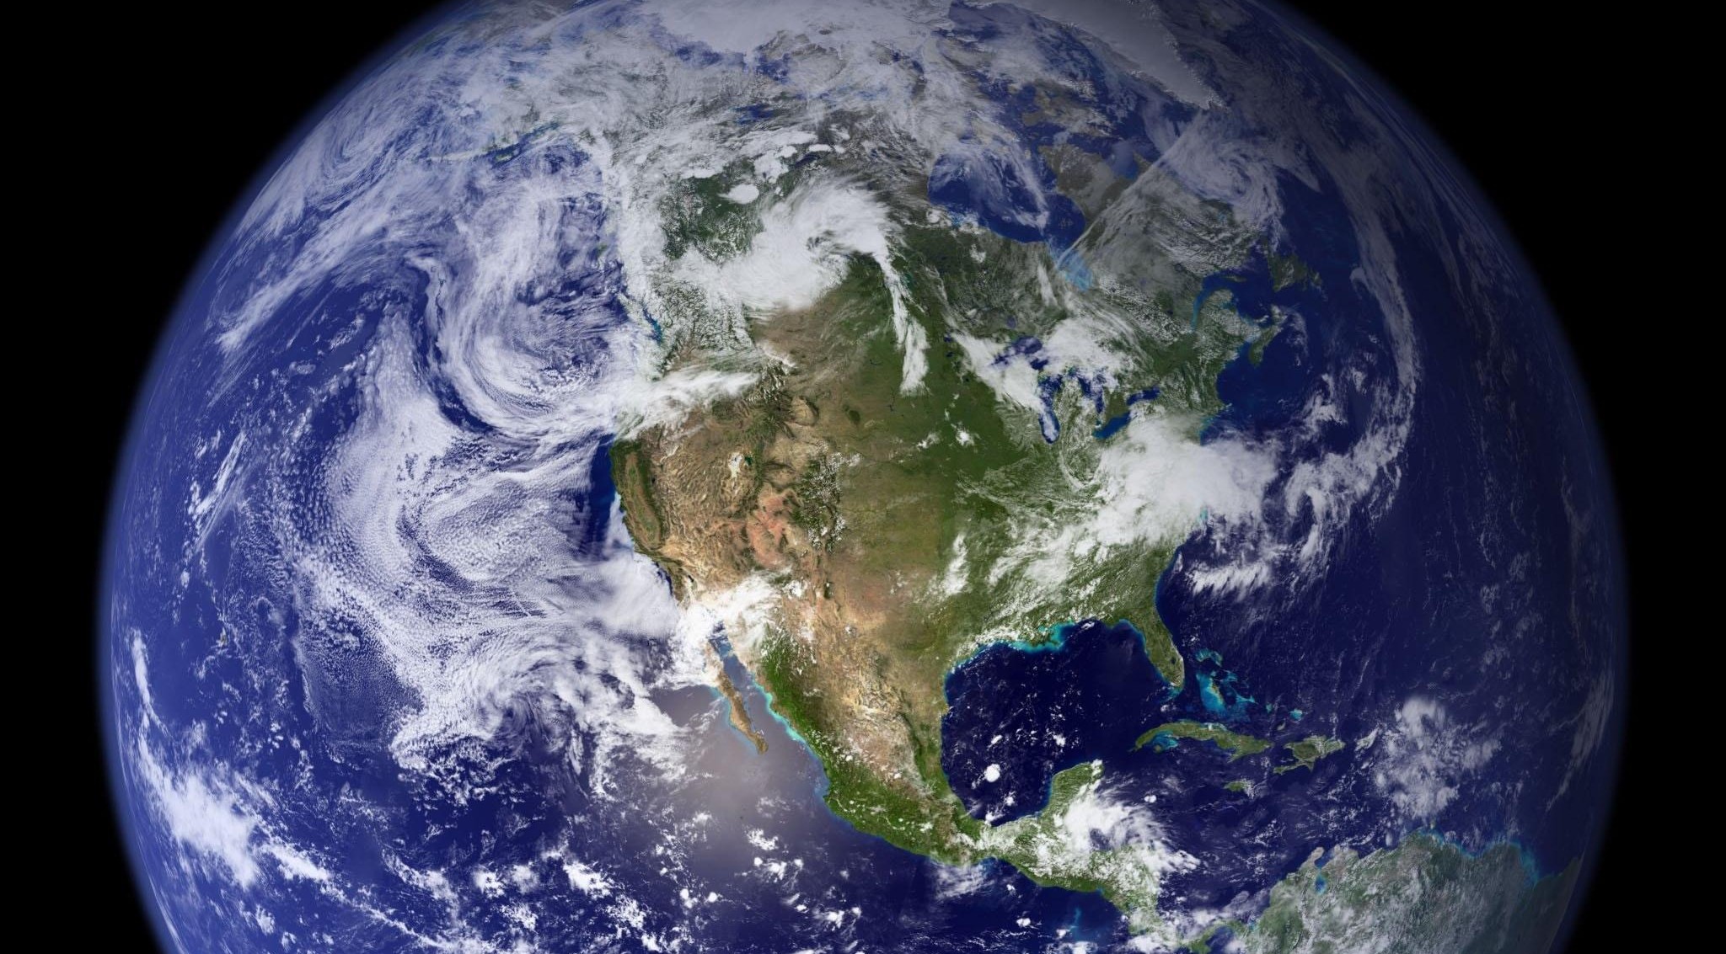
My scenario: What topic(s) will you address?
-
O
X
Transportation (e.g., public transit, cycling)
Sustainable buildings and architecture
Parks and green spaces
Waste management
Other?

Slide 17
Coding my animation
04

Slide 18
Criteria
💡 Content of the animaton
Your animation should include:
at least one concrete action you can take;
at least one backdrop;
at least two sprites;
at least one sound or one audio recording.

Slide 19
Criteria
💡 Content of the Scratch program
Your program should include :
motion blocks to animate your sprites;
at least three speech or thought blocks;
at least one programming loop;
an animation with a maximum duration of 4 minutes.

Slide 20

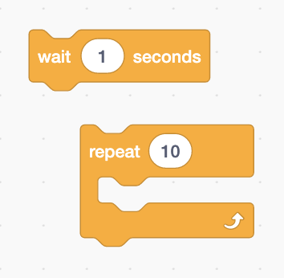
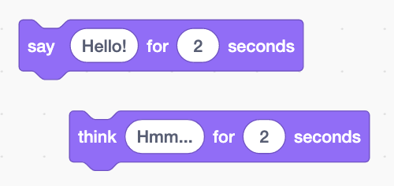
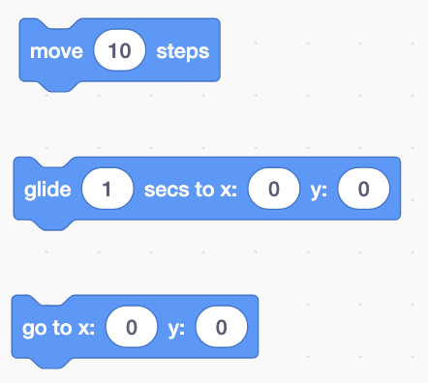

Blocks used in the program

Slide 21
Sharing my animation
05

Slide 22
Criteria (continued)
💡 Elements related to the publication
To publish your project, you should :
have a meaningful title followed by Kreocode 20XX (e.g : My Sustainable City - Kreocode 20XX);
use only copyright-free images, photos or sounds (no photos or personal information of students)
cite any sources used in the space reserved for Notes and Credits;
pay close attention to your use of language;
indicate how to start your program in the Instructions section (if it does not start with the green flag);
share the project when it is completed.

