Slide 1

Invoice App
Introduction To Platform Apps - Invoice App
Document Version - 23rd October 2020

Slide 2
What’s in it for me?
Overview of the Invoice App
1.1 Introduction
1.2 What is Invoice App used for?
User Guide

Slide 3
Overview

Slide 4
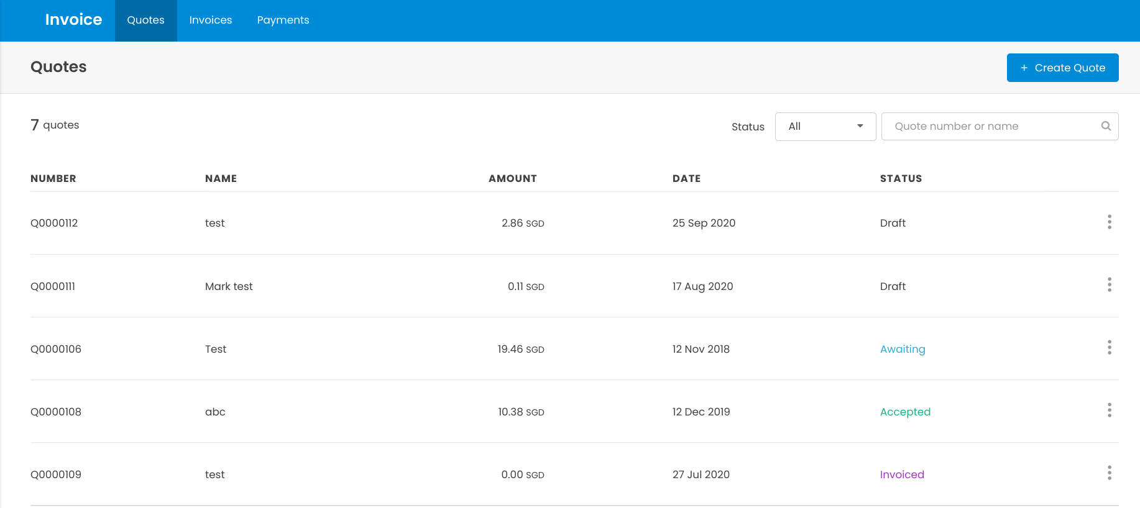
1.1 Introduction
Invoice app with simple interface, integrated automation and PDF invoice generation is designed with your convenience in mind. You can manage the commercial documents including receipts or tax invoices.

Slide 5
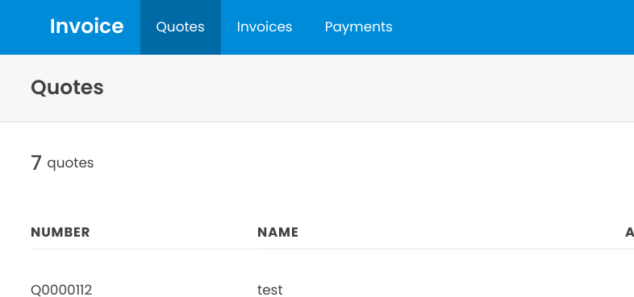
1.2 What is this app used for?
This app will allow you to create/view:
Quotes
Invoices
Payment

Slide 6
2. User Guide

Slide 7
2.1 Quotation Tab

Slide 8
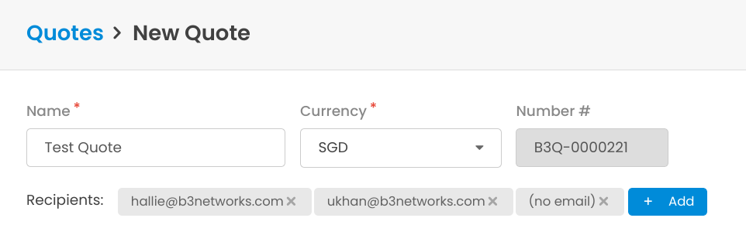
Create Quotation
A quotation is a formal statement setting out the estimated cost for a particular job or service.
1. Click [Create Quote] > Fill in Information: Quote name and recipient email address

Slide 9
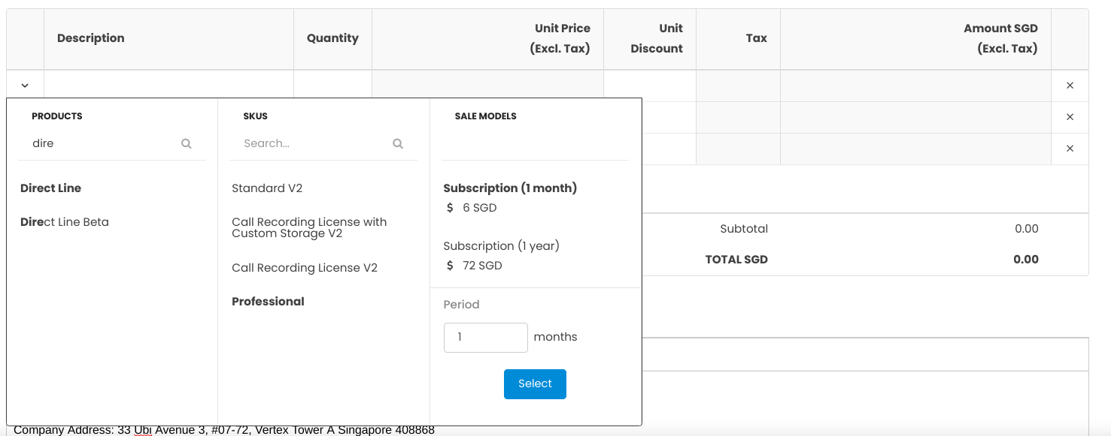
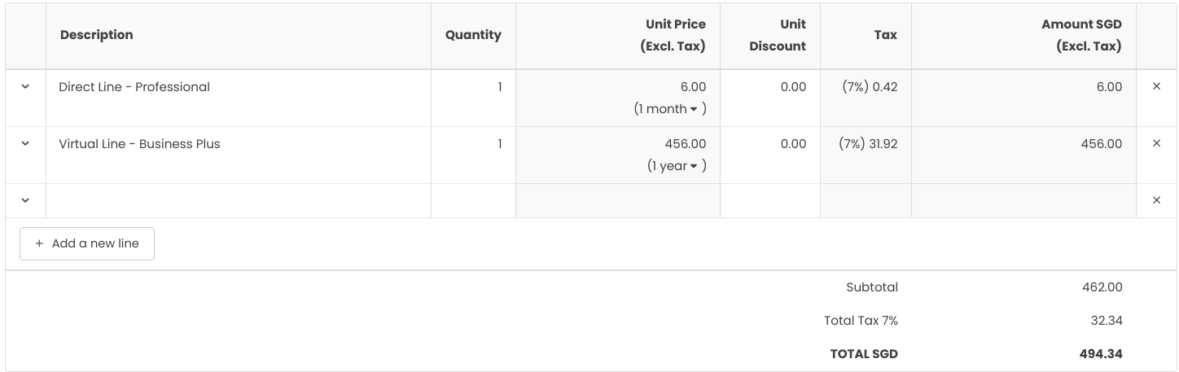
Create Quotation (cont’d)
2. Setup list of items in the table below by clicking on any rows to input value.
*NOTE: all pricing is after GST (if applied).

Slide 10
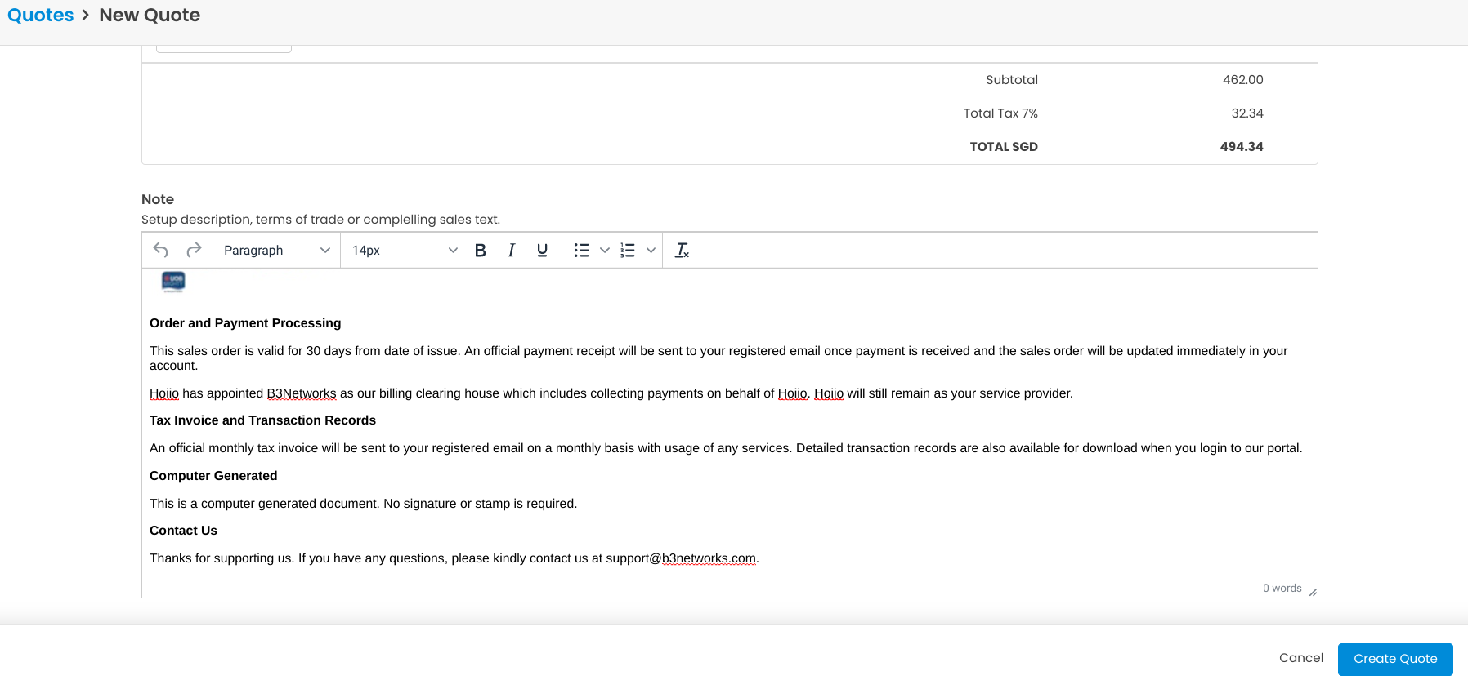
Create Quotation (cont’d)
3. Add some note for Payment information
4. [Create Quote]

Slide 11
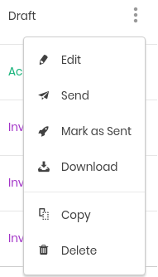
B. Manage Quotation
Edit: you can edit the content until it is perfect and accepted by your customers.
Status: Draft

Slide 12
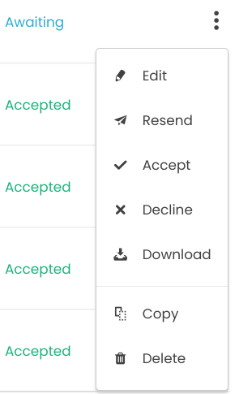
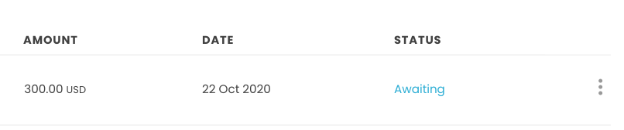
B. Manage Quotation (cont’d)
Send / Mark as Sent: to send quote to your customer.
Once it’s sent / marked as sent, status will be changed to Awaiting
The action list will be updated

Slide 13
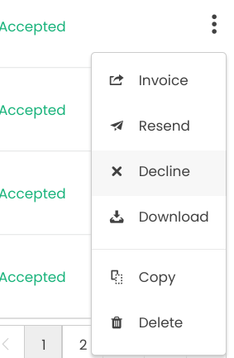

B. Manage Quotation (cont’d)
Accept: use for the case your customer accepts the quote.
Once the Awaiting quote is marked as Accept, status will be changed to Accepted
The action list will be updated again.

Slide 14

B. Manage Quotation (cont’d)
Invoice: to auto generate a proforma invoice
Once the Accepted quote is marked as Invoice, status will be changed to Invoiced
An invoice is created as Draft in Invoice Tab
(image taken from Invoice app)

Slide 15
2.2 Invoice Tab

Slide 16
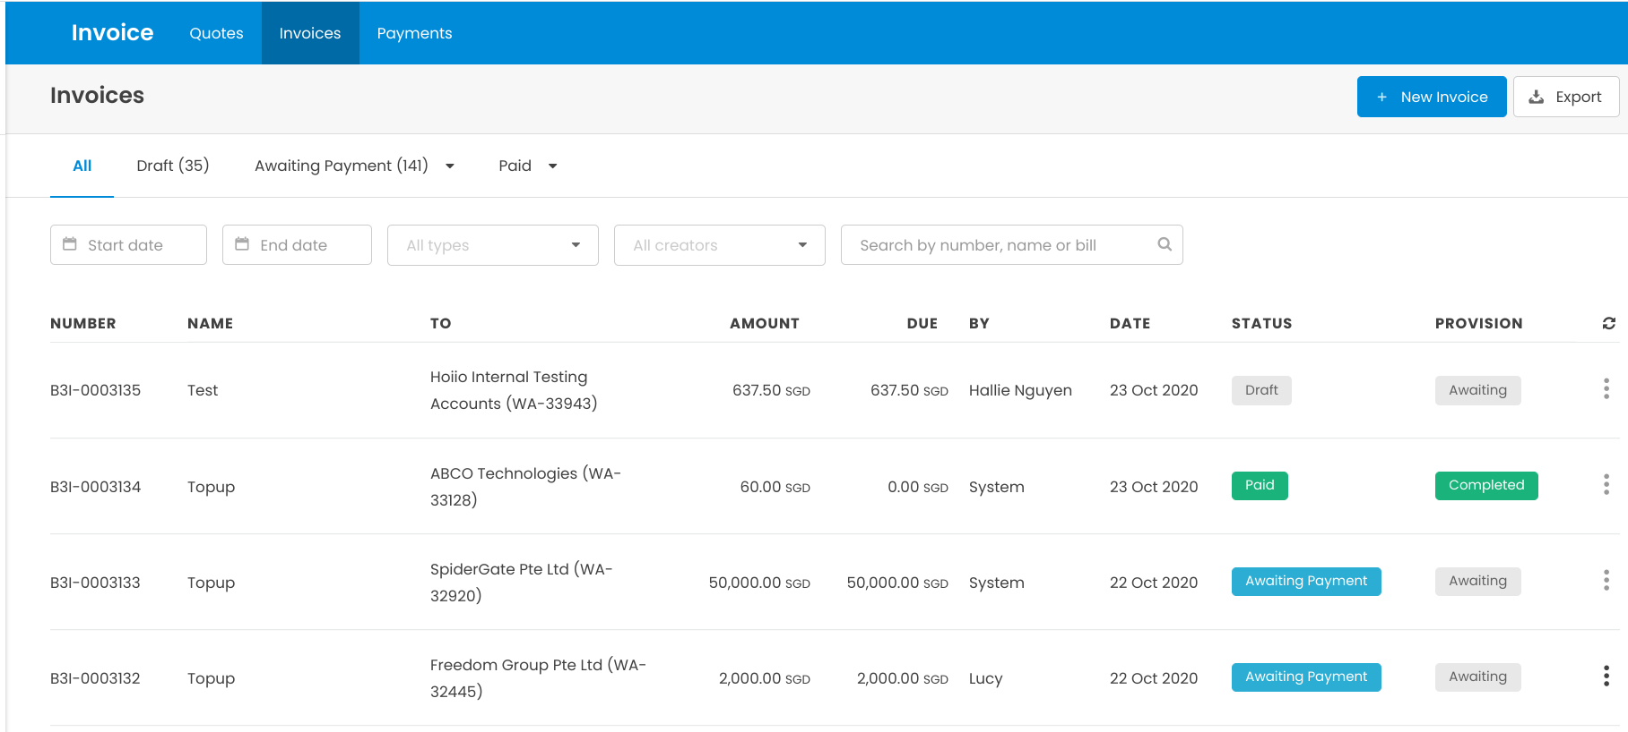
A. Type of invoices
There are 3 types of invoice:
Top up invoice
Proforma invoice
Tax invoice

Slide 17
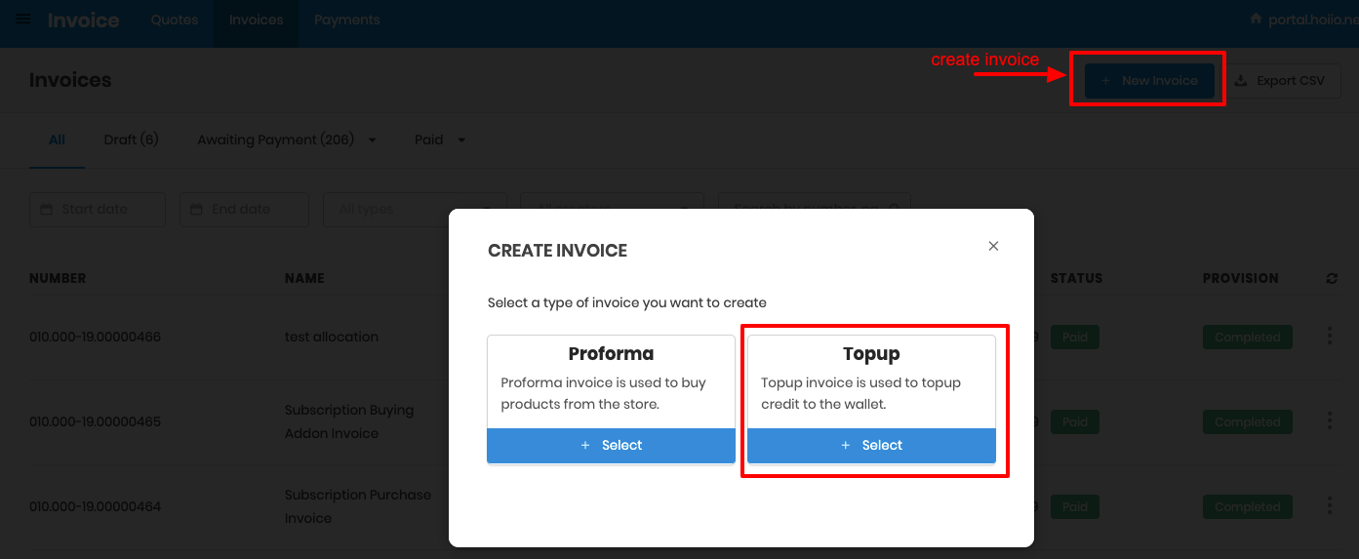
A1. Top Up Invoice
This is the invoice that you issue to your customer to top up their balance.
Create a top-up invoice
Go to [Invoice] tab > [Create invoice] > Choose [Topup]

Slide 18
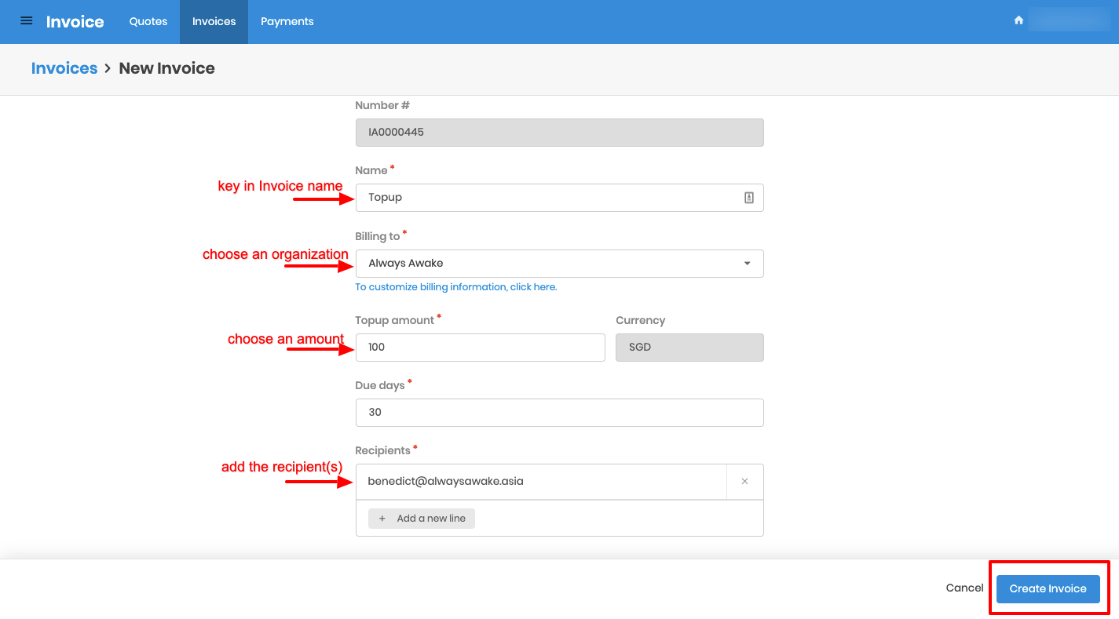
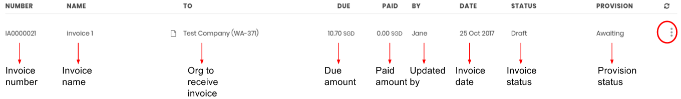

A1. Top Up Invoice (cont’d)
Create a top-up invoice (cont’d)
2. Fill in the necessary info
3. [Create Invoice]
4. After an Invoice is created, its status is Draft.

Slide 19
A1. Top Up Invoice (cont’d)
Allocate payment to a top-up invoice
Using Finance App
If the topped up payment has not been spent on any transactions yet (e.g. call, sms...), it can be removed.
Topup invoice that needs to be allocated payment must be sent/marked as sent already.
Provision Top-up invoice
When the top-up invoice is allocated a payment, it is being provisioned.
(e.g, when you allocate $100 to a top-up invoice of user A, the balance of user A will increase by $100 and the top-up invoice becomes provisioned and will be marked as paid)

Slide 20
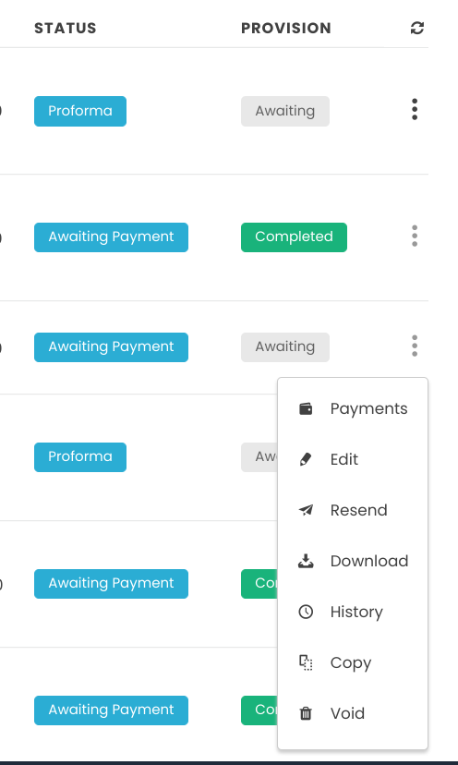
A1. Top Up Invoice (cont’d)
Void a top-up invoice
As long as the top-up invoice is NOT allocated (or provisioned) & still [Awaiting Payment], it can be voided. No credit note is required.

Slide 21
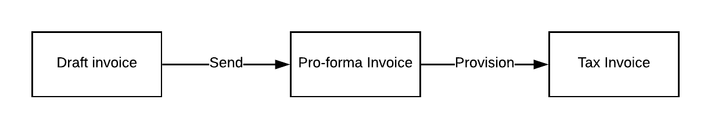
A2. Proforma Invoice
A pro-forma invoice is a preliminary bill of sale that send to buyers before service provision.
Items in pro-forma invoices are not considered as revenue => can be freely changed as required.

Slide 22
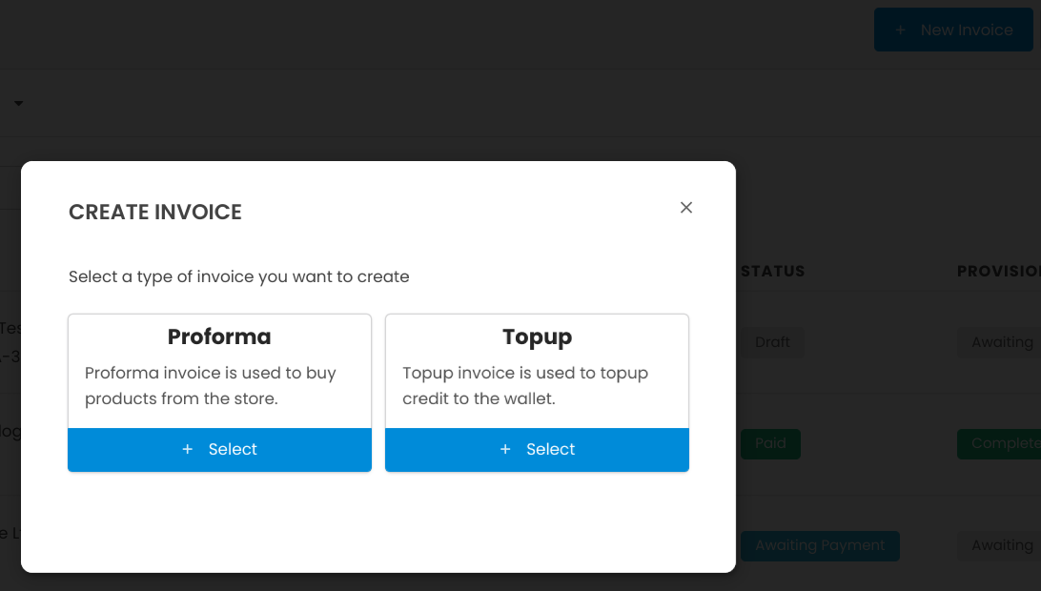
A2. Proforma Invoice
Create a proforma invoice (2 ways)
Create invoice
Generate from Quote tab & mark it as Invoice
Go to [Invoice] tab > [Create invoice] > Choose [Proforma]

Slide 23
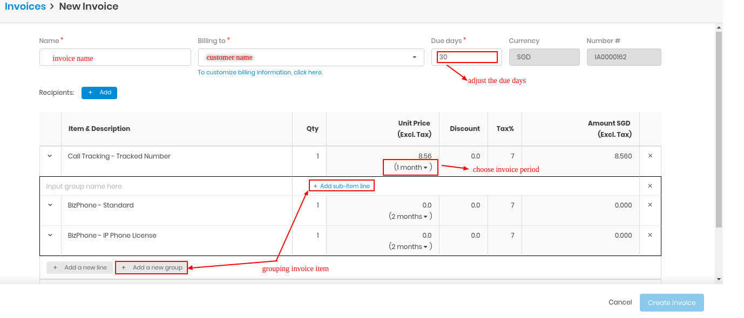
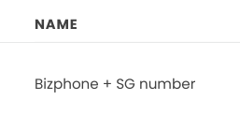
A2. Proforma Invoice
Create a proforma invoice (cont’d)
2.1 Setup list of items in the table below by clicking on any rows to input value.
2.2 [Create Invoice]
2.3 After an Invoice is created, its status is Draft.

Slide 24
A2. Proforma Invoice (cont’d)
Allocate payment to a proforma invoice
You have some ways to add payment to an invoice to mark it paid:
Auto allocate: Invoice will be Paid automatically when invoice is provisioned by customer's remaining credits.
Manually allocate a received payment to an invoice: Using Finance App
Use credit from approved (Awaiting Payment) credit notes.
NOTES:
Payment can be removed from an invoice.
If the proforma invoice is provisioned by Invoice app and becomes a tax invoice, the payment still can be removed.
Proforma invoice that needs to be allocated payment must be sent/marked as sent already.

Slide 25
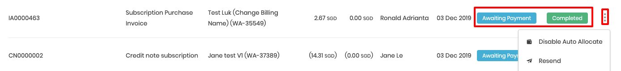
A2. Proforma Invoice (cont’d)
Allocate payment to a proforma invoice
Auto allocate: Invoice will be Paid automatically when invoice is provisioned by customer's remaining credits.
This is the default payment option of a tax invoice (provisioned & awaiting payment, or provisioned & partially paid). The invoice will be fully paid automatically when the customer tops up or when using customer's remaining credits.
In case you have multiple invoices of this type, when you perform a top-up, that payment will be allocated to those invoices randomly, from oldest to latest.
If you do not want the incoming payment to be assigned randomly like this, you can Disable this auto mode and manually allocate payment to an invoice.

Slide 26
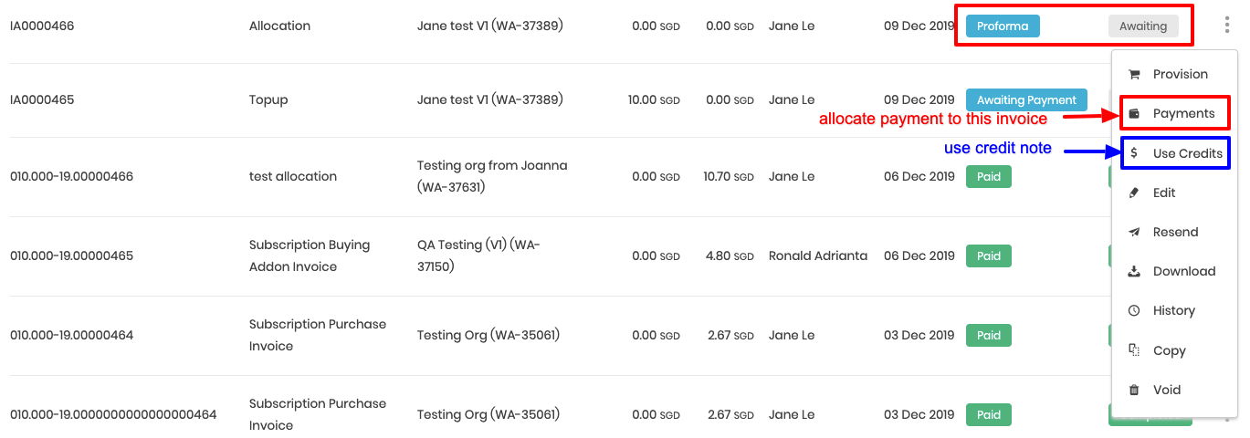
A2. Proforma Invoice (cont’d)
Allocate payment to a proforma invoice
2. Manually allocate a received payment to an invoice: Using Finance App
This happens to an invoice that is disabled auto allocation.

Slide 27
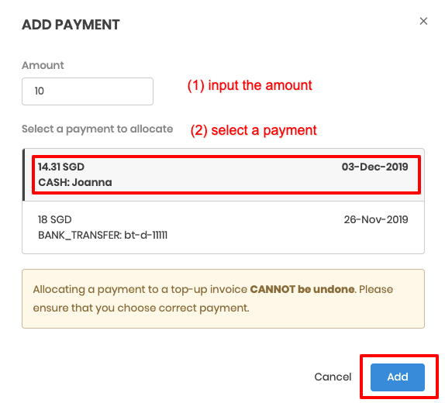
A2. Proforma Invoice (cont’d)
Allocate payment to a proforma invoice
2. Manually allocate a received payment to an invoice: Using Finance App
How to allocate a payment manually
You need to add payment and assign it to the user account.
Allocate the payment to the appropriate invoice(s)
at Finance app
or at Invoice app: from the invoice option, choose [Payment]
(via Invoice app)

Slide 28
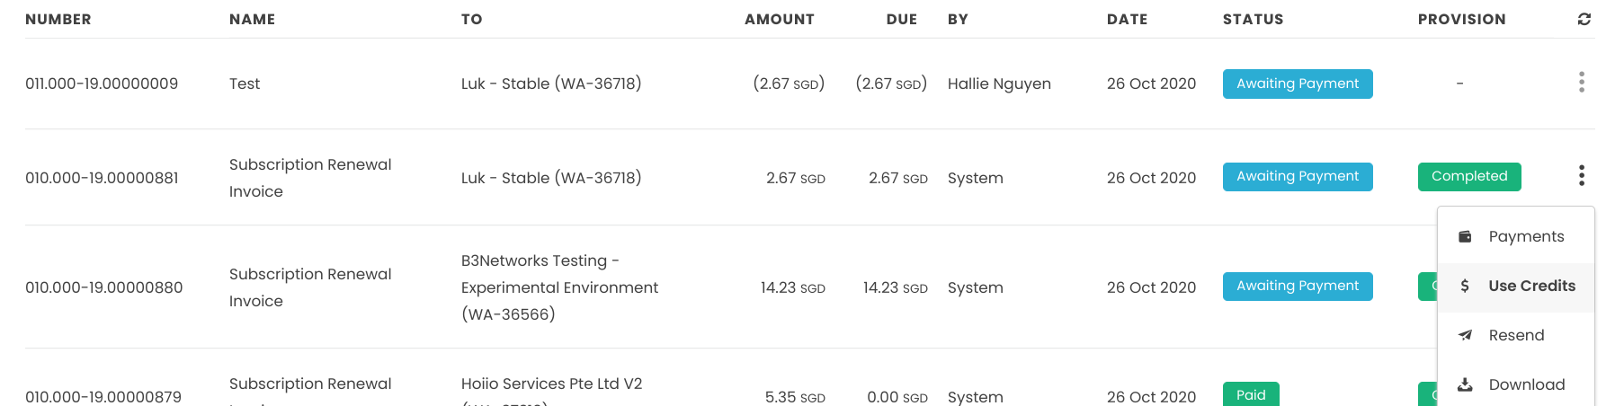
A2. Proforma Invoice (cont’d)
Allocate payment to a proforma invoice
3. Use credit from credit notes.
Step 1: Create an awaiting payment credit note via Finance App.
Step 2:
  Option A: Click the 3 dot icon on the right side of the invoice and choose Use credits.
Credit Note created via Finance App

Slide 29
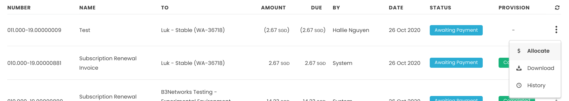
A2. Proforma Invoice (cont’d)
Allocate payment to a proforma invoice
3. Use credit from credit notes.
Step 2:
  Option B: Click [Credit Note] Invoice, then select Allocate Credit.
Credit Note created via Finance App

Slide 30
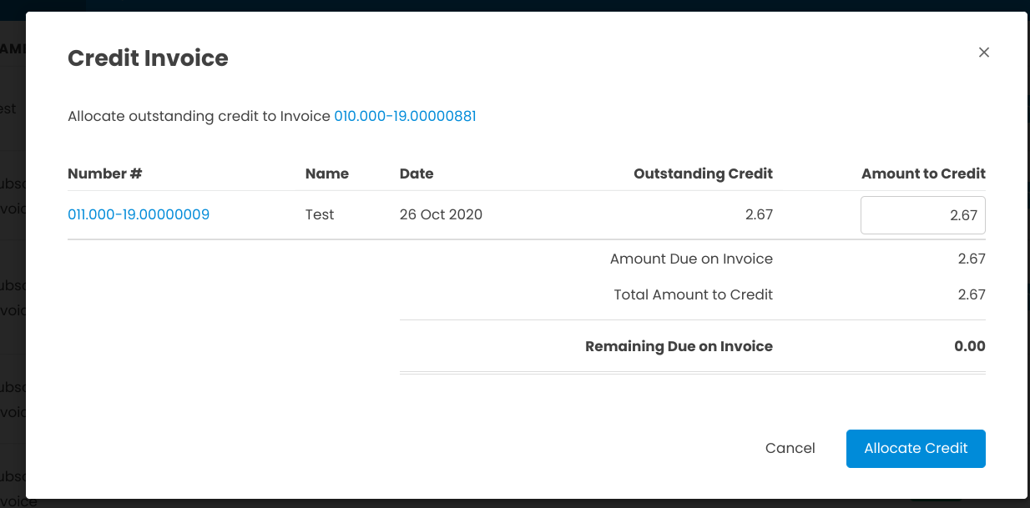
A2. Proforma Invoice (cont’d)
Allocate payment to a proforma invoice
3. Use credit from credit notes.
Step 3: Enter the amounts in the Amount to Credit fields for the unallocated credit notes you want to use. You can apply the full credit amount or just some of it.

Slide 31
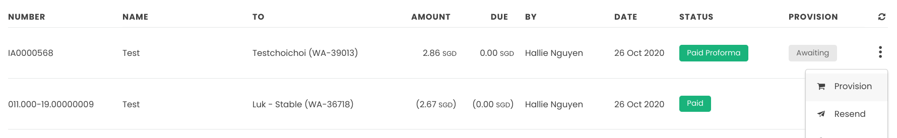
A2. Proforma Invoice (cont’d)
Provision Proforma invoice
Invoice app only supports 2 types of provisioning:
Subscription/order purchase
Subscription extension
Subscription add-on addition is not supported as the charge varies depending on provision date.
Subscription renewal is also not supported as it is similar to subscription extension, albeit with alignment, whose charge varies depending on provision month.

Slide 32
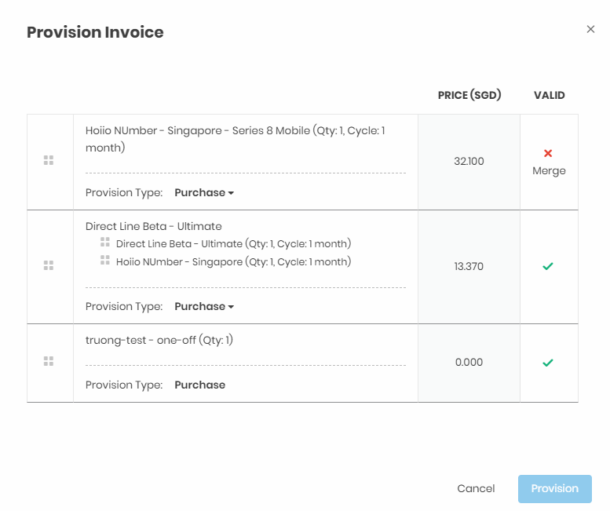
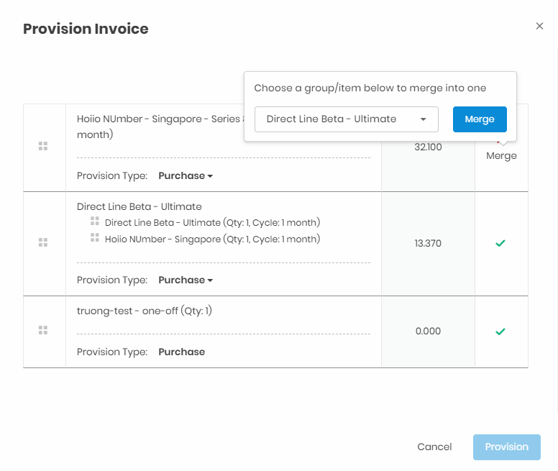
A2. Proforma Invoice (cont’d)
Provision Proforma invoice
All pro-forma invoices must be provisioned in Invoice app.
A pro-forma invoice must be provisioned in its entirety, or fail entirely.
There will be a validity check to ensure that all of the items in an invoice can be provisioned.
After the Pro-forma invoice is provisioned, it will be converted to a Tax invoice.

Slide 33
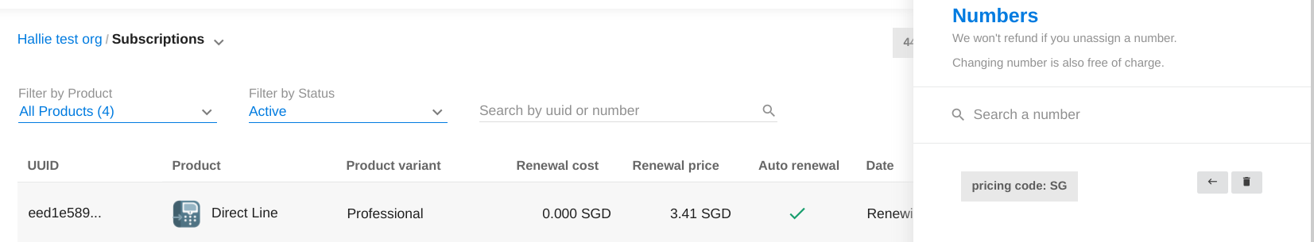
A2. Proforma Invoice (cont’d)
Provision Proforma invoice
A Pro-forma Invoice can only be provisioned if all of the following satisfied:
All items pass validity check
The invoice is fully paid with manual payment, or has enough credit to cover for the unpaid amount of the invoice
Invoice app will automatically provision all the items by calling the appropriate modules. There are some actions that user still need to do manually, such as assigning a number to a subscription.

Slide 34
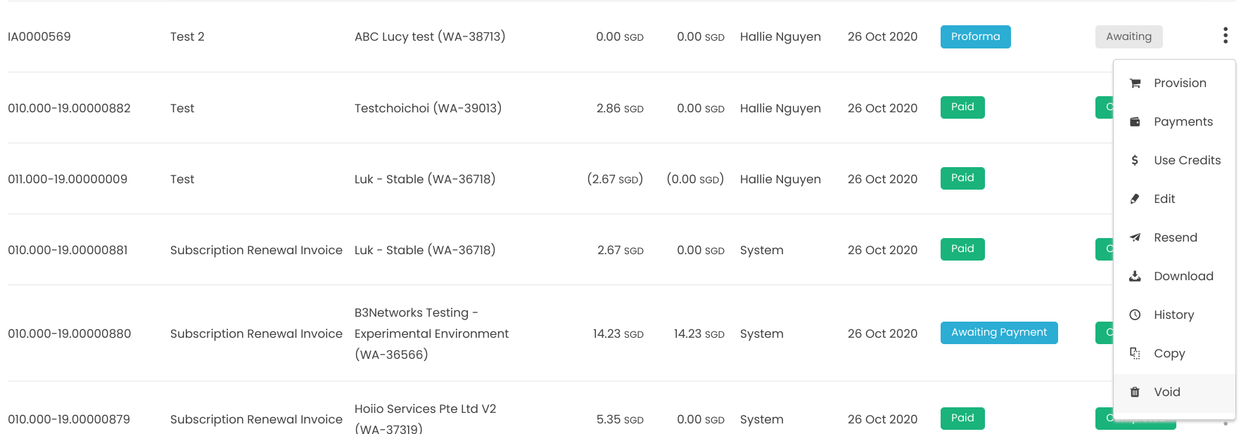
A2. Proforma Invoice (cont’d)
Void a Proforma invoice
A Pro-forma invoice which has not been allocated payment can be voided.
NOTE: a paid or partially paid Pro-forma invoice cannot be voided. To do that, the payment must be unallocated from the invoice first.

Slide 35
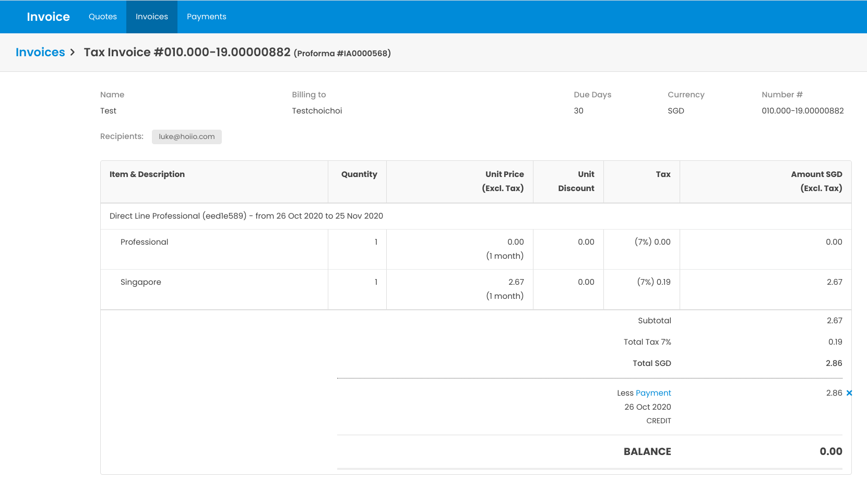
A3. Tax Invoice
An invoice is provisioned with the services belong to it is a tax invoice.
Every invoice (top-up, proforma) after being provisioned will become a tax invoice.
The tax invoice cannot be voided as it is considered as revenue once it is issued.

Slide 36
Negative Invoice
Usually, the amount of a monthly tax invoice is positive. In case the user is refunded and the total refund amount is larger than the total usage amount, the final amount is negative.
A negative invoice will still use:
The title as Tax invoice
The number range as of monthly tax invoice
General format of monthly tax invoice
NOTE section of credit note, which indicates that the invoice issuer (service provider) still owes the invoice recipient (user) an amount. This amount will be cleared for subsequent transactions.

Slide 37
2.3 Payment Tab

Slide 38
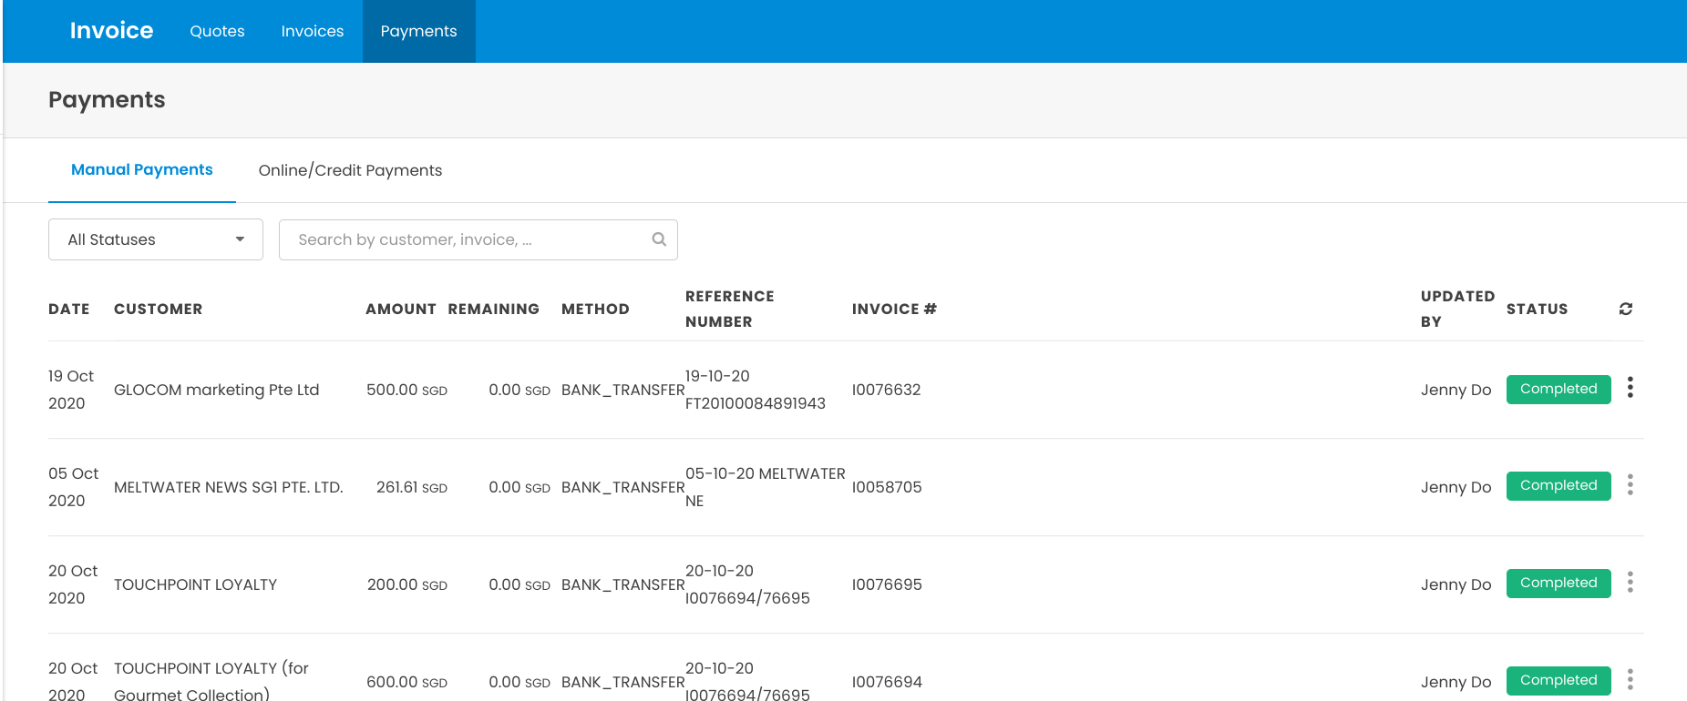
After a payment is added to an invoice, it is automatically synced to the Payment tab.
This tab is to let you know which payment is used for which invoice.
Payment added via Finance App
Payment added via Stripe

Slide 39
Thank You
For comments and feedbacks please contact:
academy@b3networks.com

