Slide 1
BF528 — Genomic Data Analysis
Introduction
Joey Orofino · Fall 2026 · Boston University

Slide 2
Course overview
Survey course in bioinformatics
Focused on high-throughput sequencing data, the tools used to analyze it, and the biological conclusions we draw from it
Project-based learning
You will develop full computational workflows to analyze next-generation sequencing data from real published studies
Hands-on analyses
The course is split between traditional lectures and interactive labs where you will get first-hand experience working with real data aon real problems

Slide 3
Learning objectives
Conceptual understanding
Understand the assays and tools used in modern bioinformatics from their molecular mechanisms to the major computational analysis steps
Workflow proficiency
Develop proficiency in creating bioinformatics workflows with an emphasis on reproducibility and portability
Biological interpretation
Analyze bioinformatics results and interpret them in context to draw meaningful biological conclusions

Slide 4
Biology became a data science in 1953

Slide 5
“It has not escaped our notice that the specific pairing we have postulated immediately suggests a possible copying mechanism for the genetic material.”
Watson and Crick, Nature (1953)

Slide 6
Biology as a Data Science
1998: first multicellular eukaryote sequenced, human SNP array prototype
2001: First draft of the human genome
1997: yeast genome on microarray, sequencing by synthesis established
1995: 1st bacterial genome sequenced, microarray technology described
1992: European Bioinformatics Institute (EMBL-EBI) founded
1990: Human Genome Project launched
Human Genome Era
1988: National Center for Biotech Information (NCBI) founded
1983: PCR invented
1977: Sanger sequencing invented, first genome sequenced
1953: DNA chemical structure published in Nature
1972: First genetic sequence determined
1970: Term “bioinformatics” coined by Paulien Hogeweg
1950
1960
1970
1980
1990
2000
2010
Notes:
1970: Paulien Hogeweg invented the term bioinformatics, also proposed a tree-based algorithm for MSA
1972: Coat protein of bacteriophage MS2
1977: Phix174 (bacteriophage for E coli)
1995: H influenzae, j craig venter

Slide 7
The Human Genome Era
2006: Solexa Genome Analyzer released,
23andMe founded
2001: First draft of the human genome
2007: Human Microbiome Project launched, Illumina buys Solexa
2008: 1000 Genomes Project launched
2002: International HapMap Project launched
2009: Illumina offers whole genome sequencing service for $48,000, single-cell sequencing technologies emerge
2010: Illumina WGS service price drops to $19,000
2003: Human Genome declared “complete”, Encyclopedia of DNA Elements (ENCODE) launched
2012: UK announces 100k Genomes Project
2014: Illumina WGS service price drops to $1,000
2018: 100k Genomes Project complete
2000
2005
2010
2015
2020
Human Genome Releases
NCBI36
GRCh37/hg19
GRCh38

Slide 8
"Big" data
Data volumes in modern genomics
Single microarray dataset: ~500 Mb
Single short-read dataset: 2 Gb – 300 Gb
One NovaSeq run: ~6 Tb
NCBI Short Read Archive
2015: 3.3 million samples, ~37 Tb
2020: 15.7 million samples, ~17,500 Tb (136,718 iPhones)

Slide 9
Conceptual history of bioinformatics
Biological sequences digitized
Databases needed to store sequences
Search tools needed for databases
Analysis tools for search results
New tools required to analyze the human genome
Those tools enable analysis of large-scale sequencing data
Sequencing data volume explodes, requiring new tools
…

Slide 10
The sequence: the fundamental datatype
Molecular sequence + computer science
Genome assembly, homology, phylogeny
+ physics
DNA/RNA/protein structure, drug prediction
+ statistics
Gene expression, population genetics, biomarkers
+ mathematics
Metabolic modeling, synthetic biology, systems biology

Slide 11
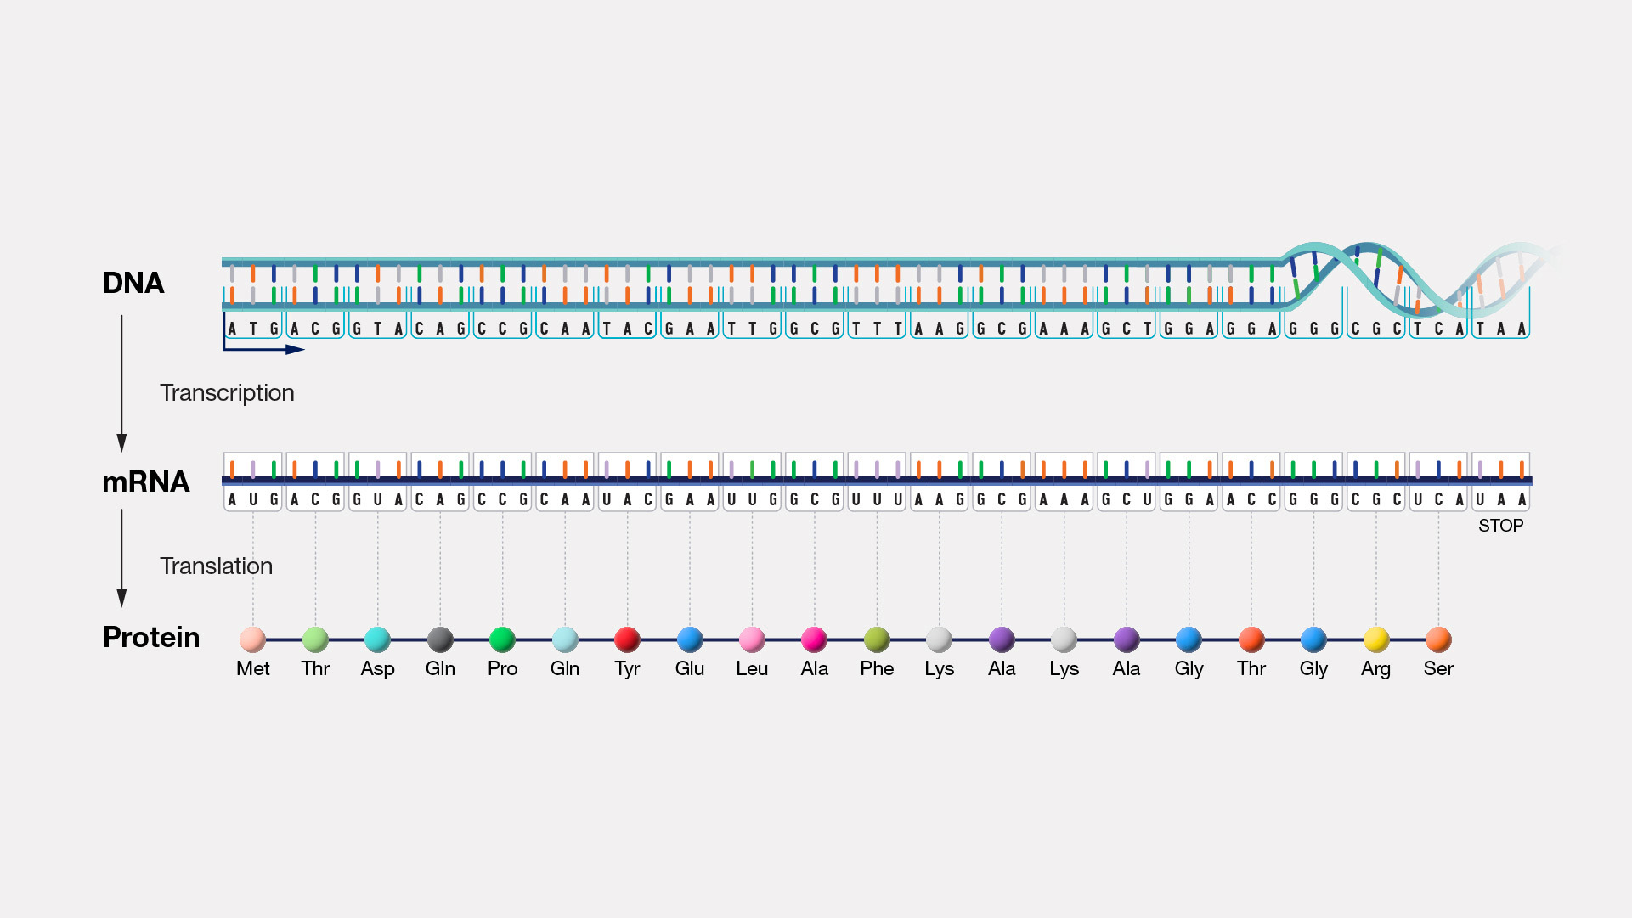
Central Dogma of Biology
Each of these molecules is a sequence
https://www.genome.gov/genetics-glossary/Central-Dogma#:~:text=The%20central%20dogma%20of%20molecular,or%20RNA%20directly%20to%20protein.

Slide 12
Instructors
Joey Orofino
Contact information on Blackboard
TAs
Contact information on Blackboard

Slide 13
Course structure

Slide 14
Course organization
Website
https://bu-bioinfo.github.io/bf528/ — all materials, lab guides, and project specs
Blackboard
Announcements and private links only
Meeting times
Mon / Fri 10:10–11:55am — CDS B62
Wed 9:00–9:55am — CAS B20

Slide 15
Project overview
Recreate findings from published studies
Four projects over the course of the semester
Feedback and self-assessment
You will receive feedback on each project and complete a self-assessment with every submission

Slide 16
Project structure
Reproducible, portable pipelines
Git and GitHub, Conda and containers (Docker), Nextflow, HPC
Write short sections of a publication describing your findings
Explore preliminary findings and draw your own conclusions
Compare with the literature
Compare your results with those from the original publication

Slide 17
Projects become progressively more independent
Project 1 — Genome Assembly
Learning Nextflow, HPC, and command line
Project 2 — RNA-seq
Detailed directions, several steps simplified
Project 3 — ChIP-seq
Less detailed directions, full steps
Final Project — Individual
Guidelines and deliverables only

Slide 18
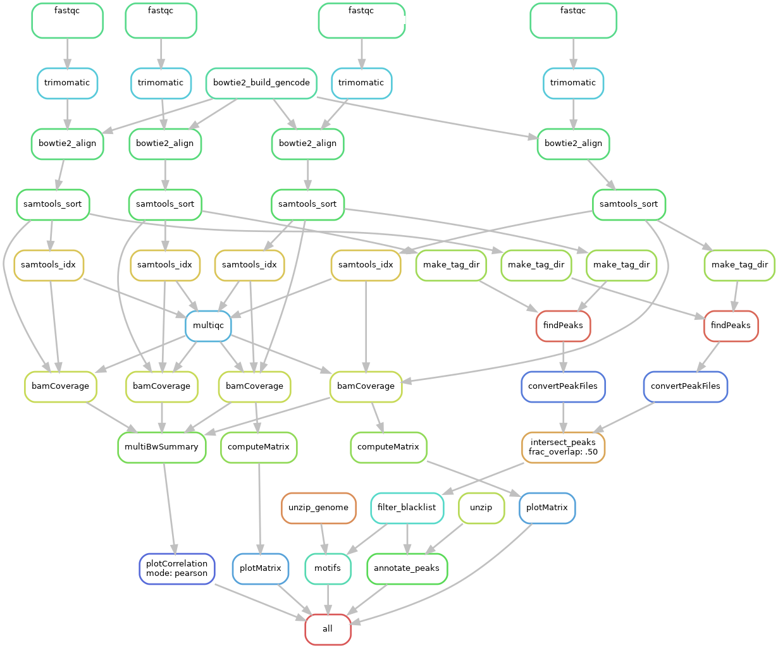
You will eventually construct pipelines that do all of this…

Slide 19
Assessment
Project self-assessments — 80%
Written reflection submitted with each project, graded on depth and honesty, not content
Lab participation and attendance — 20%
Tracked through Git commits during lab sessions
Grading is based on a growth model
No grade is final until the end of the semester — improvement is what we aim for

Slide 20
There are three components to every project
Written reports in the style of a publication
Guidelines and directions available on the course website
A lightweight specifications document
A document completed prior to working on the project where you describe in plain language the high-level requirements and design choices of the workflow
Self-assessment
After the project, you will be asked to identify areas you are hoping to improve your proficiency in and outline how you will do so

Slide 21
AI in this course

Slide 22
AI as a scientific tool
A sequencing machine doesn’t do the science. Neither does an LLM.
Both require a scientist who understands the input and output well enough to question it
LLMs are probabilistic
They sample from a probability distribution — the same prompt can produce different output on different runs, and confident-sounding output is not the same as correct output
They can and do hallucinate
Outdated annotations, wrong parameters, and incorrect biological claims missing context

Slide 23
How you use AI is as important as what you use it for
Every tool in this course can be used correctly or incorrectly
Nextflow can produce a non-reproducible pipeline. R can produce a misspecified model. A sequencer can produce low-quality reads.
The same standards apply to AI
Thoroughly test and document results and failures. Whether agentic-coded or manually coded, rigor and verification are what matter.
I will be transparent with you about AI usage in this course
I ask the same in return

Slide 24
Coding languages have undergone a natural progression to be more expressive
Assembly & C
Only specialists could program
Python & R
Scientists can perform their own analyses
Workflow management systems
Reproducible pipelines can be run simply
Agentic coding
Closer to anyone being able to code by expressing intent — our focus must shift to validation and conceptualization

Slide 25
Let’s consider Python for a moment…
Designed with readability and expressiveness foremost
Code as close to pseudocode as possible — Guido van Rossum’s explicit design goal
Abstraction of complexity
Python mostly hides memory management, type declarations, and compilation
Intent over implementation
“Sort this list” — Python handles the rest
But abstraction never eliminated the need for rigor
Python still supports unit tests, validated outputs, and reproducible environments — the abstraction changed what you wrote, not whether you checked it

Slide 26
And now agentic coding…
A continuation of the same abstraction
Instead of “did I write this correctly”, we now ask “does this do what I specified?”
The obligation to verify doesn’t disappear, it shifts
Agentic coding handles implementation so you can focus on intent and evaluation
We will approach this rigorously
Specification document, validation table, unit testing, transparency and attribution aren’t new concepts. We can and should treat AI as any other tool used in science.

Slide 27
Bioinformatics is well-suited to agentic coding
Most pipeline steps have deterministic, verifiable outputs
A sorted BAM is sorted. A count matrix has the right dimensions. These are things you can check programmatically to verify.
Specs turn intent into tests
If you can test explicitly if the outputs are correct or conform to the right structure
The outputs are deterministic. The tool that produces them is not.
LLMs are probabilistic, the specifications are meant to force you to think about your pipeline in a methodical way
Uncertainty shifts to the biology
Once the pipeline is verified, the uncertainty is in the meaning of the results and context

Slide 28
Grading is a scaffold
Feedback on each project
Meant to guide you in how to improve
Growth model
No grade is final until the end of the semester — improvement is what we aim for
Self-assessment (Level 1 — No AI)
Every submission. Graded on depth and honesty, not content.
Transparency
My hope is that the AIAS frees you to engage honestly with both the tools and the material. I will be as transparent with you as I ask you to be.

Slide 29
What this looks like in practice
Early projects
Build the pipeline yourself, develop intuition and vocabulary, annotate what you trust and why
Middle projects
Bring in AI as a collaborator, you manually self review and verify where appropriate
Final project
Full AI workflow, structured around a specification you write before you prompt
Every submission
An honest self-assessment, written without AI, that is the primary record of your learning

Slide 30
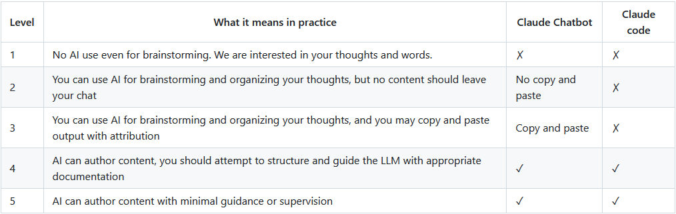
We will be using the AI Assessment Scale
Slides were generated at level 4 with extensive guidance and review using Claude Sonnet 5

Slide 31
Some additional notes about the AI Assessment Scale
Different sections of activities will be annotated with expected of appropriate AI / LLM Usage
These labels are guidance, not enforcement policies
The goal is to model transparency around where AI assists learning and where it doesn’t
We trust you to engage with the activities at the various levels
The levels are not meant to convey a value judgement
The intent was to provide a framing tool for how much AI usage, you will be given tasks with varying levels of AI usage expected (1-5)

Slide 32
Validation Table
Every project includes a table of pipeline steps — each annotated with a trust level and a rationale.
Pipeline step | Trust | Rationale
STAR alignment | High | Standard tool; index build flags verified against reference docs
DESeq2 design formula | Low | Depends on experimental design — I must choose what comparison is of interest
Gene annotation join | Medium | Column names vary across reference versions — spot check 10 genes
Volcano plot | High | Visual output, easy to inspect against expected biology

Slide 33
If any of these are unfamiliar, please re-acquaint yourself
Technical
Git and GitHub (push, pull, commit), command line and Linux, basic Conda usage
Computational
Basic plotting and figure generation, basic R
Biology
Molecular biology fundamentals
Guides and practice resources are in the textbook section of the course website

