Slide 1
Autobiography
FREE PRESENTATION TEMPLATE BY EATEMP

Slide 2
Welcome
Welcome to the world of fantasy! Join us on a journey to explore the mystical creatures, enchanted lands, and magical wonders that exist beyond our reality. Discover the wonders and secrets of this exciting realm and unlock the power of imagination.

Slide 3
01
Introduction
The Extraordinary Realm
02
Encounters
Unicorn Sightings
03
Wonders
Table of Contents
Wishes Granted
04
Magic
Spellcasting

Slide 4
Early Life
Welcome to the Fantasy World, a realm of wonder and enchantment where anything is possible. Here, dragons breathe fire, unicorns prance through meadows, and rainbows shine brightly. This world is a place where wishes come true, where potions can be cursed and spells are cast. It's a place of treasure and adventure, where the impossible becomes possible. But the greatest treasure of all is the one that lies within.
The world of fantasy is a reflection of our deepest desires, our fondest dreams, and our wildest imaginations. It's a place where we can let go of the constraints of reality and explore the boundless possibilities of the human mind. In this introduction, we will delve into the mysteries of this realm, uncovering the magic and wonder that lies within. So come with us and let's embark on a journey through the World.

Slide 5
Early Life
Unicorn Sightings
A record of the number of unicorns spotted in the fantasy realm and the beauty and mystery that surrounds these enchanting creatures.
Dragon Taming
A closer look at the art of taming dragons and the brave adventurers who dare to take on these fearsome creatures.

Slide 6
Fantasy is the gateway to the impossible, the land where the ordinary becomes extraordinary, and the impossible becomes possible. It is the realm of the imagination, where anything can happen and everything is possible.
The Dream Weaver

Slide 7
Hobbies
Unicorn
Sighting
Dragon
Taming
Rainbow
Seeing
"The Art of Archery": Discover the intricacies of the Art of Archery .
"The Music of the Elves": Immerse yourself in the enchanting music.
"The Life of an Elf": Learn about the customs and daily life of the elves.

Slide 8
Career
Graphic Design
Art Director
Creative Director
Access to the entry-level dungeons.
A limited number of quests and battles per month.
Ability to form a small party with fellow adventurers.
Access to the intermediate and advanced dungeons.
A greater number of quests and battles
Ability to form larger parties with fellow adventurers.
Access to the most challenging dungeons and encounters.
Unlimited quests and battles per month.
The ability to form the largest parties with fellow adventurers.

Slide 9
Achievements
75%
Enchanted Creatures
possess the ability to cast spells.
60%
Magic-Wielding Individuals
practice the art of illusions.
90%
Spells Cast
are dark magic, foretelling danger.

Slide 10
234,567
UNICORN SIGHTINGS
A tally of the number of unicorns spotted in the fantasy realm.

Slide 11
233 Coins
85%
Treasure Found
Wished Granted
456 Hours
544 Km
Duration of Spell Casting
Journey Distance

Slide 12
Some Graph
100
90
80
70
60
50
34.574
40
Total
30
20
10
0
1
2
3
4
5
6
7
8
Spellcasting Progress
Treasure Found
A record of the number of spells cast per year
A record of the amount of treasure found per month

Slide 13
Portal to Adventure
A web application
A web application designed for discovering the world of fantasy

Slide 14
The Future of Fantasy
An mobile app
An app designed for exploring and experiencing the enchanting realm of fantasy
Explore a magical world
Experience fantasy firsthand
Immerse in a realm of magic
Discover untold wonders
Live your fantasy dreams

Slide 15
A Gateway to a World of Fantasy and Wonder
Immerse yourself in the world of magic and mystery
Explore uncharted territories and fantastical lands
Meet mythical creatures and legendary beings
Uncover hidden treasures and secret treasures
A web application
A web application designed for discovering the world of fantasy

Slide 16
A Magic Picture

Slide 17
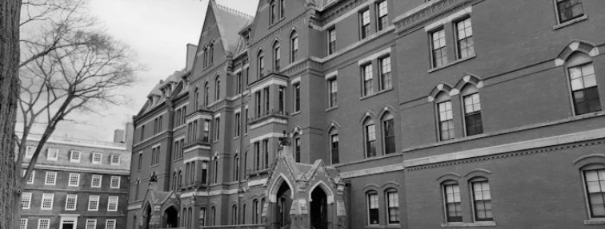
Education
Harvard University
2004-2008
Computer Scienece
Stanford University
2008-2012
Master of Business Administration

Slide 18
Where I’ve Been
The Forest
A magical forest filled with animals and creatures.
The Caves
A network of underground caves filled with crystals.
The Lair
A dangerous place where dragons reside.

Slide 19
Milestones
2022
A rare eclipse occurs, causing strange and unpredictable magical effects across the land.
2024
A group of adventurers sets out to recover an ancient artifact.
2026
A volcanic eruption devastates a nearby city, forcing its inhabitants to flee to the safety.
2028
A powerful sorcerer and a cunning thief cross paths, leading to an unlikely partnership.

Slide 20
Interests
Spellcasting
Competition
A significant event in the history of the fantasy realm, in which the greatest spellcasters of the realm.
Treasure
Hunt
A significant event in the history of the fantasy realm, in which a massive and awesome treasure hunt was organized.
Great
Adventure
A notable year in the history of the fantasy realm, in which a large number of adventurers set out to explore.

Slide 21
Family
Eldruin
Lunaria
The Fire Mage
The Moon Priestess
Elementalen
Eldruin
The Guardian
The Fire Mage

Slide 22
Challenges and Triumphs
Dragons
Fire-breathing creatures that are often powerful and dangerous
Medieval-like Settings
Worlds with castles, knights, and feudal systems
Chosen One Trope
A hero chosen by destiny to save the world
Magic
An integral part of fantasy stories, can take many forms
The Best Curse
A curse that is unique, creative, and fits within the story
Unique Creatures
A variety of fantastical beings that inhabit the world

Slide 23
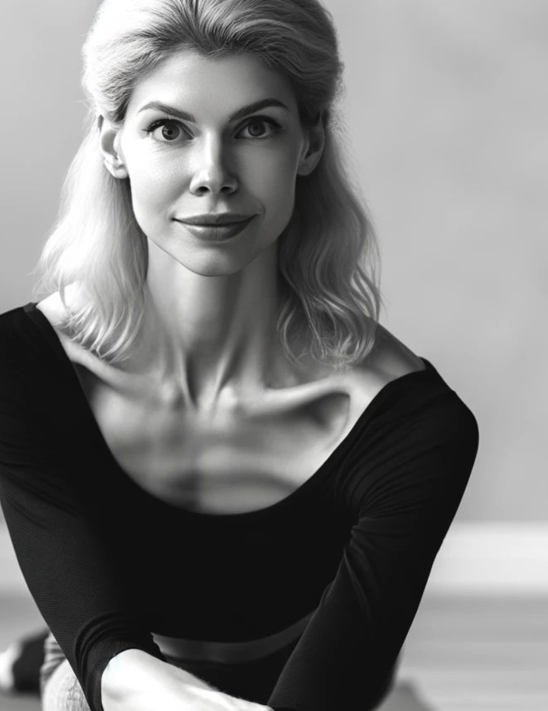
Thank you for choosing EaTemp
Credit | Image: Unsplash
We offer free and high-quality slides templates for your presentations. We appreciate you choosing us and hope our templates have been helpful.
As a new website, we rely on your support to grow, so please help us by sharing our site with your friends and colleagues.

