Slide 1
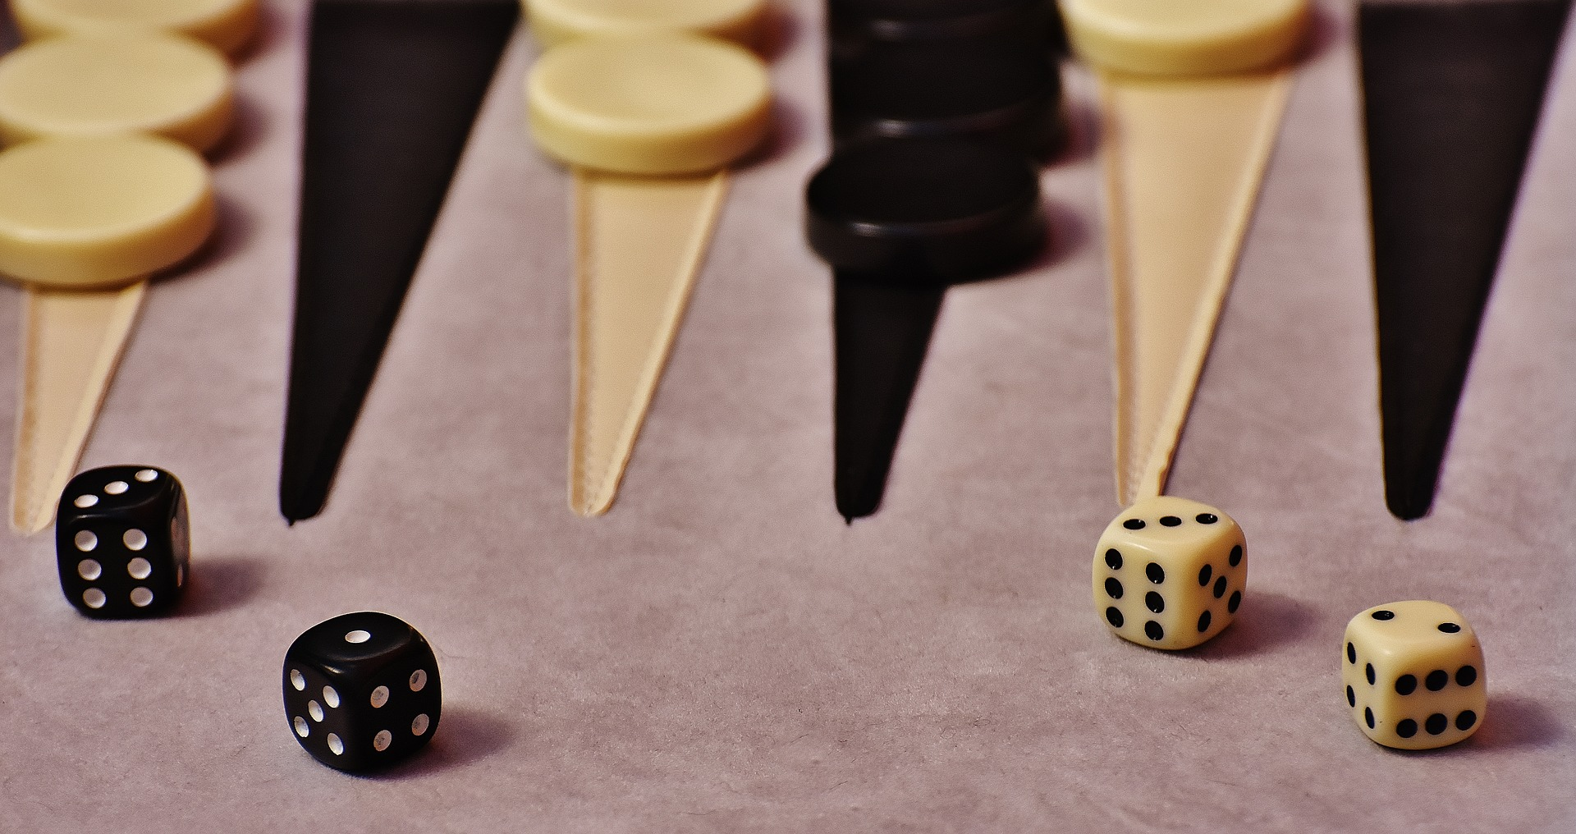

Backgammon
Template
Created and shared by:
Eric Curts - @ericcurts
www.ControlAltAchieve.com
ericcurts@gmail.com

Slide 2
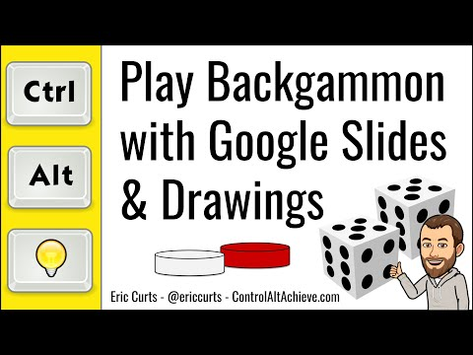
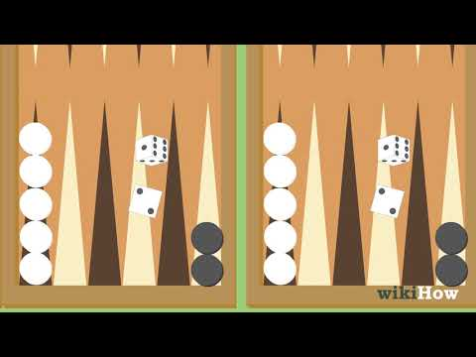

Directions
Share edit rights for this Google Slideshow with the other player.
Click the dice video to roll the dice, and click again to stop the roll.
Drag and drop the playing pieces to move your pieces.
How To
Use The
Learn
Template
To Play!
Created and shared by:
Eric Curts - @ericcurts
www.ControlAltAchieve.com
ericcurts@gmail.com

Slide 3
