Slide 1

Welder Quals User Manual

Slide 2
Contents
Click on the section you want to see
Subscribe
Create Account
Sign In
General Tips
Welder Management
  Add Welders
  Remove Welders
Welder Qualifications
  Add Qualifications
  Find and View
Welders
Confirmation of Validity
  Expiring Records
  6 Monthly
  2 Yearly Revalidation
Admin
  User Manual
  User Management
  Feedback and Feature Requests

Slide 3

Subscribe

Slide 4
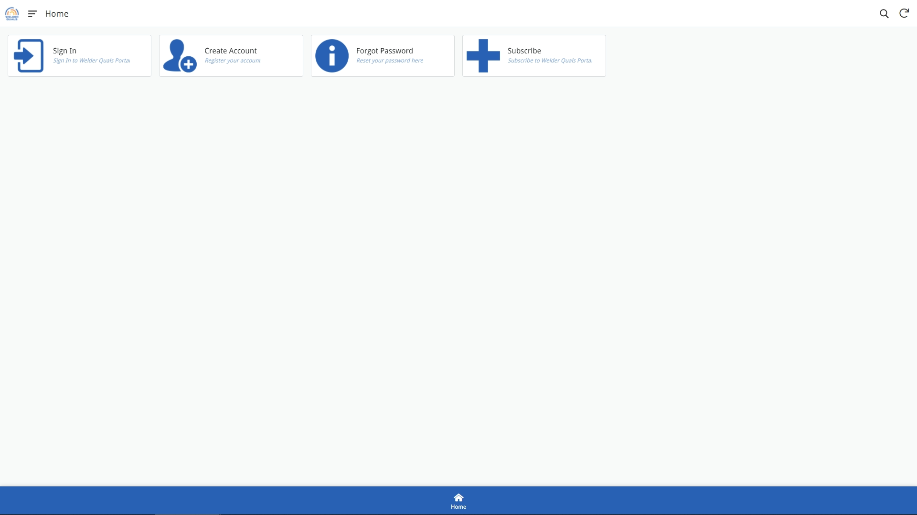
Click Here

Slide 5
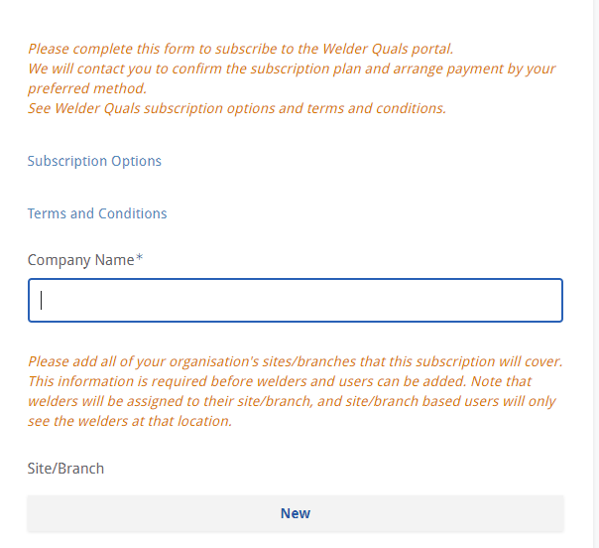
Before any users can create a log-in, their company must have an active subscription.
Enter the name of your company.
Please add all sites/branches for your company that this subscription will cover. This is for both for welders and any users that may want to view/manage welder qualifications
Please read the terms and conditions

Slide 6
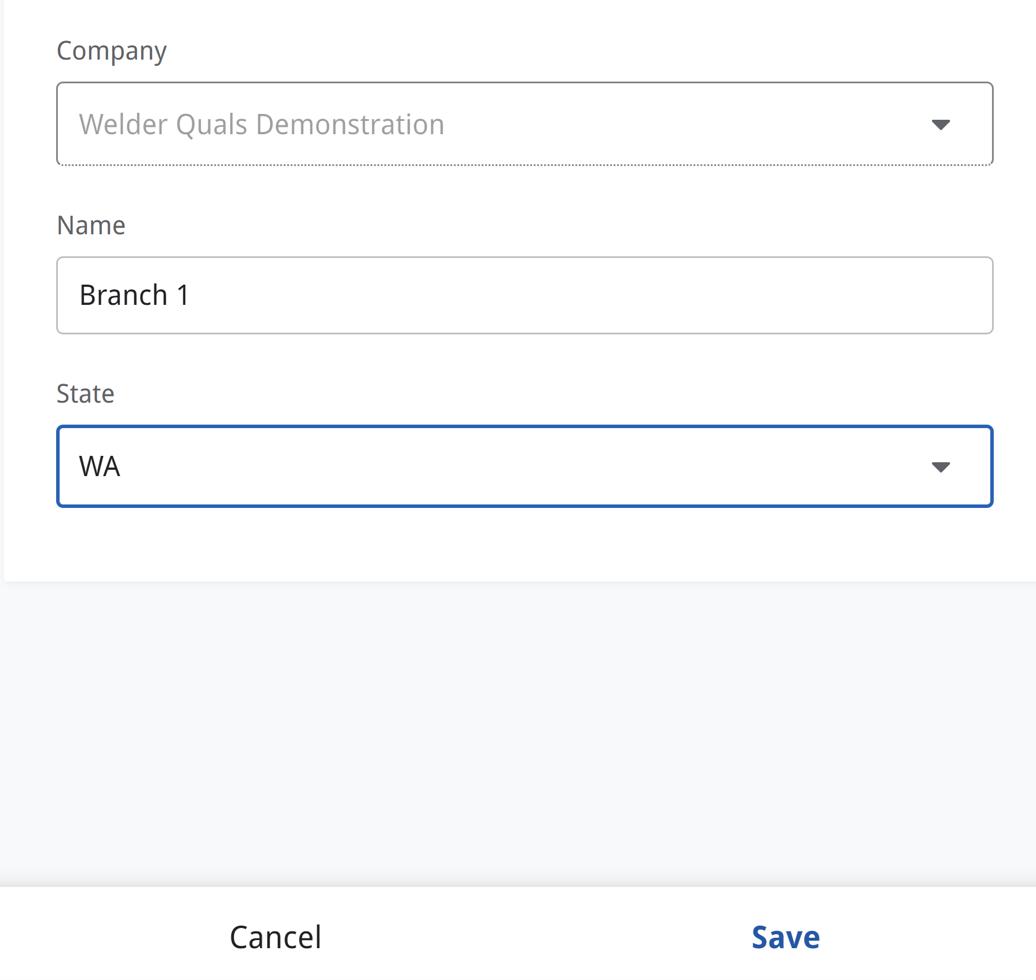
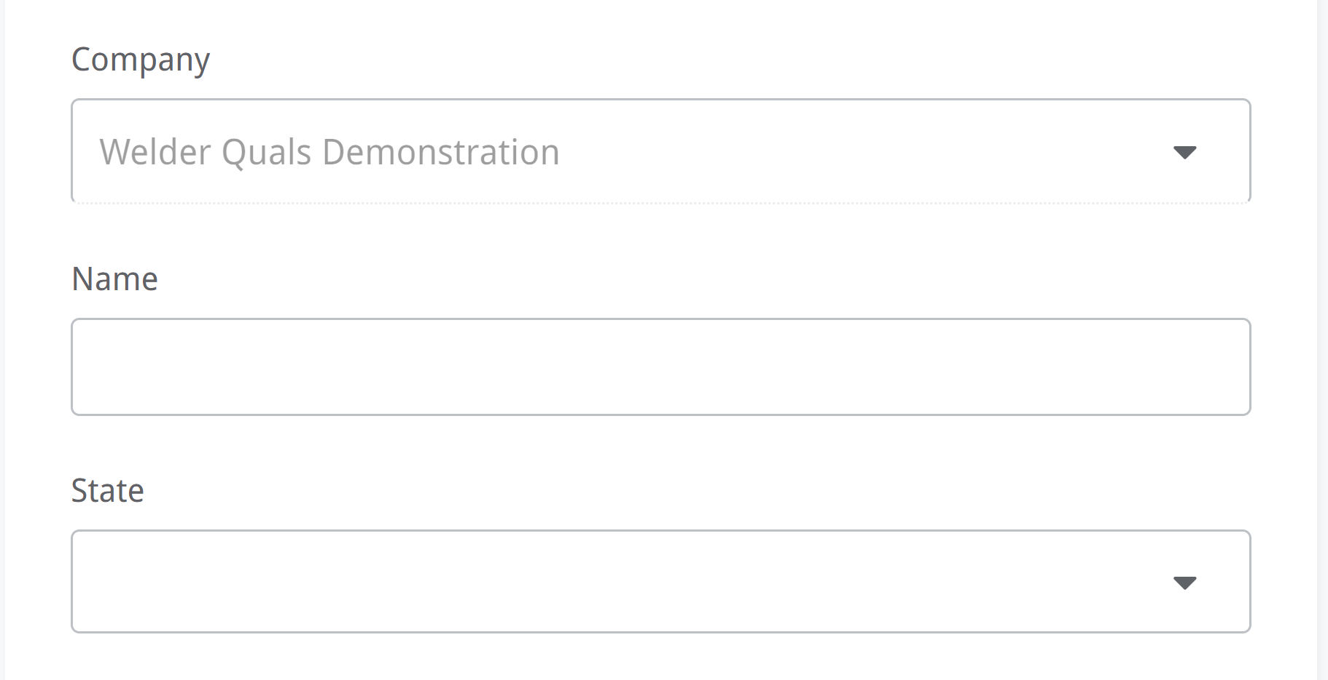
Add the branch name/location and state
Click Save

Slide 7
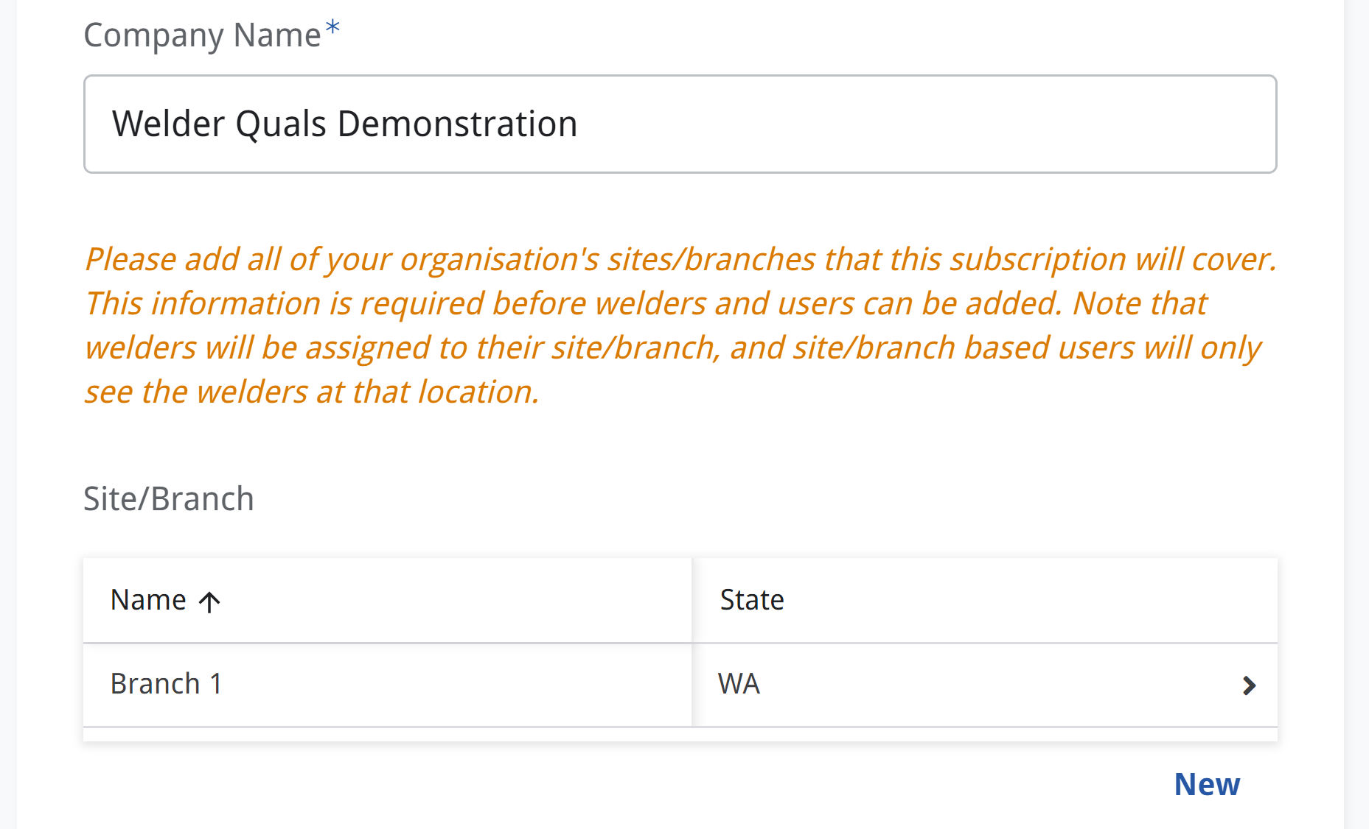
Click “New” to continue adding more sites/branches

Slide 8
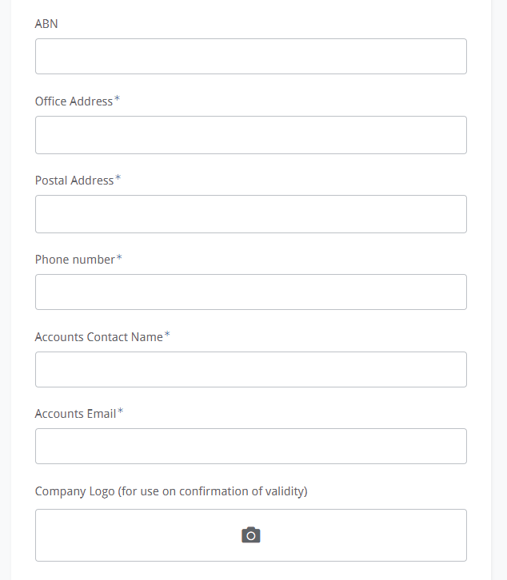
Fill in all other accounts details required
Your company logo will be used on the confirmation of validity document for each welder qualification

Slide 9
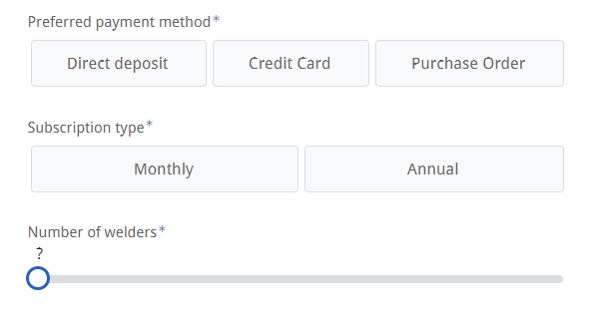
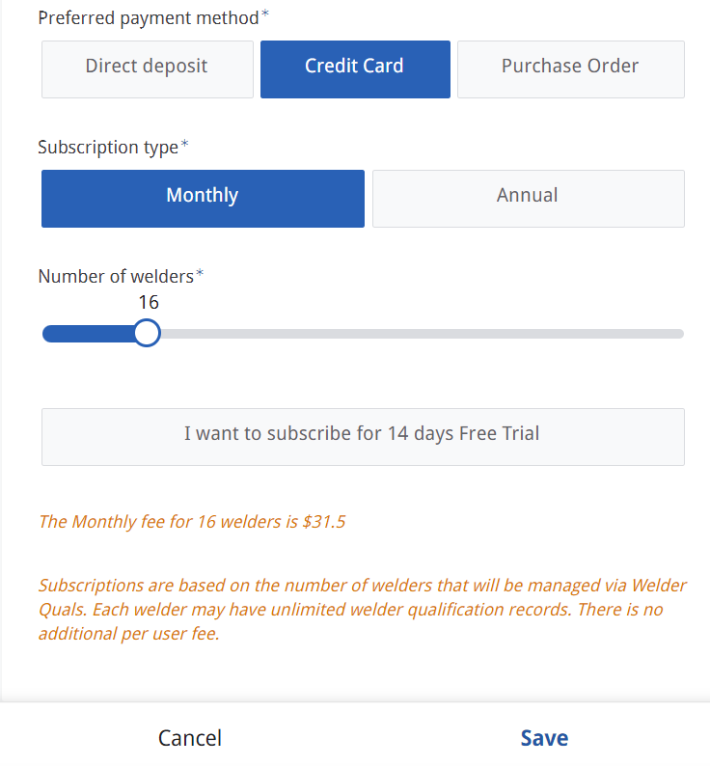
Select your preferred subscription plan and payment method
Use the slider to select the number of welders your subscription will need to cover.
For an explanation of the subscription pricing, please see the website
Click here if you want the 14 day free trial
Click Save to proceed

Slide 10
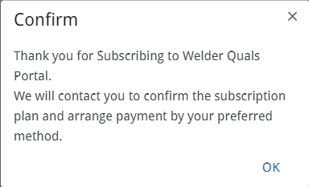
Return to main menu

Slide 11

Create Account

Slide 12
Click Here

Slide 13
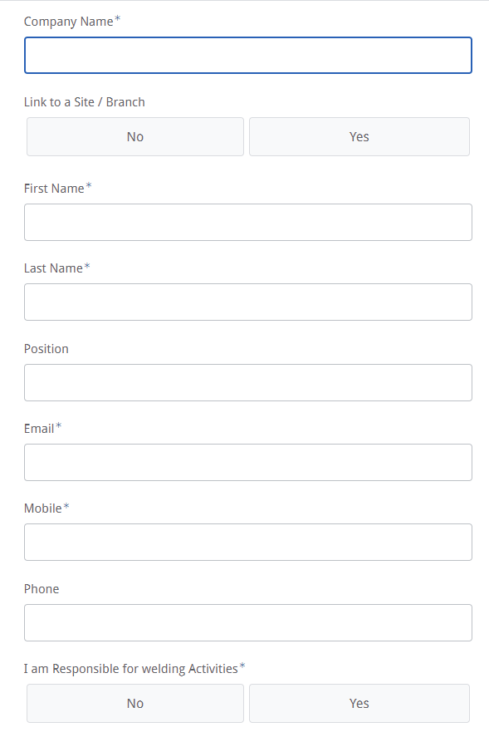
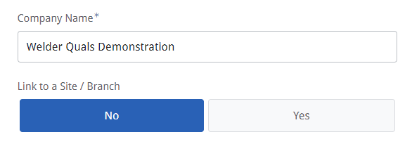
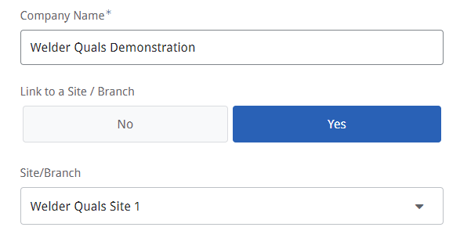
! The spelling of the Company Name must match the subscription details
Link to Site/Branch. Select NO if
You want to see welders from all of your companies sites/branches
Or
Your company only has one site/branch
Link to Site/Branch. Select YES if
You want to see welders from only your site/branch
Select your location from the drop down.

Slide 14
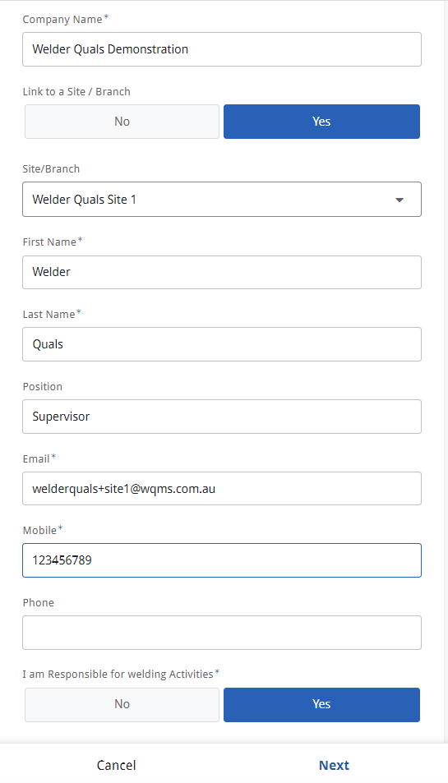
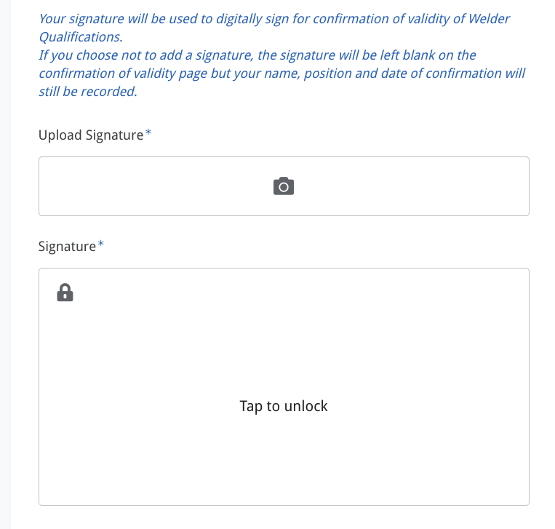
Upload a picture or scan of your signature
Or add your digital signature here by drawing it with your mouse
Click Next to proceed

Slide 15
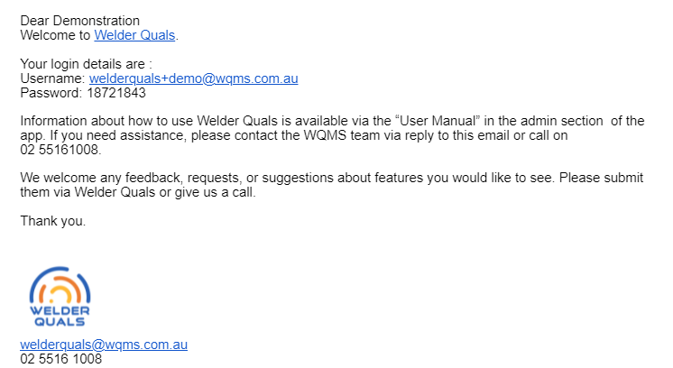
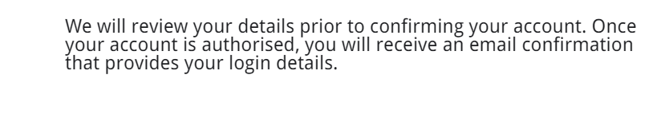
The following message will pop up once you have completed your account creation
This is a manual process to review and approve (for security purposes) so the approval step is not instantaneous. Please allow up to 24hrs to process.
You will receive an email with your login information once your account has been approved.
Return to main menu

Slide 16

Sign In

Slide 17
Click Here

Slide 18
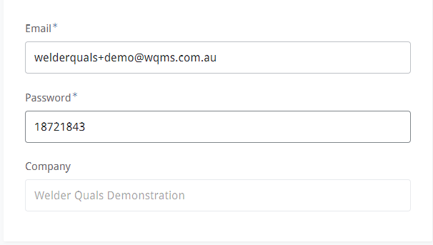
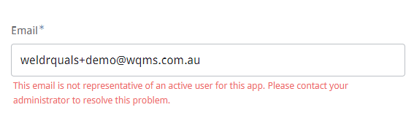

! Make sure the spelling of your email address is correct
Enter the password sent to you in the email
Your internet browser will remember your login profile, so you will not need to log in again unless cookies are cleared
Click Login
Return to main menu

Slide 19
General Tips

Slide 20
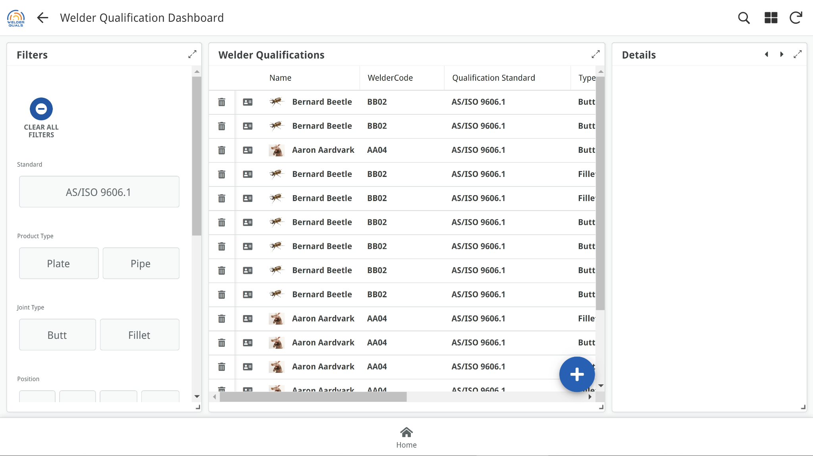
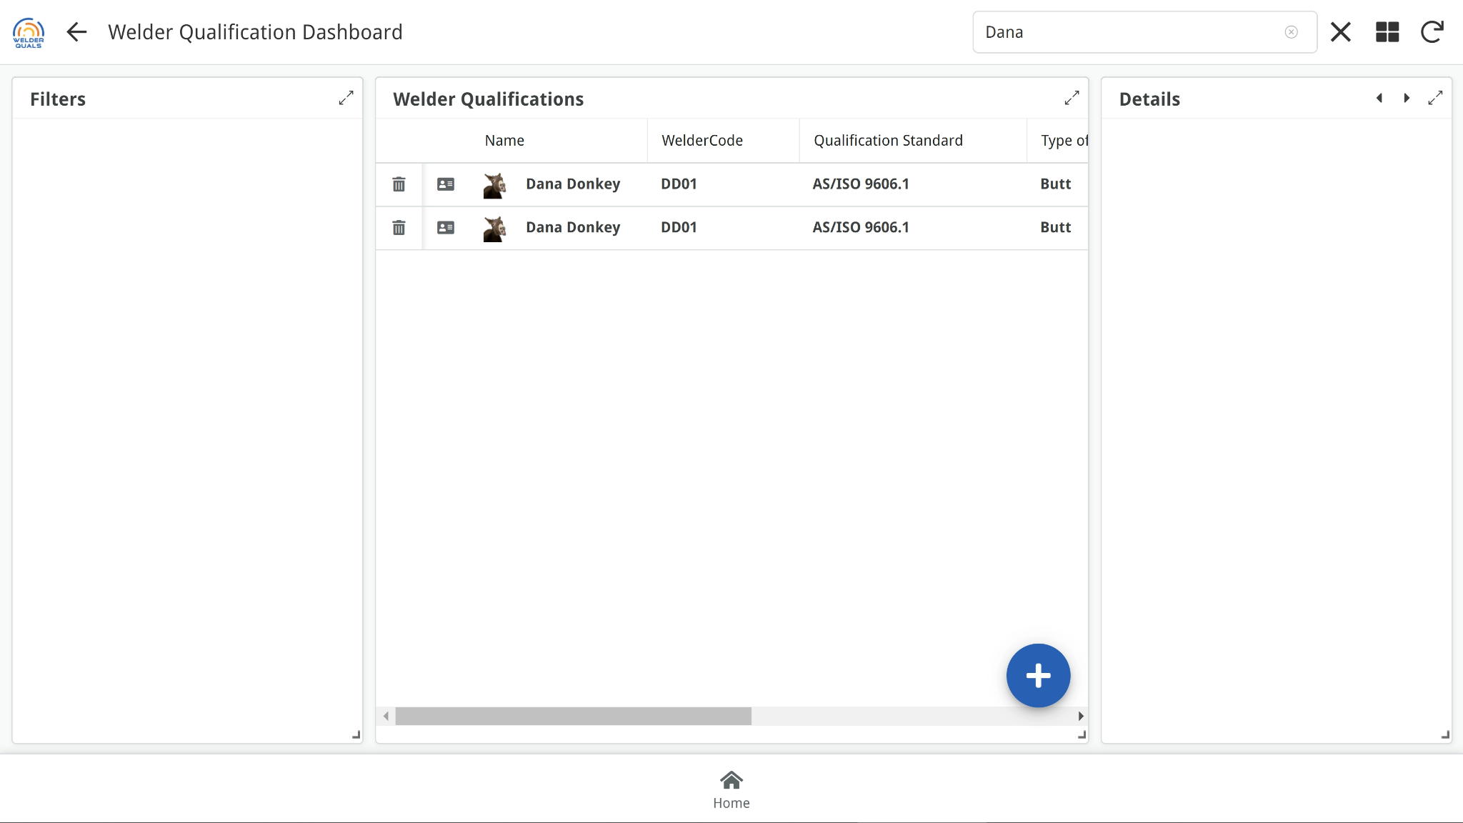
To manually refresh the app when data is added or changed, click here
Use the search function to find specific data
Use the back button to return to the previous screen
Click the home button to return to the main menu at any time
Return to main menu

Slide 21
Welder Management

Slide 22
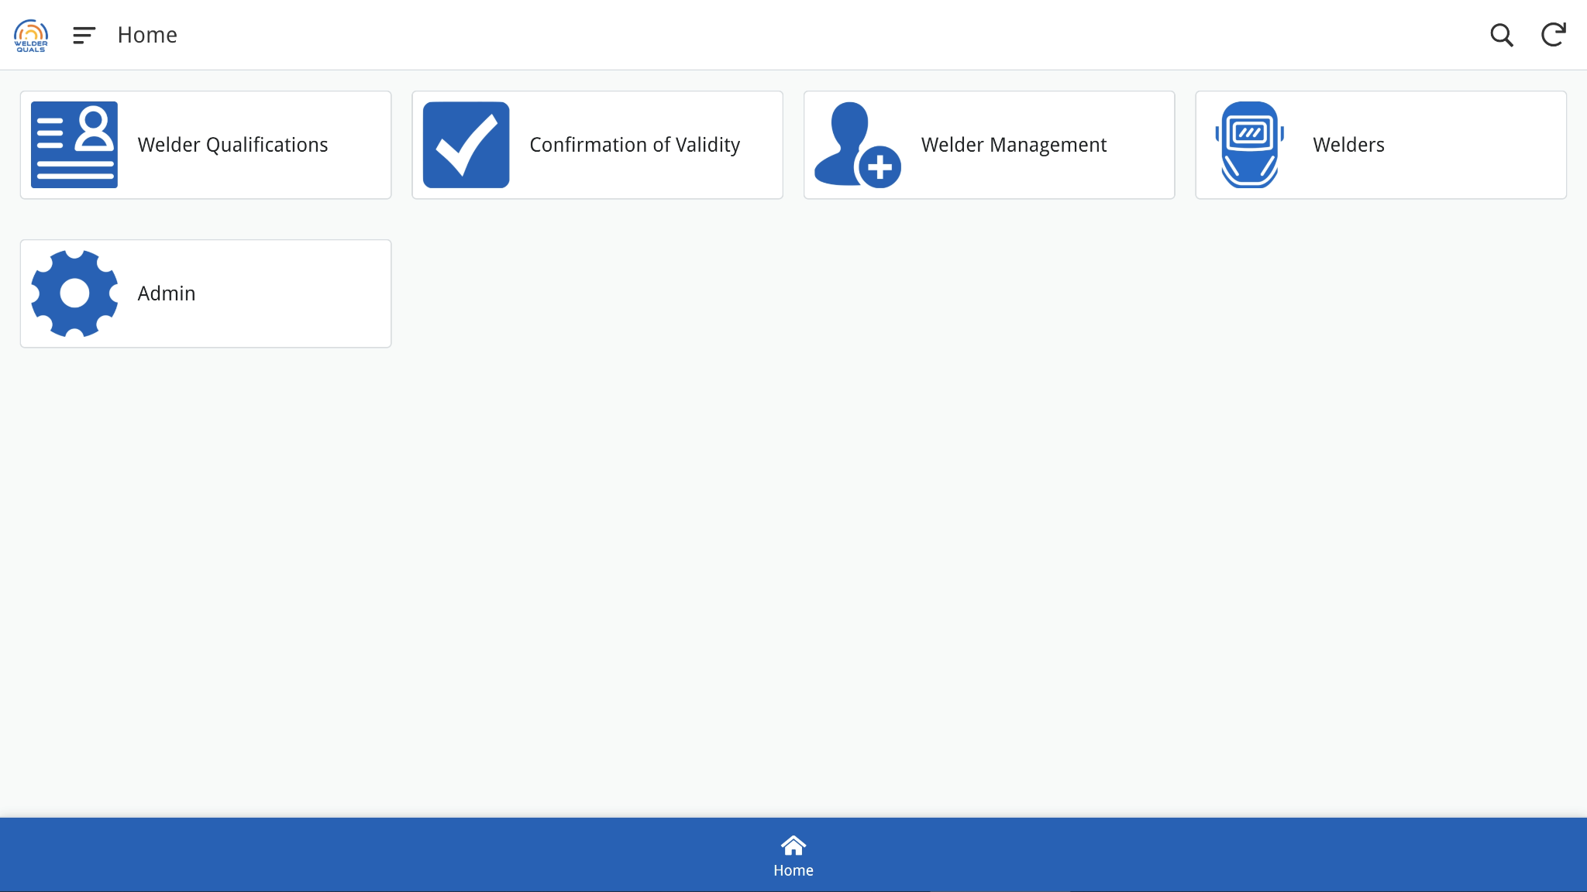
Click here to add or remove welders from your subscription

Slide 23
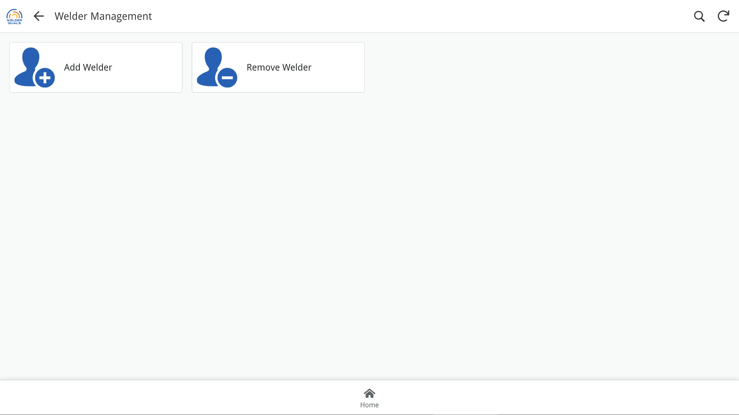
! You will need to add welders before you can enter any welder qualifications
Click here to add welders
! You will need to adjust your subscription if you add more welders than your subscription plan

Slide 24
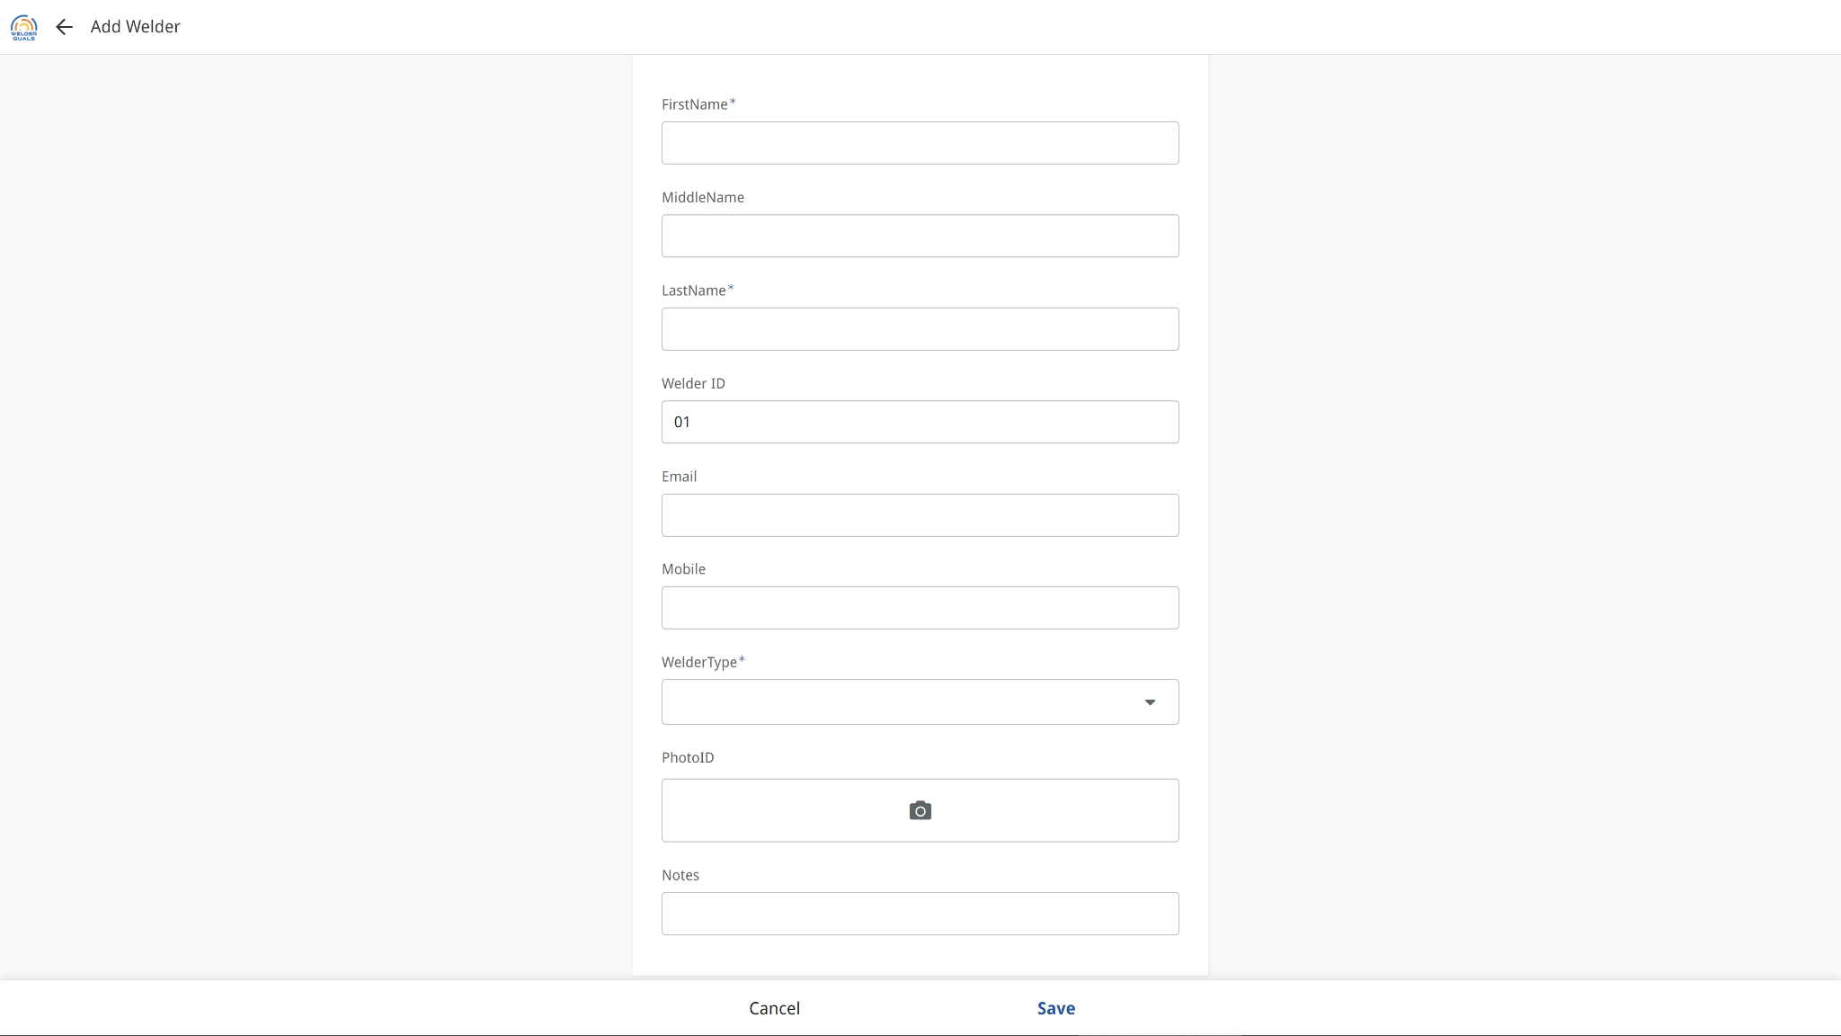
! By default, the welder will automatically be assigned a unique welder ID - XXYY
You can enter a custom welder ID if you prefer
It is recommended to upload a photo of the welder.
The photo is used on the confirmation of validity document
It also makes it easier to identify the welders in app
Click Save to proceed

Slide 25
Click here to remove welders
! Only remove welders if they are no longer employed at your workplace

Slide 26
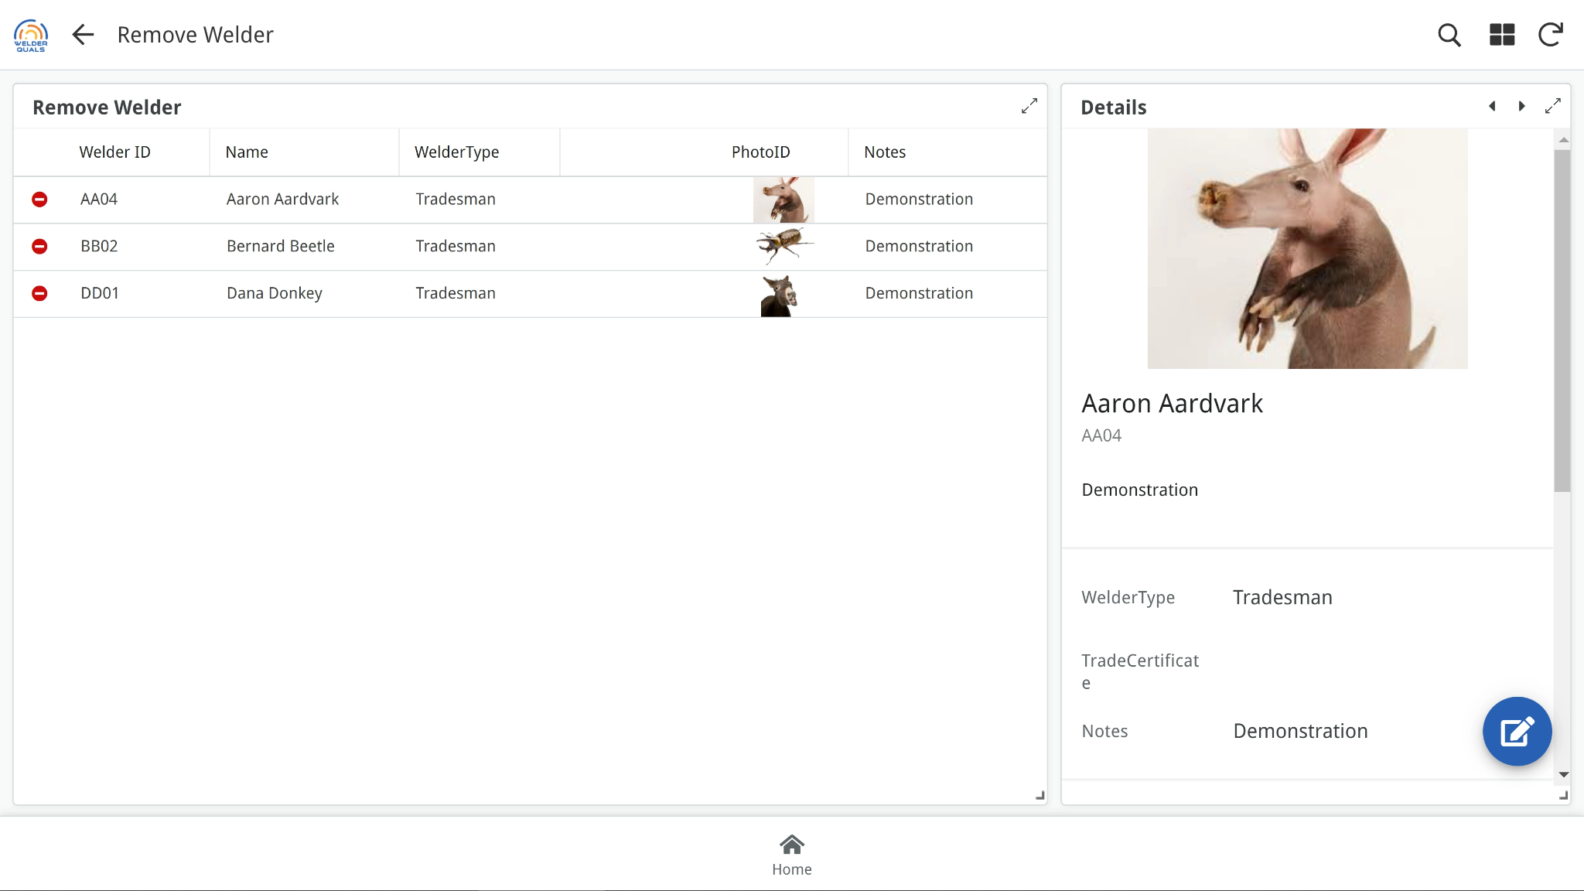
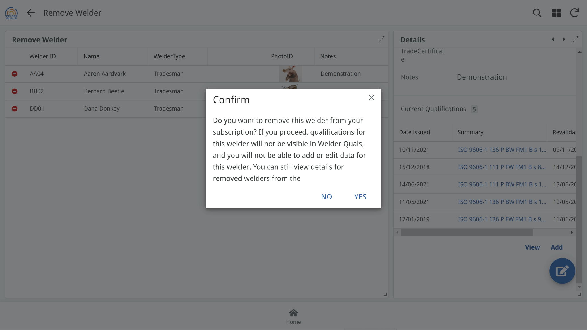
Click on the icon to remove a welder
Click YES to remove the welder from your subscription
Return to main menu

Slide 27

Welder Qualifications

Slide 28
Important Note
The initial release of Welder Quals only handles ISO 9606.1 welder qualifications
Future versions will also provide for welder qualifications to
AS/NZS 1554
AS 3992
AWS D1.1
ASME IX

Slide 29
Click Here

Slide 30
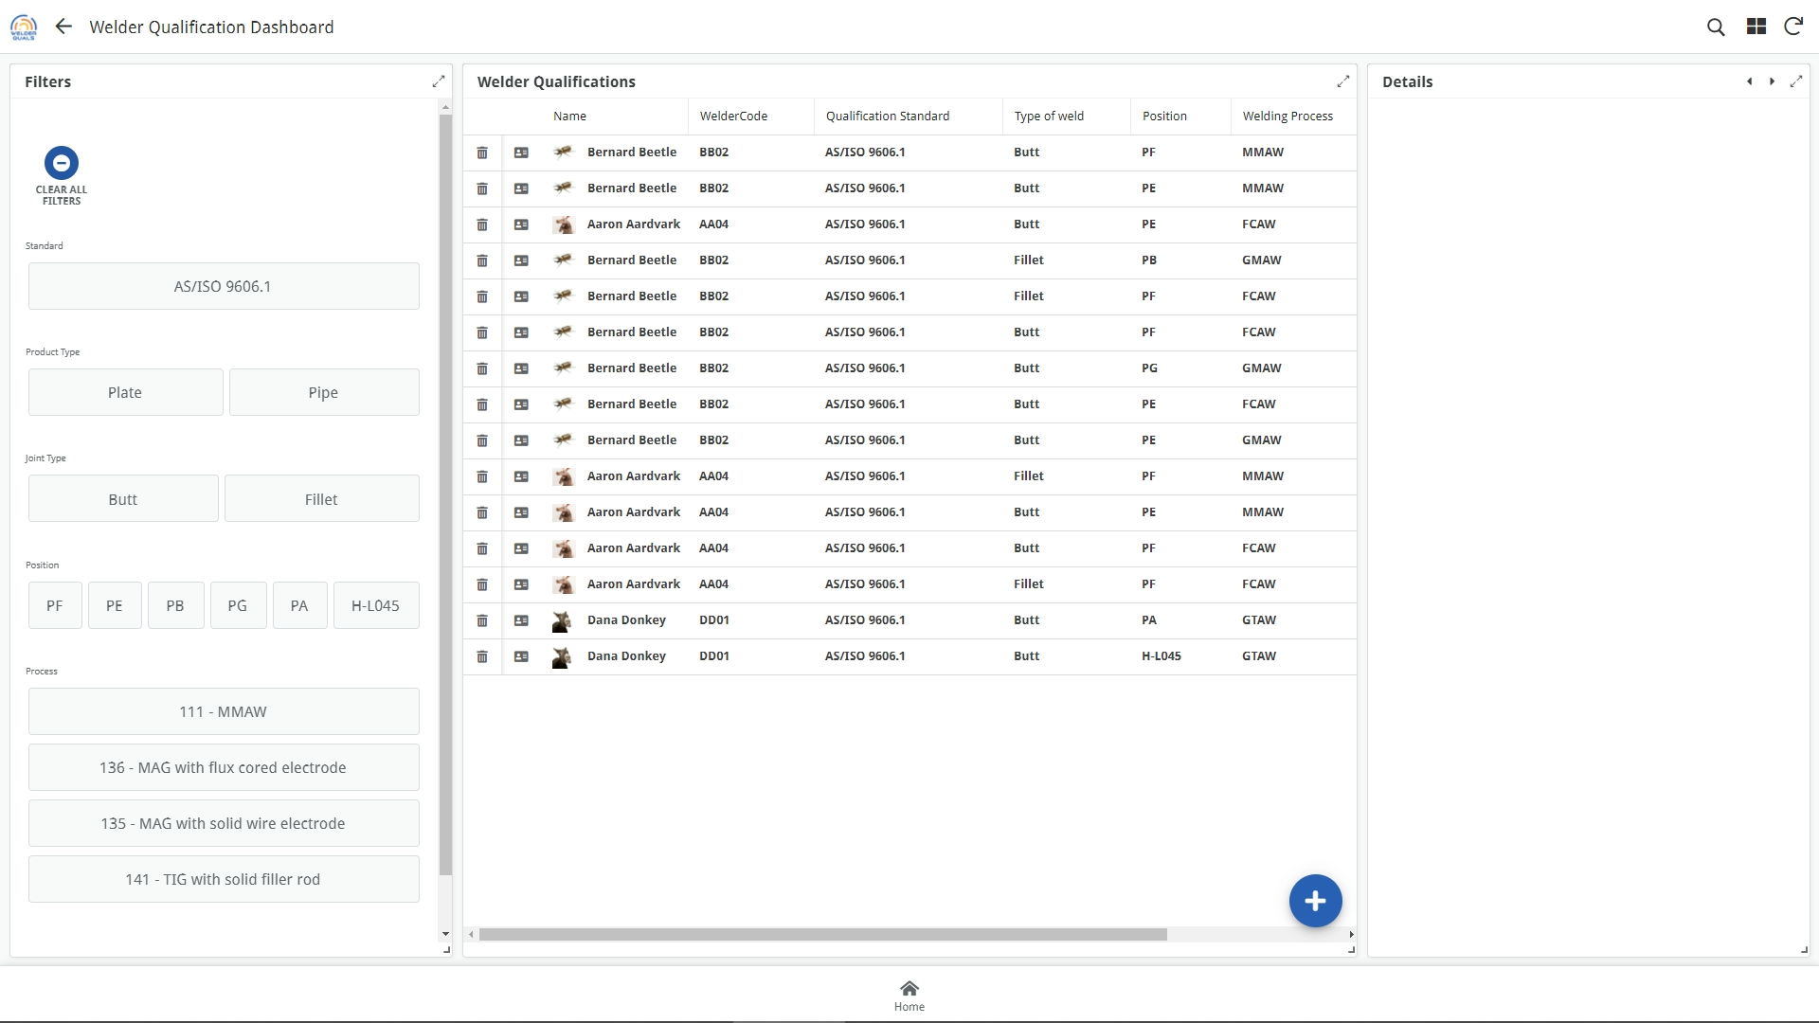
Click here to add a welder qual record

Slide 31
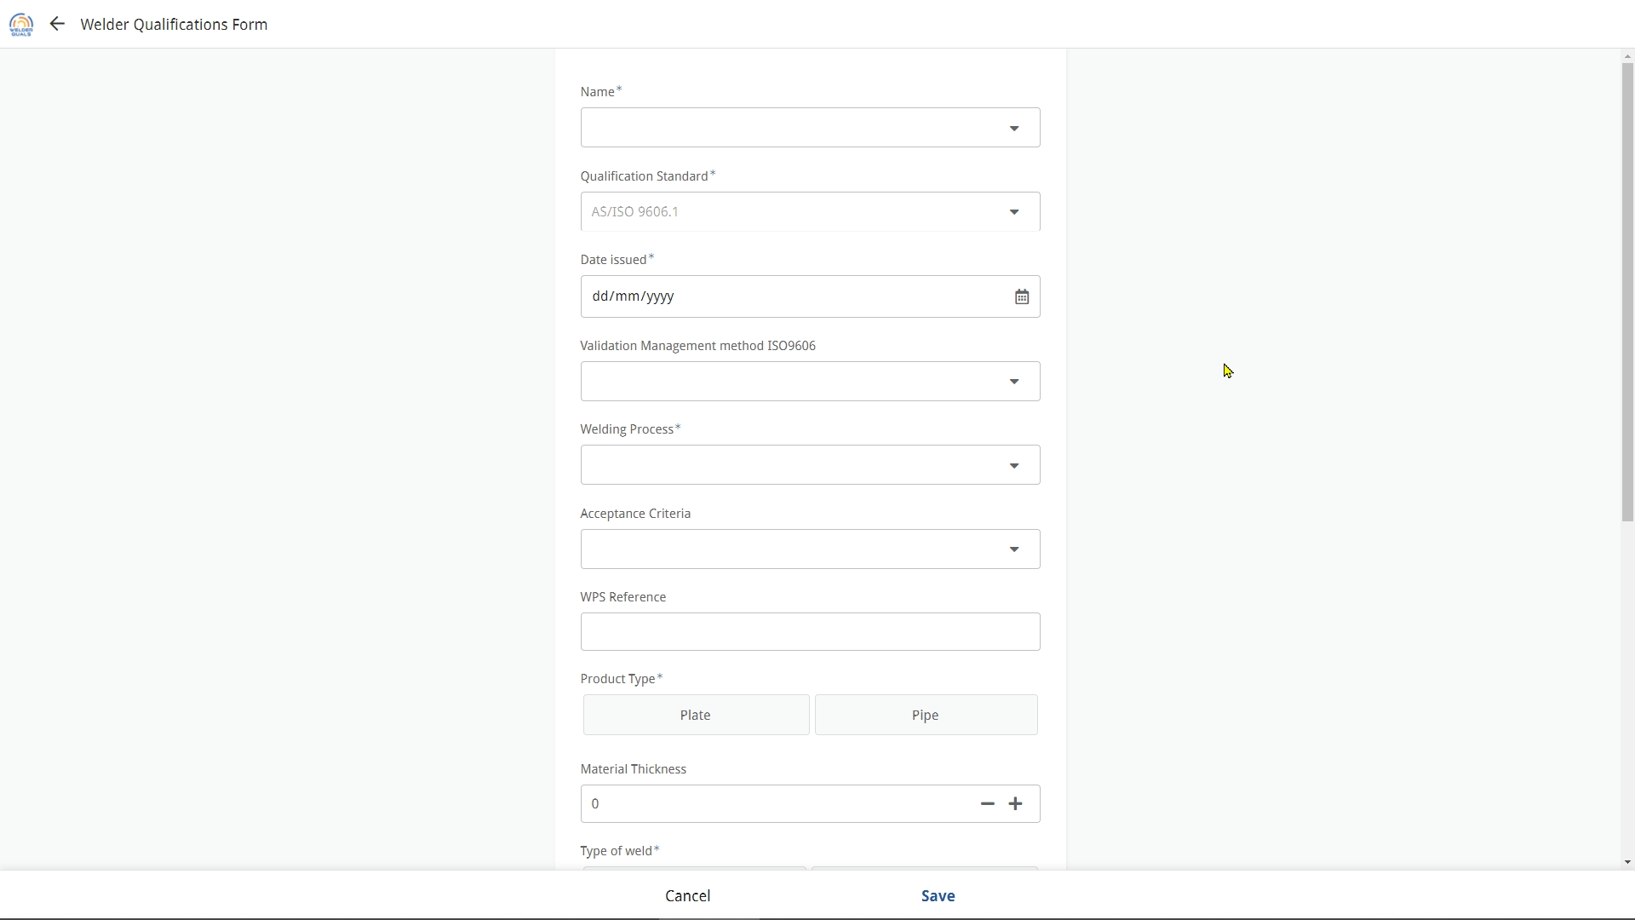
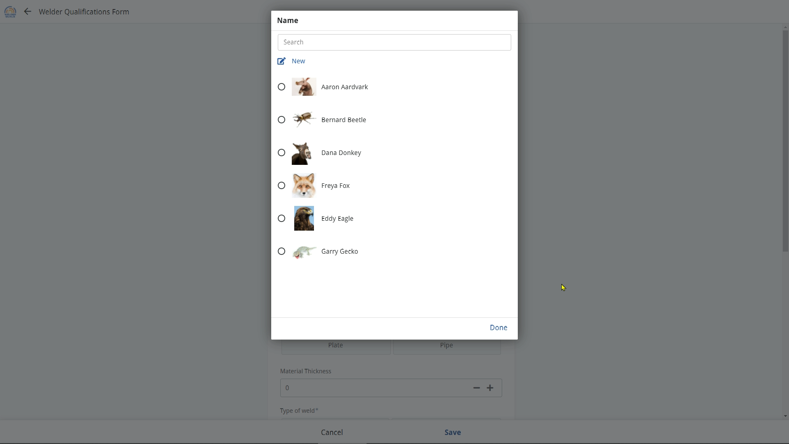
You can add a new welder by clicking here, if the welder isn’t already in the list
Select the name of the welder from the list

Slide 32
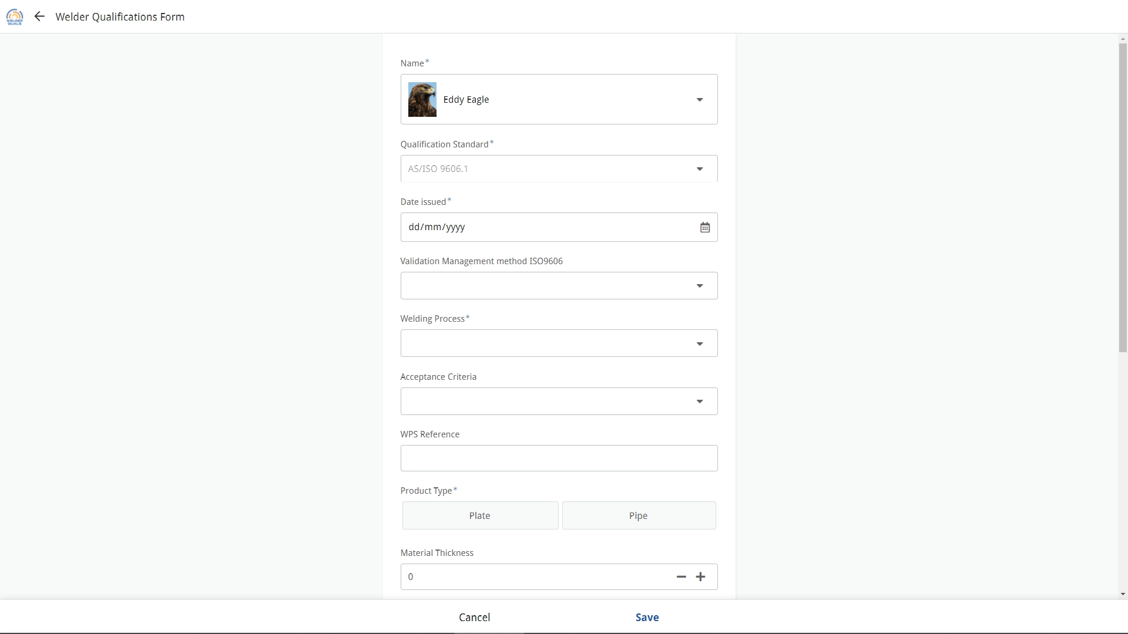
Add in all details for the welder qualification record.
The form is dynamic, providing you with selections based on the data you progressively enter
! The welder qualification designation used in this app for is automatically generated from the data entered.
It is essential that all fields have data entered or a selection made

Slide 33
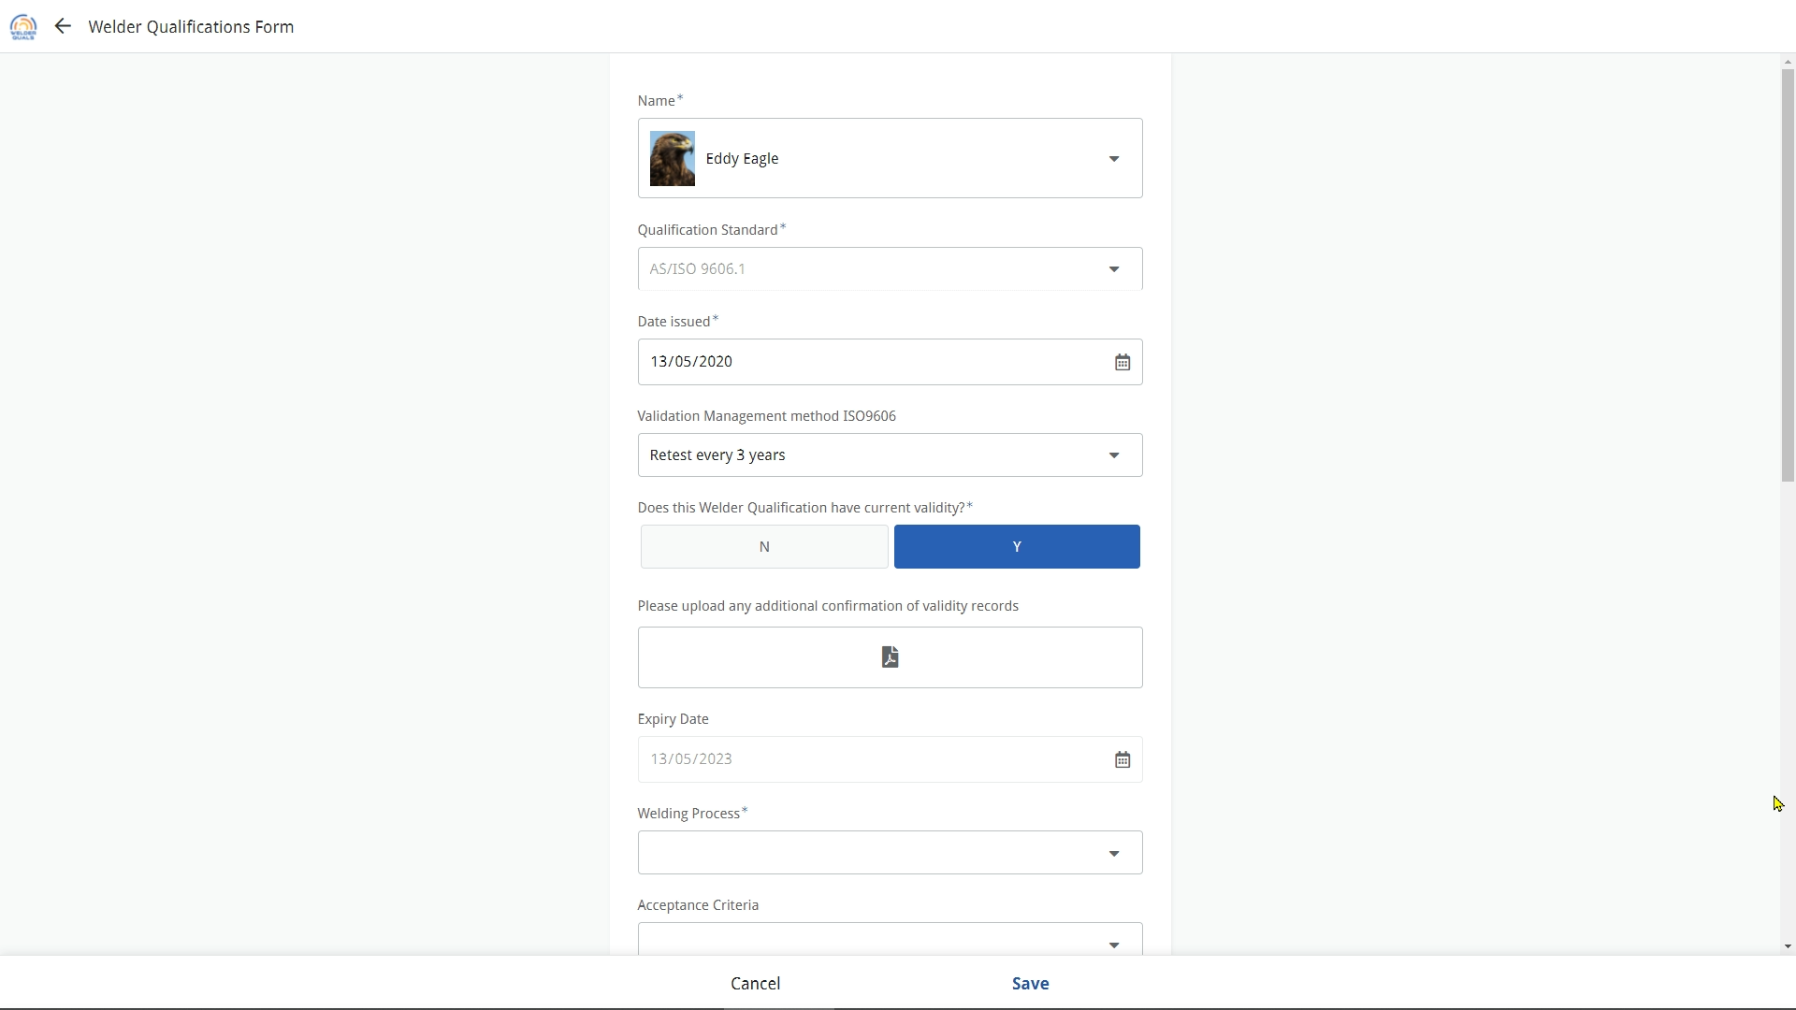
If the confirmation of validity is on a separate document, it can be uploaded here
If the record is more than 6 months old, you will be asked to confirm if it is still valid

Slide 34
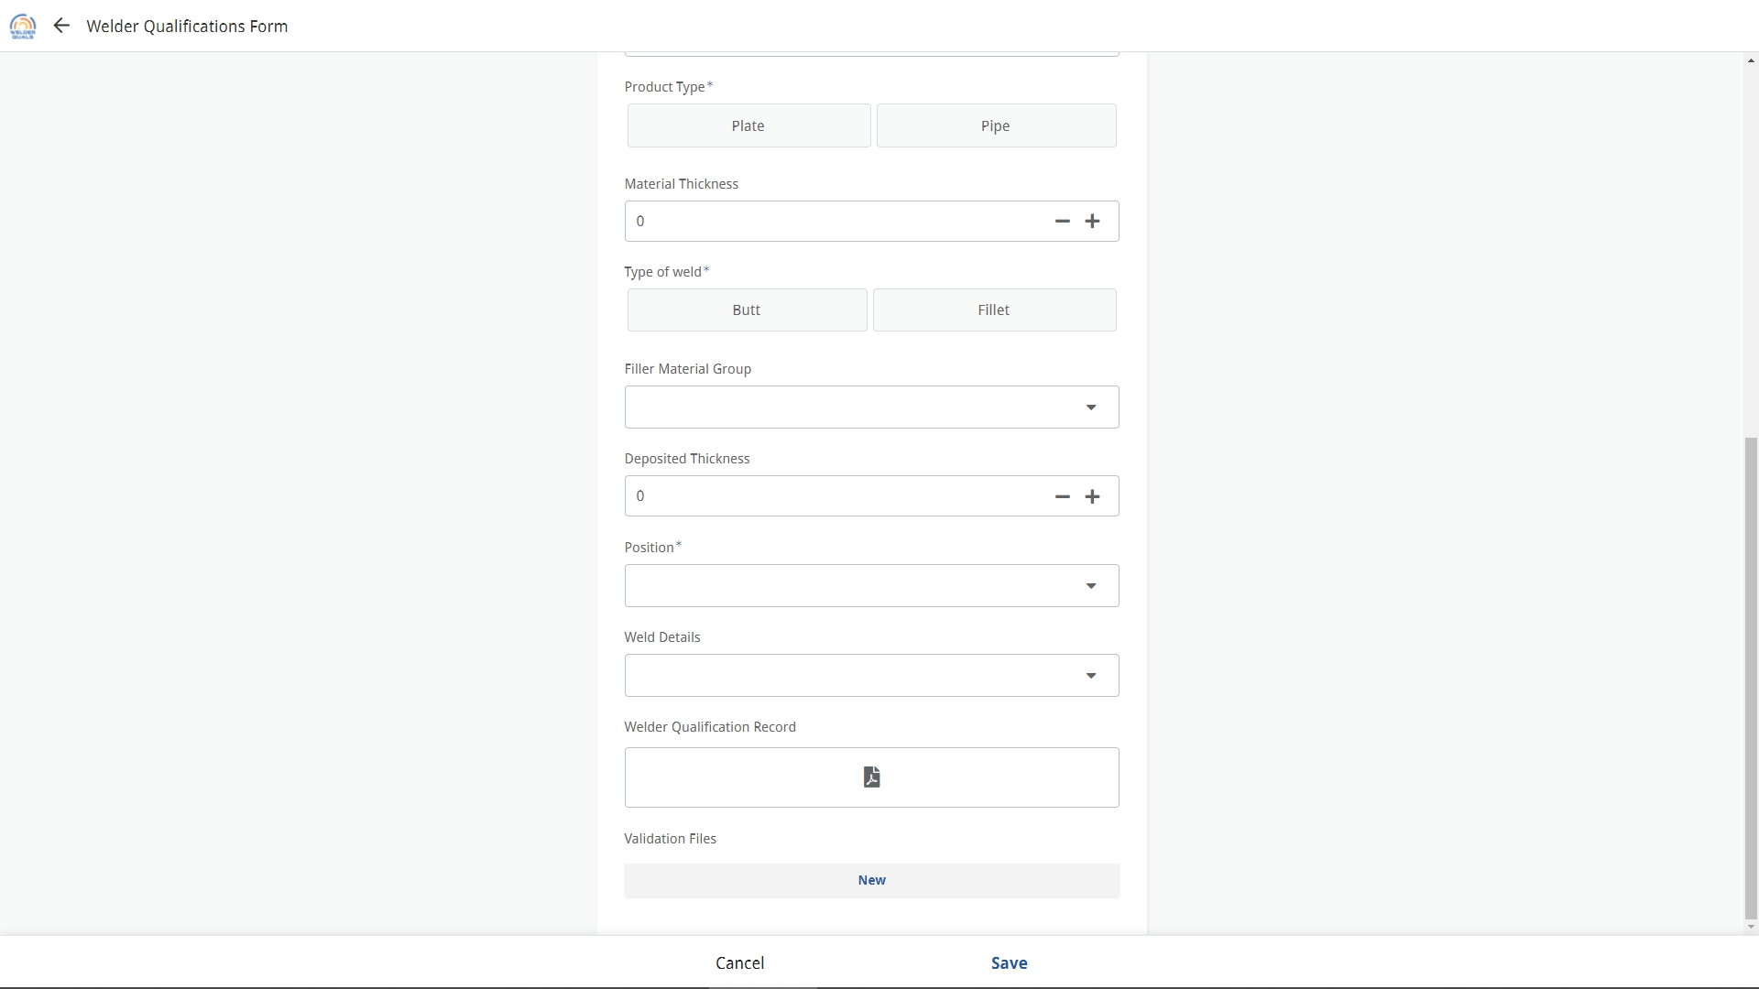
Upload a copy of the Welder Qualification record
Upload the supporting test records for the welder qualification if desired

Slide 35
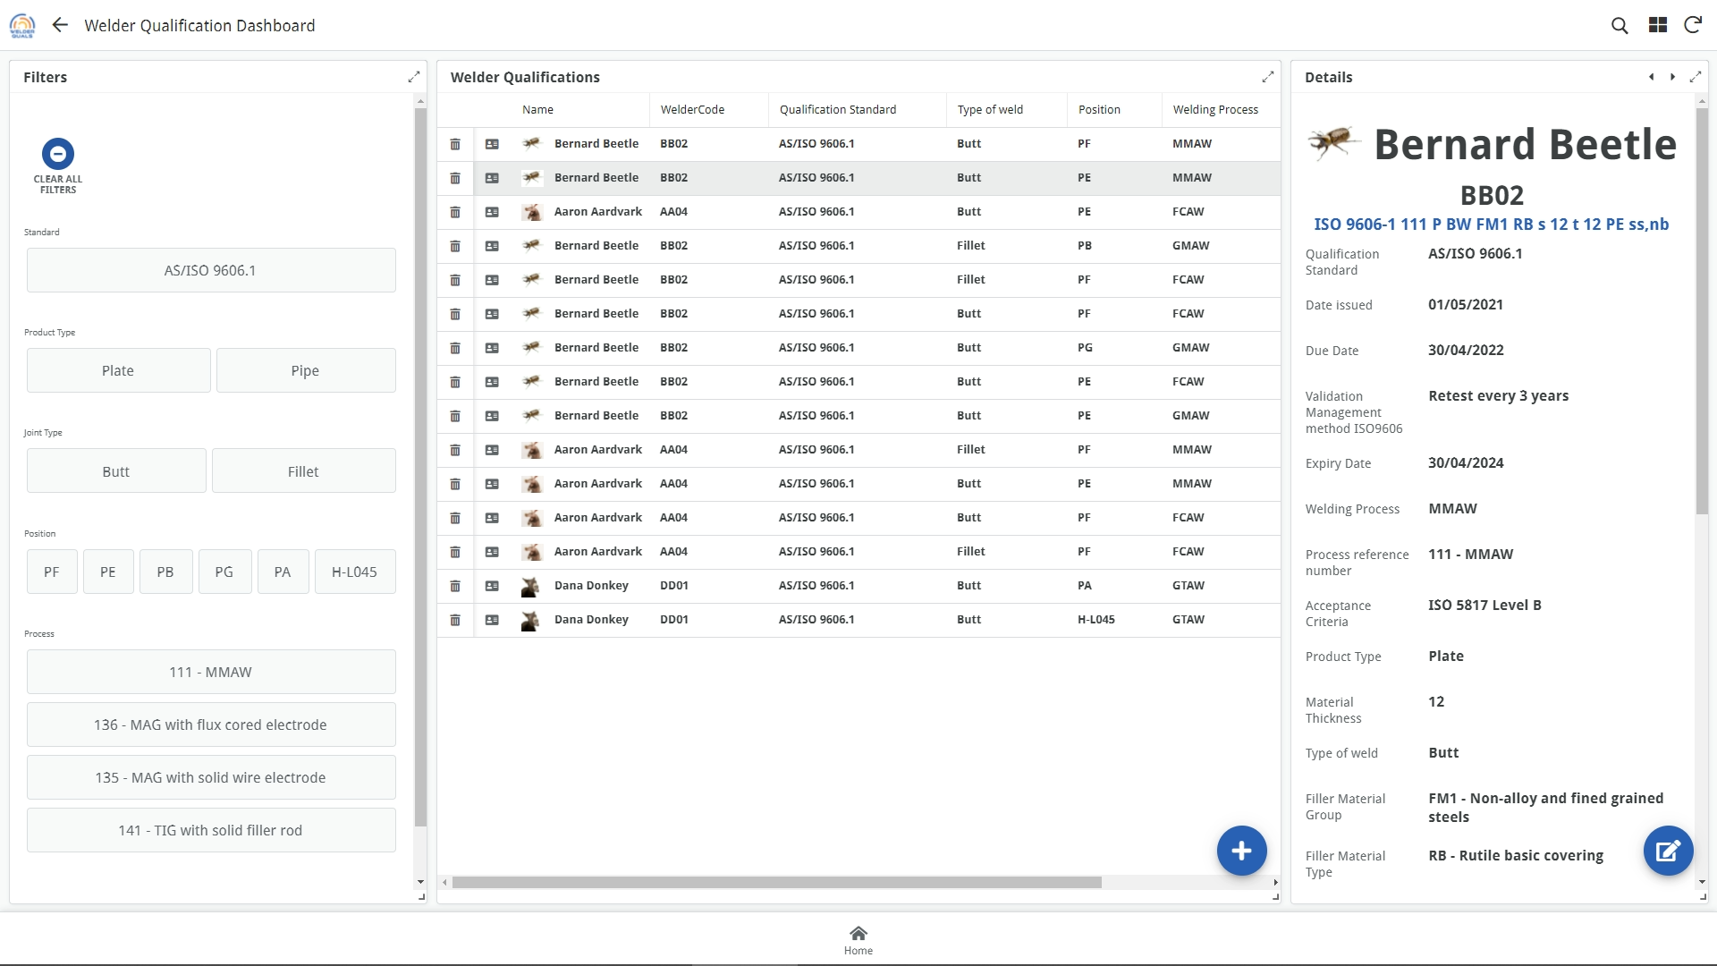
Click on any record to see the details

Slide 36
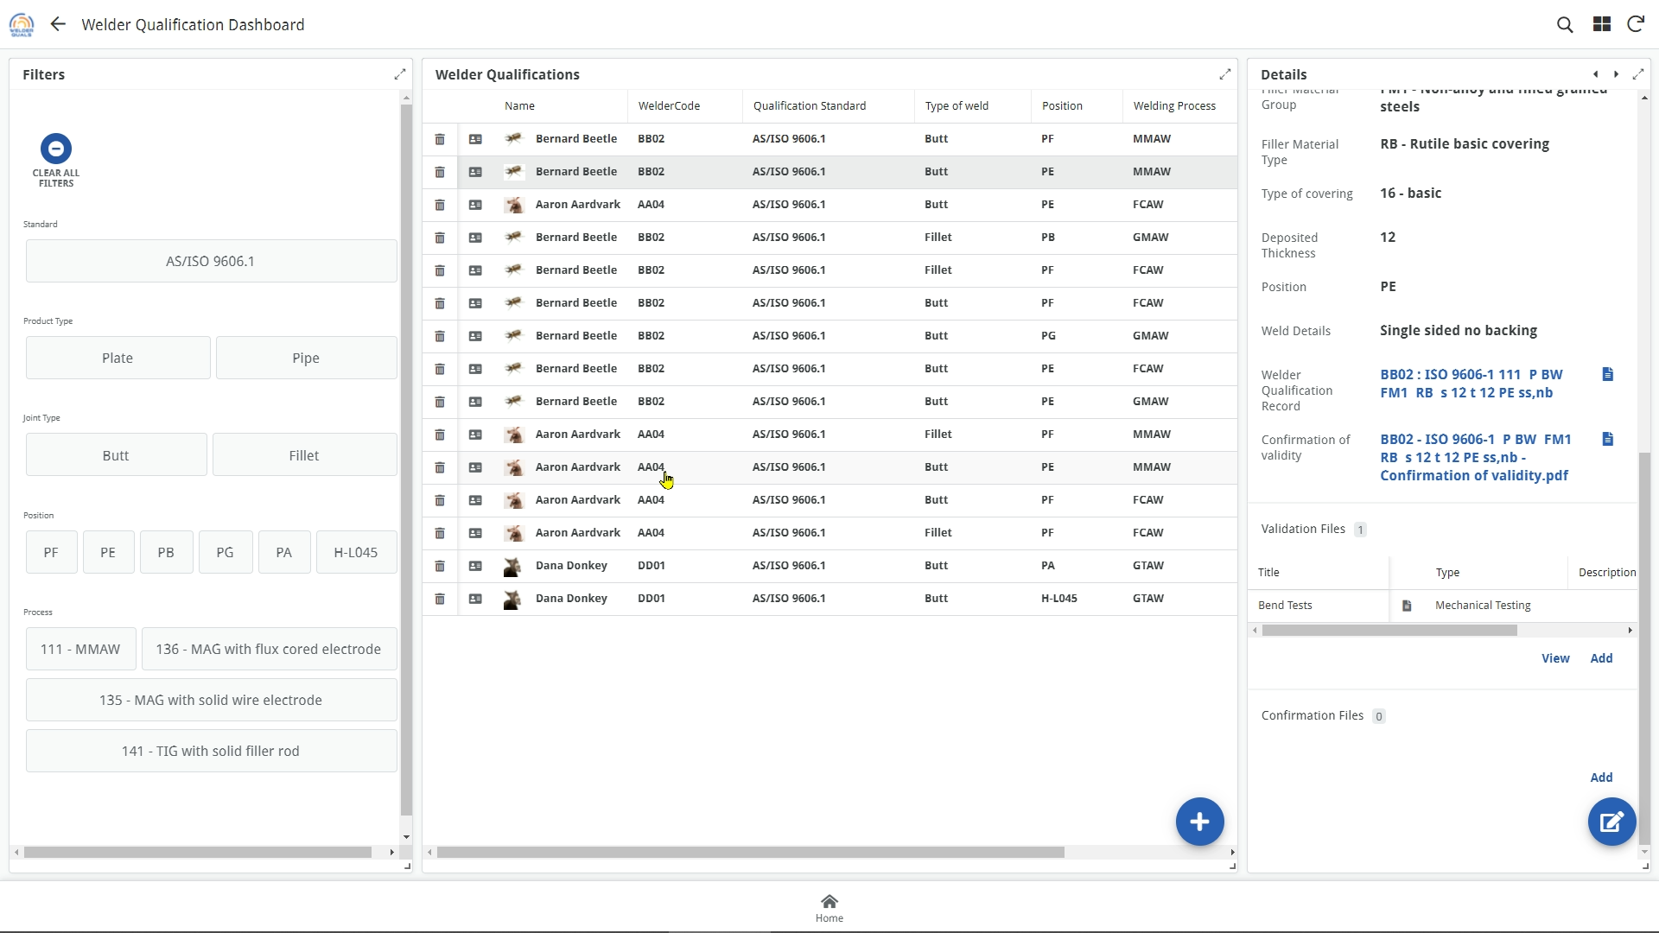
All of the uploaded files are available here, as well as the Confirmation of Validity record

Slide 37
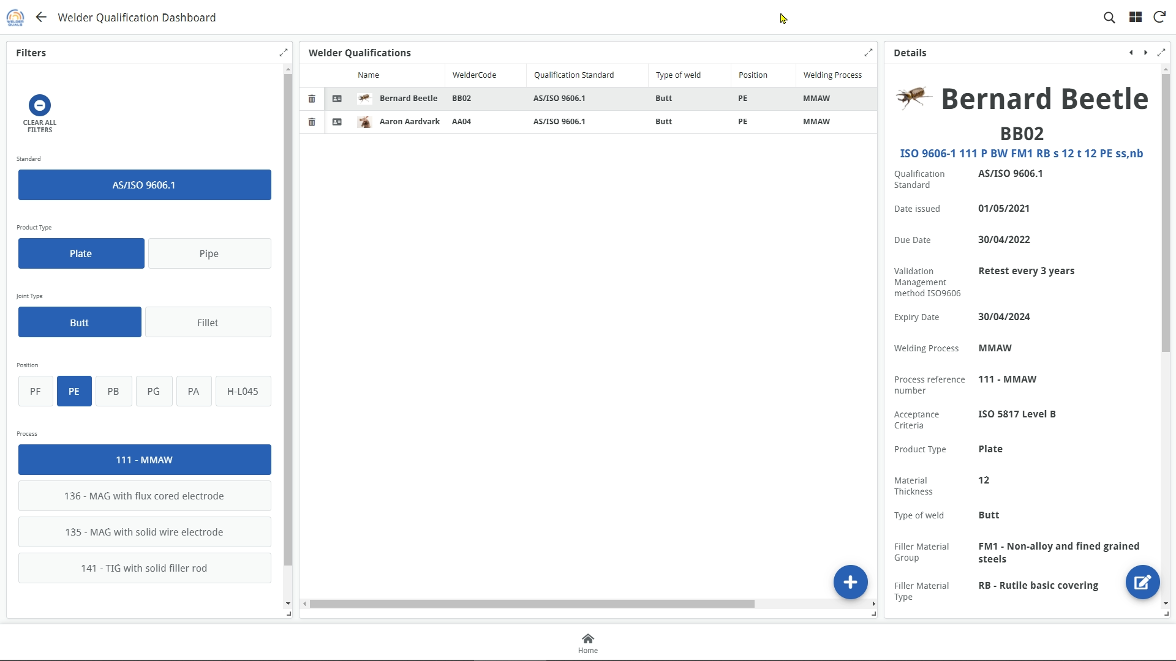
Click here to clear all filters
Click on the filter buttons to see only matching welder qualifications

Slide 38
Click on the filter buttons to see only matching welder qualifications

Slide 39
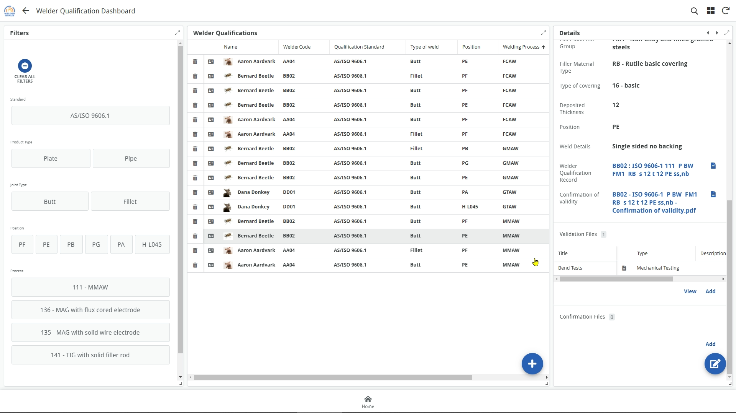
Unwanted records can be deleted by clicking on the “trash” icon
View all records for a welder by clicking on the card icon
Click on any column header to sort the data
Return to main menu

Slide 40

Welders

Slide 41
Click here to view details for each welder

Slide 42
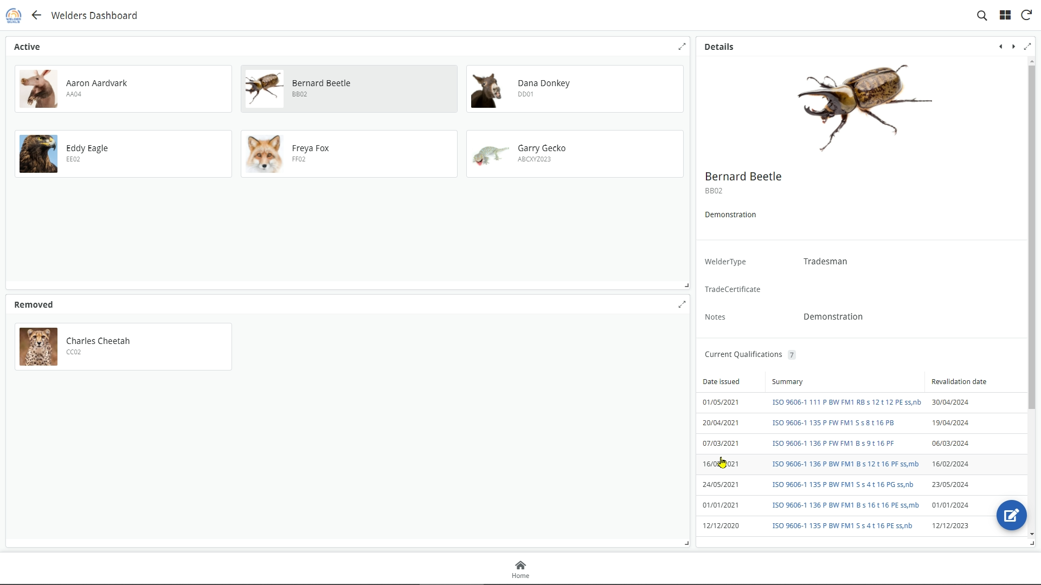
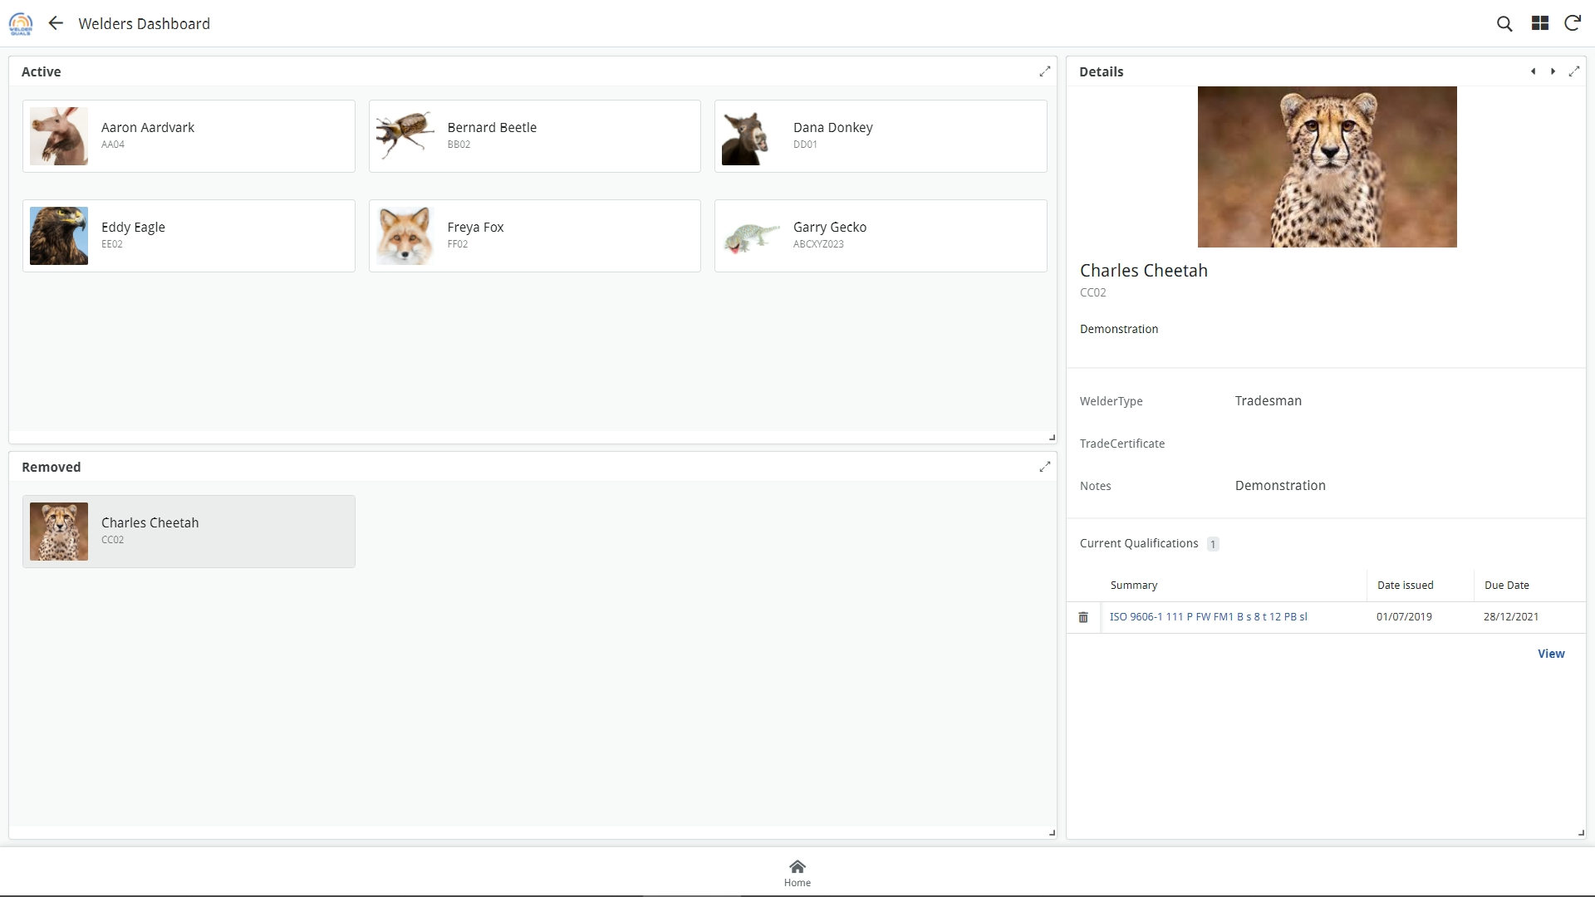
Click on a welder to see all their qualification records
Records for welders that have been removed from the subscription can only be viewed here
Return to main menu

Slide 43

Confirmation of Validity

Slide 44
Click Here

Slide 45
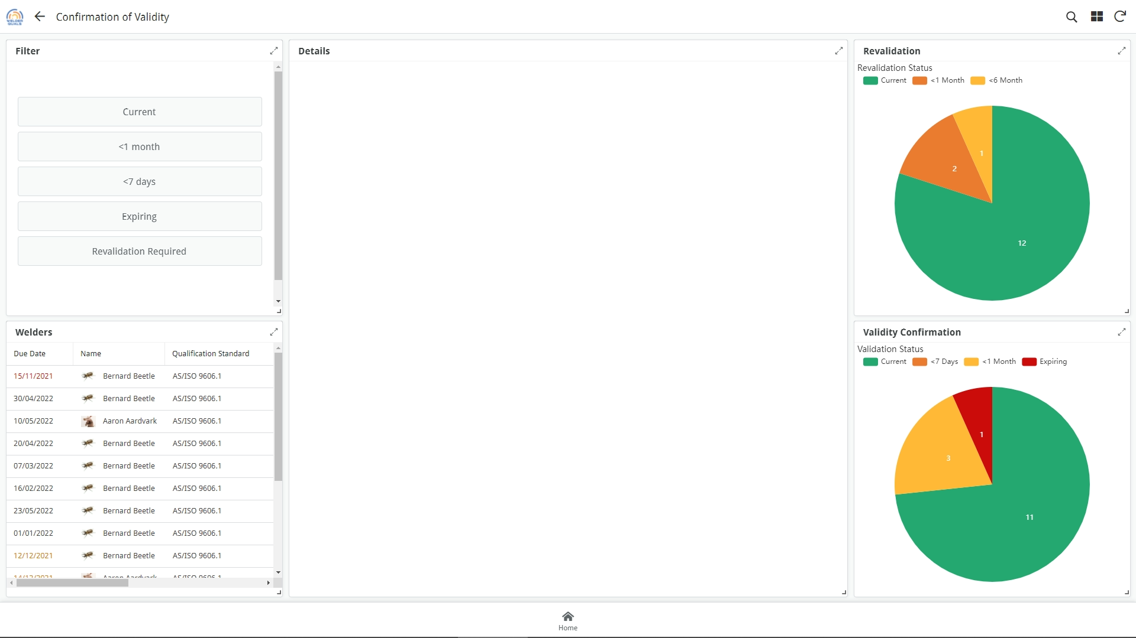
Quickly see which records will require confirmation of validity or revalidation using either the filter buttons, or the graphs
The graphs are interactive and you can click on them to see the records for each segment of the graph

Slide 46
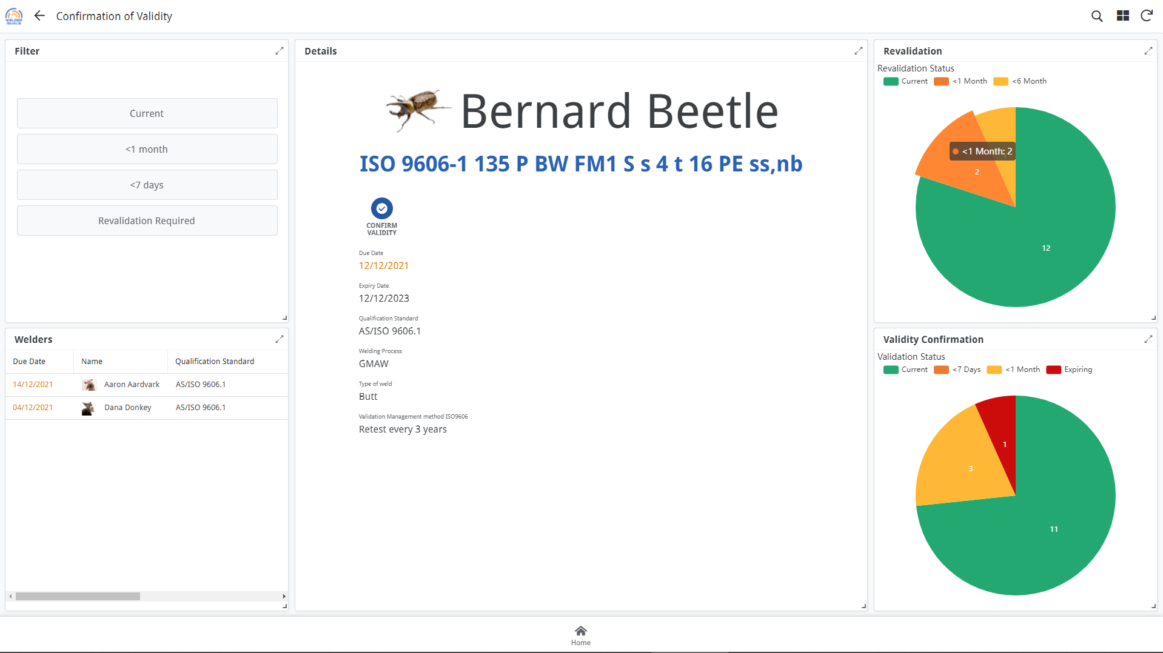
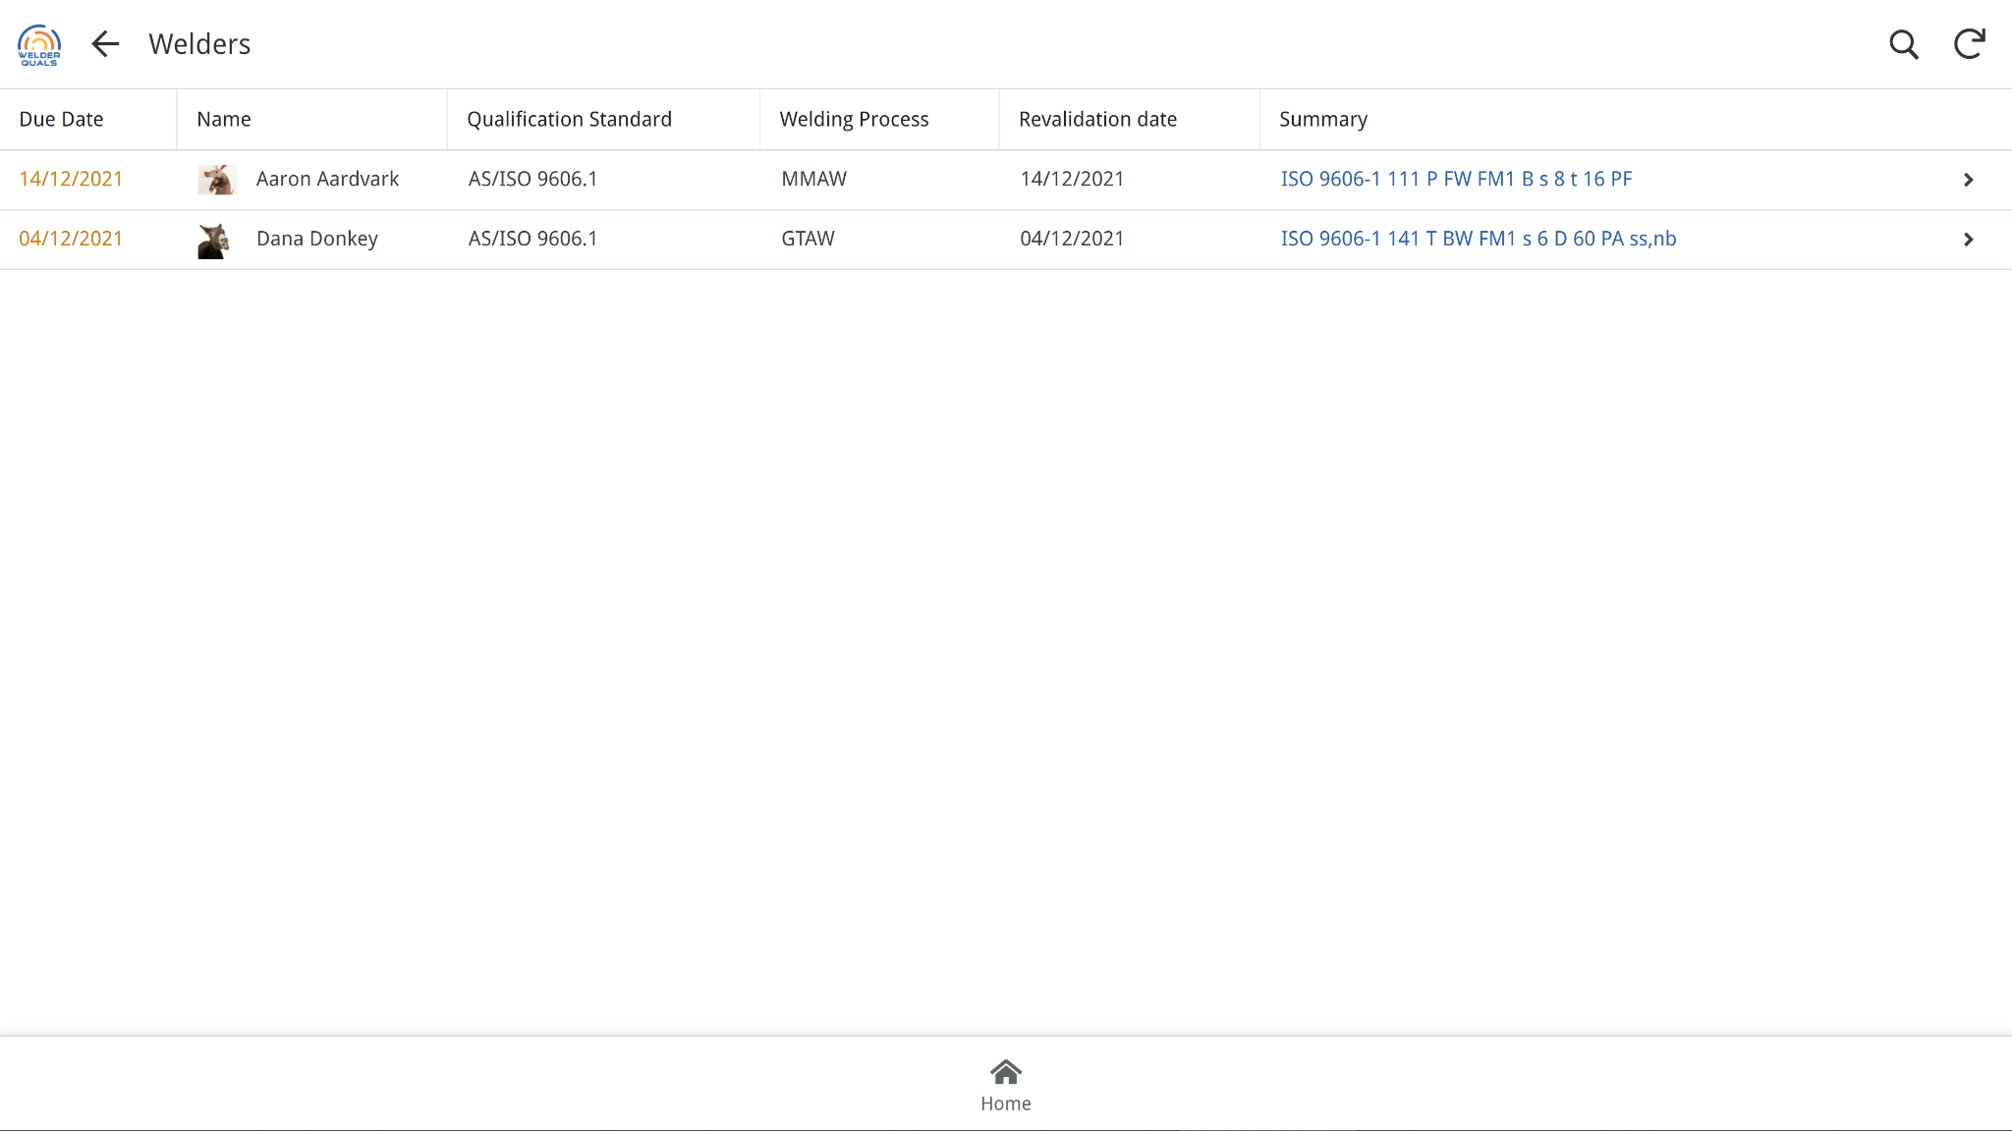
Click on a segment of the graph to see all records relating to it.

Slide 47
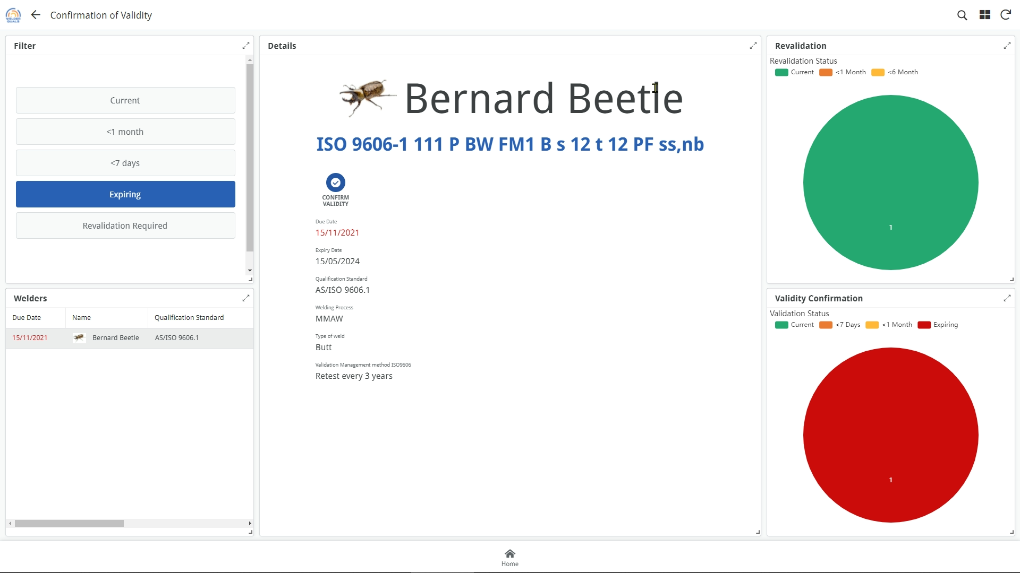
Click on this icon to carry out the Confirmation of Validity

Slide 48
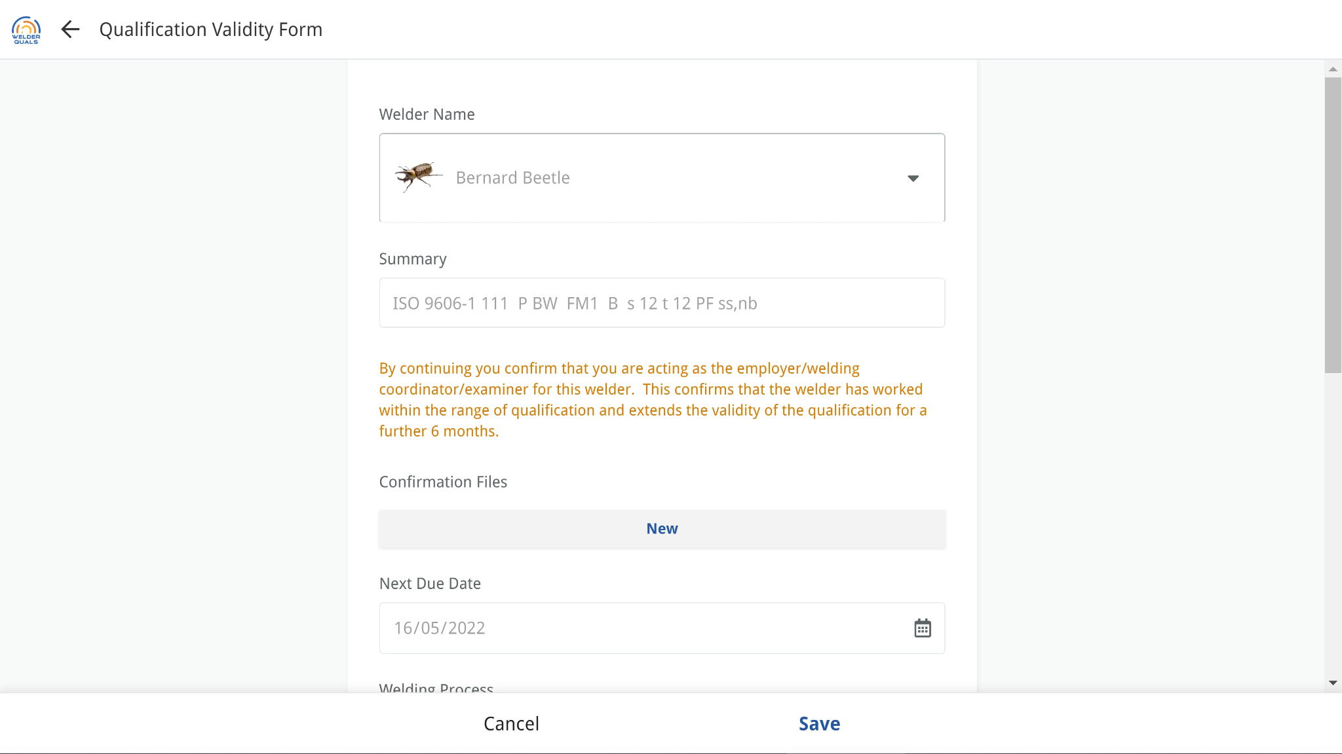
If there are inspection or test reports associated with the confirmation of validity, they can be uploaded here. Multiple files can be uploaded
This is NOT a mandatory requirement for compliance to ISO 9606.1
Click Save to generate the Confirmation document

Slide 49
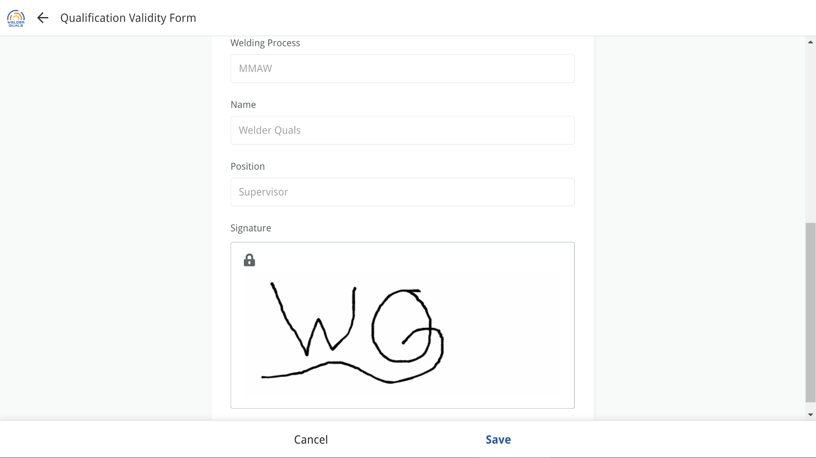
If the user added a digital signature when creating an account, it will be shown here.
Otherwise it can be manually drawn.

Slide 50
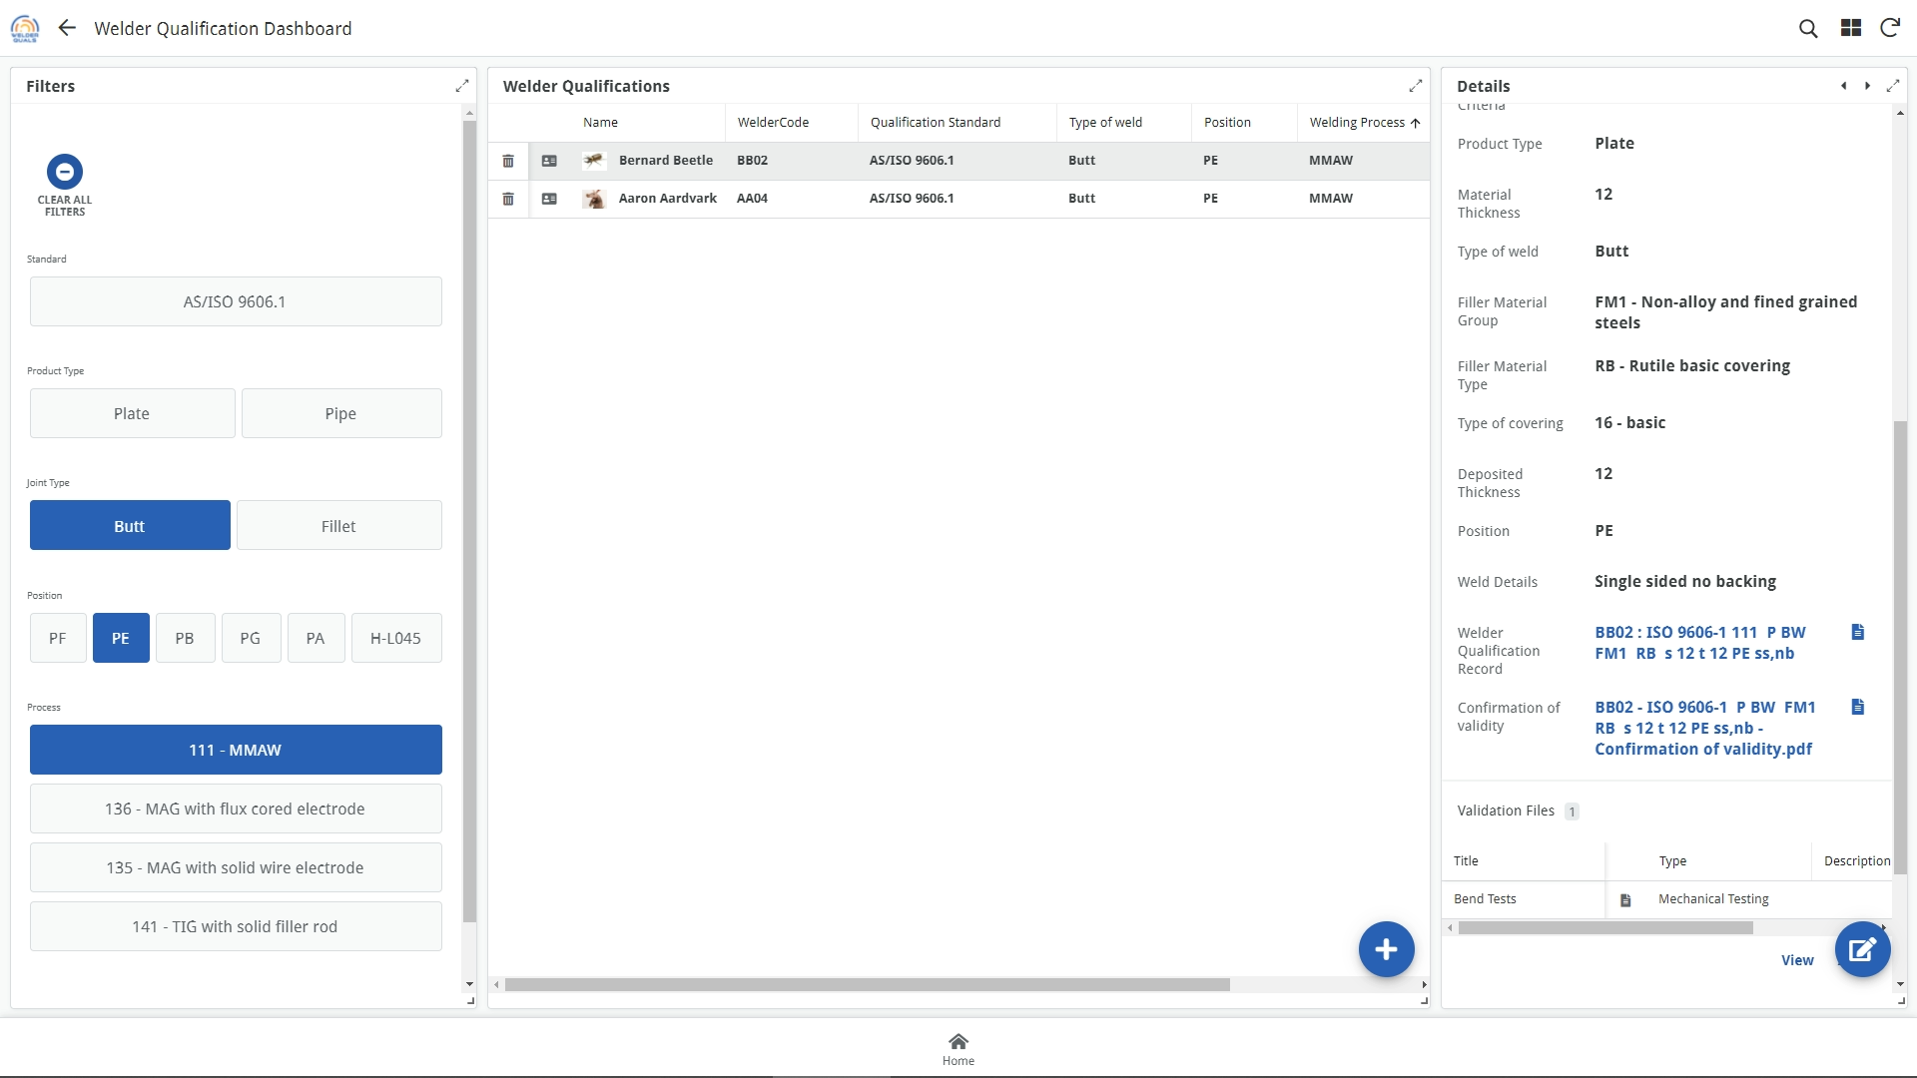
The Confirmation of Validity is generated as a separate document, and can be viewed here.

Slide 51
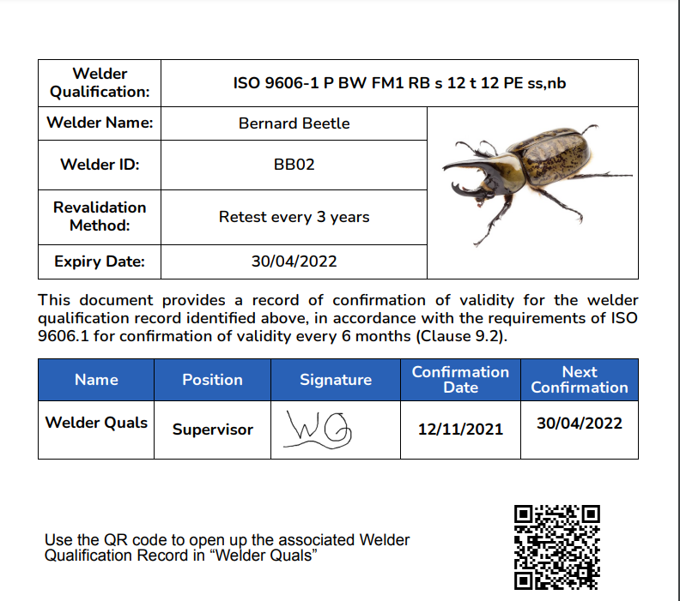
A new row is created for the confirmation of validity every 6 months
A QR code links to the record in Welder Quals

Slide 52
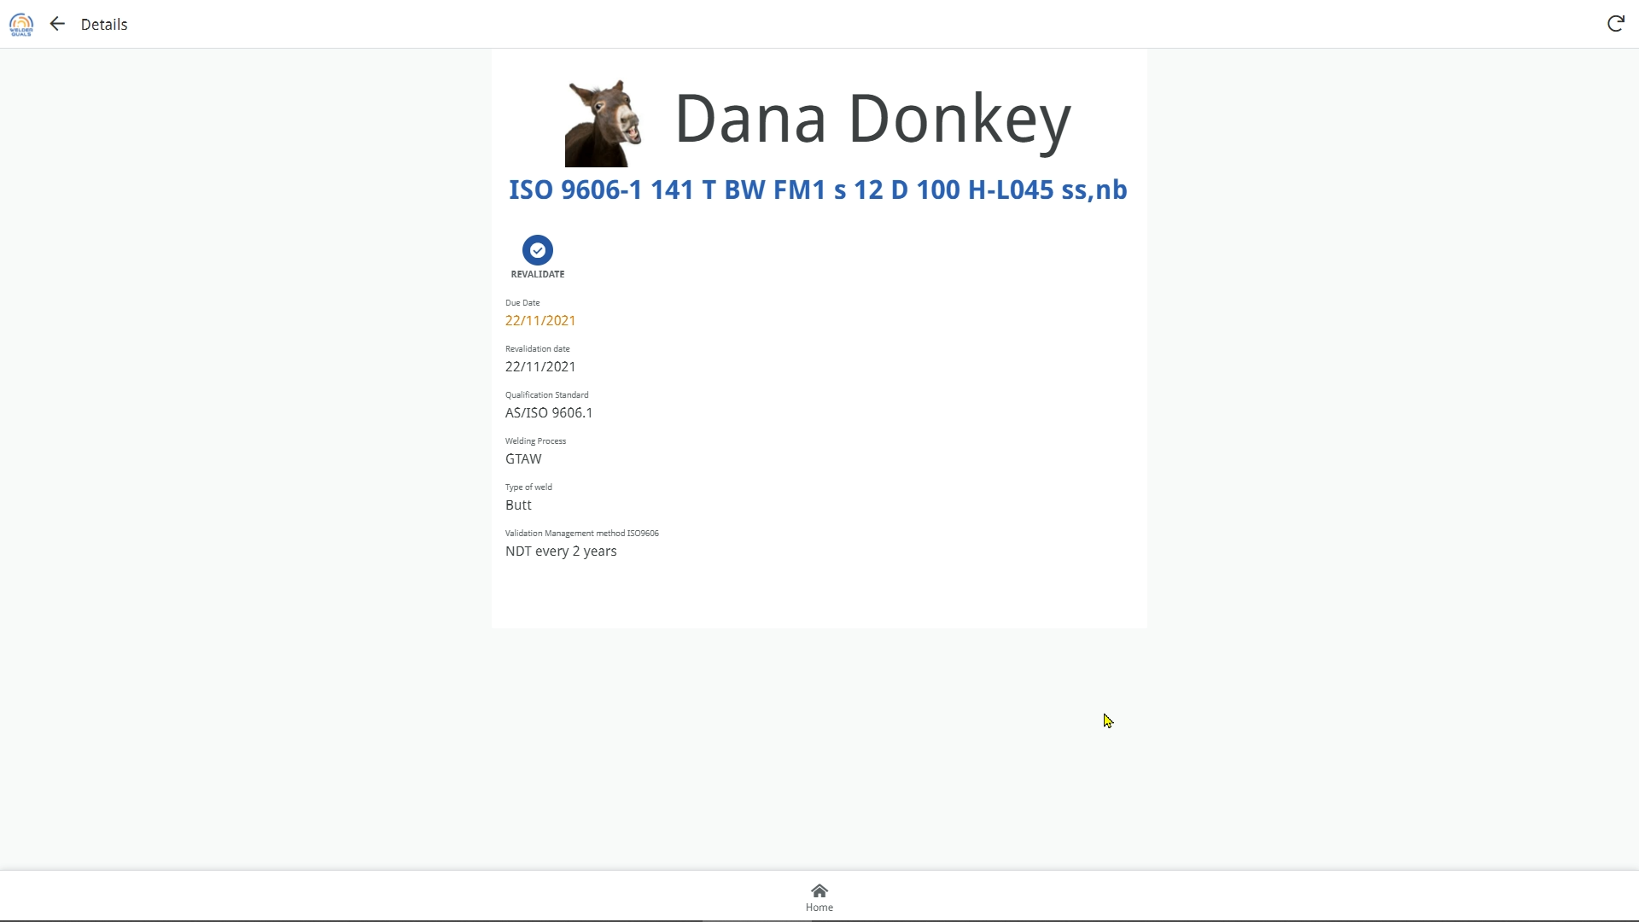
ISO 9606.1 welder qualifications that are managed using the 2 yearly revalidation method can be revalidated

Slide 53
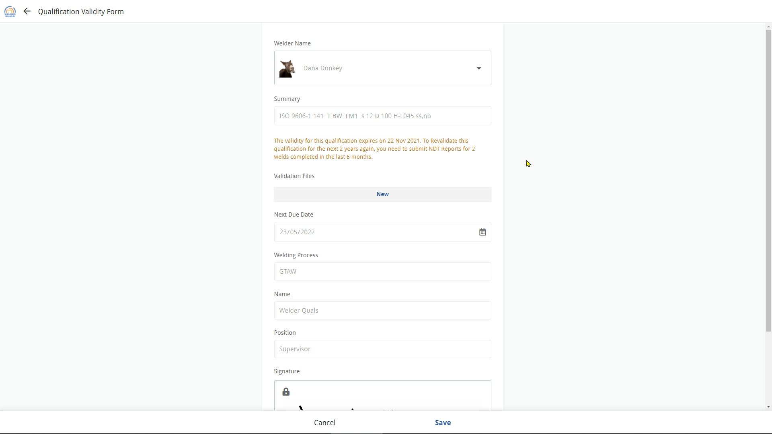
The reports for the tests completed in the 6 months prior to revalidation can be uploaded here.
Multiple files can be uploaded
Return to main menu

Slide 54

Admin

Slide 55
Click here to access the admin section

Slide 56
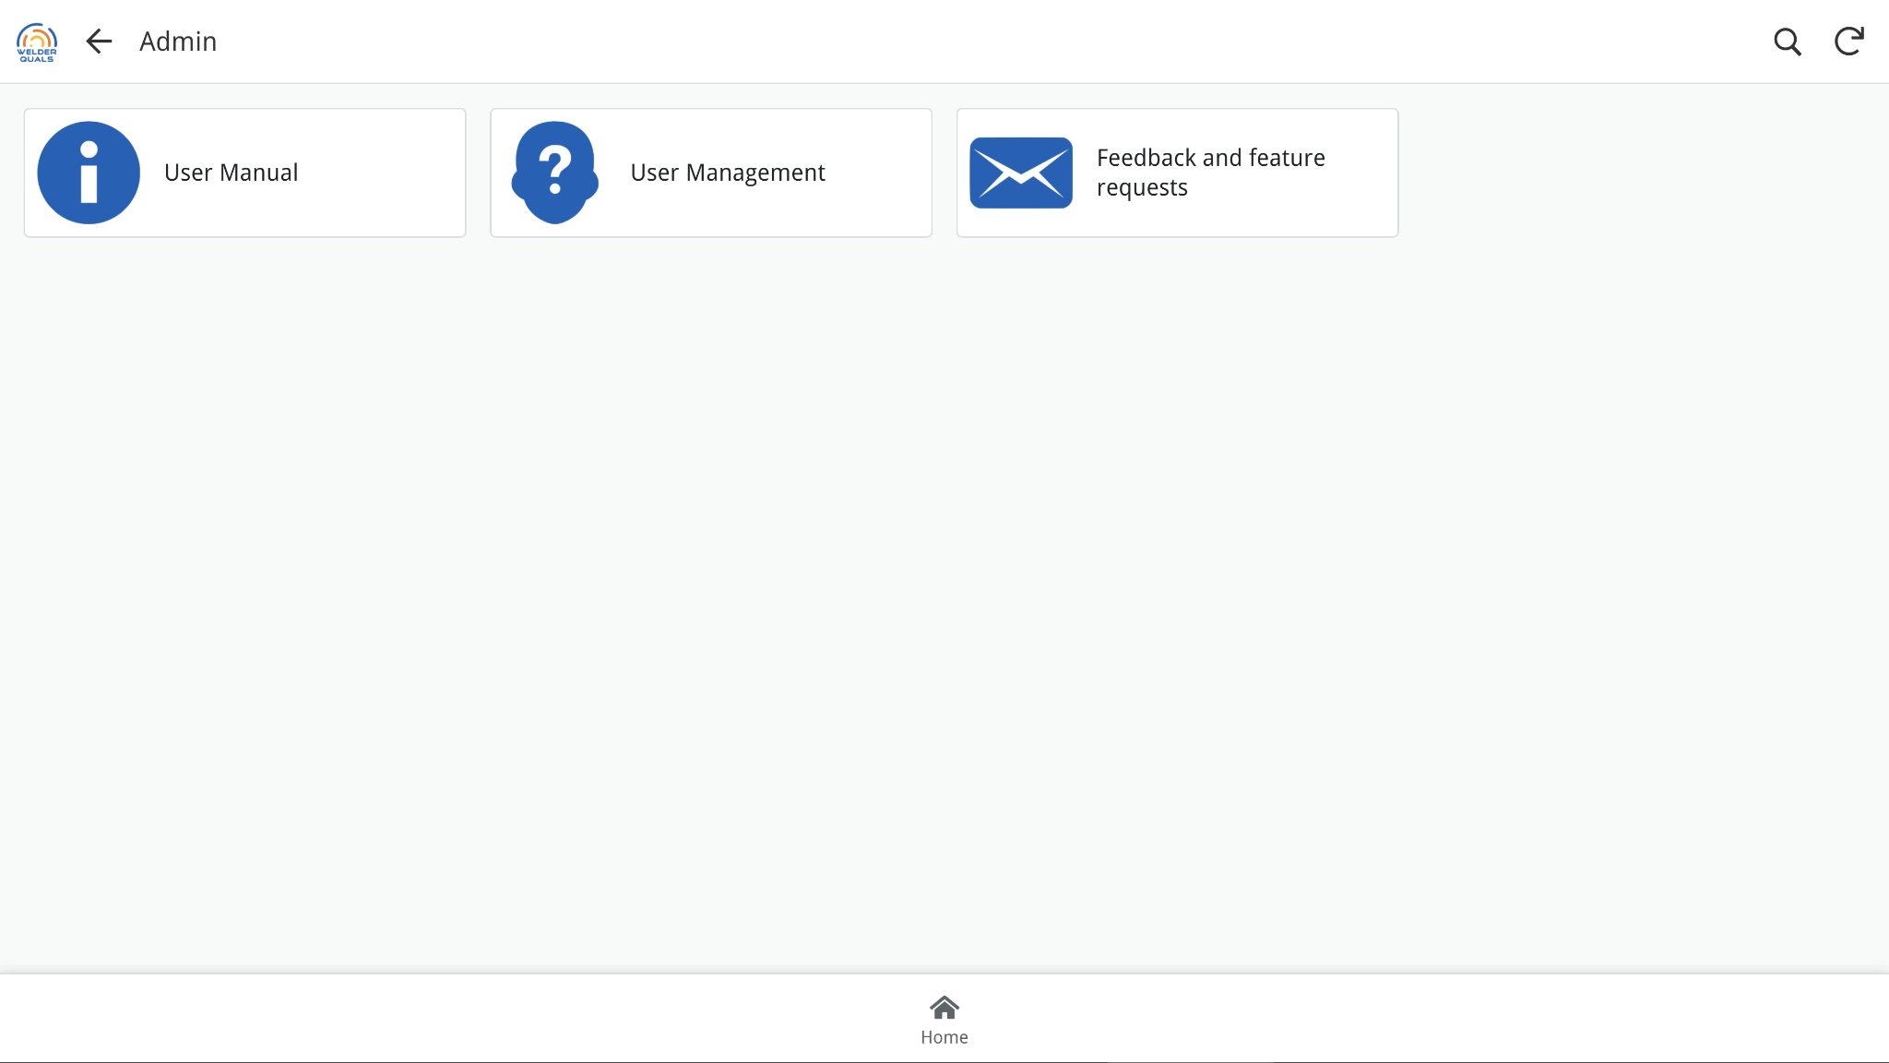
User instructions and manuals are here
The user profile can be viewed here, as well as switching users
Report any issues or make a feature request
Return to main menu

Slide 57
End

