Slide 1
Precipitation
1
NOTE: Slides for each module are numbered for easier cross-referencing with class notes
NOTE: My slides have TONS of animations and building graphics. These do not translate well to D2L, so it is best to download the power point to work through the logic behind the animations

Slide 2
Annual water balance
2
Precipitation
Evapotranspiration
Watershed
Runoff

Slide 3
Hydrologic processes
3
Energy
Precipitation
Evaporation
Interception
Throughfall
Sublimation
Snowpack
Snowmelt
Energy
(latent heat)
Evapotranspiration
Surface detention
Evaporation
Infiltration
Overland flow
Transpiration
Soil water
Percolation
Understanding the controls on the water budget is inseparable from understanding of the thermal energy budget.
Groundwater
Stream flow generation
Evaporation
Streams and lakes
Watershed
Runoff

Slide 4
Precipitation: topics covered
4
Water in the air: the fundamental vocabulary and concepts necessary for characterizing the physics of water in the air
Causes of precipitation: the local and global circulations that generate the uplift necessary to cause meaningful precipitation
Types of precipitation: the conditions that dictate the physical state of precipitation (e.g. rain vs. snow)
Measurement of precipitation: the basics of measuring precipitation at given location and translating point measurements to estimates of precipitation over watersheds
Interpreting hyetographs: fundamentals of interpreting visualizations of precipitation over time and the typical summary statistics and probabilistic approaches to analyzing hyetographs
Snow hydrology: a brief introduction to understanding water storage in a seasonal snowpack, including consideration of the energy budget as the determinant of timing of snowmelt

Slide 5
Precipitation: topics covered
5
Water in the air: the fundamental vocabulary and concepts necessary for characterizing the physics of water in the air
Causes of precipitation: the local and global circulations that generate the uplift necessary to cause meaningful precipitation
Types of precipitation: the conditions that dictate the physical state of precipitation (e.g. rain vs. snow)
Measurement of precipitation: the basics of measuring precipitation at given location and translating point measurements to estimates of precipitation over watersheds
Interpreting hyetographs: fundamentals of interpreting visualizations of precipitation over time and the typical summary statistics and probabilistic approaches to analyzing hyetographs
Snow hydrology: a brief introduction to understanding water storage in a seasonal snowpack, including consideration of the energy budget as the determinant of timing of snowmelt

Slide 6
Precipitation: physics of water in air
6
Partial pressure ($e_{w}$): the amount of a gas in a mixture of gasses expressed as the force per unit area exerted by that gas [F L⁻²] example units: kPa (kN m⁻²), psi, mm Hg
Vapor pressure (or absolute vapor pressure): partial pressure of water in air [F L⁻²]
Absolute humidity: concentration or density of water in the air [M L⁻³] example units: kg m⁻³
Saturation vapor pressure($e_{w}^{∗}$): vapor pressure at saturation, or the limit of how much water vapor the air can hold [F L⁻²]
Function of temperature

Slide 7
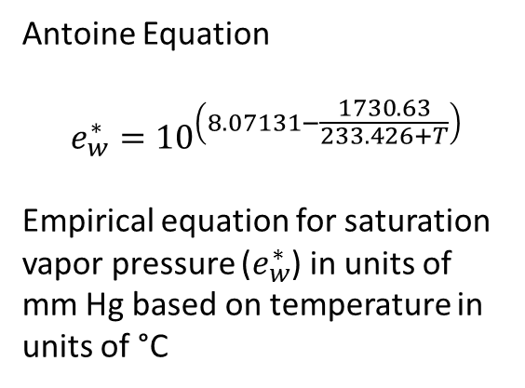
Precipitation: saturation of air
7
Antoine Equation
$$e_{w}^{∗}={10}^{\left(8.07131−\frac{1730.63}{233.426+T}\right)}$$
Empirical equation for saturation vapor pressure ($e_{w}^{∗}$) in units of mm Hg based on temperature in units of °C

Slide 8
Precipitation: physics of water in air
8
Partial pressure ($e_{w}$): the amount of a gas in a mixture of gasses expressed as the force per unit area exerted by that gas [F L⁻²] example units: kPa (kN m⁻²), psi, mm Hg
Vapor pressure (or absolute vapor pressure): partial pressure of water in air [F L⁻²]
Absolute humidity: concentration or density of water in the air [M L⁻³] example units: kg m⁻³
Saturation vapor pressure ($e_{w}^{∗}$): vapor pressure at saturation, or the limit of how much water vapor the air can hold [F L⁻²]
Function of temperature
Relative humidity ($W_{a}=\frac{e_{w}}{e_{w}^{∗}}$): ratio of measured vapor pressure to saturation vapor pressure [1]
Often given as percent: < 100% means under-saturated, > 100% means over-saturated

Slide 9

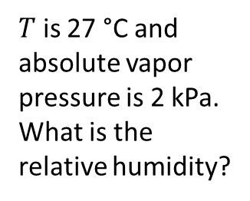
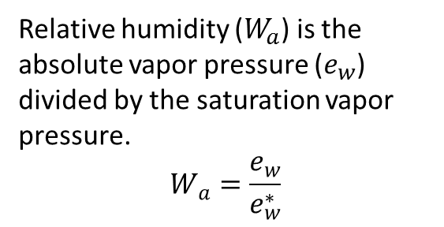
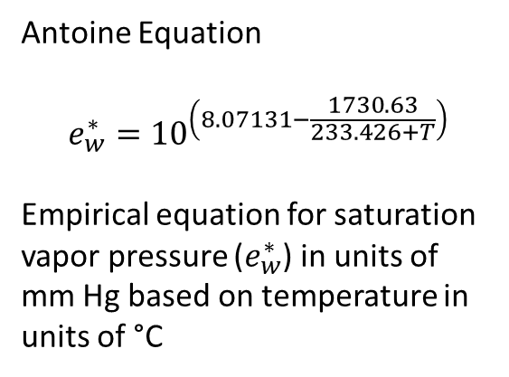
Precipitation: relative humidity
9
Antoine Equation
$$e_{w}^{∗}={10}^{\left(8.07131−\frac{1730.63}{233.426+T}\right)}$$
Empirical equation for saturation vapor pressure ($e_{w}^{∗}$) in units of mm Hg based on temperature in units of °C
$T$ is 27 °C and absolute vapor pressure is 2 kPa. What is the relative humidity?
Over-saturated
Under-saturated
Relative humidity ($W_{a}$) is the absolute vapor pressure ($e_{w}$) divided by the saturation vapor pressure.
$$W_{a}=\frac{e_{w}}{e_{w}^{∗}}$$
Relative humidity is
~57%
$$\frac{2 kPa}{3.5 kPa}=0.57$$

Slide 10

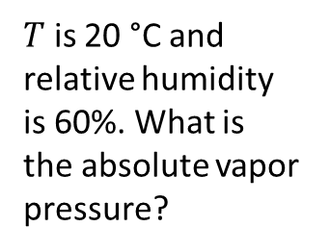
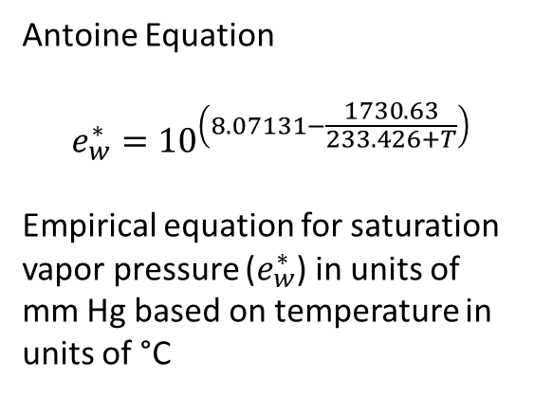

Precipitation: relative humidity
10
Antoine Equation
$$e_{w}^{∗}={10}^{\left(8.07131−\frac{1730.63}{233.426+T}\right)}$$
Empirical equation for saturation vapor pressure ($e_{w}^{∗}$) in units of mm Hg based on temperature in units of °C
$T$ is 20 °C and relative humidity is 60%. What is the absolute vapor pressure?
Over-saturated
Under-saturated
Relative humidity ($W_{a}$) is the absolute vapor pressure ($e_{w}$) divided by the saturation vapor pressure.
$$W_{a}=\frac{e_{w}}{e_{w}^{∗}}$$
$$\frac{x kPa}{2.4 kPa}=0.6$$
$$\sim 1.4 kPa$$

Slide 11
Precipitation: physics of water in air
11
Partial pressure ($e_{w}$): the amount of a gas in a mixture of gasses expressed as the force per unit area exerted by that gas [F L⁻²] example units: kPa (kN m⁻²), psi, mm Hg
Vapor pressure (or absolute vapor pressure): partial pressure of water in air [F L⁻²]
Absolute humidity: concentration or density of water in the air [M L⁻³] example units: kg m⁻³
Saturation vapor pressure ($e_{w}^{∗}$): vapor pressure at saturation, or the limit of how much water vapor the air can hold [F L⁻²]
Function of temperature
Relative humidity ($W_{a}=\frac{e_{w}}{e_{w}^{∗}}$): ratio of measured vapor pressure to saturation vapor pressure [1]
Often given as percent: < 100% means under-saturated, > 100% means over-saturated
Dew point: the temperature at which the air will be saturated with water for a given absolute humidity [T]
In other words, the temperature at which water will start to condense
(if condensation nuclei are available)

Slide 12

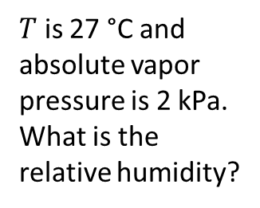
Precipitation: dew point
12
$T$ is 27 °C and absolute vapor pressure is 2 kPa. What is the relative humidity?
Antoine Equation
$$e_{w}^{∗}={10}^{\left(8.07131−\frac{1730.63}{233.426+T}\right)}$$
Empirical equation for saturation vapor pressure ($e_{w}^{∗}$) in units of mm Hg based on temperature in units of °C
Over-saturated
Under-saturated
Relative humidity is
~57%
$$\frac{2 kPa}{3.5 kPa}=0.57$$

Slide 13
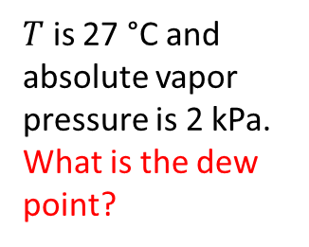
Precipitation: dew point
13
$T$ is 27 °C and absolute vapor pressure is 2 kPa. What is the dew point?
Antoine Equation
$$e_{w}^{∗}={10}^{\left(8.07131−\frac{1730.63}{233.426+T}\right)}$$
Empirical equation for saturation vapor pressure ($e_{w}^{∗}$) in units of mm Hg based on temperature in units of °C
Over-saturated
Under-saturated
Relative humidity is
~57%
$$\frac{2 kPa}{3.5 kPa}=0.57$$
Dew point is
~18 °C

Slide 14
Precipitation: topics covered
14
Water in the air: the fundamental vocabulary and concepts necessary for characterizing the physics of water in the air
Causes of precipitation: the local and global circulations that generate the uplift necessary to cause meaningful precipitation
Types of precipitation: the conditions that dictate the physical state of precipitation (e.g. rain vs. snow)
Measurement of precipitation: the basics of measuring precipitation at given location and translating point measurements to estimates of precipitation over watersheds
Interpreting hyetographs: fundamentals of interpreting visualizations of precipitation over time and the typical summary statistics and probabilistic approaches to analyzing hyetographs
Snow hydrology: a brief introduction to understanding water storage in a seasonal snowpack, including consideration of the energy budget as the determinant of timing of snowmelt

Slide 15
Precipitation: steps for formation
15
1. Air must be cooled to dew point
2. Condensation on nuclei
3. Coalescence into drops or ice of sufficient weight to fall
4. An input of more water laden air
Many mechanisms of cooling, but uplift of moist air into lower pressure conditions higher in the atmosphere dominates the causes of precipitation that are meaningful to watershed water balances
Adiabatic cooling: loss of temperature without loss of heat due to lowering of pressure

Slide 16
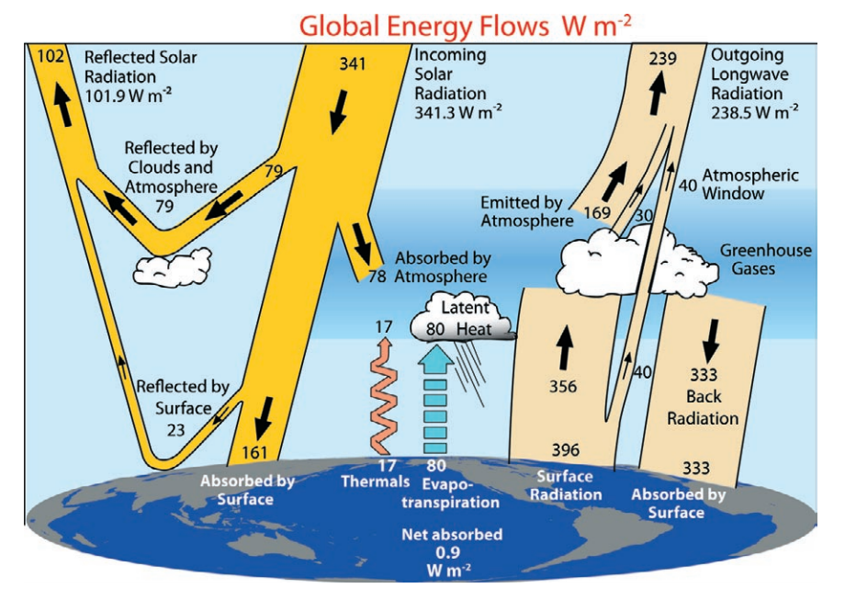
Uplift: inherently tied to the energy balance
16
From Trenberth et al. (2009)

Slide 17
Uplift: global circulation
17
N
Minimum
insolation
90 °N
Shortwave
Shortwave
Shortwave
Shortwave
Shortwave
Shortwave
Maximum
insolation
Shortwave
0 °
Shortwave
Minimum
insolation
90 °S

Slide 18
Uplift: global circulation
18
N
Minimum
insolation
High pressure
90 °N
Polar Cell
60 °N
Low pressure (uplift)
Polar
Front
Ferrel Cell
30 °N
High pressure
Maximum
insolation
Low pressure (uplift)
Surface wind directions
0 °
Hadley Cells
30 °S
High pressure
Ferrel Cell
Polar
Front
60 °S
Low pressure (uplift)
Polar Cell
Minimum
insolation
90 °S
High pressure

Slide 19
Uplift: global circulation
19
N
Minimum
insolation
High pressure
90 °N
Polar Cell
60 °N
Low pressure (uplift)
Polar
Front
Ferrel Cell
30 °N
High pressure
Maximum
insolation
Low pressure (uplift)
Surface wind directions
0 °
Hadley Cells
30 °S
High pressure
Ferrel Cell
Polar
Front
60 °S
Low pressure (uplift)
Polar Cell
Minimum
insolation
90 °S
High pressure

Slide 20
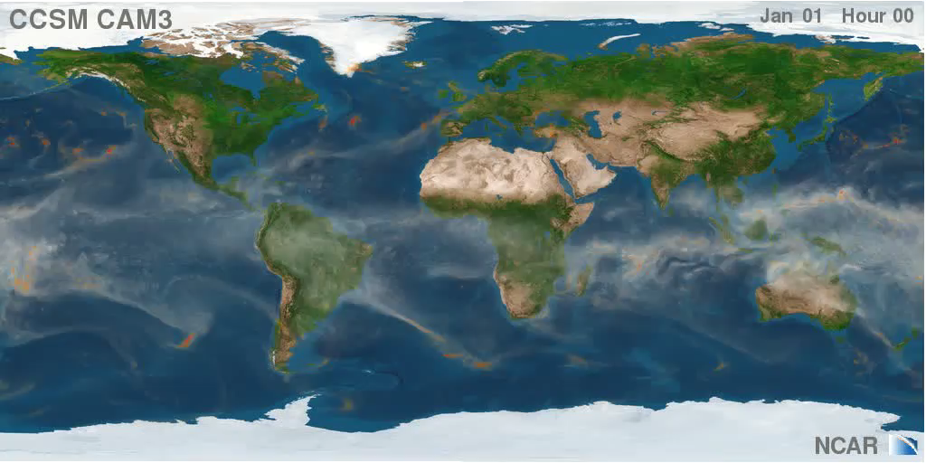
Uplift: global circulation
20
60 °N
Up (Low P)
30 °N
Down (High P)
0 °
Up (Low P)
30 °S
Down (High P)
60 °S
Up (Low P)

Slide 21
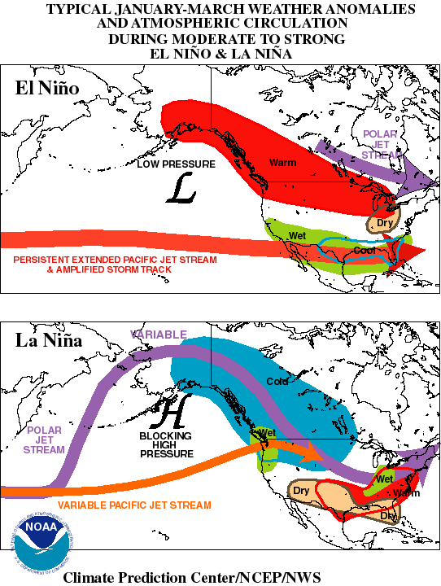
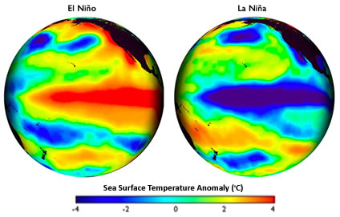
Anomalies and teleconnections
21
El Niño – Southern Oscillation (ENSO)
NOAA Education resources

Slide 22
Uplift: causes
22
Convergence at the equator
Global circulation
Frontal convergence (or frontal storms, extra-tropical cyclones)
along the polar front
Larger scale
Tropical cyclones (hurricanes, non-frontal)
Movement
Form from a local low pressure over warm oceans, feedback between evaporation, uplift, and condensation
Convective storms
Smaller scale
Form due to heating of land creating local uplift of moist air
Orographic effect
Horizontal moving air masses hitting topographic relief
Varied scales
Interacts with other uplift mechanisms to enhance effect of storms with elevation

Slide 23
Precipitation: topics covered
23
Water in the air: the fundamental vocabulary and concepts necessary for characterizing the physics of water in the air
Causes of precipitation: the local and global circulations that generate the uplift necessary to cause meaningful precipitation
Types of precipitation: the conditions that dictate the physical state of precipitation (e.g. rain vs. snow)
Measurement of precipitation: the basics of measuring precipitation at given location and translating point measurements to estimates of precipitation over watersheds
Interpreting hyetographs: fundamentals of interpreting visualizations of precipitation over time and the typical summary statistics and probabilistic approaches to analyzing hyetographs
Snow hydrology: a brief introduction to understanding water storage in a seasonal snowpack, including consideration of the energy budget as the determinant of timing of snowmelt

Slide 24
Precipitation: rain or snow?
24
Why do we care?
Storage of water (water balance, accumulation of snowpack)
Latent and specific heat (energy balance, will snowpack melt)

Slide 25
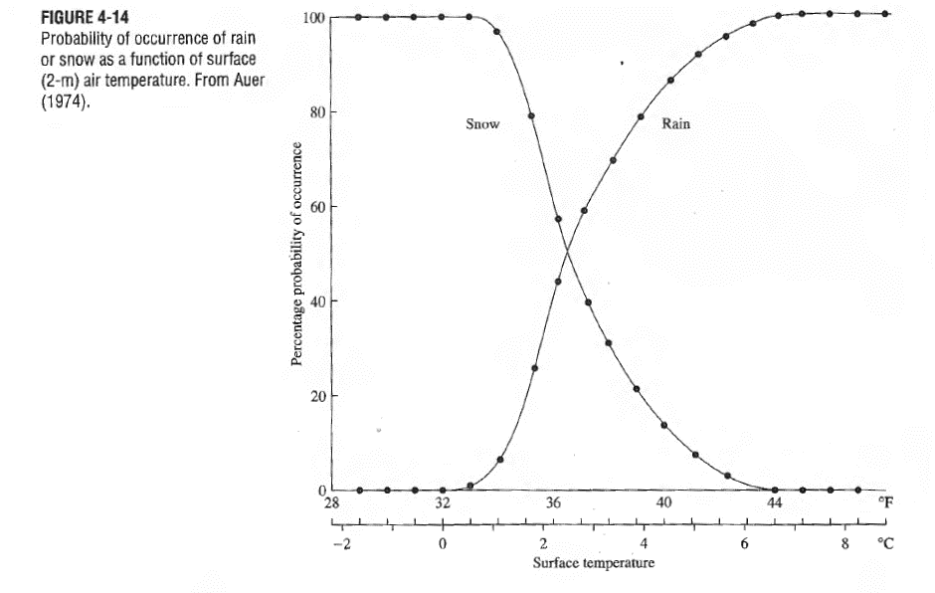
Precipitation: rain or snow?
25

Slide 26
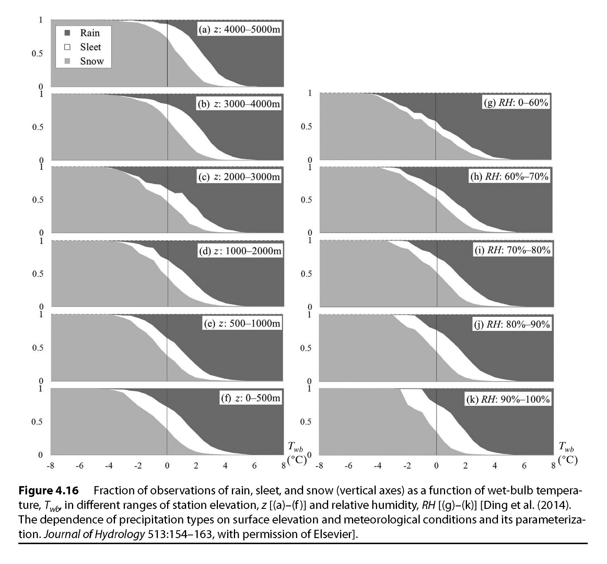
Precipitation: rain or snow?
26
Wet bulb temperature (a metric of heat + latent heat) is a better predictor of precipitation type
Lower pressures allow snow and sleet at higher temperatures
Higher relative humidity increases the uncertainty of precipitation type

Slide 27
Precipitation: topics covered
27
Water in the air: the fundamental vocabulary and concepts necessary for characterizing the physics of water in the air
Causes of precipitation: the local and global circulations that generate the uplift necessary to cause meaningful precipitation
Types of precipitation: the conditions that dictate the physical state of precipitation (e.g. rain vs. snow)
Measurement of precipitation: the basics of measuring precipitation at given location and translating point measurements to estimates of precipitation over watersheds
Interpreting hyetographs: fundamentals of interpreting visualizations of precipitation over time and the typical summary statistics and probabilistic approaches to analyzing hyetographs
Snow hydrology: a brief introduction to understanding water storage in a seasonal snowpack, including consideration of the energy budget as the determinant of timing of snowmelt

Slide 28
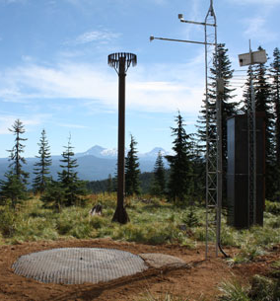
Precipitation: measurement
28
SNOTEL – managed by Natural Resources
Conservation Service (NRCS)
Precipitation gauge considerations (is “catch” accurate?)
Size of orifice
Height (snow depth)
Shielding (Alter shield)
Obstructions
State changes

Slide 29
Precipitation: measurement
29
SNOTEL – managed by Natural Resources
Conservation Service (NRCS)
Snow measurements
Snow pillow (weight of snow)
Snow
density
Sonic range finder (depth of snow)
NRCS web page

Slide 30
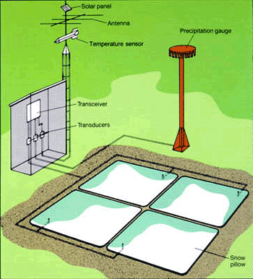
Precipitation: measurement
30
SNOTEL – managed by Natural Resources
Conservation Service (NRCS)
Logging and telemetry
Plumbed to manometer (antifreeze)
Pressure transducers
Radio transceiver
NRCS web page

Slide 31
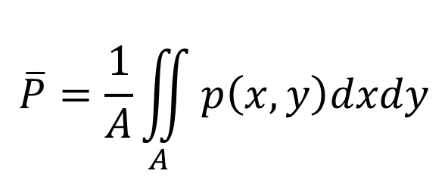
Precipitation: sources of error
31
Measurement error
Scaling point measurements to estimates over large areas
Characterizing spatial distributions
Dealing with missing data
$$\overline{P}=\frac{1}{A}\iint_{A}{p\left(x,y\right)dxdy}$$

Slide 32
Precipitation: spatial distribution
32
Strategies
Weighted averages
Arithmetic average
Thiessen Polygons (nearest neighbor)
Hypsometric method
Weight areas based on a model of the spatial distribution of precipitation as a function of elevation
Interpolate a surface
Kriging (geostatistics)

Slide 33
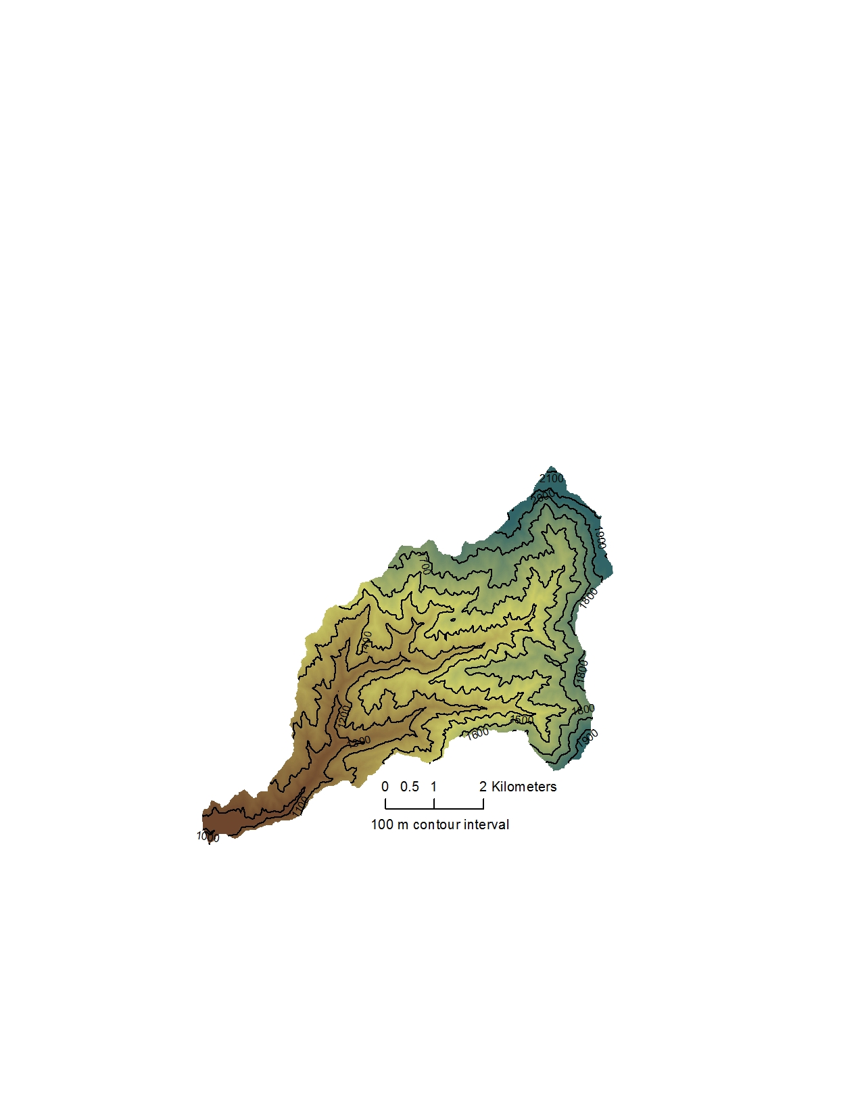
Thiessen polygons or nearest neighbor
Each pixel in the watershed has the same precipitation as the nearest gauge (by Euclidean distance)

Slide 34
Thiessen polygons or nearest neighbor
Each pixel in the watershed has the same precipitation as the nearest gauge (by Euclidean distance)

Slide 35
Thiessen polygons or nearest neighbor
Each pixel in the watershed has the same precipitation as the nearest gauge (by Euclidean distance)

Slide 36
Thiessen polygons or nearest neighbor
Each pixel in the watershed has the same precipitation as the nearest gauge (by Euclidean distance)

Slide 37

Thiessen polygons or nearest neighbor
Each pixel in the watershed has the same precipitation as the nearest gauge (by Euclidean distance)

Slide 38
854 mm
Hypsometric model
Closest
gauge
Each pixel in the watershed has the precipitation predicted by a model of precipitation vs. elevation
Gauge with similar elevation
~580 mm
708 mm
450 mm

Slide 39
Hypsometric method (or average weighted by elevation)
Sample spreadsheet

Slide 40
Precipitation: topics covered
40
Water in the air: the fundamental vocabulary and concepts necessary for characterizing the physics of water in the air
Causes of precipitation: the local and global circulations that generate the uplift necessary to cause meaningful precipitation
Types of precipitation: the conditions that dictate the physical state of precipitation (e.g. rain vs. snow)
Measurement of precipitation: the basics of measuring precipitation at given location and translating point measurements to estimates of precipitation over watersheds
Interpreting hyetographs: fundamentals of interpreting visualizations of precipitation over time and the typical summary statistics and probabilistic approaches to analyzing hyetographs
Snow hydrology: a brief introduction to understanding water storage in a seasonal snowpack, including consideration of the energy budget as the determinant of timing of snowmelt

Slide 41
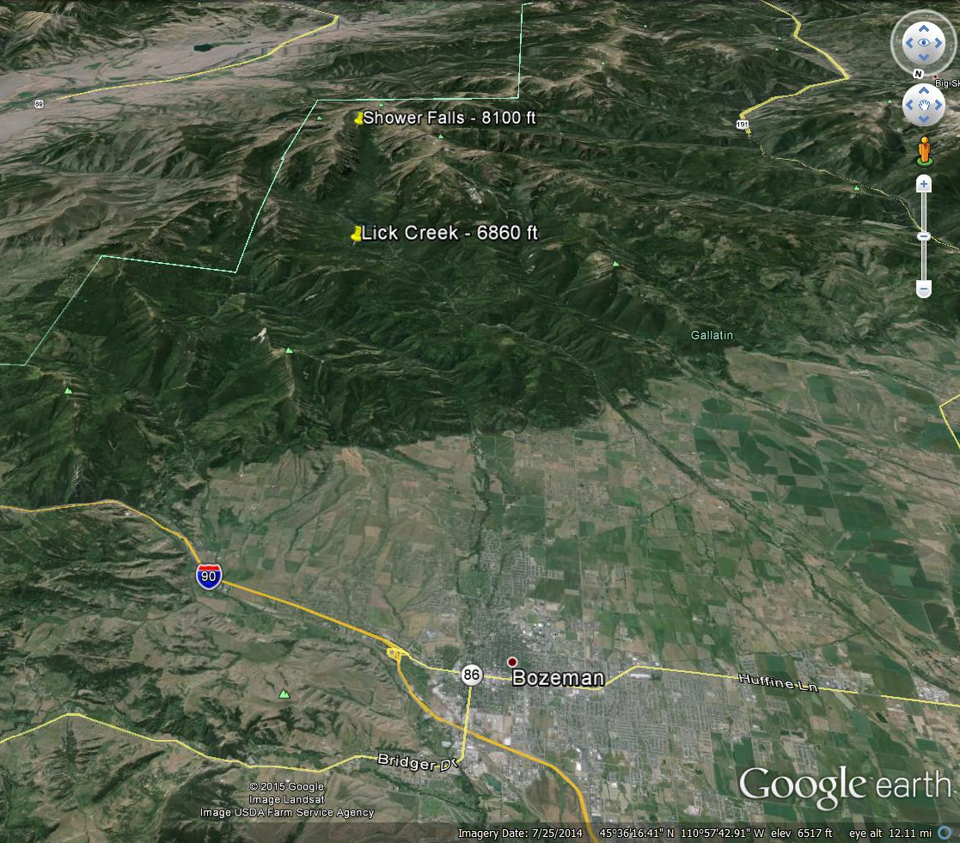
Precipitation: examples of hyetographs and orographic effect
41

Slide 42
Precipitation: the hyetograph
42
Bar graphs are more appropriate to avoid integration errors
Bar graphs help visualize the timing of precipitation events
Elevation = 6860 ft
Elevation = 8100 ft

Slide 43
Precipitation: the hyetograph (cumulative)
43
Annual total volume
Elevation = 6860 ft
Elevation = 8100 ft
Cumulative hyetographs are generally easier to compare across gauges and allow immediate visualization of total volumes
More precipitation
Less precipitation

Slide 44
Precipitation: risk and probabilistic analysis
44
For hydrograph: flood frequency analysis
Exceedance probability of annual maximum flow
Exceedance probability of annual maximum instantaneous flow
50 year return interval for annual maximum flow is 2000 m³ sec⁻¹
For hyetograph: depth (or intensity) duration frequency analysis
Exceedance probability of annual maximum <duration of interest> rainfall
Exceedance probability of annual maximum 2-hour rainfall
Storm duration

Slide 45
Precipitation: risk and probabilistic analysis
45
Exceedance probability of annual maximum 2-hour rainfall
13:00
13:30
14:00
14:30
15:00
15:30
16:00
16:30
17:00
This is not generally how the calculations are done for precipitation because it may not capture the highest precipitation rate over a given duration.
Depth 1
Depth 2
A “sliding window” summary statistic is used instead.

Slide 46




Precipitation: risk and probabilistic analysis
46
Exceedance probability of annual maximum 2-hour rainfall
Sliding window
13:00
13:30
14:00
14:30
15:00
15:30
16:00
16:30
17:00
Depth 1
Depth 2
Depth 3
Depth 4
Depth duration
frequency analysis
$$\frac{Depth 1}{2 hours}$$
$$\frac{Depth 2}{2 hours}$$
$$\frac{Depth 3}{2 hours}$$
$$\frac{Depth 4}{2 hours}$$
Intensity duration
frequency analysis

Slide 47
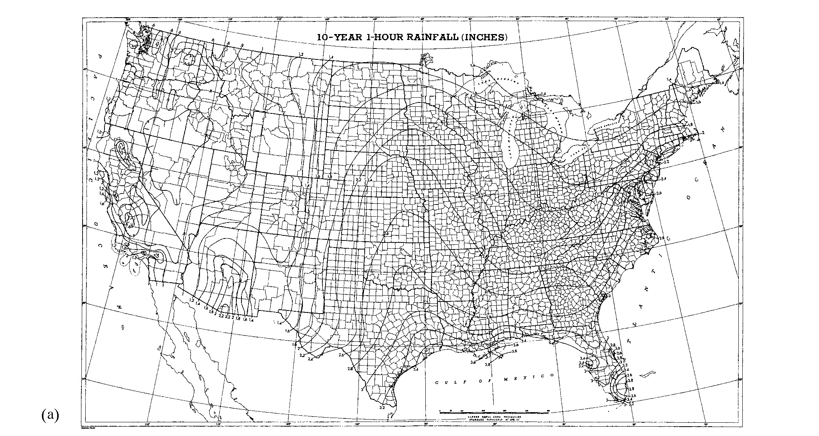
47
Figure 4.46 in Physical Hydrology 3rd Edition by Dingman

Slide 48
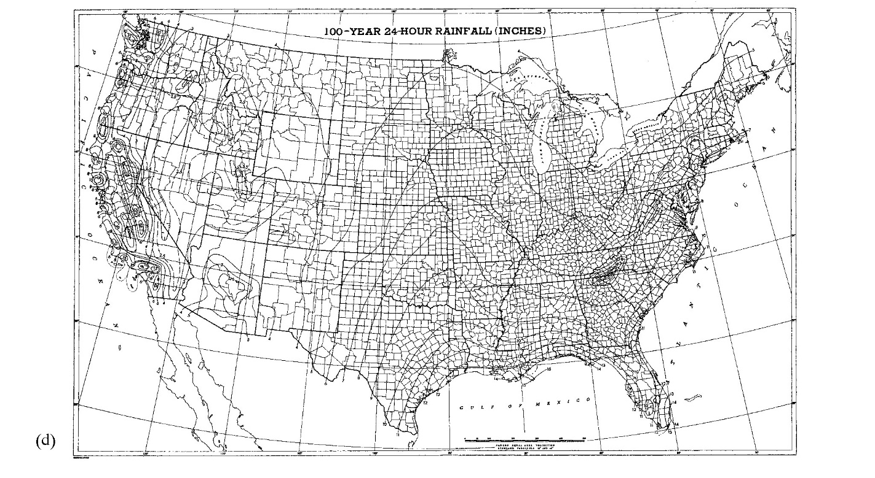
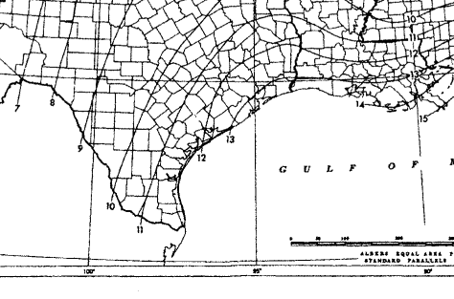
48
Figure 4.46 in Physical Hydrology 3rd Edition by Dingman

Slide 49
Precipitation: topics covered
49
Water in the air: the fundamental vocabulary and concepts necessary for characterizing the physics of water in the air
Causes of precipitation: the local and global circulations that generate the uplift necessary to cause meaningful precipitation
Types of precipitation: the conditions that dictate the physical state of precipitation (e.g. rain vs. snow)
Measurement of precipitation: the basics of measuring precipitation at given location and translating point measurements to estimates of precipitation over watersheds
Interpreting hyetographs: fundamentals of interpreting visualizations of precipitation over time and the typical summary statistics and probabilistic approaches to analyzing hyetographs
Snow hydrology: a brief introduction to understanding water storage in a seasonal snowpack, including consideration of the energy budget as the determinant of timing of snowmelt

Slide 50
Precipitation: rain vs. snow
50
Elevation = 6860 ft
Elevation = 8100 ft

Slide 51
Precipitation: storage in snowpack
51
Elevation = 6860 ft
Elevation = 8100 ft

Slide 52
Snowmelt
52
Elevation = 6860 ft
Elevation = 8100 ft

Slide 53














Snowmelt: water and heat budget
53
$$∆S_{W}=$$
$$P$$
$$−M$$
$$± E$$
$$∆S_{H}=$$
$$P_{H}$$
$$−M_{H}$$
$$±L_{E}$$
$$±H_{A}±H_{G}$$
$$+K$$
$$−K_{R}$$
$$±L$$
Ablation = Total loss =
Snowmelt + evaporation/sublimation
Advection
Albedo =
Potential to reflect radiation
Evaporation/
Sublimation/
Condensation
Heat in
Precipitation
Shortwave
Radiation
(insolation)
Reflected
shortwave
radiation
Sensible
air
Net
Longwave
Precipitation
Latent
P
E
P_{H}
L_{E}
H_{A}
K
K_{R}
L
Atmosphere
$∆S_{W}$ SWE
$∆S_{H}$ Temperature and specific heat
M
M_{H}
H_{G}
Earth
Snowmelt
Heat in
Snowmelt
Sensible
ground

Slide 54
Thought exercise: conditions for large melt events
54
What mechanisms of heat exchange are important to snowmelt on...?
Warm, sunny days
Shortwave radiation
Sensible and net longwave input from warm air
Rain on snow
Precipitation brings in heat and mobilizes water
Condensation (latent heat of vaporization)
Condensation (latent heat of fusion)

Slide 55
Snowmelt: periods and phases
55
Accumulation period
Temperature < 0 °C and multiday average change in temperature <= 0 C°
Melt period
Warming phase: temperature < 0 °C and multiday average change in temperature > 0 C° (sensible, specific heat of ice)
Ripening phase: temperature = 0 °C (isothermal), added heat melts water,
melt water retained by surface tension (latent heat of fusion)
Output phase: temperature = 0 °C (isothermal), added heat melts water,
weight of melt water overcomes surface tension (latent heat of fusion)

Slide 56
Snowmelt: periods and phases
56
Accumulation and warming phase
T < 0 °C
Ripening phase
T = 0 °C (isothermal)
Output phase
T = 0 °C (isothermal)
Snow (ice) particles
Liquid water

Slide 57
Sample problem: energy necessary to produce meltwater
57
The snow is 60 cm deep and has a water content (SWE) of 20 cm. If the current snow temperature is -3 °C, what is the area-normalized thermal energy needed to start producing melt water?
Step 1: How much heat is necessary to warm the snow to 0 °C ?
Warming phase
Step 2: How much latent heat is necessary to melt enough snow for the liquid to start overcoming tension?
Ripening phase

Slide 58
Warming Phase (Sensible Heat)
Equation 5.18d in Dingman Texbook:
Specific heat of ice, 2102 J kg⁻¹ K⁻¹
[E M⁻¹ Θ⁻¹]
Snow Water Equivalent
[L]
Cold Content, or net energy per area required complete the warming phase (warm the snow to its melting point)
[E L⁻²]
Average Snowpack Temperature minus Melting Point Temperature
[Θ]
Density of Water, 1000 kg m⁻³
[M L⁻³]
Mass of water (as ice) per unit area
[M L⁻²]
Notes:
Cold content = amount of energy to get to ripening phase (or to get snow to an isothermal state)
Sensible heat, Q = mC delta T (same here but normalized to area so dimensionality is a little different

Slide 59



Sample problem: energy necessary to produce meltwater
59
The snow is 60 cm deep and has a water content (SWE) of 20 cm. If the current snow temperature is -3 °C, what is the area-normalized thermal energy is needed to start producing melt water?
Step 1: How much heat is necessary to warm the snow to 0 °C?
$$U_{cc}=−c_{i}ρ_{w}h_{swe}\left(T_{s}−T_{m}\right)$$
$$−2$$
$$\left(\frac{1 MJ}{1000000 J}\right)$$
Warming phase
$$=−\left(2102 J kg^{−1}{°C}^{−1}\right)\left(1000 kg m^{−3}\right)\left(0.2 m\right)\left(−3 °C−0 °C\right)$$
$$=1.26 MJ m^{−2}$$
Step 2: How much heat is necessary to produce enough liquid water to start overcoming tension?
Ripening phase

Slide 60
Ripening Phase (Latent Heat)
(Equation 5.26 in Dingman Texbook}
Latent Heat of Fusion, 0.334 MJ/kg
[E M⁻¹]
Net energy per unit area to complete the ripening phase
[E L⁻²]
Liquid Water Holding Capacity
[L]
Maximum Volumetric Water Content Snow can retain against gravity
[L³ L⁻³]
(Equation 5.23 in Dingman Texbook)
(Equation 5.25 in Dingman Texbook)

Slide 61

Snow Water Equivalent, [L]
$$ρ_{s}=\frac{h_{SWE}}{h_{s}}ρ_{w}$$
The amount of water contained in snow, expressed as an area normalized volume
Equation 5.10 in Dingman Texbook:
melting
h_{s}
Snow Water Equivalent
[L]
Snowpack depth
[L]
Ratio of snow and water density
[-]
h_{SWE}
Notes:
Area normalization

Slide 62




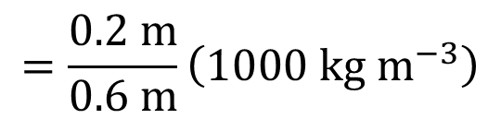
Sample problem: energy necessary to produce meltwater
62
The snow is 60 cm deep and has a water content (SWE) of 20 cm. If the current snow temperature is -3 °C, what is the area-normalized thermal energy is needed to start producing melt water?
Step 1: How much heat is necessary to warm the snow to 0 °C?
$$U_{cc}=−c_{i}ρ_{w}h_{swe}\left(T_{s}−T_{m}\right)$$
$$−2$$
$$\left(\frac{1 MJ}{1000000 J}\right)$$
Warming phase
$$=−\left(2102 J kg^{−1}{°C}^{−1}\right)\left(1000 kg m^{−3}\right)\left(0.2 m\right)\left(−3 °C−0 °C\right)$$
$$=1.26 MJ m^{−2}$$
Step 2: How much heat is necessary to produce enough liquid water to start overcoming tension?
$$ρ_{s}=\frac{h_{SWE}}{h_{s}}ρ_{w}$$
$$=\frac{0.2 m}{0.6 m}\left(1000 kg m^{−3}\right)$$
$$=333 kg m^{−3}$$
$$θ_{ret}=\left(3×{10}^{−10}\right)ρ_{s}^{3.23}$$
$$=\left(3×{10}^{−10}\right){\left(333 kg m^{−3}\right)}^{3.23}$$
Ripening phase

Slide 63
Sample problem: energy necessary to produce meltwater
63
The snow is 60 cm deep and has a water content (SWE) of 20 cm. If the current snow temperature is -3 °C, what is the area-normalized thermal energy is needed to start producing melt water?
Step 1: How much heat is necessary to warm the snow to 0 °C?
$$U_{cc}=−c_{i}ρ_{w}h_{swe}\left(T_{s}−T_{m}\right)$$
$$−2$$
$$\left(\frac{1 MJ}{1000000 J}\right)$$
Warming phase
$$=−\left(2102 J kg^{−1}{°C}^{−1}\right)\left(1000 kg m^{−3}\right)\left(0.2 m\right)\left(−3 °C−0 °C\right)$$
$$=1.26 MJ m^{−2}$$
Step 2: How much heat is necessary to produce enough liquid water to start overcoming tension?
$$ρ_{s}=\frac{h_{SWE}}{h_{s}}ρ_{w}$$
$$=\frac{0.2 m}{0.6 m}\left(1000 kg m^{−3}\right)$$
$$=333 kg m^{−3}$$
$$θ_{ret}=\left(3×{10}^{−10}\right)ρ_{s}^{3.23}$$
$$=\left(3×{10}^{−10}\right){\left(333 kg m^{−3}\right)}^{3.23}$$
Ripening phase
Not going to give the right units ?!?! Are we wrong?
No, this is an empirical approximation. We are not wrong, but it’s a hint we need to be VERY careful with units.

Slide 64




Sample problem: energy necessary to produce meltwater
64
The snow is 60 cm deep and has a water content (SWE) of 20 cm. If the current snow temperature is -3 °C, what is the area-normalized thermal energy is needed to start producing melt water?
Step 1: How much heat is necessary to warm the snow to 0 °C?
$$U_{cc}=−c_{i}ρ_{w}h_{swe}\left(T_{s}−T_{m}\right)$$
$$−2$$
$$\left(\frac{1 MJ}{1000000 J}\right)$$
Warming phase
$$=−\left(2102 J kg^{−1}{°C}^{−1}\right)\left(1000 kg m^{−3}\right)\left(0.2 m\right)\left(−3 °C−0 °C\right)$$
$$=1.26 MJ m^{−2}$$
Step 2: How much heat is necessary to produce enough liquid water to start overcoming tension?
$$ρ_{s}=\frac{h_{SWE}}{h_{s}}ρ_{w}$$
$$=\frac{0.2 m}{0.6 m}\left(1000 kg m^{−3}\right)$$
$$=333 kg m^{−3}$$
$$θ_{ret}=\left(3×{10}^{−10}\right)ρ_{s}^{3.23}$$
$$=\left(3×{10}^{−10}\right){\left(333 kg m^{−3}\right)}^{3.23}$$
$$=0.0421 m^{3} m^{−3}$$
Ripening phase
$$−2$$
$$U_{r}=θ_{ret}h_{s}ρ_{w}λ_{f}$$
$$=\left(0.0421\right)\left(0.6 m\right)\left(1000 kg m^{−3}\right)(0.334 MJ kg^{−1})$$
$$=8.44 MJ m^{−2}$$
Step 3: Sum
$9.70 MJ m^{−2}$ is necessary for the snowpack to start producing melt water

Slide 65

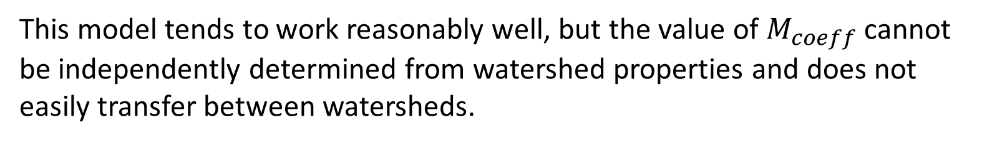
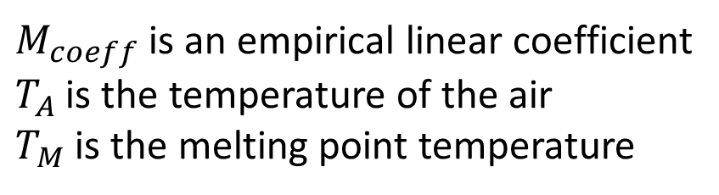
Snowmelt: simple temperature index models
65
Temperature index approach (empirical)
The mechanisms of heat input all tend to correlate with air temperature
$$M=M_{coeff}\left(T_{A}−T_{M}\right) T_{A}≥T_{M}$$
$$M=0 T_{A}<T_{M}$$
$M_{coeff}$ is an empirical linear coefficient
$T_{A}$ is the temperature of the air
$T_{M}$ is the melting point temperature
This model tends to work reasonably well, but the value of $M_{coeff}$ cannot be independently determined from watershed properties and does not easily transfer between watersheds.

Slide 66
Precipitation: topics covered
66
Water in the air: the fundamental vocabulary and concepts necessary for characterizing the physics of water in the air
Causes of precipitation: the local and global circulations that generate the uplift necessary to cause meaningful precipitation
Types of precipitation: the conditions that dictate the physical state of precipitation (e.g. rain vs. snow)
Measurement of precipitation: the basics of measuring precipitation at given location and translating point measurements to estimates of precipitation over watersheds
Interpreting hyetographs: fundamentals of interpreting visualizations of precipitation over time and the typical summary statistics and probabilistic approaches to analyzing hyetographs
Snow hydrology: a brief introduction to understanding water storage in a seasonal snowpack, including consideration of the energy budget as the determinant of timing of snowmelt

