Slide 1
Derivation of a saturating hyperbolic model

Slide 2

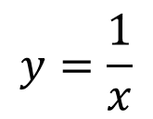

The hyperbola
Asymptotes on $x=0$
$$y=\frac{1}{x}$$
Asymptotes on $y=0$

Slide 3

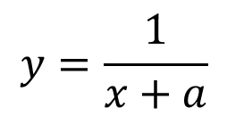


Asymptotes on $x=0$
The hyperbola
$$y=\frac{1}{x}$$
$$x≥0$$
$$y=\frac{1}{x+a}$$
a
Asymptotes on $y=0$

Slide 4
The hyperbola
$$y=\frac{1}{x}$$
$$x≥0$$
$$y=\frac{1}{x+a}$$
Asymptotes on $y=0$

Slide 5

The hyperbola
$$y=\frac{1}{x}$$
$$x≥0$$
$$y=\frac{1}{x+a}$$
$$?$$
Asymptotes on $y=0$

Slide 6
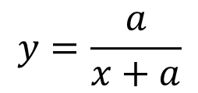
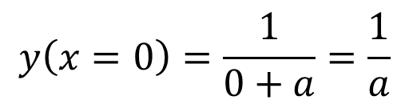


The hyperbola
$$y=\frac{1}{x}$$
$$1$$
$$x≥0$$
$$y=\frac{1}{x+a}$$
$$\frac{1}{a}$$
Rescale
$$y\left(x=0\right)=\frac{1}{0+a}=\frac{1}{a}$$
$$y=\frac{a}{x+a}$$
Asymptotes on $y=0$

Slide 7

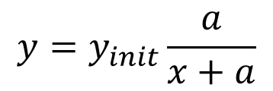
Hyperbolic decay
$$y=\frac{1}{x}$$
$$y_{init}$$
$$x≥0$$
$$y=\frac{1}{x+a}$$
$$y\left(x=0\right)=\frac{1}{0+a}=\frac{1}{a}$$
$$y=\frac{a}{x+a}$$
Asymptotes on $y=0$
$$y=y_{init}\frac{a}{x+a}$$

Slide 8
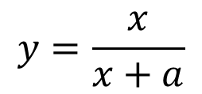
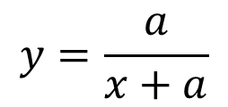

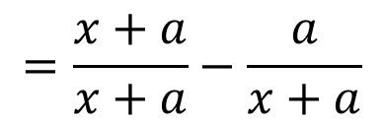
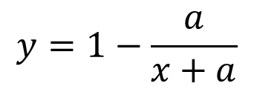
Hyperbolic saturation
$$y=\frac{a}{x+a}$$
$$1$$
Asymptotes on $y=1$
$$y=1−\frac{a}{x+a}$$
$$=\frac{x+a}{x+a}−\frac{a}{x+a}$$
Flip on y-axis
$$y=\frac{x}{x+a}$$
Asymptotes on $y=0$

Slide 9
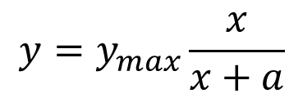


Hyperbolic saturation
$$y=\frac{a}{x+a}$$
$$y_{max}$$
Asymptotes on $y=y_{max}$
$$y=1−\frac{a}{x+a}$$
$$=\frac{x+a}{x+a}−\frac{a}{x+a}$$
$$y=\frac{x}{x+a}$$
$$y=y_{max}\frac{x}{x+a}$$

Slide 10
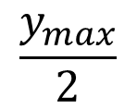
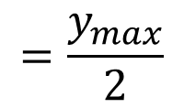
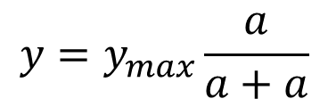
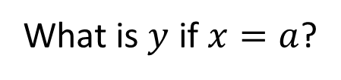
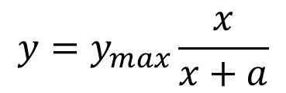

Hyperbolic saturation
$$y=y_{max}\frac{x}{x+a}$$
$$y_{max}$$
Asymptotes on $y=y_{max}$
What is $y$ if $x=a$?
$$y=y_{max}\frac{a}{a+a}$$
$$=\frac{y_{max}}{2}$$
$$\frac{y_{max}}{2}$$
$$a$$

Slide 11

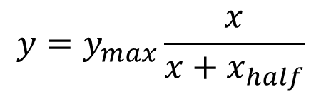

Hyperbolic saturation
$$y=y_{max}\frac{x}{x+a}$$
$$y_{max}$$
Asymptotes on $y=y_{max}$
What is $y$ if $x=a$?
$$y=y_{max}\frac{a}{a+a}$$
$$=\frac{y_{max}}{2}$$
$$\frac{y_{max}}{2}$$
$$a=x_{half}$$
$$y=y_{max}\frac{x}{x+x_{half}}$$
$$x_{half}$$

Slide 12
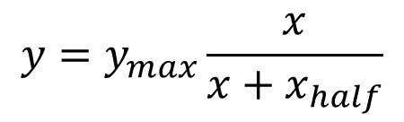
Hyperbolic saturation
$$y=y_{max}\frac{x}{x+x_{half}}$$
$$y_{max}$$
Asymptotes on $y=y_{max}$
$$\frac{y_{max}}{2}$$
$$x_{half}$$

