Slide 1


Multiple Measures -
Observation
Principal Professional Learning
Professional Growth and Evaluation Series
April 5, 2023

Slide 2

Shared Norms
Be on time and prepared
Stay engaged
Respect all voices
Assume best intent
Notes:
Time: 1 minute
Presenter Notes:: Welcome and remind of norms

Slide 3
Elementary Presenters
Rick Anthony Assistant Superintendent
Jon Adams Leadership and Improvement Director
Secondary Presenters
Cindy Dunn Leadership and Improvement Director
Bill Kenley Director of Administrative Onboarding
Afternoon Presenters
Bill Kenley Director of Administrator Onboarding
Cindy Dunn Leadership and Improvement Director
Notes:
Time: 1 minute
Presenter Notes: share information

Slide 4
Afternoon Session
1:30
Jones Center
Assistant Principal Opportunity
Notes:
Time: 1 minute
Presenter Notes: Reminder of opportunity for assistant principals

Slide 5
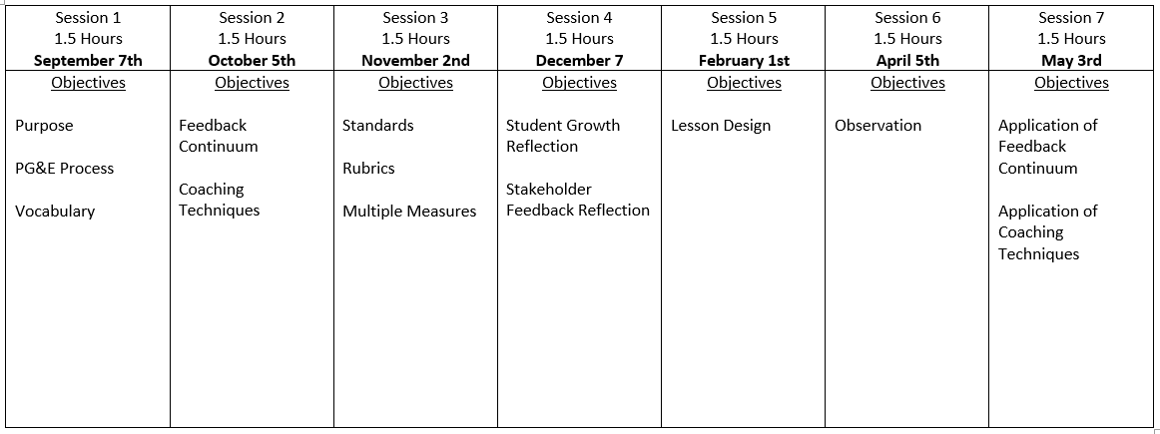
Notes:
Time: 1 minute
Presenter Notes: Review objective for today and for upcoming presentation

Slide 6
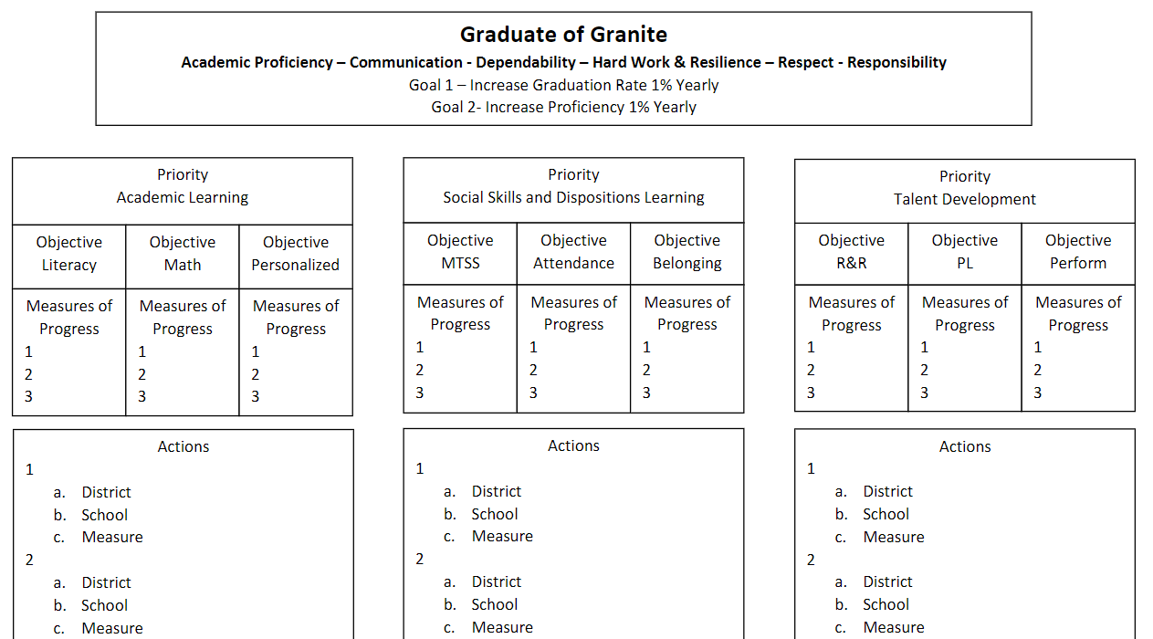
Notes:
Time: 1 minute
Presenter Notes: Review how this professional learning connects with the Graduate of Granite Strategic Plan

Slide 7


Objectives
Principals will understand how observation is one of multiple measures in performance evaluation.
Principals will know observation best practices in relation to educator standards.
Notes:
Time: 1 minute
Presenter Notes: Review Objectives for today’s learning session

Slide 8
Domain 2: Collective Commitment to Learning
2A. Continuous Improvement Culture
Builds a professional culture of collaboration, transparency, and responsibility for student learning by encouraging a cycle of planning, performing, analysis of outcomes, and adjusting practice. Personally engages in the improvement cycle by continually deepening understanding and practice related to content standards, assessment, data, capacity building, evaluation, feedback, and professional learning processes.
2B. Human Capital Development
Recruits, hires, places, and retains effective staff members. Builds the capacity of staff through personnel evaluation processes that develop and improve professional practice by providing focus, opportunities to practice, and specific, timely, and actionable feedback.
2C. Instructional Practice
Works with individuals and a variety of groups to ensure the use of Utah Core Standards, the district provided tools, data in assessing student learning, collaborative problem solving, and adjustment to evidence-based instruction to meet student learning needs.
Notes:
Time: 1 Min
Presenter Notes: Review Leadership Standards for today’s learning

Slide 9
Observation v. Evaluation
Historical Use of Observation and Evaluation
Notes:
Time: 5 Min
Presenter Notes: Explain the historical shifts in platforms and tools. Ask some veterans to share their experience in the shifts.
We are guilty of our platform and our process emphasizing Observation as evaluation.
Explain how our current mindset creates the belief that observation is all there is to evaluation and that we need to start to consider multiple measures in addition to observation.

Slide 10
Multiple Measures and Evaluation
Reflection on stakeholder input - December
Reflection on student growth - December
Lesson design review - February
Observation - April
Notes:
Time: 5 Min
Presenter Notes: Educator Standards can be observed in settings other than just the classroom. The series this year has covered four areas that can provide evidence to use in generating feedback.

Slide 11
Observation v. Evaluation
Table Discussion -
What is problematic with an evaluation being solely based on classroom observation?
Notes:
Time: 10 Min
Presenter Notes: Take 5 minutes at your table to discuss. Share out 5 minutes.

Slide 12
Quick Read-Granite Educator Standards
Which Educator Standards align with observation?
Domain 1- and Assessment
Domain 2- Planning and Preparation
Domain 3- Learning Environment
Domain 4- Professional Responsibilities
Notes:
Time: 5 Min
Presenter Notes: What do you notice about the connections between the domains and lesson design? Pull from educator standards and do a shout out…. Find an indicator that is most closely aligned to classroom observation? Find an indicator that is most closely aligned to an observation you have made outside of the classroom. Whole Group Share Out.

Slide 13
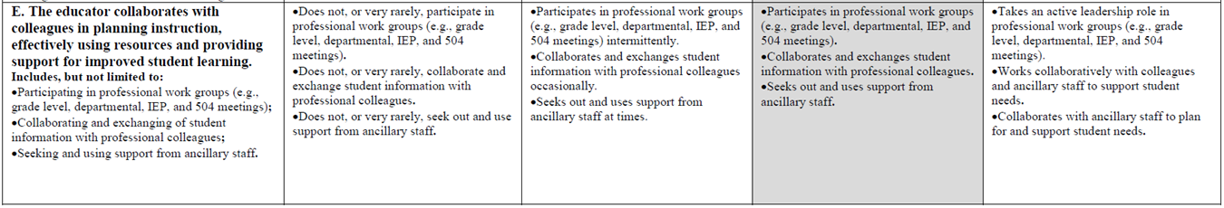
Multiple Measures
Notes:
Time: 3 Min
Presenter Notes: Example of a standard that is not well seen in classroom observation.
Emphasize in indicators - Includes but not limited to

Slide 14
Classroom Observation vs. Observation
Classroom
PLC
Committee
General Interactions
Notes:
Time: 1 Min
Presenter Notes: Emphasize educator standards can be observed in settings other than just the classroom.

Slide 15
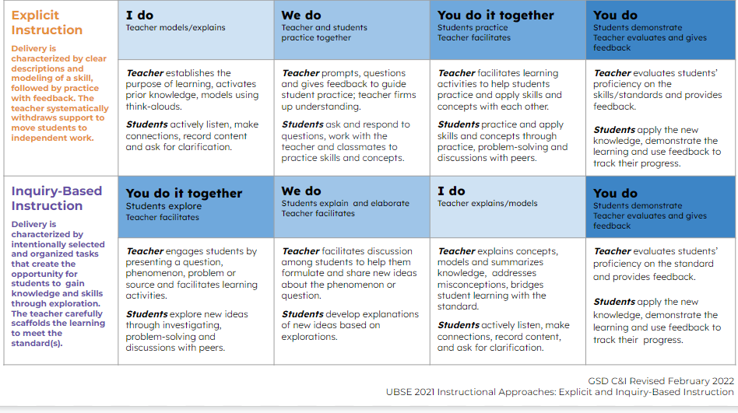
Notes:
Time: 3 Min
Presenter Notes: Review from last Month.
Note that in a classroom observation I might only see I do or We do or You do - it depends on when and how long you are observing. Even if you were there for over an hour, you may only see we do.

Slide 16
Classroom Observation
The teacher is presenting | The students are working together without the teacher
The teacher and students are working together | The students are working independently
You do together
I do
We do
You do
Notes:
Time: 2 Min
Presenter Notes: Here we have provided a translation or definition of I Do - We do - You do Together - You do.

Slide 17
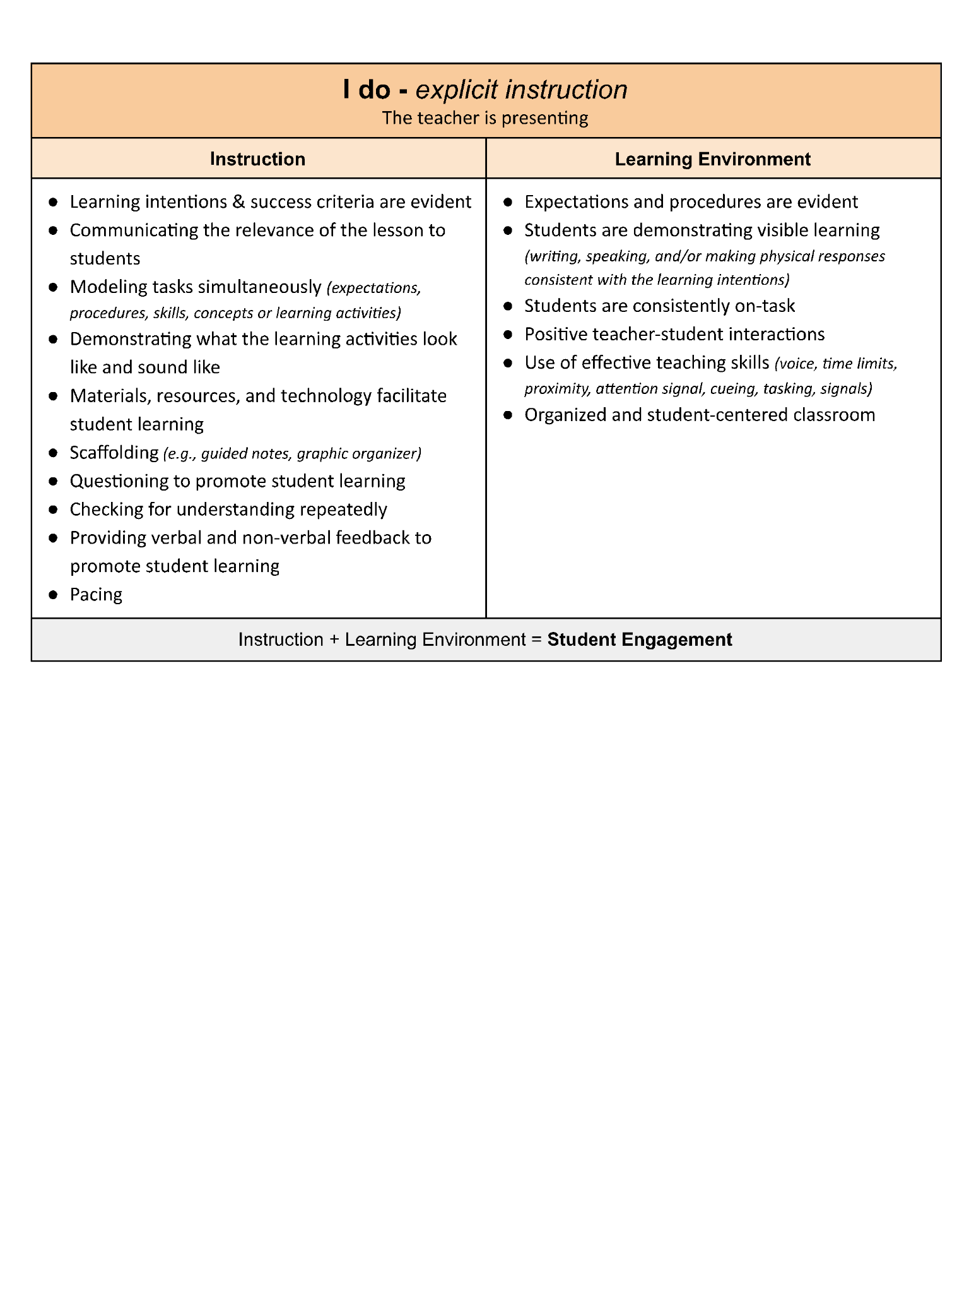
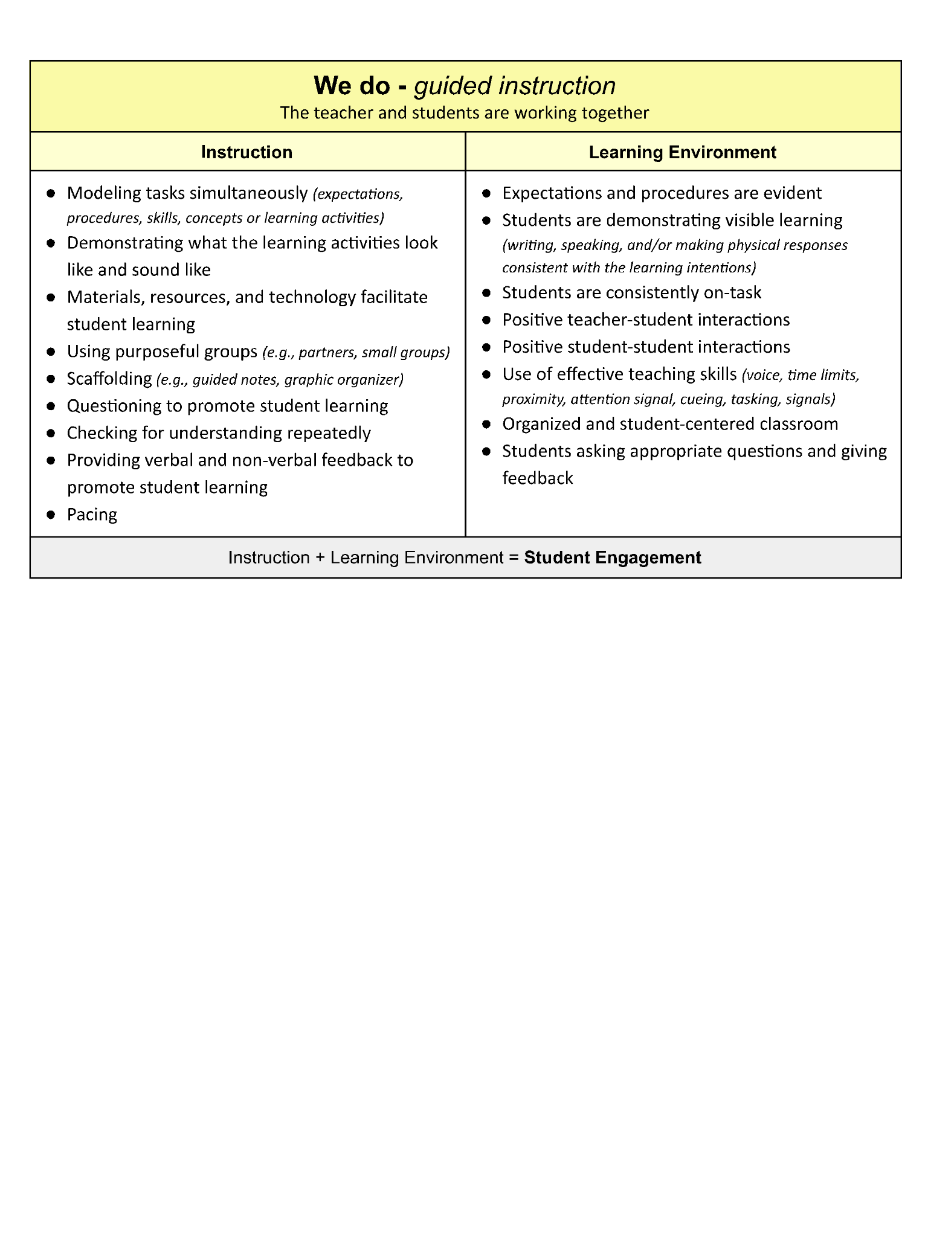
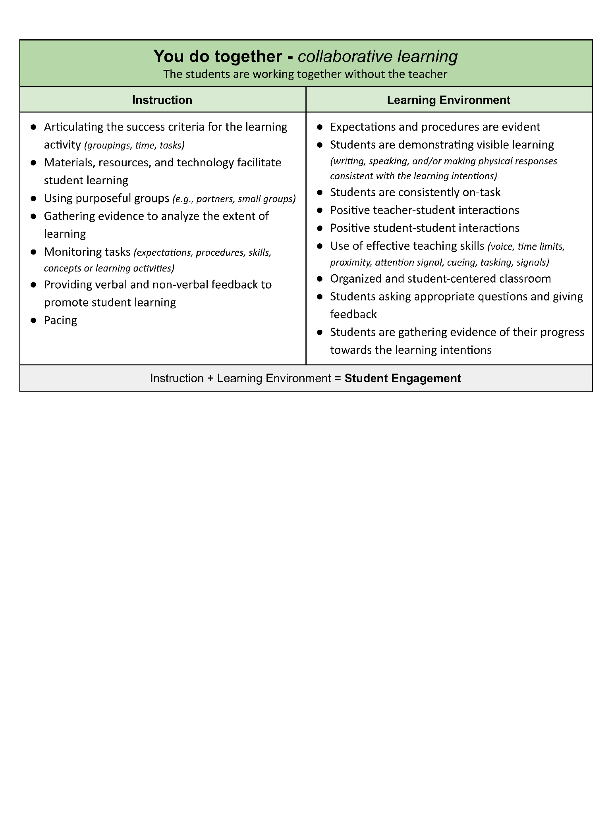
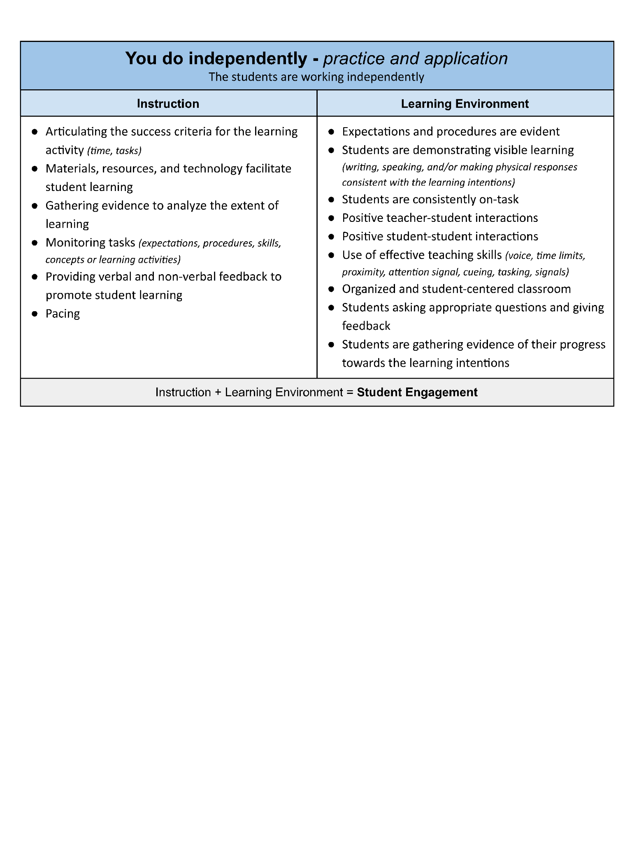
Granite’s Best Practices
Refer to the appropriate section for Granite’s Best Practices of instruction and learning environment.
The teacher is presenting | The students are working together without the teacher
The teacher and students are working together | The students are working independently
Common to all
https://docs.google.com/document/d/1MunRtJnBbi7RyesFndy8He9-ioJH05TMgsQe4I7Q2AY/edit?usp=sharing
Notes:
Time: 2 Min
Presenter Notes: Point out to participants that there we have provided a specific sheet for each of the 5 areas we are going to discuss.
Link: https://docs.google.com/document/d/1MunRtJnBbi7RyesFndy8He9-ioJH05TMgsQe4I7Q2AY/edit?usp=sharing

Slide 18
Granite’s Best Practices
Instruction (Lesson Design & Delivery) | Learning Environment (Classroom Culture and Behavior Supports)
Instruction + Learning Environment = Student Engagement
When student engagement is suffering, then that signals that the instruction, learning environment, or both are not effective.
Notes:
Time: 3 Min
Presenter Notes: Orient the participants to how this has been organized in Best Practice sheets.
For the purpose of Granite’s Best Practices sheets we have combined Lesson Design and Delivery to be Instruction. We have combined Classroom Culture and Behavior Supports to be Learning Environment.
Instruction consists of lesson design and delivery.
Learning environment includes classroom culture and behavior supports.

Slide 19
Granite’s Best Practices
Common To All 4 Stages
Instruction | Learning Environment
Instruction + Learning Environment = Student Engagement
When student engagement is suffering, then that signals that the instruction, learning environment, or both are not effective.
Notes:
Time: 3 Min
Presenter Notes:
The slide is animated to allow you to point out that there are two columns on each sheet and they are always labeled “Instruction” and “Learning Environment.” These columns will eventually hold a bulleted list of things you can look for when doing a classroom observation.
Make sure to discuss that Student Engagement is the “result of” effective instruction and an effective learning environment. Once we realize that student engagement is a “result of” other elements being effective, then we don’t place it within the two columns. Instead, when student engagement is not happening, that signals that the instruction, learning environment, or both are not effective.

Slide 20
Granite’s Best Practices
Common to All Four Stages
Instruction | Learning Environment
Materials, resources, and technology facilitate student learning Providing verbal and non-verbal feedback to promote student learning Pacing Checking for understanding Use of effective teaching skills (voice, time limits, proximity, attention signal, cueing, tasking) | Expectations and procedures are evident Learning intentions and success criteria are evident Students are demonstrating visible learning (writing, speaking, and/or making physical responses consistent with the learning intentions) Students are consistently on-task Positive teacher-student interactions (praise, use of student names) Organized and student-centered classroom Smooth Transitions
Instruction + Learning Environment = Student Engagement
Notes:
Time: 2 Min
Presenter Notes: Review there are best practices common to any time. Review bullets.

Slide 21
Granite’s Best Practices
I do The teacher is presenting
Instruction | Learning Environment
Communicating the relevance of the lesson to students Modeling tasks simultaneously (expectations, procedures, skills, concepts or learning activities) Demonstrating what the learning activities look like and sound like Scaffolding (e.g., guided notes, graphic organizer) Questioning to promote student learning | See Common to All
Instruction + Learning Environment = Student Engagement
Notes:
Time: 6 mins Explanation (1 mins) Review all four sheets individually (6 mins)
Explain that you will be seeing four different sheets with bullets representing Granite’s Best Practices. Explain there will a total of 5 minutes, which breaks down to just over a minute per sheet.

Slide 22
Granite’s Best Practices
We do The teacher and students are working together
Instruction | Learning Environment
Modeling tasks simultaneously (expectations, procedures, skills, concepts or learning activities) Demonstrating what the learning activities look like and sound like Using purposeful groups (e.g., partners, small groups) Scaffolding (e.g., guided notes, graphic organizer) Questioning to promote student learning | Positive student-student interactions Students responding and giving feedback
Instruction + Learning Environment = Student Engagement

Slide 23
Granite’s Best Practices
You do together The students are working together without the teacher
Instruction | Learning Environment
Articulating the success criteria for the learning activity (groupings, time, tasks) Using purposeful groups (e.g., partners, small groups) Gathering evidence to analyze the extent of learning Monitoring tasks (expectations, procedures, skills, concepts or learning activities) | Positive student-student interactions Students responding and giving feedback Students are gathering evidence of their progress towards the learning intentions
Instruction + Learning Environment = Student Engagement

Slide 24
Granite’s Best Practices
You do independently The students are working independently
Instruction | Learning Environment
Articulating the success criteria for the learning activity (time, tasks) Gathering evidence to analyze the extent of learning Monitoring tasks (expectations, procedures, skills, concepts or learning activities) | Students responding and giving feedback Students are gathering evidence of their progress towards the learning intentions
Instruction + Learning Environment = Student Engagement

Slide 25
Learning Activity: Observation Practice
We will be watching short video clips of Granite District classrooms. We will see each video and take notes. This process will enable us to become familiar with the Granite Best Practices sheets in real time and with real teachers.
DIRECTIONS:
VIDEO CLIPS
Watch the video and figure out which stage of the lesson you are observing AND select the appropriate Best Practices sheet to use.
As you watch the video take notes. You can mark up the table and take notes in the blank portion at the bottom of the sheet.
TABLE DISCUSSION
Discuss both what you observed and what you wrote on your sheet.
Notes:
Time: 5
Presenter Notes: See slide for instructions - be explicit, check they understand.
Best Practices Sheets
https://docs.google.com/document/d/1MunRtJnBbi7RyesFndy8He9-ioJH05TMgsQe4I7Q2AY/edit?usp=sharing

Slide 26
Example #1
https://drive.google.com/file/d/12P44b6L7YIOZtMK7jiyKkkcia9G-2hsQ/view?usp=sharing
Notes:
Time: 10 mins Example #1
Presenters Notes: Don’t tell the participants what part of the lesson they are observing. You want them to figure that out as they watch - what they select does not matter as much as they are looking for the parts of the lesson and can identify best practices.
DIRECTIONS:
2 mins Which part of the lesson you are observing AND select the appropriate Best Practices sheets to use.
3 mins Mark up the table and jot notes in the blank portion at the bottom of the sheet.
5 mins Discuss both what you observed and what you jotted on your sheet.

Slide 27
Example #2
Select one:
ELEMENTARY
https://drive.google.com/file/d/1GjglSgFGkpBI2IxSh0qV-gaxkgL7Jgmv/view?usp=sharing
HIGH SCHOOL
https://drive.google.com/file/d/1-KrdfY5CqyL3KSGQZubbRvvu8HFfJIM6/view?usp=sharing
Notes:
Time: 10 mins Example #2 - ELEMENTARY or High School.
Presenters Notes: Don’t tell the participants what part of the lesson they are observing. You want them to figure that out as they watch - what they select does not matter as much as they are looking for the parts of the lesson and can identify best practices.
DIRECTIONS:
2 mins Which part of the lesson you are observing AND select the appropriate Best Practices sheets to use.
3 mins Mark up the table and jot notes in the blank portion at the bottom of the sheet.
5 mins Discuss both what you observed and what you jotted on your sheet.

Slide 28
Example #3
https://drive.google.com/file/d/1xCj2m5ZpQzKukn5Bfo8VJDqtXLq77s84/view?usp=sharing
Notes:
Time: 10 mins Example #3
Presenters Notes: Don’t tell the participants what part of the lesson they are observing. You want them to figure that out as they watch - what they select does not matter as much as they are looking for the parts of the lesson and can identify best practices.
DIRECTIONS:
2 mins Which part of the lesson you are observing AND select the appropriate Best Practices sheets to use.
3 mins Mark up the table and jot notes in the blank portion at the bottom of the sheet.
5 mins Discuss both what you observed and what you jotted on your sheet.

Slide 29
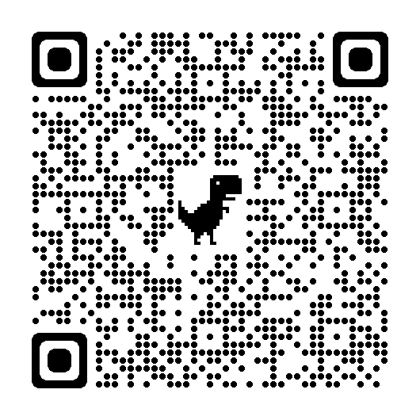
Wrap Up
Please give us your feedback:
Survey
Notes:
Time: 5 min
Presenters Notes: The reality is deciding is complex and not linear. What we are providing is not lock step instructions, we are providing guard rails.
Ask participants to share what they discovered in the exercises at their tables.

Slide 30
Wrap Up
Notes:
Time: 5 min
Presenters Notes: The reality is deciding is complex and not linear. What we are providing is not lock step instructions, we are providing guard rails.
Ask participants to share what they discovered in the exercises at their tables.

