Slide 1


India's Next
Renewable Energy Unicorn.
'Some People and Companies Invest and Make Money; Some People and Companies Invest and Make a Difference for Generations and Make Money' - Which are You?
www.enigma-tech.io

Slide 2

‘Necessity, is the Mother of All Invention’
Enigmasoft Technologies, A Unique Tech Start Up Marrying Market Leading Software & Globally Unique Physical Engineering, Global Outsourcing & Multiple Patent IP’s.
We do not restrict ourselves to specific technologies as Technology is ingrained in our DNA. We started as a bespoke software application firm and then opened our minds.We provide our services and develop productivity solutions because of the lack of trained workers in Western economies and our benefit of being located in India, the world's IT capital.
Unlike other outsourcing and software enterprises, we are a hybrid of incubator and outsourcing company. We help start up’s develop and accelerate and take equity and long-term outsourcing contracts.
‘Be The Change You Want to See in the World’
www.enigma-tech.io
‹#›

Slide 3

Global Crisis – Problem
Global Temperature to rise by 2⁰C by 2100
Mass Starvation and Human Displacement
Unlivable Equatorial Regions
Sea and Ocean Acidification
Mass Floodings, Droughts, Wildfires
Massive Global Economic Losses
7th Global Mass Extinction of Species
‘This is Humanity’s Trajectory right now. Very avoidable through science, innovation and commerce’.
www.enigma-tech.io
‹#›

Slide 4
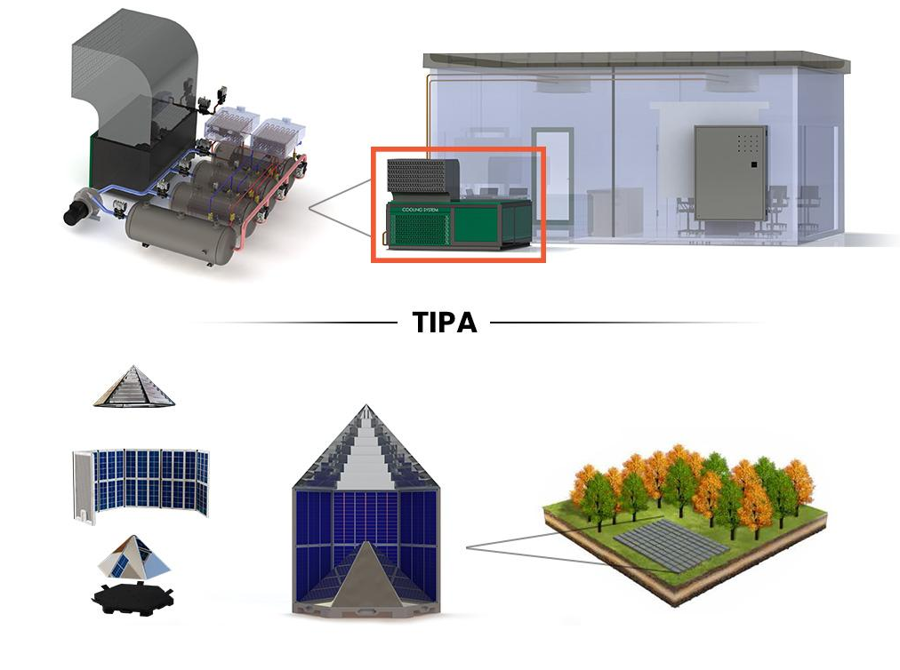
SSCCO2T - Sequential Sublimation Condensation Carbon Dioxide Turbine
We are on the verge of massively mitigating climate change.
A new solar system called TIPA and a new cooling and electricity generation system called SSCCO2T cooling.
Unique Global Patents on Zero Emission Technology saving millions of tonnes of Carbon Dioxide
Up to 50% reduction in cost of electricity generation.
Fully scalable and Global Market
Economic value worth billions of dollars upon full development
Low Technological Development Risk – utilising established technologies in new novel processes.
Fast Time to Market
Combined Patent Technologies to reduce GLOBAL Carbon Dioxide Emissions by up to 10%
TIPA - Total Internal Photonic Absorption
‘If properly resourced, science has a solution for every man-made problem!’
It is worth billions once the full prototype is developed.
www.enigma-tech.io
‹#›

Slide 5
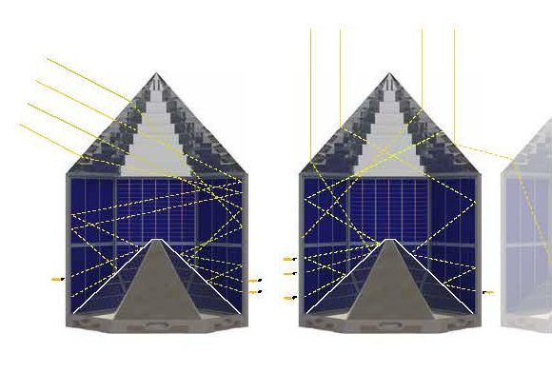
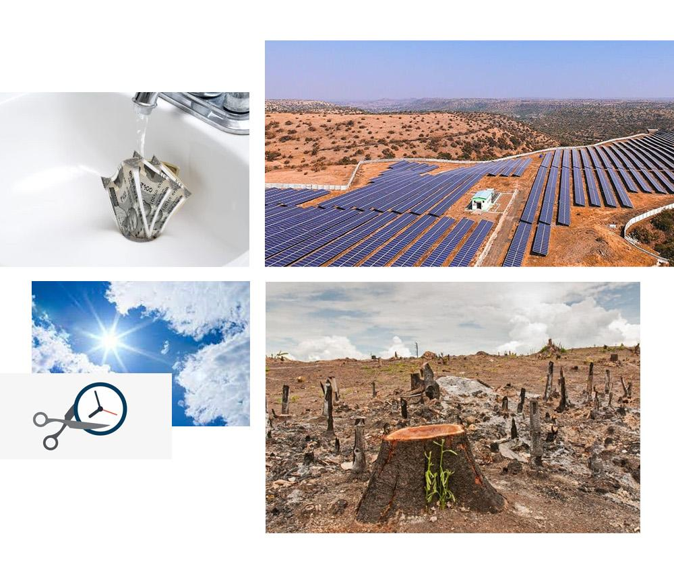
Problem - 1
Solution
Crucial drawbacks of conventional solar panels:
TIPA is a specially designed photo-voltaic and heat capture hybrid system. The TIPA system in general allows us to capture solar energy within the interior of the module and convert the photons into electricity by means of specially oriented and shaped solar cells.
Less sun hours. Power generation duration is only for 05:30 hours daily
Energy density should improve
Land area required is more, it occupies 49.16 m² area with respect to 10kW
Installation cost is high, on an average Rs 98742/-
High maintenance cost, on an average Rs 15000/- per year
‹#›

Slide 6

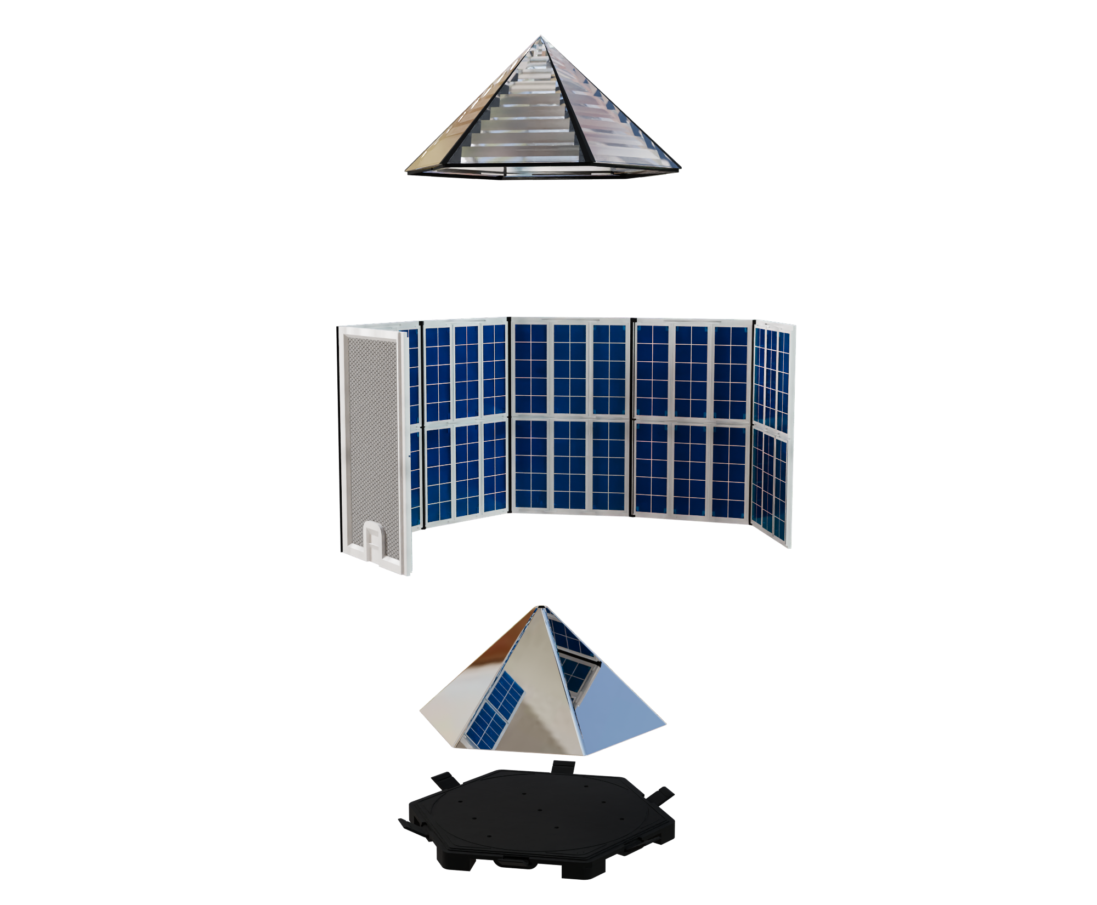
Global Crisis – Mitigation
Science and Innovation will Stop Climate Change and not Policies. If we can send rockets to Mars, we can create energy without Fossil Fuels. A Global Governmental Consensus is missing, so without an Affordable Scientific Solution, climate change cannot be averted.
Total Internal Photonic Absorption – TIPA
Up to 50% lower cost of generation compared to existing PV Panels
70% lower land area required
Lower Cost of Maintenance
Scalable – Suitable for On-Grid and Off Grid use
Lighter, faster to manufacture and can be manufactured with existing technologies
Combined Heat and Power Patents being developed. Large Patent Pipeline
www.enigma-tech.io
‹#›

Slide 7

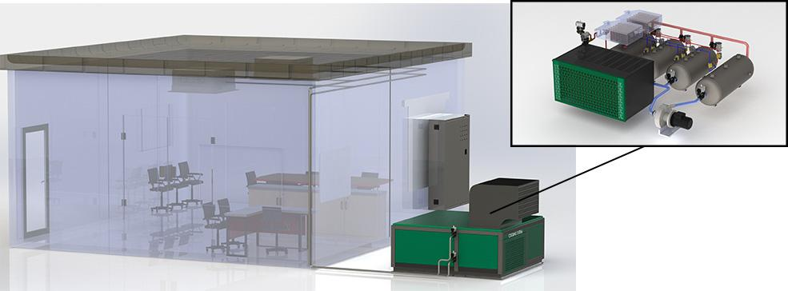
Problem - 2
Solution
The World is heating up due to climate change. As a result, more energy is expended on cooling habitable areas, data centers and industries.
This energy is produced by fossil fuels, which contributes to increased heat, greater climate change, and increased cooling needs, which in turn results in more climate change.
Data Centres, Offices, Hotels, Shops, Malls and Houses all require cooling. Energy cannot be created or destroyed, only changed in form. This is the principle of SSCCO2T.
SSCCO2T Cooling converts the extracted heat to electricity instead of just expelling it
Low grade energy is concentrated to create pressure to turn an electricity generator
No Fossil Fuels or Emissions
Can be retro-fitted to existing Air Conditioning and Cooling Systems
Lower cost than any cooling system in the world
Total Global Market Size ($150 billion annually)
Low development Risks. Existing technology in a new process
www.enigma-tech.io
‹#›

Slide 8

Outsourcing Valuation
India is already the IT Capital of the World but Covid 19 has changed perceptions of outsourcing. Small and Medium Enterprises are open to outsourcing and utilising remote working to their advantage.
In 2021/2022, Enigmasoft Technologies profits was 27 Crore. This reduced in 2022/2023 due to the focus on renewable technologies and IP but is due to increase to 20 crore due to multiple contracts signed with UK companies in FinTech and Telecoms.
‹#›

Slide 9
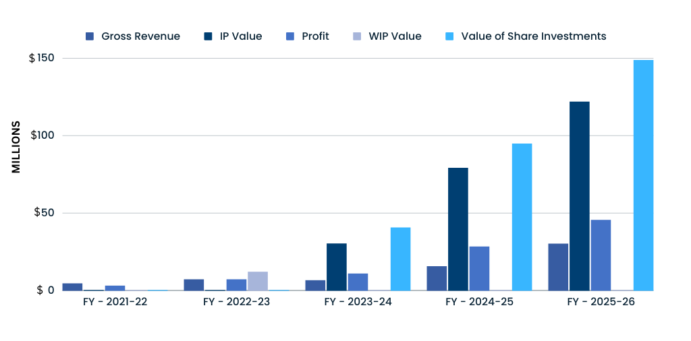

Financial Projections
IP Value
$100M
www.enigma-tech.io
‹#›

Slide 10

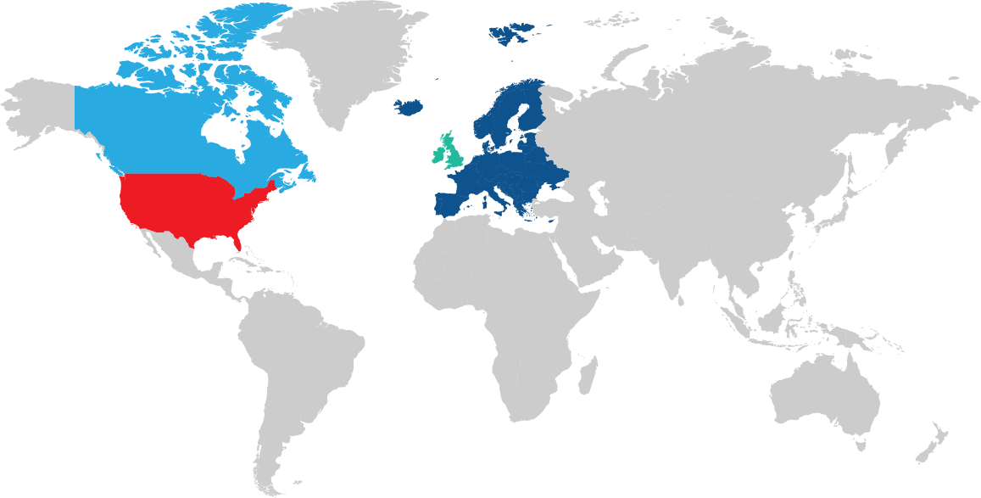
Market Research (Outsourcing)
US Market
Share Of Market
$16.7B
Serviceable Attainable
Market
$128.7B
Total Addressable
Market*
$1.2T
UK Market
Share Of Market
$1.2B
Serviceable Attainable
Market
$9.5B
Total Addressable
Market*
$95.2B
2023
to
2027
2023
to
2027
Canada Market
Global Market
UK Market
Canada Market
Europe Market
Share Of Market
$403M
Serviceable Attainable
Market
$2.9B
Total Addressable
Market*
$29.9B
Share Of Market
$5.4B
Serviceable Attainable
Market
$40.6B
Total Addressable
Market*
$406.9B
2023
to
2027
2023
to
2027
US Market
Global Market
Share Of Market
$1.3B
Serviceable Attainable
Market
$957.8B
Total Addressable
Market*
$9.5T
Europe Market
2023
to
2027
www.enigma-tech.io
‹#›
‹#›

Slide 11


Utilisation Of Funds
15%
15%
$20M
Team
Marketing
Tech
Admin
10%
For 10% equity in Enigmasoft
Technologies
60%
PROPOSITION
www.enigma-tech.io

Slide 12

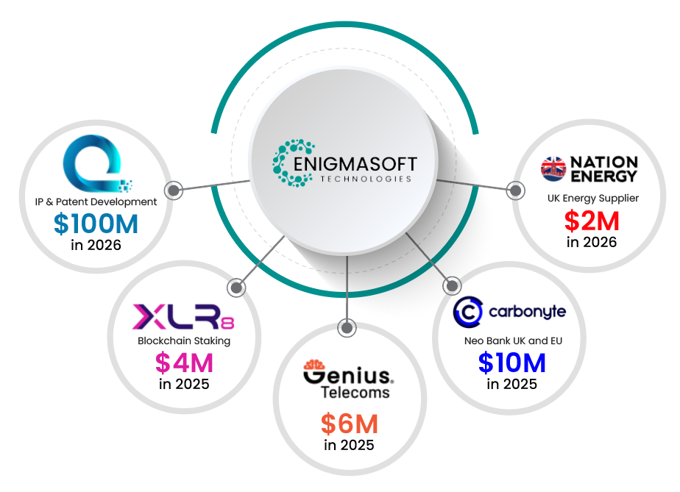
Our Partners
Estimated Value of Equity Holdings in 2025
Convertible Loans and Equity Holdings vest upon delivery of Enigmasoft Technologies milestones to clients.
www.enigma-tech.io
‹#›

Slide 13






Summary
Enigmasoft Technologies is a prime candidate for spin offs. The Renewable Energy IP would be spun off into a Special Purpose Vehicle (SPV) which could then be sold off or be subject to an IPO. The PE ratio for the spin off would be higher than when bundled with the outsourcing companies.
The Outsourcing Incubator Division, would be subject to an IPO which would consider the balance sheet of the multiple equities Enigmasoft Technologies is holding and the forward future revenue therein. In our humble estimate the IPO would be in excess of $200m.
Current Estimated IP Value and Exit Strategy
$100m+
Outsourcing Value
$28m
www.enigma-tech.io
‹#›

