Slide 1


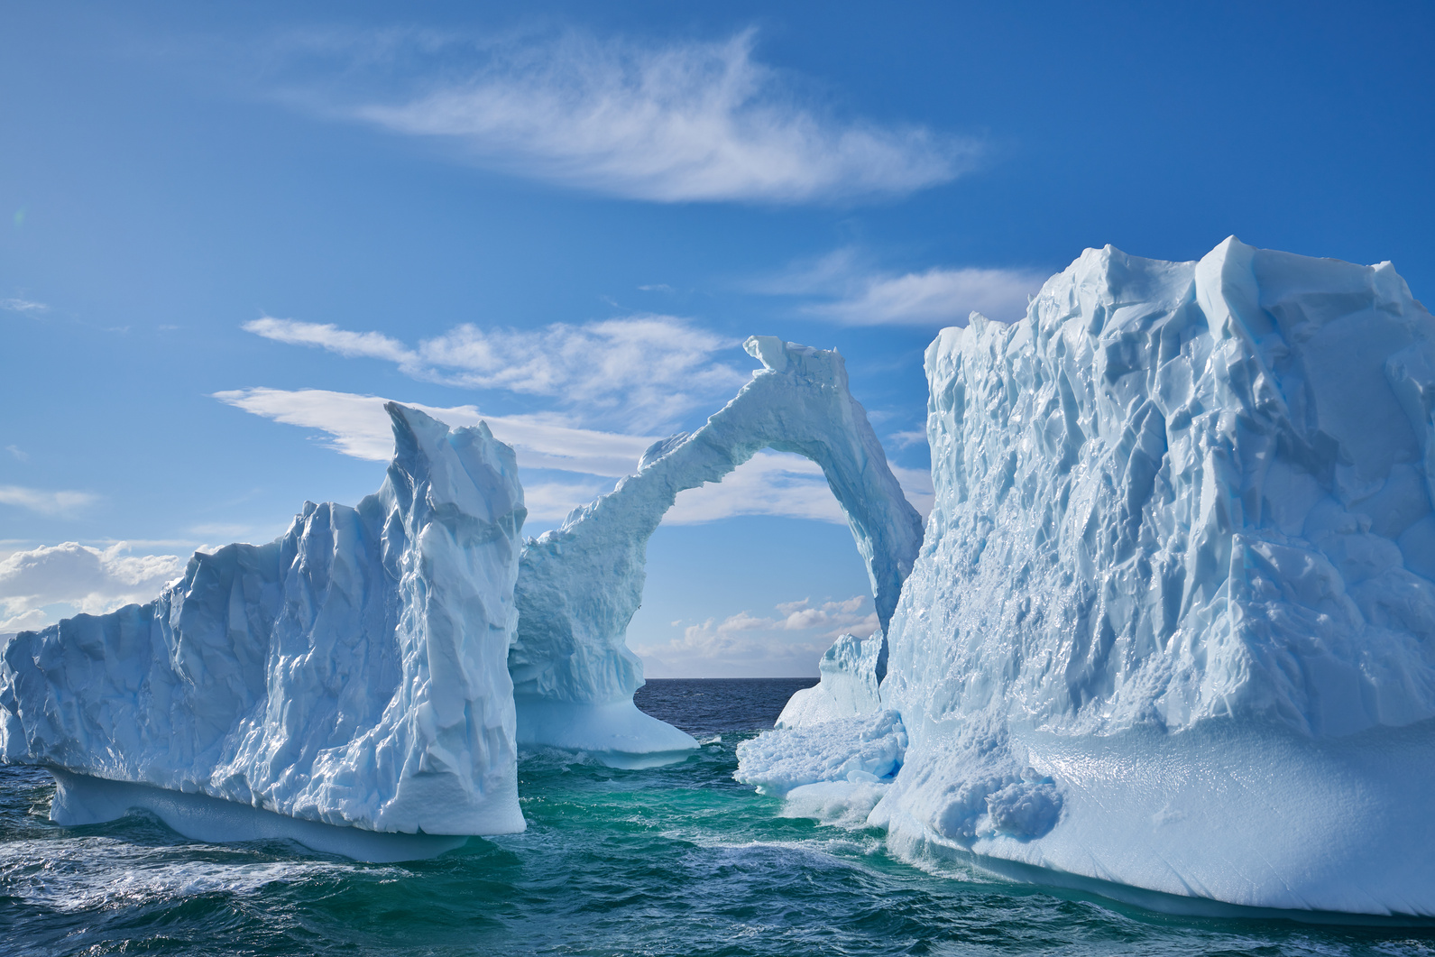


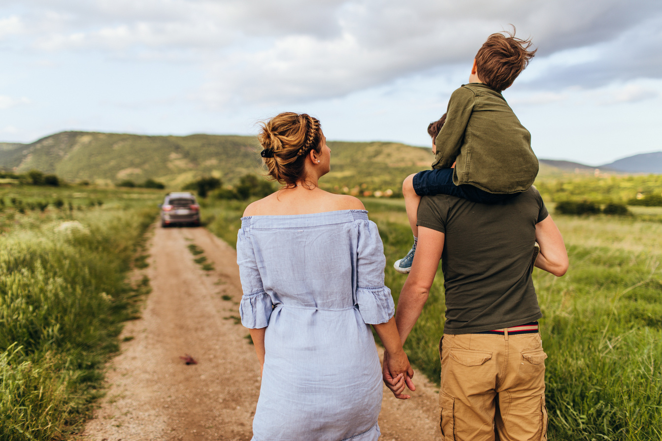



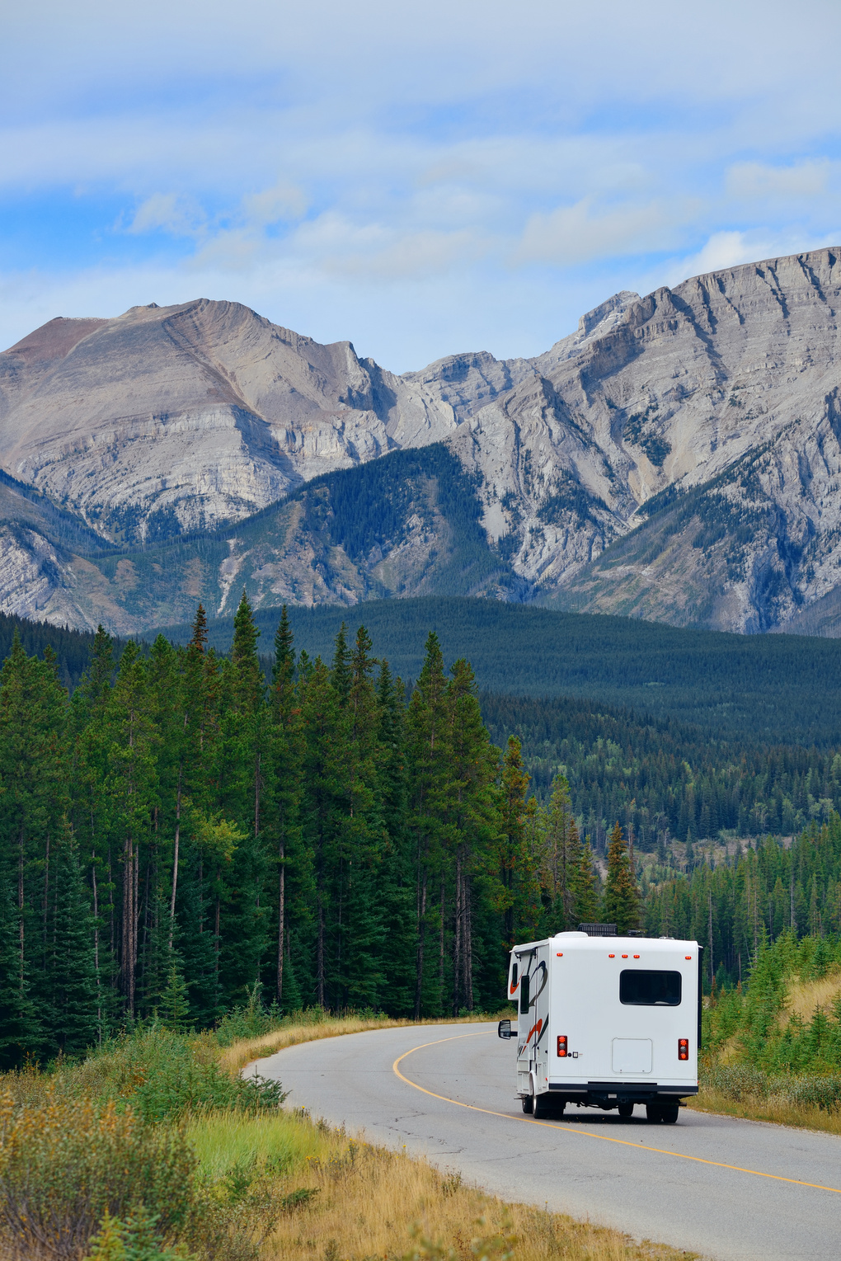
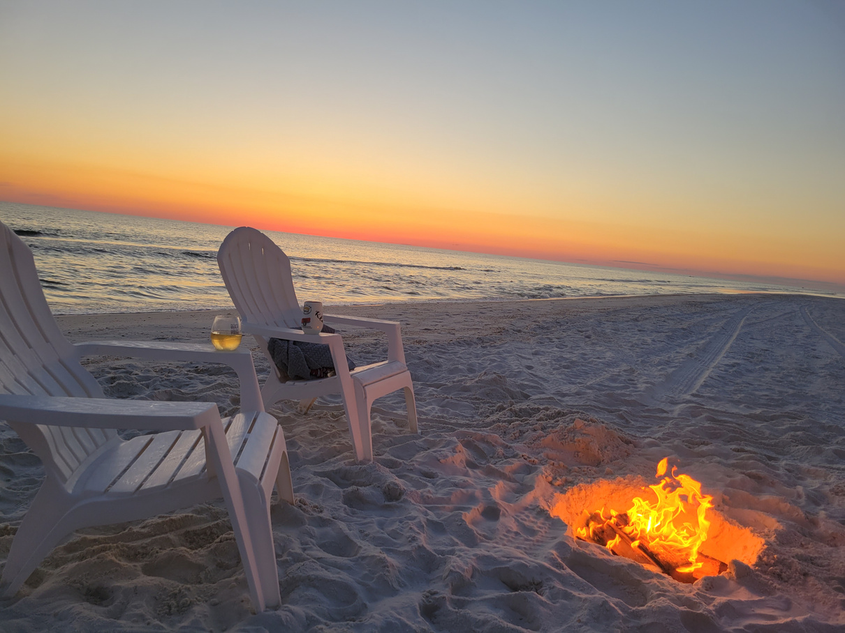
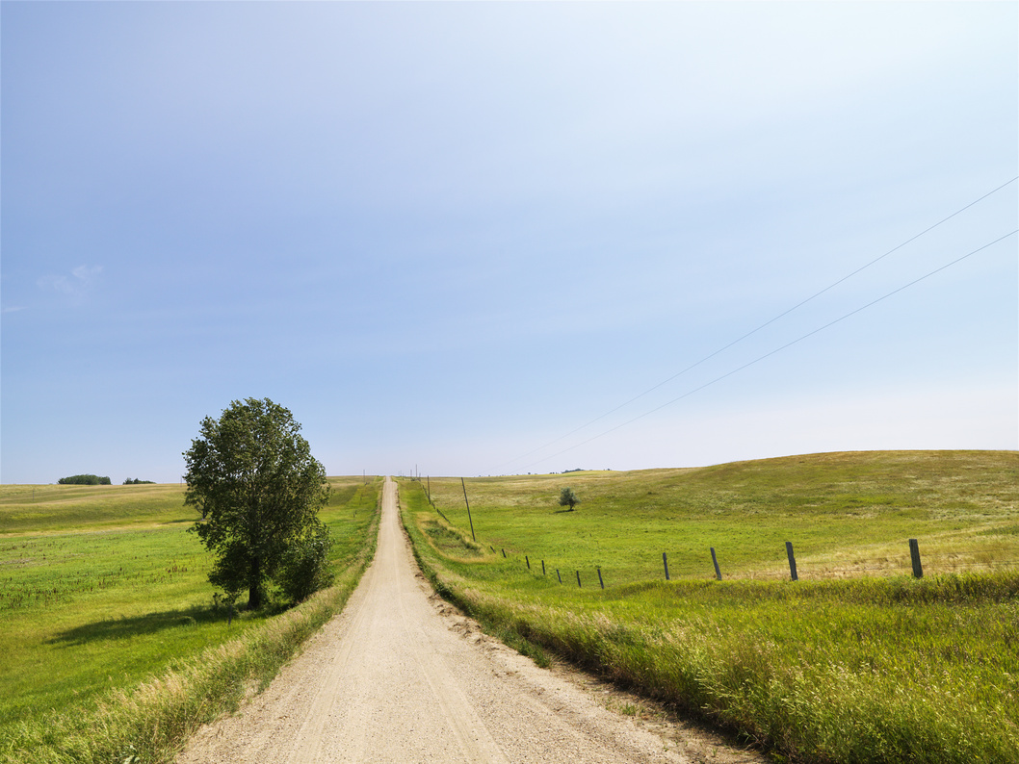
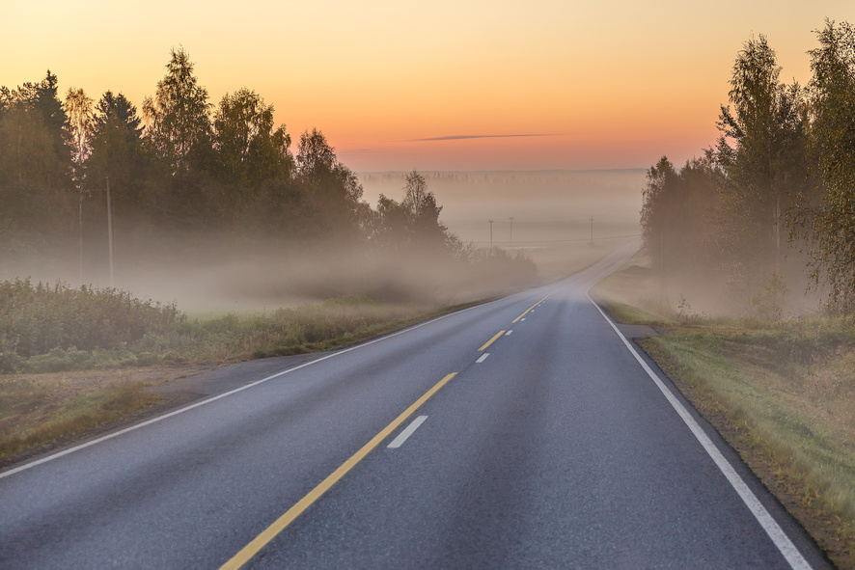
VISION
BOARD
See it, Believe it. Do it today.
Notes:
Add images of: your next projects you will find, your lifestyle and freedom, your legacy or purpose, your bucket list car/holiday/home, the people you will share success with, financial or family goals.

