Slide 1
The Wing Institute Summit 2007
Is RtI
Evidence-based?

Slide 2
What Would Confirm RtI As An Evidence-based Process?
Hierarchies of Evidence
Confirmation through Randomized Clinical Trials that RtI is effective
Efficacy studies - research settings
Effectiveness studies - field based settings
Meets the What Works and The Campbell Collaborative standards
Rigorous research supporting comparable models (models that are comprised of all RtI components)
Confirmation of RtI effectiveness through rigorous research of RtI components
Progress monitoring
Evidence based selection of interventions
Tiered intervention model (public health model)

Slide 3
What is the Current Evidence Supporting RtI?
Efficacy Research: RtI studies in research settings
Randomized Clinical Trials completed?
None
Quasi-experimental studies completed
Minimal
Effectiveness Evidence: RtI studies in field settings
Randomized Clinical Trials Completed?
None
Quasi-experimental studies completed
Minimal

Slide 4
What is the Evidence Supporting RtI Components?
Research on the components of RtI
Progress monitoring
Extensive
Evidence-based selection
Extensive
Public Health - tiered (intensity level) intervention (prevention) model
Extensive

Slide 5
What is the Evidence Supporting RtI Comparable Models?
Evidence of rigorous research of similar approaches built around the Public Health Tiered Prevention Model
Positive Behavior Supports - Behavior
Randomized Clinical Trials in process
Project Target - Johns Hopkins Bloomberg School of Public Health
90 School Study - University of Oregon
Direct Instruction - Academics
American Institute for Research, CSRQ Report on Elementary School Comprehensive School Reform Models - 56 studies & 12 met rigorous standards for research - November 2005

Slide 6
When Designing an Experimental Study What Do We Compare RtI To?
Compare RtI to Current Practices
Student Progress: Pre And Post RtI Implementation

Slide 7
How Do We Know If RtI Works?
General Education
Progress Monitoring
Academic Progress
Report Cards
Attendance
High Stakes Testing: National Assessment of Educational Progress (NAEP)
Behavioral Progress
Expulsion
Detention
Arrest
Office referrals

Slide 8
How Do We Know If RtI Works?
Special Education:
Eligibility
Learning Disabilities (LD)
Special Education Referrals
Student Progress Monitoring
Report Cards & High Stakes Testing
Standardized Test: Brigance, Woodcock Johnson , etc.
Developmental Standards
Curriculum based measures
IEP Progress
Systems Monitoring
Early Intervention
Time in Special Education

Slide 9
Review of the Research
“Meta-analytic Review of Responsiveness-to-Intervention Research: Examining Field-based and Research Implemented Models” - Matthew K. Burns, James J. Appleton and Jonathan D. Stehouer - Journal of Psycho-educational Assessment 2005; 23; 381
Study Design
A Review of four large scale RtI models: Heartland Agency (Iowa Model), Ohio’s Intervention Based Assessment, Pennsylvania’s Instructional Support Teams, and Minneapolis Public Schools Problem Solving Model
The study compared field-based and research based models
21 studies met criteria to be included in the study
All studies were quasi-experimental in design
The Study examined two categories of Outcomes Measures:
Student Outcomes: Academic skill assessments, time on task, task completion, and growth in skill acquisition
Systemic Outcomes: Special Education referrals, placements, Time in services, and # students retained in grade
Notes:
Randomization results in an assignment that on average is initially the same

Slide 10

Results of the Study
Results of the Study - Both field based and research based RtI models demonstrated significantly strong effects
UEE = a weighted estimator of effect incorporating sample size of each study
Notes:
Randomization results in an assignment that on average is initially the same

Slide 11
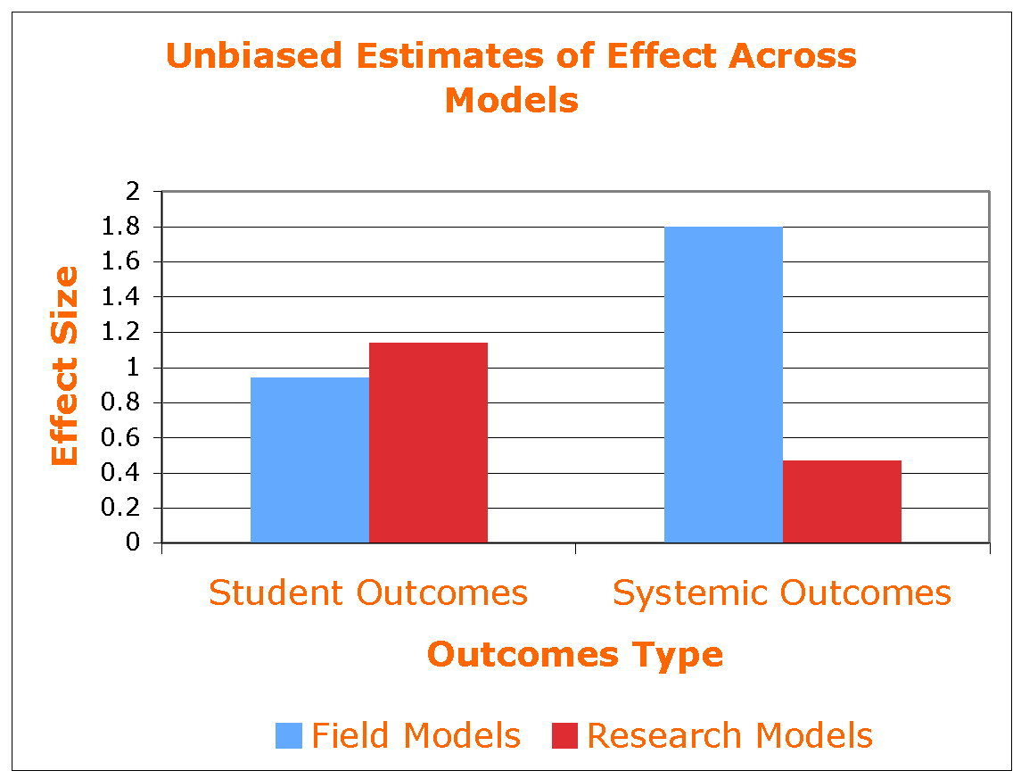
Results of the Study
Results of the Study: Outcome comparison of field based and research based models
The Unbiased Estimates of Effect (UEE) was larger for systemic outcomes in RtI field based models
The Unbiased Estimates of Effect (UEE) was larger for student outcomes in RtI Research based models
Notes:
Randomization results in an assignment that on average is initially the same

Slide 12
Study Conclusions
The study found ample evidence that field based RtI models consistently produced strong effects
Both RtI models demonstrated improvement in student as well as systemic outcomes
Large scale RtI models led to fewer LD students being identified
On average less than 2% of students were identified as LD in the field models as compared to the US Dept of Ed national rate of 5.7%
RtI early identification of reading did not increase the number of students identified for special education, but indicated that it reduced the numbers. Note: reduction in identification alone is not sufficient to make claims of effectiveness!

Slide 13
Study Recommendations
Randomized Clinical Trials should be conducted to definitively answer questions of causation.
Further research should be conducted on implementation fidelity
Further development of special education outcome measures should be conducted to include; referrals and placement, time spent in special education, and grade retention.
Further research should be conducted to identify the discrepancy in results observed between field based and research based implementation.

Slide 14
Challenges to Building the RtI Evidence Base
Substantial impediments to randomized clinical trials
Identification of measurable RtI outcomes
Maintenance of control groups throughout the study period
Resources limitations
Time required to complete studies
Obstacles hinder adoption
Limitations to training opportunities
Compromises to implementation fidelity

Slide 15
Conclusion
Although much research remains to be conducted on RtI, current evidence holds great promise for RtI offering:
Delivery of more effective services than the current problem solving model(s)
Delivery of services earlier than current practices

Slide 16
Recommendations
Conduct randomized clinical trials on RtI as a system
Efficacy studies - research settings
Effectiveness studies - field based settings
Organize the RtI component research data to make it more accessible to educators
RtI is reviewed by What Works Clearinghouse and The Campbell Collaboration and meets standards of evidence of these organizations

