Slide 1
Hints on Delivering PowerPoint Presentations Well
Or…….
How to avoid looking like a PowerPoint learner
CC 0 – Public Domain

Slide 2
Notes
This includes hints on how to deliver a PowerPoint presentation more effectively.
This does not include notes on how to create presentations.
There are plenty of guides on how to create a good presentation
Eg. Tips for creating and delivering an effective presentation
CC 0 – Public Domain

Slide 3
Prepare
Create your presentation as usual
Run through your presentation
Check the time you are allotted
Make sure your presentation is within this time
Key points early so they are not lost if time is reduced
Get a critic to listen and review
CC 0 – Public Domain

Slide 4
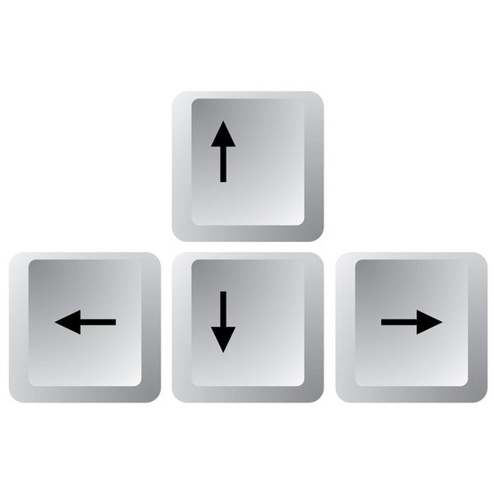
Moving Between Slides – the basics
Go to previous slide
Go to previous slide
Go to next slide
Go to next slide
CC 0 – Public Domain

Slide 5
Moving Between Slides – Mouse
If you have a computer mouse, instead of access to keyboard:
Scroll Down – Next Slide
Scroll Up – Previous Slide
Note: slight movement only needed.
CC 0 – Public Domain

Slide 6
Short Cuts
Some really useful shortcuts to speed things up:
Icon (lower right) starts a Slide show from the Presentation
This only applies if not using a PowerPoint Slide Show file
B – Displays a blank black screen during a slide show
Press B again returns to the show
Esc – Ends a PowerPoint slide show
CC 0 – Public Domain

Slide 7
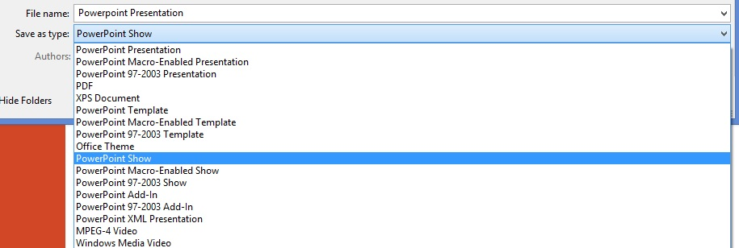
Save as a PowerPoint Show Option
Did you know that if you save your presentation as a PowerPoint Show, it will automatically open ready to run (just like this slideshow did)?
No need to open, then switch to slideshow.
File…Save As….PowerPoint Show
CC 0 – Public Domain

Slide 8
Why Save as a PowerPoint Show?
This avoids many of the software version issues in reading a file.
Can actually show it in a Browser if required.
Automatically starts at the beginning
But you can move around the show to go to specific slide by
Right Click when showing
Select ‘See all Slides’
Click on the one you want to open this slide and continue the show
Note: PowerPoint Show files are not editable (easily)
Go on, try it!
CC 0 – Public Domain

Slide 9
Laser Pointer Mouse Mode
If you want to highlight a part of a slide there is an option to turn your cursor into what looks like a laser pointer.
Hold down the Ctrl button and left mouse button at same time
This will make the cursor look like a laser pointer
Move around to highlight points in the slide
Let go either button will remove the laser look
Hard to operate with touchpad on laptops.
CC 0 – Public Domain

