Slide 1
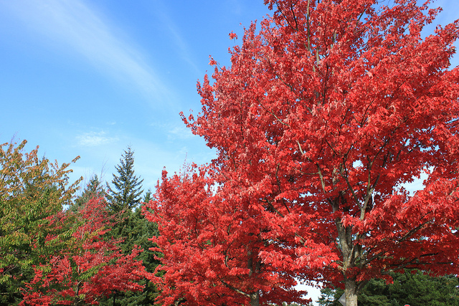
Name _____________________
How Does a Leaf Know When
to Change its Color?
The leaves of the red maple tree change from green to red in the autumn months, then fall off the tree before winter. Places like Vermont and New Hampshire, in the northeastern United States, are famous for the beautiful red color of their red maple trees.
The red maple leaves turn red every autumn, year after year. It's as if the trees have some kind of calendar they're keeping. How do maple trees know when it’s time for their leaves to change color?
You might guess it has to do with
warmth. In autumn, days are starting
to get colder. Maybe the leaves start
to change color when the temperature
gets cold?
One clue is to look at maple trees
that have been planted in
California. In California, the weather
stays warm all year. Yet even here,
the maple leaves turn red in autumn.
The autumn weather is very different in California than it is in Vermont. But in both places, the days get shorter in autumn. Each day the Sun comes up lower and lower in the sky.
Scientists wondered if somehow leaves change color because of the length of the day. Sure enough, when a maple tree is grown indoors under artificial lights, it can be tricked. Its leaves will not change color.
Earth & Space Patterns

