Slide 1
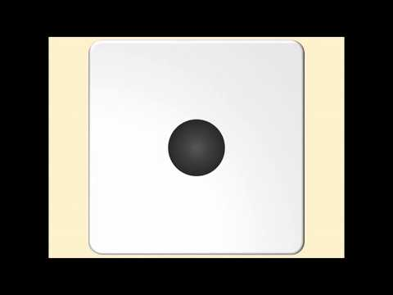
Name that Muscle
Let's
play!

Slide 2
How to Play the Game
Start: Each player gets to roll the die 1 time. The player who rolls the largest number starts the game followed by the next highest number. If two people roll the same number, each player rolls again after all other players have had their initial roll. Any roll that matches a previous number will automatically go after the first person who rolled that number. (ex. Player 1 rolls a 5. Player 3 rolls a 5 on the second attempt due to a tie in the first roll. Player 1 will go before player 3 in the game)
Playing around the board: Move forward until you reach your roll number and click on that space. If a player answers correctly, that player gets to stay at that spot. If a player answers incorrectly, that player must go back to start. You will always return to start if you miss a question. -Players rotate every roll regardless of a correct or incorrect answer given by a player.
How to return to the game board for the next roll: Hit the large X on the upper right corner
How to win: Be the first player to reach the finish space. The exact number must be rolled so that the winner lands and STAYS on the last space.

Slide 3
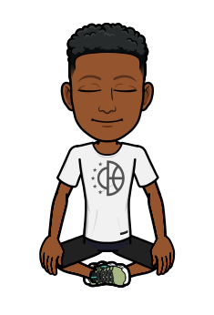
Question 1
What is the name of the muscle that you sit on most often?
Click here for the answer

Slide 4
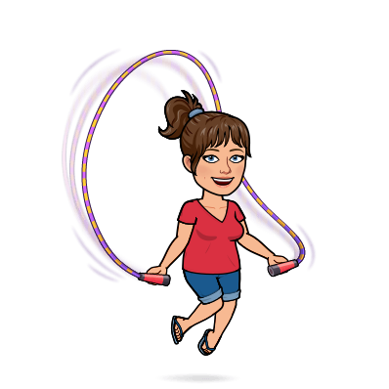
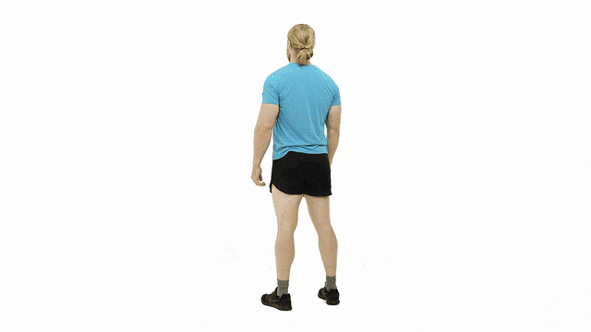
Question 2
Which muscle is the primary mover in this exercise?
Click here for the answer

Slide 5
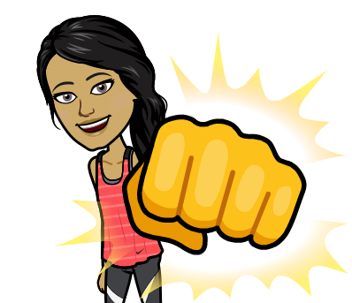
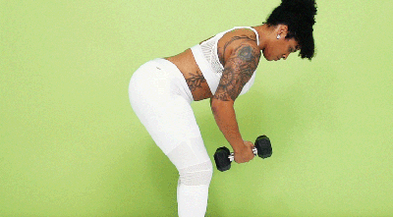
Activity 3
Which muscle is the primary mover in the reverse fly exercise?
Click here for the answer

Slide 6
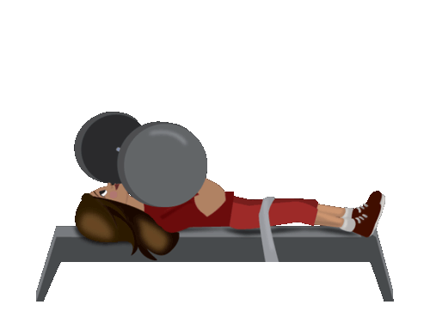
Activity 4
What is the name of the muscle located on the front of the chest?
Click here for the answer

Slide 7
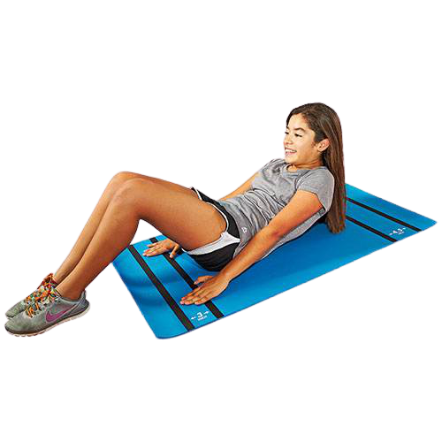
#5
Which muscle is the primary mover in a basic crunch exercise?
Click here for the answer

Slide 8
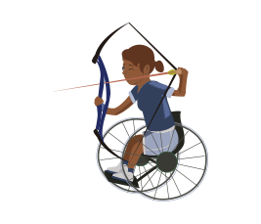
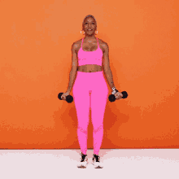
Activity 6
Which muscle is the primary mover in this exercise?
Click here for the answer

Slide 9
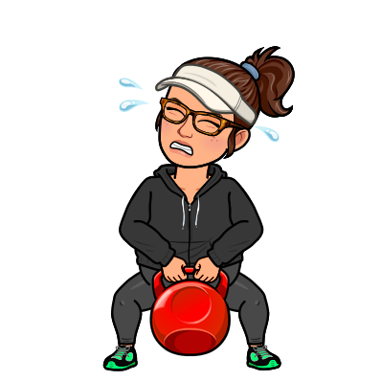
Activity 7
Which muscle is the antagonist to the quadriceps?
Click here for the answer

Slide 10
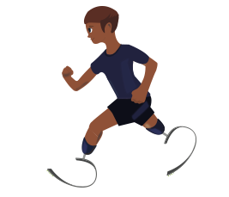
Activity 8
Which muscle is being worked during cardio-respiratory exercises?
Click here for the answer

Slide 11
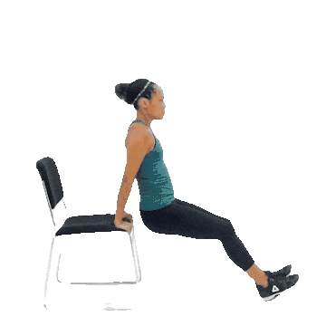
Activity 9
What is the name of the antagonist muscle located opposite the biceps on the upper arm?
Click here for the answer

Slide 12
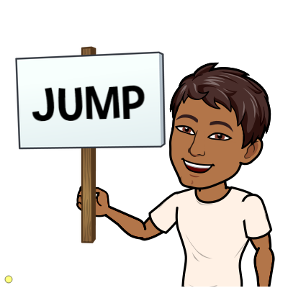
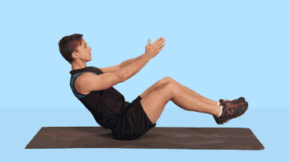
Activity 10
What is the primary muscle in this exercise that twists the body side to side?
You got it!
Click here for the answer

Slide 13
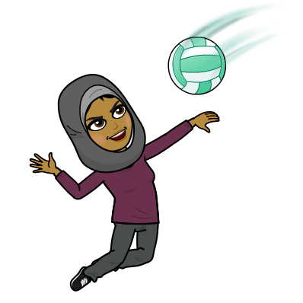
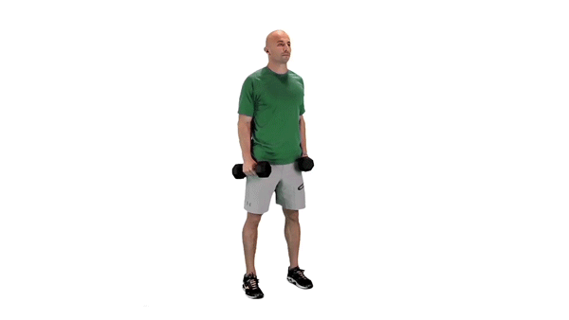
Activity 11
Which muscle makes up the shoulder area that is being used in this exercise?
Click here for the answer

Slide 14
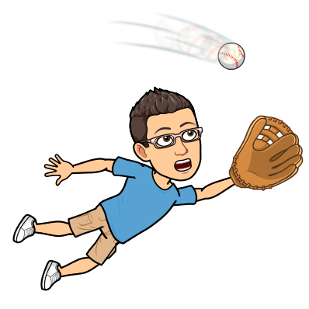
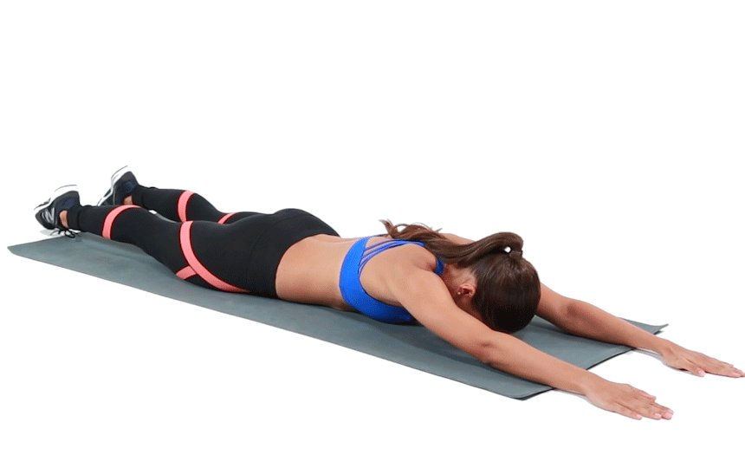
Activity 12
What is the name of the antagonist muscle located opposite the muscles working here?
Click here for the answer

Slide 15
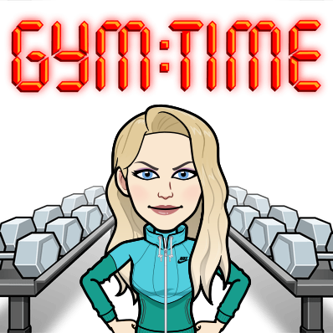
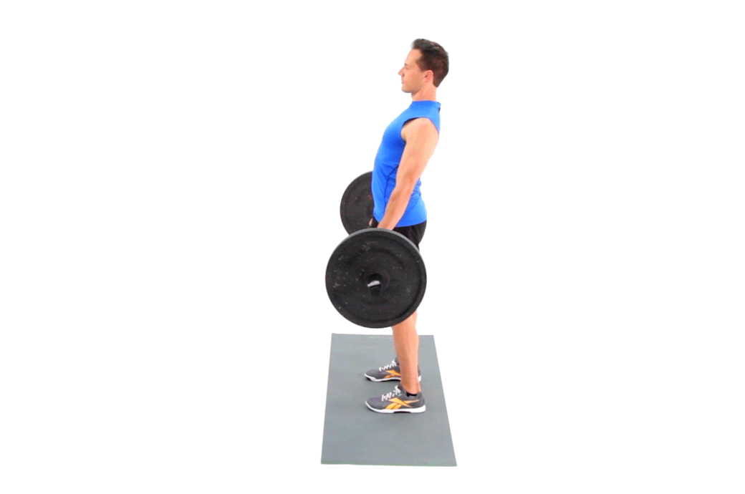
Activity 13
What is the primary muscle being worked in the deadlift exercise?
Click here for the answer

Slide 16
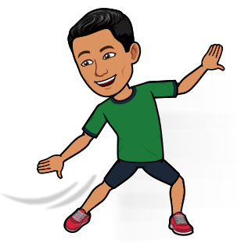
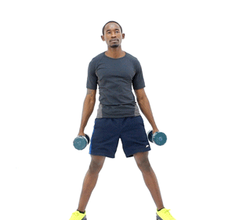
Activity 14
Which muscle group helps bend the body from side to side as seen in this exercise?
Click here for the answer

Slide 17
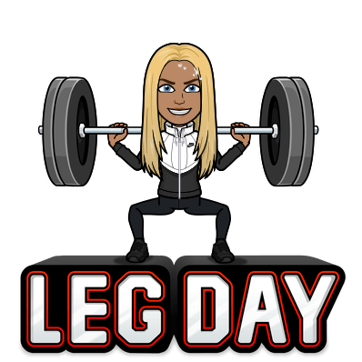
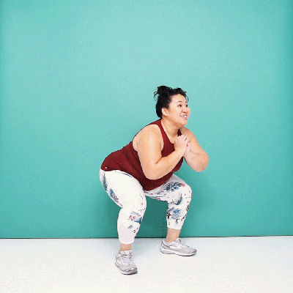
Activity 15
What is the primary muscle located on the front of the upper leg that is used in the squat exercise.
Click here for the answer

Slide 18
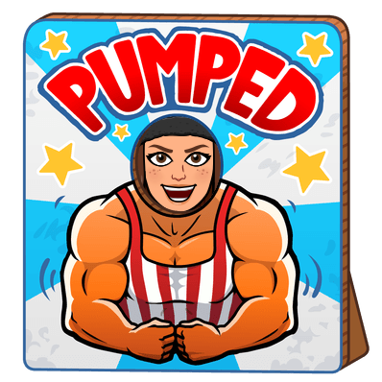
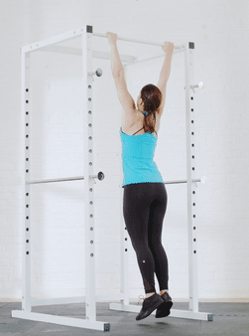
Activity 16
Which muscle is the primary mover when performing a pull up?
Click here for the answer

Slide 19
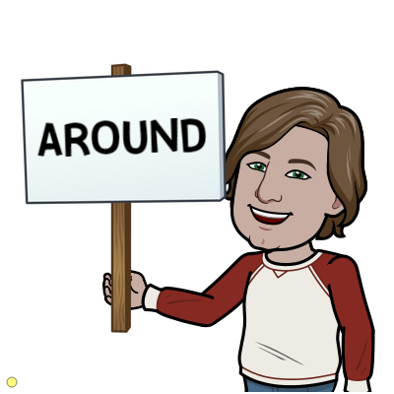
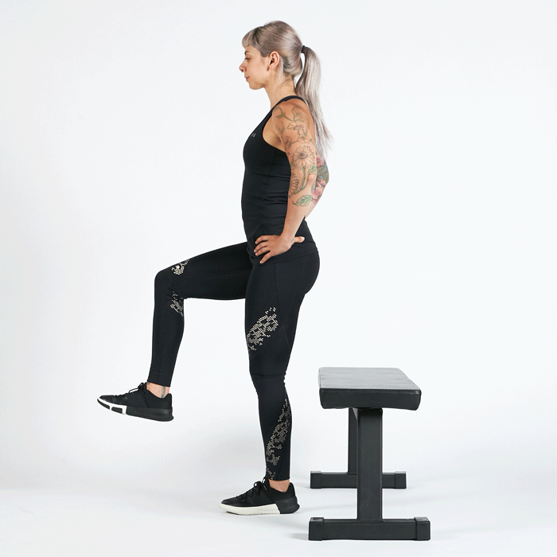
Activity 17
What is the muscle group working to straighten the leg in this exercise?
Crushin’ it!
Click here for the answer

Slide 20
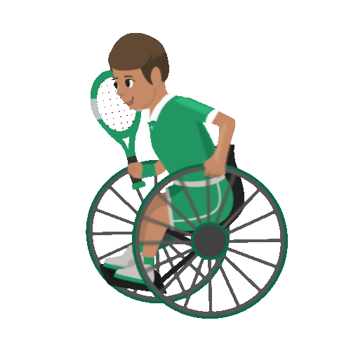
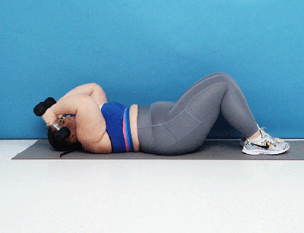
Activity 18
What muscle is the primary mover in the skull crusher exercise?
Click here for the answer

Slide 21
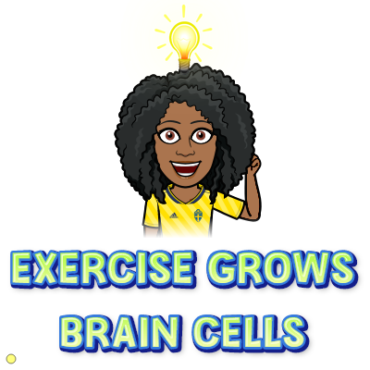
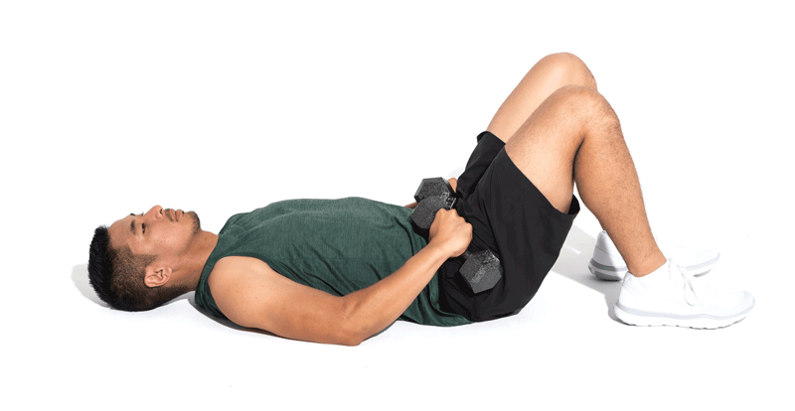
Activity 19
Name one of the two muscles primarily responsible for performing a bridge
Click here for the answer

Slide 22
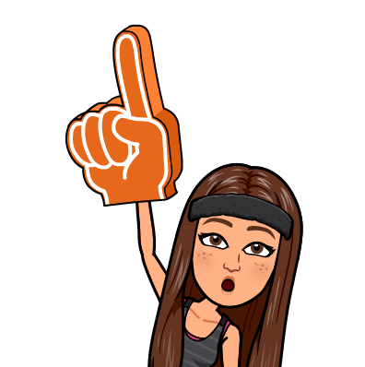
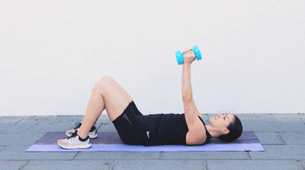
Activity 20
What muscle group is the primary mover in the pullover exercise?
Click here for the answer

Slide 23
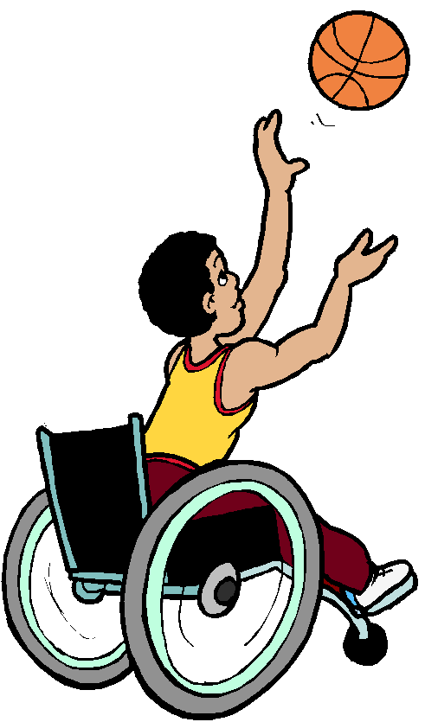
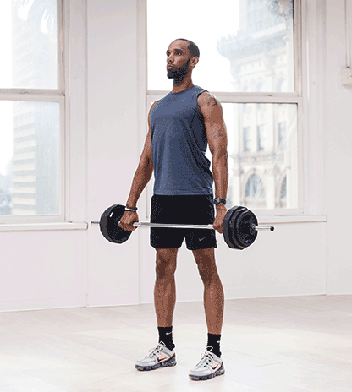
Activity 21
What muscle is the primary mover when performing a shrug?
Click here for the answer

Slide 24

Winner, Winner...Chicken Dinner!
You win!

Slide 25
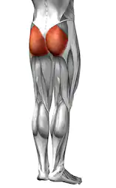
Answer for Question 1
GLUTEUS MAXIMUS

Slide 26
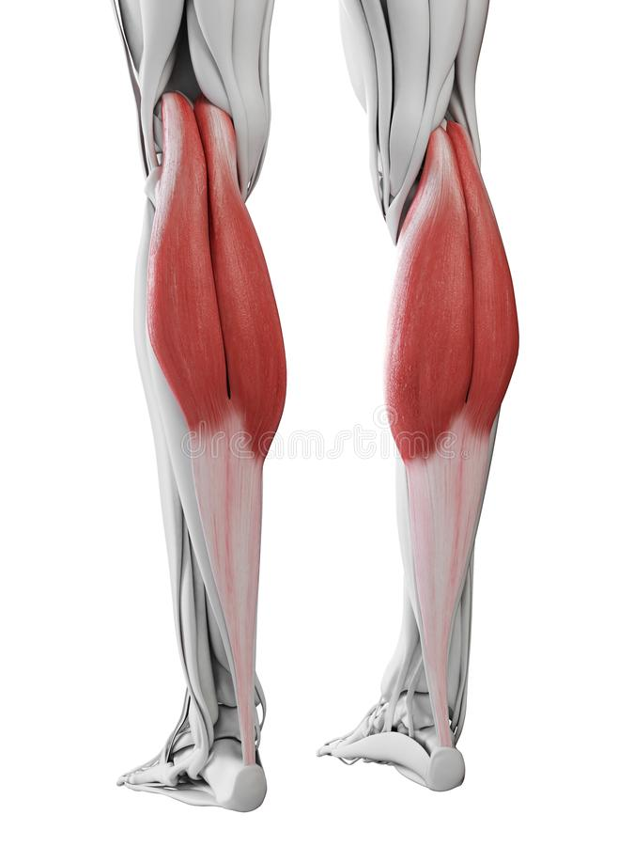
Answer for Question 2
Gastrocnemius

Slide 27
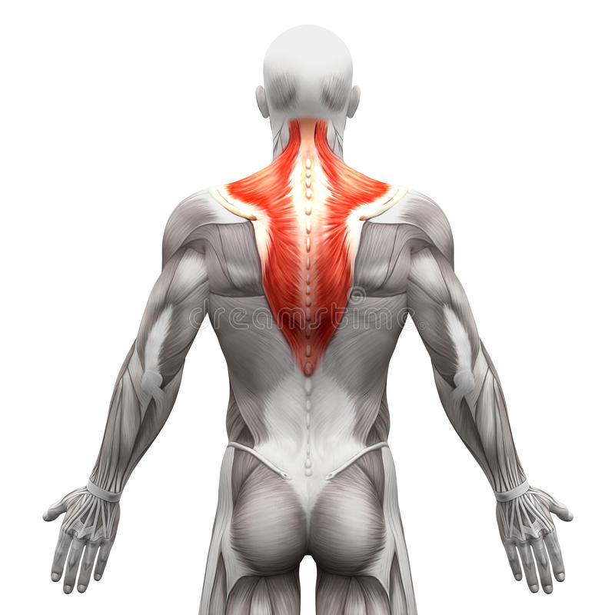
Answer for Question 3
Trapezius

Slide 28
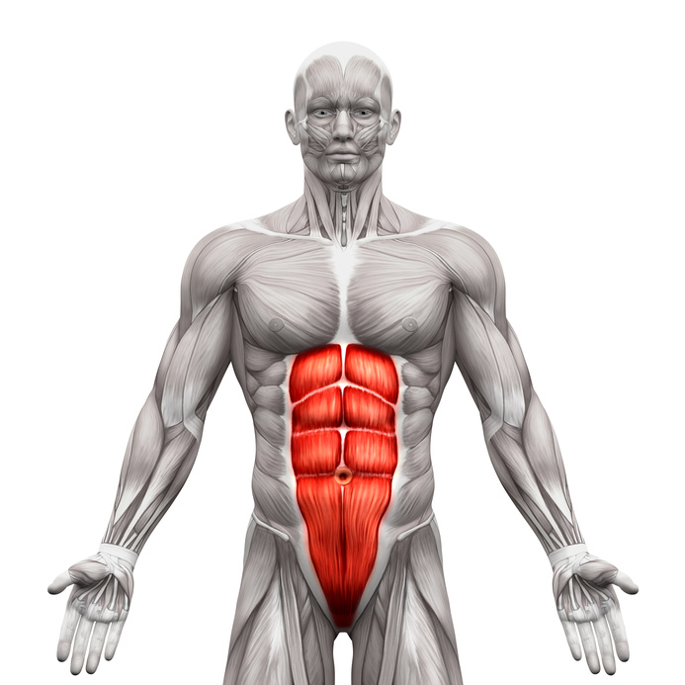
Answer for Activity 5
Rectus Abdominis

Slide 29
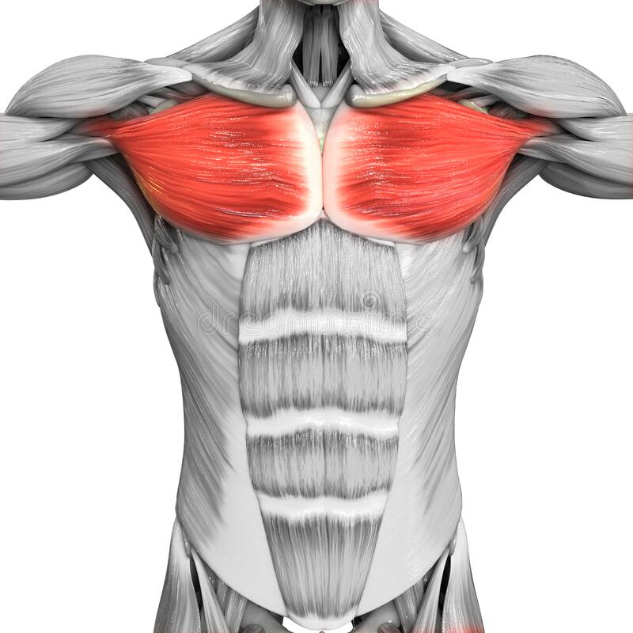
Answer for Question 4
Pectoralis Major

Slide 30
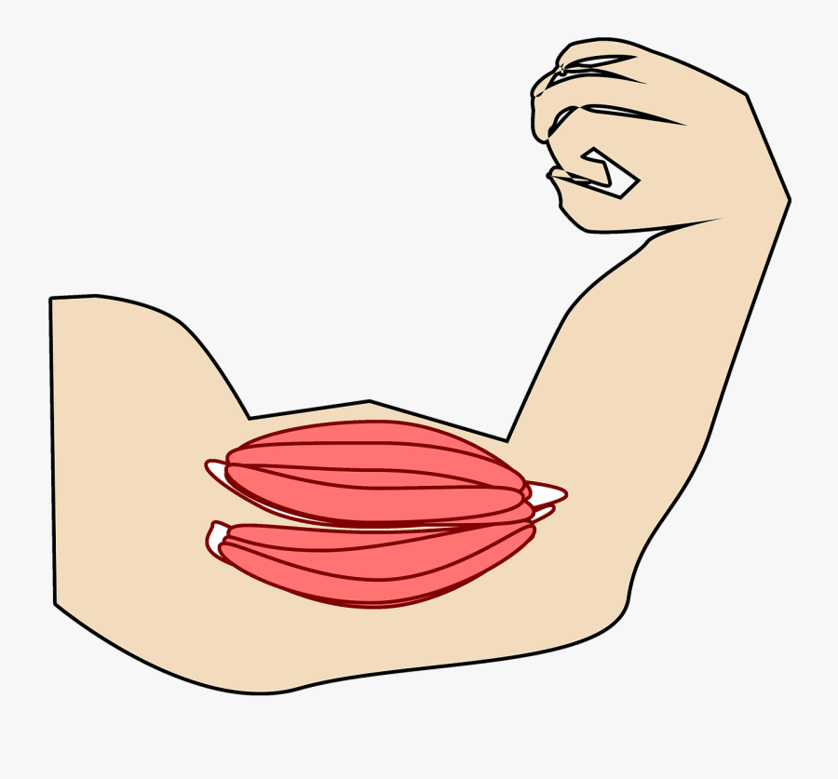
Answer for Question 6
Biceps

Slide 31
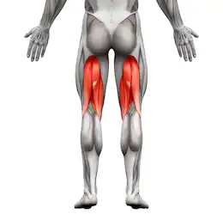
Answer for Question 7
Hamstrings

Slide 32
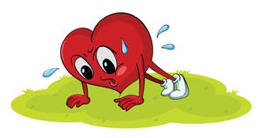
Answer for Question 8
The Heart

Slide 33
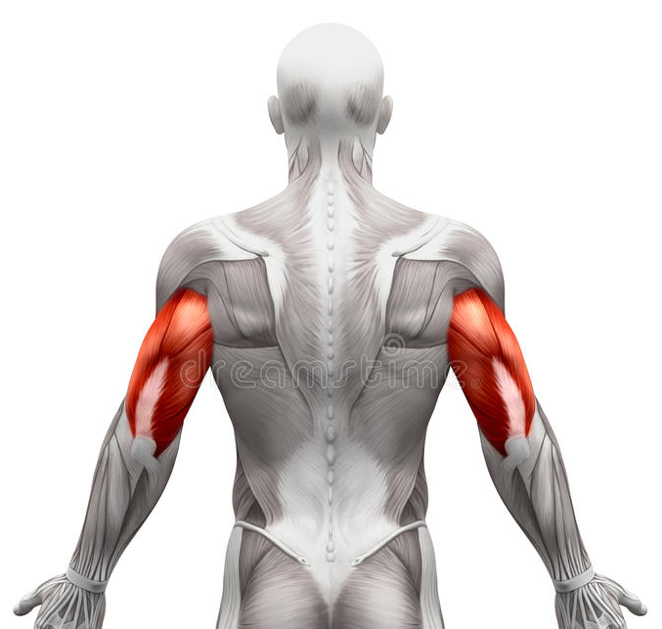
Answer for Question 9
Triceps

Slide 34
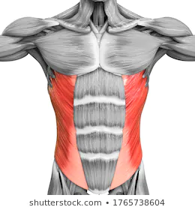
Answer for Question 10
Obliques

Slide 35
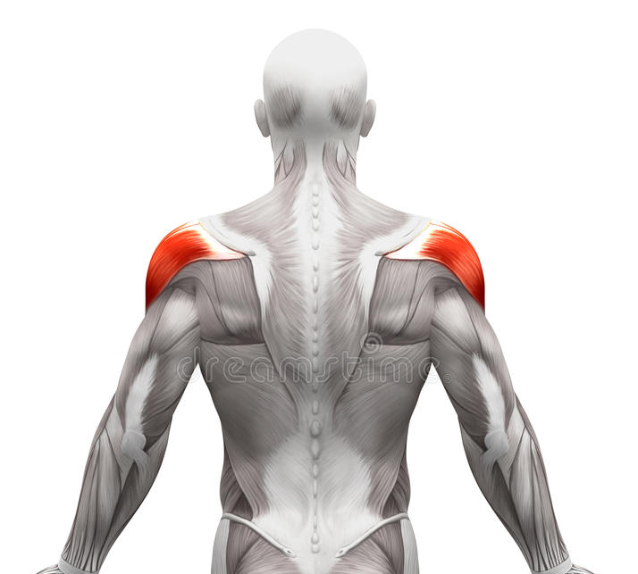
Answer for Question 11
Deltoid

Slide 36
Answer for Question 12
Rectus Abdominis

Slide 37
Answer for Question 13
Hamstrings

Slide 38

Answer for Question 14
Obliques

Slide 39
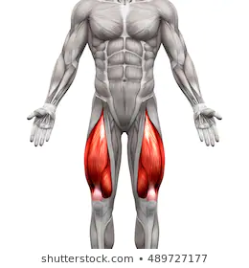
Answer for Question 15
Quadriceps

Slide 40
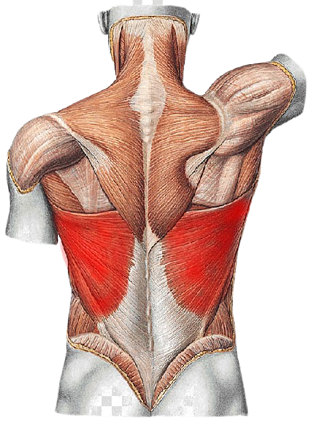
Answer for Question 16
Latissimus Dorsi

Slide 41
Answer for Question 17
Quadriceps

Slide 42
Answer for Question 18
Triceps

Slide 43
Answer for Question 19
Gluteus Maximus
Hamstring

Slide 44
Answer for Question 20
Latissimus dorsi

Slide 45
Answer for Question 21
Trapezius

Slide 46

Activity Example
Which muscle group pulls the legs together as seen in this exercise?
Click here for the answer

Slide 47

Answer for Example
Adductors

