Slide 1
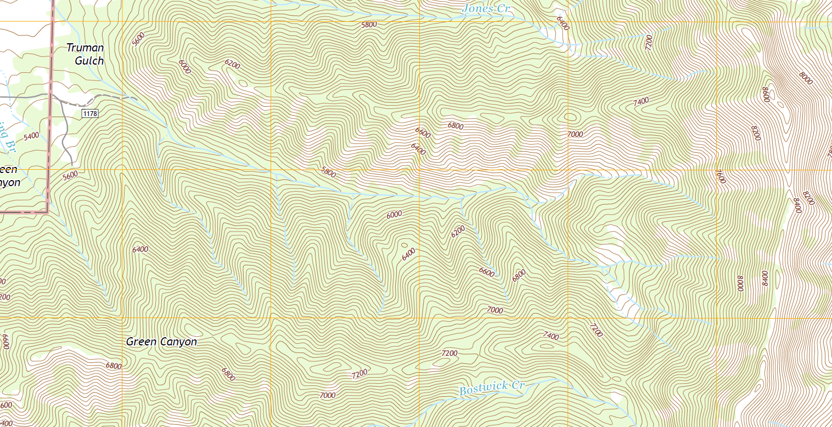
Gauging station (pour point)
Notes:
If we want to understand where the water we use comes from, we have to start at the diversion to the water treatment plant and work upstream into the mountains. Let’s take a closer look at the mouth of Sourdough Canyon.
The most obvious source of water is the stream (Bozeman Creek) flowing through the base of Sourdough Canyon. Some of the water in this stream comes from tributary streams. Once you reach the source of flow of a tributary, that water may be coming from a spring or a wetland fed by groundwater. If we make the assumption that groundwater follows flow paths that are the same as the slope of the surface topography (i.e. unconstrained water flows downhill), then we can continue to draw a groundwater flow path uphill, until we reach a point where there is no landscape that flows into our location.
These groundwater flow paths can also feed streams directly from the canyon hill slopes, either in the main canyon or in the tributaries. And groundwater flow paths might also feed other groundwater flow paths. If you keep drawing these flow paths based on the slope of surface topography, all the arrows together will define an area that we call a watershed, or the area of the landscape that drains to a given water body or flow.

Slide 2
Notes:
If we want to understand where the water we use comes from, we have to start at the diversion to the water treatment plant and work upstream into the mountains. Let’s take a closer look at the mouth of Sourdough Canyon.
The most obvious source of water is the stream (Bozeman Creek) flowing through the base of Sourdough Canyon. Some of the water in this stream comes from tributary streams. Once you reach the source of flow of a tributary, that water may be coming from a spring or a wetland fed by groundwater. If we make the assumption that groundwater follows flow paths that are the same as the slope of the surface topography (i.e. unconstrained water flows downhill), then we can continue to draw a groundwater flow path uphill, until we reach a point where there is no landscape that flows into our location.
These groundwater flow paths can also feed streams directly from the canyon hill slopes, either in the main canyon or in the tributaries. And groundwater flow paths might also feed other groundwater flow paths. If you keep drawing these flow paths based on the slope of surface topography, all the arrows together will define an area that we call a watershed, or the area of the landscape that drains to a given water body or flow.

