Slide 1
Basic hydrograph interpretation
1
NOTE: Slides for each module are numbered for easier cross-referencing with class notes
NOTE: My slides have TONS of animations and building graphics. These do not translate well to D2L, so it is best to download the power point to work through the logic behind the animations

Slide 2
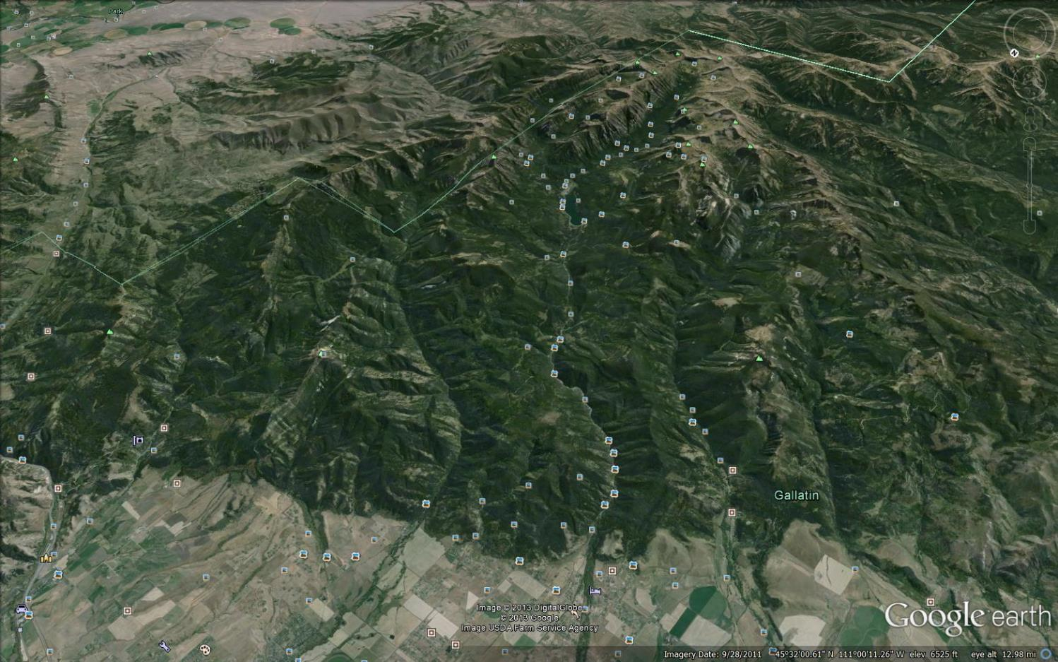
Stream flow measurement
2
Gallatin Range
?
Mt. Blackmore
?
Hyalite Creek Watershed
Bozeman Creek Watershed
Q
Q
Bozeman (Sourdough) Creek
Hyalite Creek
Bozeman

Slide 3
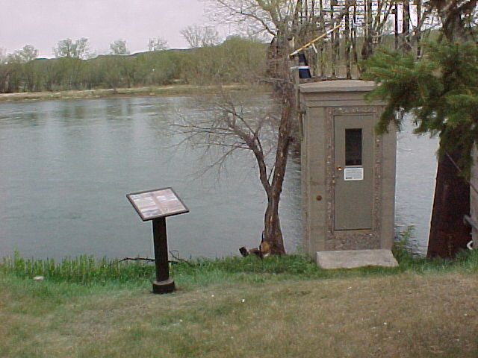
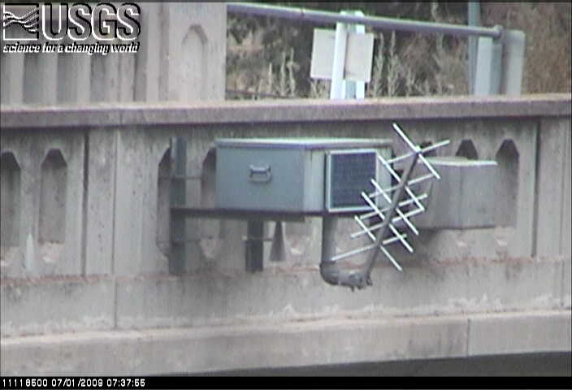
Measuring flow over time: Rivers
3
Missouri River
Fort Benton, MT
Ventura River, CA
From USGS public domain

Slide 4
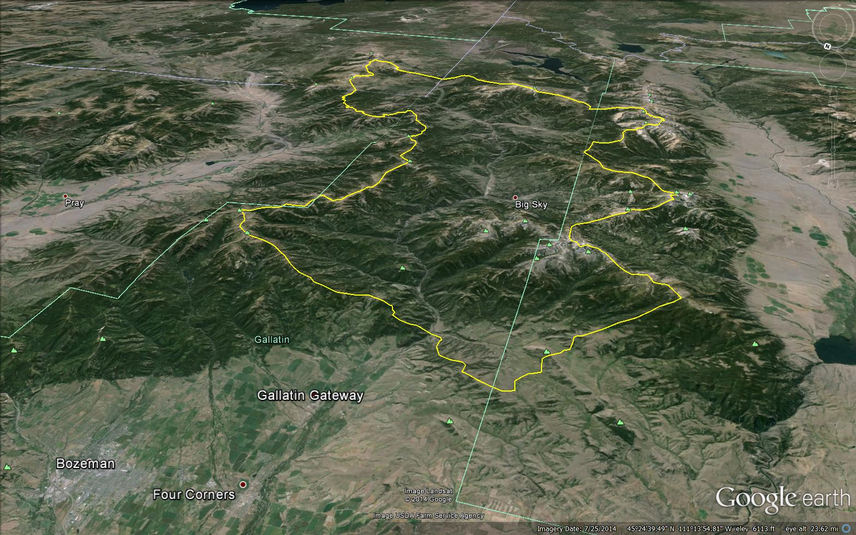
The Stream (River) Hydrograph
4
06043500 – Gallatin River near Gallatin Gateway (just downstream of Spanish Creek)

Slide 5
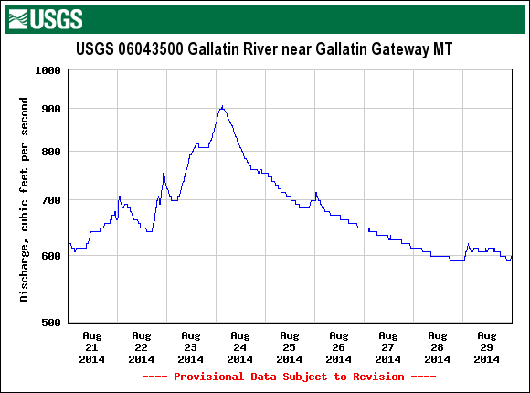
5
The Stream Hydrograph: flow vs. time
Storm response
hydrograph
Instantaneous
flow
(every 15 min)
USGS NWIS data set

Slide 6
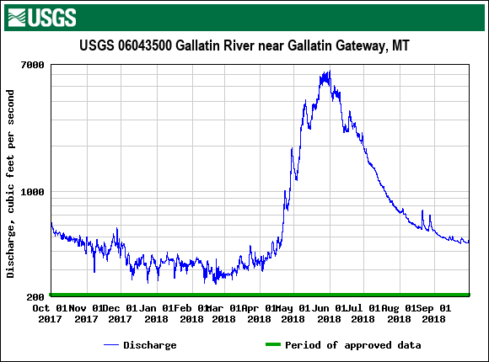
The Stream Hydrograph: flow vs. time
6
Annual
hydrograph
Instantaneous
flow
(every 15 min)
USGS NWIS data set

Slide 7
The hydrograph: different time scale = different mechanisms
7
Storm response hydrograph
Annual hydrograph
USGS NWIS data set

Slide 8
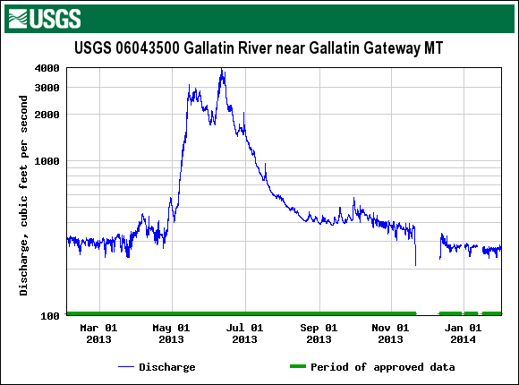
The hydrograph: arithmetic vs. log scale
8
Logarithmic
Arithmetic
USGS NWIS data set

Slide 9
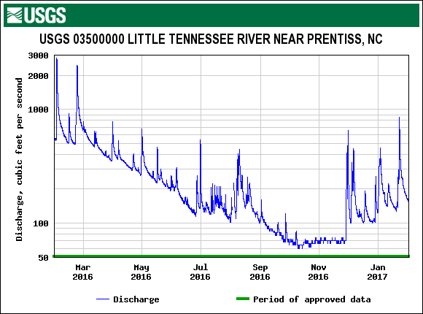
The hydrograph: comparing watersheds
9
USGS NWIS data set

Slide 10
The hydrograph: comparing watersheds
9
https://www.npr.org/sections/thetwo-way/2016/11/10/501568892/much-of-the-southeast-u-s-is-grappling-with-drought
USGS NWIS data set

Slide 11
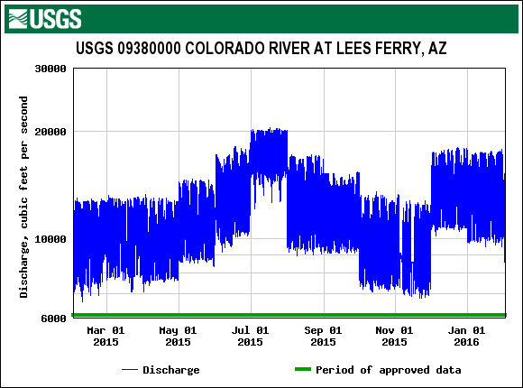
The hydrograph: comparing watersheds
10
USGS NWIS data set

Slide 12
The hydrograph: comparing watersheds
10
USGS NWIS data set

Slide 13
The hydrograph: area under curve = volume
11
Dimensions of area under curve
[L³ T⁻¹][T] = [L³]
[L³ T⁻¹]
[T]
USGS NWIS data set

Slide 14
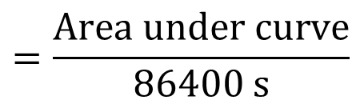
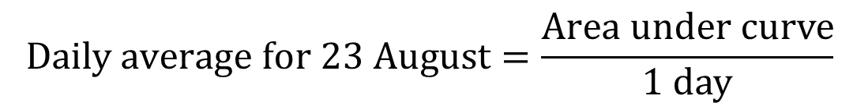
The hydrograph: temporal descriptive statistics
12
Daily average is total volume over a day divided by one day of time (in desired units of time)
$$Daily average for 23 August=\frac{Area under curve}{1 day}$$
$$=\frac{Area under curve}{86400 s}$$
USGS NWIS data set

Slide 15



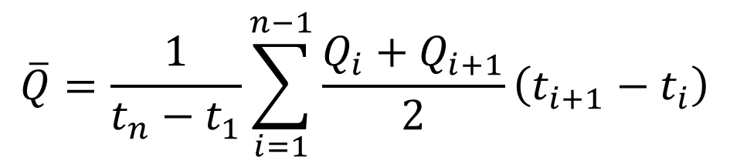
The hydrograph: average flow over time
13
Total volume over $∆t$
$$\overline{Q}=\frac{1}{∆t}\int_{t}^{t+∆t}{Qdt}$$
Total volume over $t_{n}−t_{1}$
$$\overline{Q}=\frac{1}{t_{n}−t_{1}}\sum_{i=1}^{n−1}{\frac{Q_{i}+Q_{i+1}}{2}\left(t_{i+1}−t_{i}\right)}$$

Slide 16


The hydrograph: average flow over time
13
Average flow over $∆t$
For example:
If Δt is 1 day,
“daily average”
or “daily mean”
If Δt is 1 month,
“monthly mean”
If Δt is 1 year,
“annual mean”
$$\overline{Q}=\frac{1}{∆t}\int_{t}^{t+∆t}{Qdt}$$
Average flow over $t_{n}−t_{1}$
$$\overline{Q}=\frac{1}{t_{n}−t_{1}}\sum_{i=1}^{n−1}{\frac{Q_{i}+Q_{i+1}}{2}\left(t_{i+1}−t_{i}\right)}$$
This statistic is called
“<Length of Δt> average or mean”

Slide 17
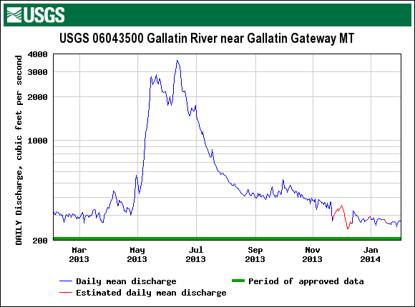
The Hydrograph: average flow over time
14
Instantaneous
Daily mean
USGS NWIS data set

Slide 18
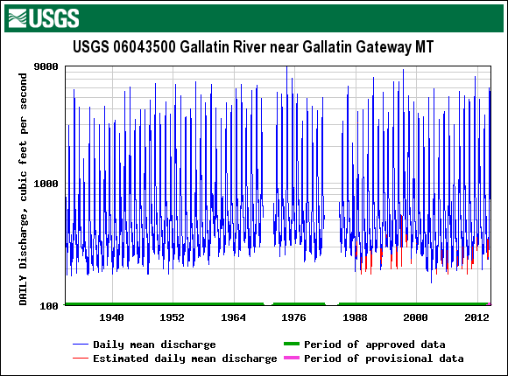
The Hydrograph: average flow over time
15
Daily mean
Annual mean
USGS NWIS data set

Slide 19
The Hydrograph: other statistics over time
16
Annual maximum
Annual minimum
Annual variance
Daily mean
USGS NWIS data set

Slide 20
The Hydrograph: historic summaries
17
Daily mean ≠ Mean daily
Mean daily is the average of all the daily means for a given day of the year across all the years of a period of record.
Mean monthly is the average of the monthly means for a given month of the year across all the years of a period of record.
Example: Mean monthly temperatures on travel sites
http://www.weatherbase.com/weather/weather.php3?s=24057&cityname=Bozeman-Montana-United-States-of-America

Slide 21
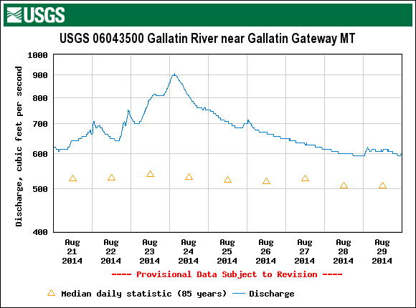
The Hydrograph: comparison with historic means
18
USGS NWIS data set

Slide 22
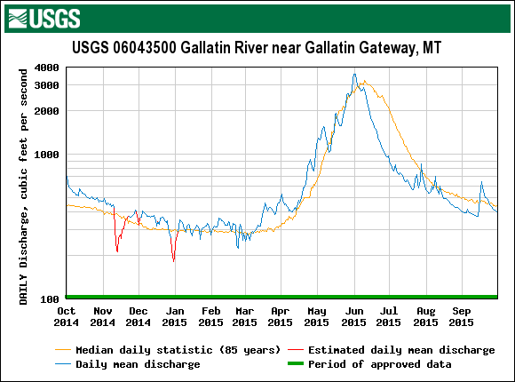
Flow duration curves: a probabilistic perspective on hydrographs
19
Annual median
?

Slide 23
Flow duration curves: a probabilistic perspective on hydrographs
19
Annual median
?
0.5

Slide 24
Flow duration curves: a probabilistic perspective on hydrographs
19a
Less
“flashy”
More
“flashy”
More
seasonal storage
Less
seasonal storage
0.5

Slide 25
Flow duration curves: a probabilistic perspective on hydrographs
20
0.5

Slide 26
Flow duration curves: flood frequency
21
Risk assessment for floods:
What is the probability of flow event “X” being exceeded over time span “Y”?
Daily mean flow
USGS NWIS data set

Slide 27
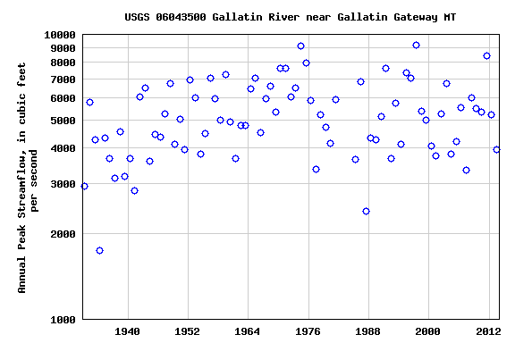
Flow duration curves: flood frequency
22
Daily mean flow
Annual peak flow
USGS NWIS data set

Slide 28
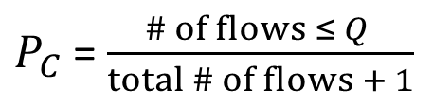
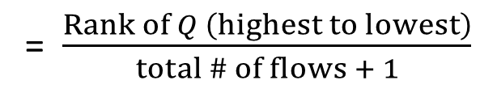
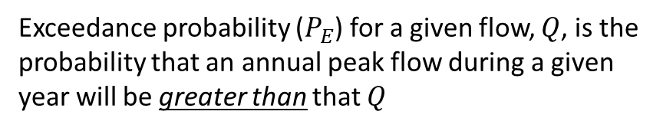
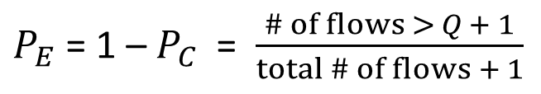
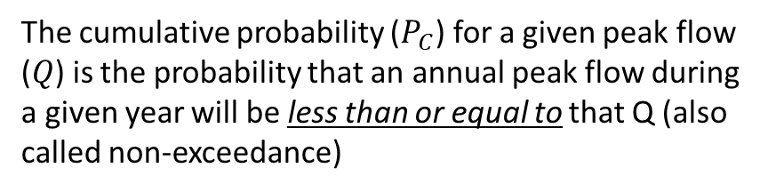
Flow duration curves: flood frequency
23
The cumulative probability ($P_{C}$) for a given peak flow ($Q$) is the probability that an annual peak flow during a given year will be less than or equal to that Q (also called non-exceedance)
Exceedance Probability estimated as a function of the fraction of flows that are GREATER THAN a given flow
$P_{C}$ = $\frac{\# of flows ≤ Q }{total \# of flows + 1}$
Exceedance probability ($P_{E}$) for a given flow, $Q$, is the probability that an annual peak flow during a given year will be greater than that $Q$
Cumulative probability estimated as a function of the fraction of flows that are LESS THAN OR EQUAL TO a given flow
$P_{E}$ = 1 – $P_{C}$ = $\frac{\# of flows > Q + 1}{total \# of flows + 1}$
= $\frac{Rank of Q \left(highest to lowest\right)}{total \# of flows + 1}$
Annual peak flow
USGS NWIS data set

Slide 29
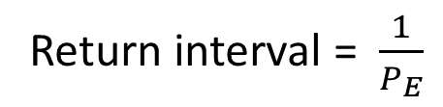
Flow duration curves: flood frequency
24
Exceedance Probability estimated as a function of the fraction of flows that are GREATER THAN a given flow
Exceedance probability for a given flow, Q, is the probability that an annual peak flow during a given year will be greater than that Q
yr⁻¹
[T⁻¹]
Return interval = $\frac{1}{P_{E}}$
yr
[T]
Be careful with return interval and
time period of flow statistic!
Has nothing to do with periodicity!
Annual peak flow
USGS NWIS data set

Slide 30
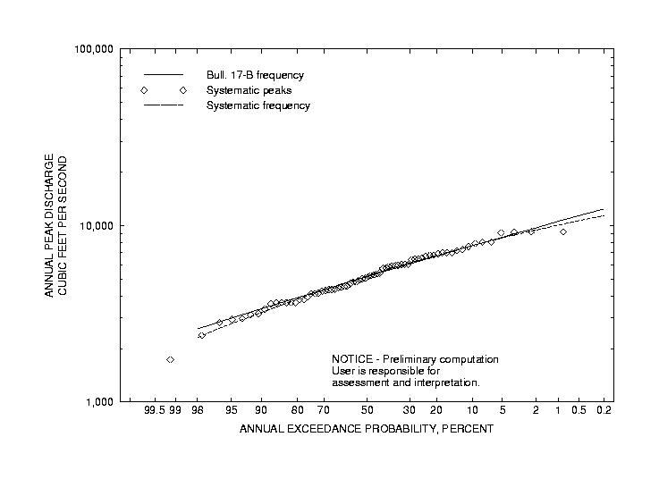
Flow duration curves: flood frequency plot
25
What flow has a
20 yr return interval?
Where do I need to look on the x axis?
~ 8300 cfs
USGS NWIS data set

Slide 31
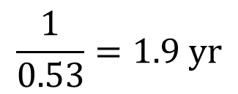
Flow duration curves: flood frequency plot
26
Return interval for
5000 cfs annual peak flow?
$$\frac{1}{0.53}=1.9 yr$$
USGS NWIS data set

Slide 32

Flood frequency curves: typical risk assessment
27
$Q=2000 m^{3} s^{−1}$ $P_{E}=0.01$
(100 yr return interval)
The 100 year flood level was exceeded last year with a peak flow of 2200$m^{3} s^{−1}$. What is the chance of exceeding a 100 yr flood this year:
0.01 ($P_{E}$ is an independent probability for each year and return interval does not provide information about periodicity)

Slide 33

Flood frequency curves: typical risk assessment
28
$Q=2000 m^{3} s^{−1}$ $P_{E}=0.01$
(100 yr return interval)
Probability of peak flow exceeding 2000 m³ s⁻¹ for 2 consecutive years:
$$=\left(0.01\right)\left(0.01\right)={\left(0.01\right)}^{2}=0.0001$$
Probability of peak flow exceeding 2000 m³ s⁻¹ every year for n consecutive years:
$$={P_{E}}^{n}$$

Slide 34

Flood frequency curves: typical risk assessment
29
$Q=2000 m^{3} s^{−1}$ $P_{E}=0.01$
(100 yr return interval)
Probability of peak flow NOT exceeding 2000 m³ s⁻¹ for 2 consecutive years:
$$=\left(1−0.01\right)\left(1−0.01\right)={\left(0.99\right)}^{2}=0.98$$
Probability of peak flow NOT exceeding 2000 m³ s⁻¹ every year for n consecutive years:
$$={\left(1−P_{E}\right)}^{n}={P_{C}}^{n}$$
Cumulative probability

Slide 35


Flood frequency curves: typical risk assessment
30
$Q=2000 m^{3} s^{−1}$ $P_{E}=0.01$
(100 yr return interval)
Probability of peak flow exceeding 2000 m³ s⁻¹ at least once over 75 years:
First calculate the probability of peak flow NOT exceeding 2000 m³ s⁻¹ over 75 years:
$$={\left(1−P_{E}\right)}^{n}={\left(1−0.01\right)}^{75}=0.47$$
Then subtract from one to get the probability of at least one flow exceeding
2000 m³ s⁻¹ over 75 years:
$$=1−0.47=0.53$$
Overall, the equation for finding the probability of at least one exceedance over n years is:
$$={1−\left(1−P_{E}\right)}^{n}={1−P_{C}}^{n}$$

Slide 36

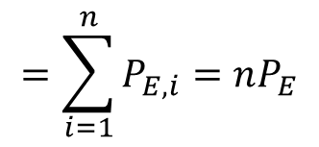


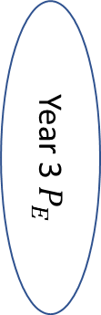
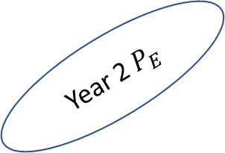
$$=\sum_{i=1}^{n}{P_{E,i}}=nP_{E}$$
$$P_{E}=0.01$$
$P_{E,1}⋃$ $P_{E,2}⋃ P_{E,3}$ $⋃$ $P_{E,4}⋯⋃ P_{E,n}$
What is the probability of this event being exceeded at least once in n years?
Possible space
Year 2 $P_{E}$
Year 1 $P_{E}$
Year 3 $P_{E}$

Slide 37

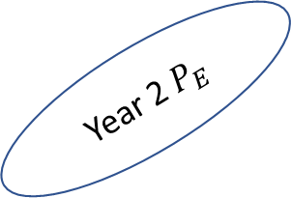

$$=\sum_{i=1}^{n}{P_{E,i}}=nP_{E}$$
$$P_{E}=0.01$$
$P_{E,1}⋃$ $P_{E,2}⋃ P_{E,3}$ $⋃$ $P_{E,4}⋯⋃ P_{E,n}$
What is the probability of this event being exceeded at least once in n years?
Possible space
Year 2 $P_{E}$
Year 1 $P_{E}$
Year 3 $P_{E}$

Slide 38





The $P_{E}$ for each year is independent, so there is a shortcut
$$P_{E}=0.01$$
$P_{E,1}⋃$ $P_{E,2}⋃ P_{E,3}$ $⋃$ $P_{E,4}⋯⋃ P_{E,n}$
$$=1−{\left(1−P_{E}\right)}^{n}$$
What is the probability of this event being exceeded at least once in n years?

