Slide 1


Starting Roblox…
Cancel
www.roblox.com

Slide 2








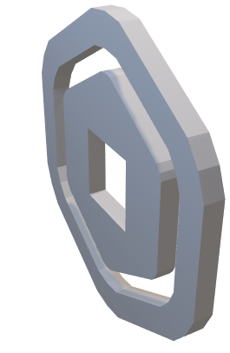
Welcome to
www.roblox.com

Slide 3

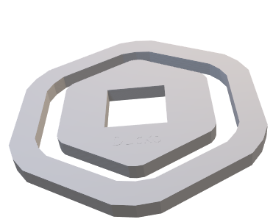

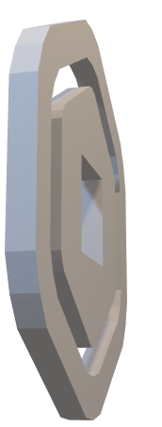





Welcome to
Close App
Roblox
0
Notifications
Home
You’re not Logged to your Account. You current as Guest! Make a FREE account on www.roblox.com. Also you cannot Play the Games and edit Avatar
Login
Sign In
Avatar
www.roblox.com

Slide 4
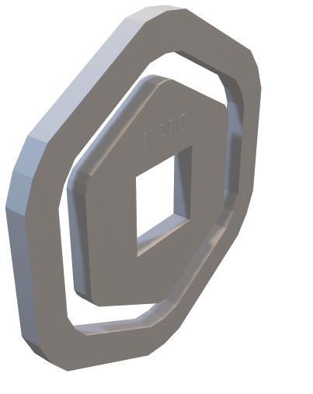

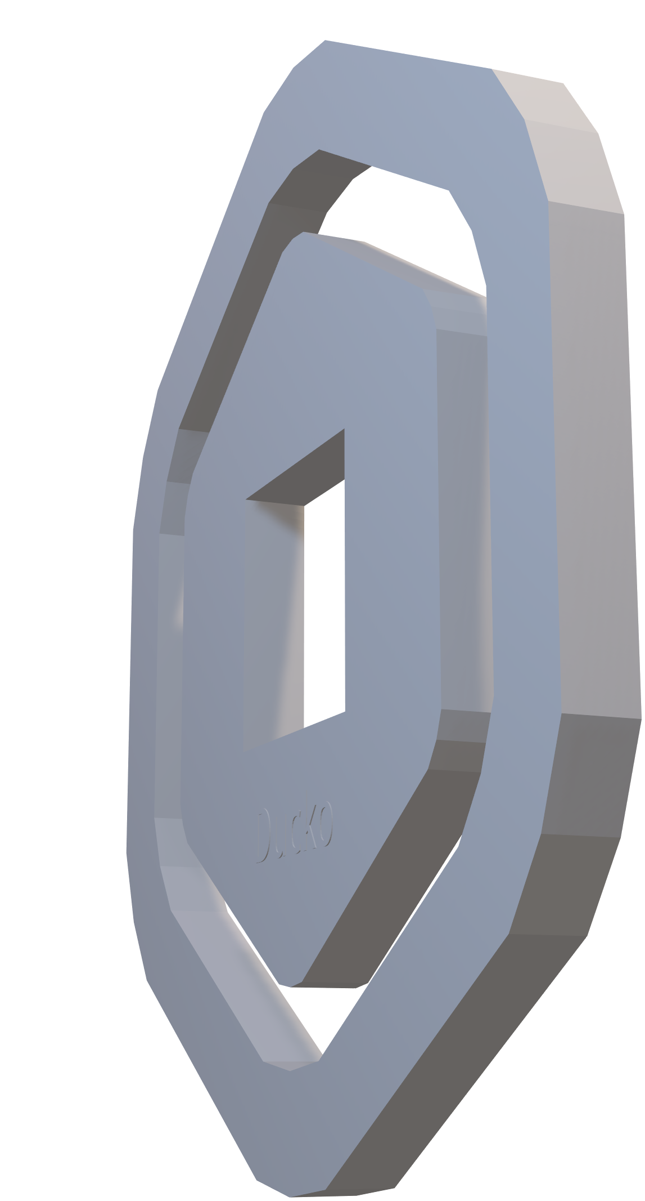

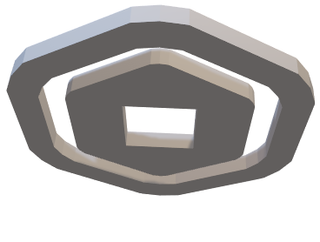
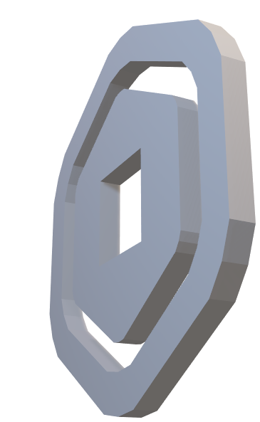
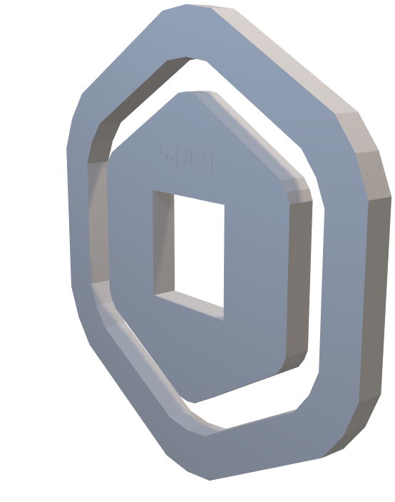
Welcome to
Close App
Roblox
0
Notifications
Home
You’re not Logged to your Account. You current as Guest! Make a FREE account on www.roblox.com. Also you cannot Play the Games and edit Avatar
Login
Sign In
Avatar
www.roblox.com

Slide 5
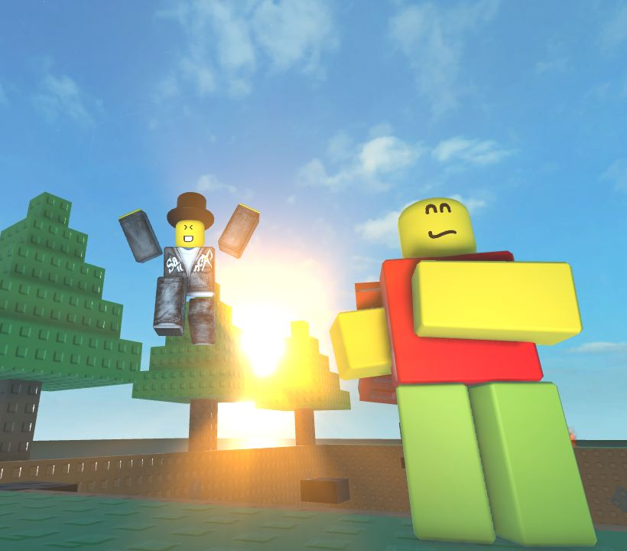
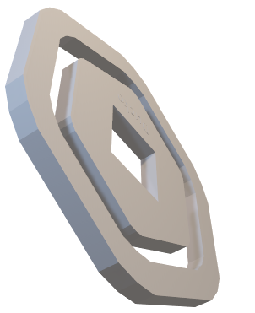





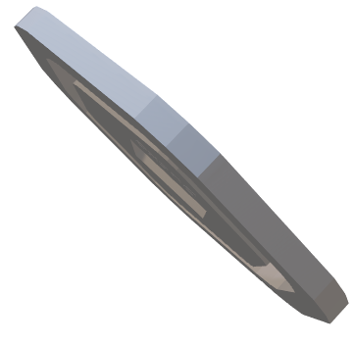
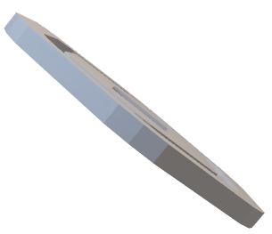
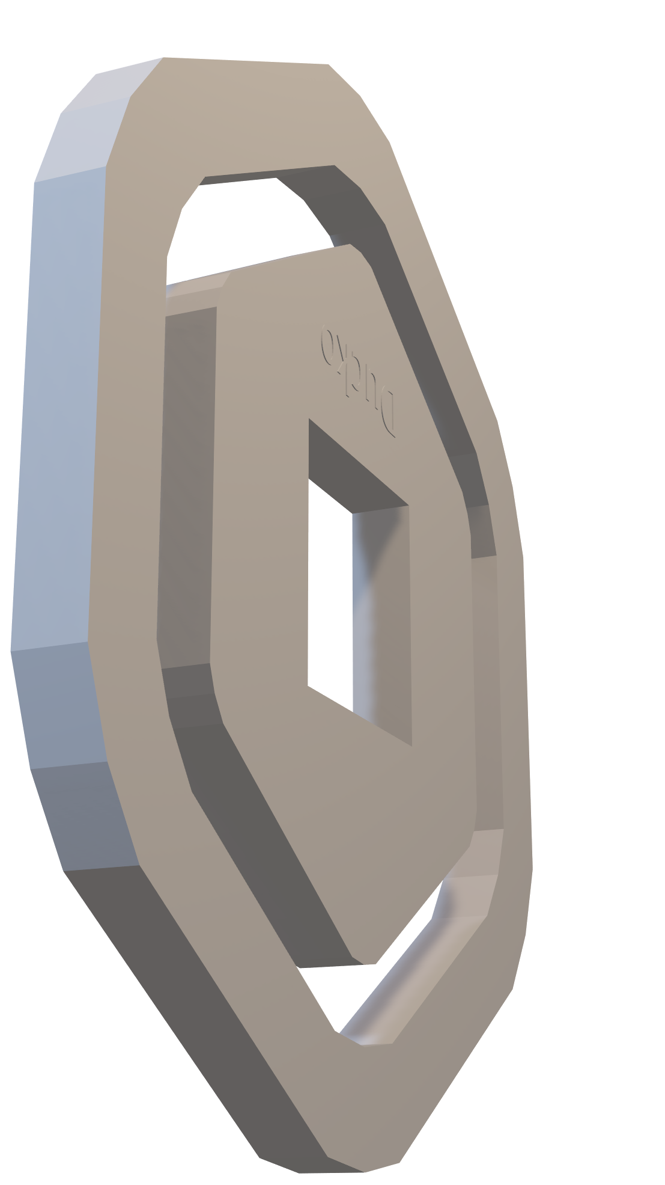


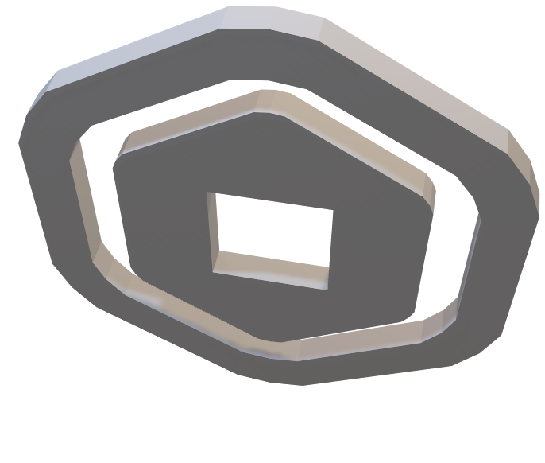
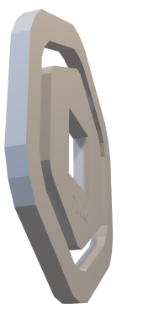
Close App
0
Notifications
Home
You’re not Logged to your Account. You current as Guest! Make a FREE account on www.roblox.com. Also you cannot Play the Games and edit Avatar
Obstacles
Login
Sign In
Avatar

Slide 6
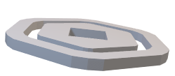


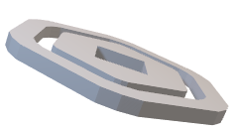
Close App
Robux
Your Balance: 0R$
Back
Cannot buy Robux on Third Party App

Slide 7




Close App
Notifications
Back
You’re not Logged to your Account. You current as Guest! Make a FREE account on www.roblox.com

Slide 8
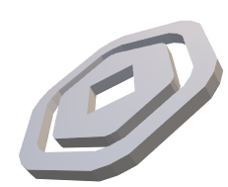

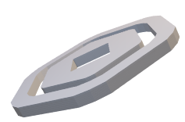
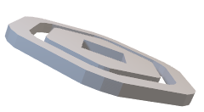
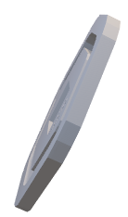
Close App
Avatar
0
Back
Marketplace
Customize
Cannot change you’re look because you’re not Logged to your Account. You current as Guest! Make a FREE account on www.roblox.com

Slide 9

X
Obstacles!
By @Grisin_Roman
Waiting For Server…

Slide 10

Not Work
Obstacles!
By @Grisin_Roman
Waiting…

