Slide 1
Water and energy balance of watersheds
1
NOTE: Slides for each module are numbered for easier cross-referencing with class notes
NOTE: My slides have TONS of animations and building graphics. These do not translate well to D2L, so it is best to download the power point to work through the logic behind the animations

Slide 2
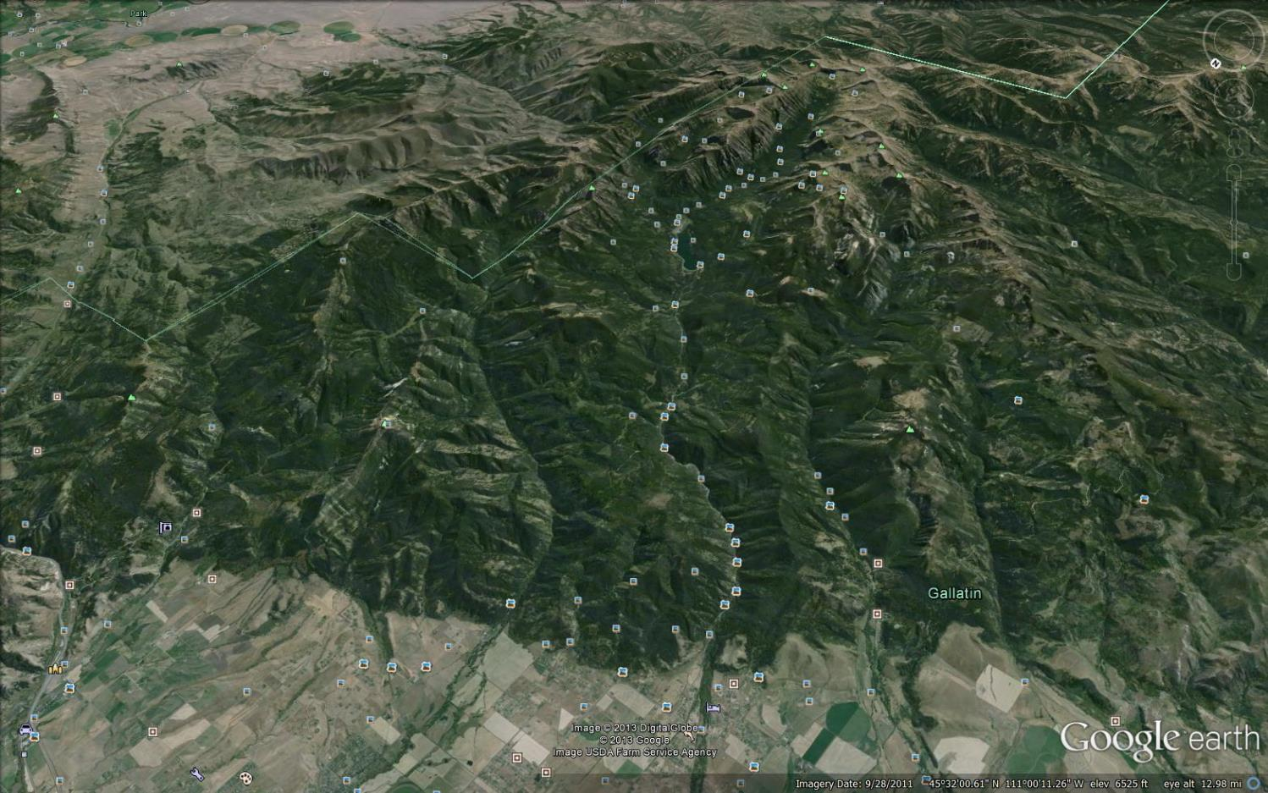
Stream flow measurement and hydrographs
2
Gallatin Range
?
Mt. Blackmore
?
Hyalite Creek Watershed
Bozeman Creek Watershed
Q
Q
Bozeman (Sourdough) Creek
Hyalite Creek
Bozeman

Slide 3
Stream flow measurement
3
Watershed delineation
Gallatin Range
?
Mt. Blackmore
?
Hyalite Creek Watershed
Bozeman Creek Watershed
Q
Q
Bozeman (Sourdough) Creek
Hyalite Creek
Bozeman

Slide 4
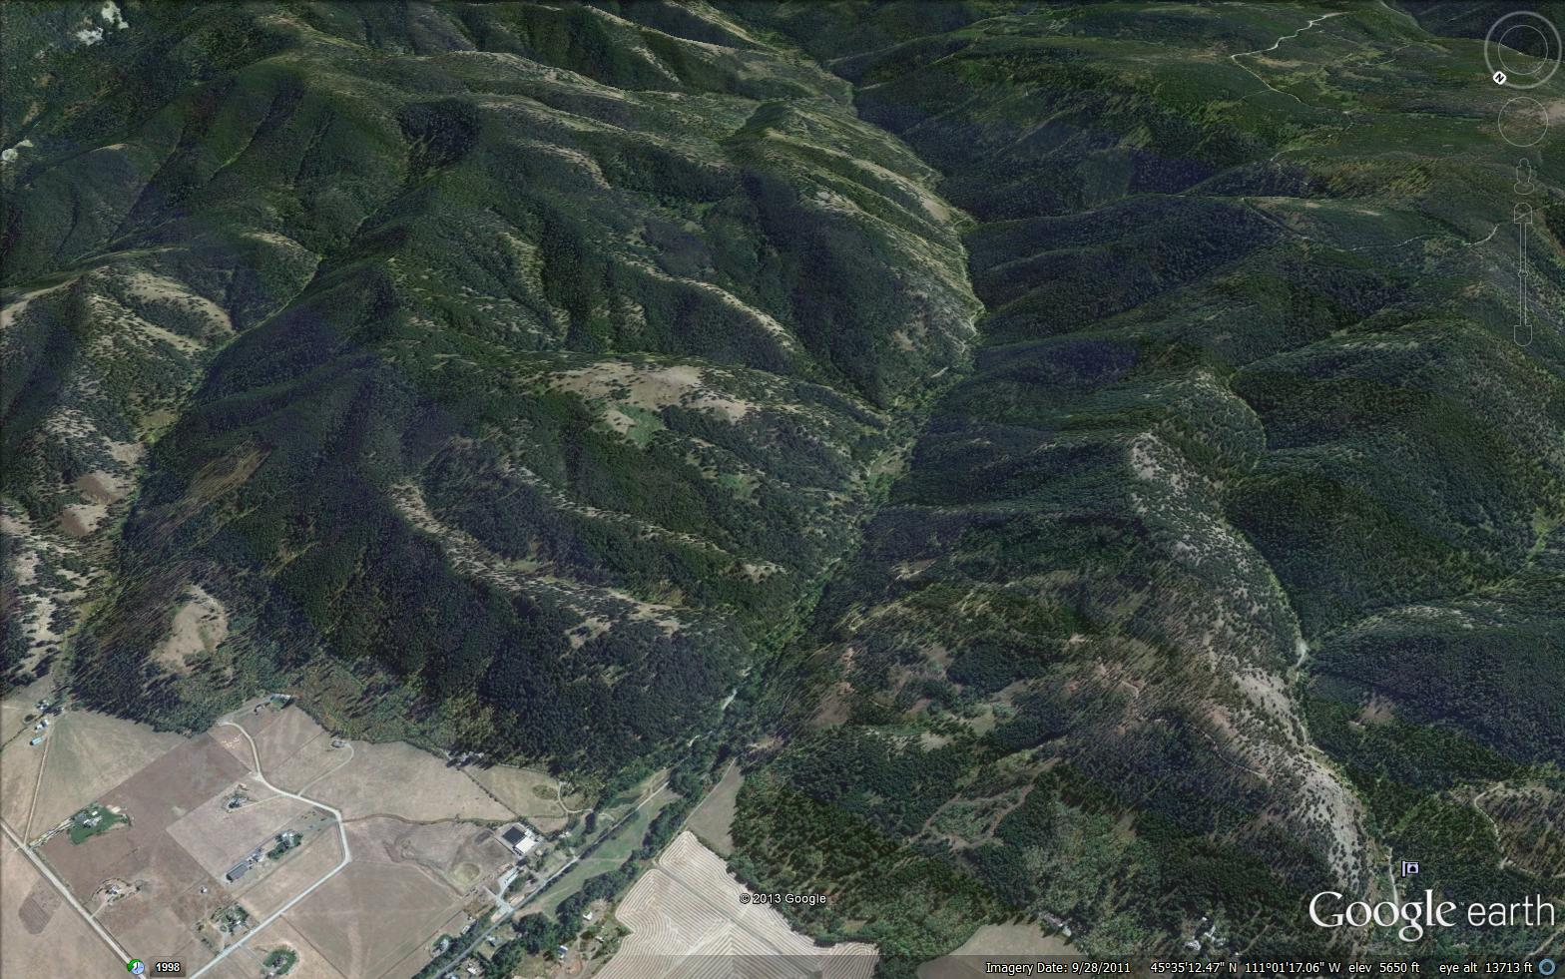
4
Watershed delineation
stream <- groundwater
Bozeman (Sourdough) Creek
Groundwater
Streams

Slide 5

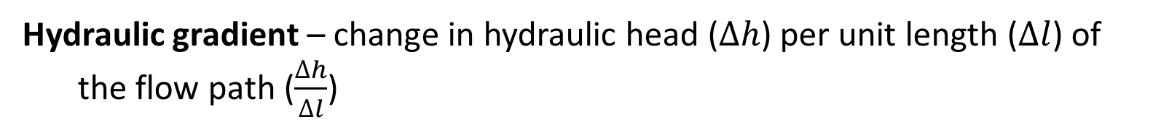
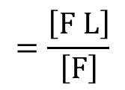

5
Watershed delineation: what determines flow direction?
Hydraulic gradient – change in hydraulic head ($Δh$) per unit length ($Δl$) of the flow path ($\frac{∆h}{∆l}$)
Hydraulic head – potential mechanical energy of water per unit weight
$$\frac{\left[E\right]}{\left[F\right]}$$
$$=\frac{\left[F L\right]}{\left[F\right]}$$
$$=\left[L\right]$$
Elevation head – potential mechanical energy due to gravity (one component of total hydraulic head)
Positive $Q$ follows a negative $\frac{∆h}{∆l}$ (water flows down a gradient)
Water tends to follow the path with the steepest hydraulic gradient (highest $\frac{∆h}{∆l}$)

Slide 6
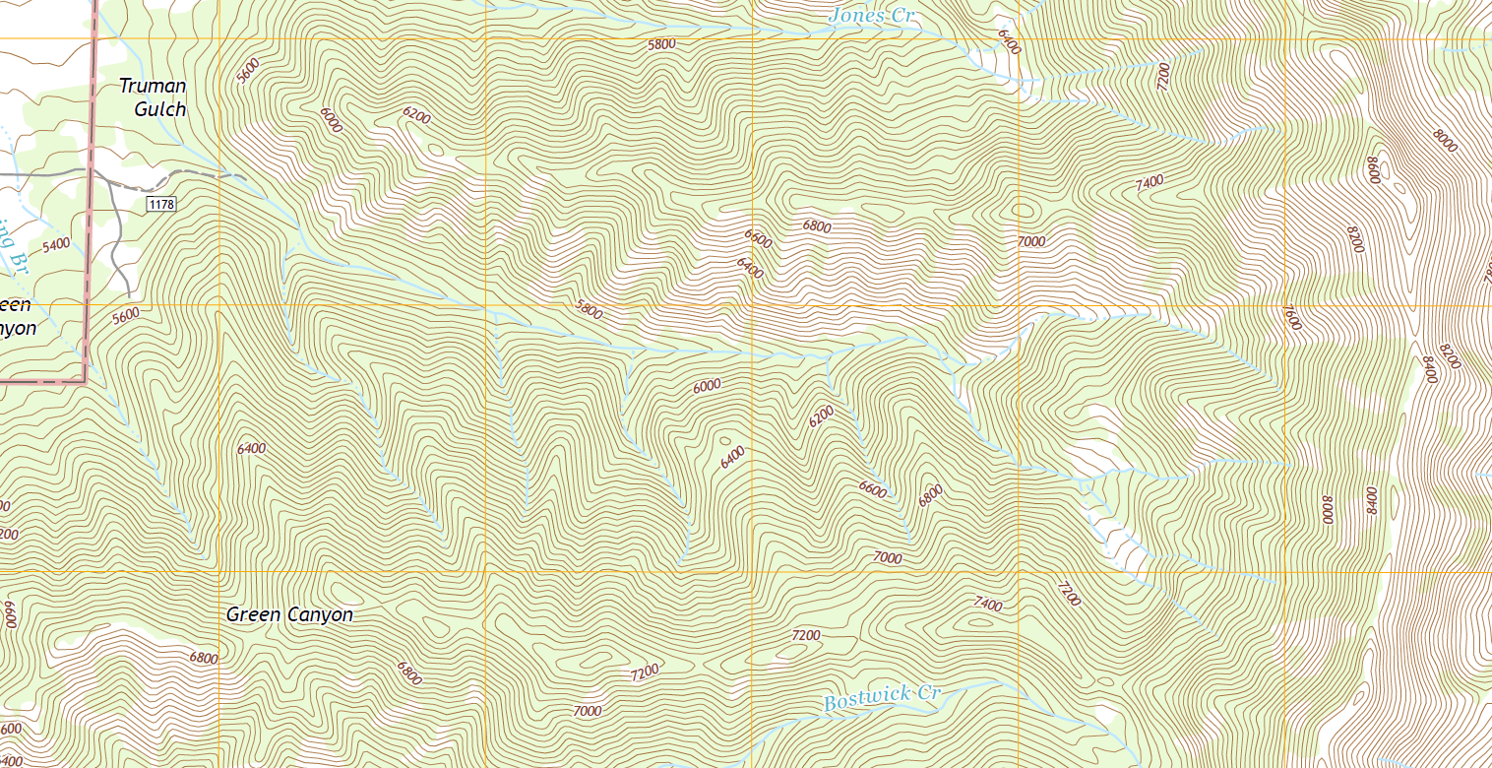
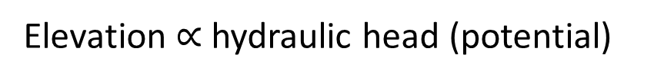
6
Watershed delineation: topographic flow nets
Contours = lines of equal elevation
Elevation $∝$ hydraulic head (potential)
Contours lines are lines of equipotential
Flow lines must be perpendicular to equipotential lines
= water flows down the steepest hydraulic gradient
Topographic flow paths in a watershed must be perpendicular to contours and down the elevation gradient

Slide 7
Watershed delineation: convergence and divergence
7
Divergent
Convergent
500
500
100
100

Slide 8
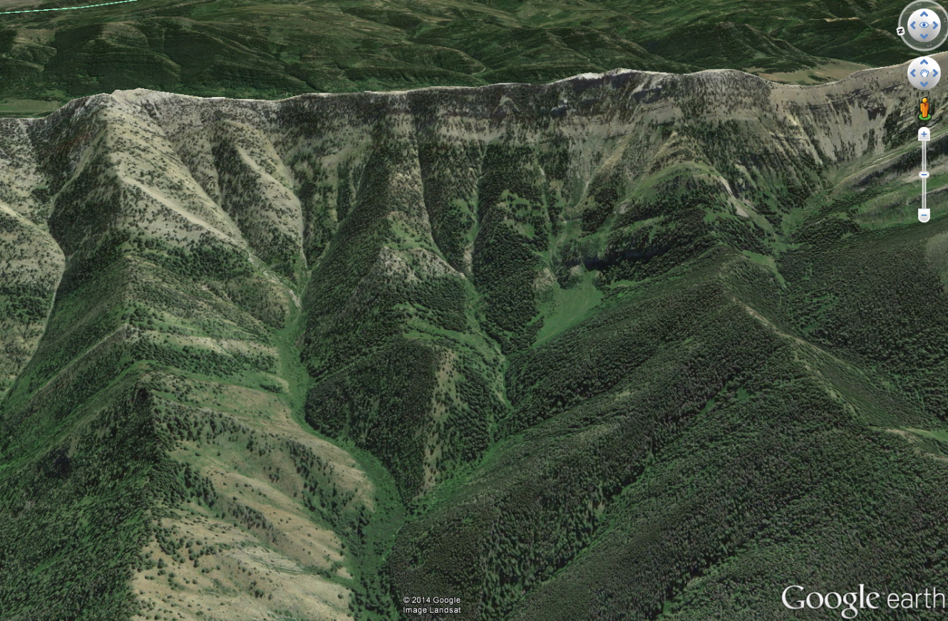
8
Watershed delineation: topographic flow nets
Gauging station (pour point)
Why you start at the pour point and work up: (Video of how NOT to do it) https://youtu.be/ajF0DsuuY4k?t=273

Slide 9
9
Watershed delineation: topographic flow nets
Gauging station (pour point)

Slide 10
10
Watershed delineation: topographic flow nets
Gauging station (pour point)

Slide 11
11
Watershed delineation: topographic flow nets
Gauging station (pour point)
Nested hierarchy
Notes:
If we want to understand where the water we use comes from, we have to start at the diversion to the water treatment plant and work upstream into the mountains. Let’s take a closer look at the mouth of Sourdough Canyon.
The most obvious source of water is the stream (Bozeman Creek) flowing through the base of Sourdough Canyon. Some of the water in this stream comes from tributary streams. Once you reach the source of flow of a tributary, that water may be coming from a spring or a wetland fed by groundwater. If we make the assumption that groundwater follows flow paths that are the same as the slope of the surface topography (i.e. unconstrained water flows downhill), then we can continue to draw a groundwater flow path uphill, until we reach a point where there is no landscape that flows into our location.
These groundwater flow paths can also feed streams directly from the canyon hill slopes, either in the main canyon or in the tributaries. And groundwater flow paths might also feed other groundwater flow paths. If you keep drawing these flow paths based on the slope of surface topography, all the arrows together will define an area that we call a watershed, or the area of the landscape that drains to a given water body or flow.

Slide 12
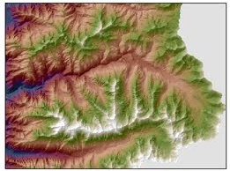
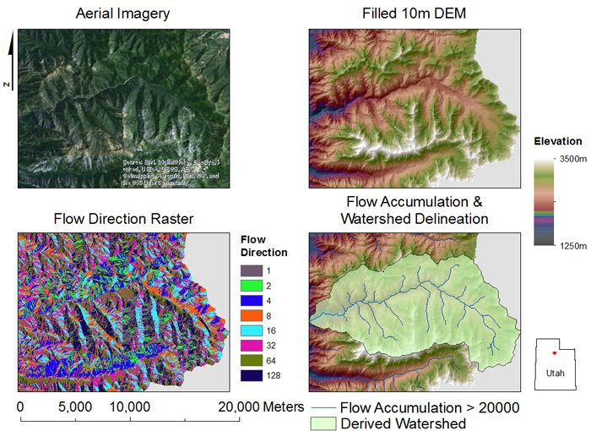
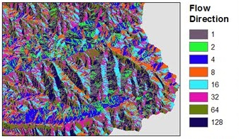
Watershed delineation: from digital elevation models
12
Digital Elevation Model
Flow Direction Surface
From https://sites.google.com/site/ilesgis/labs/lab-08
Watershed delineation

Slide 13
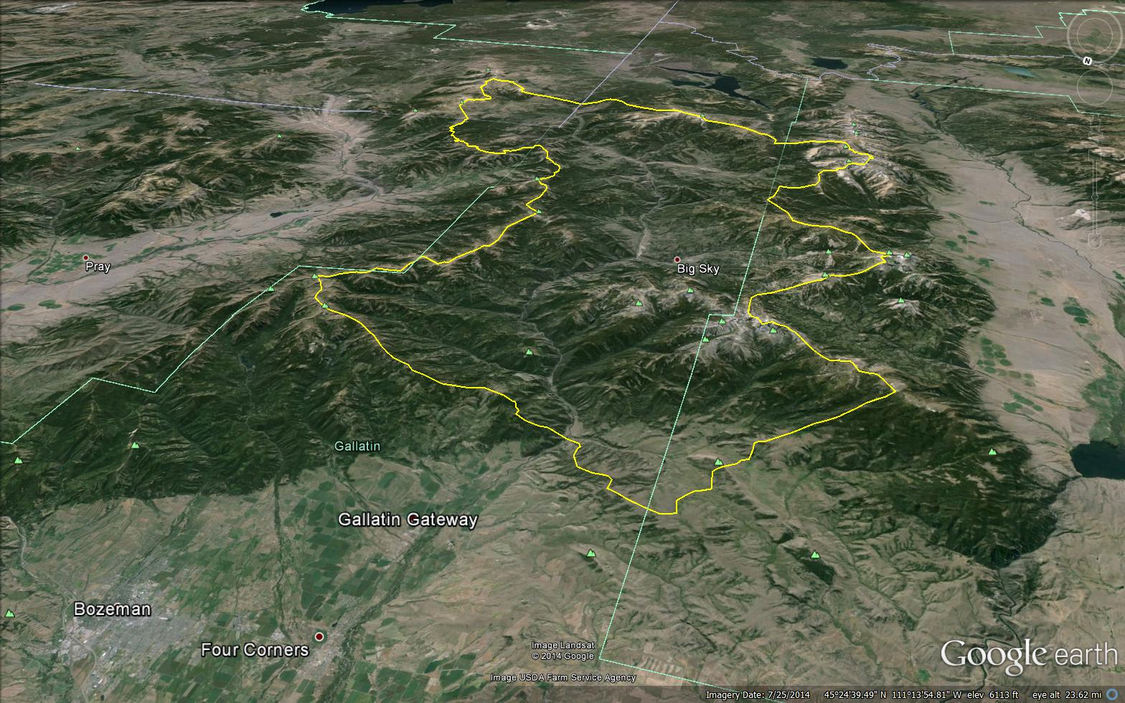
The Watershed and its Hydrograph
13
06043500 – Gallatin River near Gallatin Gateway (just downstream of Spanish Creek)
Area = 825 mi²

Slide 14

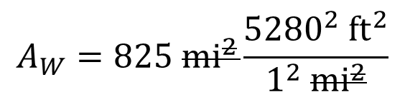
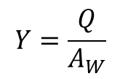
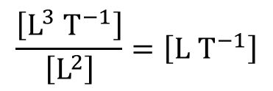
The Watershed and its Hydrograph: area normalized flow
14
Area normalized flow: a.k.a.
Areal yield, specific discharge
$$Y=\frac{Q}{A_{W}}$$
$$\frac{\left[L^{3} T^{−1}\right]}{\left[L^{2}\right]}=\left[L T^{−1}\right]$$
$$A_{W}=825 {mi}^{2}\frac{{5280}^{2} {ft}^{2}}{1^{2} {mi}^{2}}$$
$$=2.30×{10}^{10} {ft}^{2}$$

Slide 15
The Watershed and its Hydrograph: area normalized flow
15
Area normalized flow: a.k.a.
Areal yield, specific discharge
$$Y=\frac{Q}{A_{W}}$$
$$\frac{\left[L^{3} T^{−1}\right]}{\left[L^{2}\right]}=\left[L T^{−1}\right]$$
$$A_{W}=825 {mi}^{2}\frac{{5280}^{2} {ft}^{2}}{1^{2} {mi}^{2}}$$
$$=2.30×{10}^{10} {ft}^{2}$$

Slide 16
The Watershed and its Hydrograph: area normalized flow
15a
Area normalized flow: a.k.a.
Areal yield, specific discharge
$$Y=\frac{Q}{A_{W}}$$
$$\frac{\left[L^{3} T^{−1}\right]}{\left[L^{2}\right]}=\left[L T^{−1}\right]$$
$$A_{W}=825 {mi}^{2}\frac{{5280}^{2} {ft}^{2}}{1^{2} {mi}^{2}}$$
$$=2.30×{10}^{10} {ft}^{2}$$

Slide 17
The Watershed and its Hydrograph: area normalized flow
16
Why?
Removes variation in flow that can be explained simply by the area of precipitation captured.
Remaining variation is more likely to explain differences in hydrologic processes within compared watersheds.
Has common dimensionality with precipitation and evapotranspiration.

Slide 18
Stream flow measurement
17
Watershed delineation
Gallatin Range
?
Mt. Blackmore
?
Hyalite Creek Watershed
Bozeman Creek Watershed
Q
Q
Bozeman (Sourdough) Creek
Hyalite Creek
Bozeman

Slide 19
Stream flow measurement
18
Watershed causality
Gallatin Range
?
Mt. Blackmore
?
Hyalite Creek Watershed
Bozeman Creek Watershed
Q
Q
Bozeman (Sourdough) Creek
Hyalite Creek
Bozeman

Slide 20
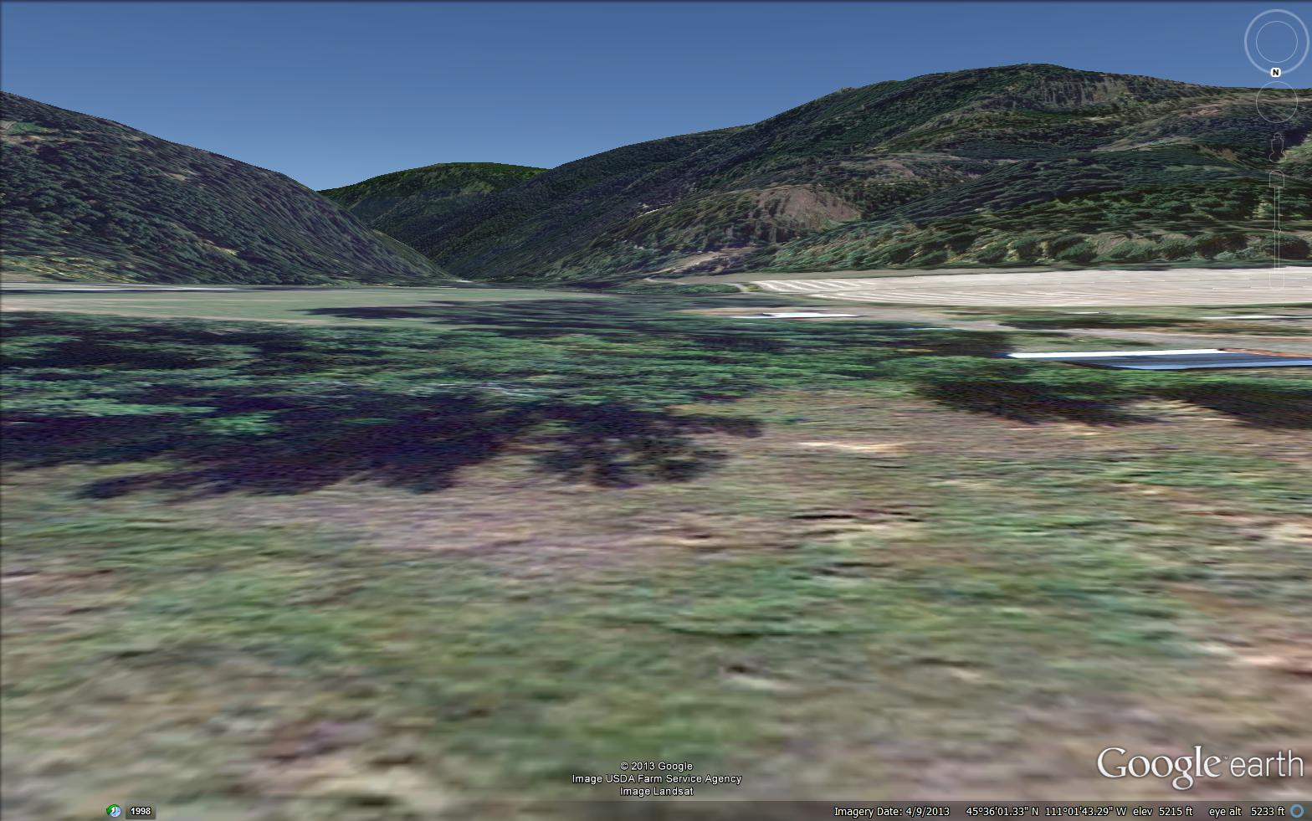
19
Water balance: derivation
Bozeman (Sourdough) Creek
Notes:
In order to characterize how each of these puzzle pieces works, we need to find a general abstraction of how water tends to move through these systems. One repeatable pattern that we find in mountain watersheds is a V or U shaped valley. This pattern tends to be repeated along many of the streams and even some of the subsurface flow paths within the watershed.

Slide 21



20
Water balance: derivation
Precipitation = P
Evaporation (and Transpiration) = E_{ET}
Infiltration /
Recharge
Groundwater flow
Runoff = Q_{OUT}
Conservation equation
Change in storage = Inputs - Outputs
$$∆S =$$
$$P$$
$$−Q_{OUT}−E_{ET}$$
Notes:
So let’s spend some time thinking about how water moves through this kind of landscape. We start with the stream, which you can think of flowing out of the screen toward you. Movement of water over the surface is called runoff, and the stream carrying water out of the watershed is one form of runoff (e.g. where water is diverted to the Bozeman water treatment plant). Runoff is frequently represented by the letter Q, which is the variable frequently used for stream discharge (we will talk about why it is called discharge in a little bit). The subscript “out” designates stream flow out of a watershed.
Streams are generally located where the groundwater table is closest to the surface. The water table is located near the transition from unsaturated conditions above to saturated conditions below in the subsurface. Technically, the water table is the surface of zero pressure head, which is somewhat below the transition from saturated to unsaturated conditions due to capillary forces (but lets not worry about that detail, yet).
Remember our assumption that groundwater follows the same flow direction as surface topography? Well, in order for that to occur, the water table must have a similar shape as the surface topography in valleys. Therefore, the dotted groundwater flow lines in the earlier figures would look something like this in profile in this picture.
The groundwater ultimately comes from precipitation (which we designate with the variable “P”). There are many ways water may get from precipitation to groundwater (particularly where humans get involved), but for now lets think of the dominant pathway in a natural watershed as infiltration of precipitation into the soil. Any infiltrated water that eventually makes it to the water table is then called recharge (which is why stream flow generation is often called discharge).
Finally, not all the water that infiltrates into the soil makes it to groundwater. Plants on the landscape are hydraulic ecological engineer specialists, using narrow tubes in their trunks (xylem) and evaporation from pores in the leaves (stomata) to create a pressure head gradient between the soil and leaves that overcomes gravity, thus pulling water out of the soil and up to their leaves. Water evaporating from leaves in this manner is called transpiration. Water can also evaporate directly from the soils when the relative humidity is below 100%. Together these processes are called “evapotranspiration” and the bulk of evapotranspiration within the rooting depth of soils is driven by transpiration in vegetated environments.
With these principles we can start to think about the water balance, or the mass balance of water that is either imported, exported, or stored within the system.
A mass balance always starts with setting the change in storage within a system equal to the difference between the inputs to and outputs from the system. Let’s start by setting the variable for storage to “S” so that we can designate the change in storage as delta “S”. Storage in the watershed can be many places. It can be the relatively slow moving water in the soils or groundwater. It can be in surface water reservoirs (natural or otherwise) such as ponds, lakes, or wetlands. It can also be on the surface in the form of frozen water, or the snow pack. The snow pack is particularly important in Montana because it indicates how much stored water is going to be available during our relatively dry summers.
The input to our system is precipitation from the atmosphere. And there are two potential outputs, either movement of water back into the atmosphere via evapotranspiration or flow out of the system via runoff in the stream.
Finally, we arrive at the mass balance, where the change in storage of water within the system over a given time period has to be equal to the precipitation into the system during that time minus the stream flow out of the system during that time and minus the evapotranspiration from the system during that time.

Slide 22
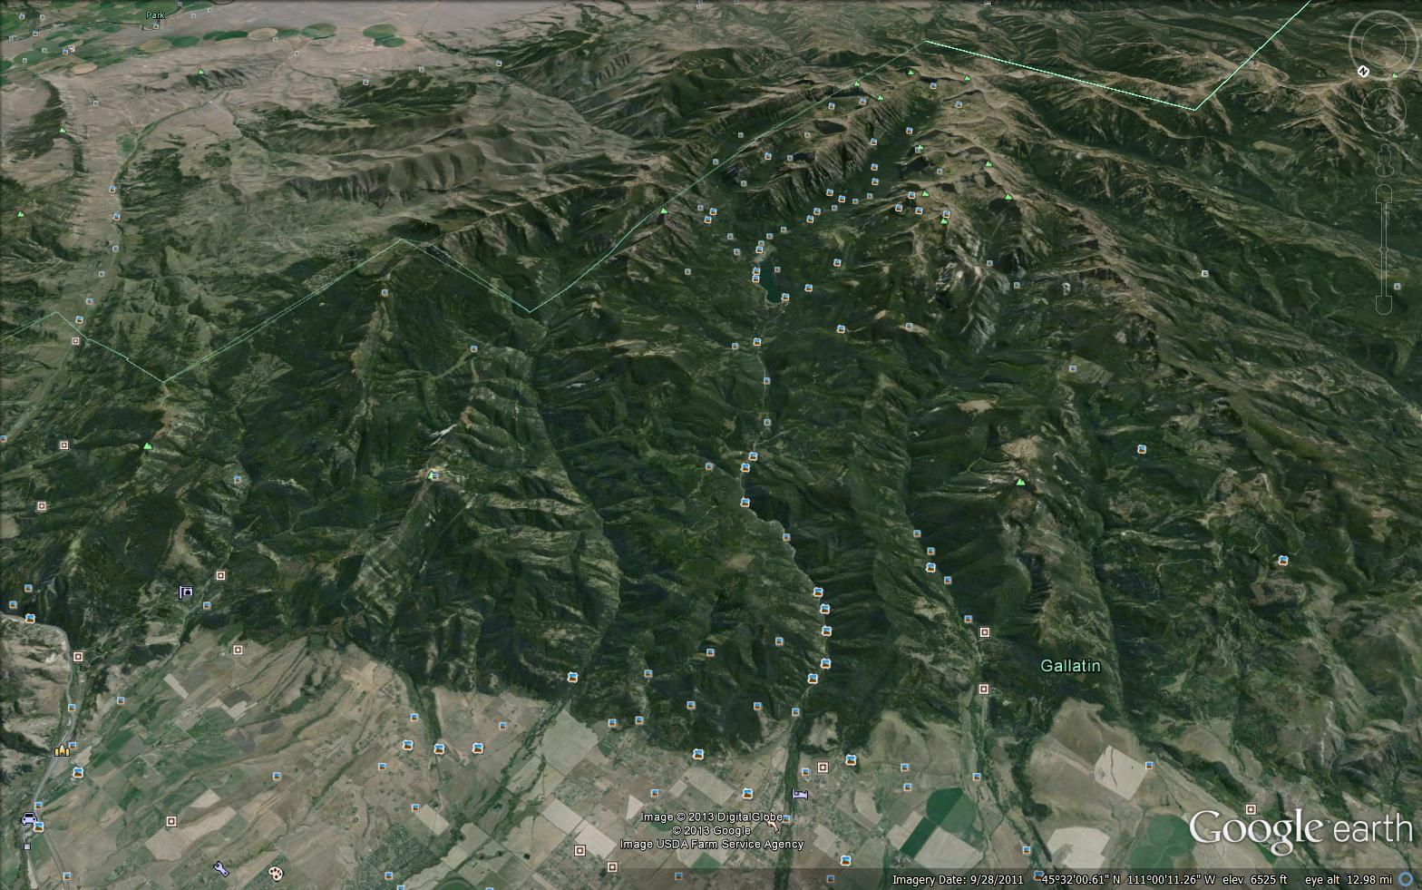








21
Water balance: conservation in a control volume
Gallatin Range
$$∆S=$$
$$P$$
$$−Q_{OUT}−E_{ET}$$
Simplified water balance: specific to fully delineated watersheds and subject to assumptions about groundwater
P
ET
Mt. Blackmore
Q_{IN}
P
$∆$S
Bozeman Creek Watershed
$∆$S
Q_{OUT}
$$∆S=$$
$$+ Q_{IN}$$
Bozeman (Sourdough) Creek
$$P$$
Bozeman
Notes:
Now that we understand some of the details based on flow paths in valleys, we can think about how this water balance extends over the whole watershed. The change in storage of water within the watershed has to be equal to the total precipitation across the watershed, minus the evapotranspiration across the watershed, minus the runoff from the watershed outlet.
Remember, our original assumption is that groundwater flow paths are similar to those dictated by the slope of the land surface. Well, if we are dealing with areas of the landscape that do not follow this assumption we need groundwater input and output terms in our mass balance. Subsurface flow paths are likely to be different from surface topography when the bedrock contacts are tilted in a different directions, or when the bedrock is subject to fracturing or dissolution (i.e. caves in limestone systems). Also, we are not always interested in complete watersheds, and we might need more surface water input terms in our water balance.
The movie about the Bozeman water supply provided an example where they were particularly interested in the lower 1/3 of the watershed. The lower 1/3 of the Hyalite Creek watershed might look something like this. As before, we can start the water balance by setting the change in storage equal to inputs minus outputs, however now we have more inputs and outputs. For example, an additional input is going to be the stream flow entering the upstream boundary of our partial watershed. Another input might be groundwater coming from an adjacent watershed if the groundwater flow paths do not match the surface topography. There may be other areas where groundwater is moving out of the watershed, resulting in an additional output. Overall, this defines a more complete water balance for a given part of the landscape, not subject to any assumptions about complete watersheds or groundwater movement.

Slide 23
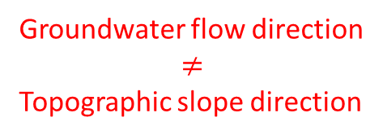

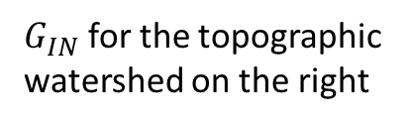
22
Water balance: conservation in a control volume
Topographic divide
Groundwater divide
$G_{IN}$ for the topographic
watershed on the right
Low permeability
$$ΔS$$
Groundwater flow direction
$$≠$$
Topographic slope direction

Slide 24
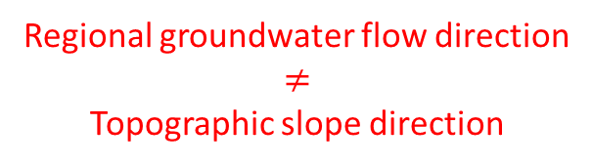

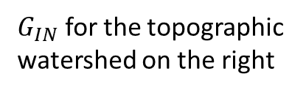
Water balance: conservation in a control volume
23
$$ΔS$$
Local groundwater flow
Local groundwater flow
$G_{IN}$ for the topographic
watershed on the right
Regional groundwater flow direction
$$≠$$
Topographic slope direction
Regional groundwater flow

Slide 25



Water balance: conservation in a control volume
24
Gallatin Range
$$∆S=$$
$$P$$
$$−Q_{OUT}−E_{ET}$$
Simplified water balance: specific to fully delineated watersheds and subject to assumptions about groundwater
P
ET
Mt. Blackmore
Q_{IN}
P
$∆$S
ET
G_{OUT}
Bozeman Creek Watershed
G_{IN}
Full water balance:
generalized for any control volume on Earth’s surface
$∆$S
Q_{OUT}
Q_{OUT}
$$∆S=$$
$$+{ Q}_{IN}$$
$$+ G_{IN}$$
Bozeman (Sourdough) Creek
$$P$$
$$−Q_{OUT}−E_{ET}$$
$$−G_{OUT}$$
Bozeman
Notes:
Now that we understand some of the details based on flow paths in valleys, we can think about how this water balance extends over the whole watershed. The change in storage of water within the watershed has to be equal to the total precipitation across the watershed, minus the evapotranspiration across the watershed, minus the runoff from the watershed outlet.
Remember, our original assumption is that groundwater flow paths are similar to those dictated by the slope of the land surface. Well, if we are dealing with areas of the landscape that do not follow this assumption we need groundwater input and output terms in our mass balance. Subsurface flow paths are likely to be different from surface topography when the bedrock contacts are tilted in a different directions, or when the bedrock is subject to fracturing or dissolution (i.e. caves in limestone systems). Also, we are not always interested in complete watersheds, and we might need more surface water input terms in our water balance.
The movie about the Bozeman water supply provided an example where they were particularly interested in the lower 1/3 of the watershed. The lower 1/3 of the Hyalite Creek watershed might look something like this. As before, we can start the water balance by setting the change in storage equal to inputs minus outputs, however now we have more inputs and outputs. For example, an additional input is going to be the stream flow entering the upstream boundary of our partial watershed. Another input might be groundwater coming from an adjacent watershed if the groundwater flow paths do not match the surface topography. There may be other areas where groundwater is moving out of the watershed, resulting in an additional output. Overall, this defines a more complete water balance for a given part of the landscape, not subject to any assumptions about complete watersheds or groundwater movement.

Slide 26

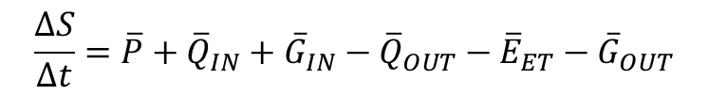
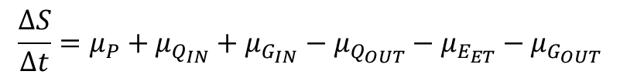

Water balance: rates
25
$$∆S=P+Q_{IN}+G_{IN}−Q_{OUT}−E_{ET}−G_{OUT}$$
Average rates over some $∆t$
$$\frac{∆S}{∆t}=\overline{P}+{\overline{Q}}_{IN}+{\overline{G}}_{IN}−{\overline{Q}}_{OUT}−{\overline{E}}_{ET}−{\overline{G}}_{OUT}$$
$$+{ Q}_{IN}$$
$$\frac{∆S}{∆t}=μ_{P}+μ_{Q_{IN}}+μ_{G_{IN}}−μ_{Q_{OUT}}−μ_{E_{ET}}−μ_{G_{OUT}}$$
Daily mean, annual mean, etc.
Will probably be normalized: dimensions [L T⁻¹] rather than [L³ T⁻¹]
(aids in thinking about partitioning of precipitation flux)
Volumes of liquid water (or equivalent volume of liquid water)
Mass is what is actually conserved, so this assumes variation in density of liquid water is negligible.

Slide 27
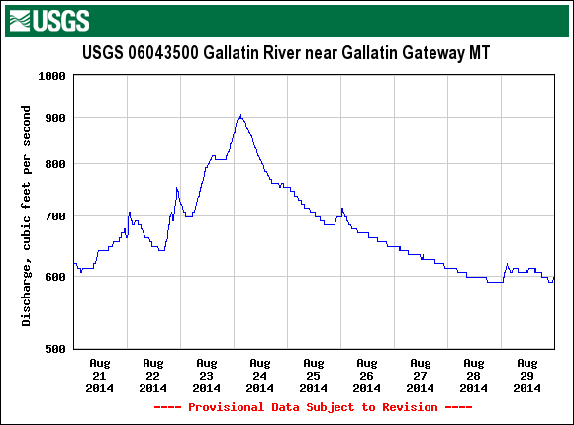
Water balance: consequences of storage
26
Precip
Response
Storage results in output variation that is buffered relative to input variation
USGS NWIS data set

Slide 28
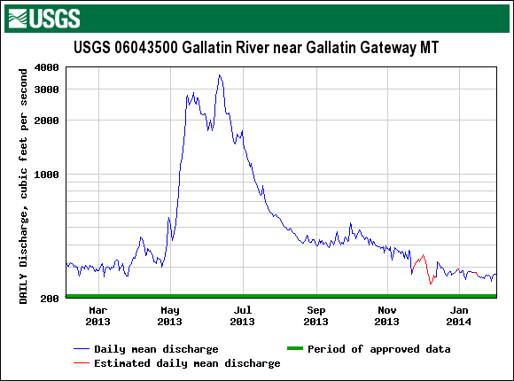
Water balance: consequences of storage
27
Abundant storage > 1 day
Minimal storage > 1 year
Strongly autocorrelated daily averages (strong persistence)
Weakly autocorrelated annual averages (weak persistence)
USGS NWIS data set

Slide 29


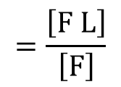
Water balance: simplifications
28
$$\frac{∆S}{∆t}=μ_{P}+μ_{Q_{IN}}+μ_{G_{IN}}−μ_{Q_{OUT}}−μ_{E_{ET}}−μ_{G_{OUT}}$$
Control volume is a complete watershed based on surface topography
$$\frac{∆S}{∆t}=μ_{P}+μ_{G_{IN}}−μ_{Q_{OUT}}−μ_{E_{ET}}−μ_{G_{OUT}}$$
Groundwater is negligible relative to time or space scale of interest
  Larger watersheds
  Interest in peak flows
  Gauged to bedrock
$$\frac{∆S}{∆t}=μ_{P}−μ_{Q_{OUT}}−μ_{E_{ET}}$$
Working with sufficiently long time scales (typically annual or greater)
Pick start and end times for $∆t$ that represent a small difference between the storage at the start and end, relative to the total volume of water passing through the watershed
The $Δt$ with the smallest difference in $S$ typically corresponds to the times with smallest $S$

Slide 30
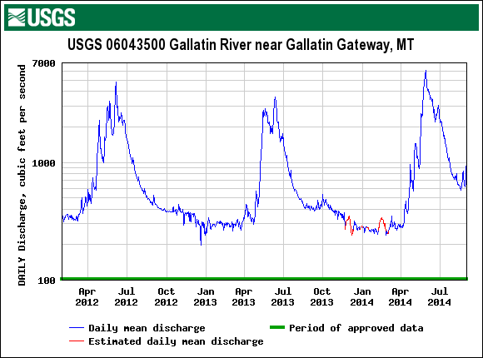
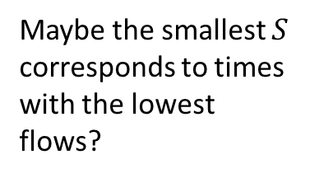
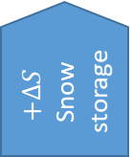

Water balance: what is a water year?
29
Maybe the smallest $S$ corresponds to times with the lowest flows?
?
$$+ΔS$$
Snow storage
$$−ΔS$$
Snow melt
USGS NWIS data set

Slide 31
Water balance: what is a water year?
30
USGS Water year is 1 October through 30 September
Example:
1 Oct 2017 –
30 Sept 2018
is the 2018 Water Year
$$+ΔS$$
Snow storage
$$−ΔS$$
Snow melt
USGS NWIS data set

Slide 32
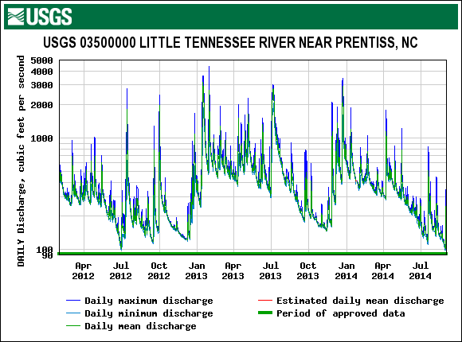
Water balance: what is a water year?
31
Where seasonal patterns in the northern hemisphere are driven by ET, October 1 is also typically around the time of minimal water storage in soils and groundwater
USGS NWIS data set

Slide 33
Water balance: what is a water year?
31
Where seasonal patterns in the northern hemisphere are driven by ET, October 1 is also typically around the time of minimal water storage in soils and groundwater
The Dingman text is an excellent reference, but no textbook is perfect.
The description of the motivation for defining the water year in Dingman 3rd edition is at best misleading, and at worst just plain wrong.
USGS NWIS data set

Slide 34

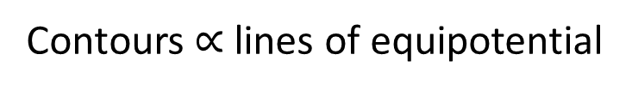
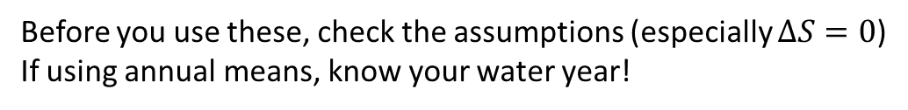

Water balance: partitioning and the runoff ratio
32
$$0=μ_{P}−μ_{Q_{OUT}}−μ_{E_{ET}}$$
$$μ_{P}=μ_{Q_{OUT}}+μ_{E_{ET}}$$
Before you use these, check the assumptions (especially $ΔS=0$)
If using annual means, know your water year!
$$μ_{E_{ET}}=μ_{P}−μ_{Q_{OUT}}$$
Runoff ratio:
$$R_{RO}=\frac{μ_{Q_{OUT}}}{μ_{P}}$$
Dimensionless [1]
When applied to annual hydrographs, summarizes how precipitation is partitioned between discharge and evapotranspiration within a year
In comparisons of watersheds, removes variation due to precipitation alone
Normalizing to precipitation usually requires normalizing discharge to area first
(need to be same units and dimensions),
...so, the runoff ratio provides a useful comparison of the hydrologic behavior of
watersheds with differing areas and precipitation inputs

Slide 35
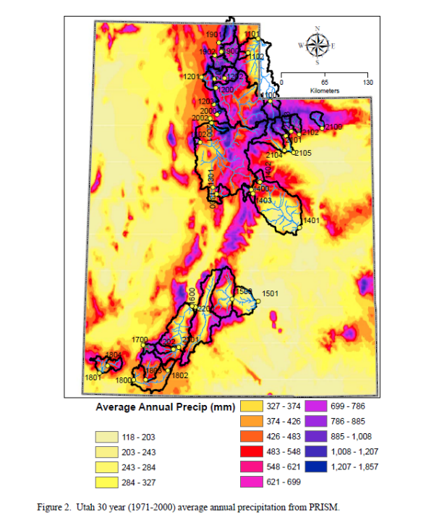
Water balance: example
33
South Fork Ogden
Mohammed, I. N., and D. G. Tarboton. 2008. Watershed management and water production study for State of Utah. A Report for the Utah Governor’s Public Lands Office.
https://digitallibrary.utah.gov/awweb/awarchive?type=file&item=27531
Mammoth Creek
Mean of the annual average precipitations over a period of record.
30 year period of record

Slide 36
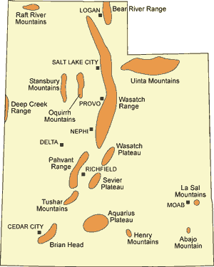
Water balance: example
34
South Fork Ogden
Mammoth Creek

Slide 37
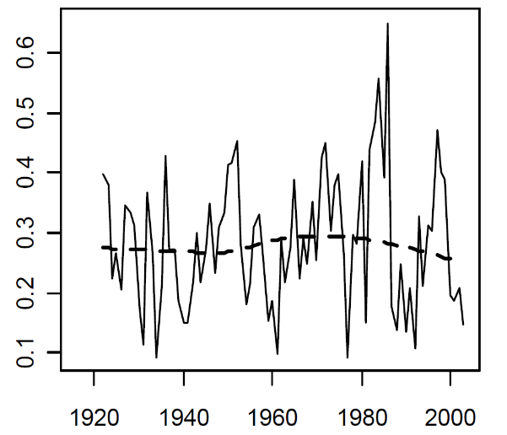
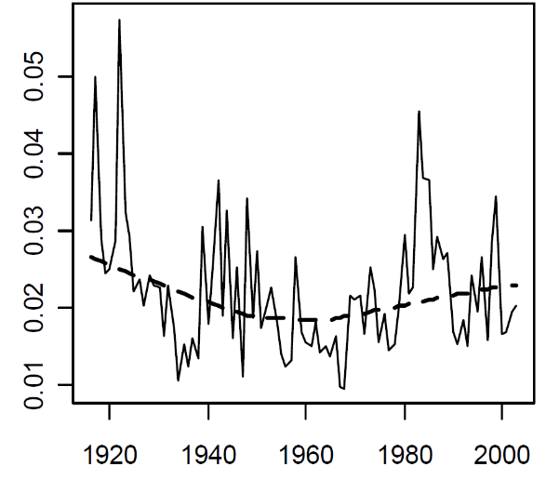
35
South Fork Ogden
Much higher yield
Annual mean Q/A (m yr⁻¹)
Mammoth Creek
Much lower yield
Annual Mean Q/A (m yr⁻¹)
(Mohammed and Tarboton 2008)

Slide 38
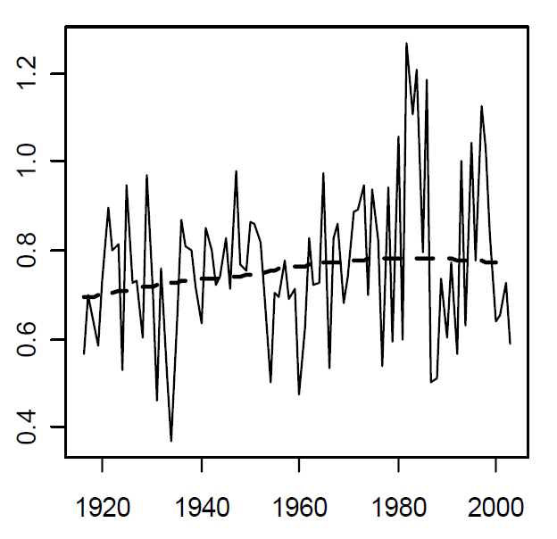

36
South Fork Ogden
Much higher yield
Somewhat higher precip.
Annual mean P (m yr⁻¹)
Mammoth Creek
Much lower yield
Somewhat lower precip.
Annual Mean P (m yr⁻¹)
(Mohammed and Tarboton 2008)

Slide 39
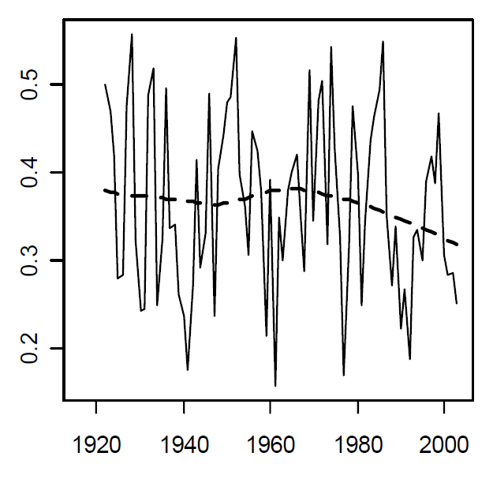
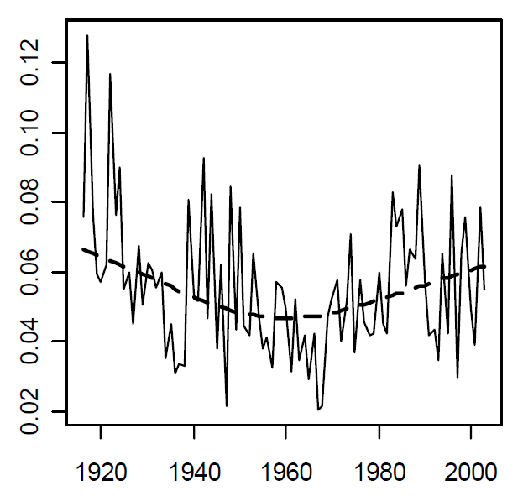
37
South Fork Ogden
Much higher yield
Somewhat higher precip.
Annual mean Q/(AP)
Much higher runoff ratio
Mammoth Creek
Much lower yield
Somewhat lower precip.
Much lower runoff ratio
Annual Mean Q/(AP)
(Mohammed and Tarboton 2008)

Slide 40
38
South Fork Ogden
Much higher yield
Somewhat higher precip.
Much higher runoff ratio
As indicated by the runoff ratio, lower runoff yields in the southern watershed are due mostly to its higher partitioning of precipitation to evapotranspiration.
Mammoth Creek
Much lower yield
Somewhat lower precip.
Much lower runoff ratio
(Mohammed and Tarboton 2008)

Slide 41
Water balance: internal balances
39
Energy
Precipitation
Evaporation
Interception
Throughfall
Sublimation
Snowpack
Snowmelt
Thermal energy
(latent heat)
Evapotranspiration
Surface detention
Evaporation
Infiltration
Overland flow
Transpiration
Soil water
Percolation
Understanding of the controls on the water budget of a watershed is inseparable from understanding of the thermal energy budget.
Groundwater
Stream flow generation
Evaporation
Streams and lakes
Watershed
Runoff
Notes:
We will talk about the energy balances within the watershed through the rest of the course.
But it is important to remember that energy is also critical to thinking about when and how much water is getting into our watershed. This requires us to think about how our watershed fits into the broader scale of the global water cycle.

Slide 42
The H₂O molecule
40
-
H
O
+
H
O
8
16
1
1
O
H
H
H
+
Electron configuration
-
+
H
1s²2s²2p⁴
1s¹
O
Hydrogen Bond
Electronegativity
(Pauling scale 0.7 to 4)
104.5 deg
H
3.44
2.20
+
Notes:
Let’s start with the basic chemistry of water
The water molecule is made up of one oxygen atom and two hydrogen atoms. The atomic number of oxygen is 8, meaning that the outermost electron shell (specifically the “p” orbitals) is 2 electrons short of being full. The atomic number of hydrogen is 1, meaning that the outermost electron shell has one electron and space for another.
The bonds between hydrogen and oxygen in water are covalent, meaning that each bond is created by electrons shared by the atoms to fill their outer orbital.
We are not going to go deep into electron orbital theory, but it is important to know that the orbitals will “hybridize” when forming covalent bonds. The critical consequence of this hybridization is that the water molecule is consistently bent at a particular angle, specifically 104.5 degrees.
By itself, this bend in the molecule does not cause any of the more remarkable properties of water. However, this bend is critical in combination with the nature of the bonds with hydrogen. Let’s think a bit more deeply about the “gray area” between covalent and ionic chemical bonding. Oxygen is more electronegative than hydrogen, meaning that the shared electrons spend more time around the oxygen than the hydrogen. Combined with the “bend” in the hydrogen configuration, this makes the water molecule “polar”.
When two water molecules are near each other, the positive hydrogen ends of a molecules are attracted to the negative oxygen end of another molecule. Similar to an ionic bond, this creates what is called a hydrogen bond.
The polarity and hydrogen bonding of water leads to its many unique properties that are important to how the landscape is shaped, and how ecosystems function. For example, we will be talking a lot about the consequences of water’s high surface tension later in the class. The relatively high cohesive forces of water amongst its molecules produces enough energy to hold or move water against gravity in the subsurface, and will be an important concept when we cover soil physics.

Slide 43
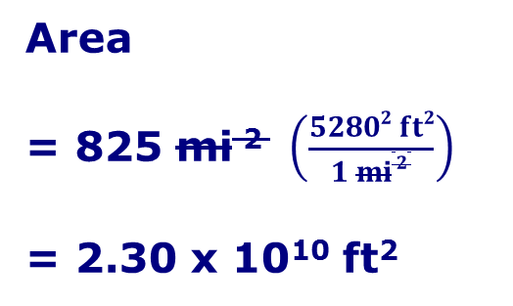
Physics of water: Density
41
Water is matter
  Water has mass, $m$ [M]:kg
  Water occupies a volume of space, $V$ [L³]:cm³
  Water has density, $ρ$
  liquid
  1 kg L⁻¹ at 4 °C
  0.959 kg L⁻¹ at 100 °C
  Ice (solid) 0.917 kg L⁻¹ (hydrogen bonding)
  Liquid water is “incompressible”
$\frac{[M]}{[L^{3}]}=$ [M L⁻³]
Notes:
Back to physical properties of water: Density
1 L of water (1000 cm³, 0.001 m³) has a mass of 1 kg at 4 degrees C
Density of liquid water is relatively constant. So close to constant that we call water an “incompressible” fluid.
Density of water is often used as a standard for measuring density of other materials. If you divide the density of the material by the density of water, you get it’s “specific density”. “Specific” is a dimensional indicator that means the quantity you are using is normalized to some standard. We will be coming across the term “specific” used this way many times throughout the course.
Density of ice is less than density of liquid water. In fact, water is at it’s most dense at 4 degrees Celsius (above the freezing point). This is due to the polar molecule. When a solid starts to form, the molecules push further apart to form their crystalline structure with hydrogen bonding, resulting in less dense material. The fact that ice floats is extremely important to the function of many aquatic ecosystems.

Slide 44
Physics of water: Heat and Temperature
42
High specific heat capacity
  Here, “specific” means normalized to mass
  [E M⁻¹ Θ⁻¹] E is energy, Θ is temperature
  Liquid water at 10 °C is 4.19 kJ kg⁻¹ K⁻¹
  For comparison, granite is 0.79 kJ kg⁻¹ K⁻¹
  Specific heat is high due to low molecular weight and hydrogen bonding
[M]:k
Notes:
Heat and temperature:
Definition of heat. Thermal energy associated with the movement (kinetic energy) of molecules.
Definition of temperature. Average kinetic energy of the molecules of a substance.
Two substances with the same amount heat can be at different temperatures, due to physical properties of the molecules. Specific heat tells quantifies how much heat it takes to change a given mass of a substance a given temperature.

Slide 45
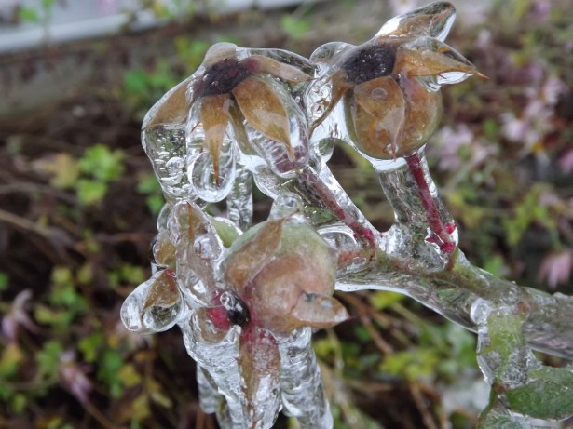
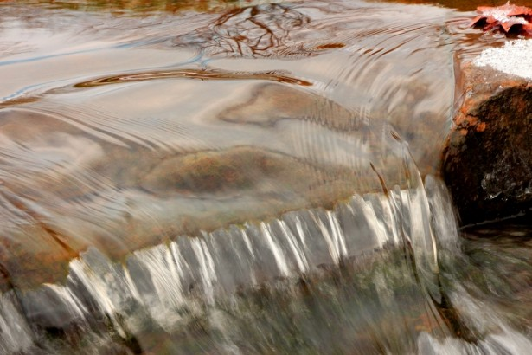
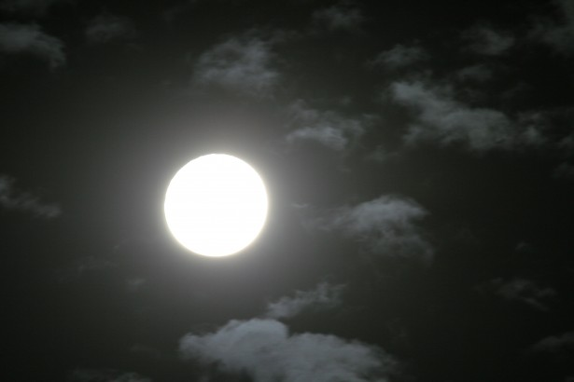
Physics of water: States and latent heat
43
Solid
Liquid
Gas
0 °C
at 1 ATM
100 °C
at 1 ATM
[M]:k
Latent heat of fusion
Latent heat of vaporization
Hydrogen bonding!
334 kJ kg⁻¹
2257 kJ kg⁻¹
Notes:
States and latent heat:
Temperature is also important in determining the physical state of water. Water is one of the few substances on earth that occurs naturally in all 3 states, which is the primary reason there is a global water cycle.
You probably already know that water freezes or thaws at 0 degrees C and melts or evaporates at 100 degrees C.
An interesting aspect of states is that they indicate storage of heat relative to the less “excited” state, similar to the specific heat of a substance at a given state. We call this “latent” heat because it is heat energy in the substance that cannot be measured by with temperature (i.e. it is not “sensible”).
Latent heats are associated with state changes, because they are most readily measurable by changing state at a constant temperature.
The latent heat of fusion is the energy released when water freezes at a constant 0 degrees C.
The latent heat of vaporization is the energy released when water condenses at a constant 100 degrees C.
For water, both of the state changes store a tremendous amount of heat relative to other substances. This goes back to the energy necessary to break hydrogen bonds, or the energy released when hydrogen bonds form.

Slide 46
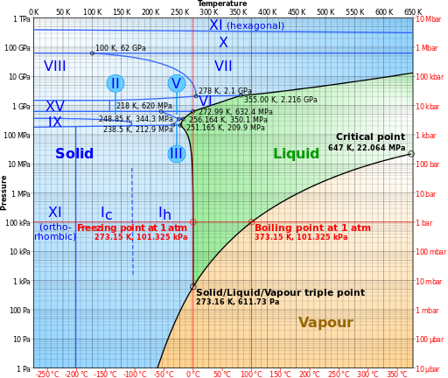
Physics of water: States and latent heat
44
In Bozeman:
Boiling point is 94.9 °C
(202.9 °F)
Wikimedia Commons, CMG Lee, http://commons.wikimedia.org/wiki/File:Phase_diagram_of_water.svg
Notes:
The idea that water freezes at 0 degrees and evaporates at 100 degrees is actually a simplification.
In particular the boiling point changes with air pressure.
The standard freezing and boiling points are determined by this red line, which is standard atmospheric pressure at sea level. The curved line here represents how the boiling point changes with pressure, separating liquid water state in green from Vapor (or gas) water state in orange. The pressure is on the y axis, and the temperature is on the x axis, so if you follow the line, you see that as the pressure decreases, the temperature of the boiling point also decreases.
Story time.

Slide 47
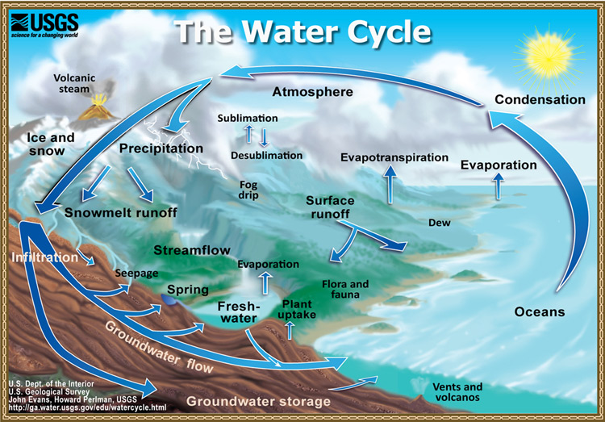
Water balance: global water cycle
45
Notes:
In the global water cycle, an import of energy is required to get water from the oceans to our watersheds. This is typically the domain of meteorologists of climatologists, rather than watershed hydrologists. But watershed hydrologists need to understand the basics in order to put their watershed in context. After all, precipitation is the first driver of watershed behavior.
Because it takes this input of energy to move water out of the oceans, it is also the energy balance that is the primary control on the distribution of water across the earth.

Slide 48
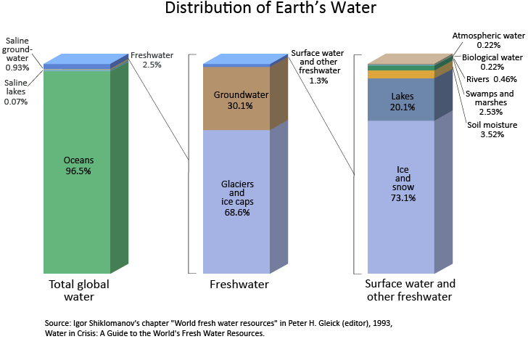
Water balance: global water distribution
46
Notes:
We can categorize water on the earth first by the oceans, which make up 96.5% of the water on the planet. We talked about how water exists in all three phases, and the oceans do include some sea ice. But the vast majority of that water is liquid. What does that tell us about the average temperature of the planet? Remember that water has a relatively high specific heat, this makes the oceans a tremendous heat sink, and it takes a tremendous amount of energy to change ocean temperatures.
Why are the oceans salty? Remember that we talked about water being a nearly universal solvent. Salty oceans occur because water is transporting dissolved materials for the landscape, which is then further concentrated by evaporation of water, leaving behind a stronger solution.
We know from this distribution that the incoming energy and global water cycle are only capable of keeping a small amount (2.5%) of the earths water as freshwater in terrestrial systems.
Of the 2.5% of freshwater in terrestrial systems. 68.6% is found in glaciers and the ice caps, 30.1% is groundwater, and only 1.3% remains for all other surface forms of freshwater.
Of that 1.3%, about 73.1% is also in ice (permafrost or snow), 20.1% is lakes. Rivers include only 0.46% of that water, and the entire atmosphere only 0.22%.

Slide 49
Energy balance: radiation
47
Space
Solar radiation (shortwave)
Atmosphere
Earth
Shortwave

Slide 50

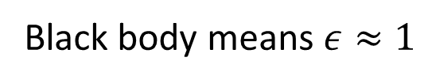
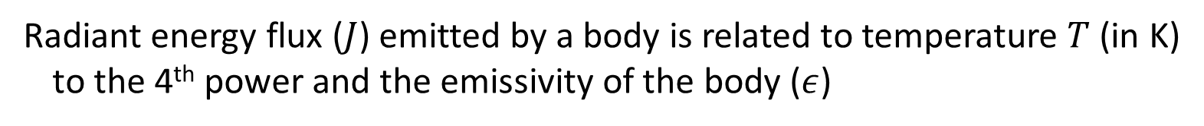
Energy balance: shortwave radiation
48
Thermal energy causes collisions that result in electromagnetic radiation
Stefan-Boltzmann law
$$J=εσT^{4}$$
Radiant energy flux ($J$) emitted by a body is related to temperature $T$ (in K)
to the 4th power and the emissivity of the body ($ε$)
Black body means $ε≈1$
Planck’s Law: Sun is a black body at 6000 K (5727 °C) and emits higher energy radiation with relatively short wavelengths (hence “shortwave” radiation).
Sun’s emission spectrum spans from ultraviolet to near-visible infrared,
which is mostly constituted by the visible spectrum (hence we have organs
that can detect those frequencies).
Note this spectrum does not include meaningful amounts of thermal infrared

Slide 51
Energy balance: radiation
49
Space
Solar radiation (shortwave)
Reflected by air (backscatter)
Absorbed by air
Reflected by clouds
Reflected by earth
Atmosphere
Absorbed by clouds
Emitted by earth
Absorbed by earth
Earth
Shortwave
Longwave

Slide 52

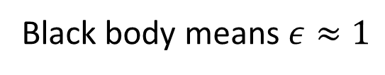
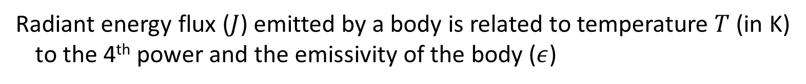
Energy balance: longwave radiation
50
Thermal energy causes collisions that result in electromagnetic radiation
Stefan-Boltzmann law
$$J=εσT^{4}$$
Radiant energy flux ($J$) emitted by a body is related to temperature $T$ (in K)
to the 4th power and the emissivity of the body ($ε$)
Black body means $ε≈1$
Planck’s Law: Earth is a black body at 290 K (17 °C) and emits lower energy radiation with relatively long wavelengths (hence “longwave” radiation).
Earth’s emission spectrum is infrared that is far from the visible spectrum
(i.e. “thermal infrared”)

Slide 53
Energy balance: radiation
51
Space
Atmospheric window for emission from earth
Solar radiation (shortwave)
Emitted by atmosphere
Emitted by clouds
Reflected by air (backscatter)
Absorbed by air
Reflected by clouds
Absorbed by air and clouds
Reflected by earth
Atmosphere
Absorbed by clouds
Emitted by atmosphere
(back radiation)
Emitted by earth
Absorbed by earth
Absorbed by earth
Earth
Shortwave
Longwave

Slide 54
Energy balance: greenhouse effect
52
Space
Atmospheric window for emission from earth
Solar radiation (shortwave)
Emitted by atmosphere
Emitted by clouds
Reflected by air (backscatter)
Absorbed by air
Reflected by clouds
Absorbed by air and clouds
Reflected by earth
Atmosphere
Absorbed by clouds
Emitted by atmosphere
(back radiation)
Emitted by earth
Absorbed by earth
Absorbed by earth
Earth
Shortwave
Longwave

Slide 55
Energy balance: dimensions and units
53
Energy
[E], units J
Power
[E T⁻¹], units J sec⁻¹ = W
Area normalized
power (energy flux)
[E L⁻² T⁻¹], units J m⁻² sec⁻¹ = W m⁻²
Notes:
Let’s talk more specifically about how the earth’s energy balance works.
First we should review the dimensions of the variables we will be using, and typical units for the values of those variables.

Slide 56
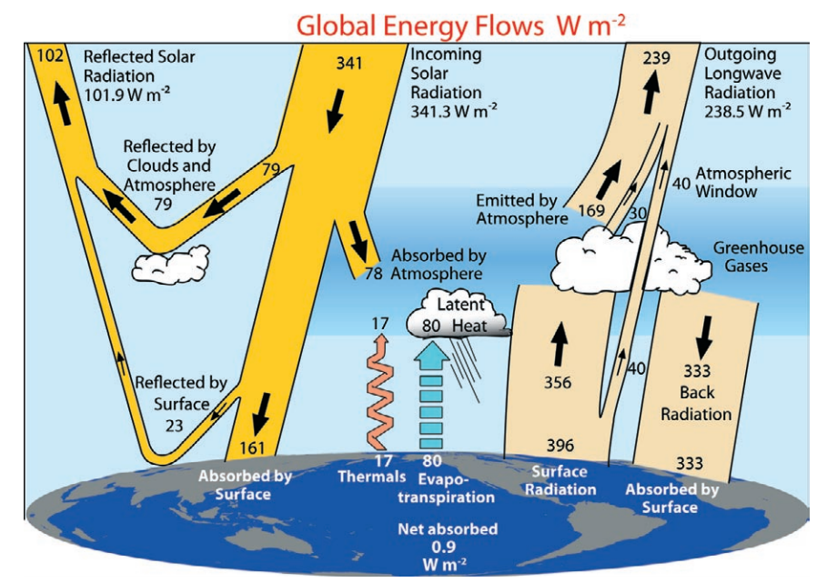
Energy balance: dynamic equilibrium model
54
Shortwave Radiation
Longwave Radiation
Sensible heat exchange (conduction and convection)
Latent heat exchange (evaporation and condensation)
From Trenberth et al. (2009)

Slide 57
Water balance: internal balances
55
Energy
Precipitation
Evaporation
Interception
Throughfall
Sublimation
Snowpack
Snowmelt
Energy
(latent heat)
Evapotranspiration
Surface detention
Evaporation
Infiltration
Overland flow
Transpiration
Soil water
Percolation
Understanding the controls of the water balance is inseparable from understanding of the energy balance.
Groundwater
Stream flow generation
Evaporation
Streams and lakes
Watershed
Runoff
Notes:
We will talk about the energy balances within the watershed through the rest of the course.
But it is important to remember that energy is also critical to thinking about when and how much water is getting into our watershed. This requires us to think about how our watershed fits into the broader scale of the global water cycle.

