Slide 1

The Granite Way
Professional Learning
Designing and Implementing an Effective Ongoing Assessment Cycle
September 2021
Instructional/Student Learning Process
Expanded Instruction and Support
Notes:
Welcome to the Granite Way Professional Learning for School Year 2020-21.

Slide 2

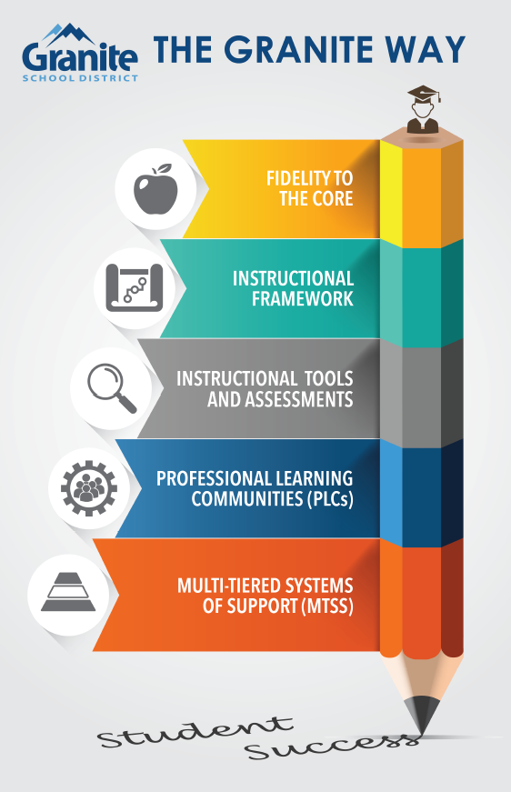
Our work centers on five essential practices that promote student achievement.
Our commitment to student achievement is non-negotiable.
Notes:
Setting the stage. The Granite Way professional learning topics stem from Our Charge and Responsibility from the Granite Board of Education and our Superintendent
Several years ago, the District established the Granite Way as the 5 essential practices that must be evident in our daily work and outcomes.
These demonstrate our non-negotiable commitment to student success.
This month, we are focusing on Instructional Tools and Assessments as a fundamental non-negotiable

Slide 3
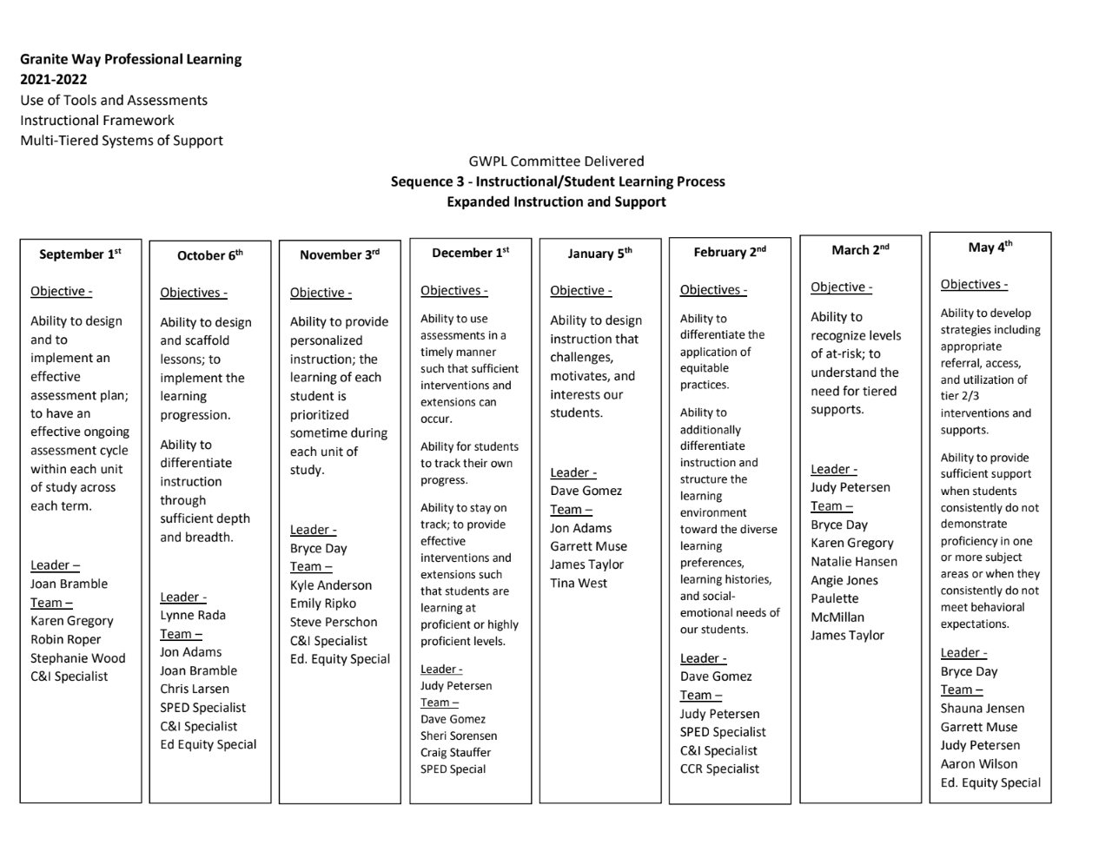
Notes:
The 2022 year will include 90 minute presentations scheduled by the school. This sequence is focused on Expanded Instruction and Support with our first training tackling how we plan effectively for assessment as part of instruction.

Slide 4


Today’s Targets/Objectives
Targets/Objectives:
Design and implement an effective assessment plan.
Implement an effective ongoing assessment cycle within each unit of study across each term.
Learners will:
Understand a balanced approach to assessment
Develop an assessment plan for an ELA and math standard
Identify components of a data protocol your team will use
Notes:
Our targets/objectives for today..

Slide 5
Assessment Literacy
The knowledge and skills needed to:
Gather accurate information about student achievement
Use the assessment process and its results effectively to improve achievement
“Assessment occupies such a central position in good teaching because we cannot predict what students will learn, no matter how we design our teaching...Assessment is the central process in instruction - students do not learn what we teach. If they did, we would not need to keep gradebooks. We could, instead, simply record what we have taught”.
-Wiliam, D (2017). Embedded formative assessment (pp. 52-54)
Notes:
(Review the concept of Assessment Literacy and its role in the learning process)

Slide 6
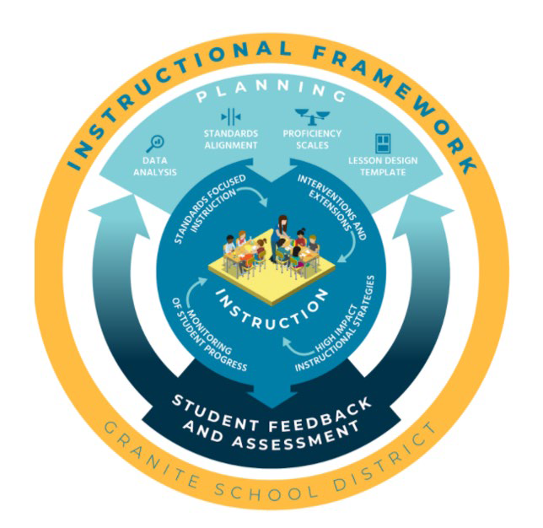
The Role of Assessment in Granite District’s Instructional Framework
What is essential is the ongoing process of student feedback and assessment to monitor student learning, adjust instruction, provide appropriate interventions or extensions, and improve programming. This is the heart of formative assessment.
Notes:
Assessment plays a critical role as an ongoing process in the instructional framework. Student feedback and assessment are at the heart of this process. Particularly salient this year. Recall the theme of our admin kick-off: find, assess, and address.

Slide 7
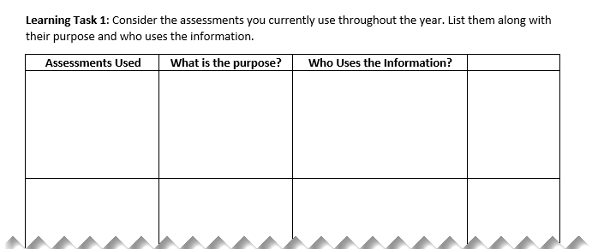
Learning Task 1
Create a list of all the assessment you use during the year.
What is the purpose of the assessment?
Who uses the information?
Notes:
As we think about assessments, take a few minutes to consider the assessments you typically use throughout the year. Create a list of these. For each one, also consider what the purpose of that assessment is and who uses the information from that assessment.
(Prompt teachers with thinking through some of these and whether there are multiple users (teachers, parents, students…) or if there ought to be and if we are also thinking about ways we communicate the results of our assessments with parents and students.)

Slide 8
Formative or Summative??
Formative assessment:
Formal and informal processes teachers and students use to gather evidence for the purpose of improving learning.
Teachers use assessment information during the learning to diagnose student needs, plan next steps in instruction, provide students with targeted practice and offer effective feedback.
Students use assessment information to act on feedback, offer each other effective feedback, to self-assess, and to set goals for improvement. They can also use it to track, reflect on, and share their progress.
Summative assessment:
Use of evidence of student achievement to make a judgment about student competence level.
Teachers use assessment information after learning has taken place to determine the level of student achievement at a given point in time in order to determine a student’s report card grade. The assessment instruments used are most often chapter and unit tests, final exams, and term projects.
Notes:
One way to think about the assessments we do, is to look at whether they are formative or summative. (Review the definitions for formative and summative assessment on the slide)
Complete the last column on Learning Task 1 - Are these assessments formative or summative?
Discussion: An assessment could be formative or summative depending upon how you are using it. The test itself is not “formative” or “summative”, but this designation is based on the use of the assessment.

Slide 9
Assessment for or of Learning
 | Assessment for Learning (Formative) | Assessment of Learning (Summative)
Reason for Assessing | Promote increases in achievement Support ongoing student growth and improvement | Document individual or group achievement or mastery of standards Measure achievement status at a point in time for purposes of reporting or accountability
Audience | Teachers about students Students about themselves | Others about students
Place in Time | A process during learning | An event after learning
Primary Users | Students, teachers, parents | Policy makers, program planners, supervisors, teachers, students, parents
Typical Uses | Provide students with insight to improve achievement Help teachers diagnose and respond to student needs Help parents see progress over time Help parent support learning | Grading decisions Promotion and graduation decisions Certify student competence Sort students according to achievement
Notes:
Another way to think about formative and summative is Assessment FOR learning and Assessment OF learning. We assess for learning when we use assessment to guide instruction in a formative way - our reasons for assessing and our audience are different. We have assessment of learning when we assess in summative ways at the end of a cycle of learning. These types of summative assessments may have started in response to policy makers wanting to know how students are performing and this may be one of the users, but we also can and do use these assessments in other ways (sometimes formatively…)

Slide 10
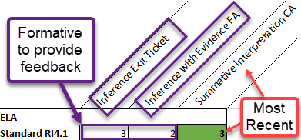
What does this look like from a PBL lens?
Assessment OF Learning (Summative):
Common Assessment for purpose of determining Proficiency Level for a grade tied to a standard
Assessment FOR Learning (Formative):
Exit tickets
Assignments on foundational skills
Observations/Discussions
Discussion: How can Assessment FOR Learning be used and recorded in Gradebook, while reserving the Assessment OF Learning for a final grade?
Notes:
(Connect these ideas to how we are using Proficiency-Based Learning.)
Assessment Of Learning in PBL is the assessment we use to determine a proficiency level for the purposes of giving a grade tied to a standard.
Assessment For Learning in PBL are opportunities to provide feedback to students related to how they are doing toward proficiency of a standard. We can also think about the assessment for learning as including many of the preliminary pieces that students need to know in order to access the assessment of learning that will be done to determine a grade/proficiency level. For example, when teaching a science concept, we may need students to understand how to graph and analyze data, but this is a basic skill that is used to show mastery of the overall standard.
Discussion : How can Assessment FOR Learning be used and even recorded in Gradebook, while reserving the Assessment OF Learning for a final grade?
The last graphic on this slide shows how these formative pieces could be scored and used for feedback for students, and included in gradebook so students and parents know where they are relative to proficiency on the whole standard. With recency, the final assessment will be the students summative grade for that standard.

Slide 11


Assessment FOR Learning
Elementary Example
Secondary Example
Notes:
As you watch this video clip, identify the ways in which the teacher is assessing for learning

Slide 12
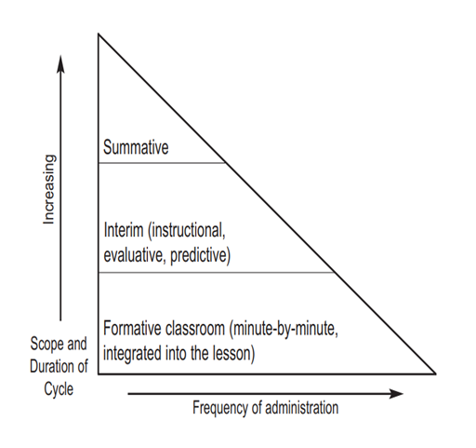
Balancing Assessments
Assessment Of
How much of each is needed?
Consider how athletes are coached….
Assessment For
Notes:
A balanced approach to assessment is important. Summative, interim, and formative components works together to provide meaningful and interpretable information
The analogy of coaching is good to use here. A coach runs through drills and practices, provides feedback and puts athletes in the game (summative); this cycle includes mostly formative work because the athletes will not improve if they are just put into a game again and again without the practice, formative loop

Slide 13
Assessment As Learning
Assessment Of Learning - Summative
Assessment For Learning - Formative
How do we make assessment meaningful for students?
How do we prompt students to be reflective and monitor their own learning?
Notes:
We talked about Assessment Of Learning, Assessment For Learning…
We also consider Assessment As Learning
This is very purposefully looking at how we are helping students make meaning from assessments. This could include involving students in creating rubrics, as well as prompting them to be reflective and monitor their own learning.

Slide 14


Assessment AS Learning
Elementary Example
Secondary Example
Notes:
Watch the following video for evidence of how the teacher is using assessment as learning (immediate feedback, use of clear rubric)
Stress the importance of having students reflect on their learning and other ideas for this. For example, on an exit ticket write the level of proficiency or drop it in a box so there is already a sort and the student has given you their self-assessment. At the end of a CFA, asking students to reflect - what proficiency do you see yourself at, what do you wish you would have spent more time on?, less time?

Slide 15
Developing an Assessment Plan with
Keys to Quality Assessment Use
Key 1: Clear Purpose
Who will use the information? How will they use it? What information do you need?
Key 2: Clear Targets/Objectives
Are learning targets clear to students? Is your instruction focused on these targets?
Key 3: Sound Design
Do your assessment methods match learning targets and success criteria?
Key 4: Formative Usefulness
Do your results guide your next steps? Do students receive and act on feedback?
Key 5: Effective Communication
Is formative information tracked? Are student engaged in this tracking?
Source: Chappuis, J. & Stiggins, R. (2020). Classroom assessment for learning: Doing it right - using it well. Pearson
Notes:
The next part of the presentation moves to the Development of an Assessment Plan. Here we will look at aligning this plan with Keys to a Quality Assessment from the Chappui and Stiggin book, Classroom Assessment for Learning: Doing it Right - Using it Well
Walk through each of the keys and the corresponding questions that ought to be considered.

Slide 16
A good
Assessment Plan begins with these 2 keys of
Quality Assessment Use
Key 1: Clear Purpose
Who will use the information? How will they use it? What information do you need?
Key 2: Clear Targets/Objectives
Are learning targets clear to students? Is your instruction focused on these targets?
Notes:
We will begin building an assessment plan with these two keys in mind...

Slide 17
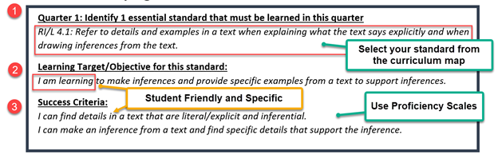
Assessment Plan Example (Elementary)
KEYS:
Clear Purpose
Clear Targets
Notes:
The keys of clear purpose and clear targets begin with identifying an essential standard from your grade level’s curriculum map. The proficiency scales are a great place to find the learning target and success criteria. The learning target is written specifically as an “I am learning…” statement as this is a process and they have not yet learned this. The success criteria is written as clear and specific I can statements so that students understand what it will look like when they have learned the standard.

Slide 18
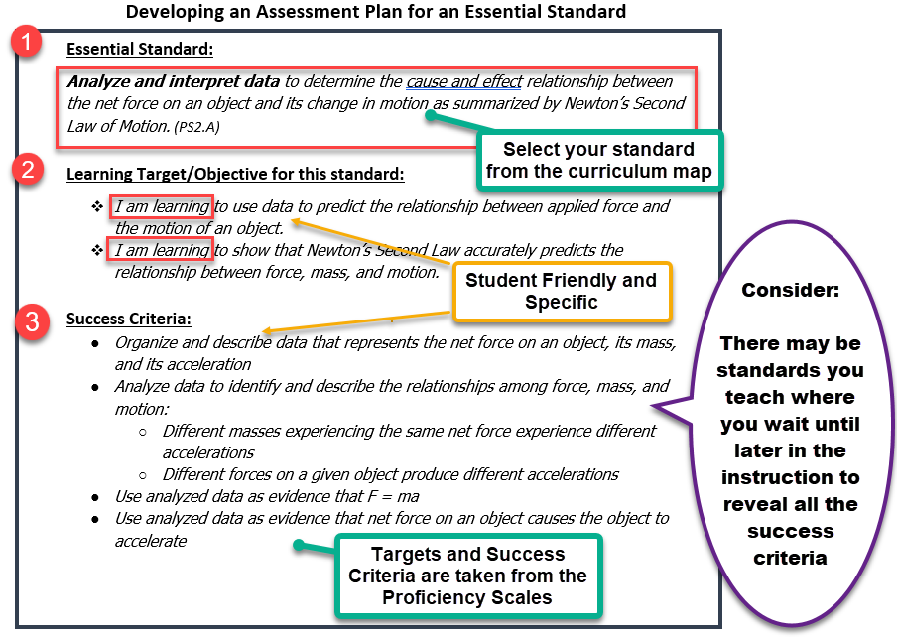
Assessment Plan Example (Secondary)
KEYS:
Clear Purpose
Clear Targets
Notes:
The keys of clear purpose and clear targets begin with identifying an essential standard from your grade level’s curriculum map. The proficiency scales are a great place to find the learning target and success criteria. The learning target is written specifically as and “I am learning…” statement as this is a process and they have not yet learned this. The success criteria is written as clear and specific I can statements so that students understand what it will look like when they have learned the standard. Sometimes you might consider waiting until later in an instructional unit to reveal all the success criteria if you are teaching in an exploratory way.
So again… the purpose of this exercise is to reinforce for teachers having very clear purpose and learning targets. Note the success criteria are taken from Proficiency Scales available on GSD Intranet site.

Slide 19
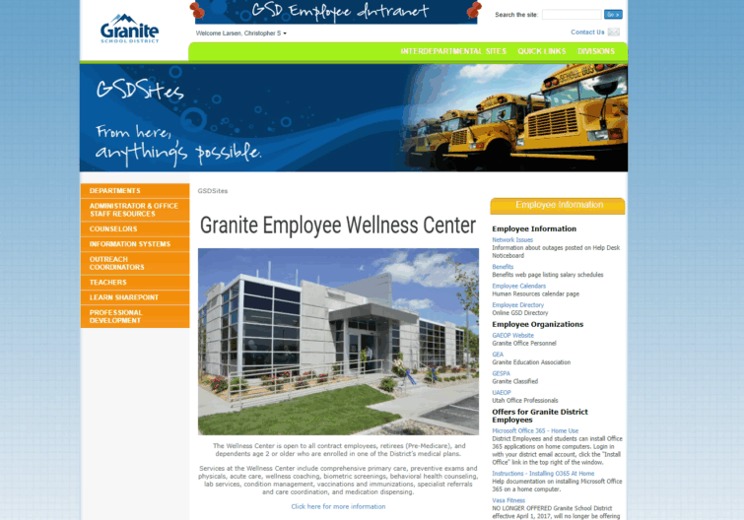
How to Access Curriculum Maps and Proficiency Scales
Go to GSD Intranet. Click on Departments
Click on Curriculum Services
Select subject and grade
Notes:
Proficiency Scales are available at the educator-facing intranet.
The steps to access are shown in this animation.
Secondary Principals: ELA scales are also loaded into Canvas as outcomes.

Slide 20
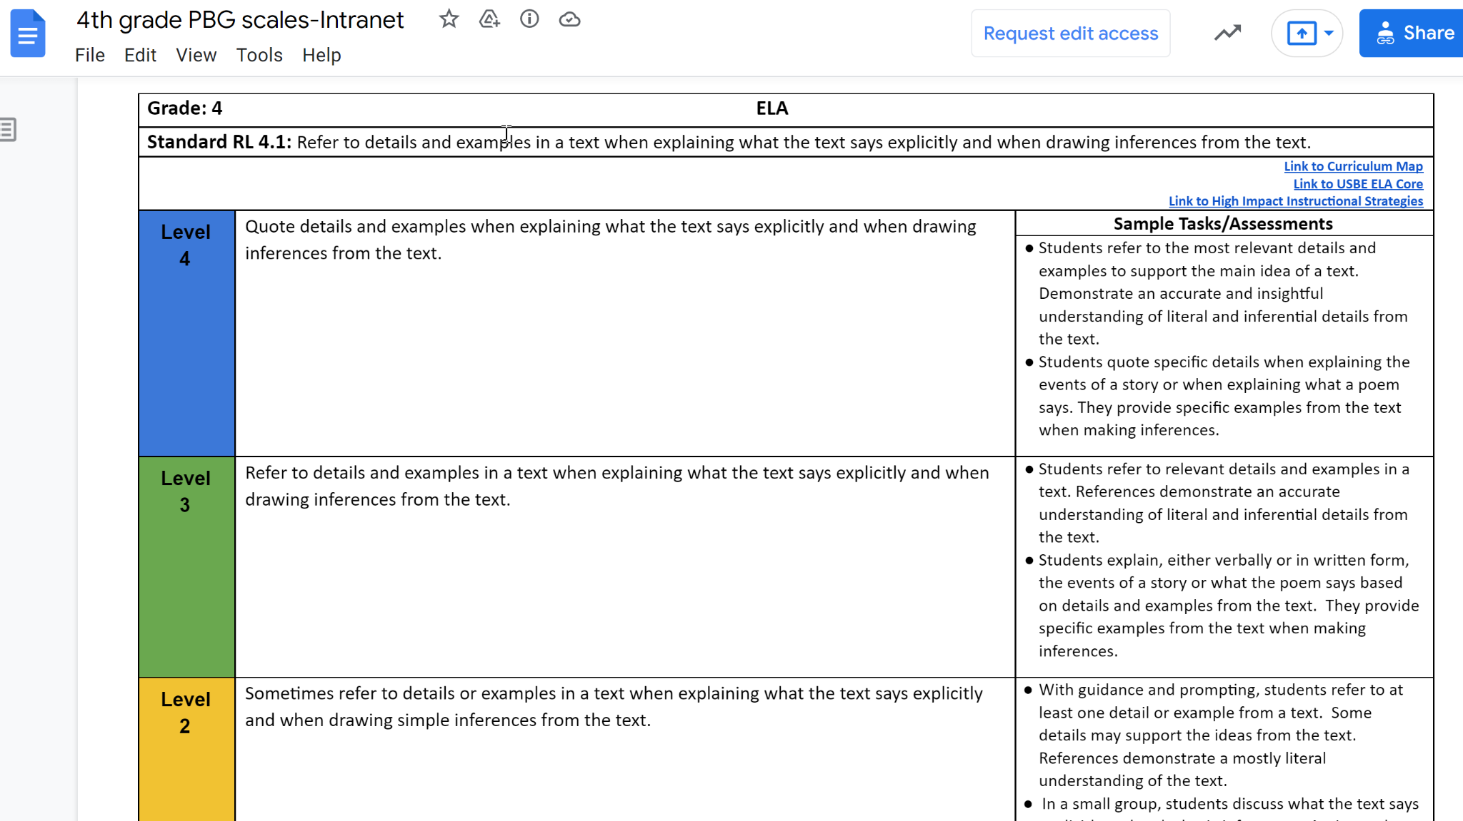
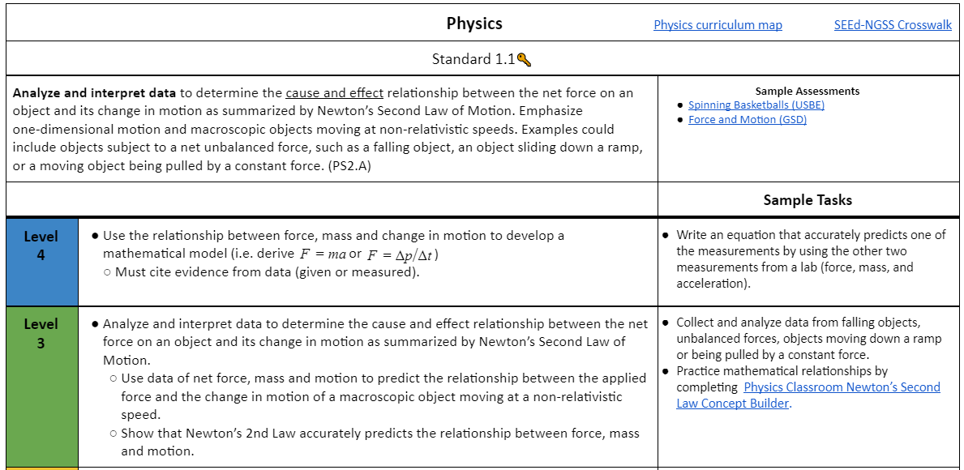
Use Proficiency Scales to support writing your target/ objectives
and success criteria
Notes:
Elementary Example: RI4.1 and Secondary Example: Physics 1.1
This intranet site is where you get your proficiency scales that are needed to write clear learning targets.
If you haven’t viewed curriculum resources page, you will likely be surprised how well they are laid out.

Slide 21
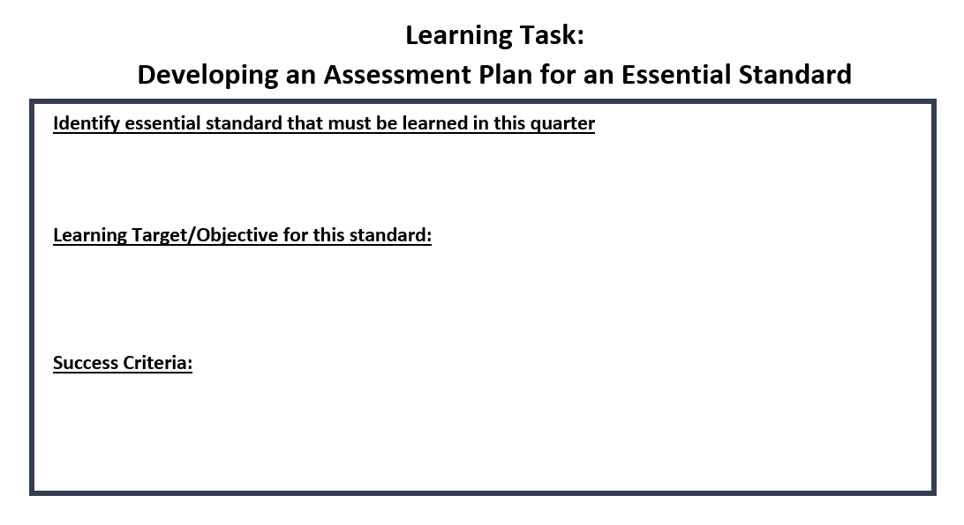
Link to this task template
Be sure to access your proficiency scales for these steps!
Link to Elementary
Part 1 Example
Link to Secondary
Part 1 Example
KEYS:
Clear Purpose
Clear Targets
Notes:
Your learning task: Select a standard and use proficiency scales to identify your learning targets and success criteria. For principals, pick a content you majored in so you have the content background knowledge. Pick an essential standard taught during first quarter.
Give teachers 10 minutes to develop this piece of the plan

Slide 22
The next step
in a good
Assessment Plan is the third key of
Quality Assessment Use
Key 1: Clear Purpose
Who will use the information? How will they use it? What information do you need?
Key 2: Clear Targets/Objectives
Are learning targets clear to students? Is your instruction focused on these targets?
Key 3: Sound Design
Do your assessment methods match learning targets and success criteria?
Notes:
The next step relies heavily on this third key - matching your assessments to the success criteria…
How often do we go into an observation and the teacher says, oh I’m just giving a test or a quiz, not a good time,” and we buy into that. Flip that narrative--what a great way for you to see… there should still be a learning target or objective on the board, and the assessment method being used should match the learning target.

Slide 23
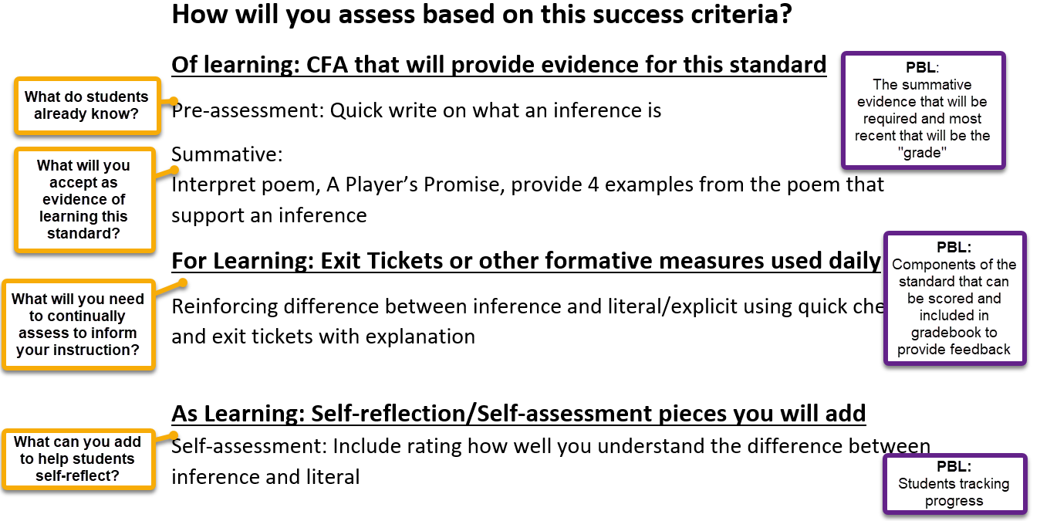
Assessment Plan Example (Elementary)
KEY:
Sound Design
Notes:
This part of the assessment plan also builds in the components of a balanced assessment plan which include assessments of… for… and as… learning.
We can also look at this through a PBL lens to see how these parts fit into this practice.

Slide 24
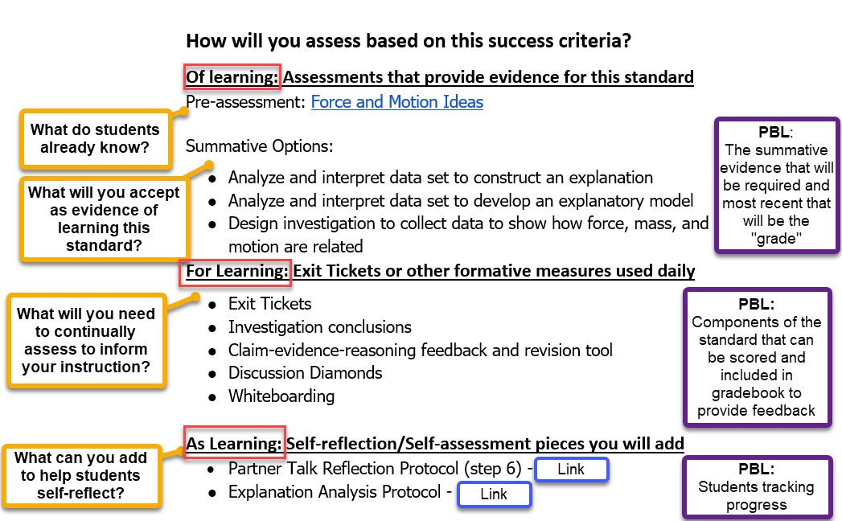
Assessment Plan Example (Secondary)
KEY:
Sound Design
Notes:
Now that you have identified essential standard and your learning target for this standard, now we build the assessment side of those things: mapping out and providing clarity on how you as the teacher will assess of learning, for learning, and also use assessment as learning.
We can also look at this through a PBL lens to see how these parts fit into this practice.
Remember of learning is we want to measure what students already know. So a pre-assessment is part of an assessment “of learning.” We can’t think of “assessments of learning” exclusively as summative assessments. Here we think of measuring what they know coming into the standard and measuring summatively what the student knows after teaching. Here the link to PBL is that the summative assessment will be the most recent grade.
In “Assessment for learning,” the teacher is continually assessing as they go. These assessments can be graded and scored in gradebook to provide the student and parent feedback.
And assessment as learning, using assessment pieces that allow for active student response so that both the student and teacher are learning through this process.

Slide 25
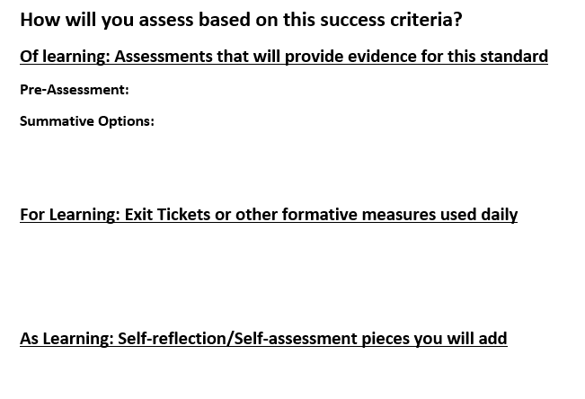
Learning Task: Complete your Assessment Plan
Link to Example Elementary Plan
Link to Example Secondary Plan
KEY:
Sound Design
Notes:
Provide teachers time (15 minutes) to complete this step as they consider the assessments that will use for each of these components

Slide 26
Final Keys for Quality Assessment Use
Key 1: Clear Purpose
Who will use the information? How will they use it? What information do you need?
Key 2: Clear Targets/Objectives
Are learning targets clear to students? Is your instruction focused on these targets?
Key 3: Sound Design
Do your assessment methods match learning targets and success criteria?
Key 4: Formative Usefulness
Do your results guide your next steps? Do students receive and act on feedback?
Key 5: Effective Communication
Is formative information tracked? Are student engaged in this tracking?
Notes:
The last two keys in Quality Assessment Use are centered around making the assessments useful in a formative way and effectively communicating the results

Slide 27
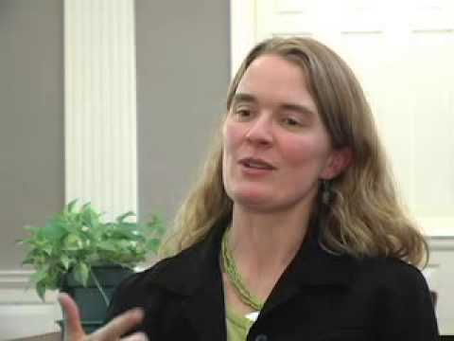
KEYS:
Formative Usefulness
Communicating Results

Slide 28
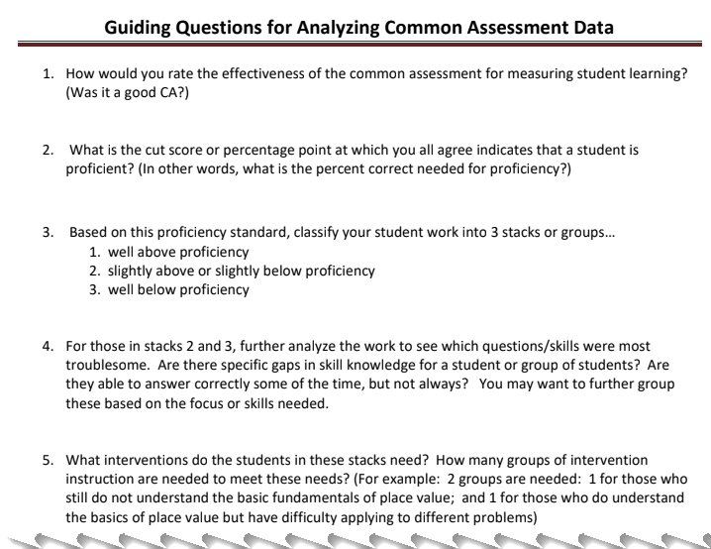
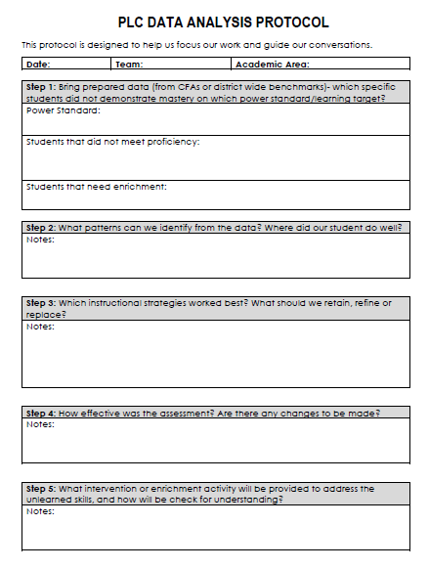
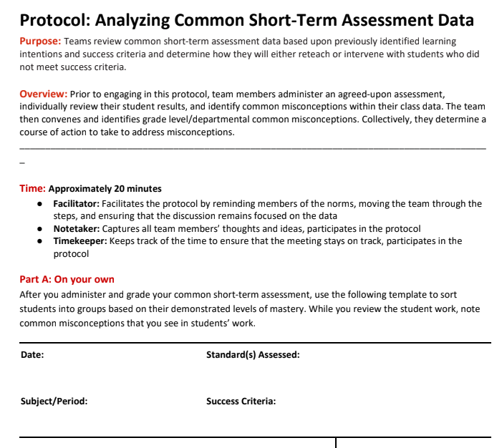
Learning Task:
Review the samples of PLC data analysis protocols and determine which protocol questions your team will use this year.
2
1
3
KEYS:
Formative Usefulness
Communicating Results
Notes:
Number off in your group by 3 and review the designated protocol. Discuss benefits and challenges of each. Share out and also discuss determining where your faculty might be in terms of protocols and whether you may need to start with building collaborative discussion protocols first.
For Principals presenting to faculty: Have your teams select a format and questions that their PLC will commit to using this year - 15 minutes

Slide 29
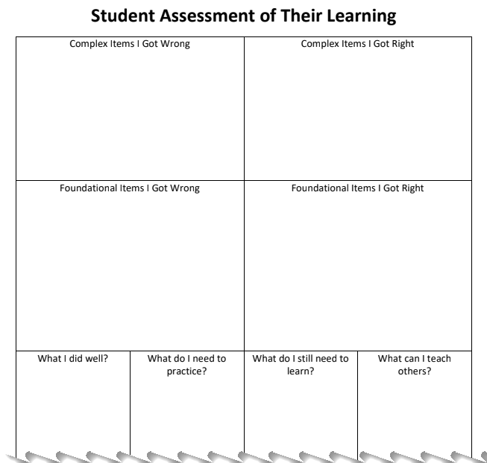
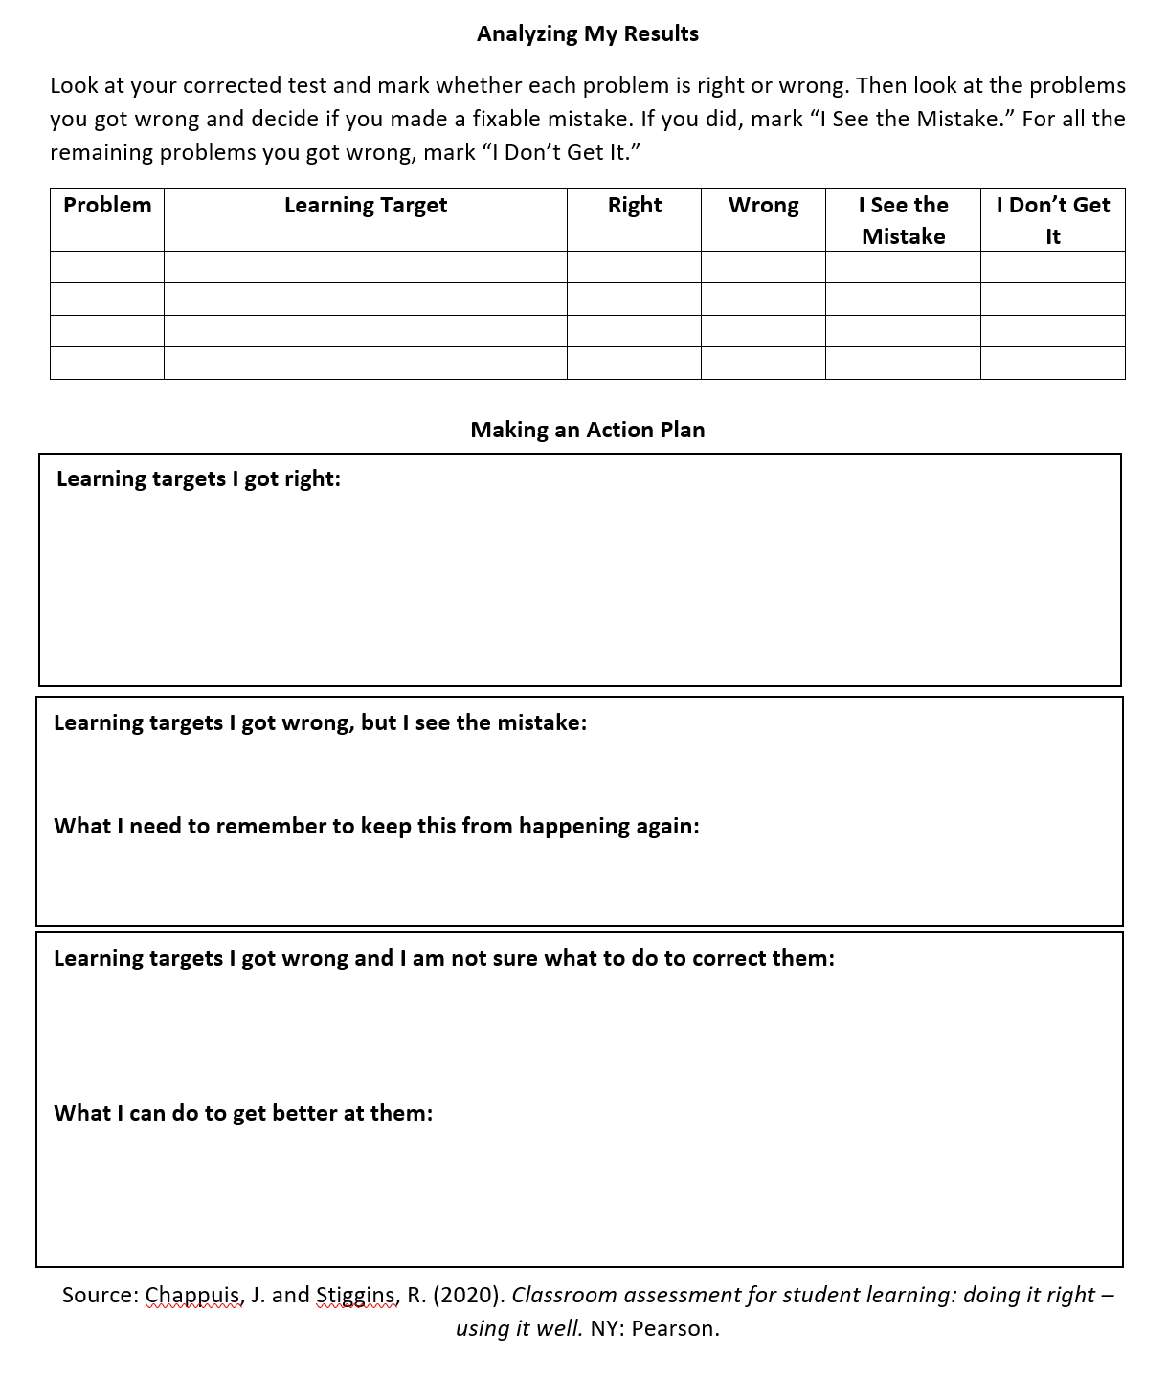
Learning Task:
Review examples of methods for students to review assessments.
Determine what your team will try this year to help students reflect on their learning.
KEYS:
Formative Usefulness
Communicating Results
Notes:
Learning Task: Determine a protocol for students - as we build our assessments process to include students and reinforce the feedback loop, consider these two examples. After reviewing these, what might your team use to help students with “assessment as learning”? 15 minutes

Slide 30
Did we meet our Target/Objective?
Target/Objective:
Design and implement as effective assessment plan.
Implement an effective ongoing assessment cycle within each unit of study across each term.
Learners will:
Understand a balanced approach to assessment
Develop an assessment plan for standards in Q1
Identify components of a data protocol your team will use

