Slide 1
THE EYELID
Composition:
Thin curtain of skin
Muscle
Fibrous Tissue
Mucus Membrane
That covers the eye like lens protectors on a camera.
Number: 4
Distribution: 2 for each each eye, i.e an upper and lower eyelid.

Slide 2
Functions
Protects the eyeball from injury
Interrupts and limits the amount of light entering the eye
Distribution of tears over the surface of the cornea moist
Provide nutrition achieved by blinking
Assist in tear flow (their movement has a pumping action on the lacrimal sac.

Slide 3
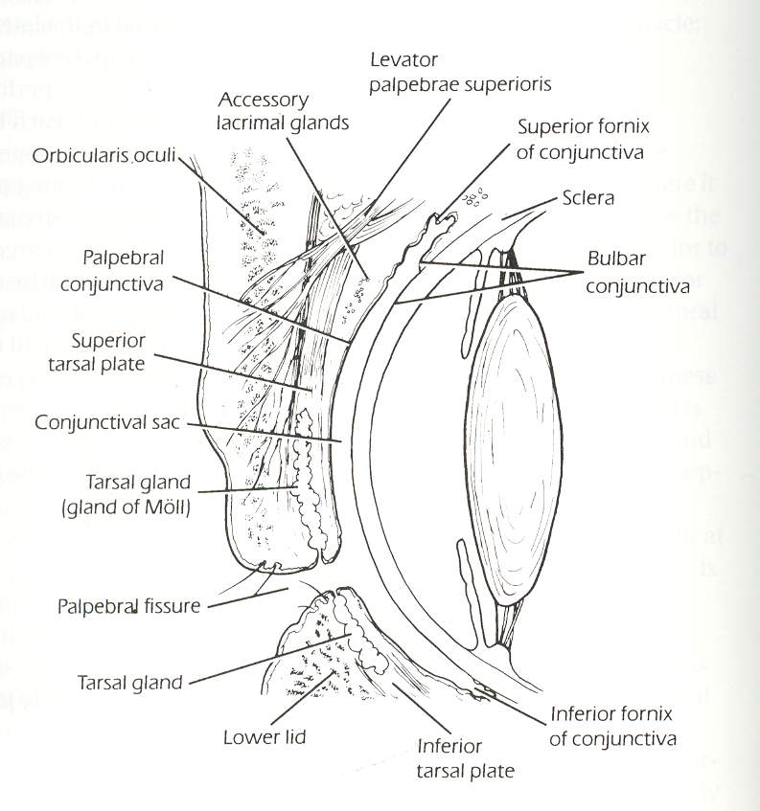
Anatomical structure of the eyelid

Slide 4
Characteristics
The eyelid is limited above by the eyebrow with when the lower eyelid merges with the check
Each eyelid is divided by a horizontal furrow (sulcus) into
An orbital and
A tarsal portion.
Palpebral fissure:
An ecliptic opening formed by the eyelids (12 by 30mm)

Slide 5
CHARACTERISTIC CONT’D
Free margin of the eyelid are:
Opening of the lacrimal canaliculus (puncta) located 5mm from the medial angle
The eyelashes (cilia)
Opening of the glands

Slide 6
Characteristics Cont’d
Thickness – 2mm
Length – 30mm
The medial 1/6 of the eyelid or the lacrimal portion has no cilia or glands opening
The eyelid margins are rounded
The lateral 5/6 has square edges

Slide 7
Characteristics Cont’d
Grey line
The intra marginal sulcus or grey line of the margin makes the anterior edge of the tarsal plate and divides it into:
Anterior leaf (muscle and skin)
Posterior leaf (tarsal and conjunctiva)

Slide 8
Characteristics Cont’d
Eyelashes originate anterior to the grey line and orifices of the tarsal glands are posterior to the grey line of the conjunctiva and stratified epithelium of the skin is at the level of the orifices of the tarsal gland
Distribution of the eyelashes:
Upper lid – more
Lower lid – less

Slide 9
CHARACTERISTICS CONT’D
Opening into the follicle of each cilium are:
Ducts of sebaceous gland
Large sweet glands of moll which open to these follicles and or directly onto the eyelid margin between the cilia

Slide 10
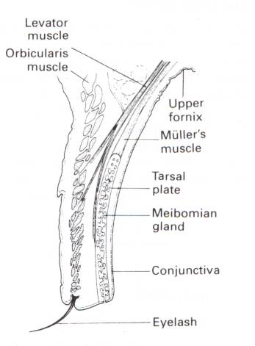
Eyelid showing it’s internal structures

Slide 11
STRUCTURES
The eyelid contain the following parts:
Skin
Muscle
Orbicularis oculi muscle (CNVII)
Orbital portion
Palpebral portion
Pre–septal portion
Pre–tarsal portion

Slide 12
STRUCTURES Cont’d
Eyelid refractors
LPSM (CNIII)
Superior tarsal muscles (sympathetic)
IRM (CNVII)
Inferior tarsal muscle (sympathetic)
Fibrous tissue
Septum orbital
Tarsal plates conjunctiva

Slide 13
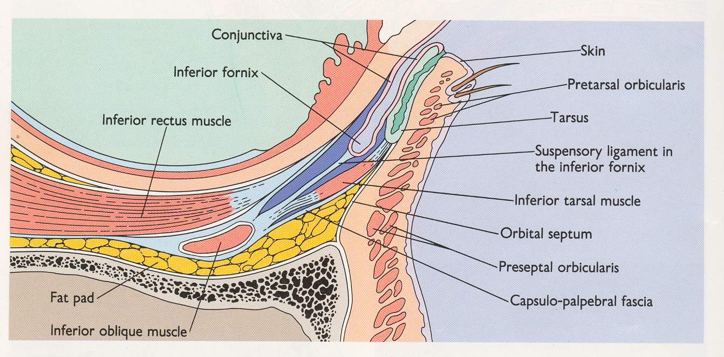
Eyelid showing composition

Slide 14
NB: The orbital septum separates the intraocular contents from the eyelid while the inter – marginal sulcus provides a line of surgical dissection separating the anterior structures of the EL from the tarsal conjunctiva

Slide 15
The skin of the eyelid
Thinnest of the body
No fat in the subcutaneous
Alveolar area
Numerous folds
Maybe distended by:
Flood
Fluid
Underlying blood vessels may appear dark blue

Slide 16
ORBICULARIS OCULI MUSCLE (CNVII)
They are striated skeletal muscles:
Peripheral orbital portion (forcible closure of the eyelid)
Central palpebral portion (involuntary blinking)
Pre–septal portion overlying the orbital septum
Pre–tarsal part underlying
Upper tarsal plates
Lower tarsal plate
The arrangement at the medial canthus, support the lacrimal puncta and with each blink create suction in the lacrimal sac.
Notes:
Stopped

Slide 17
ORBICULARIS OCULI MUSCLE (CNVII) Cont’d
The inferior tarsal muscle originate from the sheath of the IRM where it surrounds the IOM.
It courses upward and inserts into:
bulbar conjunctiva
Expansion of the fascia of IRM that inserts into the tarsals
The orbital septum separates the eyelid from the content of the orbit white.
The capsule–palpebral fascia in the lower eyelid is equivalent to the levator aponeurosis

Slide 18
ORBICULARIS OCULI MUSCLE (CNVII) Cont’d
The LPSM aponeurosis is located in the upper eyelid
The LPSM (CNIII) is closely related to the SRM in it’s:
Origin
course
The superior and inferior palpebral smooth muscles of Muller (sypmpathetic) are small sheet of muscles located immediately beneath the orbital portion of the palpebral conjunctiva.

Slide 19
ORBICULARIS OCULI MUSCLE (CNVII) Cont’d
The superior palpebral muscle originate from the under surface of the LPSM
The fibrous tissue of the eyelids consist of:
Peripheral layer
Palpebral fascia (septum)
Orbital
Thickened central portion

Slide 20
ORBICULARIS OCULI MUSCLE (CNVII) Cont’d
The tarsal plates consist of:
Firm connective tissue (not cartilage) that gives form and density to the free margin of the eyelids each.
size: 1mm thick and 25–30 mm long
Upper = 11mm
Lower = 5mm wide
Each tarsus contains:
Sebaceous (Meibomian) gland margin
Theses glands are arranged in a cycle round the tarsal plate and each consist of 10 – 15 acini placed irregularly around a central canal openings into the margin

Slide 21
ORBICULARIS OCULI MUSCLE (CNVII) Cont’d
The sebaceous gland prevents:
Overflowing of tears
Makes possible an airtight closure of the eyelid
Provides the superficial layer of the pre–corneal tear film
Prevents the rapid evaporation of tears

Slide 22
BLOOD SUPPLY TO THE EYELID
This is derived from the marginal peripheral vascular arcades and formed by the lateral palpebral branches of:
The lacrimal artery of
Medial palpebral branches of the dorso nasal artery.
Both are derived from internal carotid artery through the ophthalmic artery.

Slide 23
NERVE SUPPLY TO THE EYELID
The ophthalmic (first) division of the trigeminal nerve (CNV) provides the sensory innervation of the:
Upper eyelid
Small lateral portion of the lower lid

Slide 24
LYMPHATIC SUPPLY
The eyelids are drained by:
A medial group which drains 2/3 of the lower eyelid and
Medial 1/3 of the upper eyelid into the sub-maxillary lymph nodes
2. A lateral group drains the remaining portion of the eyelids to the pre–auricullar nodes

