Slide 1

Data Spaces Resource Library
POWERED BY

Slide 2


Background
This initial version of the Data Spaces Resource Library is based on a data spaces study commissioned by the Ministry of Transport and Communications of Finland and conducted by 1001 Lakes.
One of the key results of the study was the State of Data Spaces 2021 report that was published by the Ministry of Transport and Communications of Finland.
Further development of Data Spaces Resource Library is supported by the Ministry of Economic Affairs and Employment of Finland.

Slide 3
Contents
Fundamentals of Data Spaces
Key Initiatives and Organisations
Regulation
Soft Infrastructure
Data Spaces as Commons
Data Spaces as Ecosystems
Funding Opportunities

Slide 4
Data Spaces – Analysis Framework
Regulation
This framework was created and used to provide a more systemic view of on-going data spaces activities.
<Contibutions and aims (EU-level and national)>
<Most relevant regulatory initiatives>
Frameworks and standardization
<Common bodies>
<Major programmes>
<Standardization efforts>
Generic building blocks
<Technical building blocks>
<Governance building blocks>
<Existing and in development building blocks>
<Key facts>
<Core ideas>
<Links to relevant materials>
Ecosystems
Domain specific
Data
Platforms and solutions
Domain A
Domain B
Domain C
Domain D
‹#›

Slide 5

Fundamentals of
Data Spaces

Slide 6
Key terminology (1/2)
Term | Definition | Remarks
Data space | Decentralized infrastructure for trustworthy data sharing and exchange in data ecosystems based on commonly agreed principles. ² --- Purpose- or sector-specific or cross-sectoral interoperable frameworks of common standards and practices to share or jointly process data for, inter alia, development of new products and services, scientific research or civil society initiatives. ³ | "Space" has two meanings in English: "physically bounded space” (e.g. room) and "infinite space” (e.g. outer space); which meaning is more important for data spaces? The European debate highlights the economic dimension of the concept. Data space is a framework and a medium that creates a secure space for data exchange.
Data sharing | Act of providing data access for use by others, subject to applicable technical, financial, legal, or organisational use requirements.¹ --- Provision by a data holder of data to a data user for the purpose of joint or individual use of the shared data, based on voluntary agreements, directly or through an intermediary. ³ | There is a need to emphasize that data sharing may include limitations on the users authorised to access the data, conditions for data use including the purposes for which the data can be used, and requirements on data access control mechanisms through which data access is granted. Phrases like ”conditioned data access and sharing arrangements” and ”data usage control” have been introduced. Data sharing requires clarified and balanced terms of use and data interoperability frameworks and standards. Data sharing is conditioned exchange of data aiming to create added value.
Data ecosystem | Integration of and interaction between different relevant stakeholders including data holders, data producers, data intermediaries and data subjects, that are involved in, or affected by, related data access and sharing arrangements, according to their different roles, responsibilities and rights, technologies, and business models. ¹ | Data ecosystems include public organizations, private organizations and individuals as stakeholders and actors. Ecosystems should not be considered only from industrial viewpoint and premises; we need a human-centric approach to building a fair data economy.
References:
(1) OECD: Recommendation of the Council on Enhancing Access to and Sharing of Data (October 2021).
(2) OPEN DEI: Design Principles for Data Spaces (May 2021)
(3) EU Data Governance Act (draft by EU Council, October 2021)
‹#›

Slide 7
Key terminology (2/2)
Term | Definition | Remarks
Data sovereignty | The capability of a natural person or organisation for exclusive self-determination with regard to its economic data goods. ² | Ownership of data is legally problematic, replacing the concept of ownership with the concept of sovereignty does not resolve these problems. The concept is intended to have an empowering effect. Data sovereignty is self-determination in a digital world.
Data intermediary | Service providers that facilitate data access and sharing under commercial or non-commercial agreements between data holders, data producers, and/or users. Data holders and trusted third parties can act as data intermediaries. ¹ --- Data spaces could require an entity to structure and organise (‘orchestrate’) such data spaces. Data intermediation services could include inter alia bilateral or multilateral sharing of data or the creation of platforms or databases enabling the sharing or joint use of data, as well as the establishment of a specific infrastructure for the interconnection of data holders and data users. ³ | The concept defines a wide set of data intermediation actors and services: data marketplace provider, data broker, data clearing house, vocabulary provider, data service catalogue provider, MyData operator, etc. Data intermediation services can be very different in terms of their functions and potential business models. Can such a diverse set be regulated in a meaningful way? How important and realistic is it for data intermediaries to be fully independent from other actors in the data ecosystem?
Soft infrastructure | Neutral building blocks and core services. Provides a level playing field for data sharing and exchange. Made up of technology neutral and sector agnostic agreements and standards specifying how organisations and individuals can participate in the data economy and how they need to act and behave in compliance with commonly agreed rules and directives. ² | Legislation is needed, which should be permissive and promote data sharing and prevent lock-in. Flexibility is also needed; agreements and bilateral practices that serve as examples for legislation. Data is in bunkers. Building blocks and examples are needed to get data moving. Soft infrastructure is a milestone on the way to creating an interoperable digital market.
References:
(1) OECD: Recommendation of the Council on Enhancing Access to and Sharing of Data (October 2021).
(2) OPEN DEI: Design Principles for Data Spaces (May 2021)
(3) EU Data Governance Act (draft by EU Council, October 2021)
‹#›

Slide 8
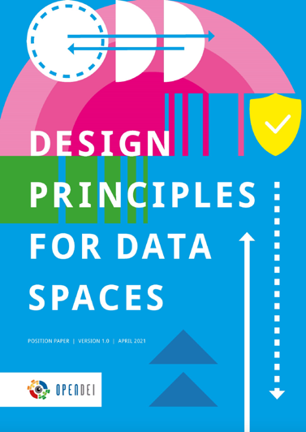
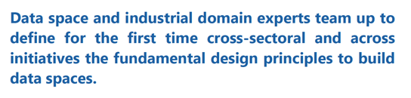
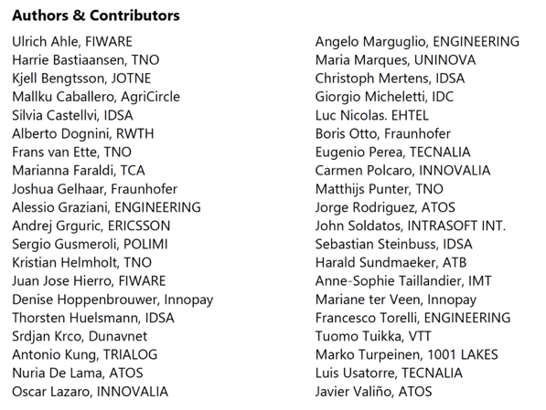
Design Principles for Data Spaces
Regulation
Proposes data space governance bodies and
novel models, for example Data Exchange Board
at the EU-level.
Key facts
Collaborative effort organised by EU project OPEN DEI. This resulted in Design Principles for Data Spaces v.1.0 white paper published in May 2021.
Proposes four design principles for data spaces.
Sector specific needs analysed for manufacturing, energy, health, agri-food.
Framework proposed is used as an underlying structure in this study.
Frameworks and standardization
Framework for soft infrastructure and building
ecosystems from generic building blocks.
Aim is to contribute as a design basis to data space programmes and standardization efforts.
Generic building blocks
Introduces building blocks in four categories:
interoperability, trust, data value, governance.
Ecosystems
Domain specific
Data
Platforms and solutions
👉 https://design-principles-for-data-spaces.org/
Domain A
Domain B
Domain C
Domain D
‹#›

Slide 9
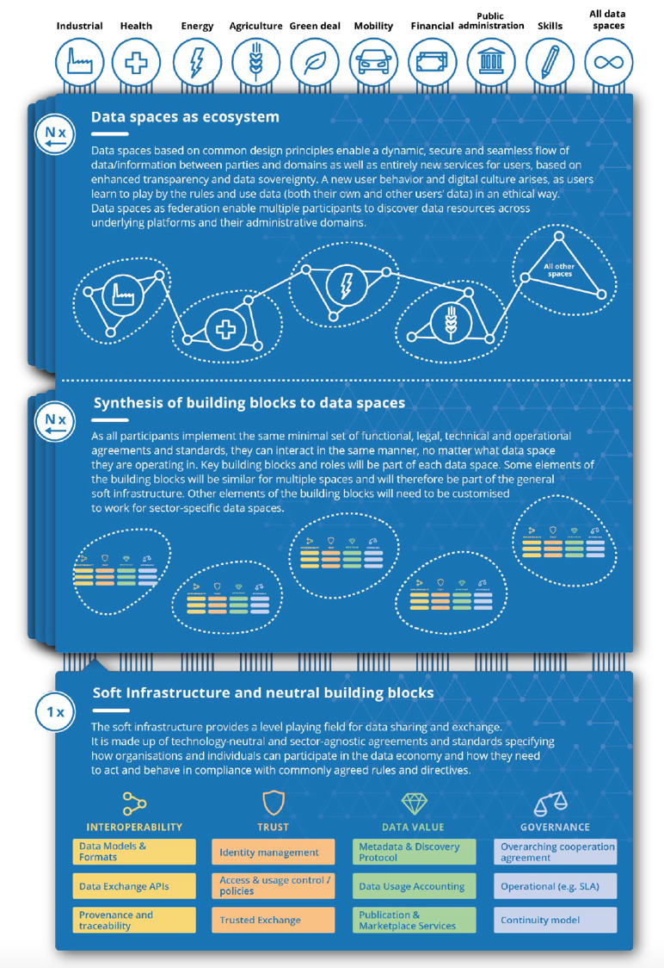


Data Spaces as Ecosystems
Data sharing networks and data marketplaces
Service and value exchange
Use case and business driven
Cross-sectorial ecosystems also made possible
Rulebooks complement standards and regulation
Data Spaces as Commons
General and sector-specific principles
Built on common soft infrastructure
Apply sector-specific standards and regulation
Domain-specific metadata & vocabularies
Examples: European Health Data Space, European Mobility Data Space
Soft Infrastructure
Neutral building blocks and core services
Interoperability
Trust
Data Value
Governance
‹#›

Slide 10
Key Initiatives and
Organisations

Slide 11
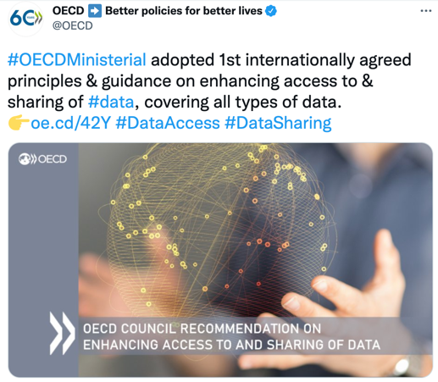
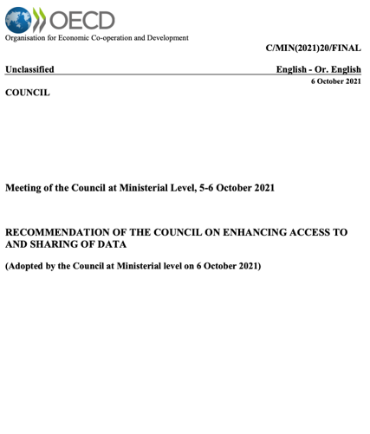
OECD – Recommendation on Data Access and Sharing
Regulation
Recommends that Adherents adopt a strategic whole-of-government approach to data access and sharing
Key facts
First internationally agreed principles and policy guidance on enhancing data access and sharing arrangements while protecting individuals’ and organisations’ rights and taking into account other legitimate interests and objectives
Reinforcing Trust Across the Data Ecosystem
Stimulating Investment in Data and Incentivising Data Access and Sharing
Fostering Effective and Responsible Data Access, Sharing, and Use Across Society
Frameworks and standardization
The recommendation aims to influence underlying principles for international data space frameworks and standards, but does not boost or promote any specific initiatives.
Generic building blocks
Ecosystems
Domain specific
Data
Platforms and solutions
👉 http://oe.cd/42Y
Domain A
Domain B
Domain C
Domain D
The aim of OECD is to ”empower and pro-actively engage all relevant stakeholders alongside broader efforts to increase the trustworthiness of the data ecosystem.”
‹#›

Slide 12

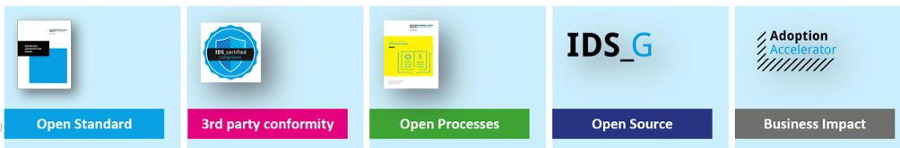

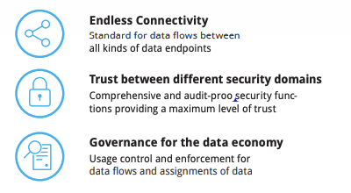
International Data Spaces (IDS)
Regulation
Key facts
Goals: (1) Driving Data Spaces in Europe and (2) Organizing the initiation and growth of data spaces everywhere
Started as a research-driven Industrie 4.0 initiative, currently in broad scale adoption phase
Initially focused on industrial data, currently includes all data and all domains
Strongly linked with Gaia-X, providing many of the data spaces building blocks
Aims to influence EU Data Strategy, Digital Europe Programme, Data Governance Act, Data Act, Data Innovation Board, …
Frameworks and standardization
IDSA is the organizational body with approximately 200 members behind the IDS framework.
Five core pillars of IDSA offering
Generic building blocks
IDS Reference Architecture Model (v.3.0)
IDS_G
Open Source Core Services
Open Processes (Rulebooks)
Guiding principles
Ecosystems
Domain specific
Data
Platforms and solutions
👉 https://internationaldataspaces.org/
Domain A
Domain B
Domain C
Domain D
”As an open standard, IDS guarantees data security for all parties involved in the exchange of sensitive and valuable data sets, ensures a level playing field and enforces data sovereignty with technical measures”, Lars Nagel, CEO of IDSA.
‹#›

Slide 13


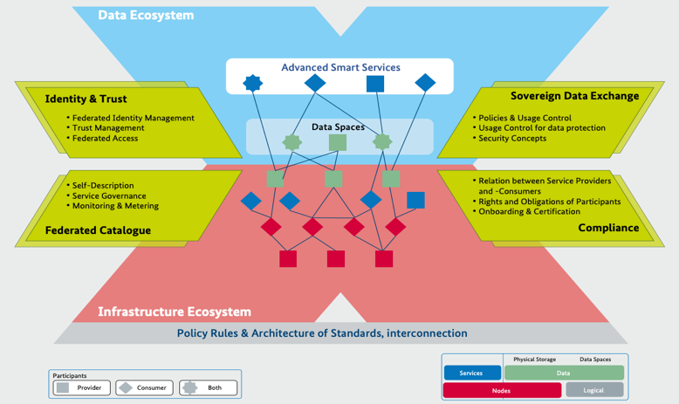
Gaia-X
Regulation
Mentioned in the European Data Strategy. Exchange between Gaia-X and the European Commission to identify synergies between Gaia-X and initiatives and programs such as the European Cloud Federation, CEF 2 and Digital Europe.
Key facts
Core initiative in Europe to implement European Data Strategy
The Gaia-X project had initially a strong European cloud focus (how and where data is stored, processed and used within the data infrastructure).
Gaia-X has evolved to include data spaces more broadly and focuses now on secure, privacy-protected and sovereign exchange and use of data.
Leadership from France and Germany, interest growing globally.
Main drive from EU commission and European industry (75% of members).
1800+ participants from ca. 500 companies and organisations.
Relation to cloud hyperscalers (Amazon, Microsoft, Google) is evolving and becoming more inclusive instead of Gaia-X being positioned as the European alternative cloud solution.
Frameworks and standardization
Gaia-X AIBSL
Generic building blocks
Gaia-X
Architecture
Gaia-X
Federation Services
Gaia-X
Policy and Rules
Gaia-X Data Spaces Business Committee
Gaia-X Domain Working Groups
Ecosystems
Domain specific
Data
Platforms and solutions
Domain A
Domain B
Domain C
Domain D
👉 https://gaia-x.eu/
Our objective is to create a digital ecosystem in Europe that will foster innovation and spawn new data-driven services and applications.” Federal Minister for Economic Affairs and Energy Peter Altmaier

Slide 14

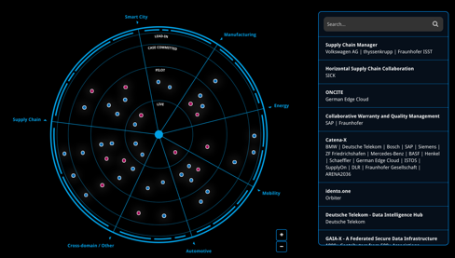
Data Spaces Business Alliance
Regulation
Aims to infuence data space regulation indirectly by promoting common views on key aspects to be regulated.
Key facts
Four key European organizations International Data Spaces Association (IDSA), Gaia-X, FIWARE, and Big Data Value Association (BDVA) have formed an alliance
Creating a one voice and a common framework to make data spaces happen
Bringing together data providers, users and intermediaries, data spaces are key to driving businesses to competitively extract value out of data
Together, the Alliance’s founding organisations represent 1,000+ leading key industry players, associations, research organisations, innovators, and policy-makers worldwide
With its combined cross-industry expertise, resources and know-how, the Alliance drives awareness, evangelises technology, shapes standards and enables integration across industries.
Frameworks and standardization
Generic building blocks
Strong contribution and commitment from all four programmes of the alliance to provide the common building blocks (combining outputs from IDSA, Gaia-X. Fiware).
Technology and architecture: Common reference model that drives interoperability by harmonising technology components and other elements.
Support: Pooling tools, resources and expertise: handbooks, roadmaps, individual evolution plans, access to Digital Innovation Hubs, acceleration programmes, go-to-market toolkit.
Identification and characterisation: ‘Data Spaces Radar’ to actively scout potential data spaces. Overview on data spaces evolution on a global level.
Ecosystems
Domain specific
Data
👉 https://internationaldataspaces.org/adopt/data-space-radar/
Platforms and solutions
Domain A
Domain B
Domain C
Domain D
”We have proven that building data spaces is possible. Now we must do it. The Data Spaces Business Alliance has all the joint capabilities to successfully build and even run data spaces. The next step is large scale adoption to fully realize the economical potential. In this Alliance, we will act now and think big for the digital future that will benefit everyone.” Reinhold Achatz, Chairman of IDSA

Slide 15
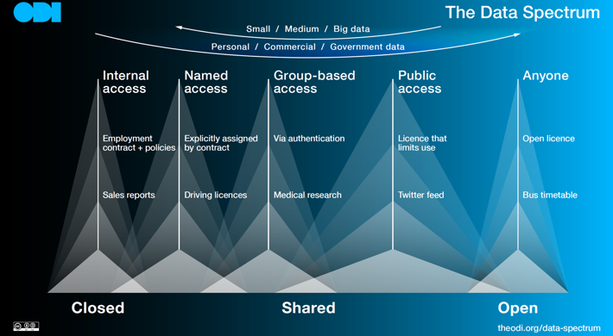

Open Data Institute
Regulation
Active contributor in the evolution of data-related regulation.
Key facts
The Open Data Institute (ODI) is a non-profit with a mission to work with companies and governments to build an open, trustworthy data ecosystem.
ODI works with a range of organisations, governments, public bodies and civil society to create a world where data works for everyone.
Improving the data practices of organisations so that they can build and manage adequate data infrastructure and data use.
Frameworks and standardization
ODI aims to enable the development of data infrastructure in ways that benefit people, companies, governments and civil society. We focus on increasing data flows around the data ecosystem, improving skills and capabilities, and encouraging innovation.
Generic building blocks
The Data Spectrum clarifies the closed/shared/open data differences:
Example of an ODI report:
Influences indirectly the principles underlying data spaces building blocks.
Ecosystems
Domain specific
Data
Platforms and solutions
👉 https://theodi.org/
Domain A
Domain B
Domain C
Domain D

Slide 16

OPEN DEI
Regulation
EU funded coordination action related to data spaces across various domains.
Indirectly influencing regulation and policies.
Key facts
OPEN DEI is an EU H2020 Coordination and Support Action (CSA) project (2019-22).
Aims to detect gaps, encourage synergies, support regional and national cooperation, and enhance communication among the EU projects implementing the EU digital strategy
Coordinates the writing of Design Principles for Data Spaces white paper. First version released in May 2021. Update planned to be released in Winter 2022.
Focuses on four sectors: manufacturing, energy, health, agri-food.
Frameworks and standardization
Aims to increase collaboration across European actors.
Project has published a white paper that proposes a design framework for data spaces.
Platform building
Comparing reference architectures and open source reference implementations, enabling a unified industrial data platform
Data ecosystem building
Enabling an innovation and collaboration platform, forging a European network of DIHs, contributing to industrial skills catalogue and observatory
Large scale piloting
Contributing to a digital maturity model, creating a set of assessment methods and a migration journey benchmarking tool
Standardisation
Conducting cross-domain surveys, performing promotion and implementation, building alliances with existing EU and standard developing organisations
Generic building blocks
Several project partners are implementing generic building blocks that are promoted by OPEN DEI project.
Ecosystems
Domain specific
Data
Platforms and solutions
👉 https://www.opendei.eu/
Manufacturing
Health
Energy
Agriculture

Slide 17


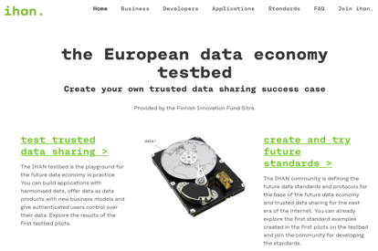
Sitra – Fair Data Economy
Regulation
Active contributor and commentor to national and European data-related regulation.
Key facts
Sitra’s IHAN® project (2018-2021), has had its focus on fair data economy, in which successful digital services are based on trust and create value for everyone.
Sitra continues the focus on Data Economy and has promoted it to be one of Sitra’s main themes alongside with circular economy and renewing democracy.
Emphasizes that a fair digital transition is one of Europe’s most important facilitator of sustainable growth and competitiveness.
Frameworks and standardization
The IHAN blueprint includes the descriptions of the principles and components of IHAN’s functional architecture as well as guidelines for building fair data economy services with the aid of existing technology.
Main arguments:
The fair data economy will benefit everyone.
Data will be shared more freely between different parties.
Trust in service providers will encourage individuals to share their data when the sharing is based on their consent.
People will obtain access to more targeted services that improve their well-being and daily lives.
Companies of all sizes will achieve growth through innovation and well-being will increase.
Generic building blocks
The programme has built the IHAN testbed as an environment for testing data sharing projects.
Fair Data Economy Rulebook model helps organizations to agree on business, legal, technical and ethical rules for data sharing.
Ecosystems
Domain specific
Data
Platforms and solutions
👉 https://www.sitra.fi/en/topics/fair-data-economy/
Domain A
Domain B
Domain C
Domain D
”The data economy should be fair for all stakeholders: the society as a whole, private companies, the public sector and, last but not least, the citizens.” Jyrki Katainen, the President of Sitra

Slide 18

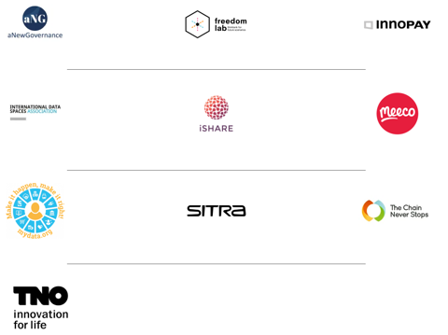
Data Sovereignty Now
Regulation
Proposes that the European Commission should take a decisive step forwards by making Data Sovereignty a legal prerequisite for every data initiative in Europe.
Key facts
Coalition of partners who believe that Data Sovereignty should become the guiding principle in the development of national and European data sharing legislation
Initiated by Innopay (NL).
Data Sovereignty the central design principle of the data economy as a whole and a prerequisite for every organisation’s own data architecture.
Frameworks and standardization
Influences frameworks and standardization by promoting data sovereignty as one of the central design principles for data spaces.
The benefits of data sovereignty
People can easily switch providers, and enable their data to be commercialised by businesses
Businesses can trade more easily, securely and cost-effectively with other businesses
All parties holding data can offer consistent functionalities and ways of working to their customers, suppliers and employees
The free flow of data will increase, thereby stimulating more and faster commercial innovation to create new kinds of data-enabled business models that generate new services
The dominance of the Big Tech giants will be reduced since customer data will no longer be ‘locked in’.
Generic building blocks
Members
Ecosystems
Domain specific
Data
Platforms and solutions
👉 https://datasovereigntynow.org/
Domain A
Domain B
Domain C
Domain D
”Data sovereignty is the right to self-determination over data.”

Slide 19
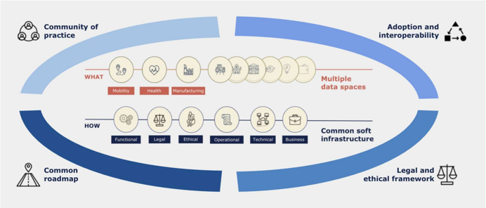
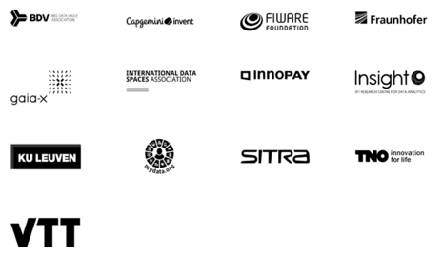
Team Data Spaces
Regulation
Aims to become the Data Spaces Support Center planned to start in 2022, strong link EU-level Data Innovation Board to be expected
Key facts
Team Data Spaces brings together the leading European players in data spaces from European associations, industry, and research organisations with a common vision to deliver European data spaces.
Frameworks and standardization
Team
Data Spaces
Generic building blocks
Focuses on boosting and adoption of common building blocks
Ecosystems
Domain specific
Data
Platforms and solutions
👉 https://dataspaces4.eu/
Domain A
Domain B
Domain C
Domain D
”Teaming Up to Support the European Data Strategy Is a Must.” Jaana Sinipuro, Sitra

Slide 20
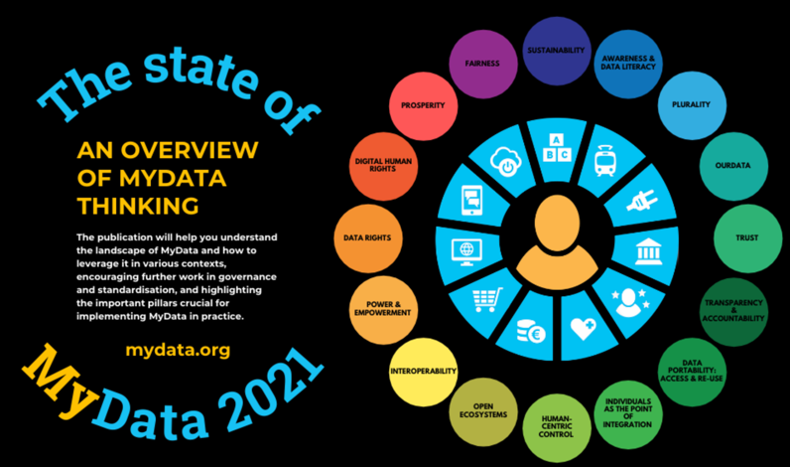
MyData Global
Regulation
MyData aims to influence regulation, and has been active in promoting the human-centric view and the data intermediary model, for example in the context of the EU Data Governance Act.
Key facts
MyData Global is an international non-profit headquartered in Helsinki.
The purpose of MyData Global is to empower individuals by improving their right to self-determination regarding their personal data.
MyData Global has over 100 organisation members and close to 400 individual members from over 40 countries, on six continents.
The human-centric paradigm aims at a fair, sustainable, and prosperous digital society, where personal data sharing is based on trust as well as balanced and fair relationship between individuals and organisations.
Frameworks and standardization
MyData is both an alternative vision and guiding technical principles. It works together with other initiatives such as IDSA and Gaia-X focusing on aspects of personal data.
Generic building blocks
MyData Global has introduced the MyData Operator model for personal data management intermediaries, consisting of several envisioned building blocks, e.g. consent management and identity management.
Ecosystems
Domain specific
Data
Platforms and solutions
👉 https://mydata.org/
Domain A
Domain B
Domain C
Domain D
”Data spaces can become a human-centric way to renew our e-identity infrastructure and to foster data sharing.” Antti ”Jogi” Poikola, Finnish Technology Industries

Slide 21
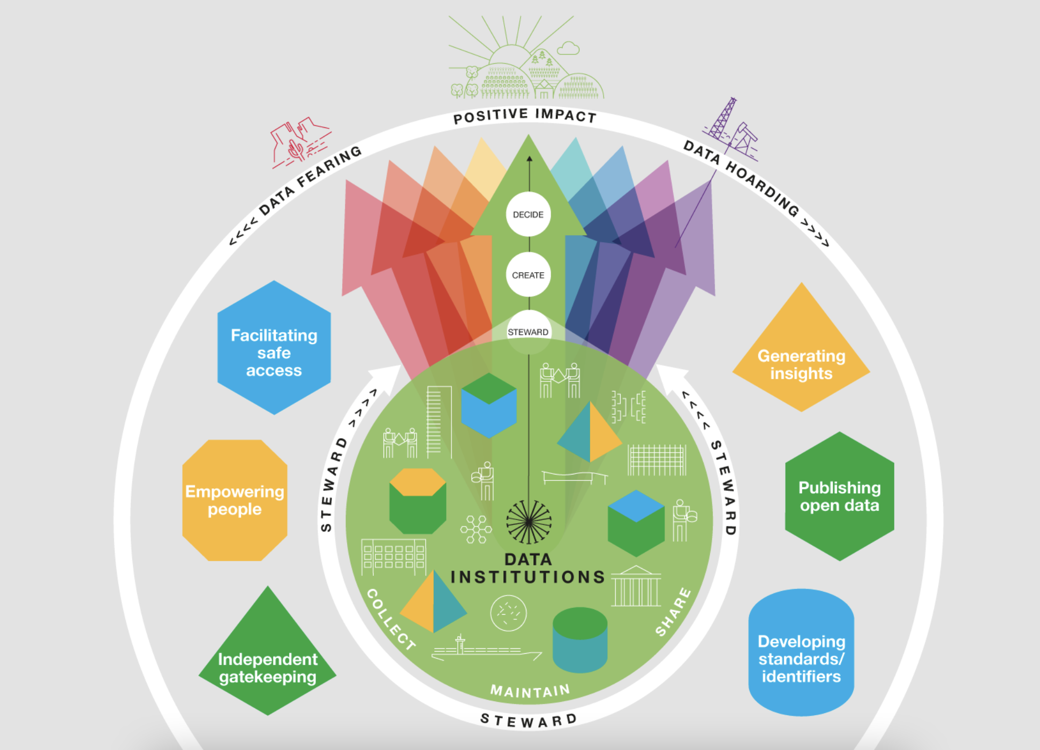
The Data Institutions Register
Regulation
Key facts
At the Open Data Institute (ODI), we’re exploring data institutions – organisations whose purpose involves stewarding data on behalf of others, often towards public, educational or charitable aims.
To support this ongoing work, we’re launching the Data Institutions Register, which is a curated, living repository of data institutions from around the world.
We intend for this register to become a systematic way to document data institutions as we come across them, which we can then use to sample data institutions for further analysis in our research projects, or to unearth interesting examples for talks and our other advocacy work.
In making the register openly accessible we also hope that others find it useful, such as:
for existing data institutions or people trying to build new ones, as a useful source of information about data institutions from different parts of the world or sectors to be inspired by or to learn from.
for policymakers, funders and others looking to create an enabling environment for data institutions, as an overview of what’s already out there and organisations to engage with.
for researchers, think-tanks and others exploring the topic of responsible data stewardship, as a source of examples of organisations practicing this in the wild.
Frameworks and standardization
Generic building blocks
Ecosystems
Domain specific
Data
Platforms and solutions
👉 https://theodi.org/article/the-data-institutions-register/
Health
Mobility
Smart Communities
Green deal
‹#›

Slide 22
Big Data Value Public Private Partnership
Regulation
Key facts
The Big Data Value Public-Private Partnership aims at creating a functional Data Market and Data Economy in Europe, in order to allow Europe to play a leading role in Big Data in the global market
The Big Data Value PPP was a partnership between the European Commission and the Big Data Value Association (BDVA) during the period 2014-2020
Frameworks and standardization
Generic building blocks
Ecosystems
Domain specific
Data
Platforms and solutions
👉 https://www.bdva.eu/PPP
Domain A
Domain B
Domain C
Domain D
‹#›

Slide 23
Regulation

Slide 24
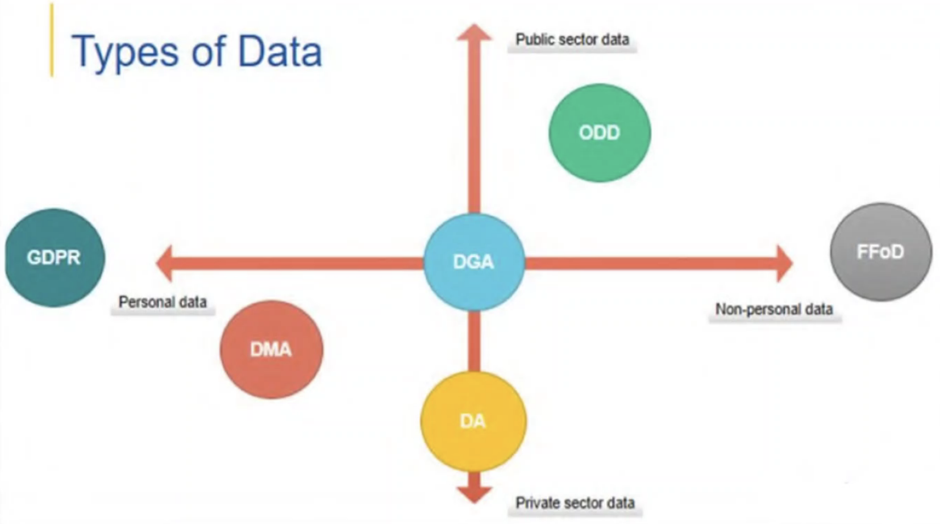
EU Data Regulation
DA Data Act
DMA Digital Markets Act
DGA Data Governance Act
ODD Open Data Directive
FFoD Free Flow of Data Regulation
GDPR General Data Protection Regulation

Slide 25
General Data Protection Regulation (GDPR)
Regulation
GDPR defines the requirements on processing personal data. It applies to organisations that process data related to individuals in the EU. In addition there are national and sector-specific data protection laws.
GDPR defines the basic rules on individuals’ rights as well as on controllers’ and data processors’ responsibilities.
The key principles include that personal data must be processed lawfully, fairly and transparently, collected for specified legitimate purposes, limited to what is necessary, accurate, stored no longer than is necessary, and processed securely.
The lawful basis for processing can be a consent, a contractual obligation, a legal obligation, a vital interests of an individual, an interest of the public, or a legitimate interest (as long as the fundamental rights and freedoms of the individual whose data are processed are not seriously impacted).
The individuals must be clearly provided with information on who is processing the personal data about them and why.
The individuals have a right to correct errors in their personal data. In certain cases they also have a right to object the processing of their personal data and a right to be forgotten.
In case of a data breach, the Data Protection Authority must be notified within 72 hours.
Requests from individuals should be responded in general without undue delay and usually within at most 1 month.
Conducting a Data Protection Impact Assessment (DPIA) is mandatory whenever the intended processing would pose a high risk to the rights and freedoms of individuals, e.g. when new technologies are used.
Frameworks and standardization
Generic building blocks
Ecosystems
Domain specific
Data
👉 http://eur-lex.europa.eu/legal-content/EN/TXT/HTML/?uri=CELEX:32016R0679
Platforms and solutions
Domain A
Domain B
Domain C
Domain D

Slide 26
Data Governance Act (DGA)
Regulation
DGA is a proposal for EU legislation to create a framework to facilitate data sharing.
Defines a mechanism for re-using certain categories of protected public sector data.
Aims to increase trust in sharing personal and non-personal data and lower transaction costs linked to B2B and C2B data sharing by creating a notification regime for data sharing providers.
Facilitates data altruism, i.e., data voluntarily made available by individuals or companies for the common good.
Frameworks and standardization
Generic building blocks
Ecosystems
Domain specific
Data
👉 https://eur-lex.europa.eu/legal-content/EN/TXT/PDF/?uri=CELEX:52020PC0767
Platforms and solutions
Domain A
Domain B
Domain C
Domain D

Slide 27
Data Act
Regulation
Data Act is a European legislative proposal that aims to create a framework to encourage business-to-government (B2G) data sharing.
The Data Act aims to ensure fairness in the allocation of data value among actors in the data economy and to foster access to and use of data.
The Act will not alter data protection legislation and will seek to preserve incentives in data generation.
In the context of this Act, a review of Directive 96/9/EC on the legal protection of databases is being undertaken in order to ensure its continued relevance for the data economy.
Frameworks and standardization
Generic building blocks
Ecosystems
Domain specific
Data
👉 https://www.europarl.europa.eu/legislative-train/theme-a-europe-fit-for-the-digital-age/file-data-act
Platforms and solutions
Domain A
Domain B
Domain C
Domain D

Slide 28
Open Data Directive
Regulation
Concerns open data and the re-use of public sector information. It has superseded the former PSI directive. It intends to strengthen the EU’s data-economy by increasing the amount of publicly held and publicly funded data available for re-use.
An obligation for public bodies to publish available data unless access is restricted or excluded.
Open and machine readable formats must be used, where possible. Dynamic data should be made available via APIs and bulk download where relevant.
The scope of the directive now includes also public undertakings and publicly funded research data.
Data should usually be made free of charge or charges limited to marginal cost recovery.
The Directive encourages transparency and openness.
Frameworks and standardization
Generic building blocks
Ecosystems
Domain specific
Data
👉 https://eur-lex.europa.eu/eli/dir/2019/1024/oj
Platforms and solutions
Domain A
Domain B
Domain C
Domain D

Slide 29
Digital Markets Act
Regulation
Proposal for a Regulation on contestable and fair markets in the digital sector. Aims at preventing unfair trading practices of the largest platform companies operating as “gatekeepers”.
The proposal intends to ensure the competitiveness and fairness of digital services.
Promotes innovation, high-quality digital products and services, reasonable and competitive prices and users’ freedom of choice.
Aims at preventing unfair trading practices of the largest platform companies, so called ‘gatekeepers’, which have a significant impact on the market, offer a core platform service that serves as an important gateway for business users to reach end users, and enjoy an entrenched and durable position in the market.
Applicable only to the largest companies that provide ‘core platform services’, like search engines, operating systems, social networking services and various online intermediation services.
The gatekeepers must, e.g., allow users to uninstall any applications, allow the installation and use of third party software in the gatekeeper’s operating system, provide portability of end-user-generated data,
The gatekeepers’ possibilities of combining personal data from different sources would be profoundly limited.
Frameworks and standardization
Generic building blocks
Ecosystems
Domain specific
Data
👉 https://eur-lex.europa.eu/legal-content/en/TXT/?uri=COM%3A2020%3A842%3AFIN
Platforms and solutions
Domain A
Domain B
Domain C
Domain D

Slide 30
Digital Services Act
Regulation
Proposal for a Regulation on a Single Market For Digital Services (Digital Services Act) aims at better protecting consumers online,
establishing a transparency and accountability framework for online platforms, and fostering innovation, growth and competitiveness.
The proposals seeks to rebalance the responsibilities of users, platforms, and public authorities according to European values, placing citizens at the centre.
It intends to better protect consumers and their fundamental rights online, establish a powerful transparency and a clear accountability framework for online platforms, and foster innovation, growth and competitiveness within the single market.
The proposal includes rules for online intermediary services, hosting services, and online platforms.
All online intermediaries offering their services in the single market, whether they are established in the EU or outside, will have to comply with the new rules.
Micro and small companies will have obligations proportionate to their ability and size while ensuring they remain accountable.
New obligations include, e.g. transparency reporting, requirements on terms of service due account of fundamental rights, and cooperation with national authorities following orders.
In addition, very large platforms will have, for example, risk management obligations and compliance officers, external risk auditing and public accountability, codes of conduct, and crisis response cooperation.
Frameworks and standardization
Generic building blocks
Ecosystems
Domain specific
Data
👉 https://eur-lex.europa.eu/legal-content/en/TXT/?uri=COM%3A2020%3A825%3AFIN
Platforms and solutions
Domain A
Domain B
Domain C
Domain D

Slide 31
Free Flow of Non-Personal Data
Regulation
Regulation on a framework for the free flow of non-personal data in the European Union aims at removing obstacles to the free movement of non-personal data between different EU countries and IT systems in Europe.
Free movement of non-personal data across borders: every organisation should be able to store and process data anywhere in the EU.
The availability of data for regulatory control: public authorities will retain access to data, even when it is located in another EU country or when it is stored or processed in the cloud.
Easier switching between cloud service providers for professional users.
Full consistency and synergies with the cybersecurity package, and clarification that any security requirements that already apply to businesses storing and processing data will continue to do so when they store or process data across borders in the EU or in the cloud.
Complements the GDPR to ensure that not only personal data, but also non-personal data can move freely within the EU.
Frameworks and standardization
Generic building blocks
Ecosystems
Domain specific
Data
👉 https://eur-lex.europa.eu/legal-content/EN/TXT/?uri=CELEX%3A32018R1807
Platforms and solutions
Domain A
Domain B
Domain C
Domain D

Slide 32
White Paper on the Data Governance Act
Regulation
Key facts
The White Paper offers an academic perspective to the discussion on the Data Governance Act proposal (“DGA proposal”), as adopted by the European Commission in November 2020. It contains a legal analysis of the DGA proposal and includes recommendations to amend its shortcomings. The White Paper aims to cover the full spectrum of the DGA proposal and therefore offers an in-depth analysis of its main provisions. In conclusion, the authors identify general patterns at work with the DGA proposal, namely, first, the (new) regulation of data as an object and, even more so, as an object of rights. This approach, the authors find, may contribute to exacerbate the risk of contradictions of the DGA proposal with the GDPR on the level of principles. Second, it discusses the relationship of the DGA proposal vis-à-vis the (regulation of) European data spaces and more generally its place in the two-pillars approach of the EC, between horizontal (sector-agnostic) and sectoral regulation of data. Finally, the DGA proposal is identified as a cornerstone of the new EU ‘digital sovereignty’ policy.
Frameworks and standardization
Generic building blocks
Ecosystems
Domain specific
Data
👉 https://papers.ssrn.com/sol3/papers.cfm?abstract_id=3872703
Platforms and solutions
Domain A
Domain B
Domain C
Domain D
‹#›

Slide 33
Soft Infrastructure

Slide 34

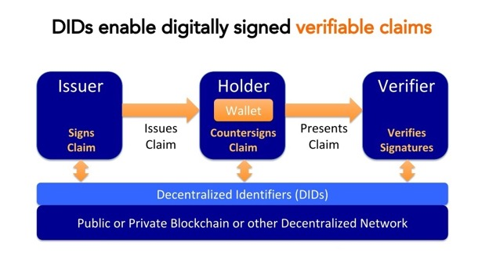



Self-Sovereign Identity (SSI)
Regulation
Key facts
Self-sovereign identity (SSI) is a Decentralised Identity (DID) system for organizations, people, things.
SSI allows individual or business to control their digital accounts and personal data.
Individuals with self-sovereign identity can store their data to their devices and provide it for verification and transactions without the need to rely upon a central repository of data.
SSI can be seen as a fundamental building block for data spaces.
Gaia-X architecture is built on the wide use of SSI.
Frameworks and standardization
Generic building blocks
SSI
Ecosystems
Domain specific
Data
Platforms and solutions
👉 https://trustoverip.org/
👉 https://idunion.org/
👉 https://findy.fi/
Domain A
Domain B
Domain C
Domain D
‹#›

Slide 35
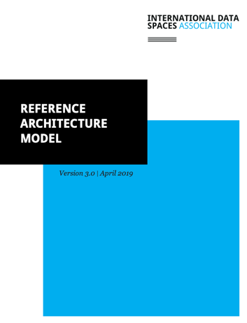
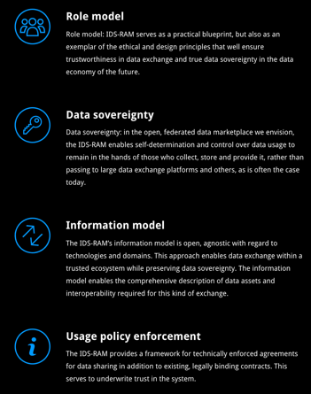
IDS Reference Architecture Model
Regulation
Key facts
IDS Reference Architecture Model (IDS RAM 3.0) a blueprint for the European Data Spaces
The IDS-RAM offers organizations all over the world the power to develop and utilize vendor-independent data ecosystems and marketplaces, open to all, at low cost and with low entry barriers. And all these systems can connect with one another across industries and technologies via IDS.
Frameworks and standardization
There are several efforts for IDS-based standardization – e.g. on European level at CEN and international level at ISO – and IDS use in public tenders. IDSA has a certification process for solutions that fulfill the IDS RAM requirements.
Generic building blocks
Data connectors, identity and access management, data usage control.
Ecosystems
Domain specific
Data
Platforms and solutions
👉https://internationaldataspaces.org/use/reference-architecture/
Domain A
Domain B
Domain C
Domain D
‹#›

Slide 36
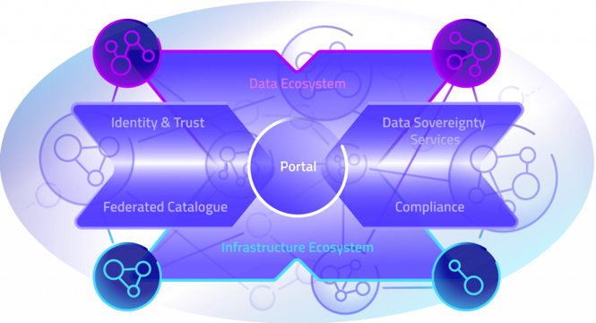
Gaia-X Federation Services
Regulation
Key facts
The Gaia-X Federation Services represent the minimum technical requirements and services necessary to operate the federated Gaia-X ecosystem of infrastructure and data.
Frameworks and standardization
Generic building blocks
SSI based identity management, verifiable credentials, data contract services, service catalogue
Ecosystems
Identity and Trust covers authentication and authorization, credential management and decentral identity management.
Federated Catalogue constitutes the central repository for Gaia-X Self-Descriptions to enable the discovery and selection of Providers and their Service Offerings.
Data Sovereignty Services enable the trustful and sovereign data exchange of Gaia-X Participants utilizing mechanisms such as Usage Control.
Compliance ensures a Participant’s adherence to Gaia-X principles in cybersecurity, data protection transparency and interoperability during onboarding and the delivery of Services.
Domain specific
Data
Platforms and solutions
👉 https://www.gxfs.de/
Domain A
Domain B
Domain C
Domain D
‹#›

Slide 37

FIWARE for Data Spaces
Regulation
Key facts
Smart applications from multiple domains can participate in the creation of Data Spaces based on FIWARE software Building Blocks. Smart applications participating in such Data Spaces share Digital Twin data in real-time using a common standard API like NGSI-LD and relying on standard data models. Each smart solution contributes to build a complete Digital Twin data representation of the real world sharing their data. At the same time, they can exploit data shared by other applications. Relying on FIWARE Data Marketplace components, smart applications can publish data under concrete terms and conditions which include pricing or data usage/access policies.
A federated cloud infrastructure and mechanisms supporting data sovereignty and trust are necessary to create Data Spaces. However, additional elements have to be added to ease the creation of data value chains and the materialization of a data economy. Standard APIs, combined with standard data models, are crucial to support effective data exchange enabling loose coupling between parties as well as reusability and replaceability of data resources and applications. Similarly, Data Spaces need to incorporate mechanisms for publication, discovery and trading of data resources. These are elements that FIWARE implements and can be combined with architecture elements like the IDS Connector proposed by IDSA or iSHARE Satellite technology to create Data Spaces supporting trusted and effective data sharing.
The alignment of FIWARE Building Blocks for Data Spaces with Connecting Europe Facility Building Blocks is essential when considering creation of Data Spaces in Europe. FIWARE mature technologies, integrated with IDS Connector technologies can contribute to accelerate materialization of GAIA-X, a project started in 2020 aimed at creating a federated form of data infrastructure in Europe that strengthens the ability to both access and share data securely and confidently.
Frameworks and standardization
Generic building blocks
The alignment of FIWARE Building Blocks for Data Spaces with Connecting Europe Facility Building Blocks for creation of Data Spaces in Europe.
Ecosystems
Domain specific
Data
Platforms and solutions
👉 https://www.fiware.org/marketing-material/fiware-for-data-spaces/
Health
Agriculture
Green deal
Manufacturing
Mobility
Smart Communities
‹#›

Slide 38
FIWARE for Digital Twins
Regulation
Key facts
This paper describes how smart applications from multiple domains can participate in the creation of smart solutions based on the Digital Twin paradigm using FIWARE software building blocks. Central in the vision, the NGSI-LD API is proposed as an open standard API for getting access to digital twin data and use of standard data models is promoted to ensure portability and replicability of solutions. Smart solutions powered by FIWARE are architected around management of a digital twin data representation of the real world sharing their data.
Frameworks and standardization
Generic building blocks
Ecosystems
Domain specific
Data
Platforms and solutions
👉 https://www.fiware.org/marketing-material/fiware-for-digital-twins/
Green deal
Health
Agriculture
Cultural Heritage
Manufacturing
Mobility
Skills
‹#›

Slide 39
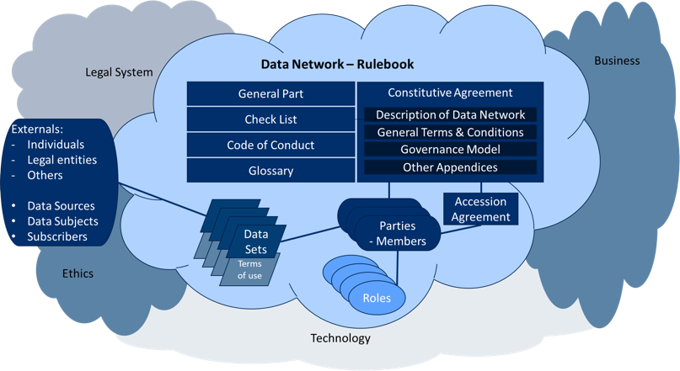

Fair Data Economy Rulebook
Regulation
Key facts
Designed to guide forming of trust-based data sharing networks with a common mission, vision and values.
Diverse workgroup of 30+ volunteers as authors – Sitra (initiator), industry, academia, authorities.
Rulebook template includes: checklists that cover business, technology, data, legal and ethical dimensions, data ecosystem design tools, contractual framework.
Recommended to be used as a template for IDS use cases in IDSA Rule Book 1.0.
Frameworks and standardization
Fair Data Economy Rulebook model has been referred to in IDSA Rulebook as an option to define and agree on rules for the IDS-compliant data space instances.
Generic building blocks
Generic model for governing data space instances. The template is domain independent and can be used by any data ecosystem.
Ecosystems
Domain specific
Data
Platforms and solutions
👉 https://www.sitra.fi/en/publications/rulebook-for-a-fair-data-economy/
Domain A
Domain B
Domain C
Domain D
‹#›

Slide 40
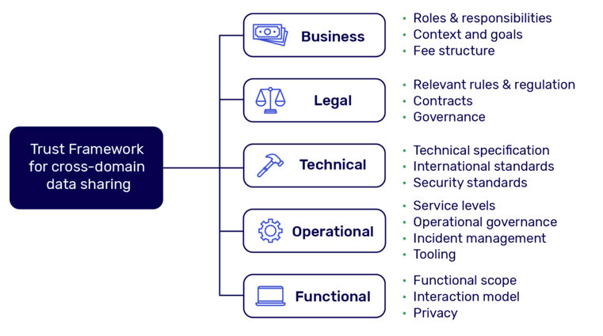

Data Sharing Canvas
Regulation
Key facts
Data Sharing Canvas is a generic toolset that helps in defining harmonised agreements for data sharing at scale
Can be applied for any type of data space instance.
Initiated by the Data Sharing Coalition based in The Netherlands.
Frameworks and standardization
Generic building blocks
Toolkit to specify the functioning for a data ecosystem from business, legal, technical, operational and functional viewpoint.
Ecosystems
Domain specific
Data
Platforms and solutions
👉 https://datasharingcoalition.eu/app/uploads/2021/04/data-sharing-canvas-30-04-2021.pdf
Domain A
Domain B
Domain C
Domain D

Slide 41
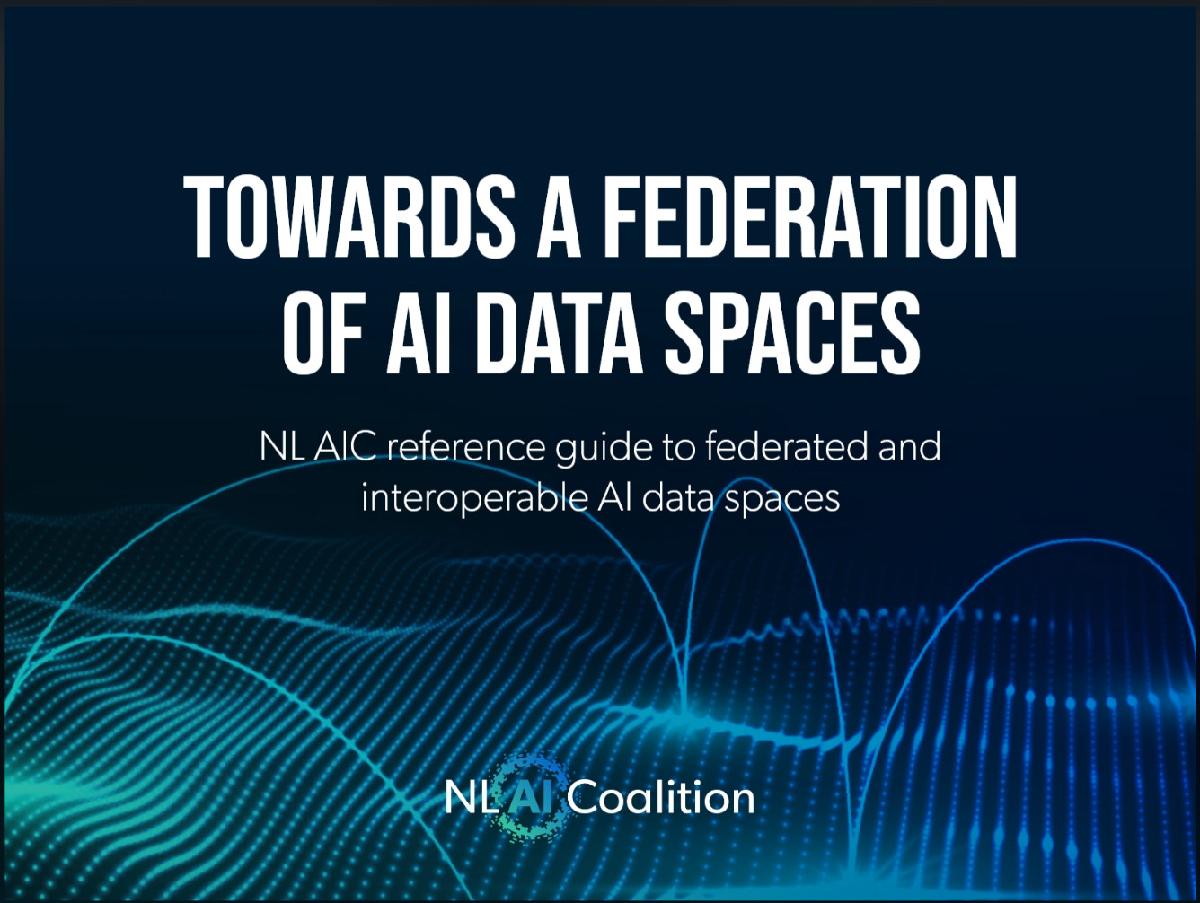
Dutch AI Coalition - AI Data Spaces
Regulation
Key facts
Dutch AI Coalition (NL AIC) presents guide for interoperable data sharing for AI applications
NL AIC has the ambition to put the Netherlands in a vanguard position in terms of knowledge and application of Artificial Intelligence (AI) for prosperity and well-being.
To achieve this goal, it is crucial to make data available on a large scale, so that AI algorithms can be better fed with correct information.
NL AIC Data Sharing Working Group has set the goal of creating reliable and interoperable AI data spaces.
The NL AIC’s goal is to co-create and build ten AI data spaces in The Netherlands based on the guidelines in this document for various sectors
Frameworks and standardization
Reference for developing interoperable AI data spaces, providing a rich set of features to support the challenges and requirements of AI, and prescriptive guidelines for ensuring trust and interoperability between such individual AI data spaces.
Generic building blocks
Building blocks for interoperability and trust.
Ecosystems
Domain specific
Data
👉 https://nlaic.com/wp-content/uploads/2021/11/NL_AIC_Towards_a_federation_of_AI_data_spaces.pdf
Platforms and solutions
Domain A
Domain B
Domain C
Domain D

Slide 42
Data Sharing Canvas
Regulation
Key facts
The Data Sharing Canvas is the foundation for generic and harmonised agreements which, once implemented, enable data sharing at scale within and across domains and sectors. This has been created together with the 40+ Data Sharing Coalition participants from different domains that represent over 100.000 organisations
Frameworks and standardization
Generic building blocks
Ecosystems
Domain specific
Data
👉 https://datasharingcoalition.eu/app/uploads/2021/04/data-sharing-canvas-30-04-2021.pdf
Platforms and solutions
Domain A
Domain B
Domain C
Domain D
‹#›

Slide 43
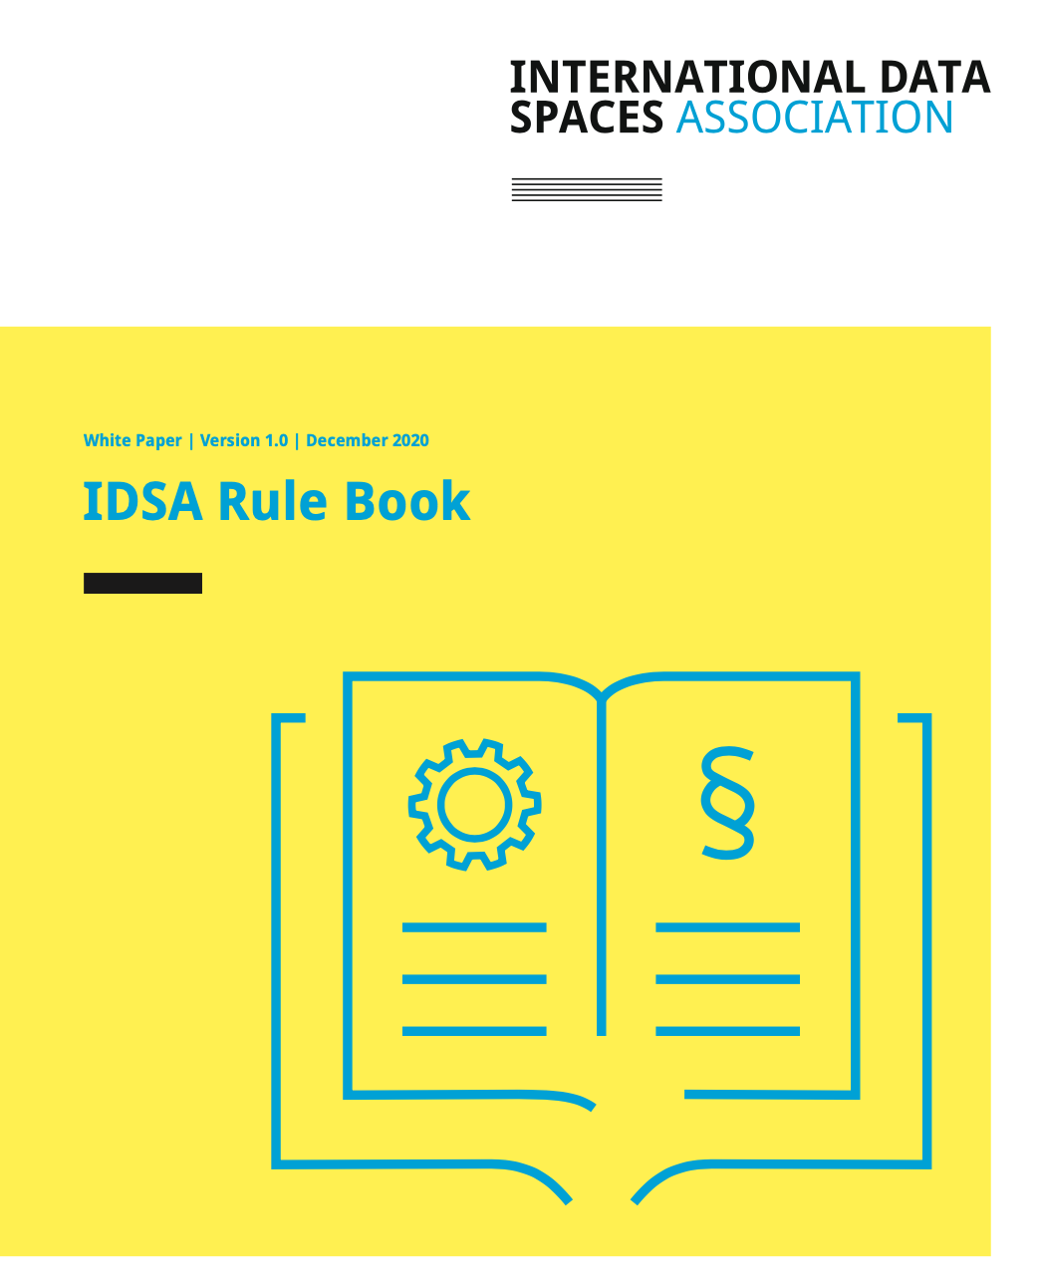
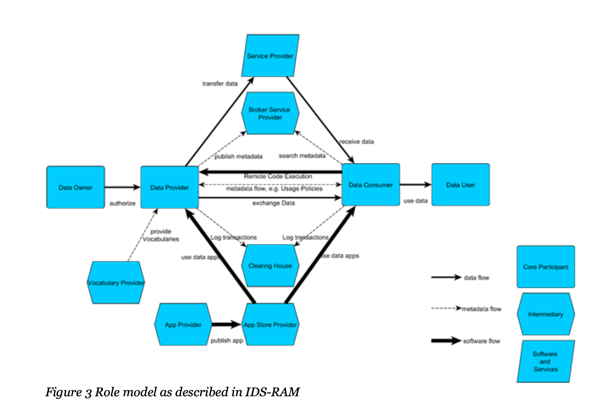
IDSA Rule Book
Regulation
Key facts
The IDSA Rulebook outlines the common governance framework that specifies the functional, technical, operational and legal agreements that structure stakeholders roles and interactions within and across the various parts of a data ecosystem.
Frameworks and standardization
Generic building blocks
Ecosystems
Domain specific
Data
👉 https://internationaldataspaces.org/wp-content/uploads/dlm_uploads/IDSA-White-Paper-IDSA-Rule-Book.pdf
Platforms and solutions
Domain A
Domain B
Domain C
Domain D
‹#›

Slide 44

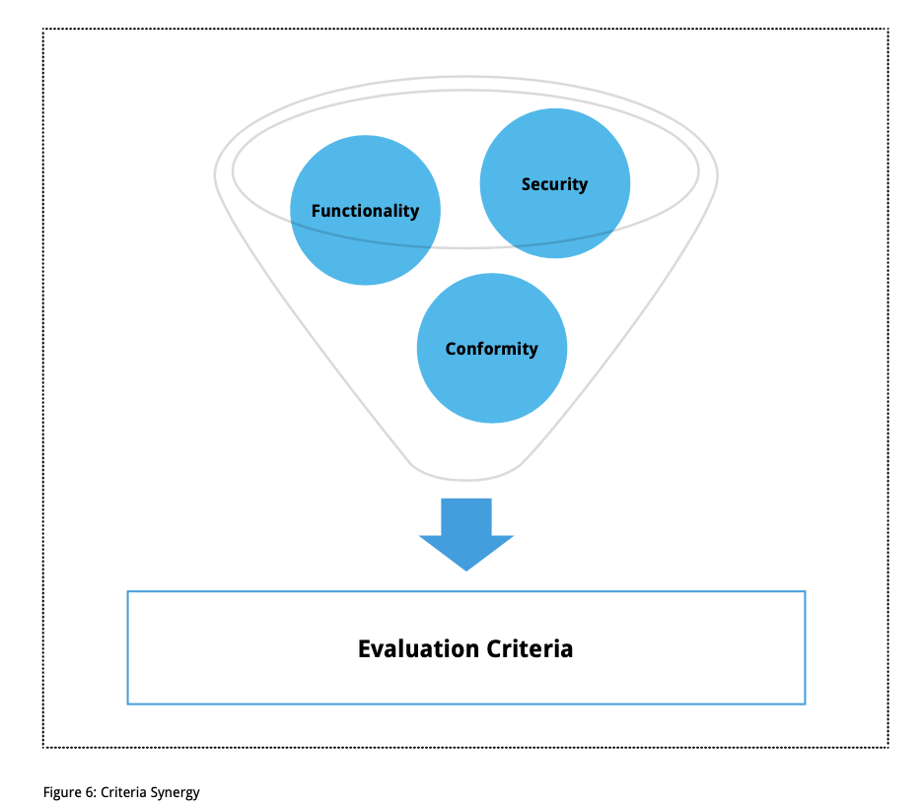
Framework for the IDS Certification Scheme
Regulation
Key facts
The International Data Spaces certification scheme encompasses all processes, rules and standards governing the certification of participants and core components within the International Data Spaces Association.
Frameworks and standardization
Generic building blocks
Ecosystems
Domain specific
Data
👉 https://internationaldataspaces.org/wp-content/uploads/dlm_uploads/IDSA-White-Paper-certification-scheme-V.2.pdf
Platforms and solutions
Domain A
Domain B
Domain C
Domain D
‹#›

Slide 45
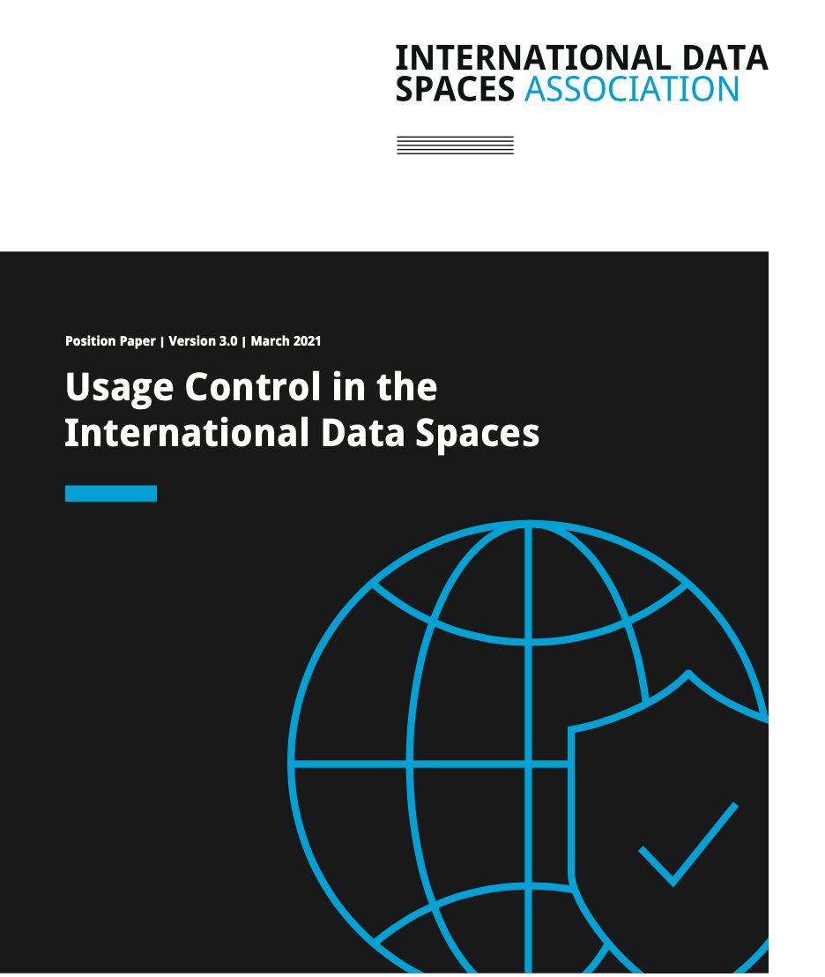
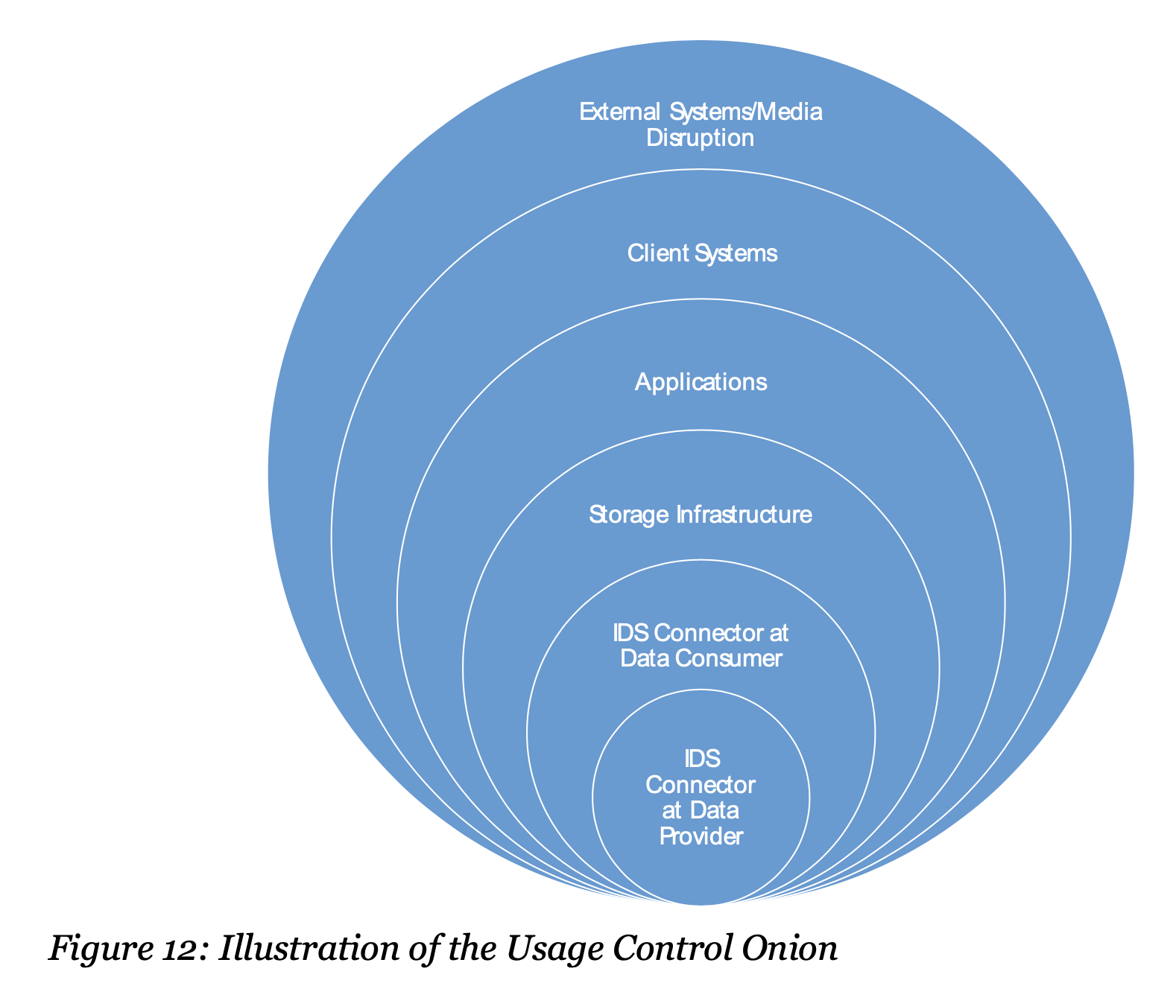
Usage Control in the International Data Spaces
Regulation
Key facts
The position paper presents the implementation of data usage control in the International Data Spaces (IDS) context.
Frameworks and standardization
Generic building blocks
Ecosystems
Domain specific
Data
👉 https://internationaldataspaces.org/wp-content/uploads/dlm_uploads/IDSA-Position-Paper-Usage-Control-in-the-IDS-V3..pdf
Platforms and solutions
Domain A
Domain B
Domain C
Domain D
‹#›

Slide 46
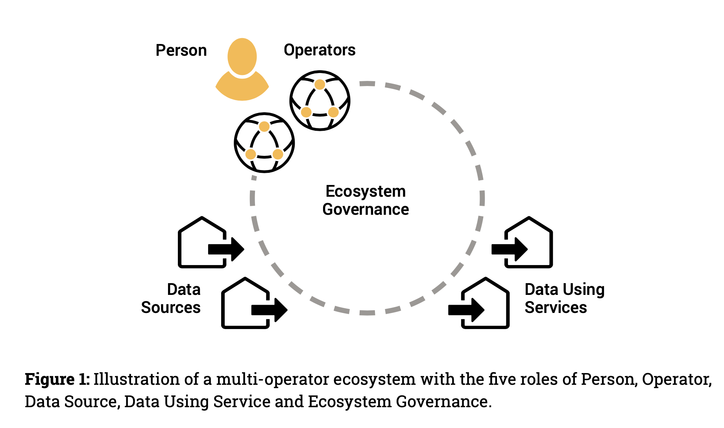
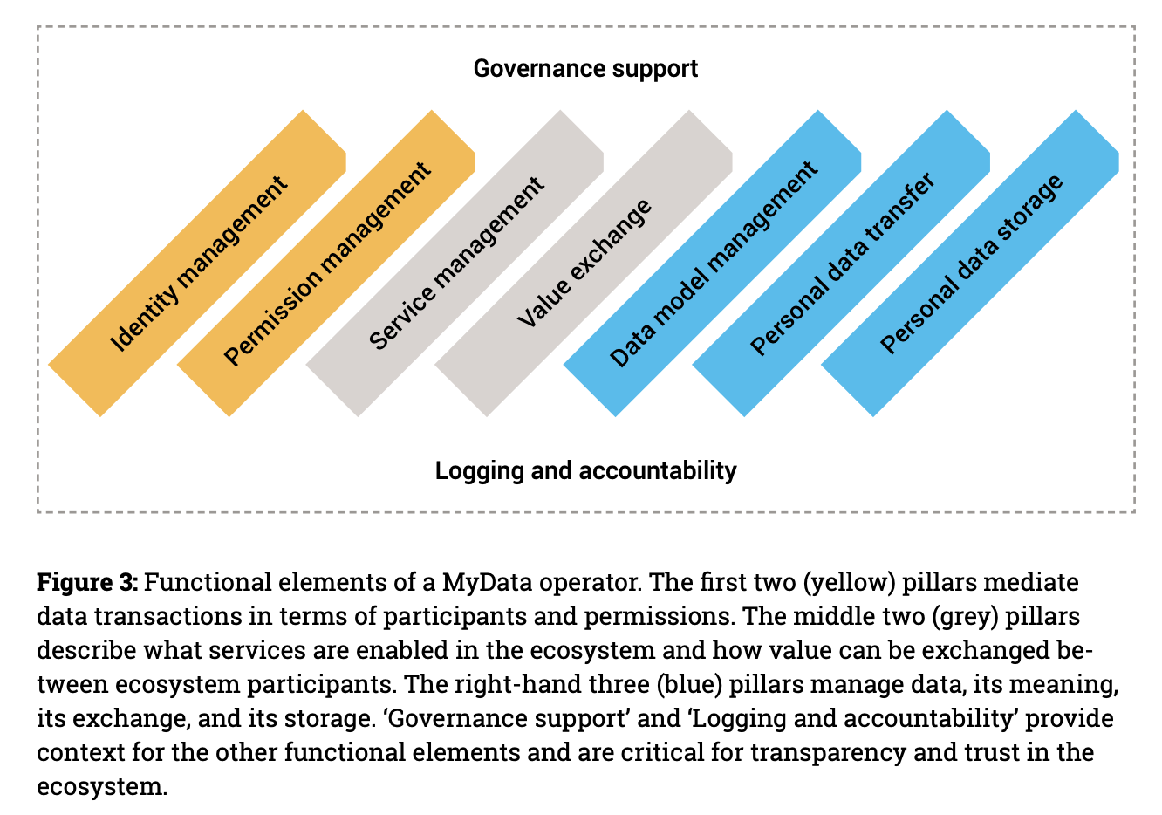
Understanding MyData Operator
Regulation
Key facts
MyData Operators are human-centric data intermediaries (see. Data Governance Act) that can provide infrastructure for data spaces and for interoperability between data spaces.
The paper describes the MyData operator reference model, which provides a structure within which to analyse operators’ offerings and characterise their functional elements. The reference model creates a baseline for expectations for an operator from individuals, other operators, and other actors in the ecosystem.
Frameworks and standardization
Generic building blocks
Ecosystems
Domain specific
Data
Platforms and solutions
👉 https://mydata.org/mydata-operators/
Domain A
Domain B
Domain C
Domain D
‹#›

Slide 47

Data Ecosystems-Conceptual Foundations, Constituents and Recommendations for Action
Regulation
Key facts
Report on the fundamentals of data ecosystems and data spaces.
Frameworks and standardization
Generic building blocks
Ecosystems
Domain specific
Data
Platforms and solutions
👉 https://www.isst.fraunhofer.de/en/news/publications.html
Domain A
Domain B
Domain C
Domain D
‹#›

Slide 48
Study on technological and economic analysis of industry agreements in current and future digital value chains
Regulation
Key facts
This final report presents the main outcomes of a study on the technological, legal and economic analysis of industry agreements (IAs) in current and future digital value chains. It summarises the study's findings with emphasis placed on the analysis of IAs in future digital value chains and related recommendations for industry and policy-makers in Europe. The study identifies three clustered innovation areas in which IA development could generate interesting opportunities and have a high economic impact: 1) Data sharing/exchange; 2) Plug & Play/interoperability; and 3) Advanced data analytics and Artificial Intelligence. An in-depth analysis is performed, of barriers that prevent the development and uptake of IAs, as well as of opportunities, for industry to take action, and for policy-makers to support initiatives to unlock the potential in each innovation area. Three "industry agreement templates", with high-level specifications from a legal and technical point of view, provide a flexible framework that can be adapted to fit the needs of individual sectors. Finally, the study presents four cross-cutting recommendations to help stimulate greater cooperation in the IA development and implementation process and promote the development of common industrial data spaces.
Frameworks and standardization
Generic building blocks
Ecosystems
Domain specific
Data
👉 https://op.europa.eu/en/publication-detail/-/publication/8c021023-53ee-11ec-91ac-01aa75ed71a1/language-en
Platforms and solutions
Agriculture
Manufacturing
‹#›

Slide 49
Data Spaces as Commons

Slide 50
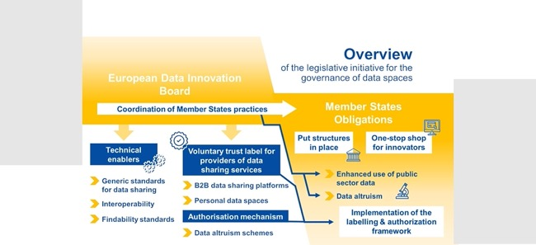
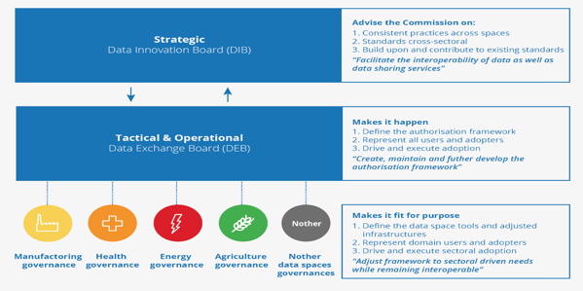
European Data Innovation Board &
Data Innovation Advisory Council
Regulation
Planned to be initiated s part of the DGA, the role of these bodies is primarily to oversee that the regulation is implemented as intended and giving guidance also to national authorities regarding interpretation of the data related regulation.
Key facts
Data Governance Act (DGA) aims to establish the European Data Innovation Board to oversee implementation of data regulation.
EU Parliament has proposed establishment of the Data Innovation Advisory Council (DIAC), as a subgroup of the board.
The proposal to establish DIAC was inspired by the Data Exchange Board proposal by the Data Sovereignty Now! Initiative, and presented in the OPEN DEI White Paper as below.
Frameworks and standardization
Board will work towards increasing interoperability and creating common standards to avoid the fragmentation of the internal market, as well as fostering the creation of Common European Data Spaces.
Generic building blocks
Ecosystems
Domain specific
Data
Platforms and solutions
Domain A
Domain B
Domain C
Domain D
‹#›

Slide 51



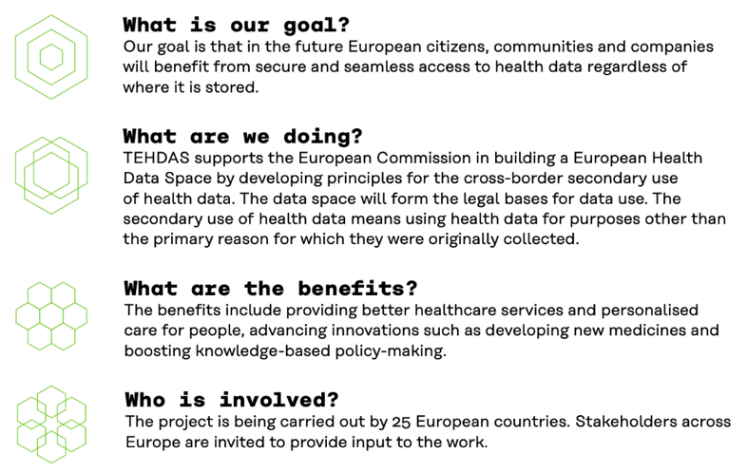
TEHDAS - European Health Data Space
Regulation
Project has a strong focus on existing and future regulation, and especially the secondary use of health data.
Coordination by
Frameworks and standardization
The project is defining the domain-specific needs for data spaces from the viewpoint of health sector.
Generic building blocks
Ecosystems
Domain specific
Data
Platforms and solutions
https://www.sitra.fi/en/projects/joint-action-towards-the-european-health-data-space-tehdas/
Health
”In order to make informed decisions on preventive and protective measures, we need high-quality, timely and interoperable health data.” Jyrki Katainen, the President of Sitra
‹#›

Slide 52

Mobility Data Space
Regulation
Key facts
Originally German initiative funded by acatech and BMWi
Broad participation from public and private sector
Different forms of mobility involved
Aims to be a role model for European Mobility Data Space
The Mobility Data Space is the data sharing community for everyone who is looking to build the future of mobility. It aims to facilitate competition around innovative, environmentally sustainable, and user-friendly mobility concepts by giving all users equal and transparent access to relevant data.
Frameworks and standardization
Generic building blocks
Ecosystems
Domain specific
Data
Participants: Municipalities, Deutscher Wetterdienst, Deutsche Telekom, Fraunhofer, HERE, Door2Door, Schenker, DHL, GDV, Deutsche Bahn, Bosch, Continental, BMW, Volkswagen, Daimler, ZF, Kühne + Nagel, etc.
Platforms and solutions
👉 https://mobility-dataspace.eu/
Mobility
”Mobility Data Space is a unique demonstration of how IDS-compliant data sharing across varied markets and sectors can translate into real value for customers.” Lars Nagel, CEO, IDSA
‹#›

Slide 53
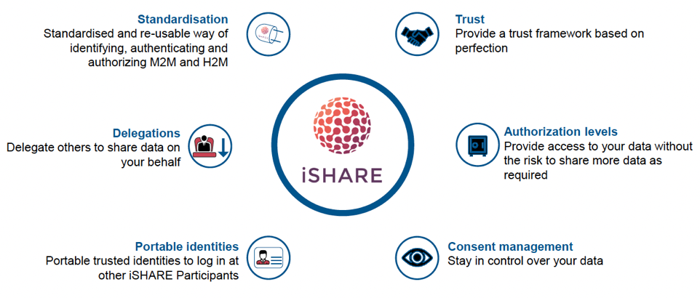
iSHARE
Regulation
Key facts
Initially logistics-focused initiative originating from the Netherlands.
iSHARE is a coherent model (”Trust Scheme”) of functional, technical and legal agreements and standards that are used within the Dutch transport and logistics sector to exchange data.
The core of the model consists of agreements and standards focusing on identification, authentication and authorization, which are intended to standardize and thus to significantly facilitate the exchange of data between organizations.
Compliance of the model is ensured and its continuous development achieved by the independent iSHARE Foundation that was specifically established for this purpose.
Frameworks and standardization
iSHARE is an example of a more general Dutch concept ”afsprakenstelsel” or ”trust scheme”. iSHARE also provides well-designed governance model to safeguard supervision and quality of data exchange.
Generic building blocks
iSHARE was originally separate from
IDS. but is currently positioned to be
compliant with IDS reference model.
Ecosystems
Domain specific
Data
Platforms and solutions
👉 https://www.ishareworks.org/
Logistics
Domain B
Domain C
Domain D
”iSHARE scheme includes Functional, Technical, Legal, and Operational agreements, co-created by the sector itself. Because all parties adhere to the same agreements, signing a contract with the iSHARE Foundation, iSHARE significantly lowers barriers to new data sharing relationships.” Mariane ter Veen, Innopay
‹#›

Slide 54
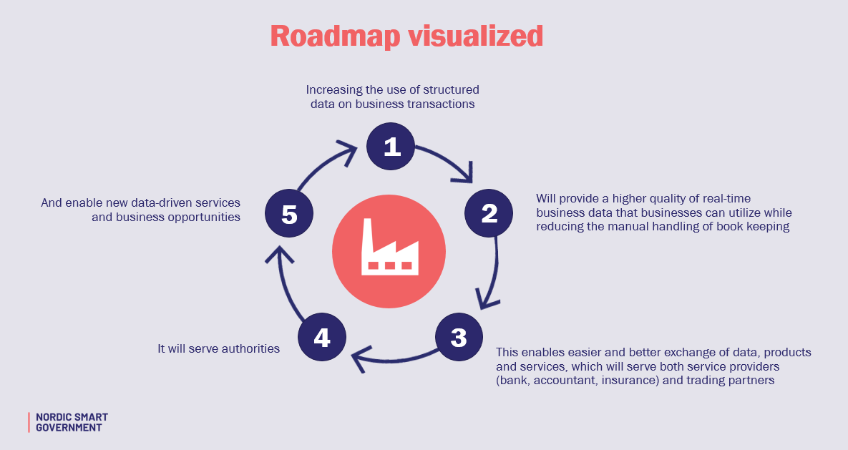
Nordic Smart Government
Regulation
Countries may need legal amendments towards the vision of NSG. E.g. increase digital business document adoption, because of a lack of other incentives.
Key facts
Nordic Smart Government is a collaboration between a number of Nordic organisations, and many more organisations, public and private, are expected to join.
Real-time economy
Create value for the SMEs by making real time business data accessible and usable for innovation and growth across the region, in an automatic, consent based and secure manner
Frameworks and standardization
Strong support for standardized solutions.
Generic building blocks
Emphasizes that the development of solution building blocks must be coordinated.
Ecosystems
Domain specific
Data
Platforms and solutions
👉https://nordicsmartgovernment.org/
Public sector
Domain B
Domain C
Domain D
‹#›

Slide 55

Data Sharing Coalition
Regulation
Key facts
Data Sharing Coalition is a collaborative initiative that aims to unlock this value by enabling organisations to share data across domains and sectors easily.
The Data Sharing Coalition builds on existing data sharing initiatives to enable data sharing across domains. By enabling multilateral interoperability between existing and future data sharing initiatives with data sovereignty as a core principle, parties from different sectors and domains can easily share data with each other, unlocking significant economic and societal value.
Practical steps towards generic agreements have been made with the release of the Data Sharing Canvas that explores the outlines of these agreements.
Membership includes 48 (Dutch) organisations which represent over a 100.000 businesses.
Frameworks and standardization
Framework for cross-sectoral data sharing based on use cases to prove the value of data sharing.
Generic building blocks
Ecosystems
Domain specific
Data
Platforms and solutions
👉 https://datasharingcoalition.eu/
Domain A
Domain B
Domain C
Domain D

Slide 56
Real-time Linked Dataspaces
Regulation
Key facts
Open Access Book authored by Edward Curry (Vice President of the Big Data Value Association)
The Real-time Linked Dataspace (RLD) is an enabling platform for data management for intelligent systems within smart environments that combines the pay-as-you-go paradigm of dataspaces, linked data, and knowledge graphs with entity-centric real-time query capabilities.
The RLD contains all the relevant information within a data ecosystem including things, sensors, and data sources and has the responsibility for managing the relationships among these participants.
It manages sources without presuming a pre-existing semantic integration among them using specialised dataspace support services for loose administrative proximity and semantic integration for event and stream systems. Support services leverage approximate and best-effort techniques and operate under a 5 star model for “pay-as-you-go” incremental data management.
Frameworks and standardization
Generic building blocks
Ecosystems
Domain specific
Data
Platforms and solutions
👉 http://dataspaces.info/
Domain A
Domain B
Domain C
Domain D
‹#›

Slide 57
Data Spaces as Ecosystems

Slide 58
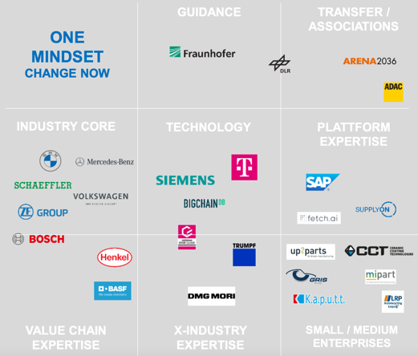
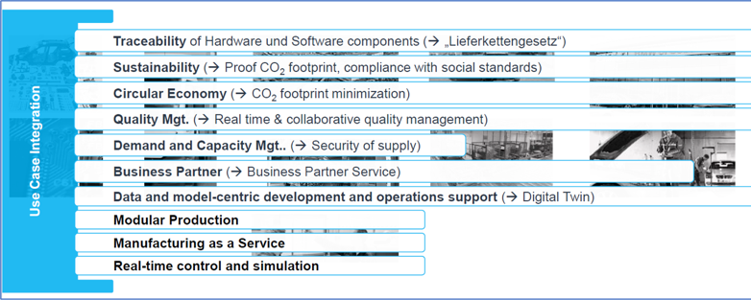
Catena-X
Regulation
Key facts
Catena-X is positioned to be the leading data space initiative for the automotive sector.
Establishment & use of the first “data driven value chain” for the automotive industry 🡪 from intra- to inter-company.
Goal: A uniform standard for continuous data exchange along the entire automotive value chain
Breakthrough target: 1000 Catena-X member organizations in 2022
Frameworks and standardization
Generic building blocks
Use cases
Ecosystems
Domain specific
Data
Platforms and solutions
👉https://catena-x.net/en/
Mobility
Manufacturing
Green Deal
“With Catena-X, the automotive industry is taking another big step in its digital transformation. The aim is to achieve secure data transfer between companies to enhance efficiency, transparency and sustainability along the entire value chain. The integration of SMEs also strengthens innovative power and digitalization of our industry. Together we have the chance to take a leading position in technology and innovation for Germany and Europe. And that’s exactly what we do now.”
Ola Källenius - Chairman of the Board of Management of Daimler AG and Mercedes-Benz AG
‹#›

Slide 59

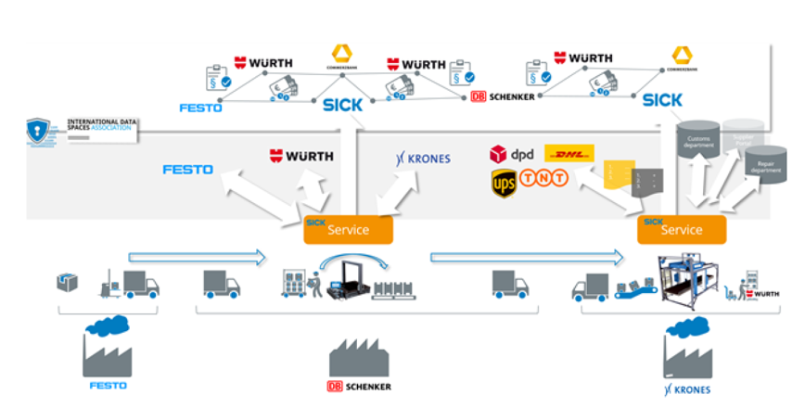
SICK - Logistics Chain Collaboration
Regulation
Key facts
Packing and logistics system that automatically keeps track all the materials moved by in the entire supply chain.
Material flows and intralogistics processes must be optimally coordinated with each other at all times.
Each shipped items location and current status is tracked and shared with the concerned participants of the supply chain.
Fully transparent supply line.
Frameworks and standardization
SICK is one of the founding members
of IDSA and has strongly promoted the
data space approach for supply chain logistics.
Generic building blocks
Ecosystems
Domain specific
Data
Platforms and solutions
👉https://www.sick.com/se/en/logistics-gets-smart-greater-efficiency-in-the-entire-supply-chain-/w/smart-logistics/
Logistics
Manufacturing
‹#›

Slide 60
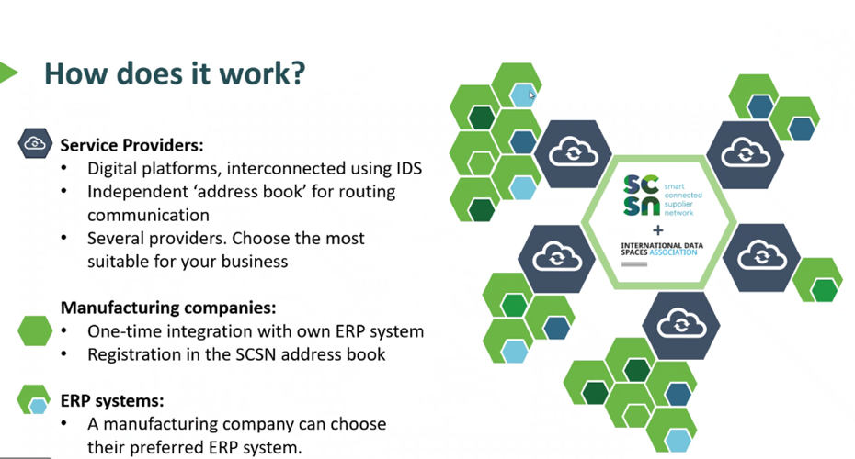
Smart Connected Supplier Network (SCSN)
Regulation
Key facts
Manufacturing companies joining forces in managing complex multi-tiered supply chains.
SCSN is a communication standard enabling the machine building industry to share data across company borders in an easier, safer, and more reliable way
Connect once, communicate with the entire supply chain.
SCSN works for the OEM, 1st, 2nd and 3rd suppliers, wholesalers and steel producers and works with most available ERP software.
Manufacturing companies in control over their own data all the time.
Frameworks and standardization
Generic building blocks
Ecosystems
Domain specific
Data
Platforms and solutions
👉 https://smart-connected.nl/
Manufacturing
”Smart Connected Supplier Network increases productivity in the supply chain. The SCSN is one of the most promising use cases based on IDS components..” -- Matthijs Punter, TNO
‹#›

Slide 61







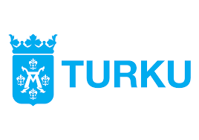


MyData for Cities
Regulation
MyData for Cities Model
Example use cases
Global model for personal data management for cities and their service ecosystems
MyData Operator functionalities: consent management, personal data wallet, secure data connectors, …
MyData for Cities Rulebook
MIM4 Open and Agile Smart Cities (OASC) specification
IDS connectivity planned
Driving permission authorization
Automated benefits
CO2-based reduced parking fees
Employment services
Asset check for city-owned rental apartments
Multi-modal mobility services across cities (MaaS roaming)
Frameworks and standardization
Generic building blocks
Ecosystems
Domain specific
Data
Platforms and solutions
Domain B
Domain D
CIties
Domain C
”Almost all data sharing use cases can be traced back to individuals, and so personal data may be involved.” Mika Huhtamäki, Vastuu Group
‹#›

Slide 62
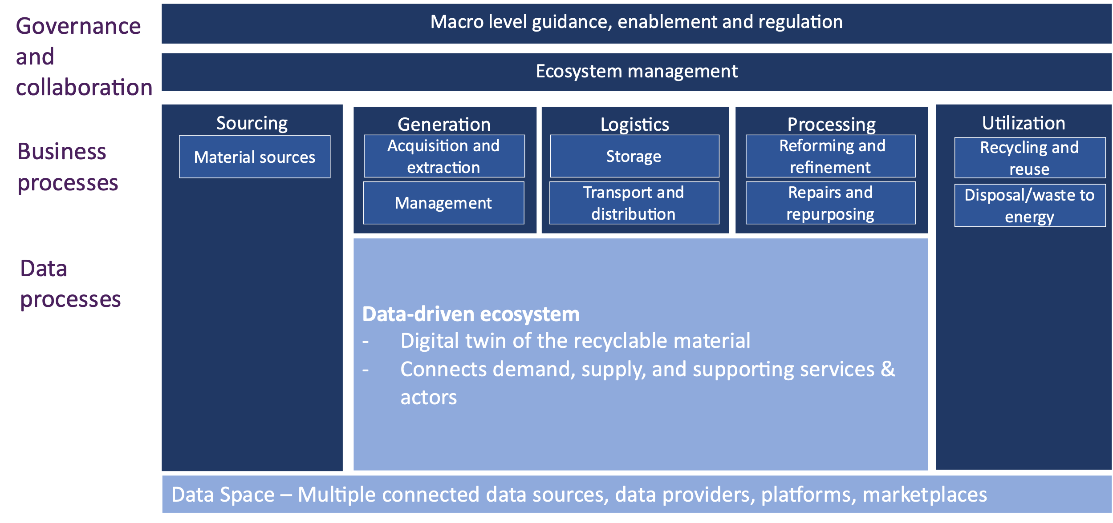



Circular Economy Data Space and Ecosystem
Regulation
Key facts
Circular ecosystem for construction and demolition sector
Improves utilization rate of recyclable materials
Improves collaboration and value creation within circular ecosystem
Enables value creation also for other platforms and market places
Frameworks and standardization
Generic building blocks
Ecosystems
Domain specific
Data
Platforms and solutions
Construction and
waste management
industries
Transport
Construction
Cities
‹#›

Slide 63
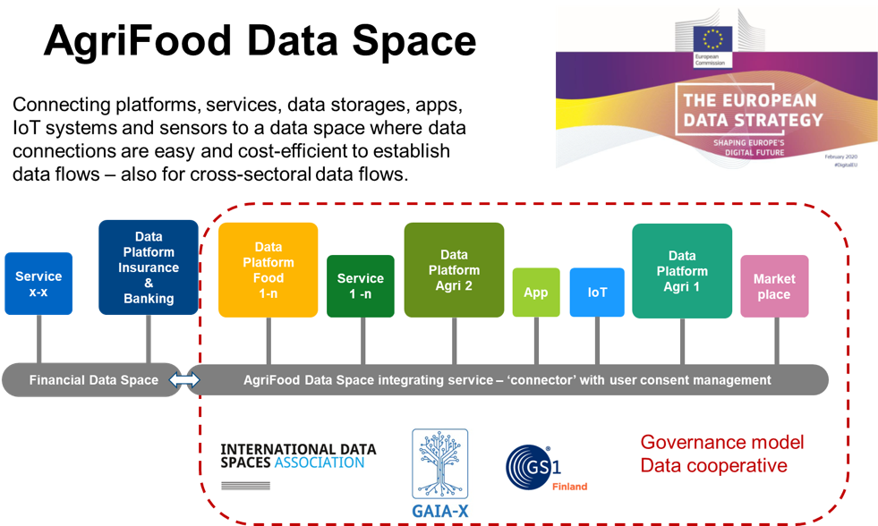
AgriFood Data Space Finland
Regulation
Key facts
Finnish initiative covering broadly the AgriFood sector
Example use case in Gaia-X Agriculture domain working group
Connected to possible agriculture growth engine (BF)
Core actors: Luke, Cinia, GS1, MTK, Pellervo, 1001 Lakes, …
Frameworks and standardization
Generic building blocks
Ecosystems
Domain specific
Data
Platforms and solutions
Agriculture
Retail
Logistics
Green Deal
‹#›

Slide 64
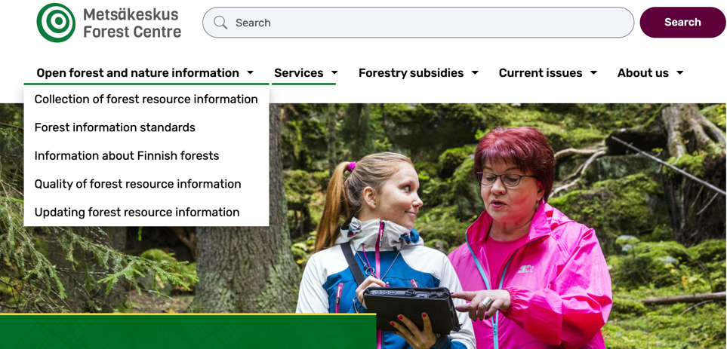
Metsään.fi
Regulation
Key facts
Forestry market data sharing allows for better estimation of value of assets for public sector, market makers and forest owners,
The use case of shared forestry market data arised from the needs of forest owners, and was brought to life by a small real estate broker SME specializing in forest ownership.
Frameworks and standardization
Generic building blocks
Ecosystems
Domain specific
Data
Platforms and solutions
👉 https://metsään.fi/
Agriculture
Green Deal
”Data space innovations may arise from surprising sources and most added value can be found from unexpected combinations.” -- Jyrki Suokas, Taival Advisory
‹#›

Slide 65
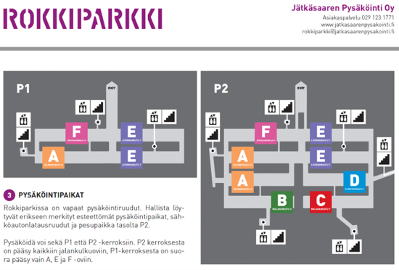

Rokkiparkki
Regulation
Key facts
Rokkiparkki is a non-profit parking garage in Jätkäsaari, Helsinki. Rokkiparkki has invested in electric car charging services. Rokkiparkki needed a service that meets the demand for faster charging by residents and fits into parking operator’s cost model, where residents themselves pay the costs of charging their cars based on the actual cost of electricity.
Virta is a company specialised in cloud-connected high-capacity electric charging service provider.
The participants have aimed at conditioned and consented data sharing of residents' electric charging data between the electricity company, residents' associations, car manufacturers, electric car rental companies, Virta and parking operator in accordance with the MyData principles.
Frameworks and standardization
Generic building blocks
Ecosystems
Domain specific
Data
Platforms and solutions
👉 https://rokkiparkki.fi/
Transport
Construction
Cities
Energy
”By providing a more dynamic and interoperable physical and soft infrastructure, we can create more and better services in the local ecosystem.” -- Pekka Koponen, Forum Virium Helsinki
‹#›

Slide 66
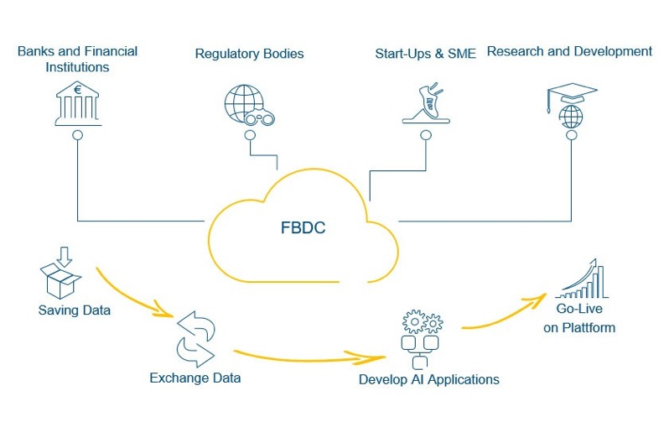






Financial Big Data Cluster
Regulation
Key facts
Enable sovereign data exchange to better data & analytics for thefinancial sector
Sustainability risk analysis (ESG, i.e. Environmental, Social, Governance)
Market integrity
Monetary policy decision optimization
Anti-money laundering (AML)
Frameworks and standardization
Generic building blocks
Ecosystems
Domain specific
Data
Platforms and solutions
Finance
‹#›

Slide 67

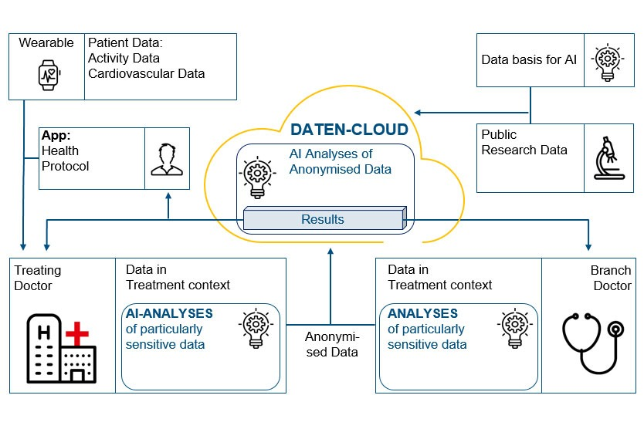
Smart Health Connect
Regulation
Key facts
Continuously monitored patient conditions using wearables
Collect sufficient data in a GDPR compliant, privacy preserving way to develop AI
Predict and detect critical situations
Integrative analysis data of wearables and clinical institutes
Frameworks and standardization
Generic building blocks
Ecosystems
Domain specific
Data
Platforms and solutions
Transport
Construction
Cities
Others
‹#›

Slide 68
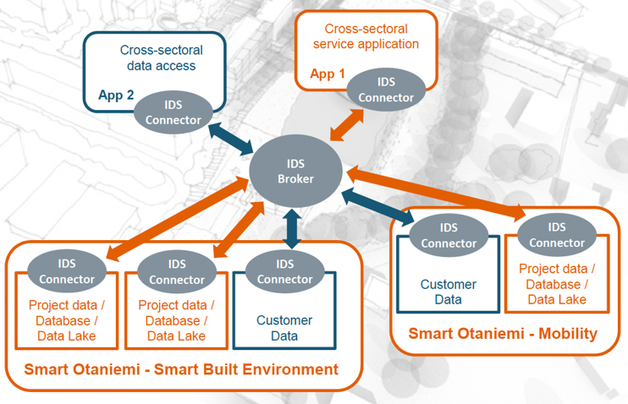
Smart Otaniemi
Regulation
Key facts
Smart Otaniemi is an innovation ecosystem in Espoo, Finland that focuses on smart energy to promote sustainability and cost-efficiency that connects experts, organisations, technologies and pilot projects.
Currently, more than 100 organisations (e.g. ABB, Nokia, Fortum, Enerim, Fingrid) are members of the Smart Otaniemi network.
Cross-sectoral VTT Research Data Space focuses on novel applications based on the access to different data silos.
Frameworks and standardization
VTT hosts the IDSA hub in Finland.
Smart Otaniemi provides a large
cross-domain IDS testbed.
Generic building blocks
Ecosystems
Domain specific
Data
Platforms and solutions
👉 https://smartotaniemi.fi/
Transport
Construction
Cities
Energy
‹#›

Slide 69
Data Sharing Coalition - Use case playbook
Regulation
Key facts
Do you want to develop new data sharing use cases to address a certain opportunity or challenge? The Use Case Playbook is a document that provides a step-by-step approach to kickstart your own data sharing use cases.
Frameworks and standardization
Generic building blocks
Ecosystems
Domain specific
Data
👉 https://datasharingcoalition.eu/app/uploads/2021/08/210422-use-case-playbook-v10.pdf
Platforms and solutions
Domain A
Domain B
Domain C
Domain D
‹#›

Slide 70
Data Sharing Coalition - Blueprint
Regulation
Key facts
This Blueprint aims to help you design your data sharing use case so that it is ready for potential future scalability by considering all relevant topics. This document presents a complete overview of the relevant topics to consider in an actionable approach.
Frameworks and standardization
Generic building blocks
Ecosystems
Domain specific
Data
👉 https://datasharingcoalition.eu/app/uploads/2021/06/210520d-blueprint-v10.pdf
Platforms and solutions
Domain A
Domain B
Domain C
Domain D
‹#›

Slide 71
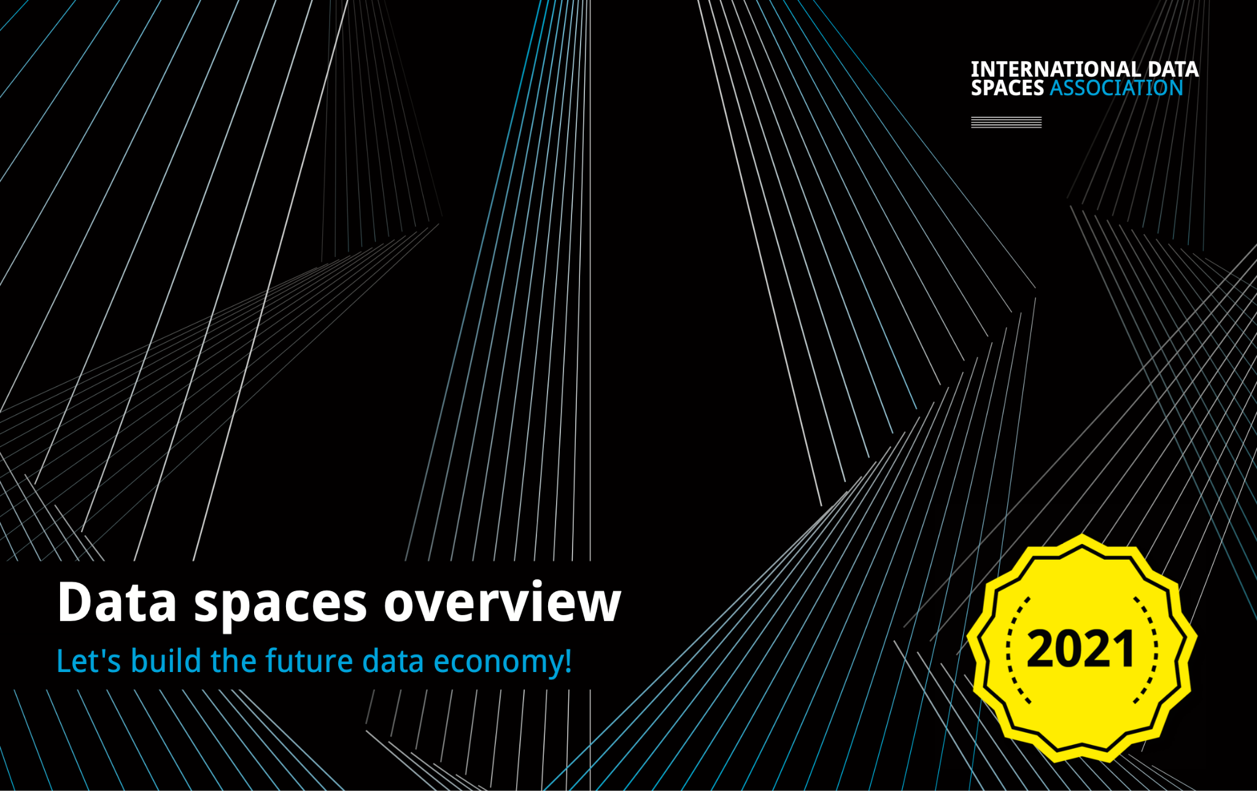

Data Spaces Brochure 2021
Regulation
Key facts
Use cases are cross-company business processes enabled by the International Data Spaces standard. They help identify, analyze, and evaluate user requirements for IDS.
Frameworks and standardization
Generic building blocks
Ecosystems
Domain specific
Data
👉 https://internationaldataspaces.org/wp-content/uploads/dlm_uploads/Use-Case-Bro_2021.pdf
Platforms and solutions
Domain A
Domain B
Domain C
Domain D
‹#›

Slide 72
Big Data Challenges in Smart Manufacturing Industry - A Whitepaper on Digital Europe Big Data Challenges for Smart Manufacturing Industry
Regulation
Key facts
This paper looks into non-technical challenges generated by an extensive and pervasive adoption of Data Technologies in Manufacturing.
Besides exploring policy, business and skills level, the paper also looks a new technological trends that have lead to a new vision of a common EU Industrial Data Spaces.
Frameworks and standardization
Generic building blocks
Ecosystems
Domain specific
Data
👉 https://bdva.eu/sites/default/files/BDVA_SMI_Whitepaper_2020.pdf
Platforms and solutions
Manufacturing
‹#›

Slide 73
Funding Opportunities

Slide 74
Digital Europe Programme
CALL 1:
Preparatory actions for the Green Deal Data Space
Preparatory actions for the Data Space for Smart Communities
Preparatory actions for the Data Space for Mobility
Preparatory actions for the Data Space for Agriculture
Health Data Space- Federated European Infrastructure for Genomics data
Preparatory actions for the Data Space for Manufacturing
Preparatory actions for the Data Space for Skills
Data Spaces Common Support Centre
CALL 2:
Data Space for Cultural Heritage (deployment)
Health Data Space – Federated European infrastructure for Cancer Images data
Data Space for Security and Law Enforcement
Open Data for AI
CALL 3:
Data Space for Mobility (deployment)
Data Space for Media (deployment)
Data Space for Smart Communities (deployment)
Data Space for Manufacturing
Notes:
Green Deal
Smart Communities
Mobility
Agriculture
Health
Manufacturing
Skills
Cultural Heritage
Security and Law Enforcement
Media

Slide 75
Digital Europe Programme (Call 1)
Digital Europe call currently open for submissions (submission deadline 22 Feb 2022):
DIGITAL-2021-CLOUD-AI-01-FEI-DS-GENOMICS Federated European infrastructure for genomics data
DIGITAL-2021-PREPACTS-DS-01-SKILLS Preparatory actions for the data space for skills
DIGITAL-2021-CLOUD-AI-01-PREP-SMART-COMM Preparatory actions for the data space for smart communities
DIGITAL-2021-CLOUD-AI-01-PREP-DS-MANUFACT Preparatory actions for data spaces for manufacturing
DIGITAL-2021-CLOUD-AI-01-PREP-DS-GREEN-DEAL Preparatory actions for the Green Deal Data Space
DIGITAL-2021-CLOUD-AI-01-PREP-DS-MOB Data Space for Mobility
DIGITAL-2021-CLOUD-AI-01-SUPPCENTRE Data Spaces Support Centre
DIGITAL-2021-PREPACTS-DS-01-AGRI Preparatory actions for the data space for Agriculture

Slide 76
Horizon Europe
Horizon Europe call currently open for submissions (submission deadline 5 Apr 2022):
HORIZON-CL4-2022-DATA-01-04 Technologies for data trading/monetizing, interoperability
HORIZON-CL4-2021-DATA-01-01 Extreme analytics/prediction/visualisation/simulation
HORIZON-CL4-2021-DATA-01-05 Extreme data mining

Slide 77
Research papers

Slide 78
Strategic Research, Innovation and Deployment Agenda (SRIDA): AI, Data and Robotics Partnership
Regulation
Key facts
This paper results from the joint work of BDVA, Claire, Ellis, EurAI and euRobotics
The paper enshrines the commitment of the five organisations to working closely together to see this SRIDA implemented by building on the AI, Data and Robotics infrastructure and ecosystem that Europe is creating.
The publication contains the Data Deep Dive, a chapter dedicated to framework, growth, opportunities, innovation ecosystem and technology enablers of the European Data Economy
Frameworks and standardization
Generic building blocks
Ecosystems
Domain specific
Data
👉 https://www.bdva.eu/sites/default/files/AI-Data-Robotics-Partnership-SRIDA%20V3.1.pdf
Platforms and solutions
Manufacturing
Mobility
Media
Agri- culture
Culture Heritage
Green deal
Health
‹#›

Slide 79
Events

Slide 80
European Big Data Value Forum
Regulation
Key facts
The European Big Data Value Forum (EBDVF) is the flagship event of the European Big Data Value and Data-Driven AI Research and Innovation community organised by the BDVA and the European Commission (DG CNECT).
The event started in 2017 and as of 2021 it had 5 editions. Its aim is to address key topics for Europe such as the development of European Data Spaces, the importance of Technology Platforms and Trust, the opportunities for market uptake and the new challenges ahead for Data and AI within the society.
Frameworks and standardization
Generic building blocks
Ecosystems
Domain specific
Data
Platforms and solutions
👉 https://european-big-data-value-forum.eu/
Domain A
Domain B
Domain C
Domain D
‹#›

Slide 81
Data Week
Regulation
Key facts
Data Week is the spring gathering of the European Big Data Value and Industrial AI research and innovation community
The event highlights European funding possibilities and gives visibility to a large number of European research and innovation initiatives and projects throughout the field
Frameworks and standardization
Generic building blocks
Ecosystems
Domain specific
Data
Platforms and solutions
👉 https://www.big-data-value.eu/data-week-2021/
Domain A
Domain B
Domain C
Domain D
‹#›

Slide 82
Backup slides

Slide 83


Four data space design principles
#1. Data sovereignty
The capability of a natural person or organisation for exclusive self-determination with regard to its economic data goods. This is the innovative and transformative concept underlying data spaces.
#2. Data level playing field
New entrants face no insurmountable barriers to entry because of monopolistic situations. When a data level playing exists, players compete on quality of service, and not on the amount of data they control. A data level playing field is a pivotal condition to create a fair data sharing economy.
#3. Decentralised soft infrastructure
The data sharing infrastructure is not a monolithic centralised IT infrastructure. It is a collection of
interoperable implementations of data spaces which comply to a unified set of agreements in all dimensions: functional, technical, operational, legal and economic. Out of the principle of data sovereignty follows functional and non-functional requirements of interoperability, portability, findability, security, privacy and trustworthiness.
#4. Public-private governance
For the design, creation and maintenance of the data level playing field a sound governance is essential. All stakeholders need to feel represented and engaged. These include users (persons, organisations) or provider of data services as well as their technology partners and professionals.
‹#›

Slide 84

Soft Infrastructure Building Blocks
Four categories of building blocks: Interoperability, Trust, Data Value, Governance
Definition and standardization of building blocks need their soft infrastructure governance mechanisms.
Decentralised data flows and automated data transactions building trust and efficiency in data exchange (e.g. data and API automation, smart contracts).
For example: what does it mean for a building block to be Gaia-X or IDS compliant, and how is this certified?
The list of individual 12 building blocks is evolving, and the building blocks are at different levels of maturity
‹#›

Slide 85

Governance for Data Spaces as Commons
Provide guidelines on how to implement common data spaces governance.
Definition of the governance for data spaces interoperability (inter-data spaces governance).
Cross-sectoral data availability by combining horizontal regulatory approach with scalable sector-specific specifications.
Access to data of public interest for critical use purposes by setting obligations and requirements for data holders.
A minimum viable set of metadata is needed to increase findability and structured data for machine readability.
For some domains we need a data governance that work at domain-specific level such as the European health data spaces governance.
‹#›

Slide 86

Governance for Data Spaces as Ecosystems
Governance for data space instances.
Ecosystems data governance (industrial ecosystems such as Catena-X).
Public-private data governance (example MyData for Cities).
Data marketplace governance.
Implementation of cross-domain data governance principles.
Data portability by strengthening individual’s rights to re-purpose data and efficient data transfers between systems and services for business users.
‹#›

Slide 87
<More terminology…>
Term | Definition | Remarks
‹#›

Slide 88
<regulation>
Regulation
Frameworks and standardization
Generic building blocks
Ecosystems
Domain specific
Data
Platforms and solutions
👉 http://
Transport
Construction
Cities
Others

