Slide 1
CPaaS
Auto Attendant -
December 2024

Slide 2
Problem Statement & Solutions
Introduction
Key Features
Value Propositions
Integration
Snapshots
Success Stories

Slide 3


Problem Statement & Solutions
Losing customers
Business communication
Lacking labor force when workloads peak leads to miss customer service calls or sales opportunities.
Professional internal and external communications are the most challenging issue for multinational companies.
Auto Attendant will help to boost efficiency, improve time-to-results, and get clients to stay by using a sophisticated automation system.
Auto Attendant provides flexible and adaptable solution that can be scaled to suit distance, location, size, and future goals of the businesses.

Slide 4


Introduction
CPaaS Auto Attendant
It is an agile solution for users to instantly set up a professional virtual hotline with customized auto attendant and extensions.
Allows users to greet customers with personalized messages and manage service requests efficiently by creating a multi-layered IVR (Interactive Voice Response) menu with specific call flows and conditions.

Slide 5



Key Features
Unlimited layers of automated phone attendant.
Multiple supported languages and accents for TTS (text-to-speech) function.
Set advanced rules that provide special handling for calls with specific information such as caller ID, date & time,...
Integrable with third party (e.g. Webhook)
Stage Inbound Callers To Departments With On Hold Messaging Features.
Multiple international DID numbers from 60+ countries.
Call hunting : Ring queue and Ring group.
Office hours and Holiday customization.

Slide 6


Value Propositions
No Expert Dependant
User can easily program their own flow as and when they wishes too, without the need to rely on supplier or vendor
Flexibility
The system is flexible in term of call-flow design, user can choose when to create a new call-flow and when to provision them as and when they need.
Support Complex Use Cases
Our solution allow support of complex use cases and integration.

Slide 7


Value Propositions
No hardware required
No need to invest is expensive hardware, which indirectly mean no hardware maintenance cost involved.
Almost immediate deployment
Once licenses is applied, user can start using the application right away, without the need to wait for engineer or technical people to do any deployment.
Enjoying the most updated technology
User will automatically enjoy the latest update without the need to perform any upgrade or to pay and extra charges.

Slide 8








Integration
Auto-Attendant
Cloud PBX Solution
Uniform Greeting
Option Selection
CPaaS Auto Attendant can integrate with the Phone System to create a Cloud PBX Solution.
It is responsible for routing incoming calls, enabling call transfers to other extensions and running all of your phone system’s communications features, such as call waiting and voicemail.
Your system can be managed using a call flow, which is a collection of features and rules you assign to a given phone number.
Phone System Users
Ext 101
Ext 102
Ext 103
Ext Group
Desktop App/ WebPhone
IP Phone
Mobile App

Slide 9
Integration
Auto-Attendant
Uniform Greeting
Option Selection
Inbound Contact Center Solution
Contact Center Queues
CPaaS Auto Attendant integrates with Phone System and Contact Center to create Inbound Contact Center Solution:
  Processing orders
  Providing dispatch services
  Offering help desk support
  Answering and transferring calls
Phone System Agents
Ext 101
Ext 102
Ext 103
Ext Group
Desktop App/ WebPhone
IP Phone
Mobile App

Slide 10



Integration
Auto-Attendant
MS Teams
Uniform Greeting
CPaaS Auto Attendant can be integrated with CPaaS Phone System and MS Teams to create an advanced Cloud PBX Solution. With Microsoft Teams phone system integration, users can call out via CPaaS SIP trunks, leveraging low cost domestic and international tariffs offered by regional SIP providers. CPaaS Phone System provides a seamless unified calling experience both for CPaaS Phone System users dialing Teams users and for Teams users who can dial out. Additionally, admins can benefit from a full-featured PBX that’s much easier to use and configure than Teams.
Option Selection
Contact Center Queues
Phone System Agents
Ext 101
Ext 102
Ext 103
Ext Group
By MS Teams App

Slide 11

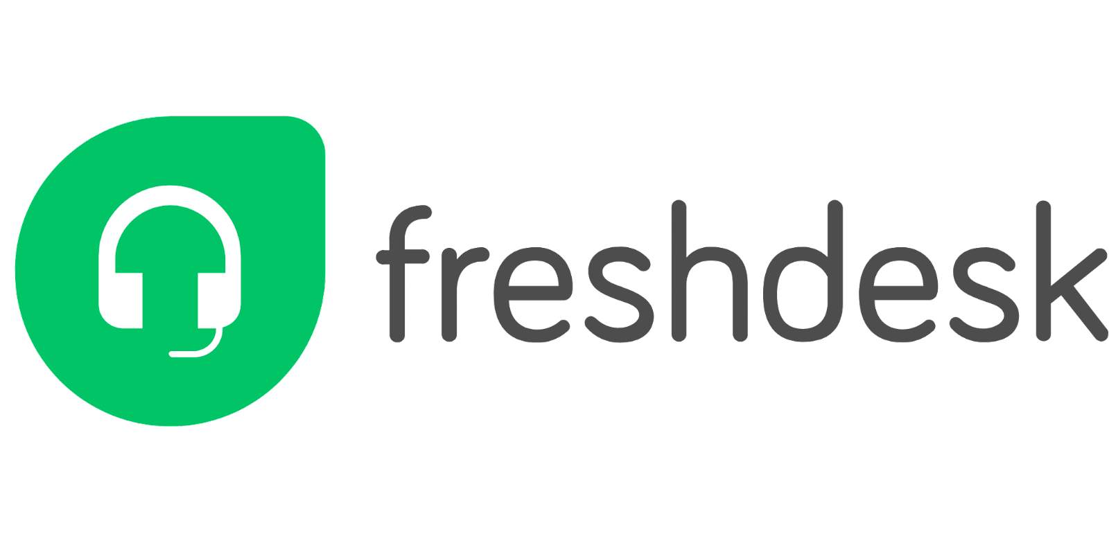


Integration
Auto-Attendant
CTI with CRM
(Simultaneously)
Computer Telephony Integration (CTI) technology allows computers and telephones to interact and exchange information. With auto-identification of the callers from CRM, the users can answer them better by checking the basic customer details. Computer Telephony Integrations solution is prominently used in Contact Center to manage inbound and outbound calls to increase human agents’ productivity.
Contact Center Queues
Freshdesk Data
Phone System Agents
Private Number
Existing Customer
New Customer
Ext 101
Ext 102
Ext 103
Ext Group
Fetch Customer
Create New Customer
Create Ticket
Freshdesk Portal

Slide 12
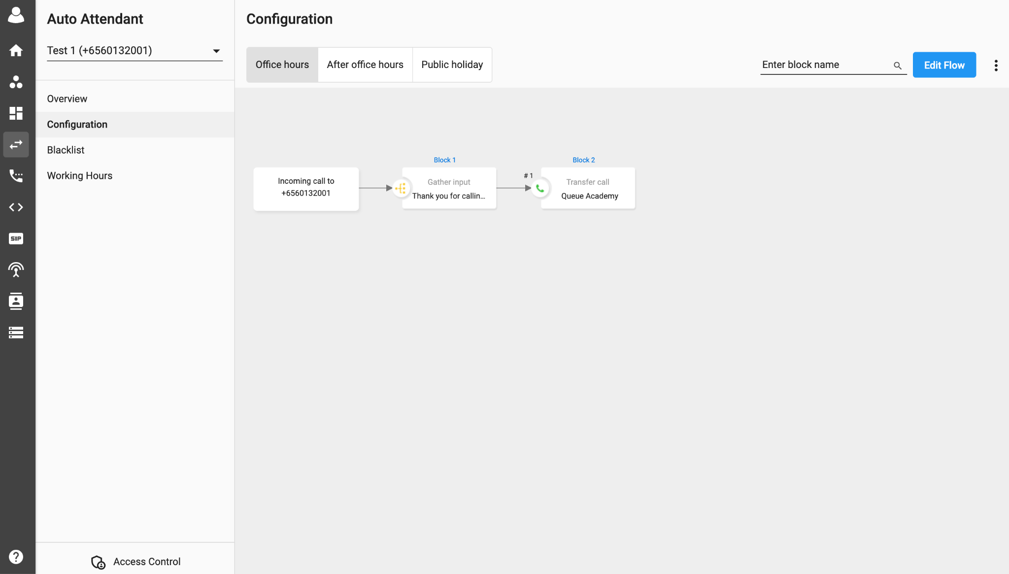

Snapshots
This is where the call flow is created. Users can create different call flows for the following relative scenarios:
Office Hours
After Office Hours
Public Holiday
Personalize customer journeys and offer self-service voice options with a graphic, flexible IVR solution. No coding or IT skills needed!

Slide 13


Success Stories
Pizza
Chain
Delivery
A pizzeria who is the premier provider of authentic Italian flavor in Singapore is using CPaaS Auto Attendant to determine the nearest outlet endpoint or branch to transfer their clients to take order via their postal code.

Slide 14





Success Stories
Eunos branch
Ext Group 1
Tampines branch
Checking the Postal Code from the uploaded digits list to transfer calls to nearest outlet
Ext Group 2
“Thanks for calling XYZ. To place a new order or check on an existing order, please enter your 6-digit postal code to speak to one of our pizza agents.”
Bishan branch
Valid
Missed
Ext Group 3
Invalid
Centralized Contact Center
Balestier branch
“Our system are unable to recognize your entered postal code. Please enter again.”
Ext Group 4
Bukit branch
Ext Group 5

Slide 15

Success Stories
Singapore Educational Group
An Educational Group in Singapore is relying on our Auto Attendant to set up a hotline with multiple conditions to improve customer journey experience.

Slide 16





Success Stories
Welcome Message
“If you are making an enquiry on one of our courses, please press 1. If you are an existing parent or student, please press 2. For ABC Camps, please press 3”
Open
Time Switch
Closed
Voicemail Greeting
Voicemail to Email
1
2
3
New customers
Existing customers
ABC Camps
8:00 - 13:30
13:31 - 19:00
1
2
3
7:00 - 8:29
8:00 - 17:30
17:31 - 19:00
Course 1
Course 2
Course 3
Sales Team A
Sales Team B
Support Team 1
Support Team 2
Support Team 3
Remote Staff 1
Support Team 4
Remote Staff 2
Voicemail to Email
Voicemail to Email
Voicemail to Email

