Slide 1

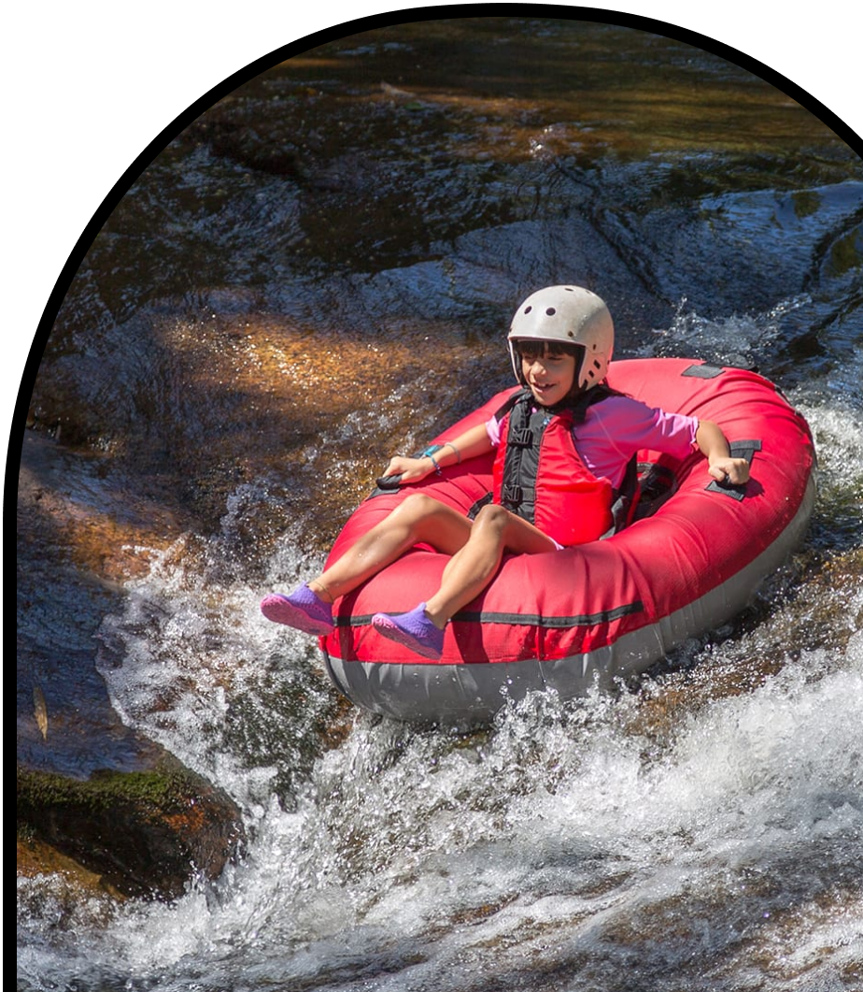
Anchor Layer Teacher Guide
A curriculum companion for Anchor Layer users
Grade 2
Erosion & Earth’s Surface
Unit Web Link • Pacing Guide • Other Units

Slide 2
Erosion & Earth’s Surface • Grade 2
Anchor Layer Teacher Guide
Unit Summary
In this unit, students explore maps, landforms, and bodies of water. They construct models of mountains to demonstrate how water flows downhill, and in the process, transforms huge rocks into the tiny grains of sand we find at the beach. Students also use models to demonstrate how erosion can happen slowly over time, but can also happen very quickly with landslides. They use this information to design solutions to slow down erosion and prevent landslides. Assessments
Performance Expectations | Science & Engineering Practices | Disciplinary Core Ideas | Crosscutting Concepts
• 2-ESS1-1. Use information from several sources to provide evidence that Earth events can occur quickly or slowly. • 2-ESS2-1. Compare multiple solutions designed to slow or prevent wind or water from changing the shape of the land. • 2-ESS2-2. Develop a model to represent the shapes and kinds of land and bodies of water in an area. • 2-ESS2-3. Obtain information to identify where water is found on Earth and that it can be solid or liquid. • K-2-ETS1-1. Ask questions, make observations, and gather information about a situation people want to change to define a simple problem that can be solved through the development of a new or improved object or tool. • K-2-ETS1-2. Develop a simple sketch, drawing, or physical model to illustrate how the shape of an object helps it function as needed to solve a given problem. • K-2-ETS1-3. Analyze data from tests of two objects designed to solve the same problem to compare the strengths and weaknesses of how each performs. | • Developing and Using Models • Planning and Carrying Out Investigations • Constructing Explanations and Designing Solutions | • ESS2.B: Plate Tectonics and Large-Scale System Interactions • ESS2.C: The Roles of Water in Erosion & Earth's Surface • ESS1.C: The History of Planet Earth • ESS2.A: Earth Materials and Systems | • Patterns • Cause and Effect • Stability and Change
Unit Lesson Flow on Next Page
‹#›

Slide 3
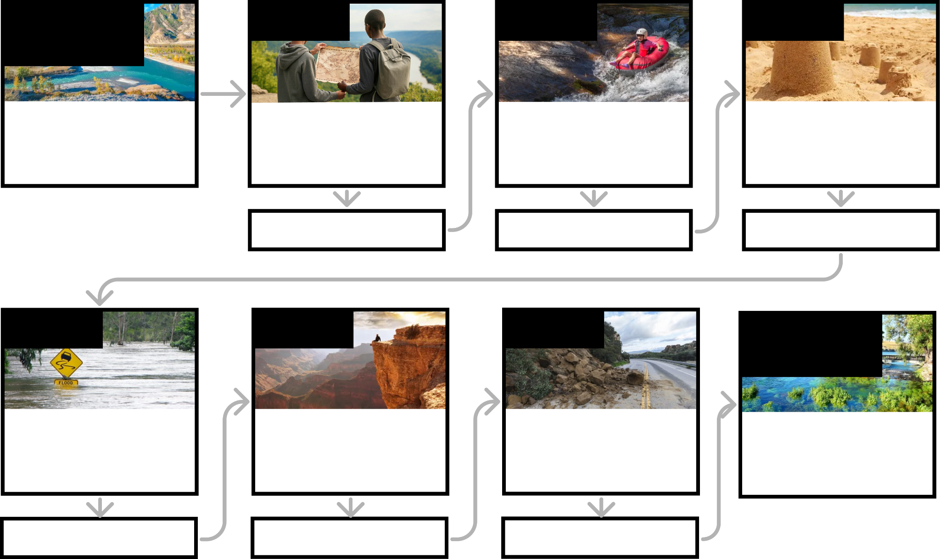
Erosion & Earth’s Surface • Grade 2
Anchor Layer Teacher Guide
Erosion & Earth’s Surface Lesson Flow
Anchor Phenomenon
Lesson 1
Lesson 2
Lesson 3
Mapping, Earth’s Surface Features, & Erosion
Strange River
Mapping Landforms & Bodies of Water
Where’s the best place to hide a treasure?
Mapping & Earth’s Surface Features If you floated down a river, where would you end up?
Rocks, Sand, & Erosion
Why is there sand at the beach?
Anchor Connection
Anchor Connection
Anchor Connection
Lesson 4
Lesson 5
Lesson 5
Performance Task
Mapping & Severe Weather
Where do flash floods happen?
Erosion, Earth’s Surface, & Landforms
What’s strong enough to make a canyon?
Erosion & Engineering
How can you stop a landslide?
Mapping & Earth’s Surface Features
How long is the shortest river?
Anchor Connection
Anchor Connection
Anchor Connection
‹#›

Slide 4
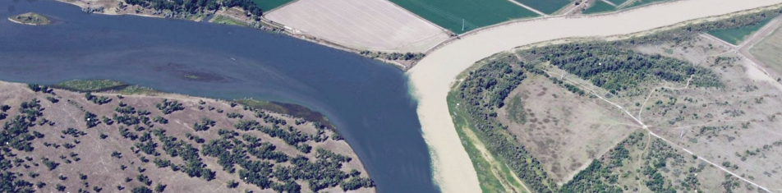
Erosion & Earth’s Surface • Grade 2
Anchor Layer Teacher Guide
Anchor Phenomenon Background
Why do these two rivers look so different?
It is easy to think of bodies of water as being just that: water. But all bodies of water on Earth are constantly changing—and being changed by—the land. This is the key idea of this Anchor Layer: to understand any river, you must also understand the land that the river flows over.
The land controls the direction and speed that rivers flow. All rivers flow downhill from higher areas to lower areas, and most rivers eventually flow into oceans. Steeper areas cause rivers to flow more quickly, and less steep areas cause rivers to flow more slowly. The flow of a river can slow down so much that it becomes a lake. The land itself is what causes a river to be calm and glassy, or to be a raging rapid or towering waterfall.
Just as the land changes the speed and direction of rivers, rivers are constantly reshaping the land that they flow over. Rivers wear the land away, forming everything from tiny gullies to mile-deep canyons.
The relentless flow of water breaks the land into smaller pieces that can be carried downstream and deposited in new places. Through this process of erosion, rivers create new landforms.
As rivers erode the land, the color of the land can temporarily change the color of the river itself. This is the reason that the Milk River looks so different from the Missouri River. As the Milk River flows through many miles of a sandy area in southern Canada, it picks up more and more grains of sand that are eventually transferred into the Missouri River. The point where the two rivers meet is known as a confluence, and this is the start of the investigation the students conduct in this Anchor Layer.
We chose to introduce the Milk River as the Strange River so that students weren’t initially led to think that the color of the river has to do with milk.
‹#›

Slide 5
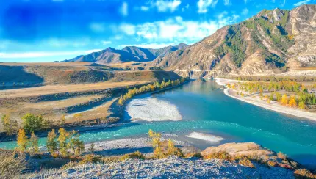
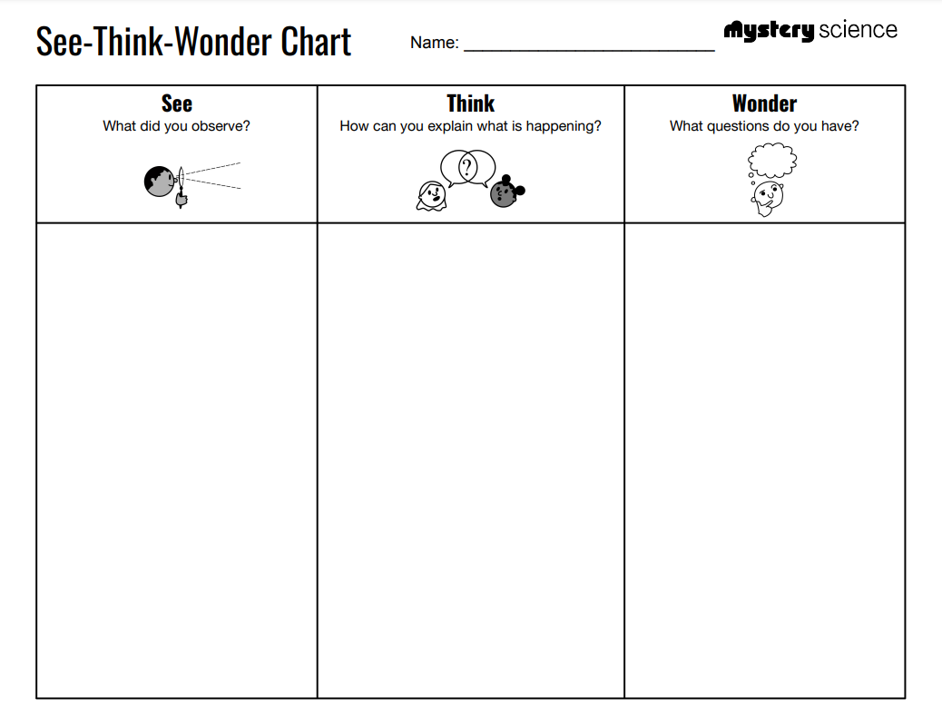
Erosion & Earth’s Surface • Grade 2
Anchor Layer Teacher Guide
Anchor Phenomenon: Strange River
Mapping, Earth’s Surface Features, & Erosion
Anchor Phenomenon Lesson Overview
Note: This lesson is part of this unit’s Anchor Layer. If you have the Anchor Layer turned on, we recommend teaching all lessons in the remainder of this unit in order.
The anchor phenomenon for this unit is a pair of rivers that flow together but look very, very different from one another. Students explore what causes rivers to have such different colors.
During the introduction, students generate observations and questions about the phenomenon and create an initial conceptual model to explain the phenomenon. Students will use these initial ideas to track how their understanding grows throughout the unit.
Anchor Phenomenon 15 mins
Guided Inquiry 25 mins
Hands-On Activity 20 mins
Student Work Samples & Notes
Students will gather clues during and after each lesson in this unit to help them improve their explanations. It is important to encourage students to recognize that even if they don't know the perfect answer yet, they are going to learn a lot throughout the unit and will have an opportunity to change or add to their first explanation.
A blue river
A light brown, cloudy river
The rivers coming together into one river
The rivers mixing together
Plants near the rivers
I think the Missouri River is clean
The Strange River is dirty or polluted
The Strange River had something dumped into it
Why is the Strange River brown?
Is the Strange River brown at the start?
Why are the rivers different colors?
‹#›

Slide 6
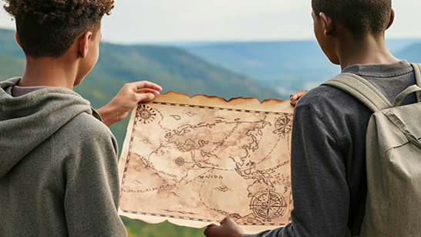
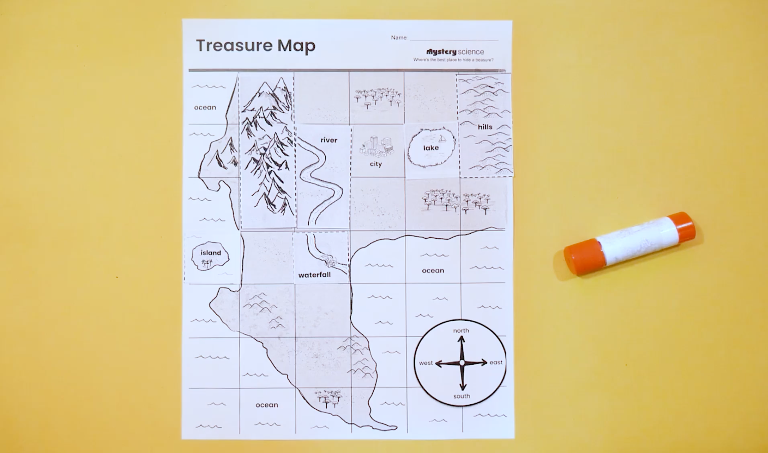
Erosion & Earth’s Surface • Grade 2
Anchor Layer Teacher Guide
Lesson 1: Where’s the best place to hide a treasure? Mapping Landforms & Bodies of Water
Overview
In this lesson, students explore maps as useful tools for understanding where landforms and bodies of water are located.
In the activity, Mystery Mapmaker, students identify different land and water features based on their shapes. Then, they use those landmarks to complete a map and locate a treasure of their very own.
Exploration 12 mins
Hands-On Activity 35 mins
Wrap-Up 12 mins
Anchor Connection 15 mins
Assessment 20 mins
Activity Notes
We suggest students work in pairs. Homeschool students can work on their own.
Anchor Connection
Maps have different shapes drawn on them to represent different land and water features. Now that students have seen a few ways to draw these different features, they may choose to revise their drawings.
Students revisit the worksheet that they worked on during the Anchor Phenomenon. Students may revise their worksheets by incorporating one or more of the land or water features that they saw on the map in the lesson. However, revisions aren’t necessary.
Connecting Storyline Question
Which way do the rivers flow?
‹#›

Slide 7
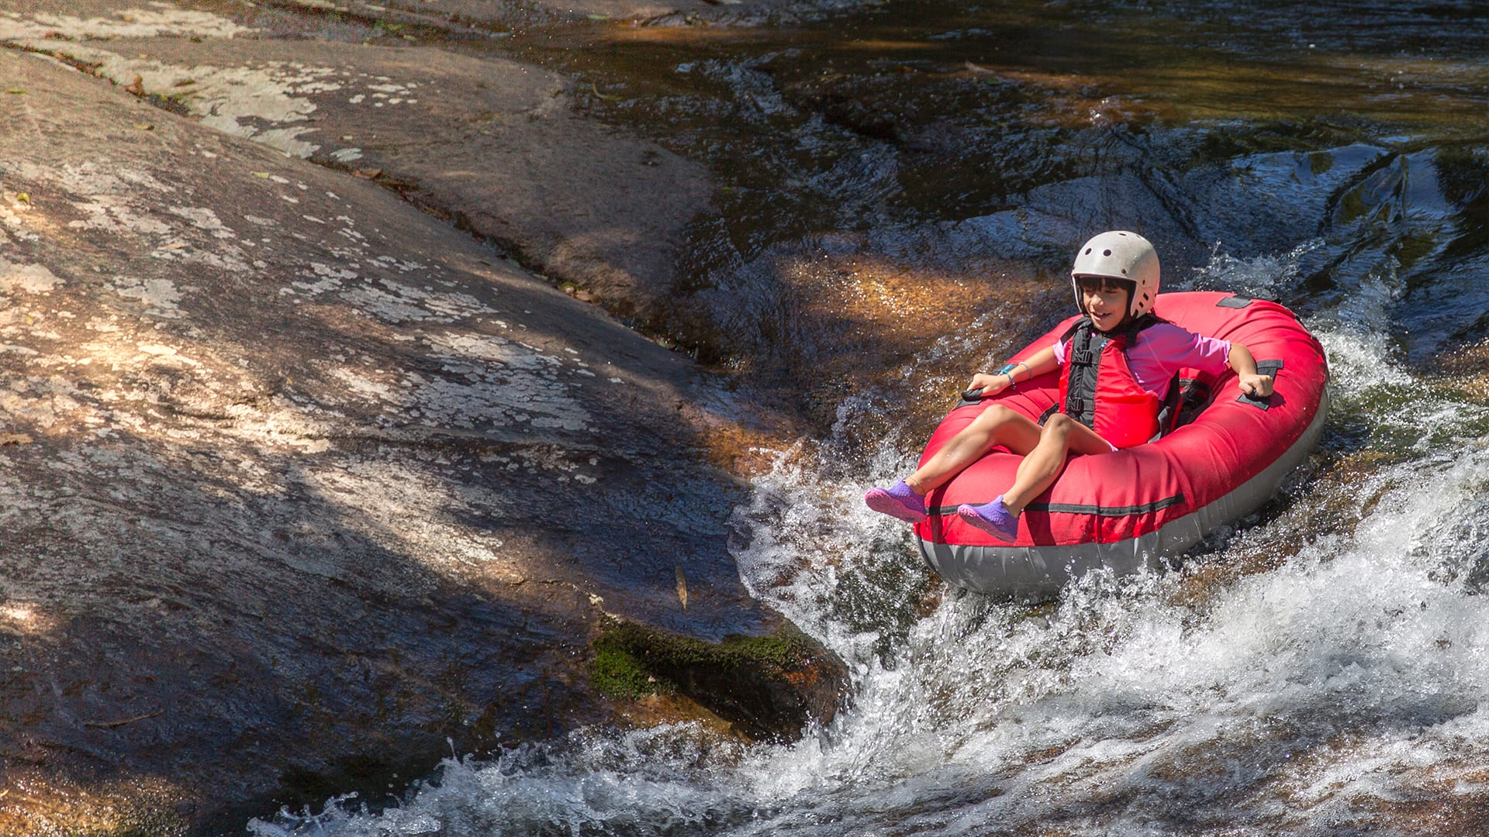
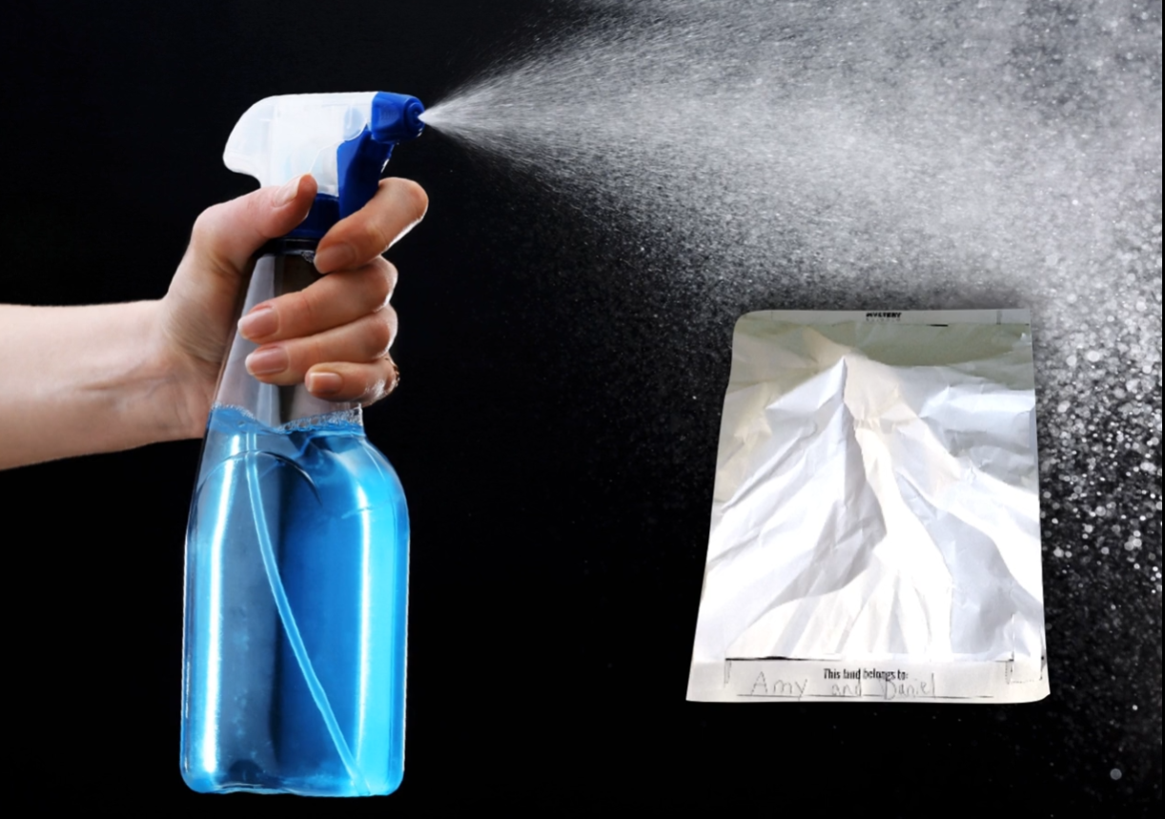
Erosion & Earth’s Surface • Grade 2
Anchor Layer Teacher Guide
Lesson 2: If you floated down a river, where would you end up? Mapping & Earth’s Surface Features (pg 1 of 2)
Overview
In this lesson, students develop a model of the earth’s surface and use it to discover an important principle about how rivers work.
In the activity, Paper Mountains, students take turns using a spray bottle to make rain fall on paper models of mountains to observe patterns of how water and rivers flow.
Anchor Connection on Next Page
Exploration 16 mins
Hands-On Activity 30 mins
Wrap-Up 4 mins
Anchor Connection 25 mins
Assessment 20 mins
Activity Notes
We suggest students work in pairs.
Students will need to cover their workspaces with plastic trash bags or table covers. Alternatively, students can work outside when they are spraying their paper mountains with water.
If students want to keep their models, be sure to give the models time to dry.
‹#›

Slide 8
Erosion & Earth’s Surface • Grade 2
Anchor Layer Teacher Guide
Lesson 2: If you floated down a river, where would you end up? Mapping & Earth’s Surface Features (pg 2 of 2)
Anchor Connection
Rivers start and end at many different places all over the world, but they all have something in common: they start at high places, and end at low places.
The Missouri River and Strange River both start in the mountains. After the two rivers come together, the water flows to the sea.
Students revisit the worksheet that they worked on during the Anchor Phenomenon. They should understand that even though the rivers look very different, they have a great deal in common. They both start in mountains, and they both flow out to the sea.
Students may add to their worksheet by showing that both rivers start at mountains and end at the sea, by labeling the mountains in their drawings, and by labeling the source and mouth of each river.
Connecting Storyline Question
Is the Strange River brown all the way up at its source, or does it change color downstream?
Exploration 16 mins
Hands-On Activity 30 mins
Wrap-Up 4 mins
Anchor Connection 25 mins
Assessment 20 mins
‹#›

Slide 9
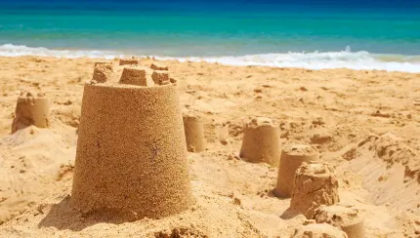
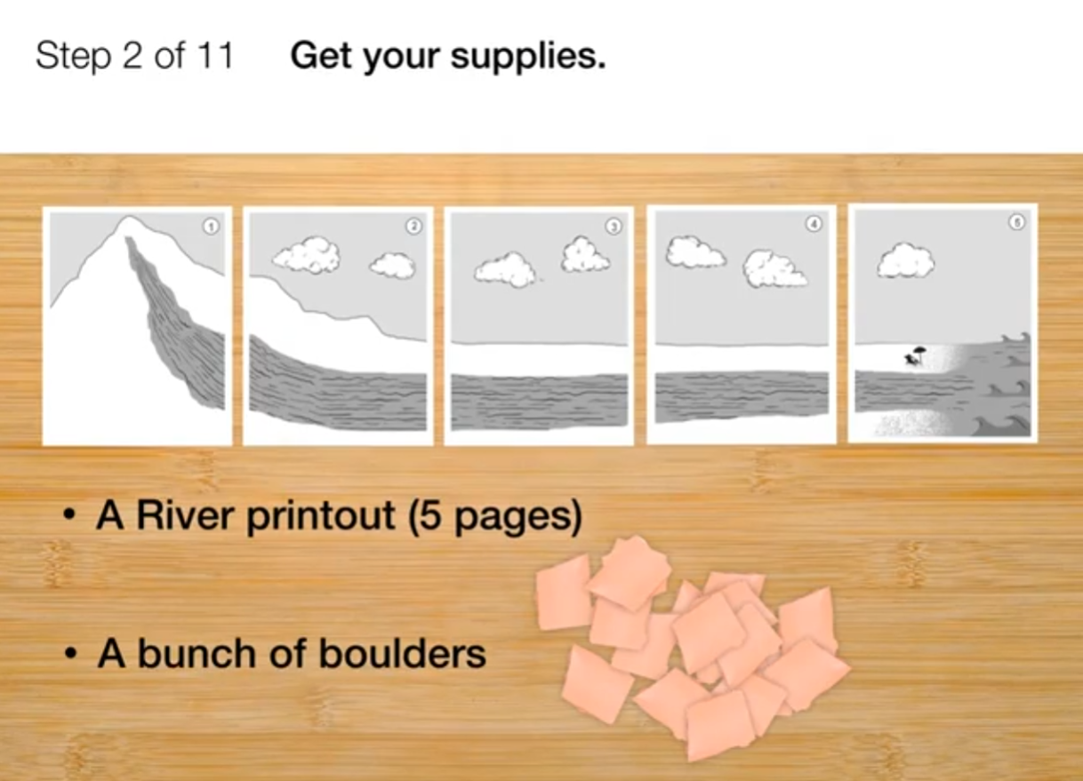
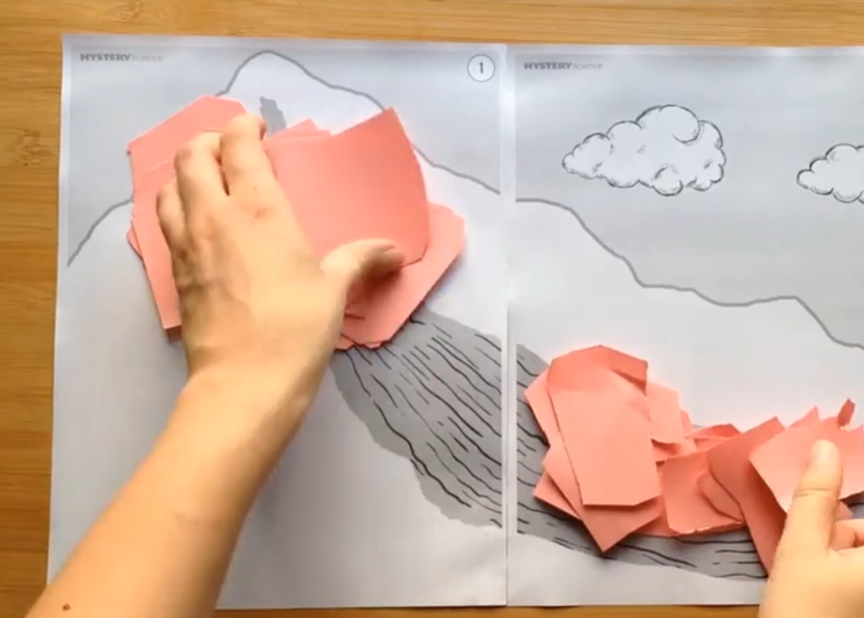
Erosion & Earth’s Surface • Grade 2
Anchor Layer Teacher Guide
Lesson 3: Why is there sand at the beach? (pg 1 of 2)
Rocks, Sand, & Erosion
Overview
In this lesson, students investigate the effects of rocks tumbling in a river. Based on their observations, they construct an explanation for why there is sand at a beach.
In the activity, Rocking the River, students pretend to be a river and tear up pieces of construction paper to model what happens to rocks as they travel along the river.
Anchor Connection on Next Page
Exploration 22 mins
Hands-On Activity 30 mins
Wrap-Up 3 mins
Anchor Connection 25 mins
Assessment 20 mins
Activity Notes
We suggest students work in groups of four. Cut or tear each sheet of construction paper into about 12 pieces. We used a paper cutter to cut many sheets at the same time, making irregularly shaped pieces, but tearing or cutting with scissors will also work.
Each group should start with 3 sheets worth of boulders (about 36). We recommend providing plenty of boulders at the beginning so that the students will still have large boulders at the end of the activity. That way, students will be able to see how the sizes of the rocks change as they move downstream.
‹#›

Slide 10
Erosion & Earth’s Surface • Grade 2
Anchor Layer Teacher Guide
Lesson 3: Why is there sand at the beach? (pg 2 of 2)
Rocks, Sand, & Erosion
Anchor Connection
Rocks can be broken down into sand and carried along by rivers to new places. In the lesson, students saw that this can change the color of beaches because of where that sand can end up.
This process can also change the color of the rivers themselves. If a river has enough sand in it, the river can take on the color of that sand.
Students look back on the worksheet that they worked on during the Anchor Phenomenon. They should understand that the water for both rivers starts the same color. Something must be changing the color of the Strange River farther downstream.
Students don’t need to update their worksheets at the end of this lesson. You may simply have a discussion about the fact that the Strange River
does not start out brown. It starts out blue, and then something must be changing its color before it reaches the Missouri River.
Connecting Storyline Question
What is causing the Strange River to change color?
Exploration 22 mins
Hands-On Activity 30 mins
Wrap-Up 3 mins
Anchor Connection 25 mins
Assessment 20 mins
‹#›

Slide 11
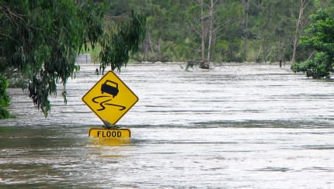
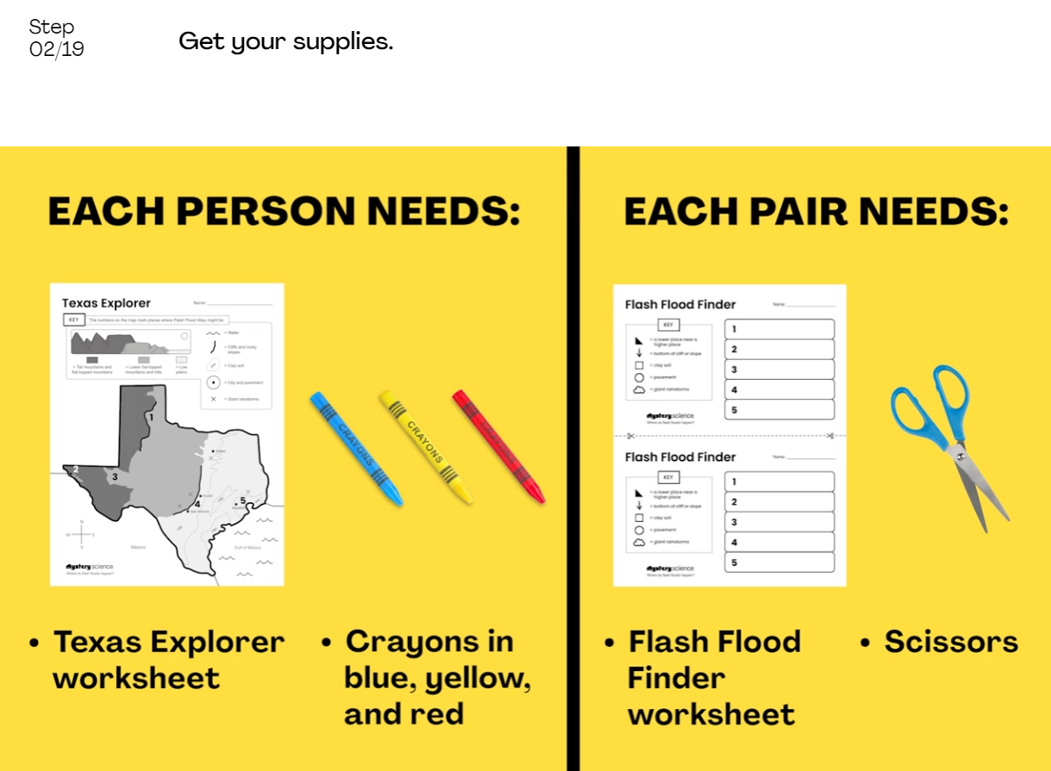
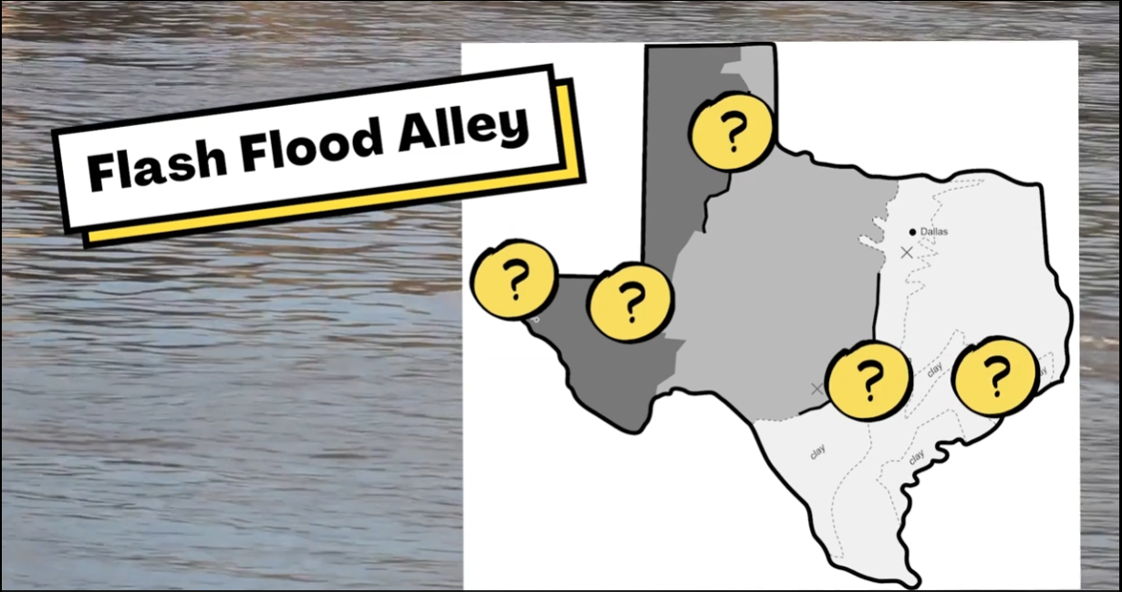
Erosion & Earth’s Surface • Grade 2
Anchor Layer Teacher Guide
Lesson 4: Where do flash floods happen?
Mapping & Severe Weather
Overview
In this lesson, students explore the phenomenon of flash floods and create an explanation of why these severe weather events are more or less likely in different regions. They specifically attempt to locate and explain a unique region in Texas known as Flash Flood Alley.
In the activity, Find Flash Flood Alley, students develop a map to document how land and water interact across the state. Students then use that map to explain how different shapes and kinds of land increase or decrease the chances of rainfall causing a flash flood.
There is not an anchor connection to follow this lesson currently.
Exploration 20 mins
Hands-On Activity 35 mins
Wrap-Up 5 mins
Assessment 20 mins
Activity Notes
We suggest students work in groups of four. Cut or tear each sheet of construction paper into about 12 pieces. We used a paper cutter to cut many sheets at the same time, making irregularly shaped pieces, but tearing or cutting with scissors will also work.
Each group should start with 3 sheets worth of boulders (about 36). We recommend providing plenty of boulders at the beginning so that the students will still have large boulders at the end of the activity. That way, students will be able to see how the sizes of the rocks change as they move downstream.
‹#›

Slide 12
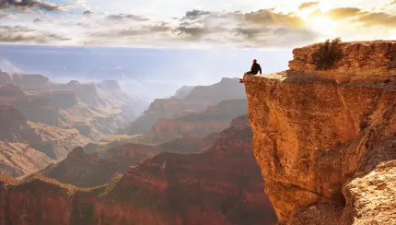
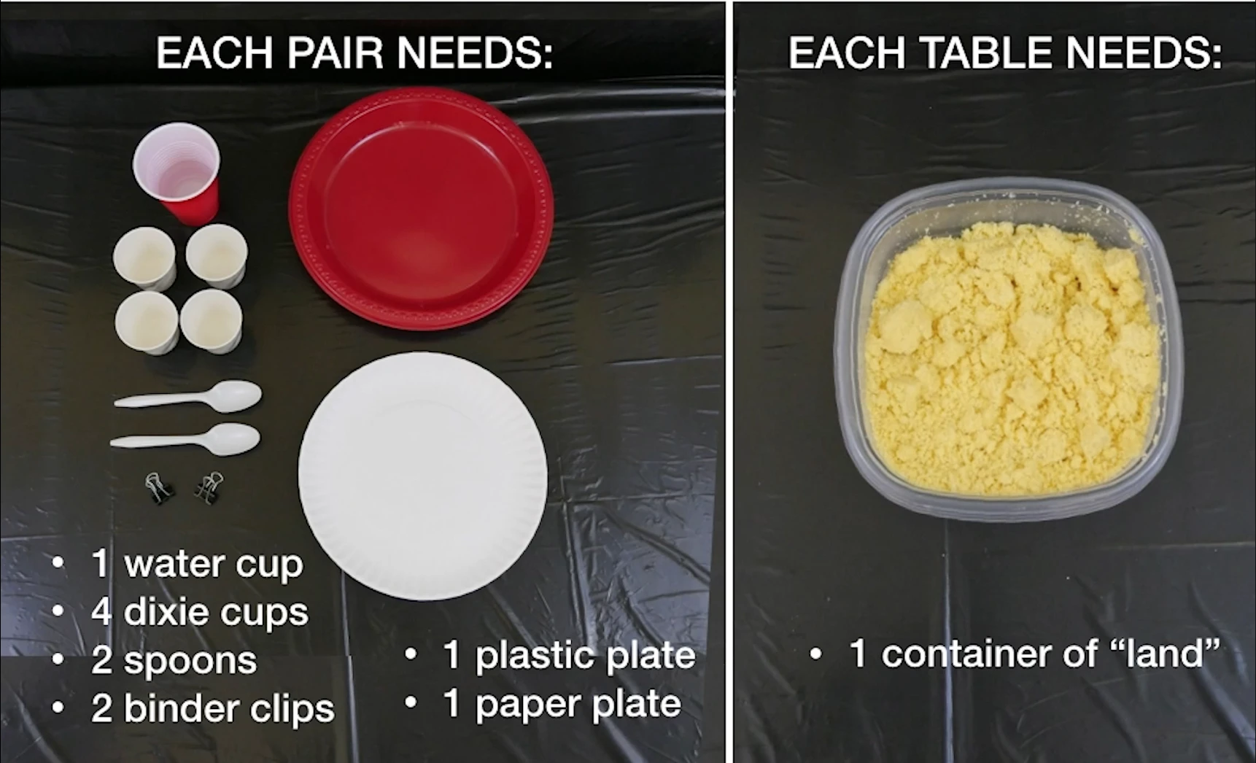
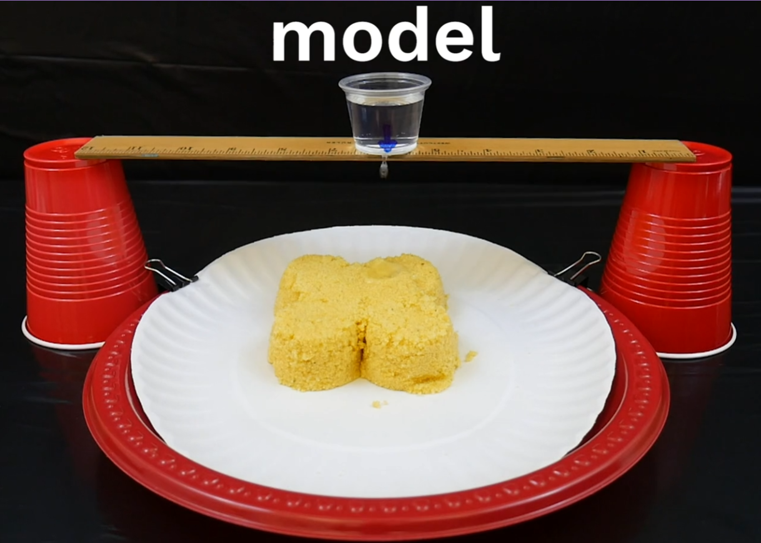
Erosion & Earth’s Surface • Grade 2
Anchor Layer Teacher Guide
Lesson 5: What’s strong enough to make a canyon? (pg 1 of 2)
Erosion, Earth’s Surface, & Landforms
Overview
In this lesson, students make hypotheses and investigate the causes of canyons.
In the activity, Cornmeal Canyons, students create a model landform using cornmeal. Then they drip water over this “land” to observe how water can change its shape and to understand how, over long periods of time, canyons can be formed through a similar process.
Anchor Connection on Next Page
Exploration 12 mins
Hands-On Activity 45 mins
Wrap-Up 3 mins
Anchor Connection 20 mins
Assessment 20 mins
Activity Notes
You will need access to water for this activity.
Students will need to cover their workspaces with a table covering (e.g., trash bag) in case of spills.
We suggest students work in pairs and share materials with another pair of students at the same table cluster.
For more detailed prep instructions, see our lesson page.
Save materials for the next lesson.
‹#›

Slide 13
Erosion & Earth’s Surface • Grade 2
Anchor Layer Teacher Guide
Lesson 5: What’s strong enough to make a canyon? (pg 2 of 2)
Erosion, Earth’s Surface, & Landforms
Anchor Connection
Just as the cornmeal hills could be washed away by dripping water in the hands-on activity, real sand and rocks can be washed away by water. There is evidence of the river itself washing sand away, and there is evidence of rain washing sand into the river as well.
Students revisit the worksheet that they worked on during the Anchor Phenomenon. They should understand that the Strange River flows through an area with brown sand and rocks. When the sand and rocks erode into the river, it changes the river’s color.
Students may add to their worksheet by drawing and labeling sandy streams on the side of the Strange River, and by showing that the Strange River changes color because of sand washing into it.
Connecting Storyline Question
How can we stop erosion?
Exploration 12 mins
Hands-On Activity 45 mins
Wrap-Up 3 mins
Anchor Connection 20 mins
Assessment 20 mins
‹#›

Slide 14
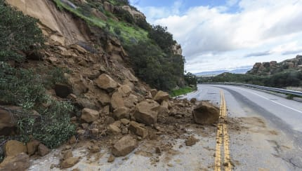
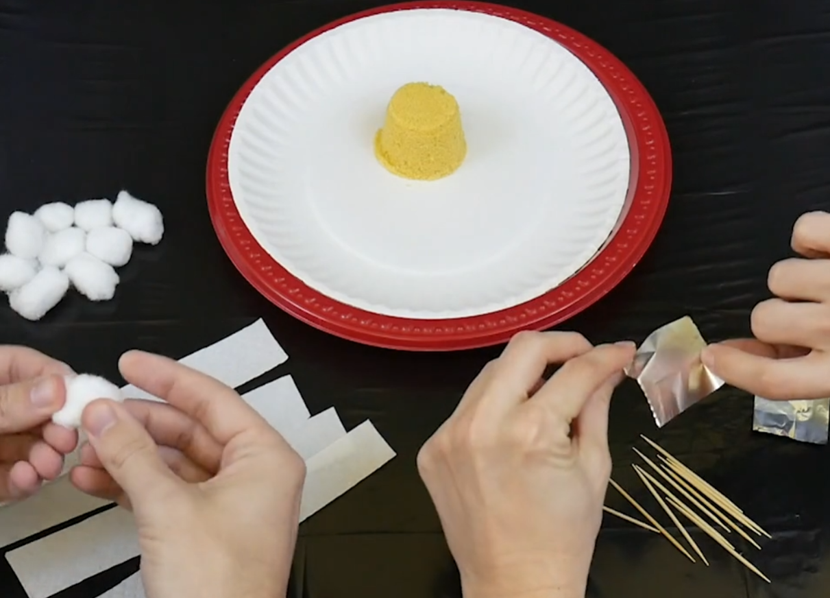
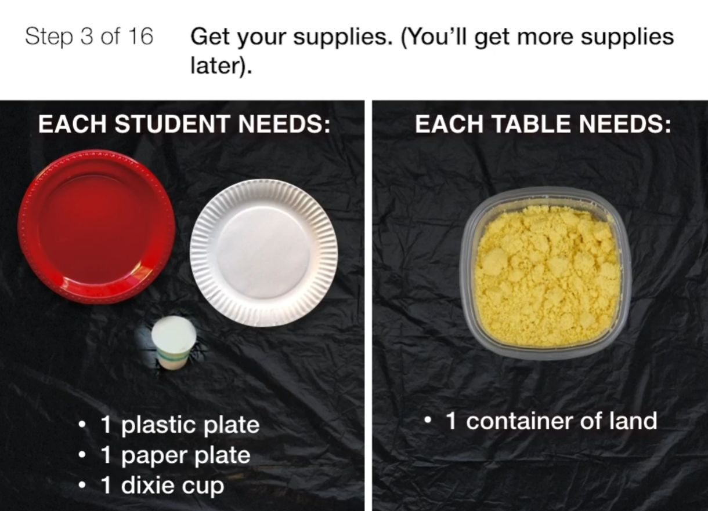
Erosion & Earth’s Surface • Grade 2
Anchor Layer Teacher Guide
Lesson 6: How can you stop a landslide? (pg 1 of 2)
Erosion & Engineering
Overview
In this lesson, students compare multiple solutions for preventing erosion.
In the activity, Erosion Engineering, they design and test ways to keep water from washing away a hill modeled out of cornmeal.
Anchor Connection on Next Page
Exploration 17 mins
Hands-On Activity 35 mins
Wrap-Up 3 mins
Anchor Connection 15 mins
Assessment 20 mins
Activity Notes
For more detailed prep instructions, see our lesson page. You will need access to water for this activity.
Students will need to cover their workspaces with a table covering (e.g., trash bag) in case of spills.
We suggest students work in pairs and share materials with another pair of students at the same table.
Prepare the Cornmeal “Land” and “Drip Sticks” Before Class
For each group of four students, you’ll need a container of the cornmeal “land” that you made for Lesson 4. Each pair of students will also need a “drip stick" that you made for Lesson 4. (If you have not taught Lesson 4, you will need to make cornmeal “land” and "drip sticks." Here’s how .)
‹#›

Slide 15
Erosion & Earth’s Surface • Grade 2
Anchor Layer Teacher Guide
Lesson 6: How can you stop a landslide? (pg 2 of 2)
Erosion & Engineering
Anchor Connection
The Missouri River is not always blue! All rivers can be a variety of colors. The color of rivers can change from day to day, depending on whether or not sand and/or rocks wash into them.
Students will also learn that the Strange River is actually called the Milk River, but it does not actually get its color from milk.
Students will look back on the worksheet that they worked on during the Anchor Phenomenon. They should understand that all rivers can change color if enough sand and rocks erode into them. This is something that all rivers have in common.
Students don’t need to update their worksheets at the end of this lesson. You will simply have a discussion about the fact that all rivers can have
different colors depending on whether or not sand and/or rocks wash into them.
Connecting Storyline Question
What other rivers flow into the Missouri River?
Exploration 17 mins
Hands-On Activity 35 mins
Wrap-Up 3 mins
Anchor Connection 15 mins
Assessment 20 mins
‹#›

Slide 16
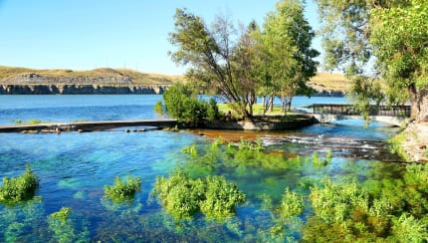
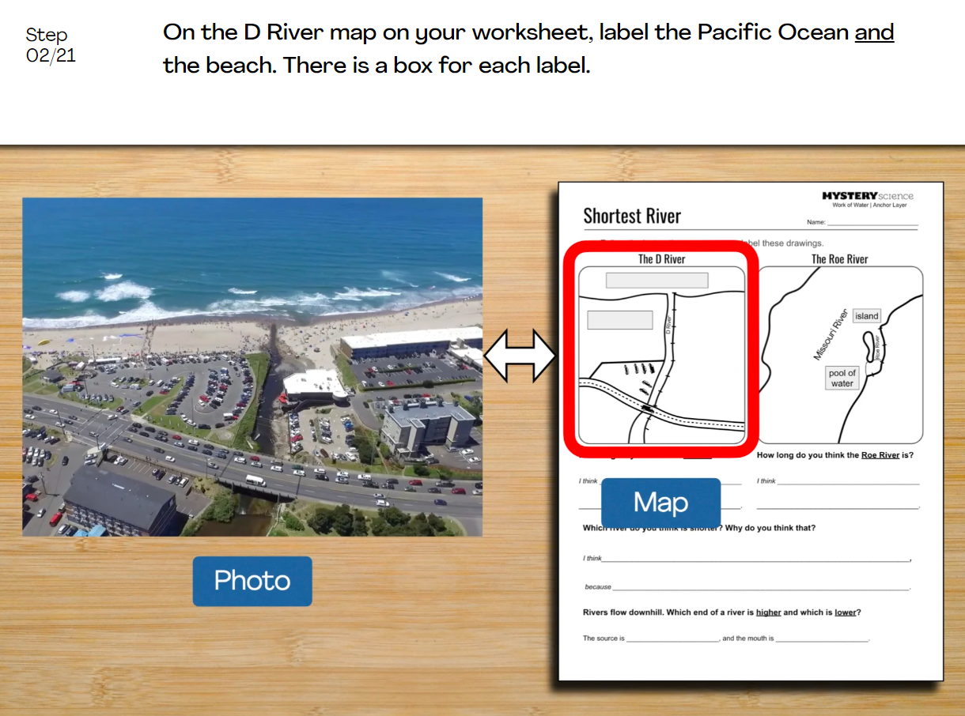
Erosion & Earth’s Surface • Grade 2
Anchor Layer Teacher Guide
Performance Task: How long is the shortest river?
Mapping & Earth’s Surface Features
Overview
In this performance task, students explore the difficulty of measuring the length of a river. Figuring out which river is the shortest river is difficult to do if you can't decide where a river starts or ends.
After a review of the Work of Water unit, students will learn about two rivers that are each possibly the shortest rivers in the United States. Then, they map those rivers out and attempt to determine which river is the shortest.
The activity can be broken into two parts: the introduction, and the activity. We suggest a point to do this in the lesson itself.
Unit Review 20 mins
Hands-On Activity 45 mins
Performance Task Notes
We included a natural stopping point in the slideshow if discussion goes long and you would like to break the hands-on activity into two parts.
Crosscutting Concepts
Systems: A system is a group of related parts that interact with one another. Rivers are not just water. The land is just as much of a part of the river system as the water itself is.
Maps are models of the world around us. They help us make sense of different natural phenomena, such as very short rivers.
‹#›

