Slide 1
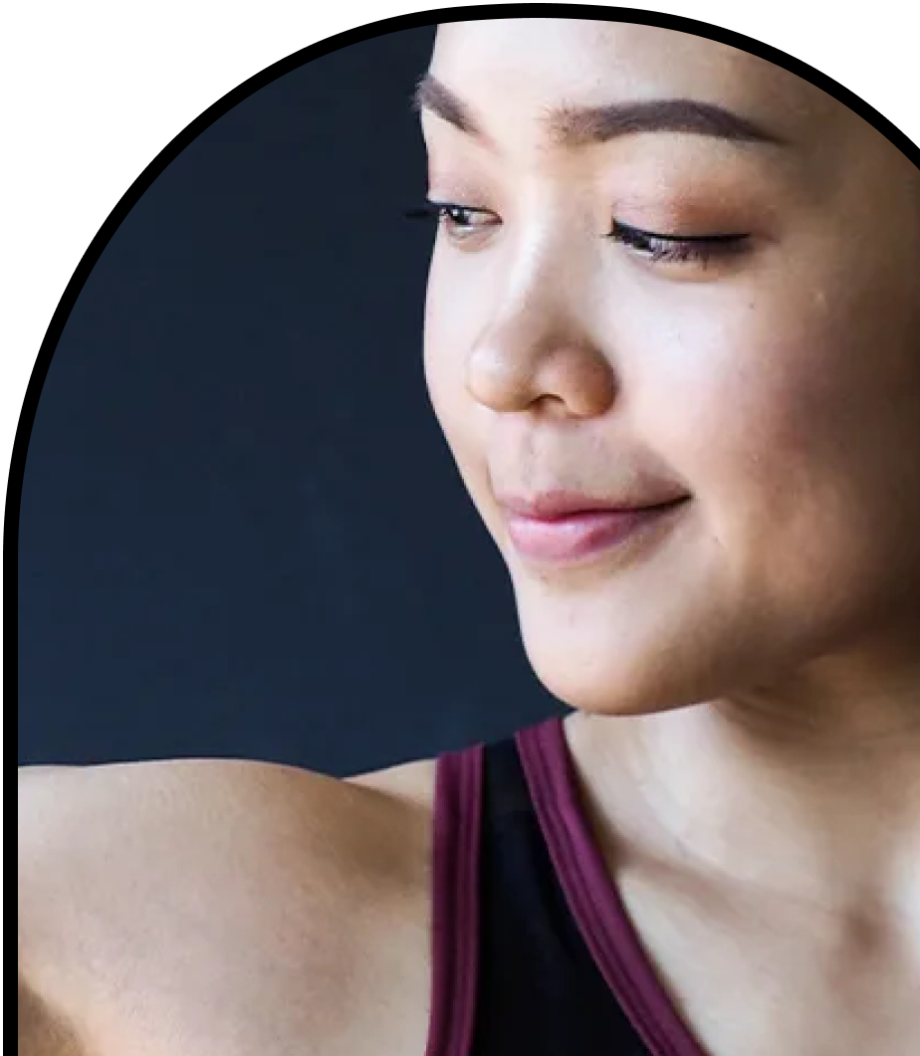
Anchor Layer Teacher Guide
A curriculum companion for Anchor Layer users
Grade 4
Human Body, Vision, & The Brain
Unit Web Link • Pacing Guide • Other Units

Slide 2
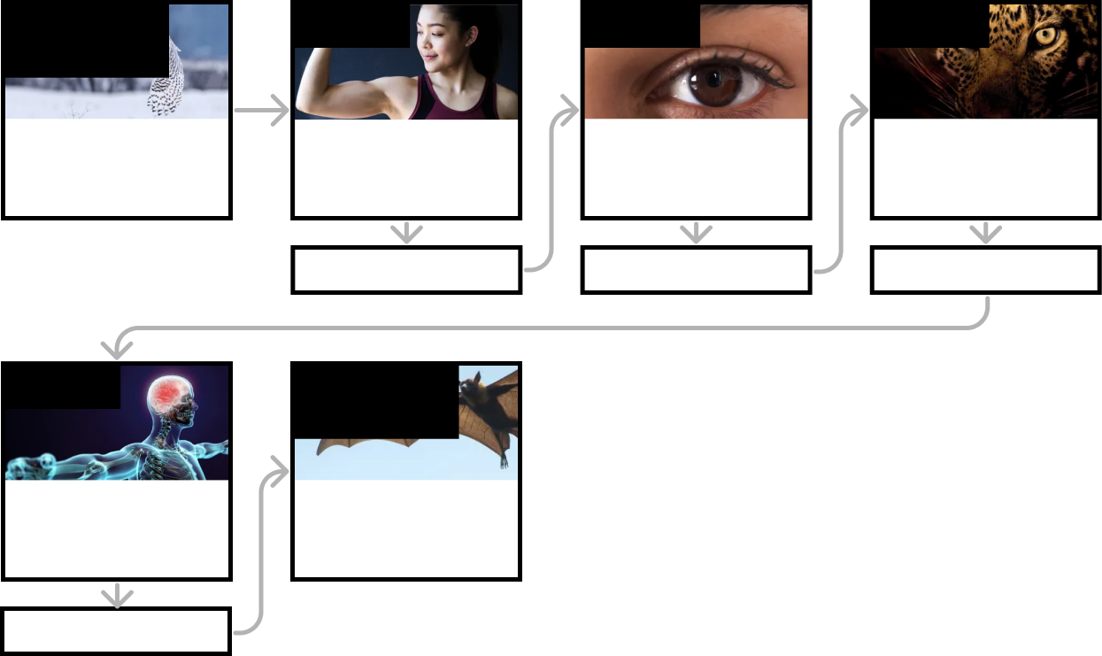
Human Body, Vision, & The Brain • Grade 4
Anchor Layer Teacher Guide
Unit Summary
In this unit, students investigate structures and functions of the human body. Students explore how our bones and muscles are interconnected, how our eyes interact with light and impact our vision, and how our brain responds to stimuli in our environment. Assessments
Performance Expectations | Science & Engineering Practices | Disciplinary Core Ideas | Crosscutting Concepts
• 4-LS1-1. Construct an argument that plants and animals have internal and external structures that function to support survival, growth, behavior, and reproduction. • 4-LS1-2. Use a model to describe that animals receive different types of information through their senses, process the information in their brain, and respond to the information in different ways. • 4-PS4-2. Develop a model to describe that light reflecting from objects and entering the eye allows objects to be seen. | • Planning and Carrying Out Investigations • Developing and Using Models • Analyzing and Interpreting Data • Constructing Explanations and Designing Solutions | • LS1.A: Structure and Function • PS4.B: Electromagnetic Radiation • LS1.D: Information Processing | • Systems and System Models • Cause and Effect
Anchor Phenomenon
Lesson 1
Lesson 2
Lesson 3
System Models
Owl Ambush
Muscles & Skeleton
Why do your biceps bulge?
Light, Eyes, & Vision
What do people who are blind see?
Structure & Function of Eyes
How can some animals see in the dark?
Anchor Connection
Anchor Connection
Anchor Connection
Lesson 4
Performance Task
Brain, Nerves, & Information Processing
How does your brain control your body?
System modeling & Explanation
How are animals and plants like machines?
Anchor Connection
‹#›

Slide 3
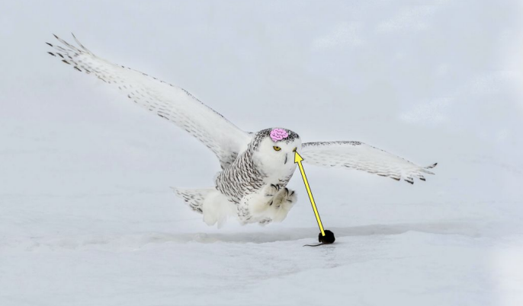
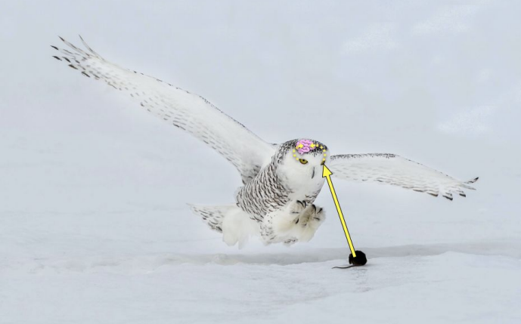
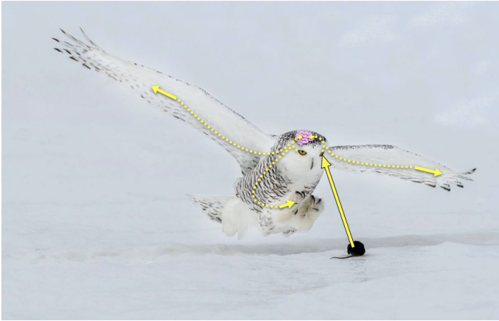
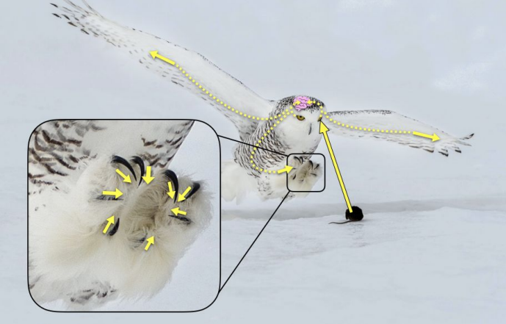
Human Body, Vision, & The Brain • Grade 4
Anchor Layer Teacher Guide
Anchor Phenomenon Background
How do the owl’s body parts work as a system to sense and respond to its environment?
Animals receive information from their environment through their senses. One sensory organ is the eye… Owls have amazing eyesight!
Light reflects off of the owl’s prey, and into their eye.
The eyes send a signal to the owl’s brain in order
for the sensory information from the environment
(prey is close by) to be processed.
The owl’s brain processes the sensory information
from the environment and sends a signal to the
external body parts to respond to the environment
(catch the prey).
The owl’s wings flap and claws contract in order to
catch the prey.
‹#›

Slide 4
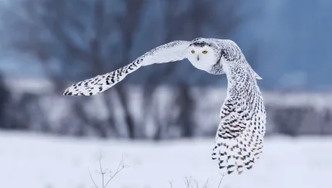
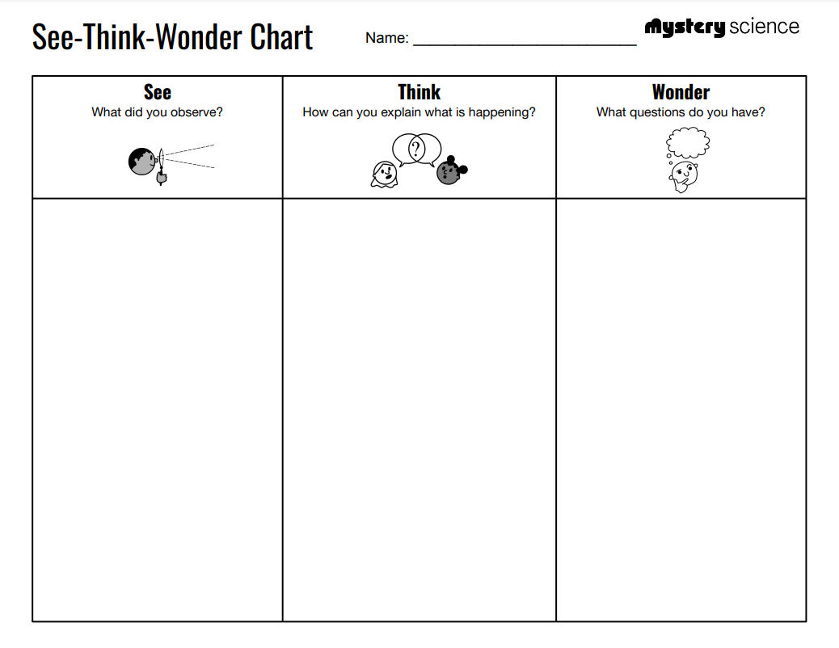
Human Body, Vision, & The Brain • Grade 4
Anchor Layer Teacher Guide
Anchor Phenomenon: Owl Ambush
System Models
Anchor Phenomenon Lesson Overview
Note: This lesson is part of this unit’s Anchor Layer. If you have the Anchor Layer turned on, we recommend teaching all lessons in the remainder of this unit in order.
The anchor phenomenon for this unit is an owl catching its prey. Students generate observations and questions about the phenomenon and create an initial model to explain how the owl's body systems work together to catch prey.
Anchor Phenomenon 8 mins
Guided Inquiry 20 mins
Hands-On Activity 30 mins
Wrap Up 2 mins
Student Work Samples & Notes
Students will gather clues during and after each lesson in this unit to help them improve their explanation. It is important to encourage students to recognize that even if they don't know the perfect answer yet, they are going to learn a lot throughout the unit and have an opportunity to change or add to their first model.
The owl can see its prey from very far away and in the dark.
The owl must be quiet because the mouse and hawk don’t hear the owl coming and run away.
The owl’s wings and claws move so it can catch the prey.
Even though we can’t see it, the owl has a brain, heart, and muscles inside to help it hunt.
The owl’s eyes see the prey and that tells the owl where to fly.
The muscles in the owl’s claws contract at the same time to grab the mouse.
The owl’s claws are like our hands. They are used to grab things.
The owl’s wings are like our legs. They are used to move.
How do the owl’s muscles know what to contract?
How can the owl see the prey from so high or in the dark?
How fast does the owl fly and catch its prey?
How does our body know what to move, breathe, and see, without being told to?
Why can’t we catch a mouse or hawk the way an owl can?
‹#›

Slide 5
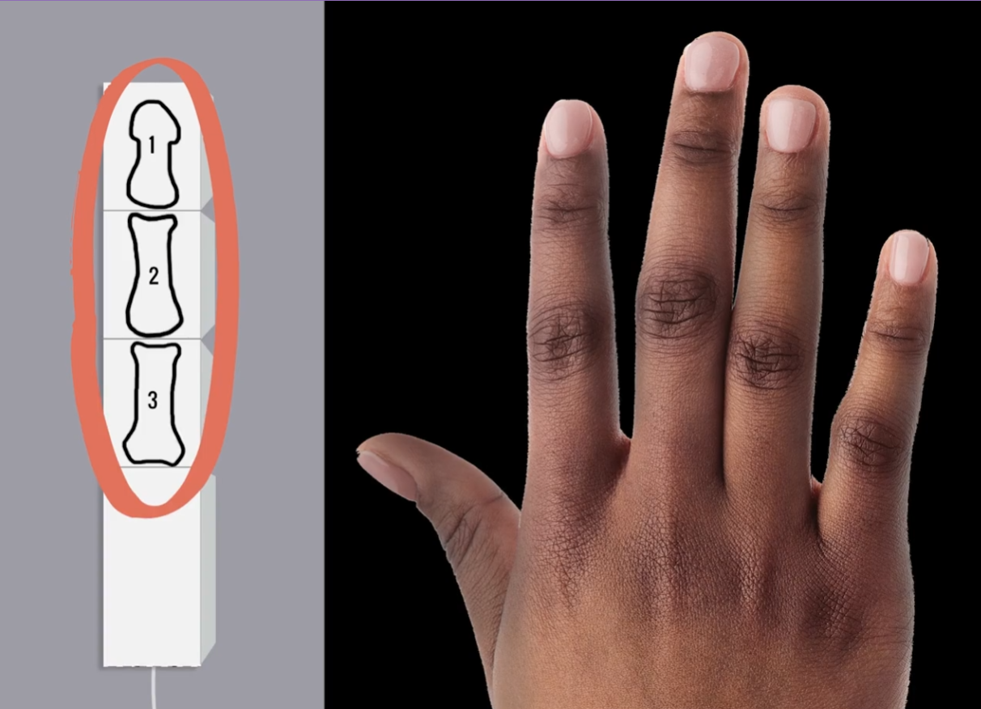
Human Body, Vision, & The Brain • Grade 4
Anchor Layer Teacher Guide
Lesson 1: Why do your biceps bulge? (pg 1 of 2)
Muscles & Skeleton
Overview
In this lesson, students discover the mechanism by which their muscles control their bones to move their bodies.
In the activity, Robot Finger, students construct a model of a human finger and observe how pulling on a string (a model for tendons) causes it to bend at the joints.
Anchor Connection on Next Page
Exploration 25 mins
Hands-On Activity 30 mins
Anchor Connection 30 mins
Assessment 25 mins
Activity Notes
We suggest students work in pairs.
Each student will need one piece of string that is 18 inches long.
In the Extensions section, we have a fun engineering extension activity where students combine four robot fingers to create a robot hand. We recommend having each group of four students assemble a hand using the robot fingers they each made. Check our "Extensions" for further instructions.
‹#›

Slide 6
Human Body, Vision, & The Brain • Grade 4
Anchor Layer Teacher Guide
Lesson 1: Why do your biceps bulge? (pg 2 of 2)
Muscles & Skeleton
Anchor Connection
Muscles pull on bones to create movement. The owl’s wings flap, claws contract, and jaw opens and closes.
Students revisit the explanation and/or drawing that they worked on during the Anchor Phenomenon. They should understand that owls also have muscles that pull on their bones in their wings, talons, and jaw to create movement when they are hunting.
Students can revise their explanation and/or drawing by adding:
Bones in claws and wings
Muscles attached to bones in claws and wings
Wings flapping
Claws contracting
Jaws opening and closing
Connecting Storyline Question
What other body parts help an owl fly toward prey and close its claws to catch the prey?
Exploration 25 mins
Hands-On Activity 30 mins
Anchor Connection 30 mins
Assessment 25 mins
‹#›

Slide 7
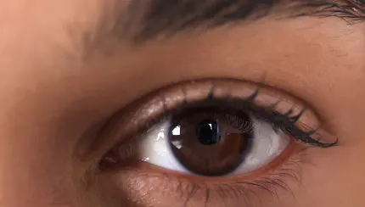
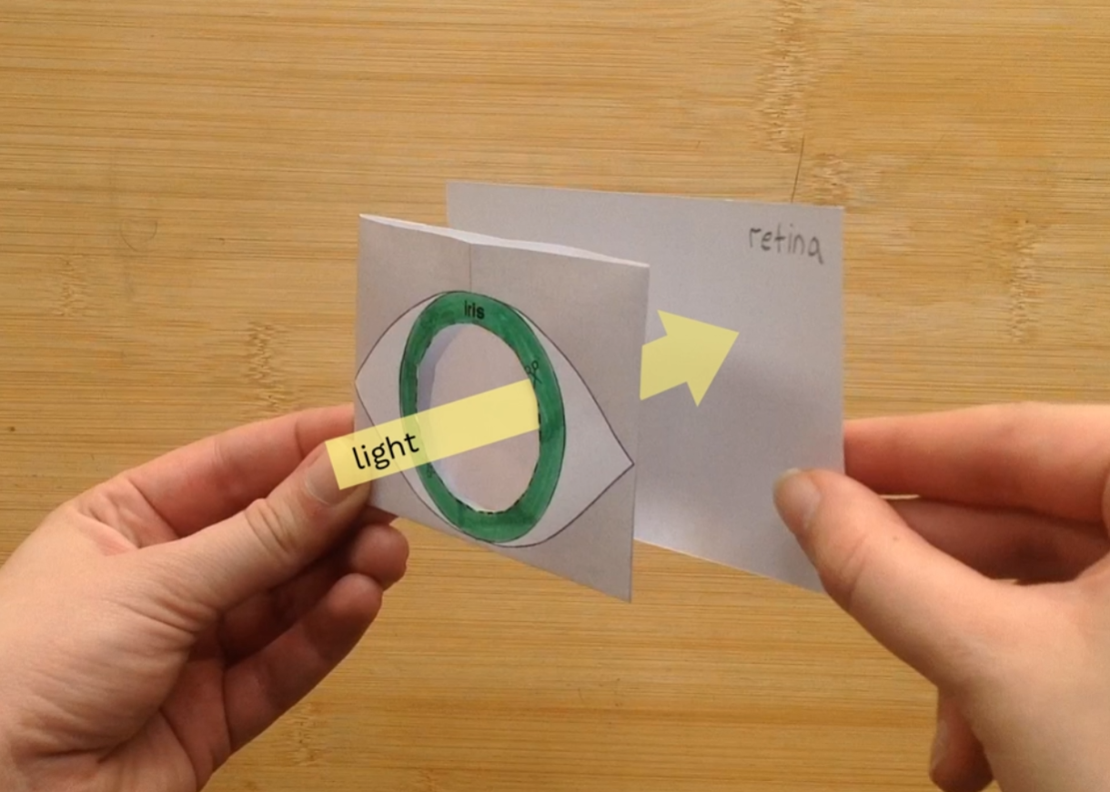
Human Body, Vision, & The Brain • Grade 4
Anchor Layer Teacher Guide
Lesson 2: What do people who are blind see? (pg 1 of 2)
Light, Eyes, & Vision
Overview
In this lesson, students discover the basics of how their eyes work, and figure out some of the causes of vision problems.
In the activity, Eye Model, students develop a working model of a human eye. They use a magnifying lens as a model of the cornea to explore how the structure of this lens is related to the function of our eyes.
If you will be teaching the next lesson "How can some animals see in the dark?", then you must save the eye models that students make in this lesson. Keep them in a safe place until you are ready to teach the next lesson.
Anchor Connection on Next Page
Exploration 21 mins
Hands-On Activity 30 mins
Wrap-Up 4 mins
Anchor Connection 30 mins
Assessment 25 mins
Activity Notes
Try making an image with the lens before class. For the best image, you need a dimly lit room and an interesting light source — like a window that lets light in, a lamp with a shade, or a television. Watch this short video for a demonstration.
After you’ve made an image, check to see what will work in your classroom. Do you have a door to the outside that you can prop open? A bright window? An interesting light fixture?
If you have a large class, you can set up a few stations with lamps around the room, or send students in batches to a window.
‹#›

Slide 8
Human Body, Vision, & The Brain • Grade 4
Anchor Layer Teacher Guide
Lesson 2: What do people who are blind see? (pg 2 of 2)
Light, Eyes, & Vision
Anchor Connection
The eyes are a sensory organ. Light reflects off the mouse and into owl’s eyes. Eyes receive information from the environment.
Students revisit the explanation and/or drawing that they worked on during the Anchor Phenomenon. They should understand that light reflects off the mouse and into the owl’s eye. This allows the owl to sense information from its environment.
Students can revise their explanation and/or drawing by adding:
Direction light travels (from the object to the eye)
Parts of the eye
Connecting Storyline Question
What other ways do animals receive information?
Exploration 21 mins
Hands-On Activity 30 mins
Wrap-Up 4 mins
Anchor Connection 30 mins
Assessment 25 mins
‹#›

Slide 9
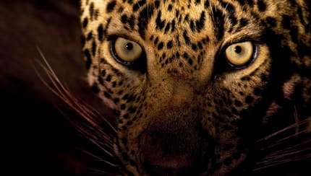
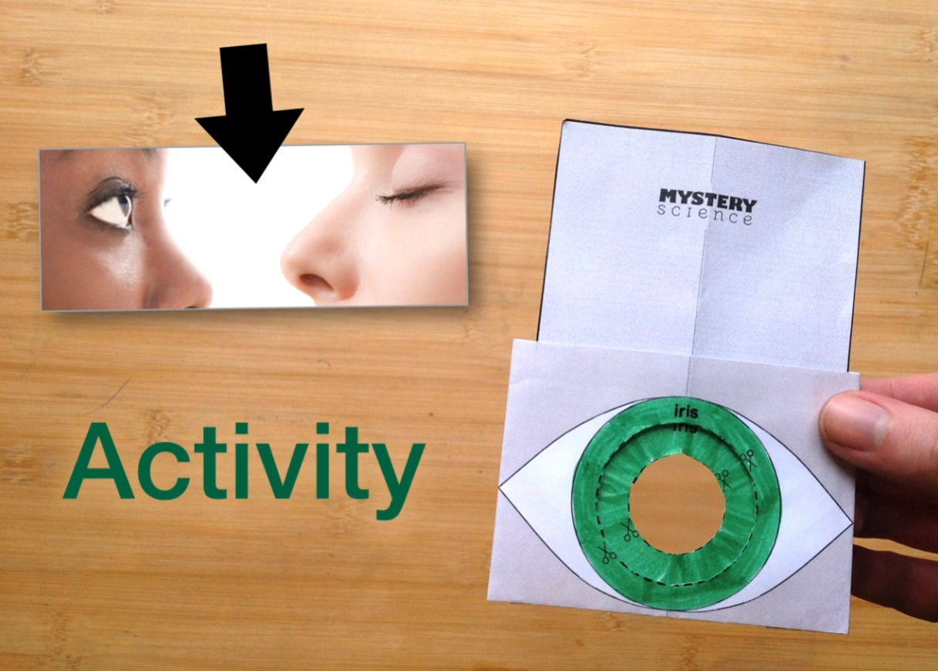
Human Body, Vision, & The Brain • Grade 4
Anchor Layer Teacher Guide
Lesson 3: How can some animals see in the dark? (pg 1 of 2)
Structure & Function of Eyes
Overview
In this lesson, students delve further into the workings of the eye, exploring the function of their iris and pupil.
In the activity, Pupil Card, students add a smaller pupil to the eye model that they created in the previous lesson. Then they observe how the changing size of the pupil controls how much light enters the eye.
Anchor Connection on Next Page
Exploration 7 mins
Hands-On Activity 30 mins
Wrap-Up 8 mins
Anchor Connection 30 mins
Assessment 25 mins
Activity Notes
We suggest students work in pairs. Students need the complete eye model (magnifying lens and the index card “retina”) that they made in the previous lesson. If any students were absent for this activity, you can pair them with someone who has an eye model.
In the first activity, students will experiment to see how their eyes change in response to changes in the light around them. Watch this video to see the change they are looking for. (You can also watch for this change in your own eyes. Look at your eyes in a mirror in a dark room and watch what happens when you turn on the lights.)
‹#›

Slide 10
Human Body, Vision, & The Brain • Grade 4
Anchor Layer Teacher Guide
Lesson 3: How can some animals see in the dark? (pg 2 of 2)
Structure & Function of Eyes
Anchor Connection
The pupil size controls the amount of light that is let in. In the dark, pupils get larger to let more light in. Owls eyes let in more light as they hunt at night and from the sky.
Students revisit the explanation and/or drawing that they worked on during the Anchor Phenomenon. They should reason that an owl’s pupil also gets larger in order to let more light in when it hunts at night.
Students can revise their explanation and/or drawing by adding:
Size of the owl’s pupil
Connecting Storyline Question
What other body parts are part of the system that helps the owl catch its prey?
Exploration 7 mins
Hands-On Activity 30 mins
Wrap-Up 8 mins
Anchor Connection 30 mins
Assessment 25 mins
‹#›

Slide 11
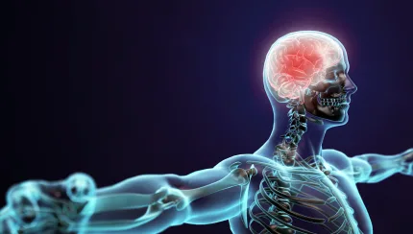
Human Body, Vision, & The Brain • Grade 4
Anchor Layer Teacher Guide
Lesson 4: How does your brain control your body?
Brain, Nerves, & Information Processing
Overview
In this lesson, students explore the brain’s role in receiving information from the senses, processing that information, and controlling the muscles to enable movement.
In the activity, Think Fast!, students test their reflexes with two very quick experiments and one more involved activity. They learn about how we process information in our brains and then respond to that information in different ways.
Anchor Connection
The owl’s brain receives information from the senses, processes the information, and controls the muscles to enable movement. This suggests that the owl’s brain is the part of its body system that processes information received from the environment in order to control its muscles.
Students can revise their explanation and/or drawing by adding:
Connection between the owl’s eye and the brain
Signals sent from brain to the muscles
Connecting Storyline Question
How do other animals’ body parts work together to help them survive?
Exploration 27 mins
Hands-On Activity 20 mins
Wrap-Up 3 mins
Anchor Connection 30 mins
Assessment 25 mins
Activity Notes
We suggest students work in pairs. Each pair of students will need a table or desk.
‹#›

Slide 12
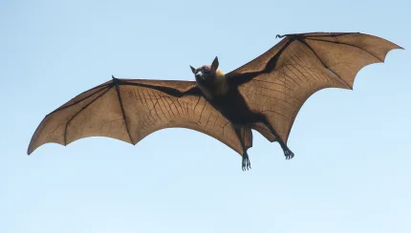
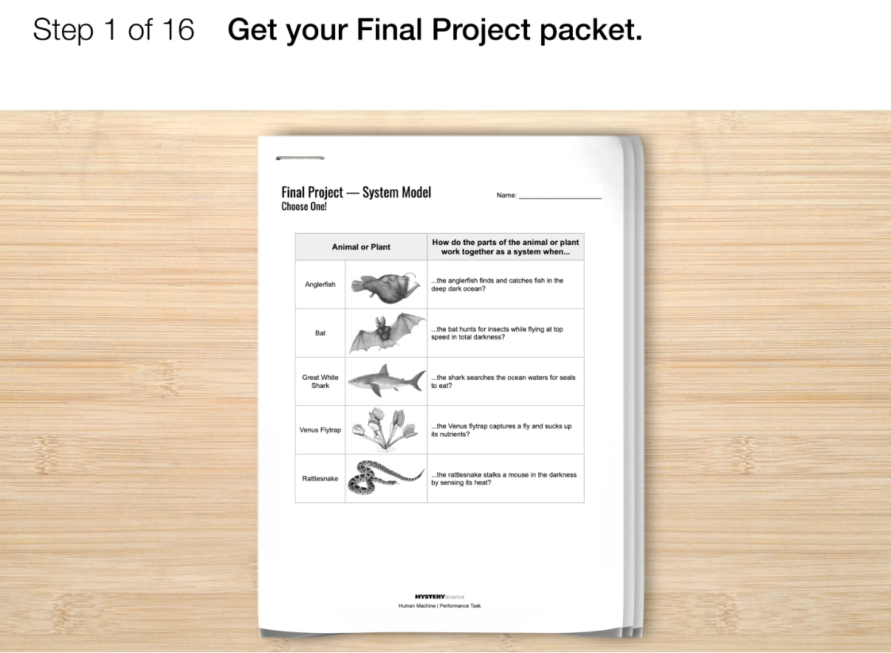
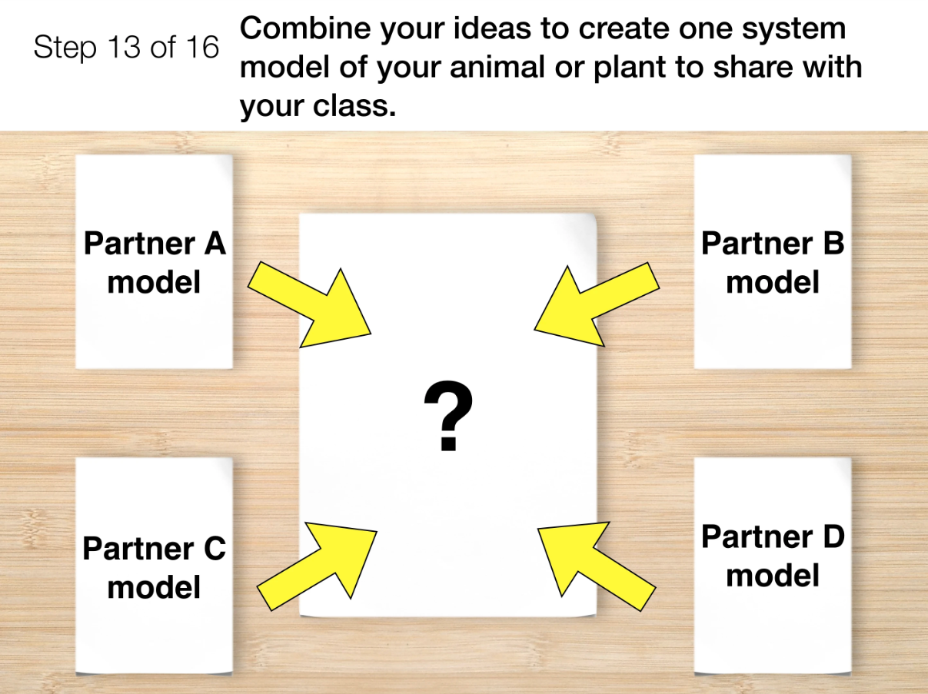
Human Body, Vision, & The Brain • Grade 4
Anchor Layer Teacher Guide
Performance Task: How are animals and plants like machines?
System modeling & Explanation
Overview
In the Performance Task, students research another animal or plant. They create a system model to explain how the animal or plant parts work together as a system to receive information, process it, and respond to its environment.
Unit Review 20 mins
Hands-On Activity 120 mins
Performance Task Notes
We have chosen four animals and one plant, and a non-fiction reading for each, that your students can use. Before the lesson, decide if you will use the provided resources or if you will have your students select their own animals or plants and find research resources independently.
If using the provided resources, print out copies of each reading for students to annotate while researching. The resources are linked below.
Students will also need their completed Owl System Model that they have been adding to after each Mystery.
Crosscutting Concepts
Systems and System Models: A system is a group of related parts that interact with one another.
Animal and plant body parts work together as a system to sense and respond to their
environments
‹#›

