Slide 1




Ramadan
FREE PRESENTATION TEMPLATE BY EATEMP

Slide 2







Welcome to the world of fantasy! Join us on a journey to explore the mystical creatures, enchanted lands, and magical wonders that exist beyond our reality. Discover the wonders and secrets of this exciting realm and unlock the power of imagination.
Welcome

Slide 3










01
Introduction
The Extraordinary Realm
02
Encounters
Unicorn Sightings
03
Wonders
Wishes Granted
Table of Contents
04
Magic
Spellcasting

Slide 4



The Realm of the Extraordinary
Welcome to the Fantasy World, a realm of wonder and enchantment where anything is possible. Here, dragons breathe fire, unicorns prance through meadows, and rainbows shine brightly. This world is a place where wishes come true, where potions can be cursed and spells are cast. It's a place of treasure and adventure, where the impossible becomes possible. But the greatest treasure of all is the one that lies within.
The world of fantasy is a reflection of our deepest desires, our fondest dreams, and our wildest imaginations. It's a place where we can let go of the constraints of reality and explore the boundless possibilities of the human mind. In this introduction, we will delve into the mysteries of this realm, uncovering the magic and wonder that lies within. So come with us and let's embark on a journey through the Fantasy World.

Slide 5






Unicorn Sightings
A record of the number of unicorns spotted in the fantasy realm and the beauty and mystery that surrounds these enchanting creatures.
Dragon Taming
A closer look at the art of taming dragons and the brave adventurers who dare to take on these fearsome creatures.

Slide 6
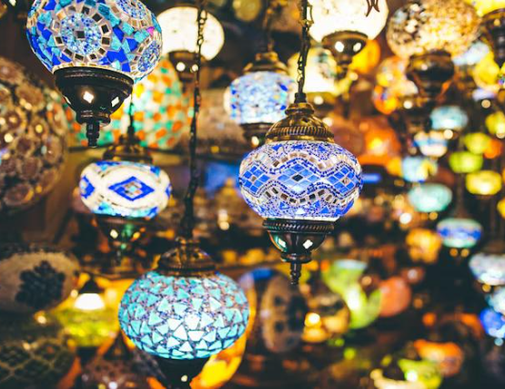
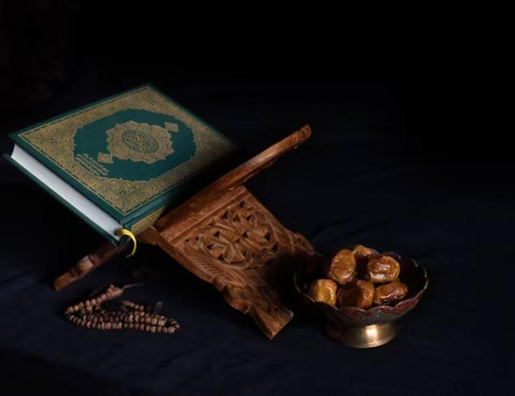
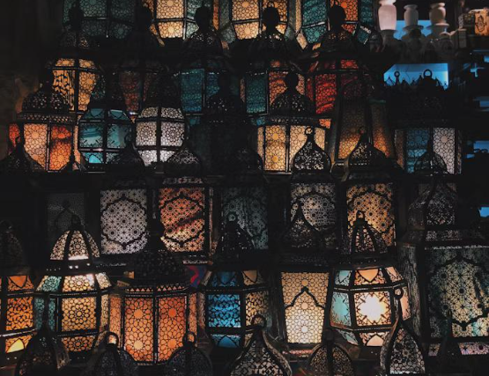
Dragon Taming
A closer look at the art of taming dragons and the brave adventurers who take on these creatures.
Unicorn Sightings
Unicorn Sightings
A record of the number of unicorns spotted in the fantasy realm and the beauty and mystery.
A record of the number of unicorns spotted in the fantasy realm and the beauty and mystery.
45%
67%
45%

Slide 7

Fantasy is the gateway to the impossible, the land where the ordinary becomes extraordinary, and the impossible becomes possible. It is the realm of the imagination, where anything can happen and everything is possible.
The Dream Weaver

Slide 8



Unicorn Sighting
Tips and tricks for spotting the elusive unicorns in their natural habitat.
Dragon Taming
A guide to taming and caring for dragons in the realm of magic.

Slide 9



The Magic of Dragons: A Research
Unicorn
Sighting
Dragon
Taming
Rainbow
Seeing
"The Art of Archery": Discover the intricacies of the Art of Archery .
"The Music of the Elves": Immerse yourself in the enchanting music.
"The Life of an Elf": Learn about the customs and daily life of the elves.

Slide 10



Pricing Plan
Basic
Elite
Legendary
  Access to the entry-level dungeons.
  A limited number of quests and battles per month.
  Ability to form a small party with fellow adventurers.
  Access to the intermediate and advanced dungeons.
  A greater number of quests and battles
  Ability to form larger parties with fellow adventurers.
  Access to the most challenging dungeons and encounters.
  Unlimited quests and battles per month.
  The ability to form the largest parties with fellow adventurers.
$10/month
$50/month
$100/month

Slide 11


S
W
O
T
Eclipse
Obtain
War
Invasion
Rare event causes unpredictable magic.
Humans acquire Crystal
Kingdoms clash in conflict.
Kingdom attacked by monsters.
Quest
Foundation
Transformation
Betrayal
Adventurers seek immortal artifact.
Shimmering City established
Peasant discovers magical powers.
Queen's advisor revealed as spy.

Slide 12
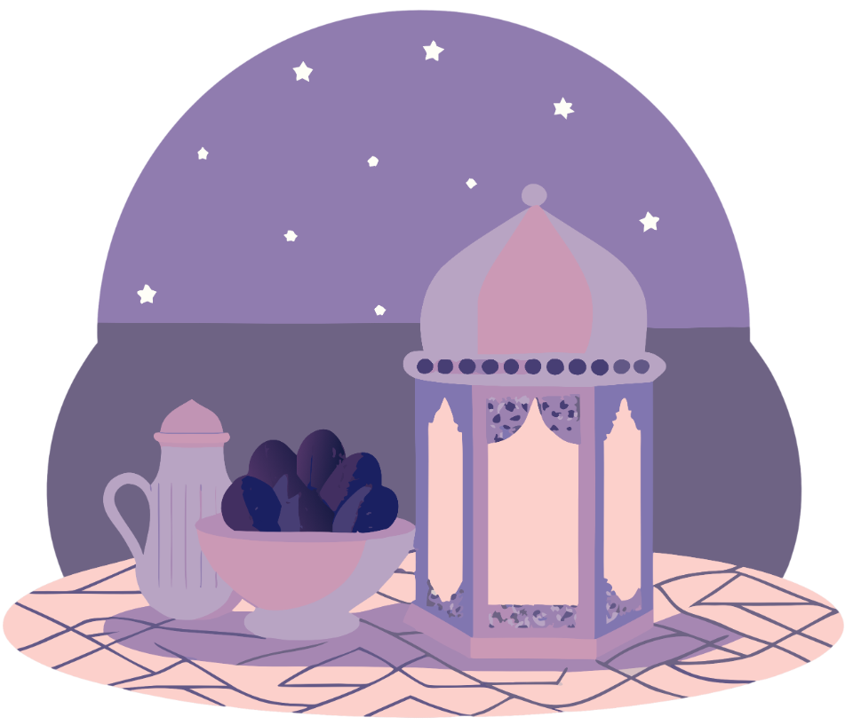
Some Data
Enchanted Creatures
75%
possess the ability to cast spells.
60%
Magic-Wielding Individuals
practice the art of illusions.
Spells Cast
90%
are dark magic, foretelling danger.

Slide 13
234,567
UNICORN SIGHTINGS
A tally of the number of unicorns spotted in the fantasy realm.

Slide 14
233 Coins
85%
Treasure Found
Wished Granted
456 Hours
544 Km
Duration of Spell Casting
Journey Distance

Slide 15






Some Graph
100
90
80
70
60
50
34.574
40
Total
30
20
10
0
1
2
3
4
5
6
7
8
Spellcasting Progress
Treasure Found
A record of the number of spells cast per year
A record of the amount of treasure found per month

Slide 16

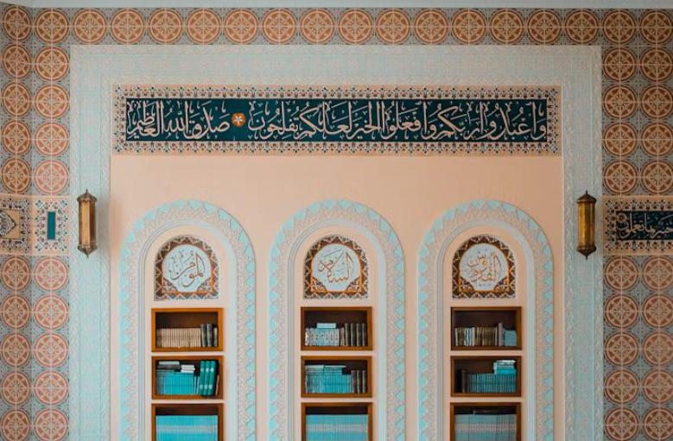
Portal to Adventure
A web application
A web application designed for discovering the world of fantasy

Slide 17


The Future of Fantasy
An mobile app
An app designed for exploring and experiencing the enchanting realm of fantasy
  Explore a magical world
  Experience fantasy firsthand
  Immerse in a realm of magic
  Discover untold wonders
  Live your fantasy dreams

Slide 18

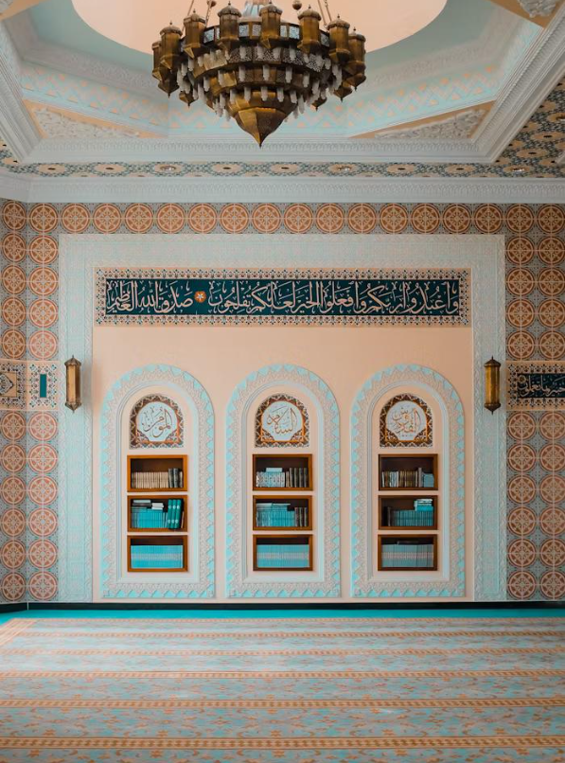
A Gateway to a World of Fantasy and Wonder
  Immerse yourself in the world of magic and mystery
  Explore uncharted territories and fantastical lands
  Meet mythical creatures and legendary beings
  Uncover hidden treasures and secret treasures
A web application
A web application designed for discovering the world of fantasy

Slide 19
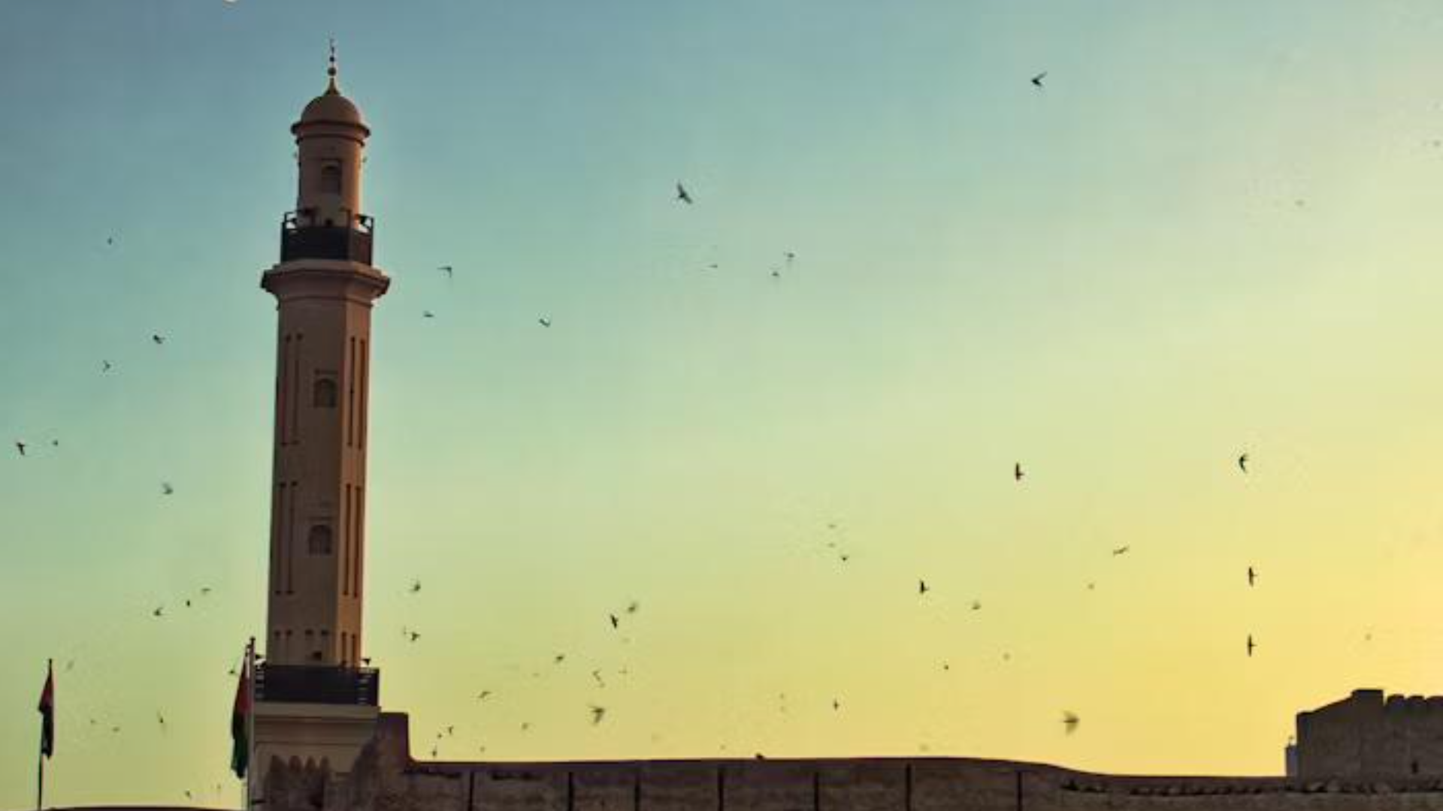
A Magic Picture

Slide 20

Fantasy Realm at a Glance
The Forest
A magical forest filled with animals and creatures.
The Caves
A network of underground caves filled with crystals.
The Lair
A dangerous place where dragons reside.

Slide 21

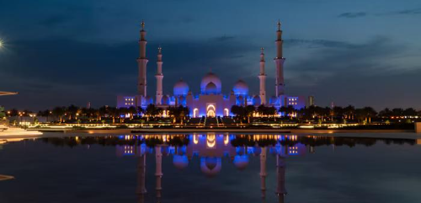
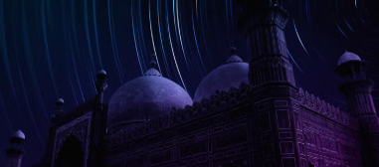
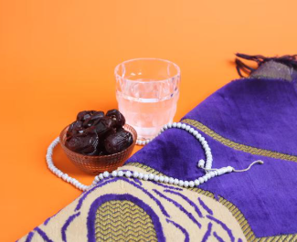
Eclipse
Quest
Obtain
Rare event causes unpredictable magic.
Adventurers seek immortal artifact.
Humans acquire Crystal
Invasion
Betrayal
Kingdom attacked by monsters.
Queen's advisor revealed as spy.
The Timeline

Slide 22




Our Team
Eldruin
Lunaria
The Fire Mage
The Moon Priestess
Elementalen
Eldruin
The Guardian
The Fire Mage

Slide 23





The Forbidden Forest: A place of mystery and wonder, where mystical creatures roam and flora flourishes.
The Crystal Caves: A network of glittering caves filled with precious gems and minerals, guarded by fierce beasts.
The Enchanted Garden: A place of pure beauty and tranquility, where the colors of the flowers are vibrant.
The Mystery

Slide 24
The List
Fire-breathing creatures that are often powerful and dangerous
Dragons
Medieval-like Settings
Worlds with castles, knights, and feudal systems
Chosen One Trope
A hero chosen by destiny to save the world
An integral part of fantasy stories, can take many forms
Magic
A curse that is unique, creative, and fits within the story
The Best Curse
Unique Creatures
A variety of fantastical beings that inhabit the world

Slide 25












The Organization
Chloe Ng
The Mage
Valtorin
Aurielle
Theronis
Dariana
The Assassin
The Priestess
The Warrior
The Shaman
Lyrisa
Lucian
Elvina
Kaelen
The Dreamer
The Conjurer
The Oracle
The Sentinel
Cedric
Seraphina
The Timekeeper
The Lightbringer
To download more editable chart, click here

Slide 26







Thank you for choosing EaTemp
Credit | Image: Unsplash
• Yes, you can use this for both personal and commercial projects.
• No, you don't have to credit us.
• No, you can't resell or redistribute it, including uploading this template online.
• And you can support us by sharing our site, EaTemp.com, with others.

