Slide 1

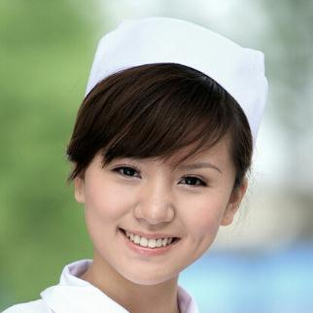

SPECIAL EXAMINATION
Presentatıon Template
www.freepptbackgrounds.net

Slide 2
Contents
2
4
1
3
Break Time
Free Time
Opening
Speakers

Slide 3
1
OPENING

Slide 4
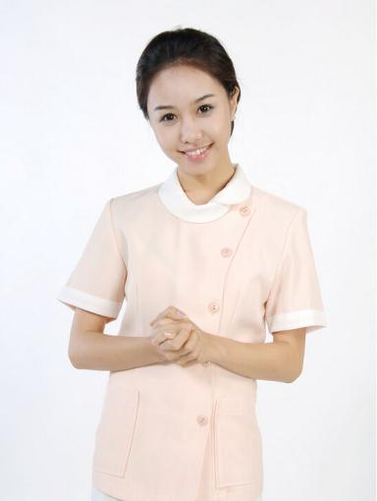
1
Opening
Name：Jessie
Age：23
Last Name：Pinkman
Father：Steven
Mother：Melissa
E-mail：zhouxiaoyu163@hotmail.com
Number：11544226045721
Blood：A
RH：+
Lenght：162CM
Sex：Female

Slide 5
1
Opening
I hope and I believe that this Template will your Time, Money and Reputation.
2019
Get a modern PowerPoint Presentation that is beautifully designed.
2020
Get a modern PowerPoint Presentation that is beautifully designed.
2013
2016
I hope and I believe that this Template will your Time, Money and Reputation.

Slide 6

1
Opening
Our Values
Vision
Mission
Easy to change colors, photos and Text.
Click on the button under the presentation preview that says "Use as Google Slides Theme.
Easy to change colors, photos and Text.

Slide 7
2
BREAK TIME

Slide 8


2
Break Time
About us
You will get a copy of this document on your Google Drive and will be able to edit, add or delete slides. You have to be signed in to your Google account.
45%
Add or delete slides. You have to be signed in to your
60%
Google account. in PowerPoint. Remember to download and install the
25%
Add or delete slides. You have to be signed in to your
98%
Google account. in PowerPoint. Remember to download and install the

Slide 9
2
Break Time
Future
Timeline
Services
Forum
We use well-known development methodologies to create a customized approach for each of the projects.
Is the color of gold, butter and ripe lemons. In the spectrum of visible light, yellow is found between green and orange.
We use well-known development methodologies to create a customized approach for each of the projects.
Is the color of gold, butter and ripe lemons. In the spectrum of visible light, yellow is found between green and orange.

Slide 10
2
Break Time
01
Annual Meeting
This allows us to achieve high quality outcomes and full transparency towards.
Split
02
Conferences
What
We press play on your digital story. Using conceptual, digital design, we work with you to build experiences that feel 'right' for your users.
Pricing
03
Transport
Annual
This allows us to achieve high quality outcomes and full transparency towards.

Slide 11
3
SPEAKERS

Slide 12

3
Speakers
We press play on your digital story. Using conceptual, digital design, we work with you to build experiences that feel 'right' for your users. We create a solid user-product relationship, one that's long and fruitful.
Skills
1
2
3
4
Moving from creative ideas to solid strategy and execution, we help your target market resonate fully with your brand. When you get them, they will get you, quicker. We leverage digital tools, design and words, to become even more relevant.

Slide 13
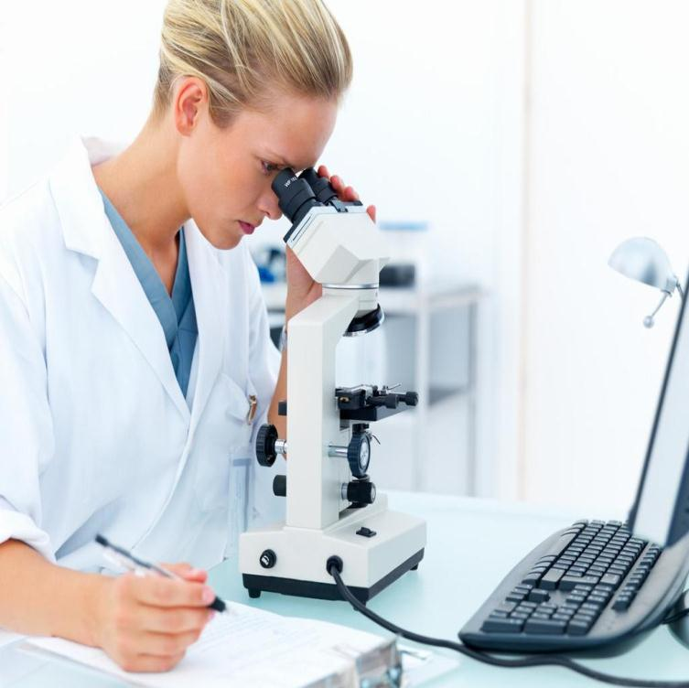
3
Speakers
Suggest
Simple & Smooth, exactly how purchasing experiences should be. We align with your users need to build and evolve a flowing shopping interface
1
Success
2
Split
3
Skills
4
Share

Slide 14

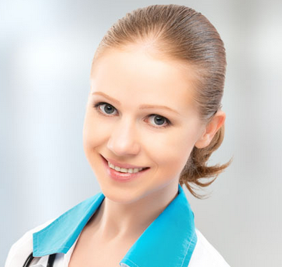
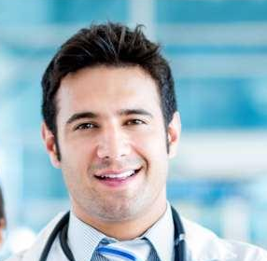
3
Speakers
Signature
Your audience relate and absorb information on different sensory levels.
We know visual stories are amplified with the right words. Sometimes it's easier to go old school, our copywriters prefer a good ball.
Ulga Vilvil
Mervy Golmen
Steven Spielberg
The user can demonstrate on a projector or computer, or print the presentation and make it into a film to be used in a wider field. Using PowerPoint
The user can make a presentation on a projector or computer, or print out the presentation to make a film.
The user can demonstrate on a projector or computer, or print the presentation and make it into a film to be used in a wider field. Using PowerPoint

Slide 15

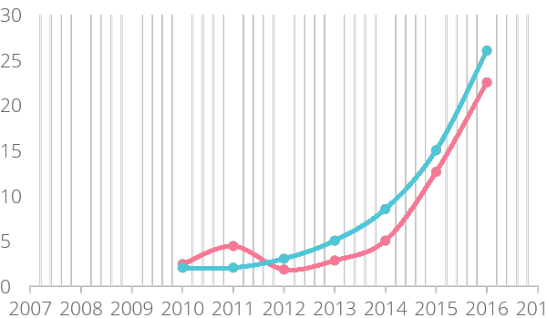

3
Speakers
10000000
We certainly do not forget you as soon as you forget us.
40000000
Tech
It is a very sad thing that nowadays there is so little useless information. Oscar Wilde
It is, perhaps, our fate rather than our merit. We cannot help ourselves. We live at home

Slide 16
4
FREE TIME

Slide 17


4
Free Time
Real Estate
Genius hath electric power which earth can never tame. Lydia M. Child
Finance
You are forced on exertion. You have always a profession, pursuits, business of some sort or other, to take you back into the world immediately
1
4
Arts & Culture
I believe that people would be alive today if there were a death penalty. Nancy Reagan
Education
I believe that people would be alive today if there were a death penalty. Nancy Reagan
2
5
Fashion
You are forced on exertion. You have always a profession, pursuits, business of some sort or other, to take you back into the world immediately
Public & NGO
Genius hath electric power which earth can never tame. Lydia M. Child
3
6

Slide 18
4
Free Time
Energy
E-commerce
Briefing
Evaluation
Genius hath electric power which earth can never tame. Lydia M. Child
I feel very strongly that change is good because it stirs up the system. Ann Richards
Genius hath electric power which earth can never tame. Lydia M. Child
I feel very strongly that change is good because it stirs up the system. Ann Richards
6
7
8
9
10
11
12
Implementation
Design
Workshops
I feel very strongly that change is good because it stirs up the system. Ann Richards
A large income is the best recipe for happiness I ever heard of. Mansfield Park
I feel very strongly that change is good because it stirs up the system. Ann Richards

Slide 19
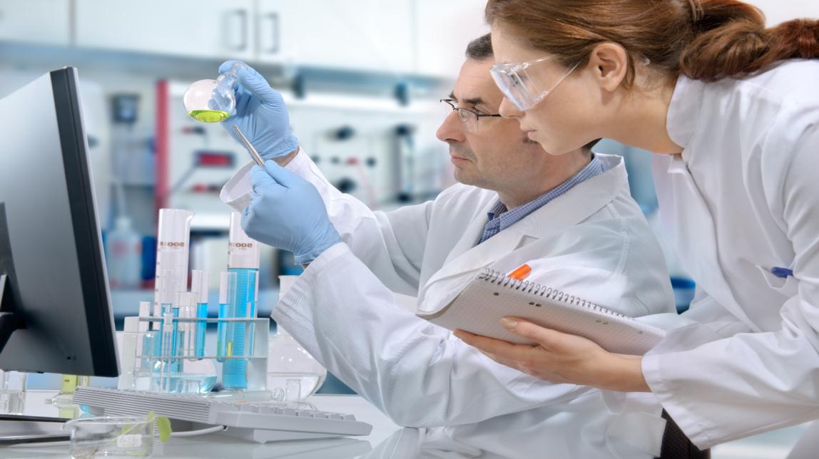
4
Free Time
01
Quality
Always give your best never worry for results . Education is the most powerful weapon which you can use to change the world. God sometimes removes people from your life to protect you. Do not run after them.
02
Assurance
Everyone wants, happiness. No one wants pain. But you can’t have a rainbow without a little rain. Enjoy the little things in life, because one day you will look back and realize they were the big things.

Slide 20
THANK YOU !
Special Examination Powerpoint Template
www.freepptbackgrounds.net

