Slide 1

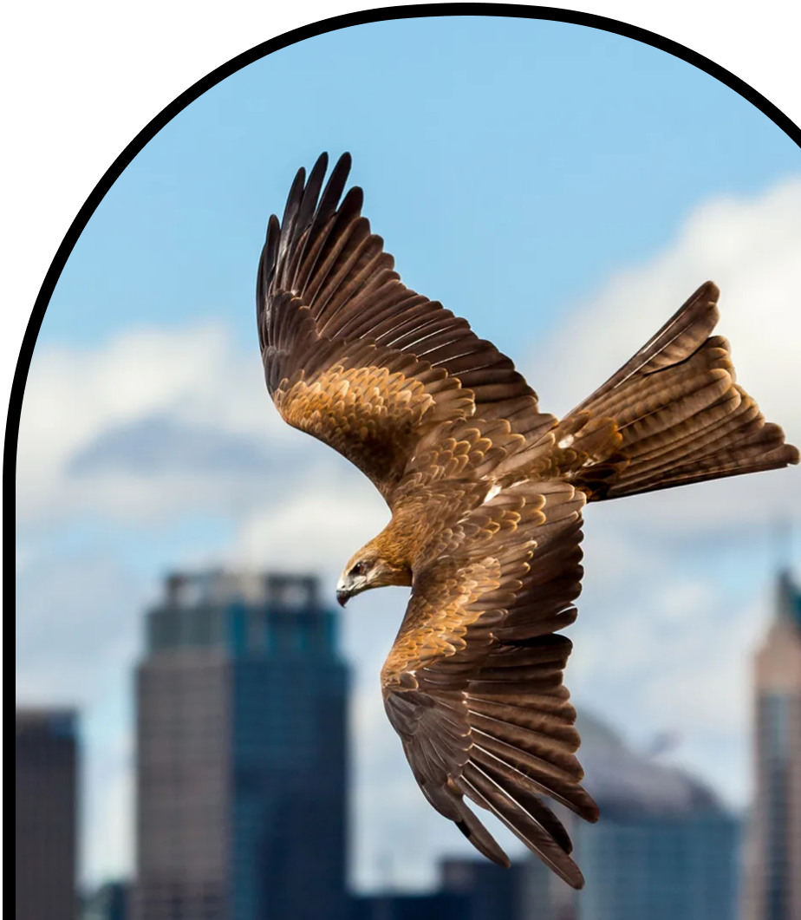
Anchor Layer Teacher Guide
A curriculum companion for Anchor Layer users
Grade 5
Ecosystems & The Food Web
Unit Web Link • Pacing Guide • Other Units

Slide 2
Ecosystems & The Food Web • Grade 5
Anchor Layer Teacher Guide
Unit Summary
In this unit, students explore how consumers, producers, and decomposers each play an important role in ecosystems. They build models of food chains and food webs to investigate how matter and energy flow through these systems. Students discover that matter continuously cycles between non-living and living components of the environment and consider ways that we can protect those environments. Assessments
Performance Expectations | Science & Engineering Practices | Disciplinary Core Ideas | Crosscutting Concepts
• 5-LS1-1. Support an argument that plants get the materials they need for growth chiefly from air and water. • 5-LS2-1. Develop a model to describe the movement of matter among plants, animals, decomposers, and the environment. • 5-ESS3-1. Obtain and combine information about ways individual communities use science ideas to protect the Earth’s resources and environment. • 5-PS3-1. Use models to describe that energy in animals’ food (used for body repair, growth, motion, and to maintain body warmth) was once energy from the sun. | • Planning and Carrying Out Investigations • Developing and Using Models • Obtaining, Evaluating, and Communicating Information • Constructing Explanations and Designing Solutions • Planning and Carrying Out Investigations • Analyzing and Interpreting Data | • LS2.A: Interdependent Relationships in Ecosystems • LS2.B: Cycles of Matter and Energy Transfer in Ecosystems • LS1.C. Organization for Matter and Energy Flow in Organisms • ESS3.C: Human Impacts on Earth Systems • PS3.D: Energy in Chemical Processes and Everyday Life | • Energy and Matter • Systems and System Models • Cause and Effect
Ecosystems & The Food Web Lesson Flow on Next Page
‹#›

Slide 3
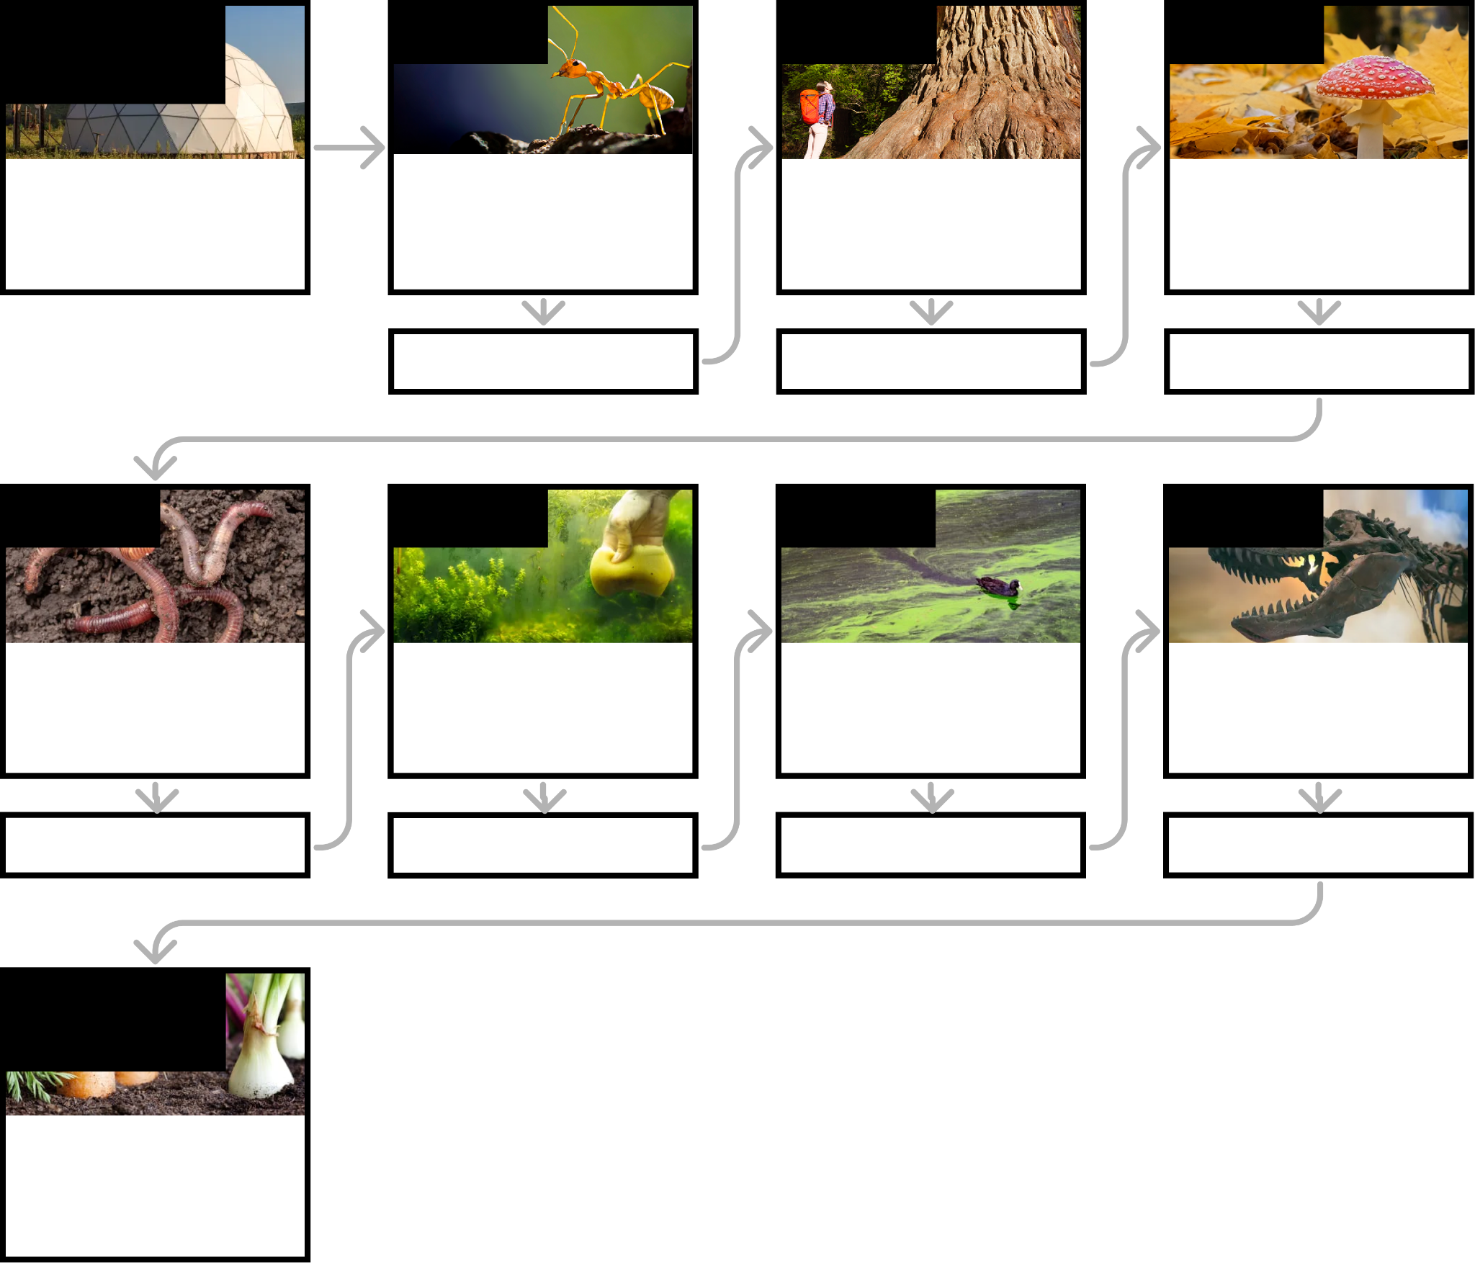
Ecosystems & The Food Web • Grade 5
Anchor Layer Teacher Guide
Ecosystems & The Food Web Lesson Flow
Anchor Phenomenon
Lesson 1
Lesson 2
Lesson 3
Ecosystem Design & Modeling
Life Inside a Dome
Food Chains & Matter Flow
What if all the ants disappeared?
Decomposers & Matter Flow How does a tiny seed become one of the heaviest trees on Earth?
Plant Growth & Matter
Where do fallen leaves go?
Anchor Connection
Anchor Connection
Anchor Connection
Lesson 4
Lesson 5
Lesson 6
Lesson 7
Decomposers, Nutrients, & Matter Cycle
Do worms really eat dirt?
Ecosystems & Matter Cycle Why do you have to clean a fish tank but not a pond?
Protecting Environments
How can we protect Earth’s environments?
Food Webs & Flow of Energy
Why did the dinosaurs go extinct?
Anchor Connection
Anchor Connection
Anchor Connection
Anchor Connection
Performance Task
Ecosystem Argument
How could we grow food on Mars?
‹#›

Slide 4
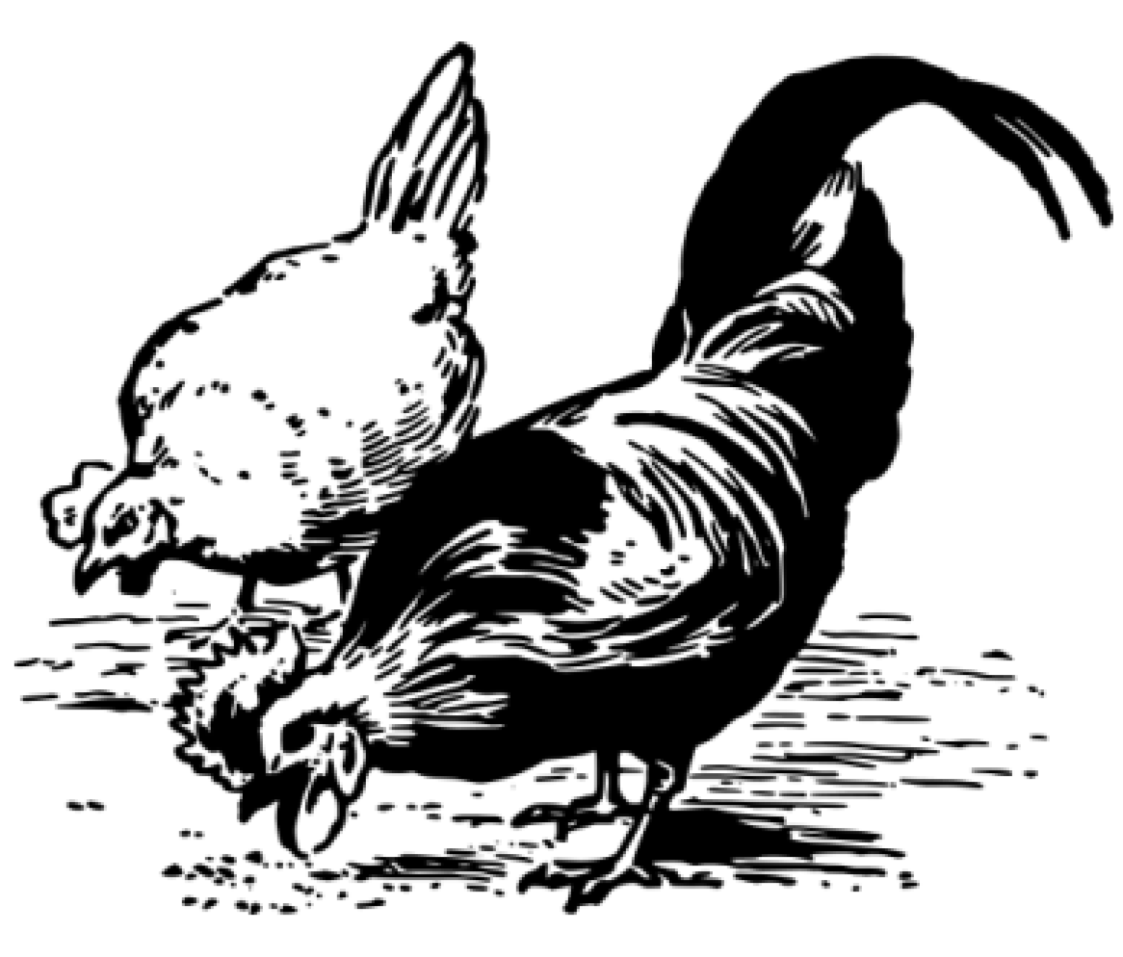
Ecosystems & The Food Web • Grade 5
Anchor Layer Teacher Guide
Anchor Phenomenon Background
How can you create an ecosystem that will provide all the food your team needs?
This anchor layer introduces Biosphere 2, an experiment where scientists tried to create a self-sustaining ecosystem in a dome in the Arizona desert.
Your students will be a part of the Biosphere 2 team. Their job is to make sure that the dome’s ecosystem can supply them with the food they need to survive.
To decide what’s in their ecosystem, students will think about what they want to eat — and where that food comes from. If they want a fried egg for breakfast, they need a bird (probably a chicken) to lay that egg. For each food-producing organism, students will need to consider what that organism needs to thrive. Animals need food to eat. Plants need pollinators to reproduce.
Students will revisit their model ecosystem after each lesson, revising it as they learn more about the web of life.
Additional resources:
If your students want more information about the original Biosphere 2 project and what happened to it, consider showing them this video (https://video.link/w/6fQp).
If students need help figuring out a menu, here is a sample menu and answer key (https://mysteryscience.com/docs/808). Students can use this menu — or start with this and modify as they wish.
Some students struggle because they don’t know what goes into the foods they eat. To help with that, here are recipes for our sample menu and a worksheet (https://mysteryscience.com/docs/809).
‹#›

Slide 5
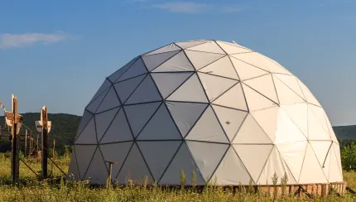
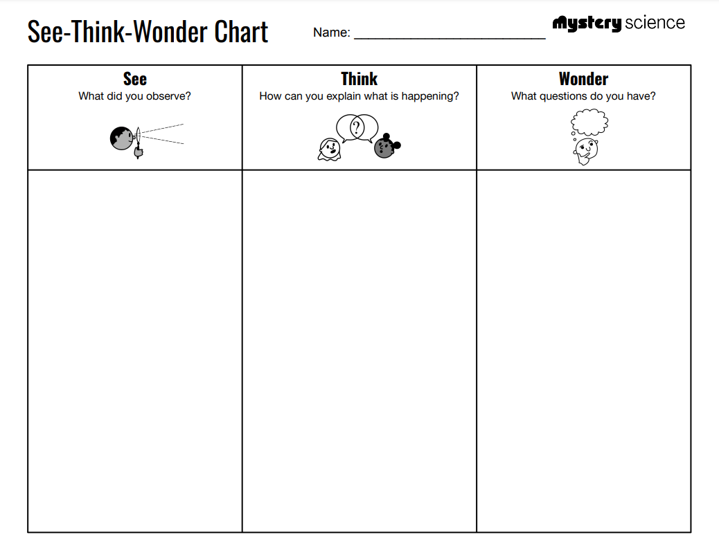
Ecosystems & The Food Web • Grade 5
Anchor Layer Teacher Guide
Anchor Phenomenon: Life Inside a Dome
Ecosystem Design & Modeling
Anchor Phenomenon Lesson Overview
Note: This lesson is part of this unit’s Anchor Layer. If you have the Anchor Layer turned on, we recommend teaching all lessons in the remainder of this unit in order.
The anchor phenomenon for this unit focuses on attempts to grow food in an enclosed ecosystem. Students generate observations and questions about the phenomenon and create an initial design solution to growing food inside a dome for two years.
Anchor Phenomenon 13 mins
Guided Inquiry 30 mins
Hands-On Activity 60 mins
Wrap-Up 2 mins
Student Work Samples & Notes
It is important to encourage students to recognize that even if they don't know the perfect answer yet, they are going to learn a lot throughout the unit and have an opportunity to change or add to their first model.
Biosphere 2 is located in the desert, which is sunny during the day.
Biosphere 2 has glass panels which will let in sunlight that plants need to grow.
The trees inside Biosphere 2 will provide oxygen for animals.
Biosphere 2 is not shaded, it will get a lot of sunlight.
Biosphere 2 is closed off from the outside world, nothing can come in or out.
Biosphere 2 is a lot smaller than the Earth and everything you need has to fit inside.
If all of the plants died, all of the animals would die and there would be no food.
You have to cook everything; boxed items would run out.
What types of animals can live inside Biosphere 2?
How many people need to be fed?
What do the animals eat?
What happens to all of the animal waste?
How do living things depend on one another to survive?
How does energy and matter move through an ecosystem?
‹#›

Slide 6
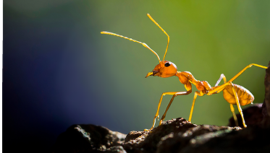
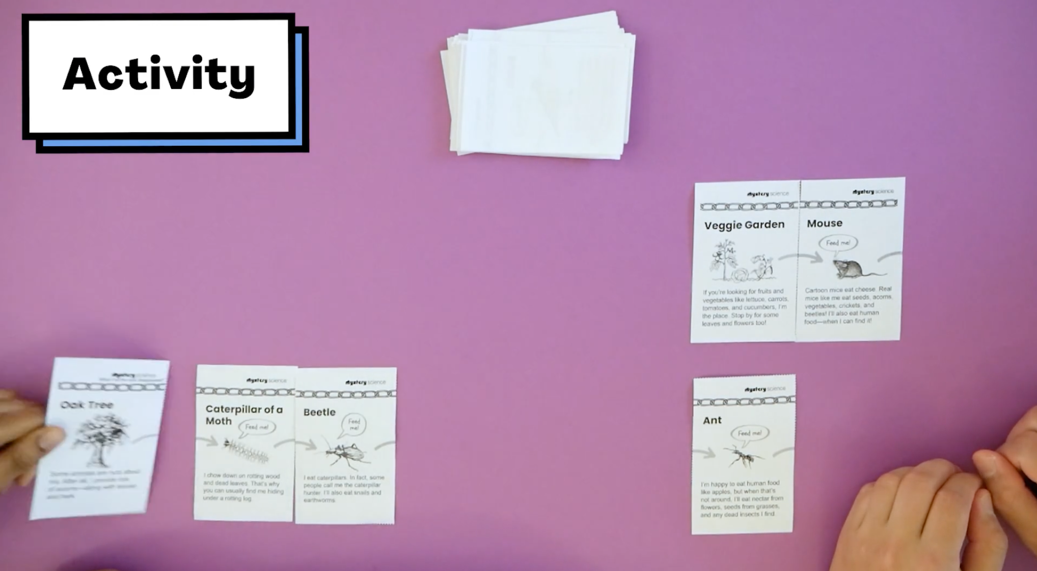
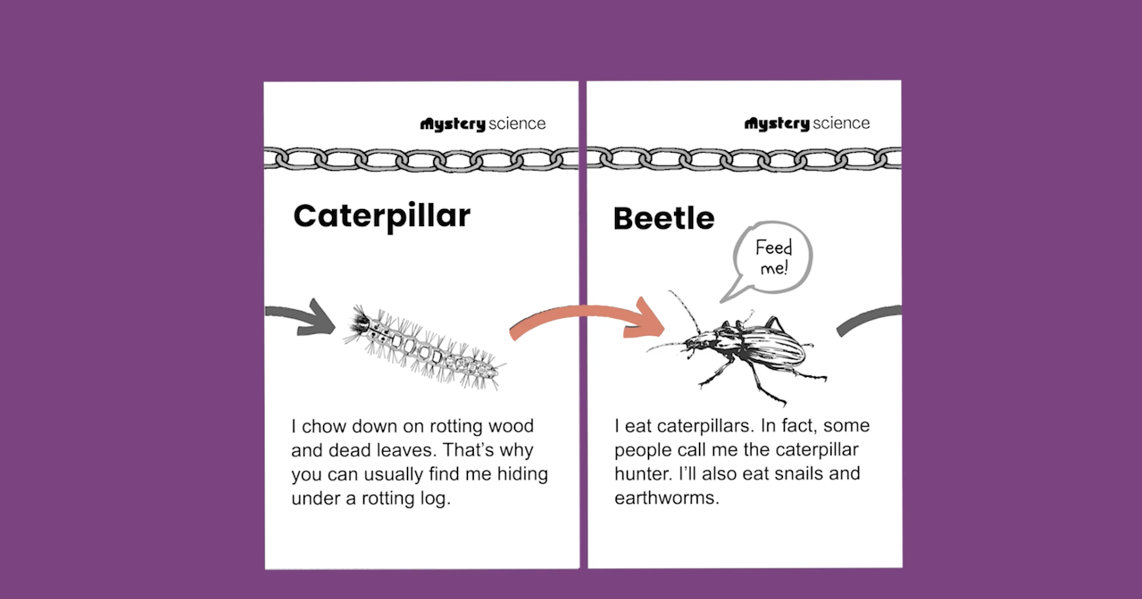
Ecosystems & The Food Web • Grade 5
Anchor Layer Teacher Guide
Lesson 1: What if all the ants disappeared? (pg 1 of 2)
Food Chains & Matter Flow
Overview
In this lesson, students develop their thinking about the predator/prey relationships between living things.
In the activity, Eat or Be Eaten, students play a card game in which they make food chains with predators and prey, and producers and consumers. The students who make the longest food chains win the game!
Exploration 10 mins
Hands-On Activity 30 mins
Wrap-up 15 mins
Anchor Connection 20 mins
Assessment 25 mins
Activity Notes
We suggest students work in groups of four. Homeschool students will need a partner to play the Eat or Be Eaten game as it is designed for 2 to 4 players.
Each group of players will need enough table space to lay out their cards as they form food chains. Clusters of student desks work well for this.
We've provided some Teacher Tips to help you guide your students and answer any clarifying questions about how the game is played.
Anchor Connection on Next Page
‹#›

Slide 7
Ecosystems & The Food Web • Grade 5
Anchor Layer Teacher Guide
Lesson 1: What if all the ants disappeared? (pg 2 of 2)
Food Chains & Matter Flow
Anchor Connection
Living things get their food through food chains. All 20 organisms students choose for their “My Biosphere” model must have a food source.
Students revisit the explanation and/or drawings that they worked on during the Anchor Phenomenon. They should understand that all living things need a food source in order to grow, and are all part of a food chain.
Students can update their explanations and/or drawings by:
Changing which living things are included in their biosphere
Drawing arrows to indicate food chains in their biosphere
Ensuring that all food chains include producers
Connecting Storyline Question
Does every living thing in my ecosystem have something to eat?
Exploration 10 mins
Hands-On Activity 30 mins
Wrap-up 15 mins
Anchor Connection 20 mins
Assessment 25 mins
‹#›

Slide 8
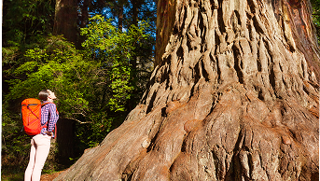
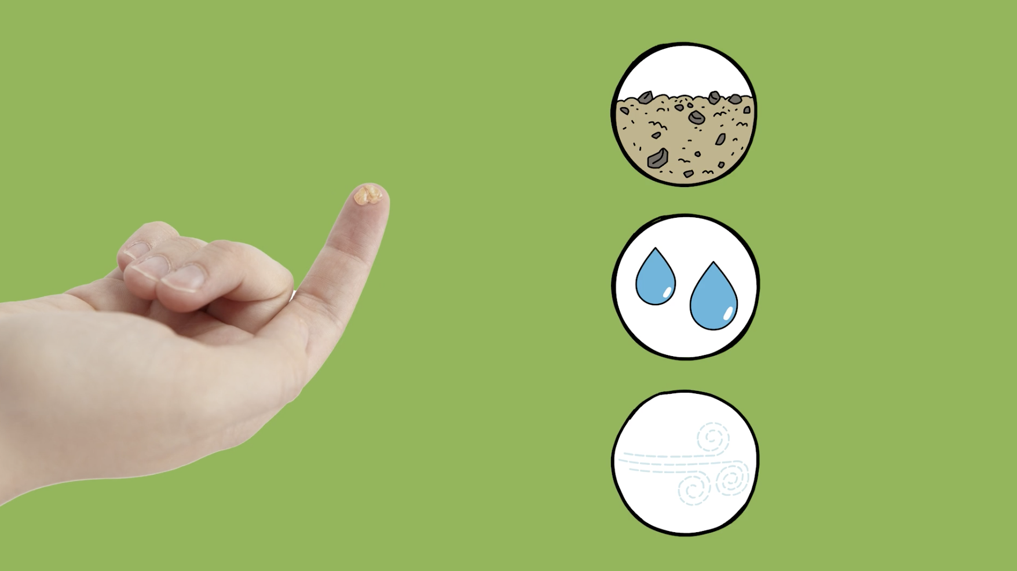
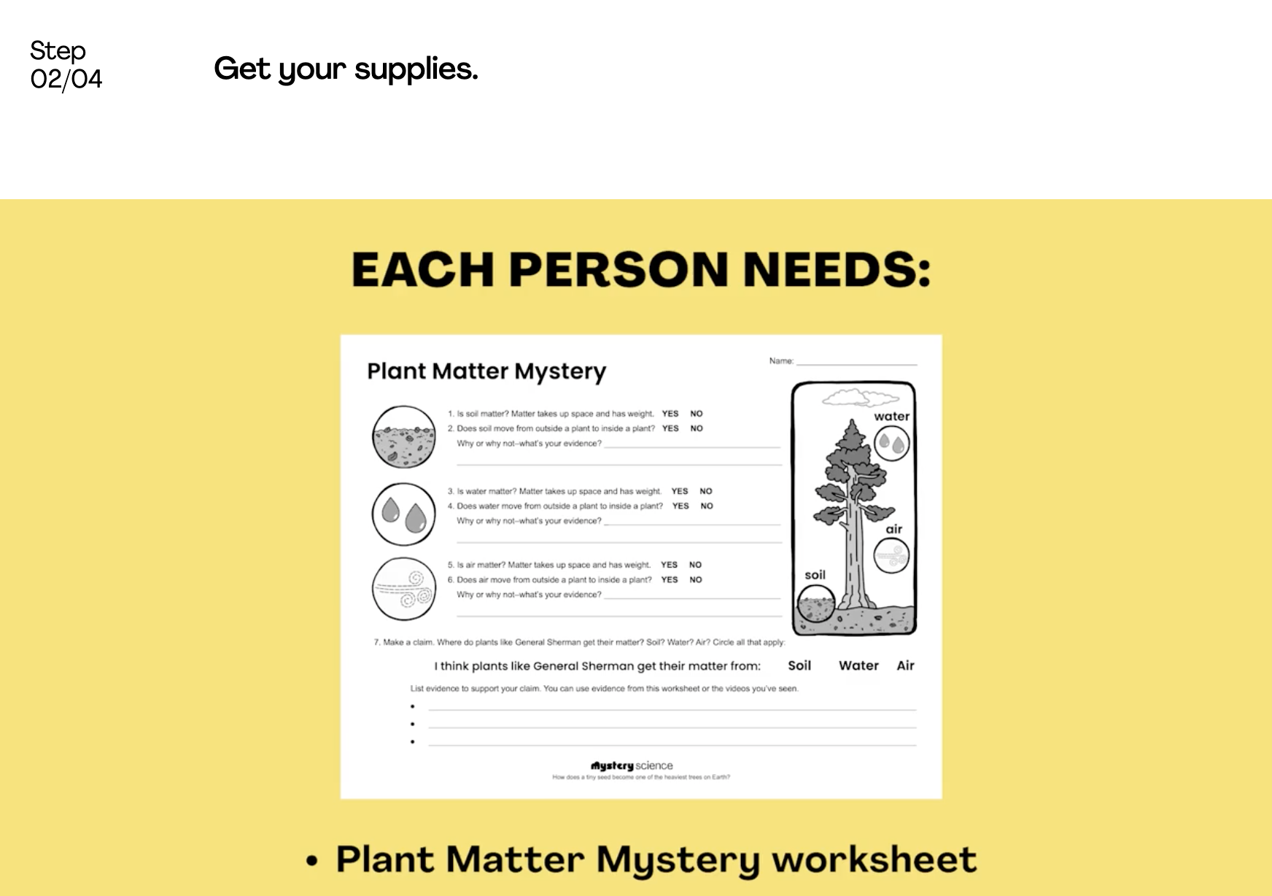
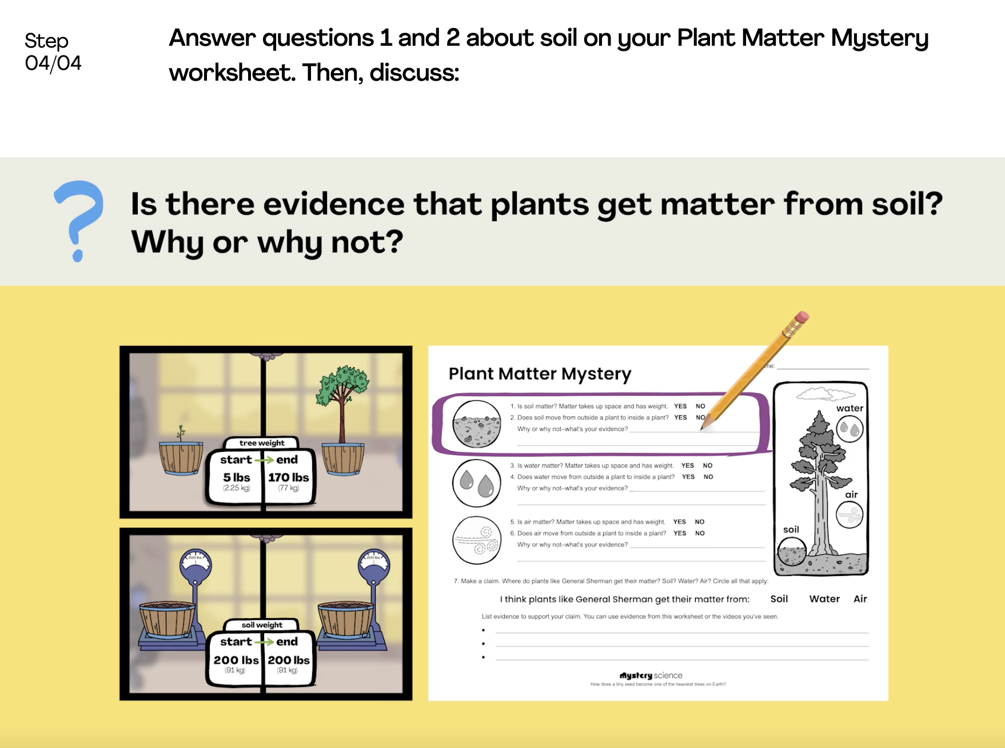
Ecosystems & The Food Web • Grade 5
Anchor Layer Teacher Guide
Lesson 2: How does a tiny seed become one of the heaviest trees on Earth?
Plant Growth & Matter (pg 1 of 2)
Overview
In this lesson, students discover how it is possible for plants to grow and gain tremendous amounts of weight without eating anything. In the activity, Plant Matter Mystery, students gather evidence from a series of virtual experiments related to plant growth. Then, they use that evidence to create an argument that plants get matter they need for growth chiefly from air and water.
Exploration 10 mins
Hands-On Activity 35 mins
Wrap-Up 15 mins
Anchor Connection 20 mins
Assessment 25 mins
Activity Notes
We suggest students work in pairs. Homeschool students can work on their own.
This lesson presents a series of virtual activities so that students can gather evidence and make a claim about what plants use for their growth: soil, water, or air. Each student needs a Plant Matter Mystery worksheet for the duration of the lesson.
Plan Your Time
If you have limited time, you can divide this lesson into two sessions. We have marked a natural stopping point after students gather evidence about soil and water.
Part 1: Soil & Water Experiments.
Part 2: Air Experiments & Making a Claim begins here. Students will need the Weighing Air worksheet in Part 2.
Anchor Connection on Next Page
‹#›

Slide 9
Ecosystems & The Food Web • Grade 5
Anchor Layer Teacher Guide
Lesson 2: How does a tiny seed become one of the heaviest trees on Earth?
Plant Growth & Matter (pg 2 of 2)
Anchor Connection
Living things get their food through food chains. All 20 organisms students choose for their “My Biosphere” model must have a food source.
Students revisit the explanation and/or drawings that they worked on during the Anchor Phenomenon. They should understand that all living things need a food source in order to grow, and are all part of a food chain.
Students can update their explanations and/or drawings by:
Changing which living things are included in their biosphere
Drawing arrows to indicate food chains in their biosphere
Ensuring that all food chains include producers
Connecting Storyline Question
Does every living thing in my ecosystem have something to eat?
Exploration 10 mins
Hands-On Activity 35 mins
Wrap-Up 15 mins
Anchor Connection 20 mins
Assessment 25 mins
‹#›

Slide 10
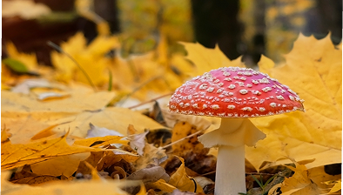
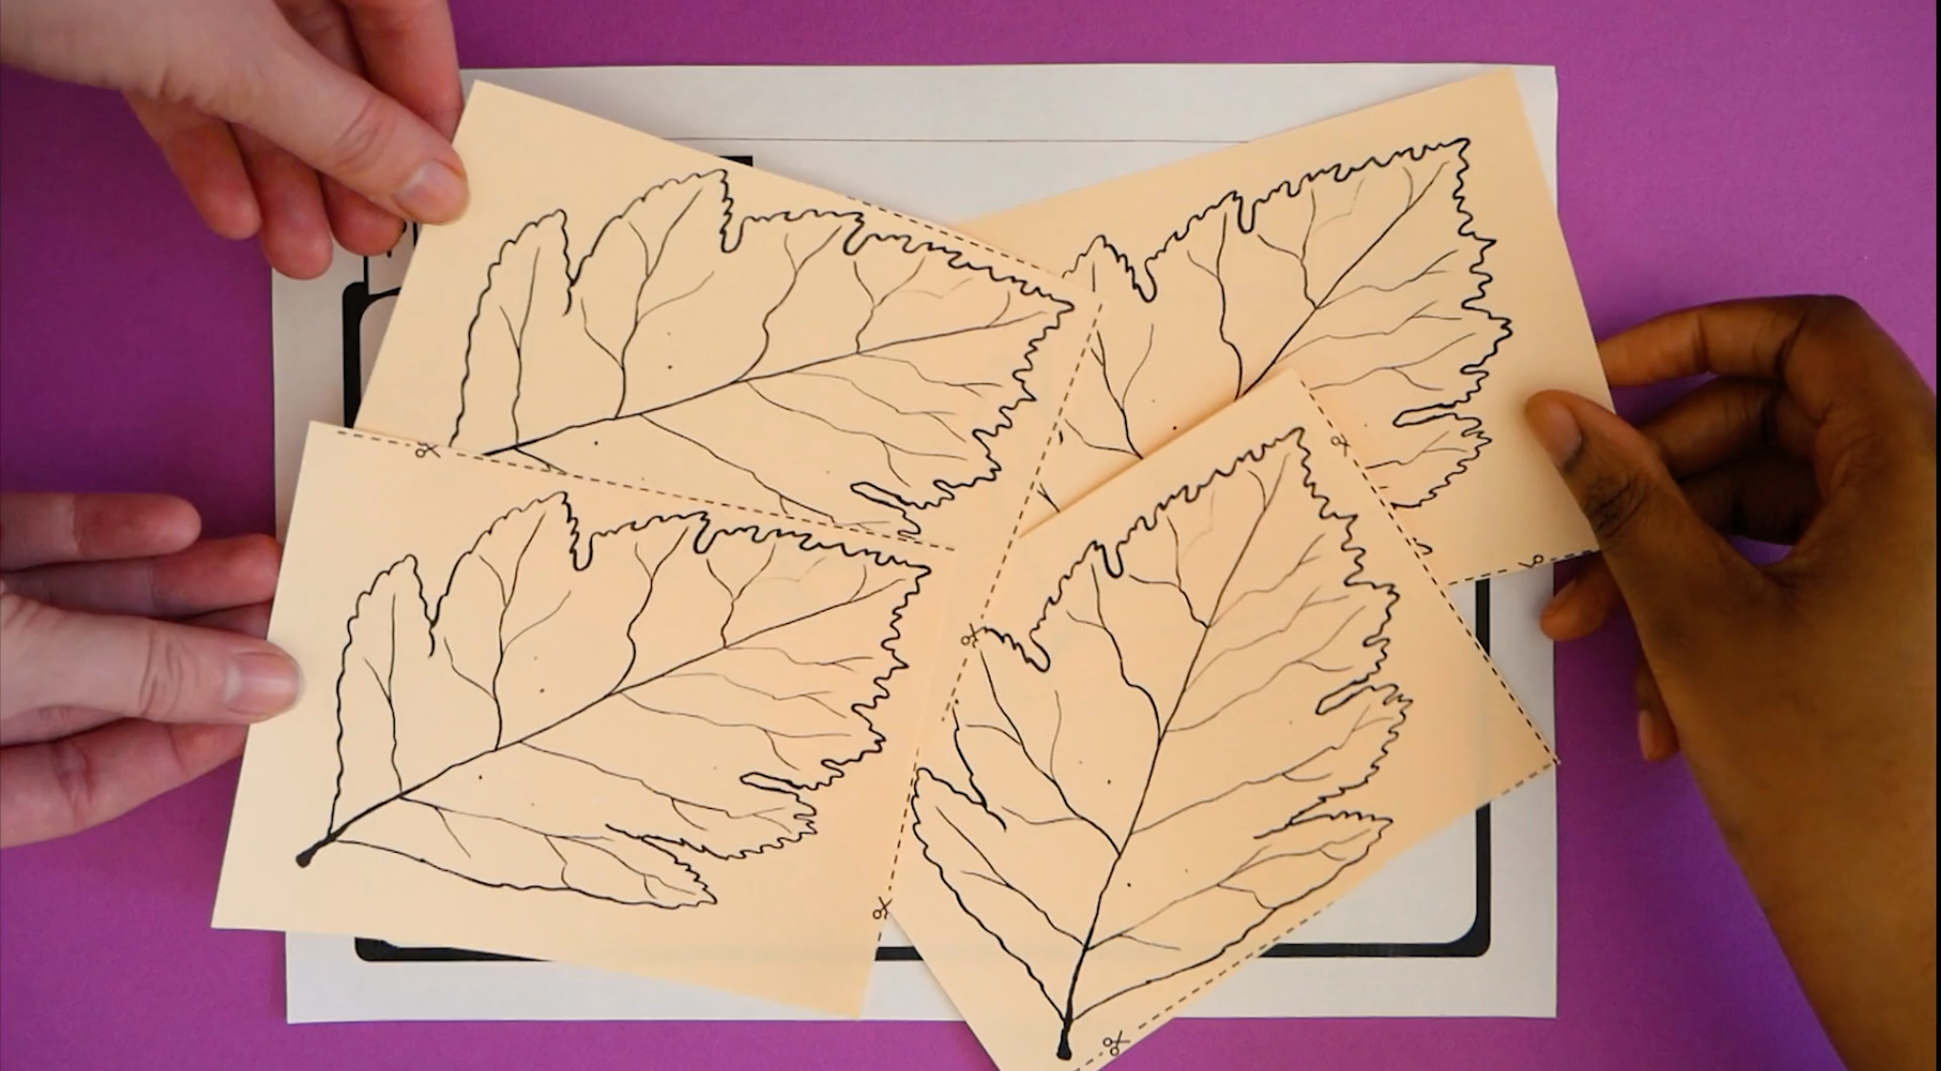
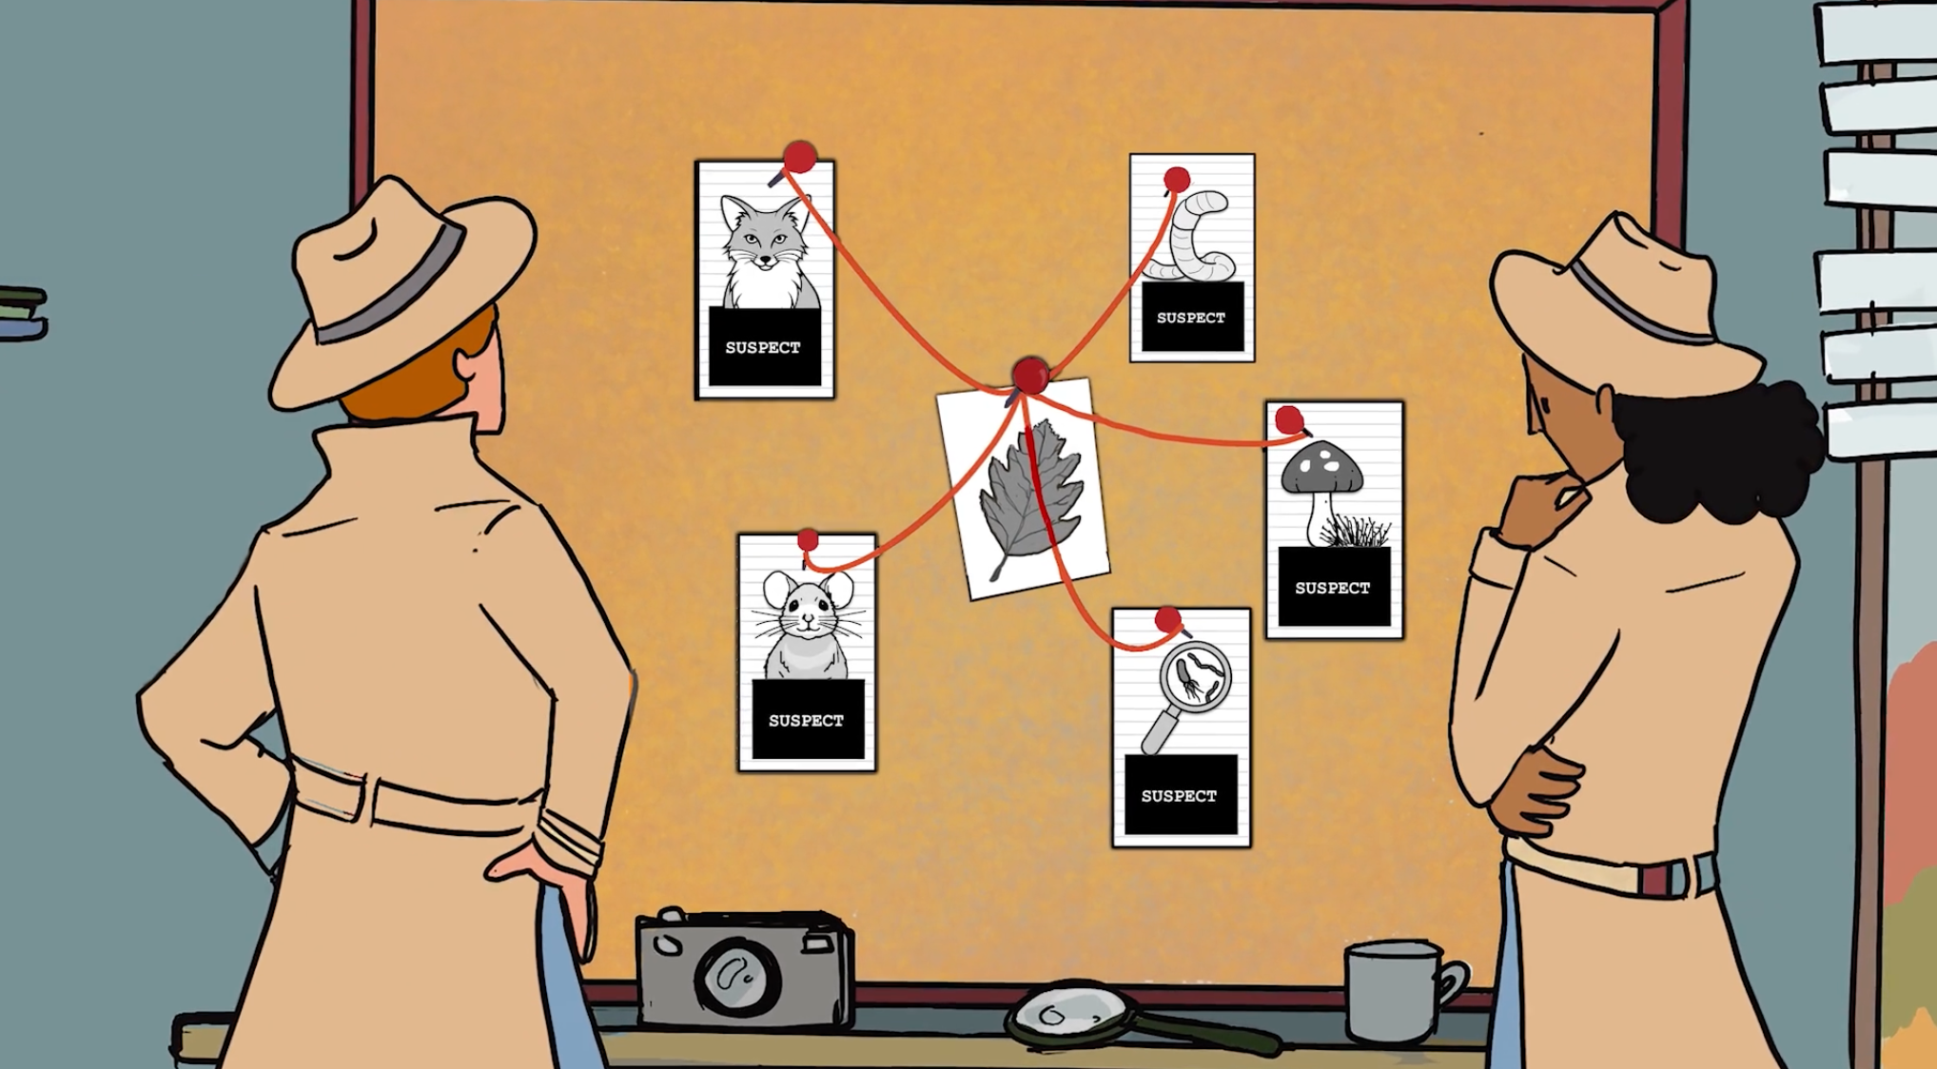
Ecosystems & The Food Web • Grade 5
Anchor Layer Teacher Guide
Lesson 3: Where do fallen leaves go? (pg 1 of 2)
Decomposers & Matter Flow
Overview
In this lesson, students develop a model to describe the flow of matter between living things and the environment, with an emphasis on decomposers.
In the activity, Decomposer Detectives, students gather information from suspects on the forest floor, and model the decomposition process of fallen leaves in order to solve the mystery of why those leaf piles seem to disappear.
Exploration 10 mins
Hands-On Activity 30 mins
Wrap-Up 15 mins
Anchor Connection 20 mins
Assessment 25 mins
Activity Notes
We suggest students work in groups of pairs. You will need access to water for this activity.
Prep Your Solve the Case worksheets Cut each of these worksheets in half so that each student has a 1/2 sheet.
Anchor Connection on Next Page
‹#›

Slide 11
Ecosystems & The Food Web • Grade 5
Anchor Layer Teacher Guide
Lesson 3: Where do fallen leaves go? (pg 2 of 2)
Decomposers & Matter Cycle
Anchor Connection
Decomposers break down dead or decaying organisms. Decomposers are necessary for a healthy ecosystem. Students need to include decomposers in their “My Biosphere” model.
Students revisit the explanation and/or drawings that they worked on during the Anchor Phenomenon. They should understand that decomposers play an important role in the ecosystem and can always be found in a healthy ecosystem.
Students can update their explanations and/or drawings by:
Adding decomposers to their biosphere
Connecting Storyline Question
How could we get rid of dead plants and animals inside the Biosphere?
Exploration 10 mins
Hands-On Activity 30 mins
Wrap-Up 15 mins
Anchor Connection 20 mins
Assessment 25 mins
‹#›

Slide 12
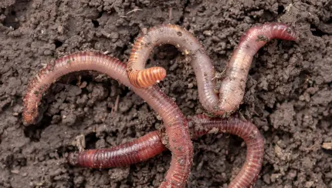
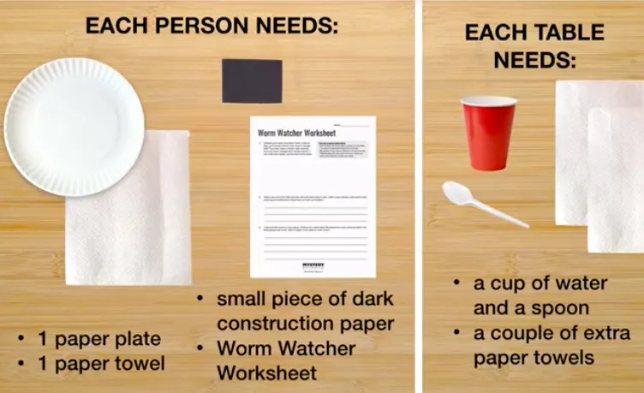
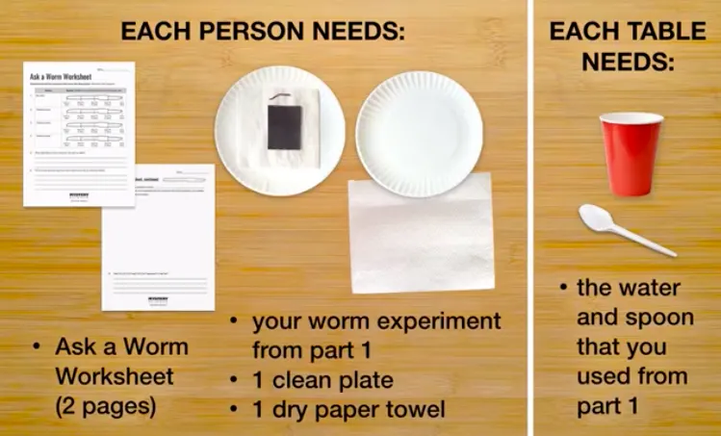
Ecosystems & The Food Web • Grade 5
Anchor Layer Teacher Guide
Lesson 4: Do worms really eat dirt? (pg 1 of 2)
Decomposers, Nutrients, & Matter Cycle
Overview
In this lesson, students discover the critical role earthworms play in decomposing dead material and releasing nutrients into the soil.
During a two-part activity, Ask a Worm, students observe earthworms and then design their own “fair test” investigations of earthworm behavior. Students first make close observations of worms. Then, students conduct a simple experiment with multiple trials to figure out if worms prefer dry or wet areas. They consider what a “fair test” is and design an experiment to answer other questions about worms.
Exploration 16 mins
Hands-On Activity 45 mins
Wrap-Up 4 mins
Anchor Connection 20 mins
Assessment 25 mins
Part 1:
Activity Notes
Source your worms in advance. We suggest students work in groups of four. Students will share supplies with their group in Part 1 and share experiment ideas with their group in Part 2. You will need access to water for this activity. See our lesson page for more detailed prep instructions.
Red worms (also known as red wigglers) can be purchased from a garden store or ordered by mail from a variety of online sources. We recommend ordering from Uncle Jim's Worm Farm. At bait shops, you can sometimes find red worms, but more commonly you’ll find earthworms. The bigger red worms are great for observations and in the natural habitat, they burrow deep in the soil, making red worms a better choice if you want to make a worm bin. Red worms live in the top layers of the soil, feeding on decomposing leaves and organic debris
Part 2:
Anchor Connection on Next Page
‹#›

Slide 13
Ecosystems & The Food Web • Grade 5
Anchor Layer Teacher Guide
Lesson 4: Do worms really eat dirt? (pg 2 of 2)
Decomposers, Nutrients, & Matter Cycle
Anchor Connection
Decomposers recycle nutrients back into an ecosystem. Students add arrows into their food chains to show the movement of nutrients from decomposers to soil.
Students revisit the explanation and/or drawings that they worked on during the Anchor Phenomenon. They should understand that worms help an ecosystem by recycling nutrients back into the soil.
Students can update their explanations and/or drawings by:
Showing how decomposers recycle nutrients within the biosphere
Connecting Storyline Question
How would adding worms to the Biosphere affect the ecosystem?
Exploration 16 mins
Hands-On Activity 45 mins
Wrap-Up 4 mins
Anchor Connection 20 mins
Assessment 25 mins
‹#›

Slide 14
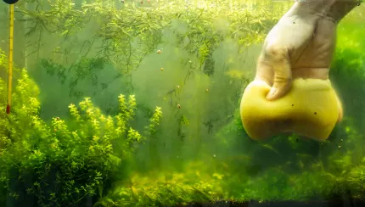
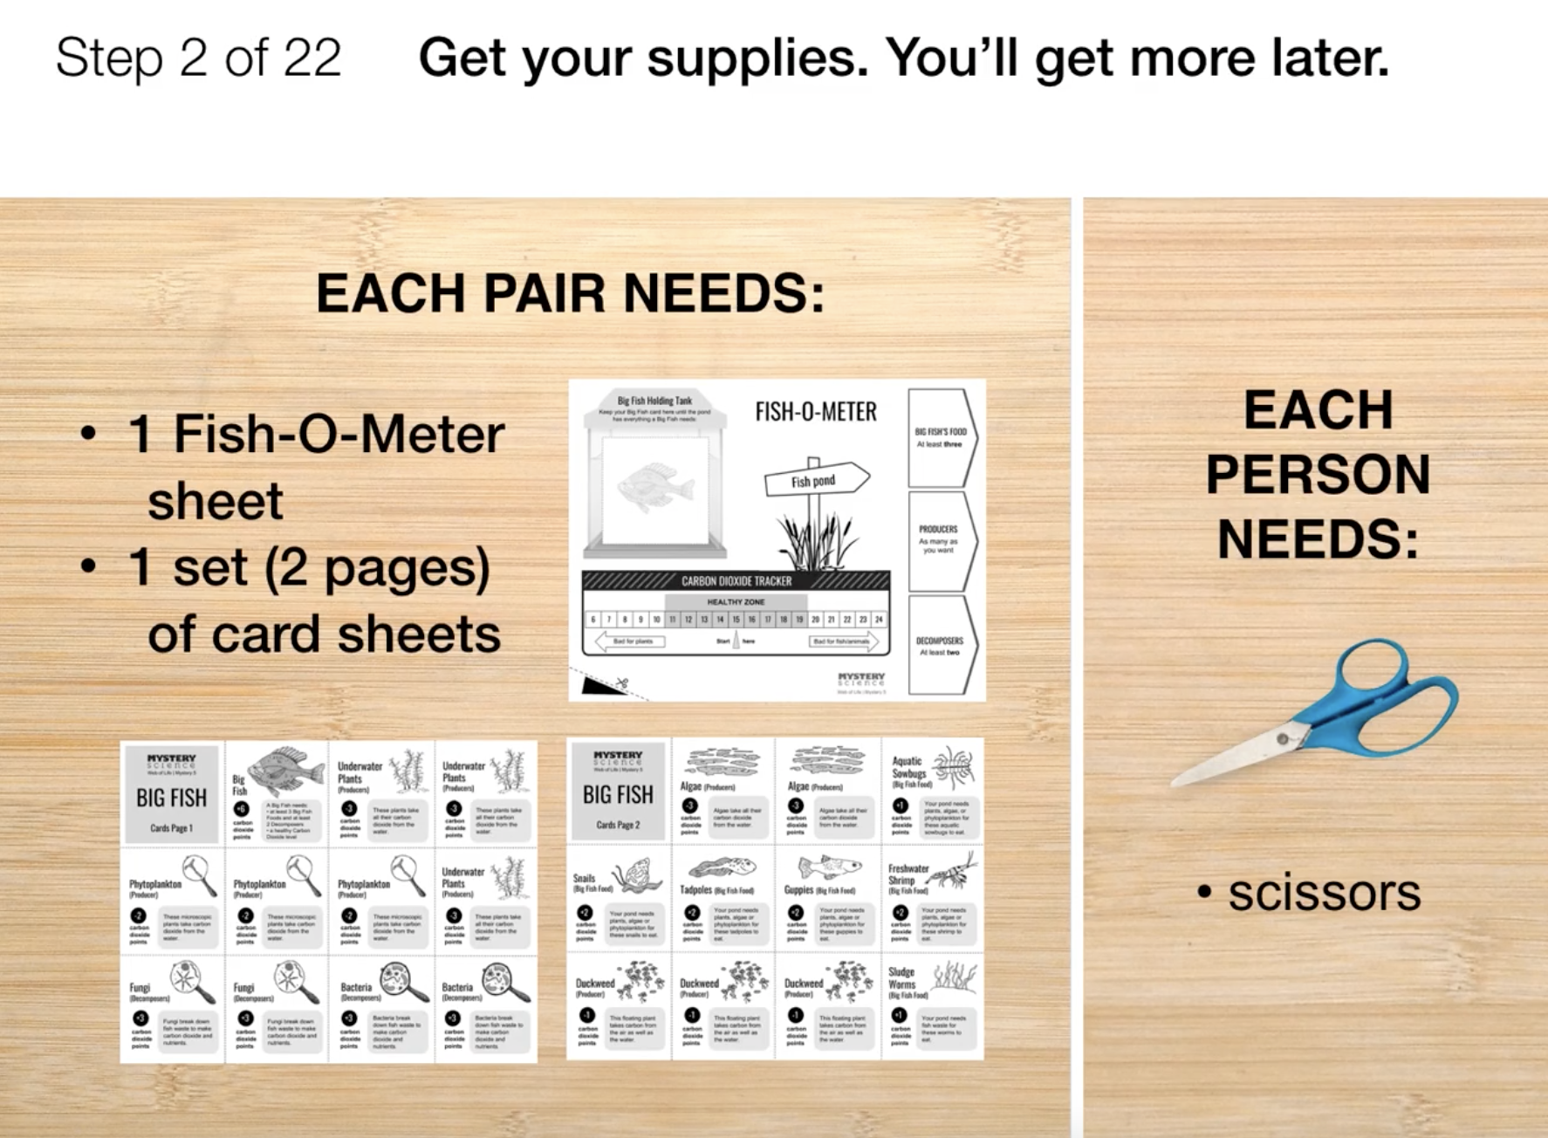
Ecosystems & The Food Web • Grade 5
Anchor Layer Teacher Guide
Lesson 5: Why do you have to clean a fish tank but not a pond?
Ecosystems & Matter Cycle (pg 1 of 2)
Overview
In this lesson, students combine what they have learned about plants, animals, and decomposers to see how they interact in an ecosystem.
In the activity, Pond Ecosystem Game, students first build a pond ecosystem that will support a sunfish. To succeed, they must make sure that carbon dioxide levels are healthy for both plants and animals. Then, students play a game called Big Fish where they compete to make a healthy ecosystem for a sunfish.
Part 1 (building an ecosystem) takes 10 to 15 minutes. Part 2 (playing the game) takes at least 20 minutes. You may want to divide this lesson into two sessions, stopping after Part 1 and continuing with the game at a later point. If you plan to do the activity in two sessions, the group game begins at Step 12.
Exploration 22 mins
Hands-On Activity 45 mins
Wrap-Up 3 mins
Anchor Connection 20 mins
Assessment 25 mins
Activity Notes
In Part 1 of this activity, students will work in pairs. In Part 2 of this activity, students will work in groups of four to play the Big Fish game.
See the lesson page for tips on dividing materials and prepping if you are planning to divide the activity into two sessions.
Anchor Connection on Next Page
‹#›

Slide 15
Ecosystems & The Food Web • Grade 5
Anchor Layer Teacher Guide
Lesson 5: Why do you have to clean a fish tank but not a pond?
Ecosystems & Matter Cycle (pg 2 of 2)
Anchor Connection
Organisms in an ecosystem depend on one another to cycle energy and nutrients. Students add arrows into their “My Biosphere” model to show the movement of nutrients between organisms.
Students revisit the explanation and/or drawings that they worked on during the Anchor Phenomenon. They should understand that ecosystems can become toxic if there is too much carbon dioxide and not enough plants or decomposers to recycle it.
Students can update their explanations and/or drawings by:
Showing how living things add or remove carbon dioxide to and from the air in the biosphere
Connecting Storyline Question
What happens if one living thing becomes overgrown in an ecosystem?
Exploration 22 mins
Hands-On Activity 45 mins
Wrap-Up 3 mins
Anchor Connection 20 mins
Assessment 25 mins
‹#›

Slide 16
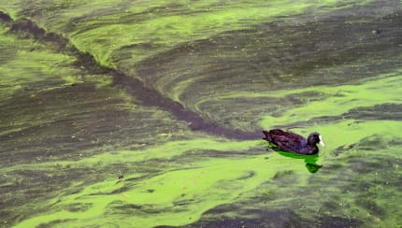
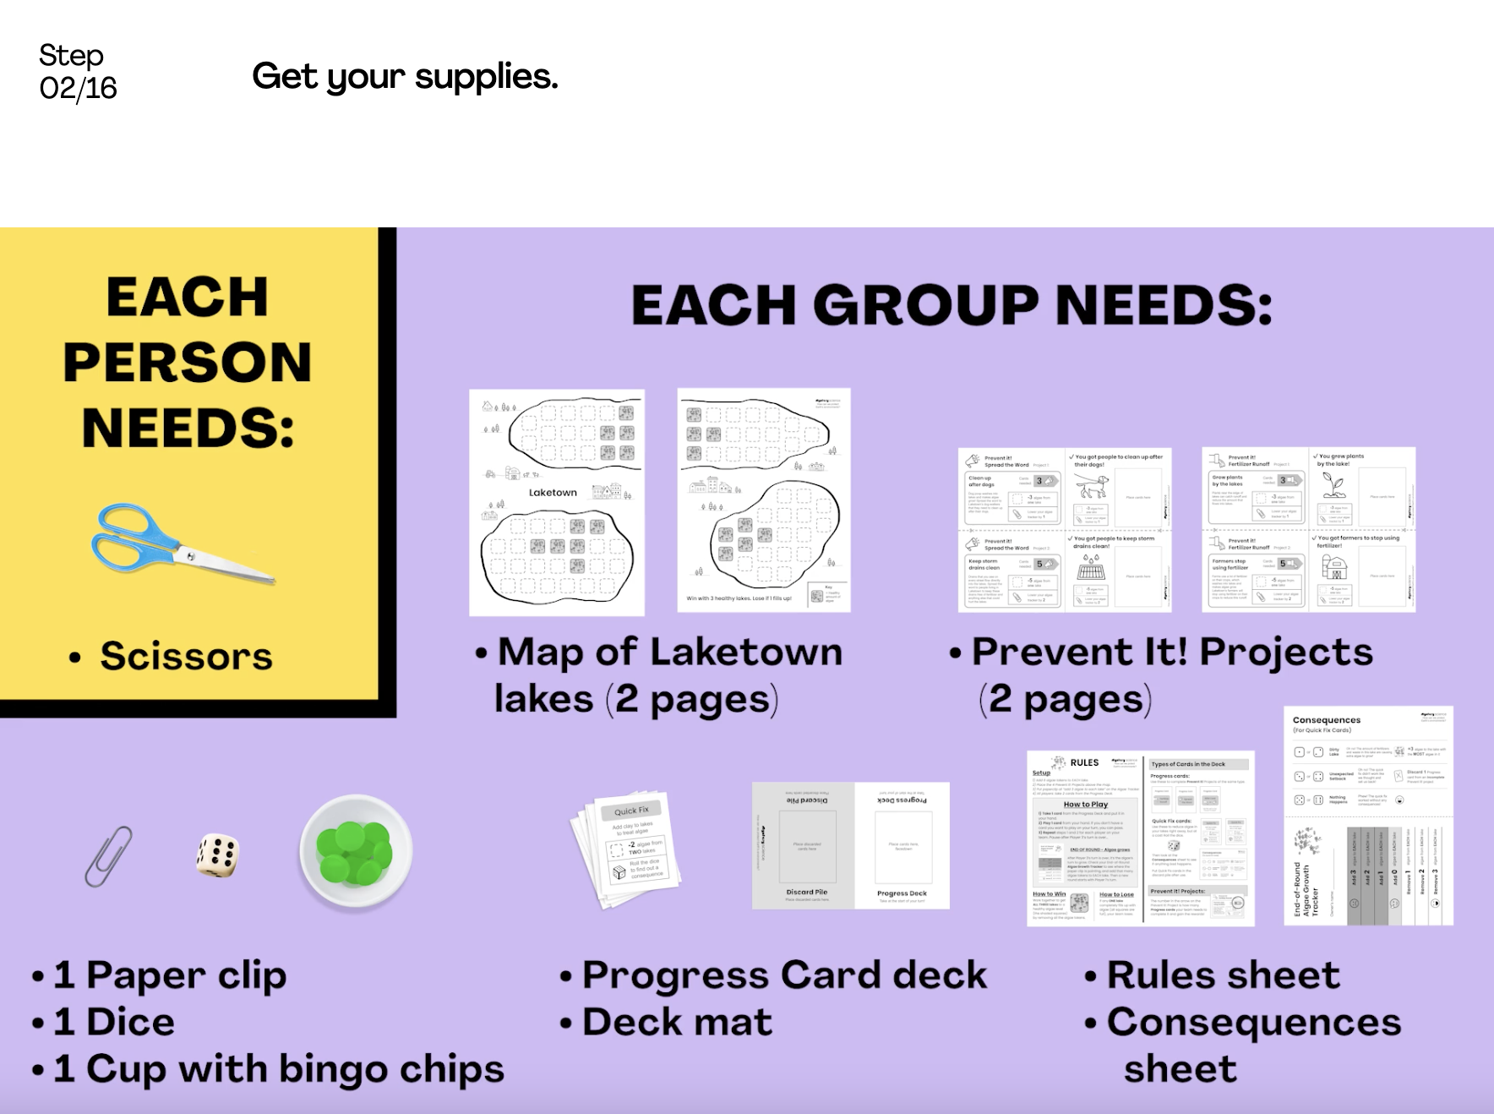
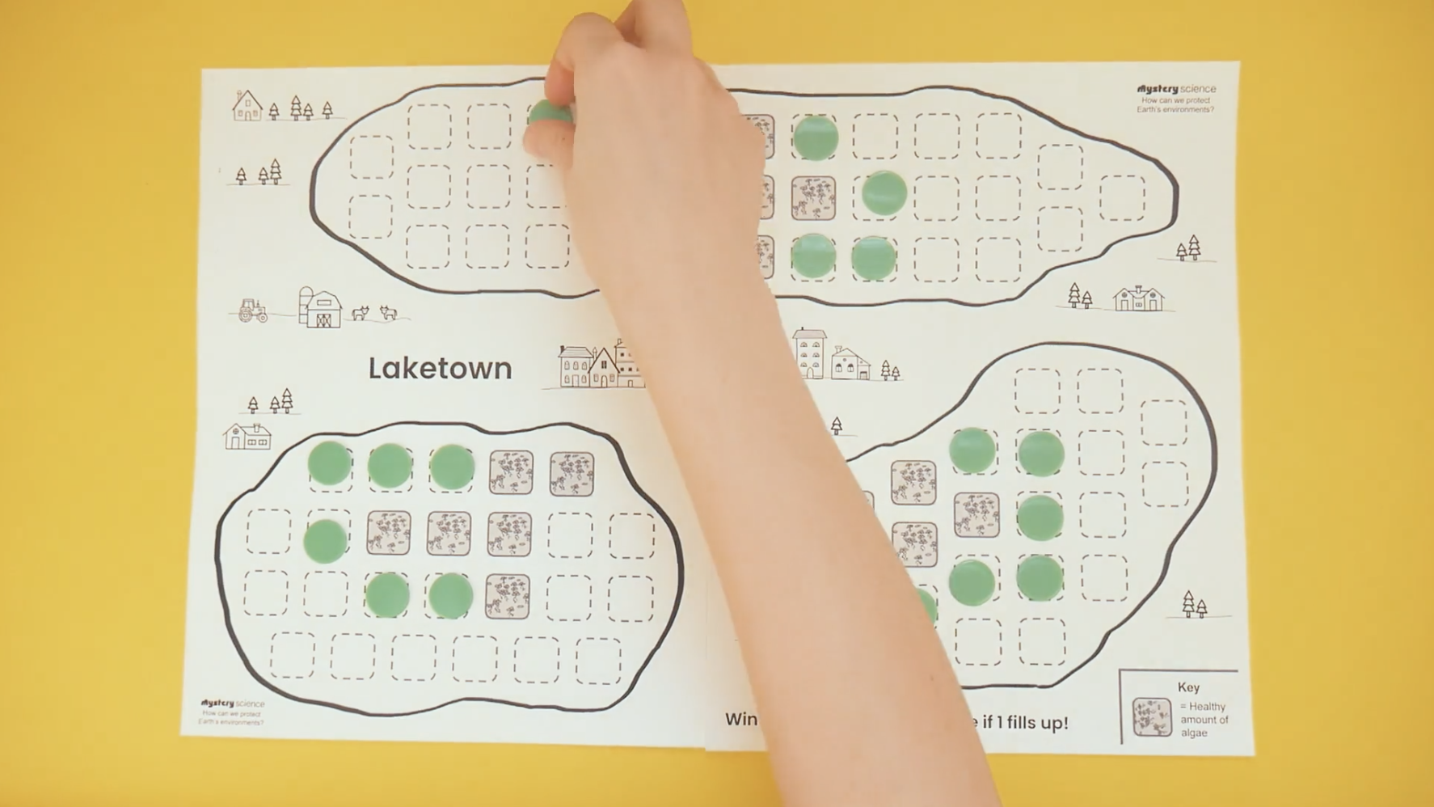
Ecosystems & The Food Web • Grade 5
Anchor Layer Teacher Guide
Lesson 6: How can we protect Earth’s environments?
Protecting Environments (pg 1 of 2)
Overview
In this lesson, students discover what happens in unbalanced ecosystems and how that can lead to an overabundance of algae and harmful algal blooms.
In the activity, Bloom Busters, students play a game in which they obtain and combine science ideas in order to help a community respond to and prevent harmful algal blooms.
Exploration 20 mins
Hands-On Activity 35 mins
Wrap-Up 7 mins
Anchor Connection 20 mins
Assessment 25 mins
Activity Notes
Teacher Background: This lesson focuses on green algal blooms, but algae come in a variety of colors. So depending on where you live, you may be more familiar with different types of harmful algae blooms, such as “red tide”.
We suggest students play the game in groups of three.
For detailed prep instructions on how to prepare cups with bingo chips, decks of cards, and organizing group materials, see the lesson page.
Anchor Connection on Next Page
‹#›

Slide 17
Ecosystems & The Food Web • Grade 5
Anchor Layer Teacher Guide
Lesson 6: How can we protect Earth’s environments?
Protecting Environments (pg 2 of 2)
Anchor Connection
All organisms in an ecosystem require water to survive. Students add information to their “My Biosphere” model to explain how they would protect their water supply from a harmful algae bloom.
Students revisit the explanation and/or drawings that they worked on during the Anchor Phenomenon. They should understand that all living things require water. Maintaining a clean water supply in a biosphere is very important.
Students can update their explanations and/or drawings by:
Explaining how to keep the water in their biosphere safe from a harmful algae bloom
Connecting Storyline Question
Which is more similar to a Biosphere: a pond or a fish tank? Why?
Exploration 20 mins
Hands-On Activity 35 mins
Wrap-Up 7 mins
Anchor Connection 20 mins
Assessment 25 mins
‹#›

Slide 18
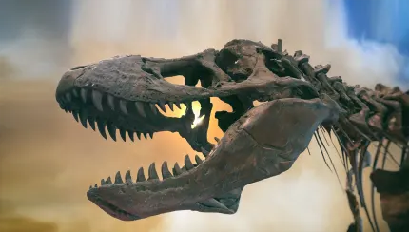
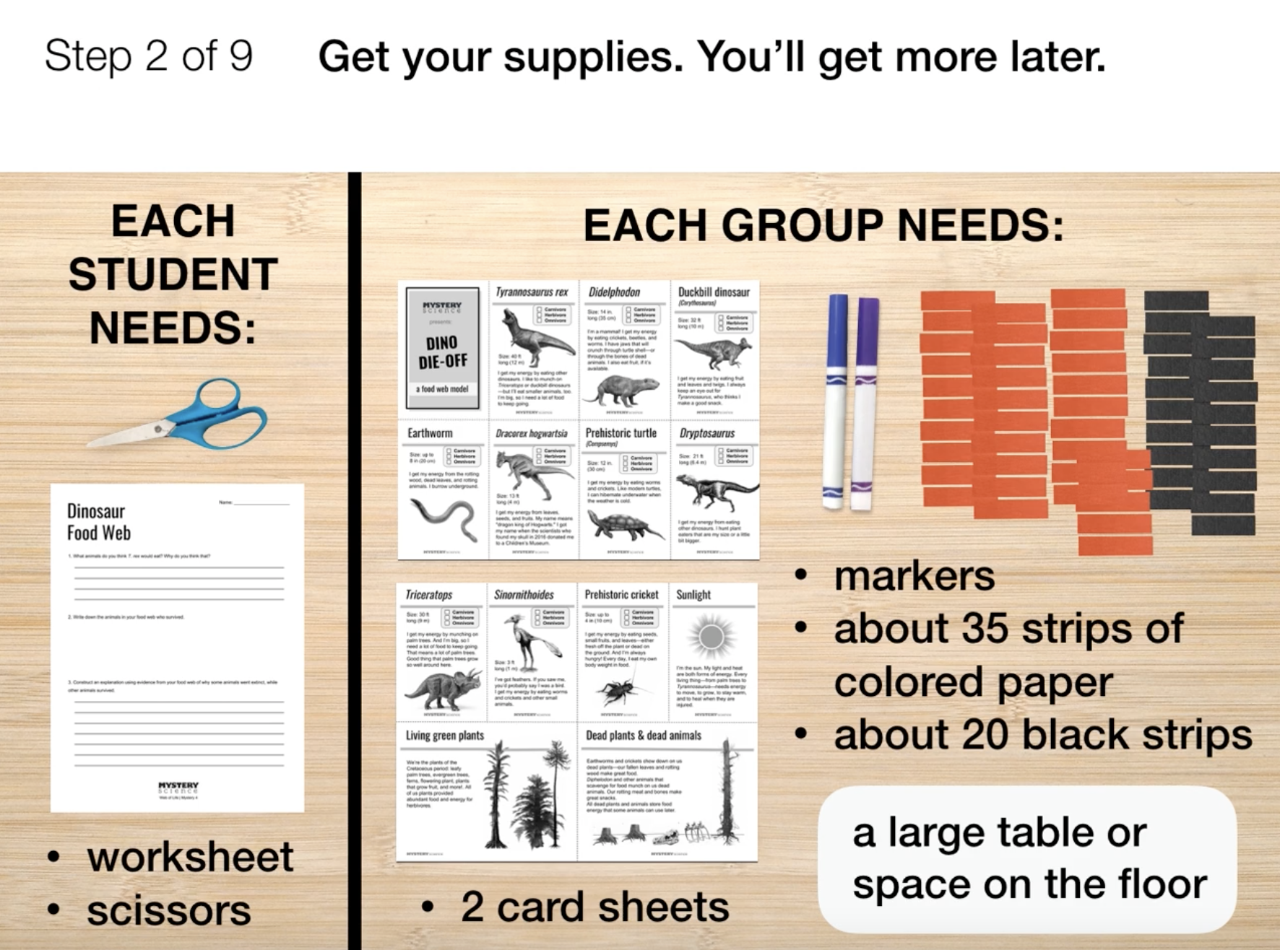
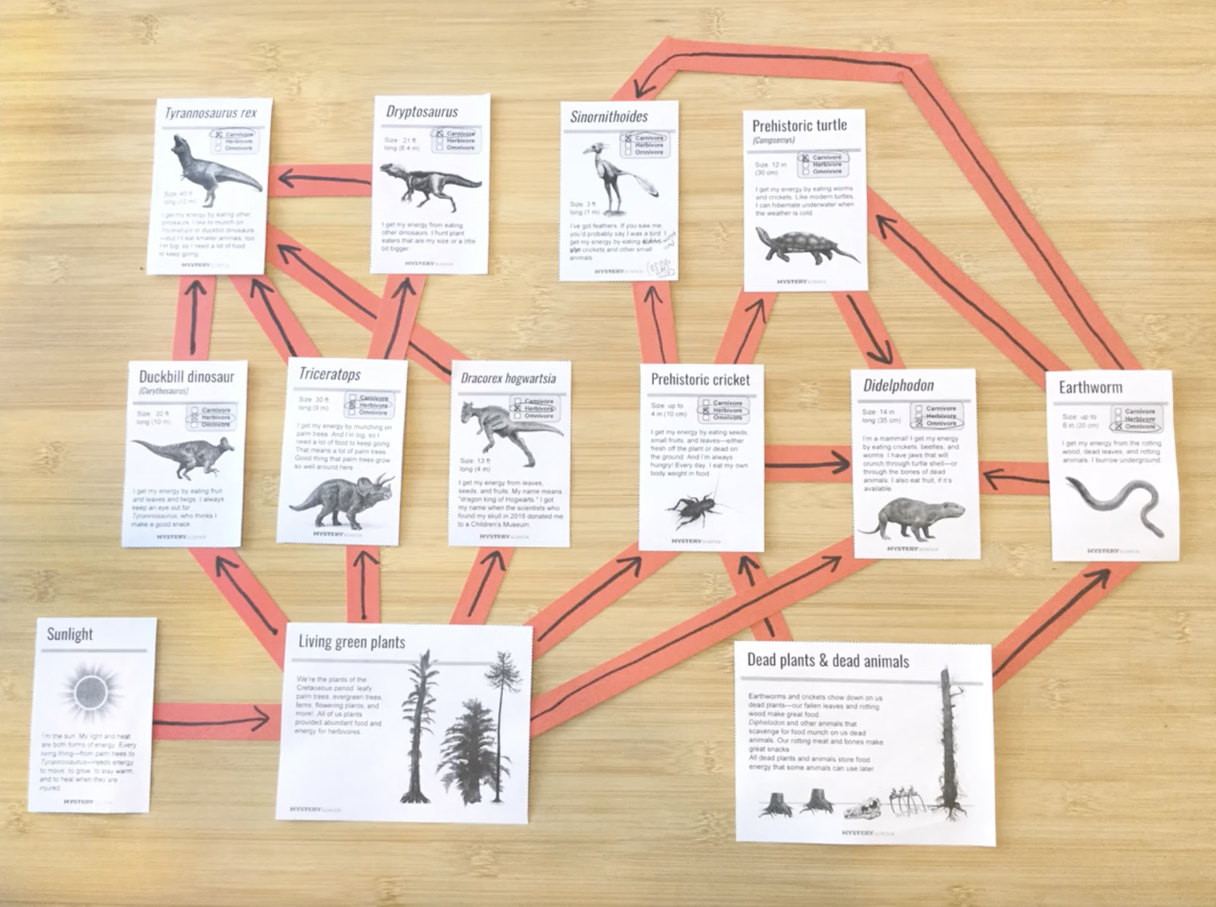
Ecosystems & The Food Web • Grade 5
Anchor Layer Teacher Guide
Lesson 7: Why did the dinosaurs go extinct? (pg 1 of 2)
Food Webs & Flow of Energy
Overview
In this lesson, students investigate the hypothesis that an asteroid impact caused the extinction of the dinosaurs.
In the activity, Create a Dinosaur Food Web, students use cards and construction paper connectors to create a food web from the time of the dinosaurs. Using this model, they follow the flow of energy through the food web and figure out why dinosaurs went extinct but some other animals survived.
Exploration 15 mins
Hands-On Activity 30 mins
Wrap-Up 5 mins
Anchor Connection 20 mins
Assessment 25 mins
Activity Notes
We suggest students work in pairs.
Each pair of students needs an area that’s about 2 feet by 3 feet for their completed food web. Plan for enough space. Students can work at desks, tables, or on the floor.
If you have access to a paper cutter, we suggest you use one to prepare the construction paper strips.
Cut the black construction paper into strips measuring 3” by ¾”. Cut your colored construction paper into strips measuring about 4” by ¾”.
Anchor Connection on Next Page
‹#›

Slide 19
Ecosystems & The Food Web • Grade 5
Anchor Layer Teacher Guide
Lesson 7: Why did the dinosaurs go extinct? (pg 2 of 2)
Food Webs & Flow of Energy
Anchor Connection
All energy in an ecosystem first came from the sun. Students add a source of energy to their “My Biosphere” model and arrows to show the movement of energy.
Students revisit the explanation and/or drawings that they worked on during the Anchor Phenomenon. They should understand that energy from the sun is the original energy source for entire ecosystems.
Students can update their explanations and/or drawings by:
Showing how energy flows within their biosphere
Connecting Storyline Question
What could cause the Biosphere ecosystem to collapse?
Exploration 15 mins
Hands-On Activity 30 mins
Wrap-Up 5 mins
Anchor Connection 20 mins
Assessment 25 mins
‹#›

Slide 20
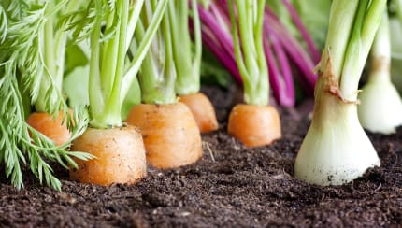
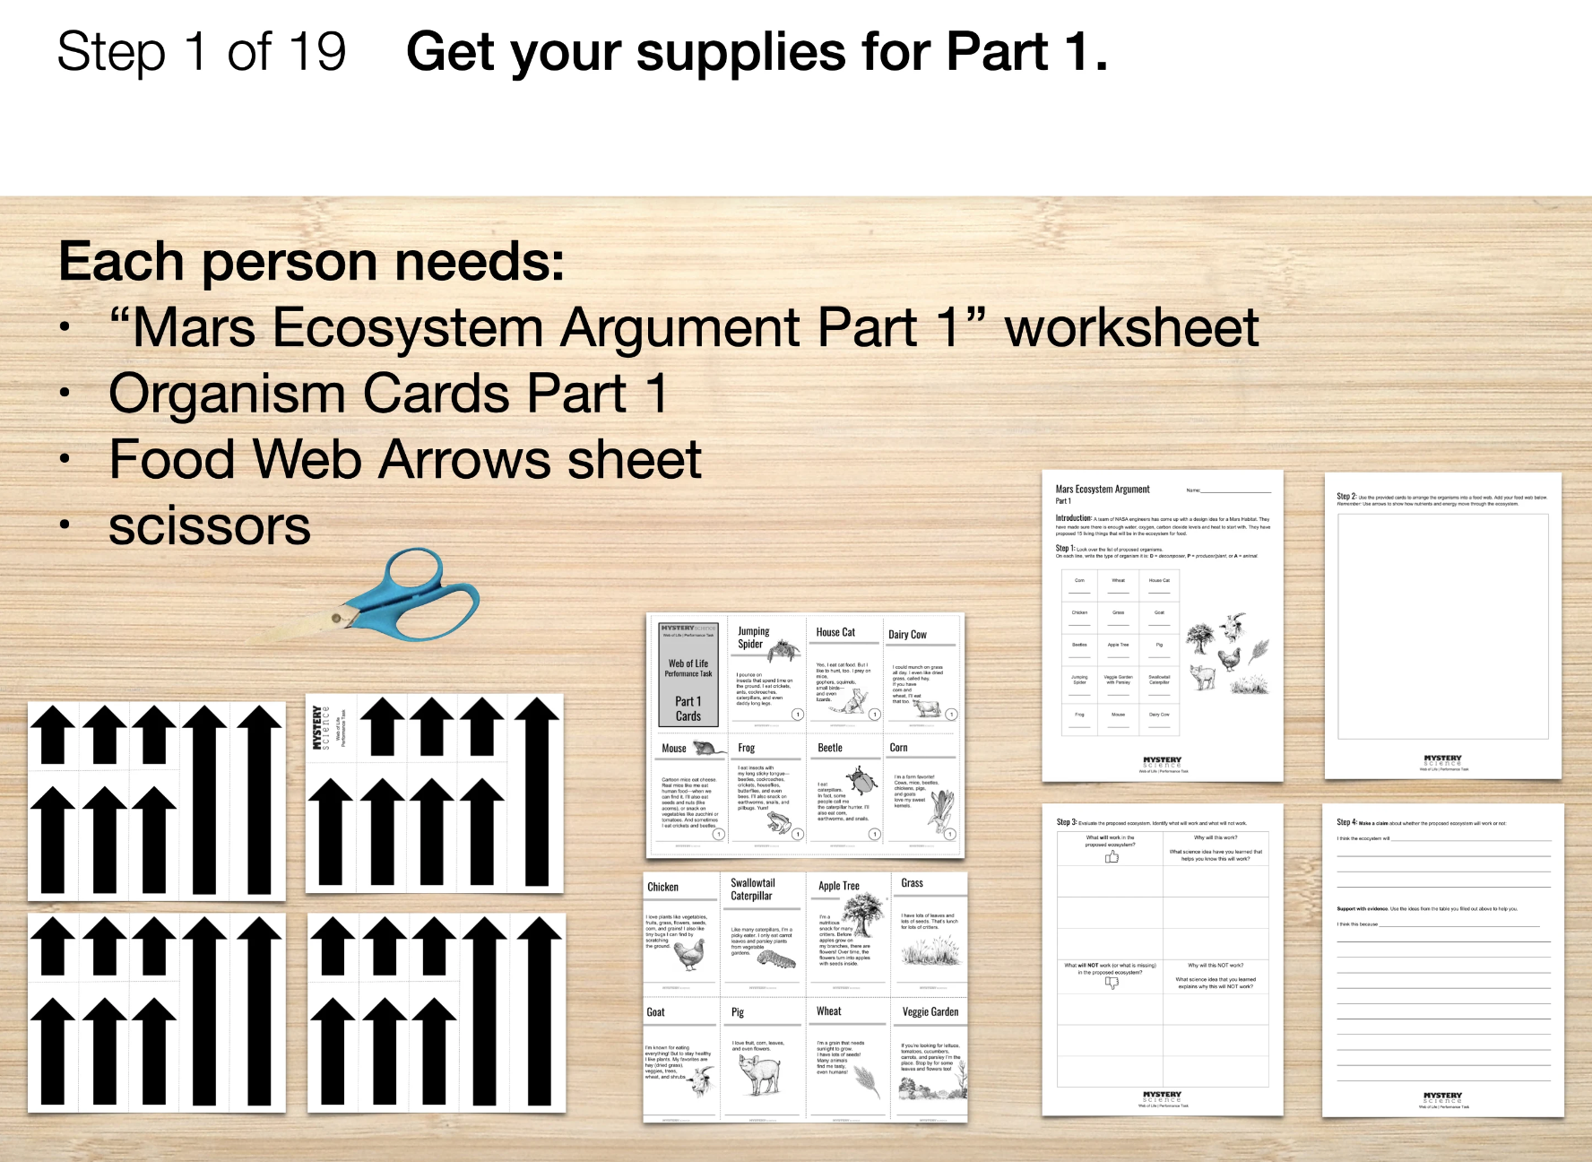
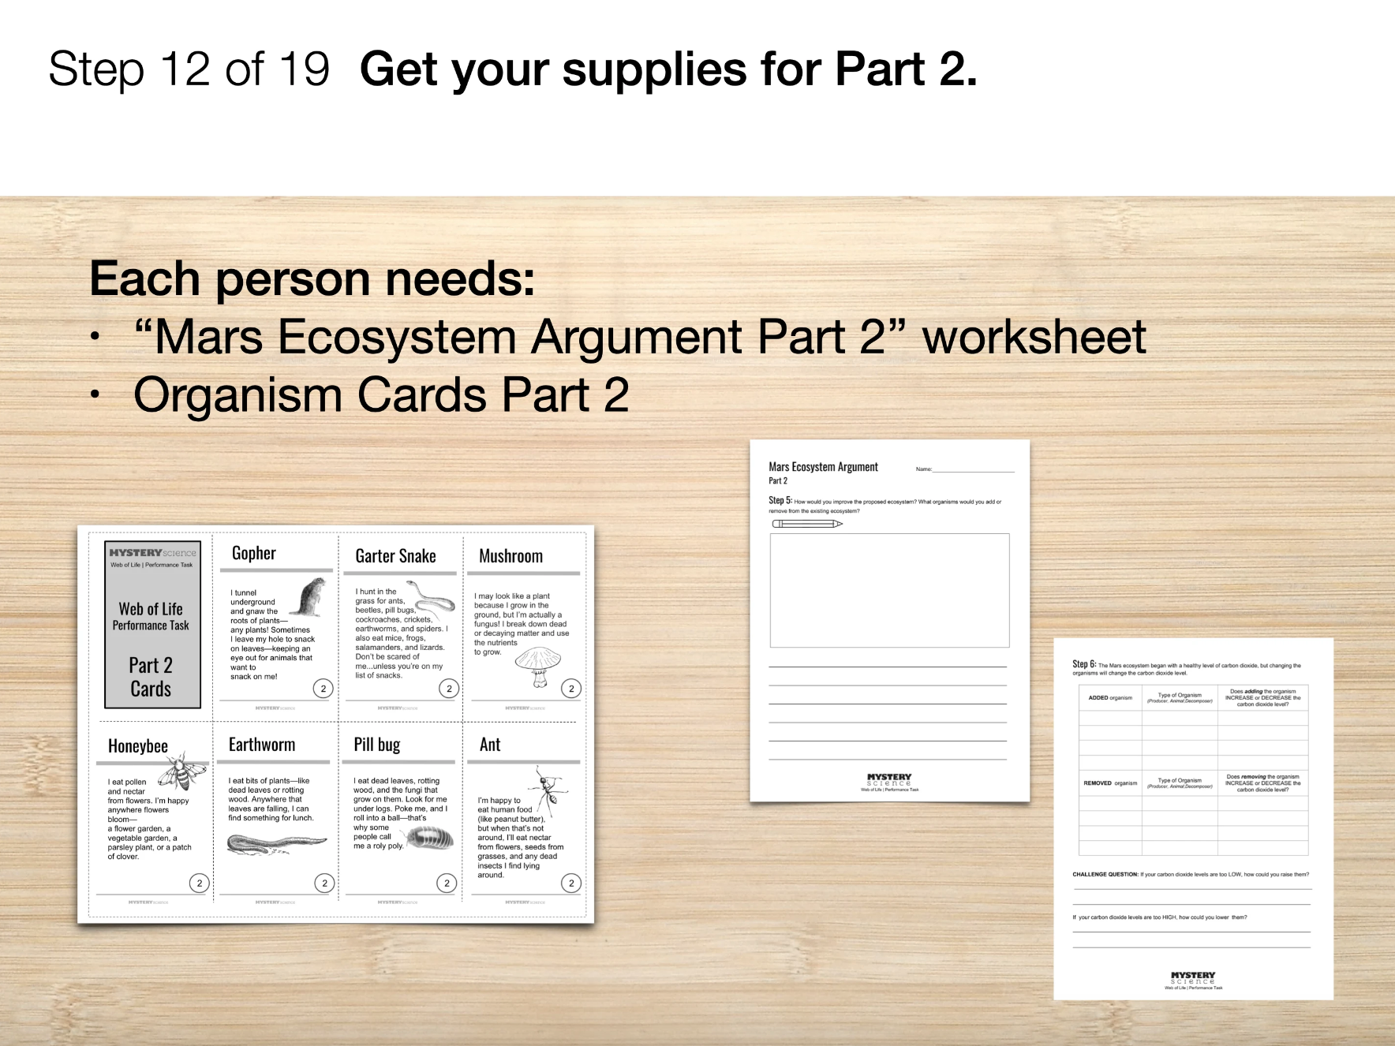
Ecosystems & The Food Web • Grade 5
Anchor Layer Teacher Guide
Performance Task: How could we grow food on Mars?
Ecosystem Argument
Overview
In this performance task, students evaluate a proposed ecosystem plan for a Mars habitat. Using evidence from the unit, they will write an argument for or against the proposed ecosystem plan. Then, students will make recommendations about how to change the ecosystem to successfully cycle energy and nutrients, keeping humans alive and healthy.
Unit Review 30 mins
Hands-On Activity 60 mins
Performance Task Notes
Students will need their completed Biosphere Bites packet that they have been revising after each Mystery.
In Part 1, students evaluate a list of proposed organisms for a Mars habitat. They write an argument for or against the proposal as a good ecosystem.
In Part 2, students make recommendations on how to improve the ecosystem.
Crosscutting Concepts
Systems and System Models: All living things in an ecosystem are dependent on one another to get the energy and nutrients they need to survive.
Energy & Matter: Energy and matter can be transferred between living organisms. All living things need energy and nutrients to survive. Living things transfer energy and nutrients to one another in an ecosystem.
‹#›

