Slide 1
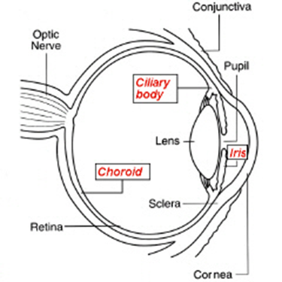
UVEAL TRACT

Slide 2
NOMENCLETURE
Intermediate coat
Middle coat
Vascular coat

Slide 3
COMPOSITION
IRIS
CILIARY BODY
CHOROID

Slide 4
IRIS
LOCATION : Lies in front of
Crystalline lens
Ciliary body
AND
Separates :
Anterior chamber
Posterior chamber

Slide 5
Average diameter : 12mm
Thickness : 0.5mm
It is a delicate diaphram with a central opennning called the PUPIL (3 – 4mm)
The pupil is suspended freely in the Anterior Segment of the eye from a peripheral attachment and the ciliary body and the LIGAMENTUM PECTINATUM

Slide 6
Iri cont’d
Thinnest at the it’s root and easily tears away on blunt trauma (iridodialysis)
The iris root appears as trucated cone because the pupillary margin is supported by the curved anterior surface of the lens
The periphery of the iris which is attached to the anterior surface of the CB is called the CILIARY MARGIN or ROOT OF THE IRIS while the pupil is surrounded by the pupillary margin and thinnest at the ciliary margin

Slide 7
Iris cont’d
The colour of the iris varies from light blue to dark brown : the colour may vary from one eye to another in the same person and in different part of the iris.

Slide 8
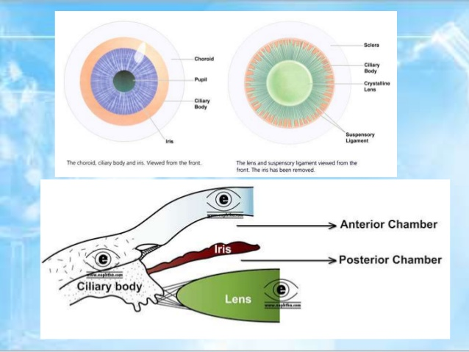
Iris cont’d

Slide 9
MACROSCOPIC APPEARANCE
TWO SURFACES
Anterior surface
Posterior surface
ANTERIOR SURFACE
COLLARETTE:
Zigzag line, 2mm from pupil, thickest, represents attachment of pupillary membrane.
Divides surface into : A
Ciliary zone
Radial zone
Crypts- peripheral- near the iris central-near collarette

Slide 10
Macroscopic appearance cont’d
Contraction furrow :
Faint lines outside collarette.
B : PUPILLARY ZONE
B/w collarette and pigment frill
Pigmented frill – black pigment at pupillary margin and represents end of the optic cup

Slide 11
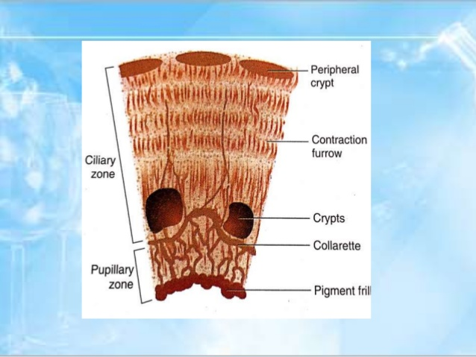

Slide 12
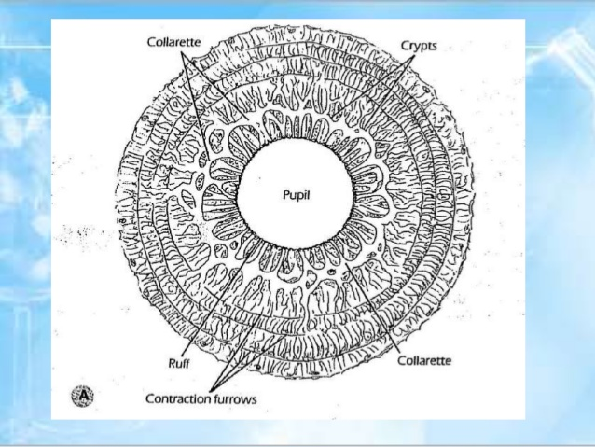

Slide 13
B. POSTERIOR SURFACE
The colour of this surface appears dark brown/black.
COMPOSITION :
Schwalbe’s line contraction folds -1mm from pupillary border,, little radial furrows
Schwalbe’s structural furrows -1. 5mm from pupillary border.
Circular furrows – finer than radial furrows.

Slide 14
MICROSCOPIC STRUCTURE
The iris contain 4 layers :
ANTERIOR LIMITING MEMBRANE
Consists of melanocytes and fibroblasts. This was previously called endothelium
Colour of iris in this layer
Blue iris – thin layer and few pigment cells
Brown iris, thick and doubly pigmented.
2. IRIS STROMA
Forms main bulk
Consist of collagenous tissue with mucopolysaccharide

Slide 15
MICROSCOPIC STRUCTURE CONT’D
Structures embedded-
SPHINTER PUPILLAE :
1mm broad circular band in pupillary area derived from the ectoderm.
Supplied by parasympathetic fibres by 3rd nerve
Constricts pupil.
DILATOR PUPILLAE :
Lies in posterior part of the ciliary zone
Supplied by cervical sympathetics
Dilates the pupil

Slide 16
Microscopic structure cont’d
VESSELS ;
Forms bulks of stroma
Radial Vessels –branches of circulous arteriosis major.
Pecularities –absence of IEL and non fenestrated capillary endothelium
Pigment cells – melanocytes
Lymphocytes, fibroblast and macrophages

Slide 17
MICROSCOPIC STRUCTURE CONT’D
C) ANTERIOR EPITHELIAL LAYER :
Anterior continuation of pigment epithelium of retina and ciliary body
Basal processes :
Give rise to dilator pupillae
D) POSTERIOR PIGMENTED EPITHELIUM ;
Anterior continuation of non pigmented epithelium of ciliary body
Derived from internal layer of optic cup
Forms pigmented frill

Slide 18
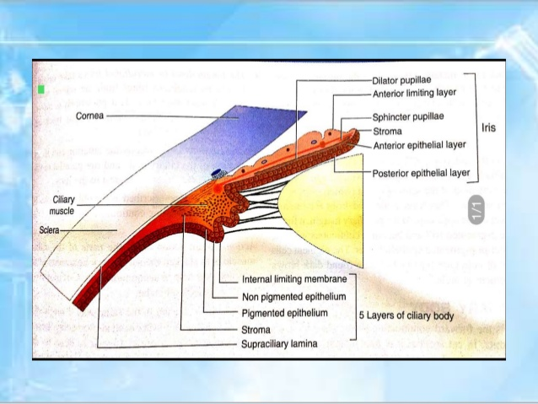

Slide 19
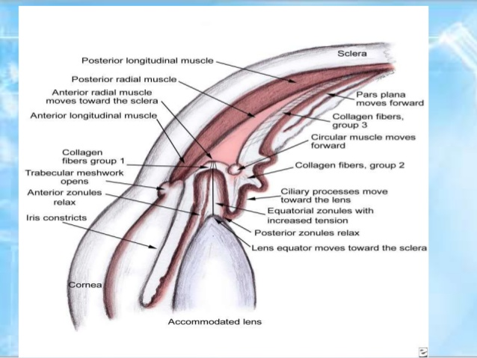

Slide 20
FUNCTIONS OF IRIS
Controls amount of light entering the eye through pupil
Defines eye colour
Control depth of focus
Source of blood ocular tissues

Slide 21
BLOOD SUPPLY
The blood supply is provided by radial vessels in the stromal layer extend from the major arterial circle of the iris located in the ciliary body.
NERVE SUPPLY
The iris is richly supplied with nerves for the short ciliary and long ciliary nerves that carry sensory motor and sympathetic.

Slide 22
CILIARY BODY
Forward continuation of choroid at ora serrata
Triangular in cut section, anterior side of it’s form part of angle in middle, attached into iris and outer part lies against sclera.
Triangle – two parts
Anterior part:– Ciliary processes (pars plicata) 2 – 2.5mm
Posterior part:–Smooth (pars plane) 5mm wide temporally and 3mm nasally
MICROSCOPIC STRUCTURE
1) SUPRACILIARY LAMINA (outermost part)
Consist of pigmented collagen fibres
Posteriorly continuation of supra choroidal lamina anterior continuous with anterior limiting membrane

Slide 24
2)STROMA
Consist:
Ciliary muscle – non striated triangular in cut section 3 parts.
Longitudinal/merilional fibre – origin for sclera spur, insert into suprachoroidal lamina
Circular fibres – in inner portion, nearest to lens
Radial fibres – obliquely placed
Actions – slacken suspensory ligament, this helps in accommodation
Circular fibres – directly as sphiricter
Nerve supply – parasynthetic fibres from ciliary ganglion.
Vascular stroma – major arterial circle lies.
Formed by anastomosis of long and short PCA
Supplies iris and ciliary body

Slide 25
3. LAYER OF PIGMENTED EPITHELIUM
Forward continuation of RPE
Anterior continuous to pigmented epithelium of iris
4. LAYERS OF NON PIGMENTED EPITHELIUM
Forward continuation of sensory retina
Continues anterior with pigmented epithelium of iris
5. INTERNAL LIMITING MEMBRANE
Line NPE
Forward continuation of internal limiting membrane of retina

Slide 26
CILIARY PROCESSES
Finger like projections from pars plicata
70 – 80 in number, 2mm long 0.5mm diameter
Site of aqueous production
ULTRASTRUCTURE
Network of capillaries – in the centre
Has endothelium with fenestrae
Stroma of ciliary processes -
A thin, separates capillaries from epithelium
3. Epithelium – two layered with apical apposition

Slide 27
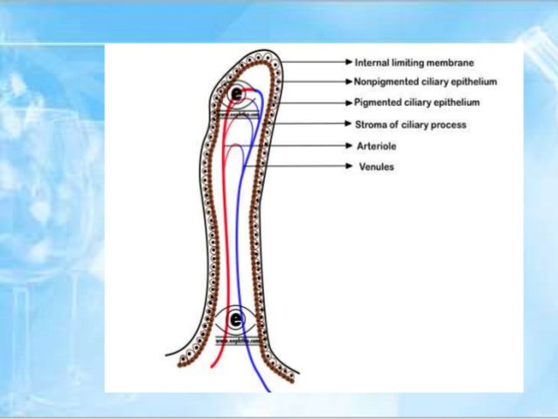

Slide 28
FUNCTIONS OF CILIARY BODY
Site of AH production
Maintenance of IOP
Constitutes blood aqueous barrier
Accommodation
Eicosanoids are synthesized in ciliary

Slide 29
CHOROID
Posterior 5/6 of the middle part of the globe
Extension – optic disc to Ora serrata
Inner surface – smooth brown and contact with RPE.
Outer surface – rough and in contact with the sclera
Thickness:
Posteriorly 0.22mm
Anteriorly 0.10mm

Slide 30
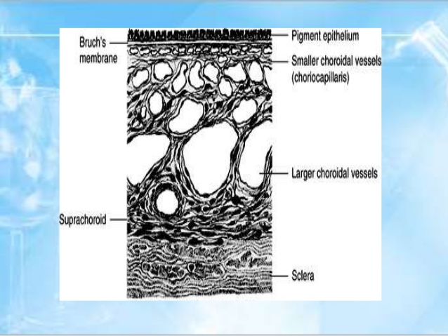

Slide 31
MICROSCOPIC STRUCTURE
Suprachoroidal – lamina fusca
Thin layer, continues anteriorly with supraciliary lamina of ciliary body
Suprachoroidal space – contains long and short ciliary arteries and nerves
Stroma – plenty of pigmented cells, macrophages, mast and plasma cells
Vessels – for the bulk
Arranged in two layers – outer consisting of large vessels (hallens layer), inner of medium vessels (sattler’s layer)

Slide 32
Choriocapillaris – rich capillary network
Supplies pigment epithelium and outer layers of sensory retina
Few anastomosis with CRA
Basal lamina – Bruch’s membrane / lamina vitrae
Innermost layer
Between choriocapillaries and RPE
Electron microscopy – basement membrane of RPE, inner collagen, middle elastic and outer collagen and basement membrane chorio-capillaries.
With increasing age – produces hyaline excrescences known as druscens.

Slide 33
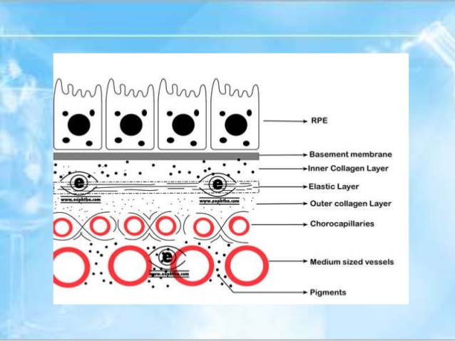

Slide 34
FUNCTIONS OF CHOROID
Blood supply to outer four layers of retina
Modulation of vascularization
Regulate retina heat
Assist in the control of intraocular pressure
Pigment absorbs excess light so avoiding reflection

Slide 35
BLOOD SUPPLY UVEAL TRACT
SHORT POSTERIOR CILIARY ARTERIES
Branches of ophthalmic artery
Divides into 10 -20 branches, pierce sclera around optic nerve
Supply choroid in segmental manner.
LONG POSTERIOR CILIARY ARTERIES
Two in No –nasal and temporal
Pierce sclera
Anastomose with anterior –
Forms major arterial circle supply- ciliary body

Slide 36
ANTERIOR CILIARY ARTERIES
From muscular arterieS
7 in No
2 each SR, IR, MR, 1 From LR
Anaatomose with LPCA
Circulus arteries major and minor

Slide 37
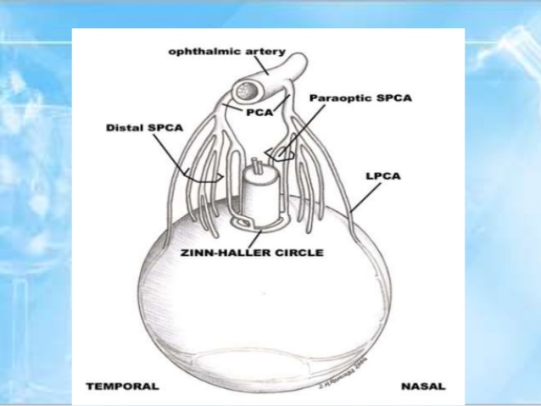

Slide 38
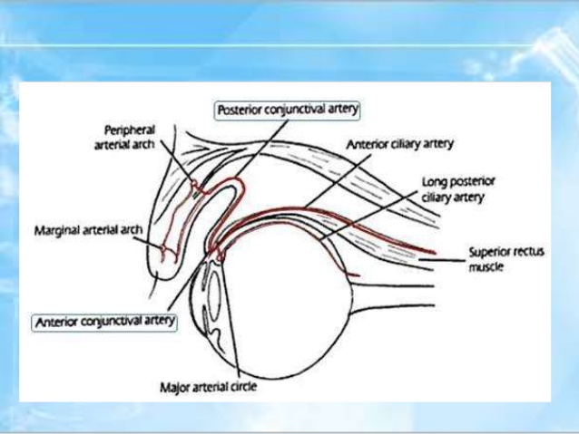

Slide 39
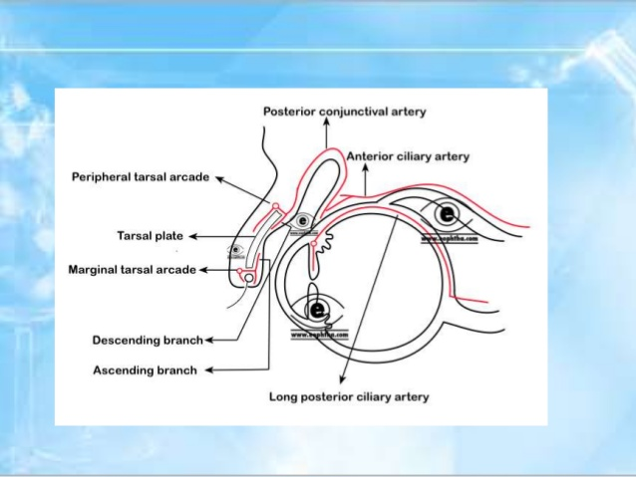

Slide 40
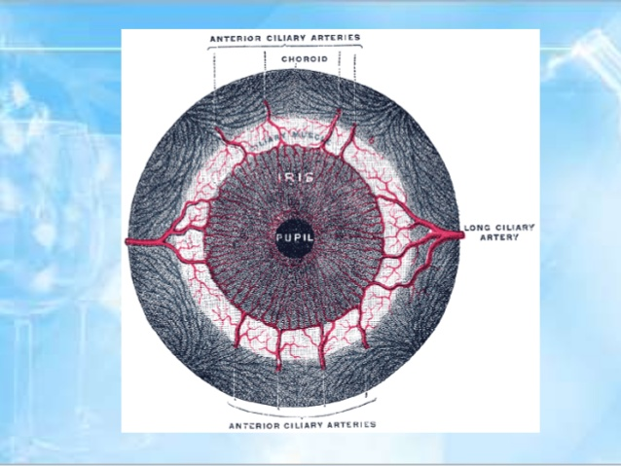

Slide 41
VENOUS DRIANAGE
ANTERIOR CILIARY VEIN –
Tributaries of muscular veins
SMALLER VEINS FROM SCLERA
Carry blood only from sclera and not from choroid
VENA VERTICOSAE
4 in No and drain whole of choroid

Slide 42
