Slide 1





BLACK PENCIL
POWERPOINT TEMPLATE
BUSINESS
IDEA
EDUCATION
TIMELINE

Slide 2

01
Public & NGO
P03
CONTENTS
02
Finance
P09
03
Arts & Cultur
P14
04
Real Estate
P19
05
Energy
P24

Slide 3


1
BUSINESS
Financial Facts
Profit & Loss
Balance Sheet
Use of Funds
Investment Opportunity

Slide 4




01
BUSINESS
ANDROID
Show and explain your web, app or software projects using these gadget templates.
CONTACT
A complex idea can be conveyed with just a single still image, namely making it possible to absorb large amounts of data quickly.
GRAPHIC
Easy to change colors, photos and Text.
Get a modern PowerPoint Presentation that is beautifully designed.
CALL
Is the color of gold, butter and ripe lemons. In the spectrum of visible light, yellow is found between green and orange.

Slide 5





01
BUSINESS
SHARING
We use well-known development methodologies to create a customized approach for each of the projects.
SETTING
This allows us to achieve high quality outcomes and full transparency towards.
LOCATION
We create a solid user-product relationship, one thats long and fruitful.
GRAPHIC
We leverage digital tools, design and words, to become even more relevant.

Slide 6




01
BUSINESS
CHINE
Your audience relate and absorb information on different sensory levels.
FRANCE
We know visual stories are amplified with the right words.
SPAIN
Sometimes it's easier to go old school, our copywriters prefer a good ball.

Slide 7
01
BUSINESS
Our Strategy
24
hours
To see what is in front of one's nose needs a constant struggle.
30
days
Our Team
Core Values
Take calculated risks. That is quite different from being rash.
A torn jacket is soon mended; but hard words bruise the heart of a child.
The time is now, the place is here. Stay in the present. You can do nothing to change the past, and the future will never come exactly as you plan or hope for.

Slide 8








01
BUSINESS
Briefing
Simple & Smooth, exactly how purchasing experiences should be.
Evaluation
Your audience relate and absorb information on different sensory levels.
Workshops
We know visual stories are amplified with the right words.
Design
We certainly do not forget you as soon as you forget us.

Slide 9

2
FINANCE
Company Information
Key Figures
Our Product & Service
Competitor Analysis

Slide 10

02
FINANCE
Our Vision
Milestone
Simple & Smooth, exactly how purchasing experiences should be.
42%
We use well-known development methodologies to create a customized approach for each of the projects.
25%
10%
Our Mission
Organization
23%
We leverage digital tools, design and words, to become even more relevant.
We create a solid user-product relationship, one thats long and fruitful.

Slide 11
02
FINANACE
2019
20XX
90%
50%
65%
40%
90%
50%
65%
40%
90%
70%
I hope and I believe that this Template will your Time, Money and Reputation.
Get a modern PowerPoint Presentation that is beautifully designed.

Slide 12

02
FINANCE
Mobile Project
Tablet Project
Desktop Project
I hope and I believe that this Template will your Time, Money and Reputation.
Get a modern PowerPoint Presentation that is beautifully designed.
We use well-known development methodologies to create a customized approach for each of the projects.

Slide 13
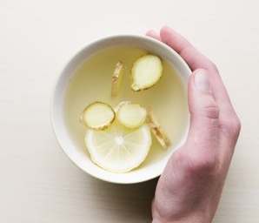

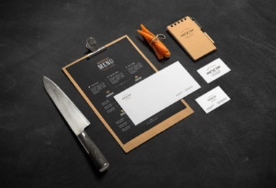
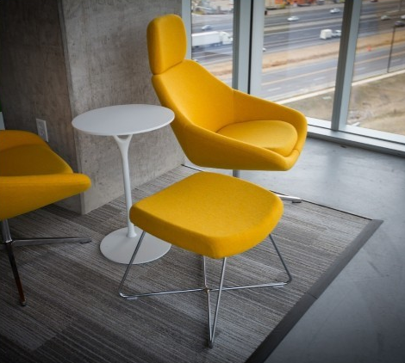
02
FINANCE
Moving from creative ideas to solid strategy and execution, we help your target market resonate fully with your brand.
80%
Free Google Slides Themes and PowerPoint Templates for Presentations.

Slide 14

3
ARTS & CULTURE
Briefing
Evaluation
Implementation
Forum

Slide 15
03
ARTS & CULTURE
Timeline
Pricing
We certainly do not forget you as soon as you forget us.
It is, perhaps, our fate rather than our merit. We cannot help ourselves.
Future
Conferences
I'm convinced that about half of what separates the successful entrepreneurs from the non-successful ones is pure perseverance.
We live at home, quiet, confined, and our feelings prey upon us.

Slide 16
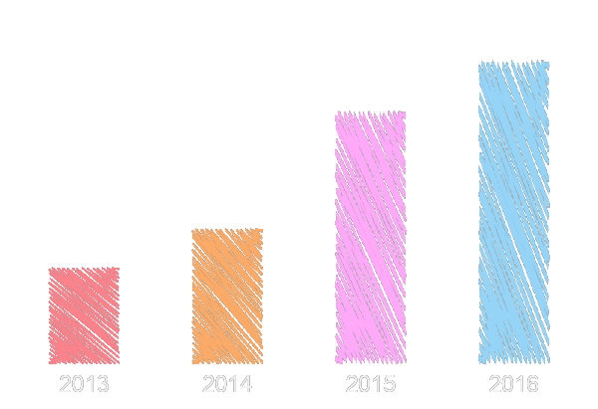
03
ARTS & CULTURE
Competitor Analysis
We certainly do not forget you as soon as you forget us. It is, perhaps, our fate rather than our merit. We cannot help ourselves. We live at home, quiet, confined, and our feelings prey upon us.

Slide 17
03
ARTS & CULTURE
Key Figures
Pricing Plan
Your audience relate and absorb information on different sensory levels.
We align with your users need to build and evolve a flowing shopping interface, one that slots easily into place with each step.
Marketing Mix
Market Trends
When you get them, they will get you, quicker. We leverage digital tools, design and words, to become even more relevant.
Sometimes it's easier to go old school, our copywriters prefer a good ball.

Slide 18


03
ARTS & CULTURE
There is only one difference between a madman and me. I am not mad.
E-commerc
Take calculated risks. That is quite different from being rash.
Action Plan
To see what is in front of one's nose needs a constant struggle.
Sale Report
A torn jacket is soon mended; but hard words bruise the heart of a child.
Contact Us

Slide 19

4
REAL ESTATE
About us
Services
Timeline
Pricing

Slide 20
04
REAL ESTATE
We know visual stories are amplified with the right words.
Free Google Slides Themes and PowerPoint Templates for Presentations.
Education
Finance
Fashion
It is a very sad thing that nowadays there is so little useless information.
Sometimes it's easier to go old school, our copywriters prefer a good ball.
Real Estate

Slide 21
04
REAL ESTATE
To see what is in front of one's nose needs a constant struggle.
Take calculated risks. That is quite different from being rash.
1
2
应用前景
Free Google Slides Themes and PowerPoint Templates for Presentations.
4
3
There is only one difference between a madman and me. I am not mad.

Slide 22
04
REAL ESTATE
SWOT Analysis
Market Strategy
There is only one difference between a madman and me. I am not mad.
A torn jacket is soon mended; but hard words bruise the heart of a child.
S
W
O
T
Marketing Mix
Sales Strategy
Take calculated risks. That is quite different from being rash.
To see what is in front of one's nose needs a constant struggle.

Slide 23
04
REAL ESTATE
Market Trends
It is, perhaps, our fate rather than our merit. We cannot help ourselves. We live at home, quiet, confined, and our feelings prey upon us. You are forced on exertion.
DOWN
UPDATE
Market Size
You have always a profession, pursuits, business of some sort or other, to take you back into the world immediately, and continual occupation and change soon weaken impressions.

Slide 24

5
ENERGY
Company Information
Key Figures
Pricing Plan
Market Trends
Market Size

Slide 25
05
ENERGY
20%
Our Vision
Our Mission
We certainly do not forget you as soon as you forget us. It is, perhaps, our fate rather than our merit.
Moving from creative ideas to solid strategy and execution, we help your target market resonate fully with your brand.
80%
Speakers Introduction

Slide 26

05
ENERGY
We certainly do not forget you as soon as you forget us. It is, perhaps, our fate rather than our merit. We cannot help ourselves. We live at home, quiet, confined, and our feelings prey upon us. You are forced on exertion. You have always a profession, pursuits, business of some sort or other, to take you back into the world immediately, and continual occupation and change soon weaken impressions.
Financial Facts
Profit & Loss
Style Guide
Revenue Model

Slide 27
05
ENERGY
Powerpoint
Keynote
We create a solid user-product relationship, one thats long and fruitful.
Simple & Smooth, exactly how purchasing experiences should be.
Slideshare Campaign
Development
Web Design
Your audience relate and absorb information on different sensory levels.
Sometimes it's easier to go old school, our copywriters prefer a good ball.

Slide 28

05
ENERGY
We align with your users need to build and evolve a flowing shopping interface, one that slots easily into place with each step.
YOUR
TEXR
YOUR
TEXR

Slide 29
05
ENERGY
Implementation
Quality Assurance
E-commerce
Tech Startup
Public & NGO
Conferences
Annual Meeting
Pricing
Future
Timeline
Services
Forum
About us
Our Values
Free Time
#4
#1
#2
#3
#5
#6
Briefing
Evaluation
Workshops
Design
Infographics
Devices
Overview
Web design
Speakers
Break time
Opening
Speakers Introduction

Slide 30
05
ENERGY
We certainly do not forget you as soon as you forget us. It is, perhaps, our fate rather than our merit. We cannot help ourselves. We live at home, quiet, confined, and our feelings prey upon us. You are forced on exertion. You have always a profession, pursuits, business of some sort or other, to take you back into the world immediately, and continual occupation and change soon weaken impressions. All the privilege I claim for my own sex (it is not a very enviable one; you need not covet it), is that of loving longest, when existence or when hope is gone.
The time is now, the place is here. Stay in the present. You can do nothing to change the past, and the future will never come exactly as you plan or hope for.
I'm convinced that about half of what separates the successful entrepreneurs from the non-successful ones is pure perseverance.
When you feel in your gut what you are and then dynamically pursue it - don't back down and don't give up - then you're going to mystify a lot of folks.
Your audience relate and absorb information on different sensory levels. We know visual stories are amplified with the right words. Sometimes it's easier to go old school, our copywriters prefer a good ball.

Slide 31
05
ENERGY
Enterprise
Base
Mobile
Project
Evaluation
Insert the title of your subtitle here
A presentation template that helps founders create a visually impressive and effective pitch.
Show and explain your web, app or software projects using these gadget templates.

Slide 32
THANK YOU
POWERPOINT TEMPLATES
Big Concept
Instructions for Use!
Instructions for Use!
Our Process is Easy
Special thanks to all the people who made and released these awesome resources for free:
Presentation template by GoogleSlides.org

Slide 33
GoogleSlides.org
Google Slides
Select slide and edit your presentation
You can download and share your presentation!
Powerpoint Templates
Free Powerpoint Presentation Template (.pptx)
You can upload Google Slides..
Free Powerpoint Templates: https://googleslides.org/free-templates
Abstract Google Slides: https://googleslides.org/free-templates/abstract-google-slides
Animal and Wildlife Presentation: https://googleslides.org/free-templates/animal-wildlife-presentation-template
Biology Powerpoint Templates: https://googleslides.org/free-templates/biology-presentation-slides
Business & Finance Google Slides: https://googleslides.org/free-templates/business-finance-templates
Chemistry Powerpoint Slides: https://googleslides.org/free-templates/chemistry-google-slides-template
Christmas Google Slides: https://googleslides.org/free-templates/christmas-new-year-templates
Education Google Slides: https://googleslides.org/free-templates/education-google-slides
Flowers Powerpoint Templates: https://googleslides.org/free-templates/flowers-powerpoint-templates
Food and Drinks Slides: https://googleslides.org/free-templates/food-drinks-powerpoint-templates
Games Powerpoint Templates: https://googleslides.org/free-templates/games-powerpoint-templates
Medical Google Slides: https://googleslides.org/free-templates/medical-powerpoint-templates
Nature Powerpoint Templates: https://googleslides.org/free-templates/nature-google-slide-templates
Religious Google Slides: https://googleslides.org/free-templates/religion-powerpoint-templates
Sports Powerpoint Slides: https://googleslides.org/free-templates/sports-presentation-slides
Technology Google Slides: https://googleslides.org/free-templates/technology-powerpoint-templates
Transportation Powerpoint Templates: https://googleslides.org/free-templates/transportation-google-slides

