Slide 1


What Works Global Summit
What Makes an Effective Principal: The Critical Role Principals Play Improving Teacher Performance
Jack States
Wing Institute
Notes:
What we know about the role Principals play in student achievement and teacher success
- What does the research tell us about principals
- How can we use this information to maximize principal effectiveness
Anecdotally my experience of working with and supervising principals, we couldn’t run an effective school with a mediocre principal – Conventional Wisdom
- Blood letting over a thousand years
- Sugar causes hyperactivity in children

Slide 2

40 years studying “research to practice” issues…
from both the “practice” and “research” perspective
25 years operating schools
15 years operating a research and policy education foundation
School leadership was a top priority in both activities

Slide 3
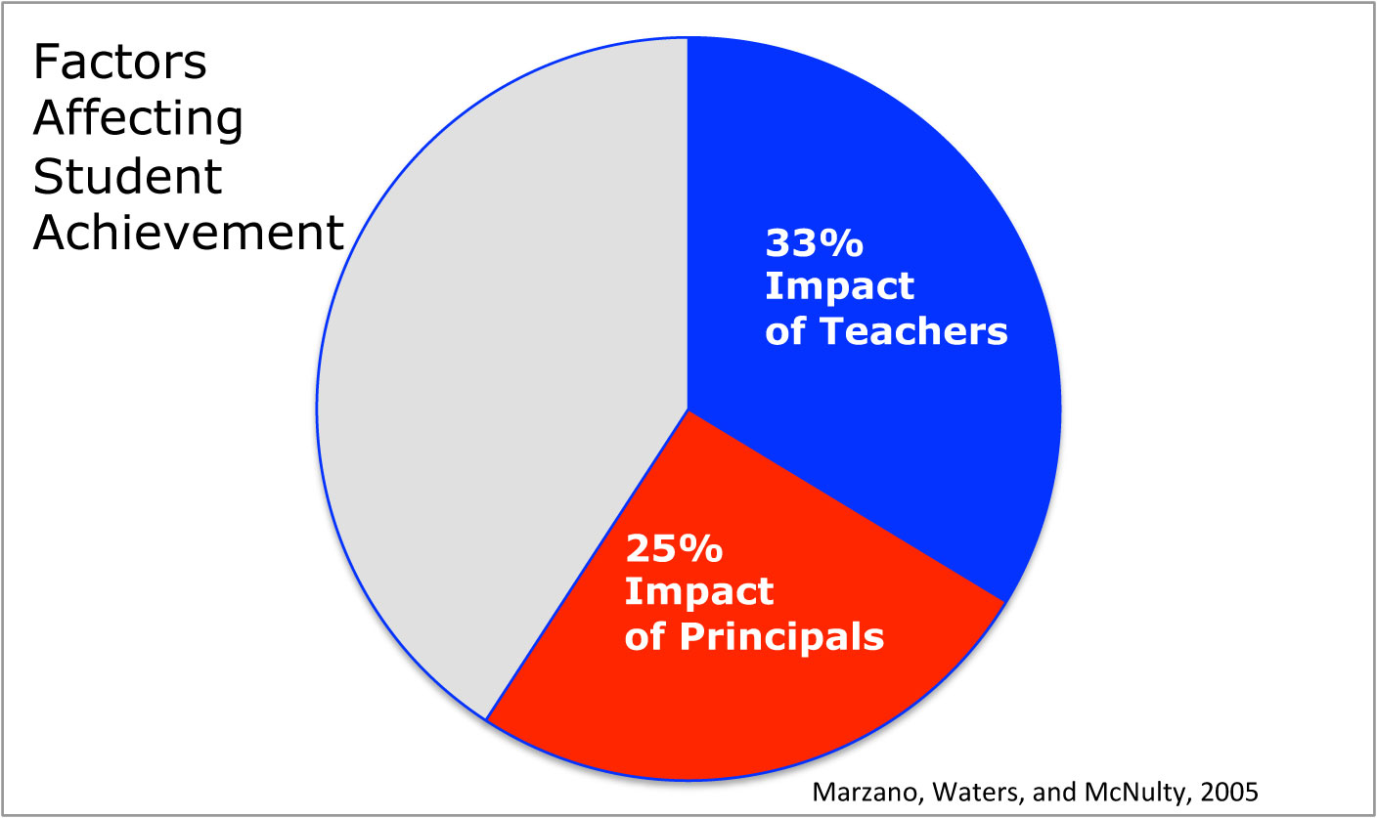
Notes:
Of those variables we control in schools

Slide 4
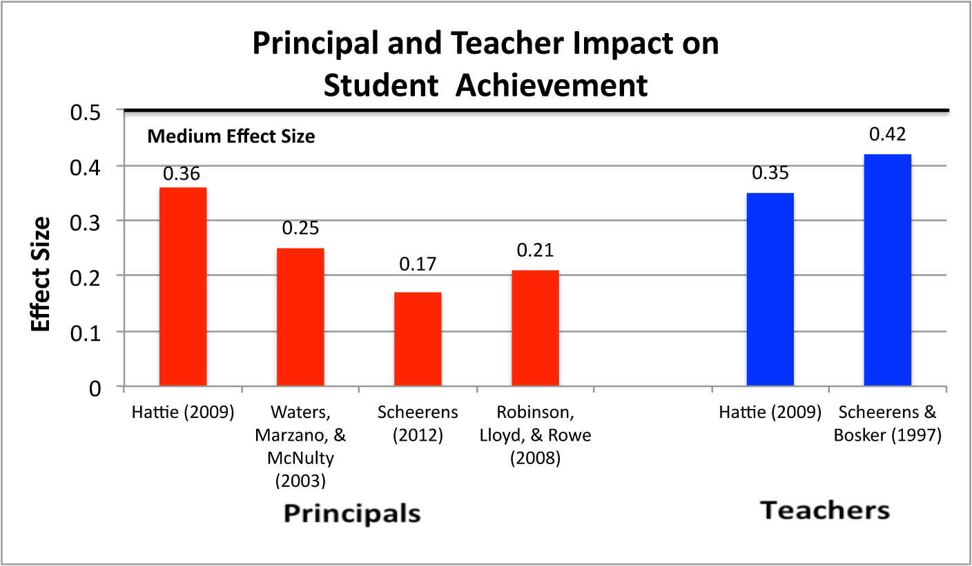
Principals Impact on Student Achievement
Notes:
When look at research we are concerned with the quality and quantity of the research.
We have quantitative studies that meet our standards for rigor to meet our standards for quality
We have quantity listed here 4 meta-analyses
Provides us with confidence that we are not wasting our time going down a blind alley.

Slide 5
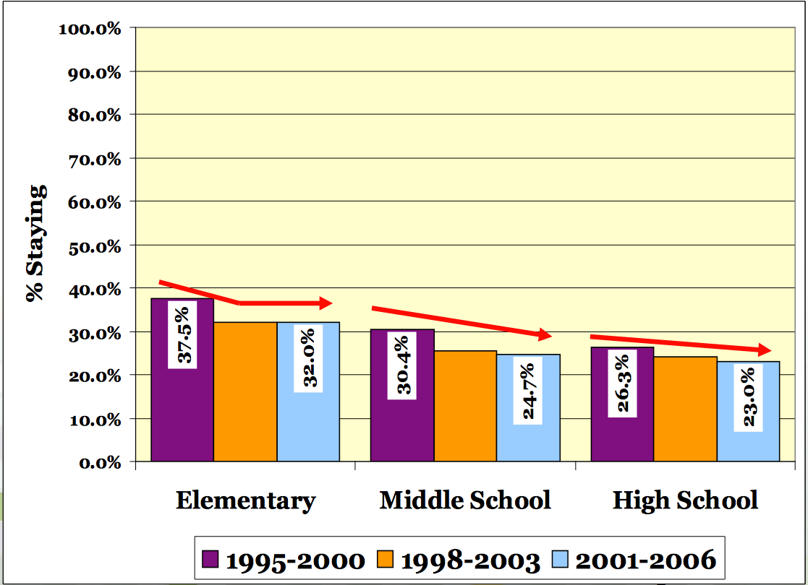
Retention of Principals Declining in Texas
Fuller, E.J. & Young, M.D. (2008)
Notes:
The average tenure for a high school principal in Texas is just over three years—the average high school principal will not see her/his first freshman class graduate
High turnover has consequences – let’s examine a few of these

Slide 6
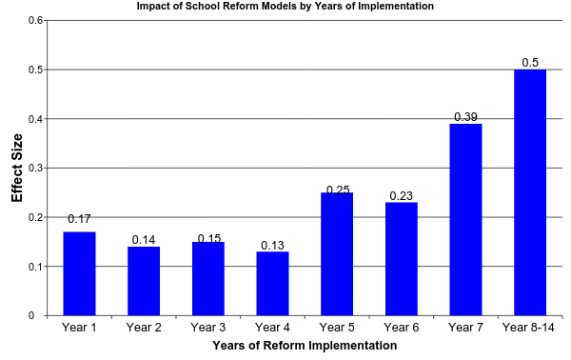
Impact of Sustained Implementation
(Borman, Hewes, Overman, and Brown, 2003)
Notes:
Average Education intervention lasts 18-48 months (Latham, 1988)
new principals change reforms causinconfusion and discontinuity
we conclude reforms that might be effective are abandoned

Slide 7
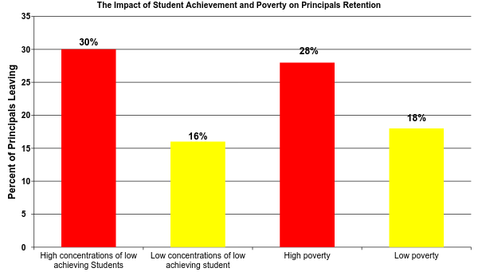
What is the Impact of Student Achievement and Poverty on Principal Retention?
Béteille, T., Kalogrides, D., & Loeb, S. (2012)
Notes:
Higher principal turnover in schools with low achieving student
Higher principal turnover in schools of high poverty
Unfortunately, these are the schools that require stable leadership
#1: We need to improve retention of principals especially in low achieving and high poverty schools if we want reform efforts to succeed

Slide 8
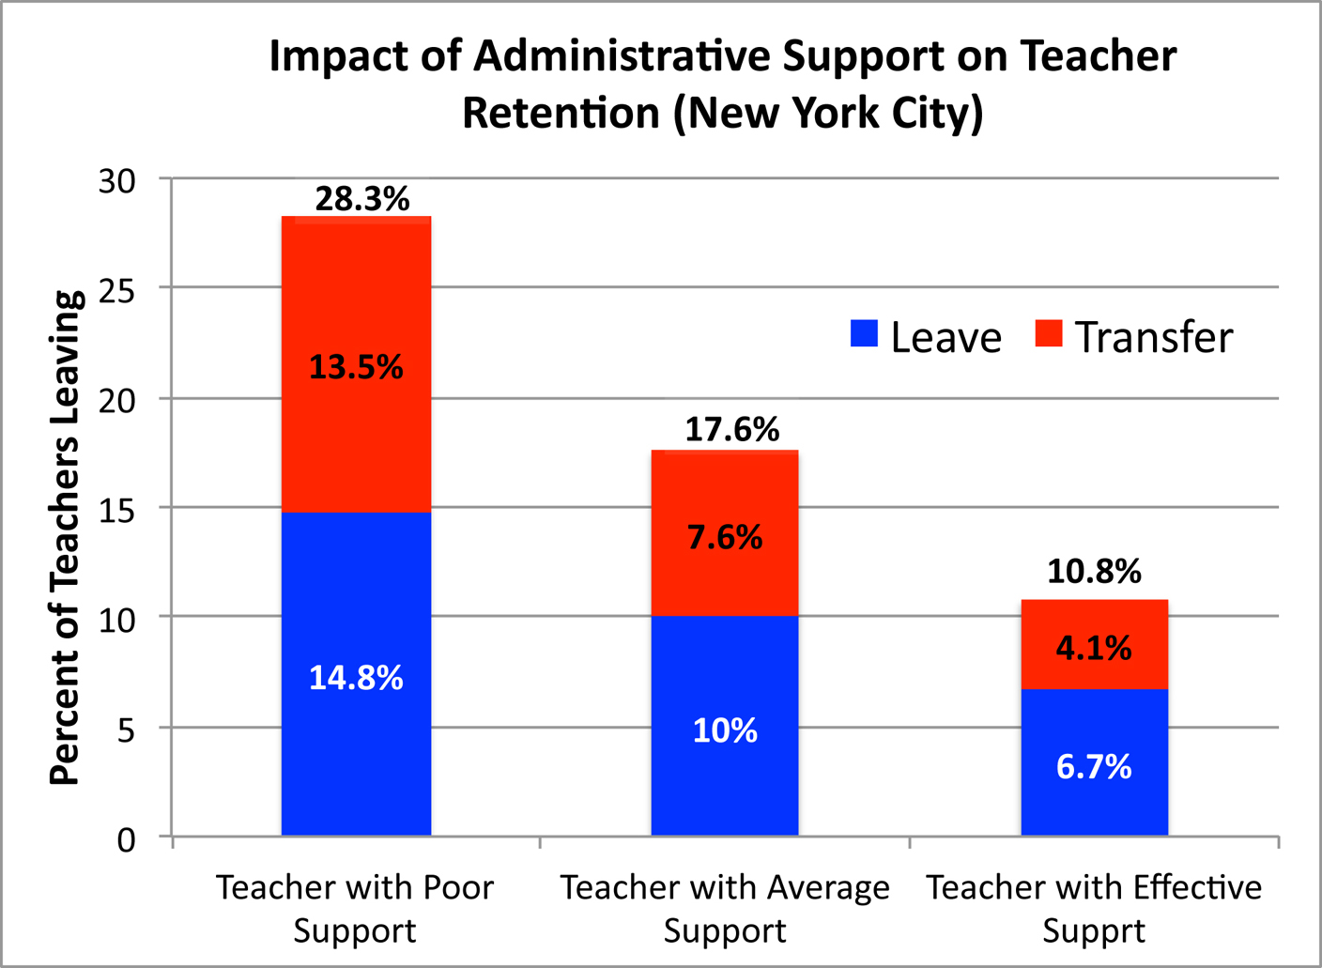
Administrators Impact on Turnover
Boyd, D., Grossman, P., Ing, M., Lankford, H., Loeb, S., & Wyckoff, J. (2011)
Notes:
1. Ineffective leadership is primary reason for teachers leaving, North Carolina Teacher Working Conditions Survey, (2008)
2. Less effective teachers leave under an effective principal, 3. while more effective teachers leave schools taken over by an ineffective principal.
4. Effective principals are more likely to replace teachers who leave with more effective teachers (Beteille, Kalogrides and Loeb 2011, Branch, Hanushek and Rivkin 2012, Portin, et al. 2003).

Slide 9
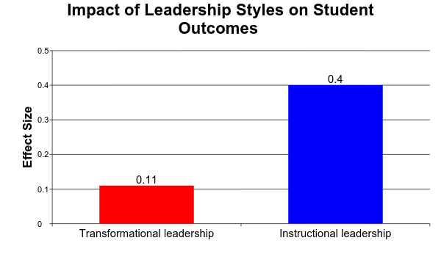
Do Leadership Styles Make a Difference?
Medium
Small
Robinson, Lloyd, and Rowe, 2008
Notes:
Instructional leadership: an approach in which the principal encourages educational achievement by making instructional quality the top priority of the school.
Transformational leadership: an approach in which the principal provides motivation through inspiration

Slide 10
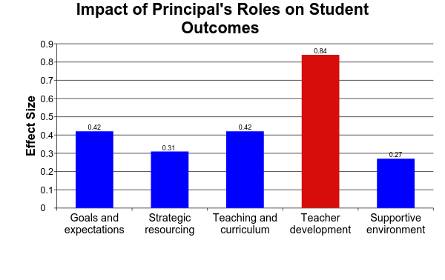
What Principals Do Makes a Difference
Large Effect Size
Robinson, Lloyd, and Rowe, 2008
Notes:
Setting the standards and goals, communicating expectations, sustain expectations over time, monitoring learning goals, and involve staff in the process
Strategic Resourcing: Aligning and allocating resources to teaching goals, and maintaining recruitment and hiring.
Teaching and Curriculum: Having a direct role in the support and evaluation of teaching, regular visits, on-going formative and summative feedback, direct oversight of curriculum, coordination across classrooms and levels, and aligning goals to curriculum and teaching.
Teacher Development: Promoting and participating in informal and formal development
Supportive Environment: Assuring and protecting time for teaching by reducing external pressures and interruptions, and establishing and supporting orderly classroom environments (classroom management and climate).

Slide 11
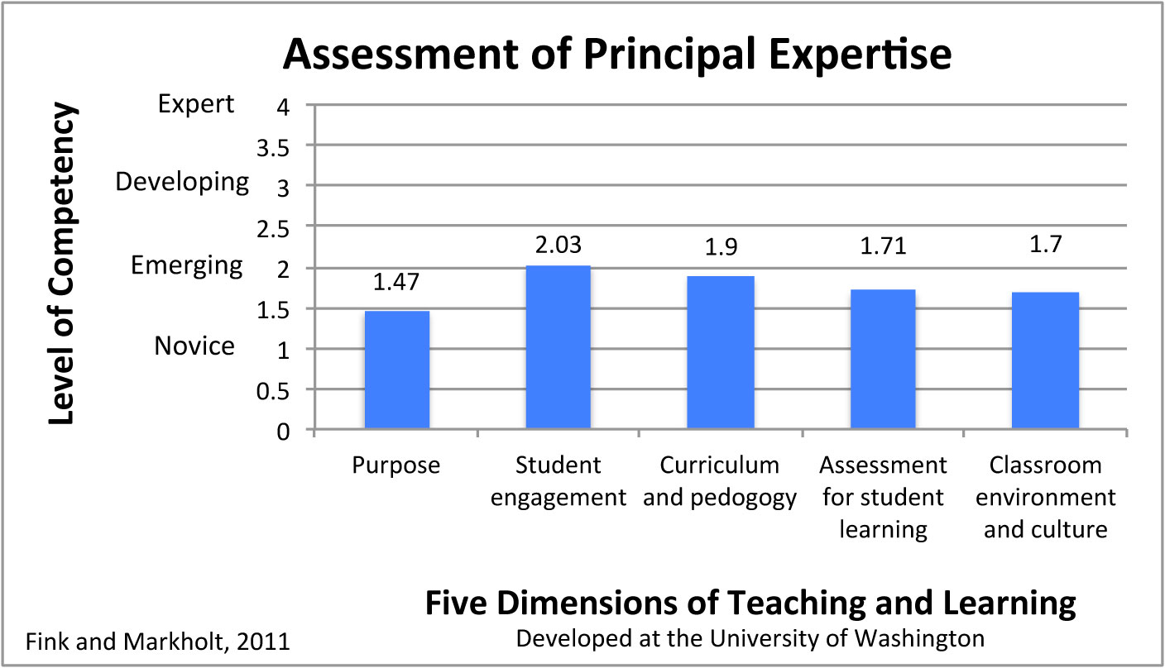
How Effective Are Principals at Identifying Valued Teachers
Notes:
98% of teachers evaluations satisfactory or better (12 districts) New Teachers Project, 2009 –
Principals 80% reported at least one teacher should not be teaching

Slide 12
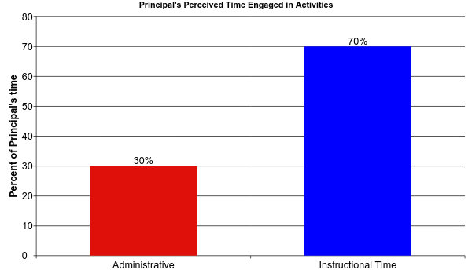
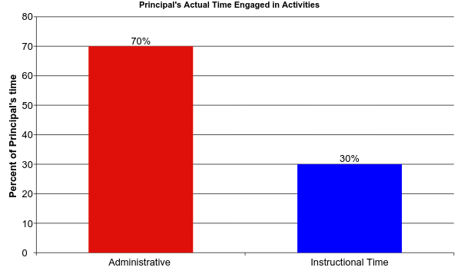
How Principals Spend Their Time
Turnbull et al., 2009

Slide 13
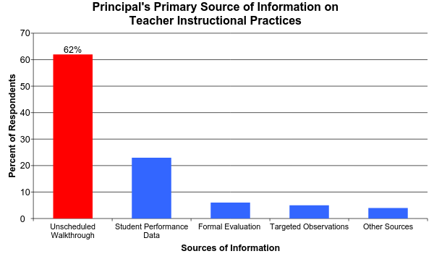
How Much do Principals Spend on Instructional Activities?
Grissom, Jason A., Susanna Loeb, and Ben Master. (2012)
Notes:
Observation data - Overall Instructional Time = 12.7
Walk-through: the most popular method of sampling can function for error detection, but not effective for improving performance

Slide 14
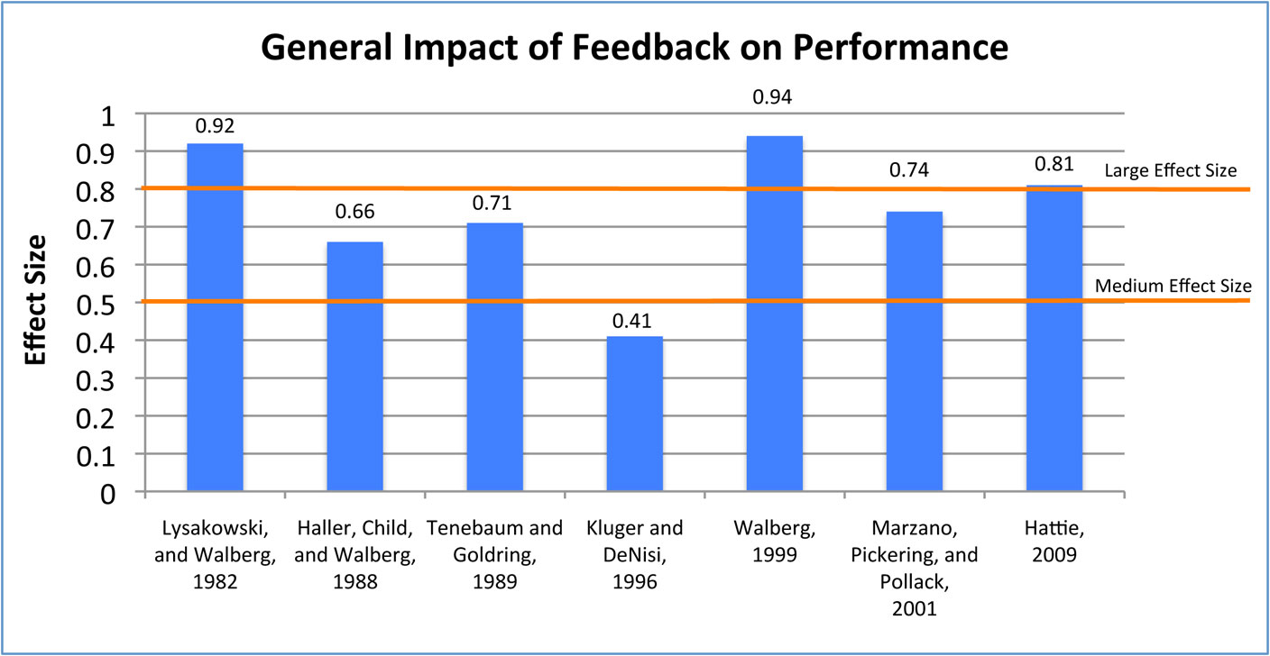
Power of Feedback
Notes:
There are two primary sources of data for delivering feedback
Direct observation
Key indicator reports of critical pieces of information
Inaccurate data means your feedback may be off target reducing effectiveness or compounding your problems

Slide 15
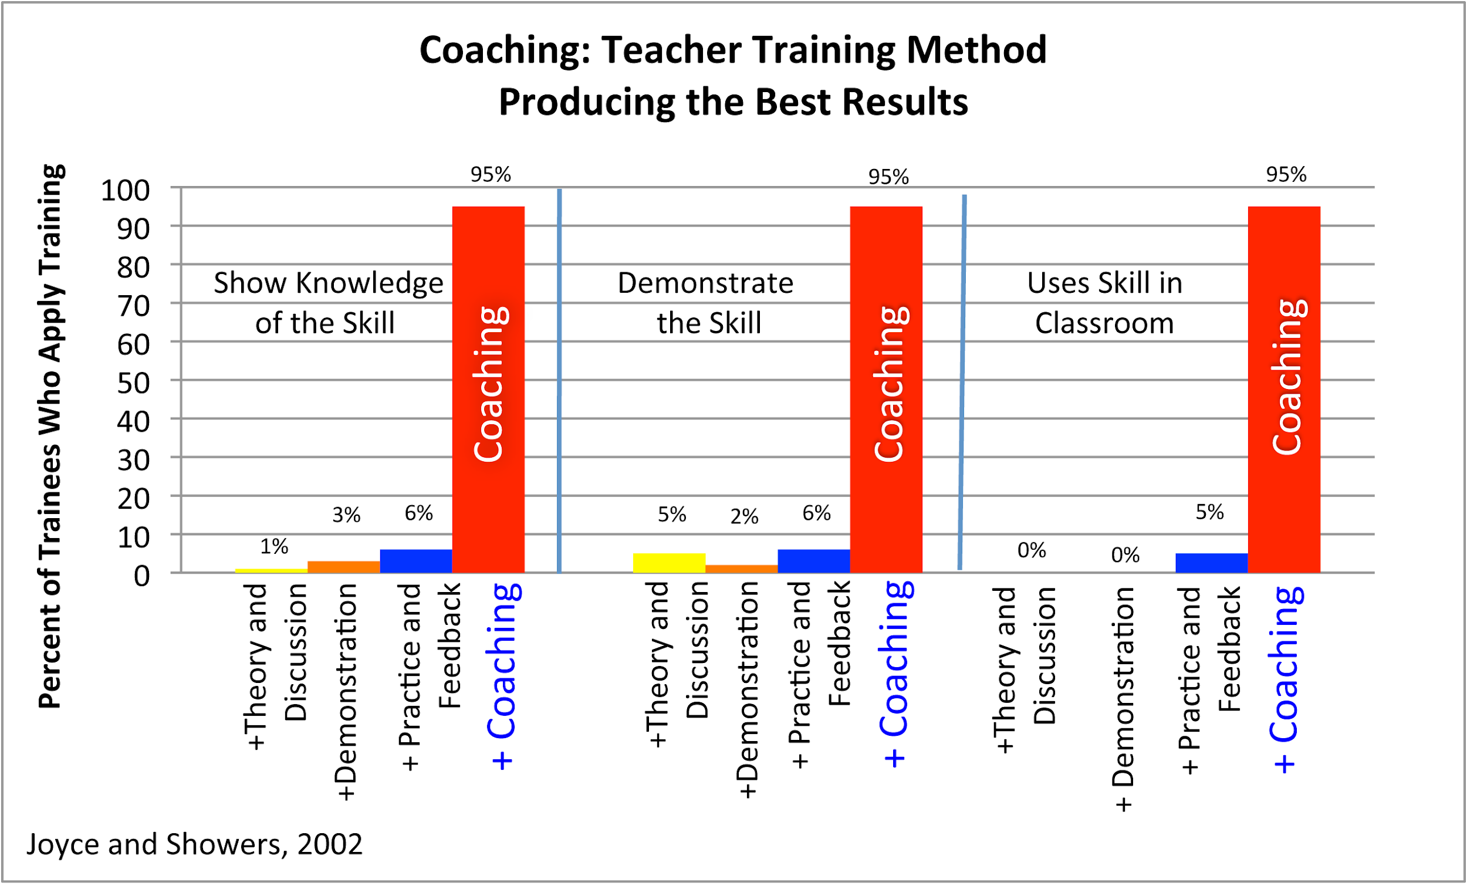
What Staff Development Methods Produce Best Results?
Notes:
Effect Size .22 - .43 over 3 years – value added study of coaching and student literacy
In the US - $18,000 per teacher is spent annually on training
Coaching: Joyce and Showers and Jim Knight

Slide 16
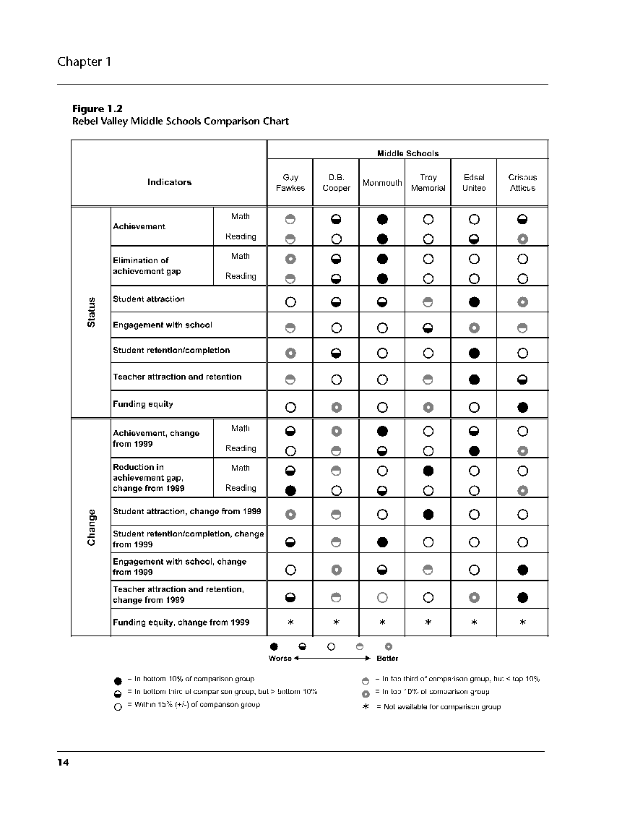
Indicator
Report
(Sample)
Achievement
Coaching
Conduct
Engagement
Retention
Teacher Retention
Funding Equity
Celio,B. and Harvey, J. (2005)
Buried Treasure
Notes:
Tell the story of Guy Fawkes: doing well now, but slipping since previous year

Slide 17
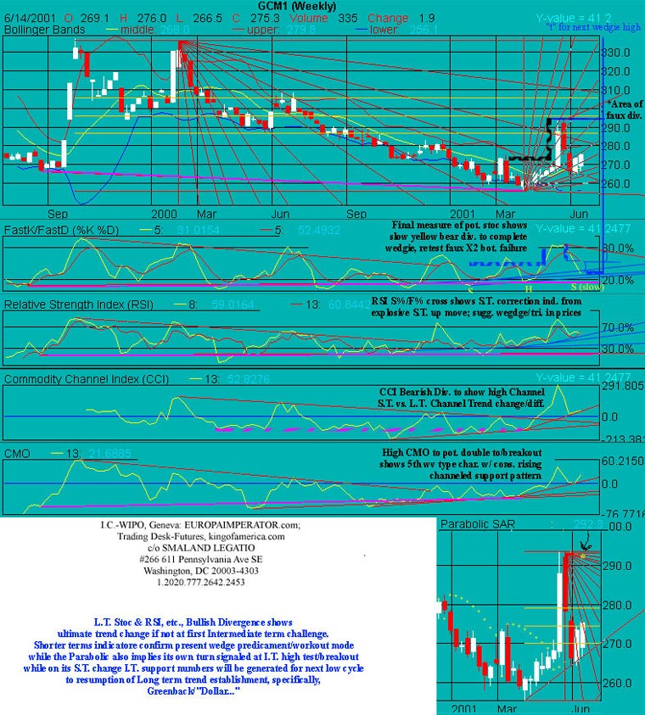
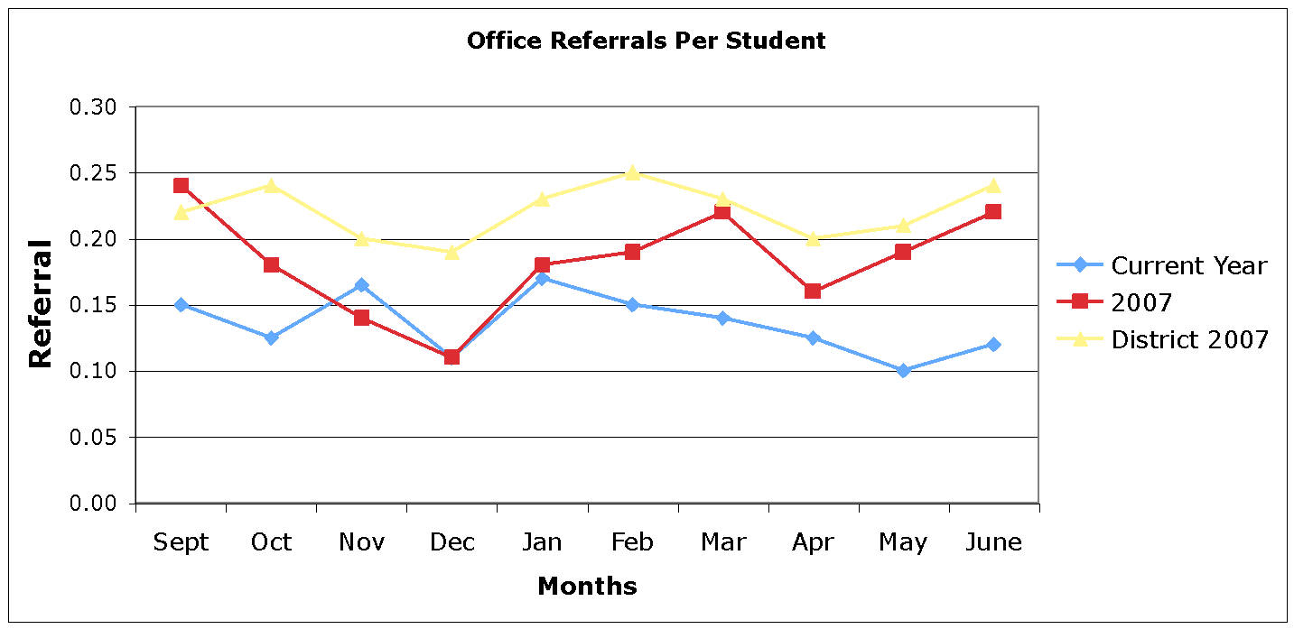
Desirable vs
Undesirable
Too Much Data!
Status, Trends, and Standards
Notes:
Feature: Graph the data – 1. easier to read and interact 2. graphing is powerful example formative assessment .26 to .70

Slide 18
Summation
Principals play a critical role
Principal turnover creates discontinuity impeding progress
  Principal leadership impacts the quality of teachers
  Leadership style should focus on instruction
  Principals aren’t as good at recognizing quality teaching because they depend on the wrong tools
  Principals need to maximize feedback through coaching and effective tracking systems
Notes:
Where does that leave us? Change what the principal does or change the model. I believe we can discount the The Heroic Leader model is flawed. We need research to tell us how many of the pieces need to be in place for significant change.

