Slide 1
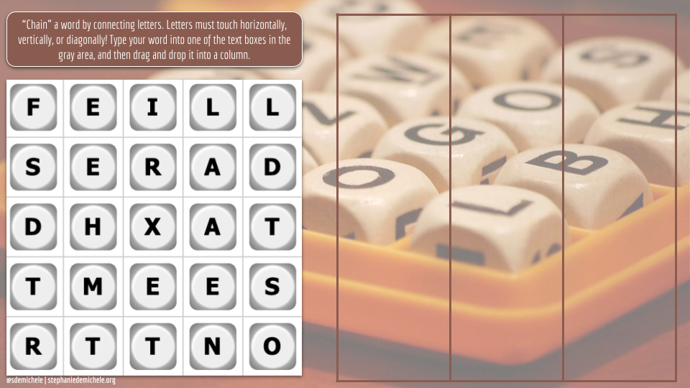

Slide 2


Slide 3


Feel free to use the game board in Slide #1. However, if you’d like to create your own game:
Go to this site to find a Boggle game that is appropriate for your students’ age level.
Screenshot the board and insert it into Slide #2.
File > Download the slide as a PNG.
In a new BLANK slide, upload the PNG file as a BACKGROUND image. (This “locks” everything.)
Then delete both my Slide #1 and your Slide #2.
HOW TO PLAY:
Before you share the game during a video conference call with students, you’ll want to first download the Fullscreen Interactive Google Slides extension.
Once you’ve downloaded it, watch this video from Kasey Bell to learn how to present this activity to students while allowing for interactivity.
You may want to zoom in or out when presenting.
It might get messy as kiddos will sometimes try to type in the same box. But that’s okay. They’ll figure it out! 😊
@sdemichele | stephaniedemichele.org

Slide 4


Stephanie DeMichele
Digital Learning Designer + Instructional Coach
Slayer of #Edtech Fears + Creator of #DigitalDoOvers
SHARING IS CARING
Please customize this template, but please also give credit to the original creator (and to those who inspired her!) when doing so and when posting to social media. In others words, make sure everyone gets credit for building upon the ideas of others!
I ❤️ WHAT I DO
I'm often asked why I don't charge for my work. Honestly, I do what I do because I'm a happy creator and sharer. A grateful teacher offered to Buy Me a Coffee once, and so, while I don't require payment--I'm always up for supporting my caffeine habit! (But only if you want to!)
#DistanceLearning is about #Flexibility | #StudentAgency | #Collaboration | #Creativity

