Slide 1

RURAL DEVELOPMENT

Slide 2
In this chapter we will study
• The meaning and significance of rural development.
• Rural development and decentralization.
• Rural development and panchayat raj institutions.
• Rural development and women

Slide 3
CONDITION OF VILLAGES
● India is a land of villages 68.8 4 village population In India according to 2011
● ⅓ rural population lives in poverty. Programs plans are fail to improve rural places
● Development of villages is the true development of India said by Gandhiji
● Rural Industries declining due to modern industries

Slide 4
● Rural people are migrating towards urban areas due to poverty
● Liberalization globalization deepened the problems
● Consequently poverty increasing. Agriculture contribution to National Income becomes less and widening the gap between rural and urban areas.

Slide 5
Meaning
‘Rural Development is improvement of the social and economic status of the rural people by proper utilization of the locally available natural and human resources’.

Slide 6
Importance:
• Rural development occupies a very important place in the development of the Indian economy
• The majority of the population lives in the villages
• Various basic facilities like education, training, health, hygiene etc. should be provided to the rural people

Slide 7



• A deplorable lack of basic amenities can be noticed in rural areas. The rural people should be provided with essential facilities
• Instead of sending the raw agricultural produce to the cities and selling them, they can be processed in the village itself and transformed into ready goods

Slide 8
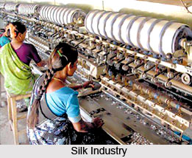

• Small-scale and cottage industries can be improved, thereby strengthening the rural economy.
• scheduled castes and scheduled tribes and other backward classes are assured of continued employment opportunities

Slide 9
The facilities and opportunities that are available to people in urban areas should be available to people in rural areas
• The villagers should be able to participate in the process of development.

Slide 10

Decentralization:
Providing administrative power and responsibility of developing village to people
● Self-reliant, self-sufficient and prosperous villages can be developed.

Slide 11
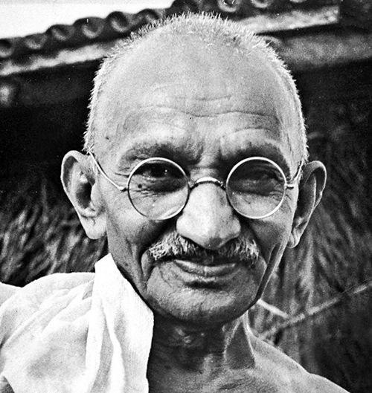
Power sharing people participation planning are the concept of grama Swaraj of Gandhiji
● Decentralization reduces exploitation uphold human dignity independence nurture human values

Slide 12

Panchayat Raj system
Panchayat Raj came to existence in 1993 according to the 73rd amendment of Indian Constitution.
● As per the Amendment, three-tier system of panchayats came into existence

Slide 13
Role of Panchayat Raj institutions in rural development
● Plays a key role in enabling in the rural people to participate in rural development
● Responsible for implementing various schemes related to poverty eradication security public amenity

Slide 14
‘Mahatma Gandhi National Rural Employment Guarantee Project’, (MGNREGP) ‘Swarnajayanti Grama swarajgar Yojana’ (SGSY)’ etc. for generation of employment and alleviation of poverty can be implemented

Slide 15
They provide basic facility like roads drains water lights toilets School hospitals and market
● Encourage adult education technical vocational training development of human resources

Slide 16
Housing programmes- ‘Indira Awas Yojana ,Yojana Ambedkar Valmiki housing program Ashraya Yojna
● ‘Swarnajayanti Grama swarajgar Yojana’ (SGSY)’
● ‘Suvarna Gramodaya Yojana’, basic facilities can be enhanced.

Slide 17

Productive activities like cattle rearing poultry fisheries nurtured
● Social welfare programs for disabled, Windows,old,sick, mental retarded people

Slide 18
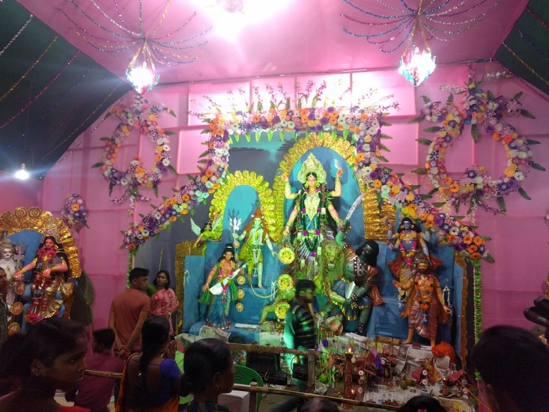


Social and cultural activities can be encouraged through celebration of village fairs and festivals. Through such activities, village arts and crafts will get an impetus

Slide 19
Women and rural development
Every man’s life is shaped by a woman. She works not only in the house but also outside as a farmer, worker, employee, officer, businesswoman and lawmaker
• working in the areas of farming, cattle-rearing, fisheries, silkworm rearing, horticulture, floriculture and poultry

Slide 20
Women are rendering exceptional service in government offices, commercial establishments, educational institutions, hospitals, old age homes etc

Slide 21
Starting from the gram panchayat to the position of a President, they are handling various responsibilities as political leaders
• A notable feature in Karnataka at present is that there are more than 50% women among the elected members of panchayat institutions

Slide 22
Women self help groups
These have been playing a very significant role in organizing poor rural women and making them financially independent.
• Members can avail of loans easily and engage in productive activities

Slide 23
Successful in mobilizing savings and in obtaining repayment of loans

Slide 24
Social evils like child marriage, dowry, caste system, superstitions, exploitation of women and children are still rampant. Through the self-help groups, alert women are able to get rid of such evils.

Slide 25
They are able to contribute towards building a clean and progressive society.

Slide 26


Thank you
Prepared by:
Praveen Banakar

