Slide 1
Lesson 1: Epidemiology
Section 1: Epidemiologic Background of HIV/HCV Co-infection in the United States
July 2017, updated September 2020

Slide 2
Authors and Funders
This presentation was prepared by Francine Cournos, MD, (Northeast/Caribbean AETC) for the AETC National Coordinating Resource Center in July 2017 and updated by the NCRC in September 2020.
This presentation is part of a curriculum developed by the AETC Program for the project: Jurisdictional Approach to Curing Hepatitis C among HIV/HCV Co-infected People of Color (HRSA 16-189), funded by the Secretary's Minority AIDS Initiative through the Health Resources and Services Administration HIV/AIDS Bureau.

Slide 3
Lesson Objectives
Identify and understand epidemiologic trends in HCV in the United States
Review the available data on epidemiologic trends in HIV/HCV co-infection in the United States
Identify how epidemiologic trends in the United States apply to men who have sex with men (MSM), people who inject drugs (PWID), and how they vary by gender, age, race, and ethnicity
Notes:
HCV = Hepatitis C Virus
HIV = Human Immunodeficiency Virus
MSM = Men who have Sex with Men
PWID = People Who Inject Drugs

Slide 4
Epidemiology of HCV in the United States
HCV is the most common chronic blood borne infection
Up to half may be unaware that they are infected
About 2.4 million people had active HCV infection, as of 2016 (~1% of the U.S. population)
4.1 million had positive HCV Ab, indicating past or current infection
Divergent trends in HCV epi:
Effective HCV treatment has decreased the overall number of people with active infection in the U.S in the past 10 years
Large increases in new HCV infections, driven by the opioid crisis, have occurred in some populations
Prevalence varies widely by state
CDC. Viral Hepatitis Surveillance 2018, 2020
Hofmeister. Hepatology, 2019
AASLD-IDSA. Hepatology, 2020
Notes:
CDC Recommendations for Hepatitis C Screening Among Adults – United States, 2020
MMWR 2020 (RR 69)
Hofmeister M, et al. Hepatology 2019
National Notifiable Diseases Surveillance System–Acute hepatitis C trends, 2009–2018–Newly reported chronic hepatitis C, 2018
Division of Viral Hepatitis, National Center for HIV/AIDS, Viral Hepatitis, STD, and TB Prevention, VIRAL HEPATITIS SURVEILLANCE UNITED STATES, 2018. Published July 2020. https://www.cdc.gov/hepatitis/statistics/2018surveillance/pdfs/2018HepSurveillanceRpt.pdf

Slide 5
Estimated HCV Prevalence by Decade of Birth
The majority of active HCV infections are in individuals born between 1945 and 1965, but increasing numbers of infections in younger persons
1.6
1.4
1.2
1.0
Number with chronic HCV (millions)
0.8
0.6
0.4
0.2
0
<1920
1920s
1930s
1940s
1950s
1960s
1970s
1980s
1990+
Graham, 2012. Adapted from Pyenson, 2009.
Notes:
Baby boomers (born 1945-65) account for >75% of HCV infections in the United States⁶⁻⁷ HCV is unusual in that it disproportionately affects baby boomers -- 82% of people infected with HCV were born from 1945 through 1965 (Figure). A majority of these people acquired HCV in the 1960s through 1980s, so they have lived with HCV for 20 to 40 years. The risk of cirrhosis, liver failure and liver cancer increases with longer duration of infection. In fact, HCV-related cirrhosis is projected to increase from 25% to 37% over the next decade, peaking at over 1 million cases by 2020 if there are no changes in screening, diagnosis, and treatment⁶ .
Pyenson B, Fitch KV, Iwasaki K. Consequences of Hepatitis C Virus (HCV): Costs of a baby boomer Epidemic of Liver Disease. New York, NY: Milliman, Inc; May 2009.

Slide 6
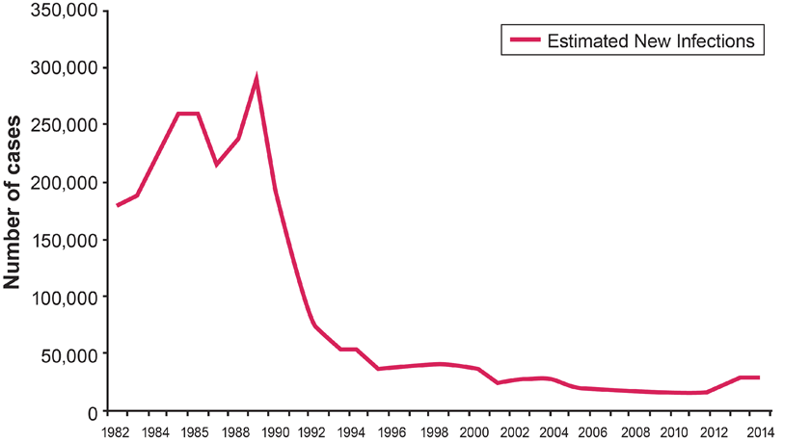
Estimated Incidence of HCV, 1982-2014
CDC, 2015
Notes:
The graphic represents the estimated number of new hepatitis C infections per year in the United States.
•HCV incidence peaked in the late 1980s and early 1990s at about 230,000 new infections per year7.
•After that, rates dropped, first among recipients of blood, blood products, and organs (d/t screening of blood supply), and then among PWID.
•note increasing infections beginning after 2012

Slide 7
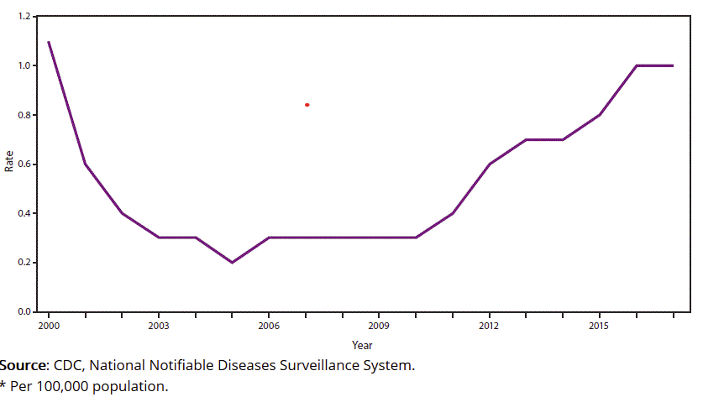
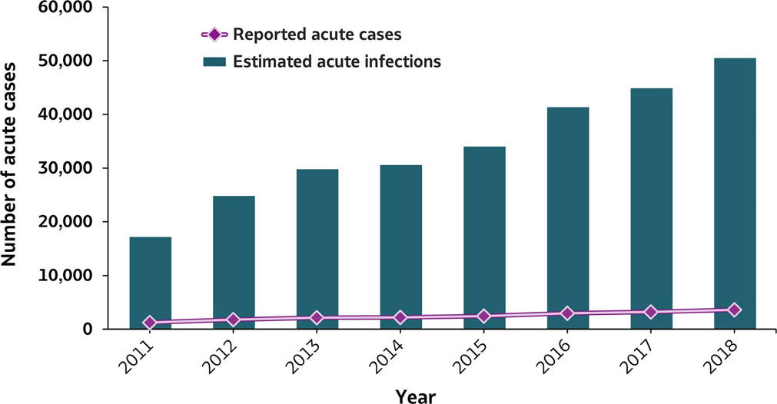
Increasing HCV Infections in Recent Years: Estimated Incidence of HCV Infection 2000-2018
Number of reported acute HCV cases and estimated infections — U.S., 2011–2018
Incidence rates* of reported acute HCV cases ── US, 2000–2017
CDC, National Notifiable Diseases Surveillance System. 2020
Notes:
Increasing rated of acute HCV in recent years
The graphic represents the estimated number of new hepatitis C infections per year in the United States. Note how the actual REPORTED number of acute HCV cases markedly differs from the ESTIMATED number of cases annually per the CDC.
The definition of acute HCV, along with the natural history of the disease (where many persons are asymptomatic after infection), make the epidemiology of acute HCV difficult to accurately grasp.
HCV incidence peaked in the late 1980s and early 1990s at about 230,000 new infections per year.
After that, rates dropped, first among recipients of blood, blood products, and organs, and then among PWID.
Since about 2005, the incidence has beenincreasing, in nearly all demographic groups

Slide 8
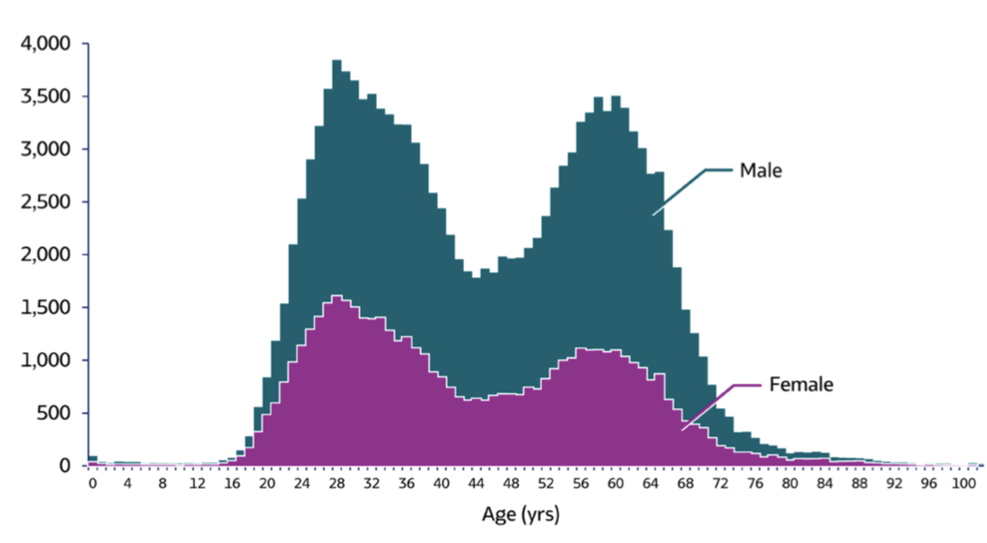
New Chronic HCV in the United States
Number of newly reported chronic HCV cases, 2018
In recent years, bimodal age distribution of newly-reported chronic HCV
Highest rates of new chronic HCV in age 20-39
Source: CDC, Viral Hepatitis Surveillance United States, 2018
Notes:
Division of Viral Hepatitis, National Center for HIV/AIDS, Viral Hepatitis, STD, and TB Prevention, VIRAL HEPATITIS SURVEILLANCE UNITED STATES, 2018. Published July 2020. https://www.cdc.gov/hepatitis/statistics/2018surveillance/pdfs/2018HepSurveillanceRpt.pdf

Slide 9
People at Risk of HCV Infection
Current or former injection drug use (with sharing of equipment)
Recipients of clotting factor concentrates before 1987
Recipients of blood transfusions or organ transplant before July 1992
Recipient of maintenance hemodialysis
PWH (primarily PWID and MSM)
Infants born to HCV-infected mothers
Notes:
PWID = People Who Inject Drugs
MSM = Men who have Sex with Men

Slide 10
Reported Risks for Acute HCV Cases, 2018
49% no data on risks
14% no risk factors identified
37% risk identified (may have more than 1 risk):
82% IDU
16% multiple sex partners
9.2% surgery
7.8% sexual contact
6.7% needlestick
2.4% MSM
≤2%: household contact, dialysis, occupational, transfusion
CDC, 2018​
Notes:
Source: CDC, Nationally Notifiable Diseases Surveillance System.
* Case reports with at least one of the following risk behaviors/ exposures reported 6 weeks to 6 months prior to symptom onset: 1) injection drug
use; 2) sexual contact with suspected/confirmed hepatitis C patient; 3) men who have sex with men; 4) multiple sex partners; 5) occupational
exposure to blood; 6) dialysis patient; 7) receive blood transfusion; and 8) underwent surgery.
† Reported cases may include more than one risk behavior/exposure.
§ Cases with more than one type of contact reported were categorized according to a hierarchy: (1) sexual contact; (2) household contact (non-sexual).
¶ A total of 2,012 acute hepatitis C cases were reported among males in 2018.

Slide 11
Percutaneous Transmission of HCV
Injection drug use (IDU) is most common means of HCV transmission in the U.S.
~72% of new HCV cases in 2018 reported IDU
~54% of PWID have positive HCV Ab
~74% of these have active infection
~33% of PWID aged 18-30 have HCV; these rates are increasing
~70-90% of older PWID have HCV
Intranasal drug use is also a risk factor
CDC, 2018
Haddad, 2015
Notes:
This slide relies on CDC data. Other sources of data may give different estimates. Our understanding of HCV epidemiology is incomplete.

Slide 12
Sexual Transmission of HCV
Since 2000, increased incidence of sexually-acquired HCV, especially in MSM with HIV
Risks: anal receptive sex (condomless)
Higher rates in MSM with HIV
Less frequent in MSM w/o HIV
Recreational drug use (non-IDU), concurrent STIs, use of sex toys
Sexual transmission of HCV in heterosexual couples appears to be rare
Hagan. AIDS, 2015
Jordan. Int J STD AIDS, 2017
Vandelli. AmJ Gastroenterol, 2004
AASLD-IDSA Guidelines
Notes:
HIV-uninfected MSM
Amsterdam study: 0 cases/100 person years
UK study: 1.5 cases/1,000 person years
Studies in Canada, Argentina, Australia: no association with sexual transmission (if no IDU present)
Slide adapted from Haddad, M. New Era of HCV Management: Innovations in Primary Care. Sep 24, 2015. Presentation online: https://careacttarget.org/library/new-era-hcv-management-innovations-primary-care

Slide 13
Perinatal Transmission of HCV
HCV mono-infected pregnant woman: rate of perinatal transmission ~4%-8% per pregnancy
Higher risk if HIV/HCV infection: 10%-15%
Transmission may occur during pregnancy or childbirth
No prophylaxis is available
Benova, CID,2014
Notes:
Benova L, Mohamoud YA, Calvert C, et al. Vertical Transmission of Hepatitis C Virus: Systematic Review and Meta-analysis. Clinical Infectious Diseases. 2014;59(6):765-73.

Slide 14
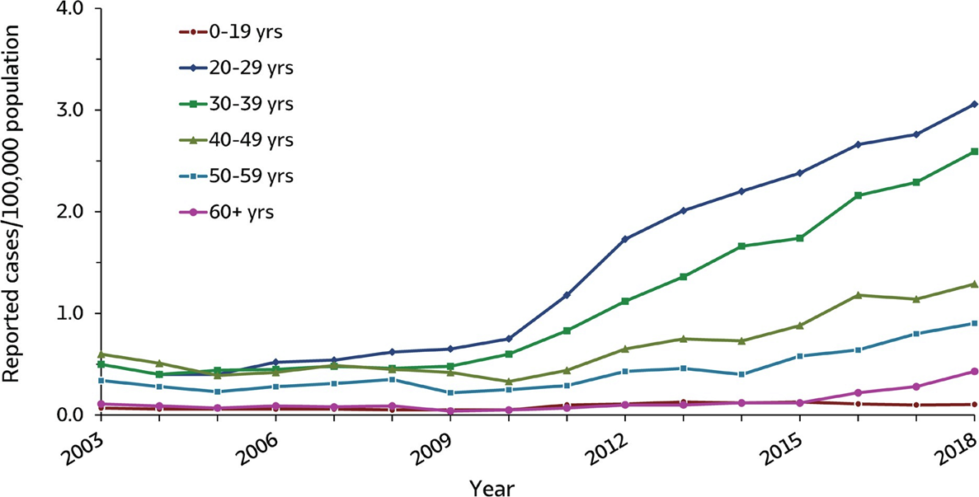
Trends in HCV Incidence by Age
Rates of reported acute hepatitis C, by age group —U.S., 2003–2018
Highest rates of new HCV infections: age 20-39
67% of reported acute HCV in 2018
CDC, 2020
Notes:
In 2017, acute HCV incidence was greatest for persons aged 20–29 years (2.8) and 30–39 years (2.3) (1). Persons aged ≤19 years had the lowest incidence (0.1) (1). Incidence was slightly greater for males than females (1.2 cases and 0.9, respectively) (1). During 2006–2012, the combined incidence of acute HCV infection in four states (Kentucky, Tennessee, Virginia, and West Virginia) increased 364% among persons aged ≤30 years. Among cases in these states with identified risk information, IDU was most commonly reported (73%). Those infected were primarily non-Hispanic white persons from nonurban areas (8). (ref 1)
Overall, the number of inci-dent hepatitis C cases reported in the United States through the National Notifiable Diseases Surveillance System increased 38.8% from 2013 through 2016, most markedly among those 20-39 years old, although increases occurred among adults of all ages.(ref hofmeister)

Slide 15
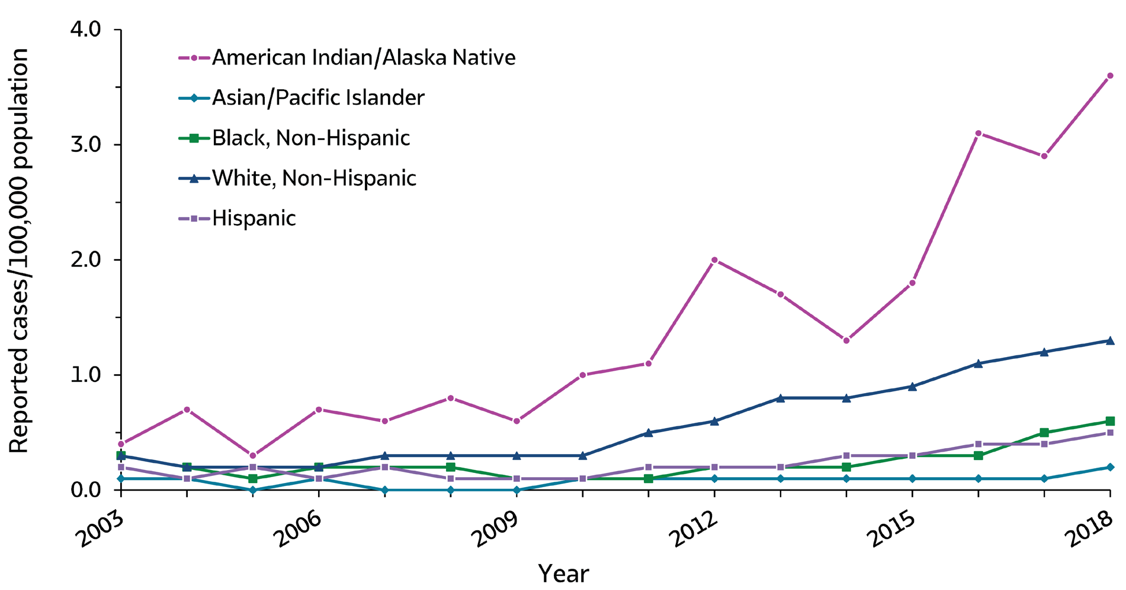
Trends in HCV Incidence by Race and Ethnicity
Rates of reported acute HCV 2003–2018
Reported acute HCV in 2018:
66% were white non-Hispanics
Highest rate: Native Americans
CDC, 2020
Notes:
In 2017, acute HCV incidence was greatest for persons aged 20–29 years (2.8) and 30–39 years (2.3) (1). Persons aged ≤19 years had the lowest incidence (0.1) (1). Incidence was slightly greater for males than females (1.2 cases and 0.9, respectively) (1). During 2006–2012, the combined incidence of acute HCV infection in four states (Kentucky, Tennessee, Virginia, and West Virginia) increased 364% among persons aged ≤30 years. Among cases in these states with identified risk information, IDU was most commonly reported (73%). Those infected were primarily non-Hispanic white persons from nonurban areas (8). (ref 1)
Overall, the number of inci-dent hepatitis C cases reported in the United States through the National Notifiable Diseases Surveillance System increased 38.8% from 2013 through 2016, most markedly among those 20-39 years old, although increases occurred among adults of all ages.(ref hofmeister)

Slide 16
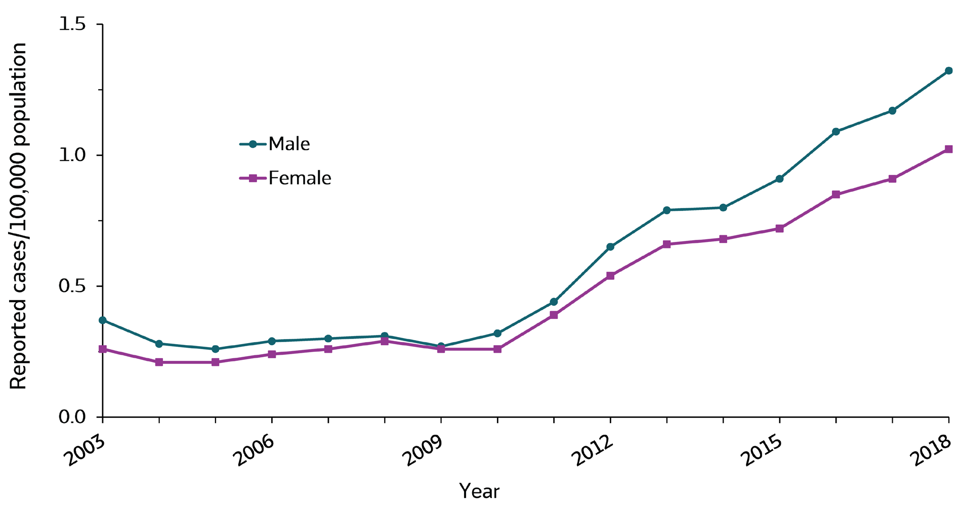
Trends in HCV Incidence by Sex
Rates of reported acute HCV, by sex, 2003-2018
Reported acute HCV in 2018:
56% male
44% female
CDC, 2020
Notes:
In 2017, acute HCV incidence was greatest for persons aged 20–29 years (2.8) and 30–39 years (2.3) (1). Persons aged ≤19 years had the lowest incidence (0.1) (1). Incidence was slightly greater for males than females (1.2 cases and 0.9, respectively) (1). During 2006–2012, the combined incidence of acute HCV infection in four states (Kentucky, Tennessee, Virginia, and West Virginia) increased 364% among persons aged ≤30 years. Among cases in these states with identified risk information, IDU was most commonly reported (73%). Those infected were primarily non-Hispanic white persons from nonurban areas (8). (ref 1)
Overall, the number of inci-dent hepatitis C cases reported in the United States through the National Notifiable Diseases Surveillance System increased 38.8% from 2013 through 2016, most markedly among those 20-39 years old, although increases occurred among adults of all ages.(ref hofmeister)

Slide 17
HCV Infection and Incarceration
An estimated 11% of incarcerated persons in the United States are living with HCV²
Treatment in correctional settings would offer significant health benefits to inmates and the communities to which they will return
Notes:
Seven studies of incarcerated persons reported HCV prevalence, with HCV antibody prevalence ranging from 11.9% to 20.6%. Of these, four studies reported HCV RNA prevalence ranging from 9.1% to 15.2%; for the other three studies, HCV RNA prevalence was calculated by multiplying the reported HCV antibody preva-lence by the 57.5% of HCV antibody–positive persons with HCV RNA from the 2013-2016 NHANES data (Table 3). The estimated mean HCV antibody prevalence was 16.1%, and the estimated mean HCV RNA prevalence was 10.7% (ref 5)

Slide 18
HCV Infection and Homelessness
An estimated 11% of unsheltered homeless people in the United States are living with HCV
Notes:
Seven studies of incarcerated persons reported HCV prevalence, with HCV antibody prevalence ranging from 11.9% to 20.6%. Of these, four studies reported HCV RNA prevalence ranging from 9.1% to 15.2%; for the other three studies, HCV RNA prevalence was calculated by multiplying the reported HCV antibody preva-lence by the 57.5% of HCV antibody–positive persons with HCV RNA from the 2013-2016 NHANES data (Table 3). The estimated mean HCV antibody prevalence was 16.1%, and the estimated mean HCV RNA prevalence was 10.7% (ref 5)

Slide 19
Projected HCV Morbidity and Mortality without HCV Treatment (HCV monoinfection)
Davis, Gastroenterology, 2010
Notes:
Without treatment, decompensated cirrhosis and HCC would rise into the 2020s.
Projected number of cases by year of decompensated cirrhosis (purple) and hepatocellular carcinoma (green). The model assumes a first year mortality of 80% to 85%, so in contrast to the decompensated cirrhosis projection, the number of cases of hepatocellular carcinoma the prevalence demonstrated here closely resembles annual incidence of liver cancer.
Without the advantage of effective new treatments, decompensated cirrhosis cases will continue to increase through 2020-2030.
Without the advantage of effective new treatments, hepatocellular carcinoma is expected to peak in 2019 at 14,000 cases.
This slide does not reflect the impact of direct-acting antivirals for HCV infection.
Morbidity and mortality due to HCV infection are projected to rise into the 2020s as illness and deaths from decompensated cirrhosis and HCC peak among baby boomers, the generation with the highest infection rates
The delayed effect of morbidity and mortality following initial HCV infection reflects the long time period that usually passes between initial infection and the onset of severe hepatic illness
Widespread treatment of HCV infection would diminish but not totally reverse this projected increase in mortality

Slide 20
Effective Treatment Will Significantly Reduce Mortality from HCV Infection
HCV monoinfection; few data on HIV/HCV coinfection
van der Meer AJ et al. JAMA. 2012
Notes:
SVR = cure for HCV.
From HCV Guidance:
“Numerous studies have demonstrated that hepatitis C therapy and the achievement of an SVR in this population results in dramatic decreases in hepatic decompensation events, hepatocellular carcinoma, and liver-related mortality. (Morgan, 2013); (van der Meer, 2012); (Backus, 2011); (Dienstag, 2011); (Berenguer, 2009); (Mira, 2013) In the HALT-C study, patients with advanced fibrosis secondary to HCV infection who achieved an SVR, compared with patients with similarly advanced liver fibrosis who did not achieve an SVR, had a decreased need for liver transplantation (hazard ratio [HR], .17, 95% confidence interval [CI], .06–.46), development of liver-related morbidity and mortality (HR, .15, 95% CI, .06–.38) and hepatocellular carcinoma (HR, .19, 95% CI, .04–.80).”

Slide 21
HCV Deaths Surpassed HIV Deaths in 2006-7
15,106
12,734
Ly KN et al., 2012
Notes:
FIGURE. Annual age-adjusted mortality rates from hepatitis B and hepatitis C virus infections and HIV infections listed as causes of death in the United States between 1999 and 2007.
In the United States, the annual number of deaths due to HCV infection are increasing, and have risen above that of HIV infection.
Notes
In an analysis of ~22 million death certificates from 1999 to 2007, the mortality rate due to HCV infection increased to 15,106 in 2007. During the same timeframe, deaths due to HBV remained relatively constant (1815 deaths in 2007) and HIV-related deaths decreased slightly to 12,734.¹
During the study period, annual deaths due to HCV surpassed that of HIV infection.¹
While these data indicate the increasing mortality burden of chronic HCV infection, deaths due to HCV are frequently underreported; thus the accurate mortality is likely to be higher than is captured by death certificates.^{1,2}
Because a decedent can have multiple causes of death, a record listing more than 1 type of infection was counted for each type of infection.

Slide 22
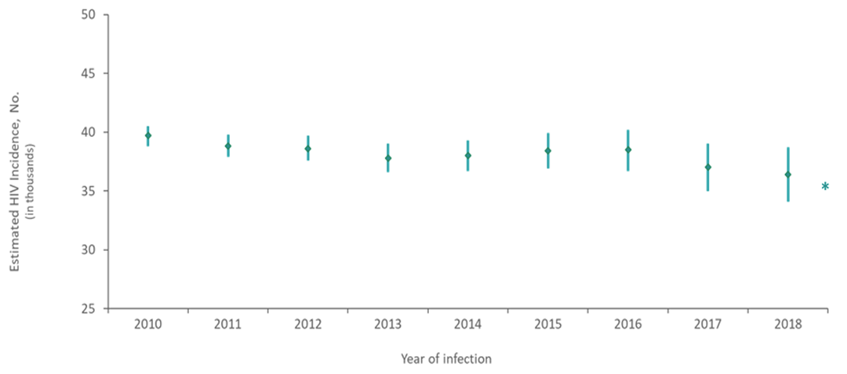
Epidemiology of HIV in the United States
Estimated 1.2 million people with HIV in the U.S. (2018) (~0.5% of the U.S. population)¹
14% undiagnosed
~38,000-40,000 new infections/yr - decreasing in some areas and populations, flat or increasing in some
CDC, 2020

Slide 23
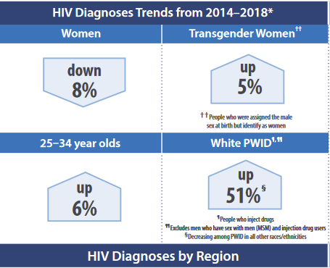
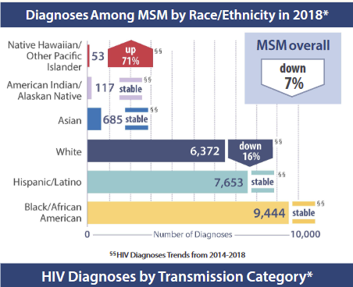
Epidemiology of HIV in the United States
~38,000-40,000 new infections/yr - decreasing in some areas and populations, flat or increasing in some
CDC, 2018 and 2020

Slide 24
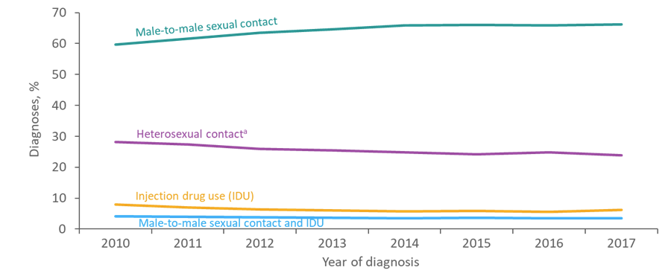
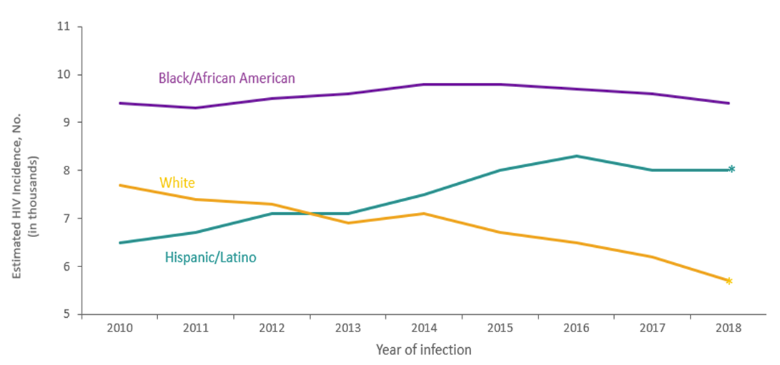
Trends in HIV Incidence by Transmission Category
Sex between men is the predominant mode of HIV transmission
Blacks and Latinx/Hispanics are more likely to be infected
HIV Incidence by Transmission Category
HIV Incidence in MSM by Race/Ethnicity
Note. Estimates were derived from a CD4 depletion model using HIV surveillance data.
* Difference from the 2010 estimate was deemed statistically significant (P < .05).
CDC, 2018 and 2019
Notes:
Left: This slide presents the percentage distribution of adults and adolescents with diagnosed HIV infection from 2010 through 2017, by transmission category, for the United States and 6 dependent areas.
The percentage of adults and adolescents with diagnosed HIV infection attributed to male-to-male sexual contact increased from 60% in 2010 to 66% in 2017. The percentages of diagnosed HIV infections attributed to injection drug use, male-to-male sexual contact and injection drug use, and heterosexual contact decreased from 2010 through 2017. The “Other” transmission category is not displayed as it comprises less than 1% of cases. The category includes hemophilia, blood transfusion, perinatal exposure, and risk factor not reported or not identified.
Data have been statistically adjusted to account for missing transmission category.
Heterosexual contact is with a person known to have, or to be at high risk for, HIV infection.
Right: This slide presents estimated HIV incidence among men who have sex with men (MSM) aged ≥13 years, in the United States from 2010 though 2018, by race/ethnicity.
The annual number of HIV infections in 2018, compared with 2010, increased among Hispanic/Latino MSM (23%), but decreased among white MSM (−26%). The number of infections remained stable among black/African American MSM.
In 2018, black/African American MSM had the largest percentage (39%) of HIV infections among all MSM.
Estimates were derived from a CD4 depletion model using HIV surveillance data. Estimates are rounded to the nearest 100 for estimates >1,000 and to the nearest 10 for estimates ≤1,000 to reflect model uncertainty. Data have been statistically adjusted to account for missing transmission category.
Data on men who have sex with men do not include men with HIV infection attributed to male-to-male sexual contact and injection drug use.
Hispanics/Latinos can be of any race.
An asterisk (*) next to the trend line indicates that the difference in the estimate for 2018 from the 2010 estimate was deemed statistically significant (P < .05). Differences that were not statistically significant were deemed ‘stable’.
All data presented in this slide set are from the same dataset (reported to CDC through December 2019) and CD4 model used for the HIV Supplemental Surveillance Report “Estimated HIV Incidence and Prevalence in the United States 2014–2018”. Please see the Commentary and Technical Notes for information on the methods used to produce the estimates. The report can be found at: https://www.cdc.gov/hiv/library/reports/hiv-surveillance.html

Slide 25
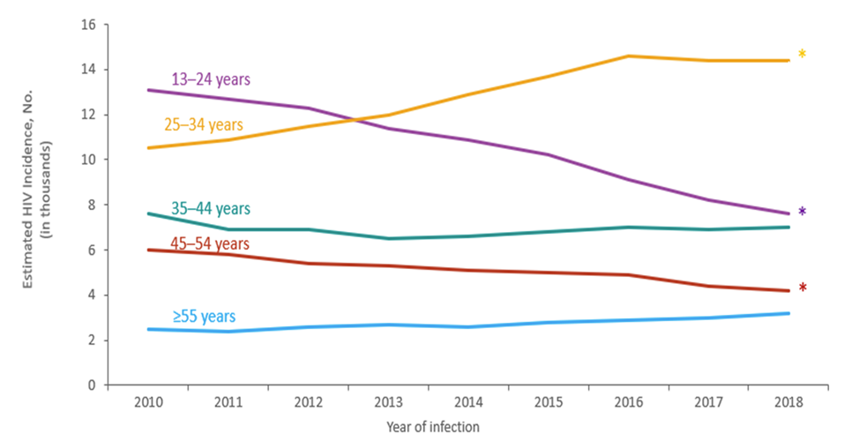
Trends in HIV Incidence by Age
CDC, 2019
Note. Estimates were derived from a CD4 depletion model using HIV surveillance data.
* Difference from the 2010 estimate was deemed statistically significant (P < .05).
Notes:
TThis slide presents estimated HIV incidence among persons ≥13 years in the United States from 2010 through 2018, by age.
The annual number of HIV infections in 2018, compared with 2010, increased among persons aged 25–34 years (37%), but decreased among persons aged 13–24 years (−42%) and 45–54 years (−30%). The number of infections in 2010 and 2018 remained stable among persons aged 35–44 and ≥55 years.
In 2018, persons aged 25–34 years accounted for the largest percentage (40%) of HIV infections; whereas, persons aged ≥55 years accounted for the smallest percentage (9%) of HIV infections.
Estimates were derived from a CD4 depletion model using HIV surveillance data. Estimates are rounded to the nearest 100 for estimates >1,000 and to the nearest 10 for estimates ≤1,000 to reflect model uncertainty.
An asterisk (*) next to the trend line indicates that the difference in the estimate for 2018 from the 2010 estimate was deemed statistically significant (P < .05). Differences that were not statistically significant were deemed ‘stable’.
All data presented in this slide set are from the same dataset (reported to CDC through December 2019) and CD4 model used for the HIV Supplemental Surveillance Report “Estimated HIV Incidence and Prevalence in the United States 2014–2018”. Please see the Commentary and Technical Notes for information on the methods used to produce the estimates. The report can be found at: https://www.cdc.gov/hiv/library/reports/hiv-surveillance.html
From 2010 through 2014, rates of diagnoses of HIV infection remained stable among persons aged 13–24 years and 25–34 years. Decreases were seen in rates among persons aged 35–44 years (-21.0%), 45–54 years (-19.3%), and ≥55 years (-15.7).
Data include persons with a diagnosis of HIV infection regardless of stage of disease at diagnosis.

Slide 26
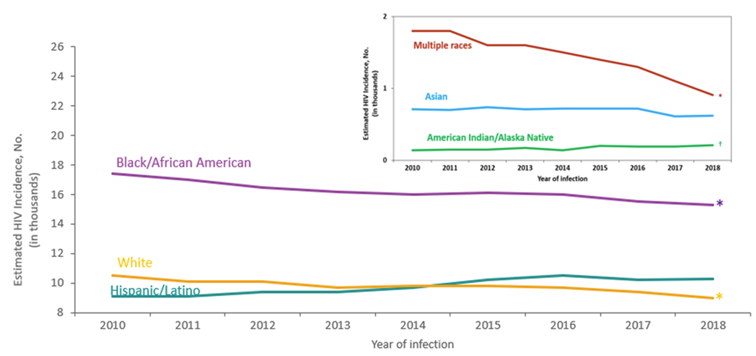
Trends in HIV Incidence by Race/Ethnicity
CDC, 2019
Note. Estimates were derived from a CD4 depletion model using HIV surveillance data.
* Difference from the 2010 estimate was deemed statistically significant (P < .05).
Notes:
This slide presents estimated HIV incidence among persons ≥13 years in the United States from 2010 through 2018, by race/ethnicity.
From 2010 through 2018, blacks/African Americans accounted for the highest number of HIV infections each year in the United States.
The annual number of HIV infections in 2018, compared with 2010, decreased among blacks/African Americans (−12%), whites (−14%), and persons of multiple races (−49%). The annual number of infections remained stable for Hispanics/Latinos and Asians.
In 2018, 42% of HIV infections were among blacks/African Americans, 28% among Hispanics/Latinos, 25% among whites, 3% among persons of multiple races, 2% among Asians, and less than 1% for American Indians/Alaska Natives.
Estimates were derived from a CD4 depletion model using HIV surveillance data. Estimates are rounded to the nearest 100 for estimates >1,000 and to the nearest 10 for estimates ≤1,000 to reflect model uncertainty.
Hispanics/Latinos can be of any race.
An asterisk (*) next to the trend line indicates that the difference in the estimate for 2018 from the 2010 estimate was deemed statistically significant (P < .05). Differences that were not statistically significant were deemed ‘stable’.
Estimates for American Indians/Alaska Natives should be used with caution because the RSEs are 30%–50%.
Estimates are not provided for Native Hawaiians/other Pacific Islanders because the RSEs are >50%.
All data presented in this slide set are from the same dataset (reported to CDC through December 2019) and CD4 model used for the HIV Supplemental Surveillance Report “Estimated HIV Incidence and Prevalence in the United States 2014–2018”. Please see the Commentary and Technical Notes for information on the methods used to produce the estimates. The report can be found at: https://www.cdc.gov/hiv/library/reports/hiv-surveillance.html

Slide 27
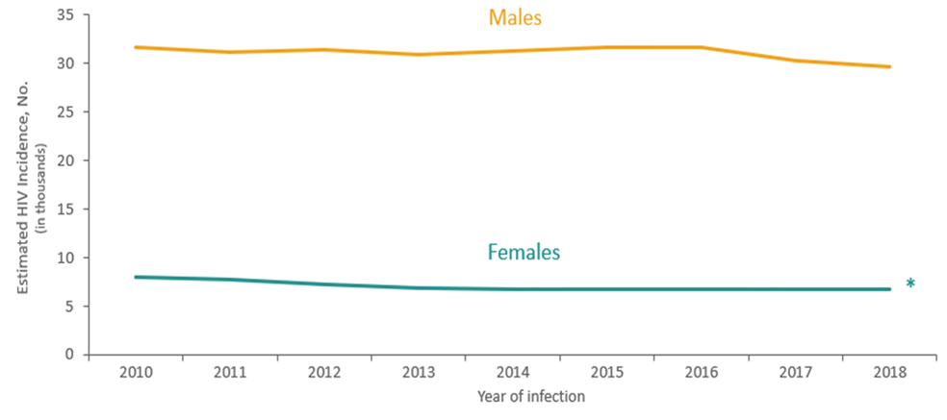
Trends in HIV Incidence by Sex at Birth
CDC, 2018
Note. Estimates were derived from a CD4 depletion model using HIV surveillance data.
* Difference from the 2010 estimate was deemed statistically significant (P < .05).
Notes:
This slide presents estimated HIV incidence among persons ≥13 years in the United States from 2010 through 2018, by sex at birth.
The annual number of HIV infections among persons aged ≥13 years in 2018, compared with 2010, decreased among females (−16%), but remained stable among males.
In 2018, of the estimated 36,400 HIV infections among persons aged ≥13 years, 82% were among males and 18% were among females.
Estimates were derived from a CD4 depletion model using HIV surveillance data. Estimates are rounded to the nearest 100 for estimates >1,000 and to the nearest 10 for estimates ≤1,000 to reflect model uncertainty.
An asterisk (*) next to the trend line indicates that the difference in the estimate for 2018 from the 2010 estimate was deemed statistically significant (P < .05). Differences that were not statistically significant were deemed ‘stable’.
All data presented in this slide set are from the same dataset (reported to CDC through December 2019) and CD4 model used for the HIV Supplemental Surveillance Report “Estimated HIV Incidence and Prevalence in the United States 2014–2018”. Please see the Commentary and Technical Notes for information on the methods used to produce the estimates. The report can be found at: https://www.cdc.gov/hiv/library/reports/hiv-surveillance.html

Slide 28
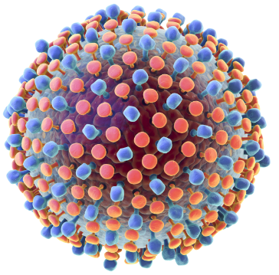
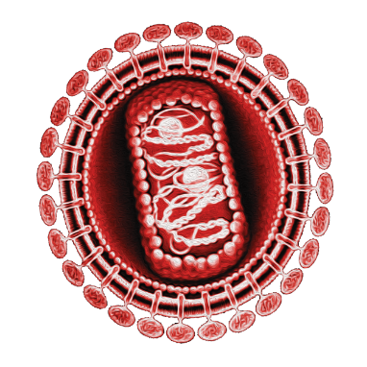
HIV/HCV Coinfection
About 25% of PWH in the U.S. also have current or past HCV infection (HCV Ab+)
Higher in some HIV+ groups (e.g., IDU – 60-80%)
Overlapping risk factors (e.g., IDU, MSM)
HIV 300K HCV
HIV
1.2M
HCV
3.4M

Slide 29
Disclaimer and Permissions
Users are cautioned that because of the rapidly changing medical field, information could become out of date quickly.
You may use or present this slide set and other material in its entirely or incorporate into another presentation if you credit the author and/or source of the materials.
The complete HIV/HCV Co-infection: An AETC National Curriculum is available at: https://aidsetc.org/hivhcv

Slide 30
References (1)
Schillie S, Wester C. Osborne, M et al, CDC Recommendations for Hepatitis C Screening Among Adults – United States, 2020. MMWR 2020 (RR 69). https://www.cdc.gov/mmwr/volumes/69/rr/rr6902a1.htm#T1_down
Hofmeister MG, Rosenthal EM, Barker LK, et al. Estimating Prevalence of Hepatitis C Virus Infection in the United States, 2013‐2016. Hepatology Volume 69, Issue 3 March 2019. 1020-1031.
Centers for Disease Control and Prevention. Viral Hepatitis Surveillance — United States, 2018. https://www.cdc.gov/hepatitis/statistics/SurveillanceRpts.htm. Published July 2020. Accessed September 2020.
Ly KN, Xing J, Klevens M et al. The increasing burden of mortality from viral hepatitis in the United Status between 1999 and 2007. Ann Intern Med. 2012; 156: 271-278.
Hagan H, Jordan AE, Neurer J, et al. Incidence of sexually transmitted hepatitis C virus infection in HIV-positive MSM: a systematic review and meta-analysis. AIDS. 2015;29:2335–2345.
Jordan AE, Perlman DC, Neurer J, et al. Prevalence of hepatitis C virus infection among HIV+ men who have sex with men: a systematic review and meta-analysis. Int J STD AIDS. 2017 Feb; 28(2): 145–159. PMID: 26826159
Vandelli C, Renzo F, Romano L, et al. Lack of evidence of sexual transmission of hepatitis C among monogamous couples: results of a 10-year prospective follow-up study. AmJ Gastroenterol. 2004;99:855–859.
Yehia BR, Schranz AJ, Umscheid CA, et al. The treatment cascade for chronic hepatitis C virus infection in the United States: a systematic review and meta‐analysis. PLoS One 2014;9:e101554.
Degenhardt L, Peacock A, Colledge S, et al. Global prevalence of injecting drug use and sociodemographic characteristics and prevalence of HIV, HBV, and HCV in people who inject drugs: a multistage systematic review. Lancet Global Health. 2017;5(12):e1192-1207.
Armstrong GL, Wasley A, Simard EP, et al. The prevalence of hepatitis C virus infection in the United States, 1999 through 2002. Ann Intern Med. 2006 May 16;144(10):705-14. PubMed PMID: 16702586
Edlin BR, Eckhardt BJ, Shu MA, et al. Toward a more accurate estimate of the prevalence of hepatitis C in the United States. Hepatology. 2015 Nov;62(5):1353- 63.
Centers for Disease Control and Prevention. Hepatitis C virus infection among adolescents and young adults: Massachusetts, 2002-2009. MMWR.
Denniston MM, Klevens RM, McQuillan GM, Jiles RB. Awareness of infection, knowledge of hepatitis C, and medical follow-up among individuals testing positive for hepatitis C: National Health and Nutrition Examination Survey 2001-2008. Hepatology. 2012 Jun;55(6):1652-61. PubMed PMID: 22213025

Slide 31
References (2)
Smith BD, Morgan RL, Beckett GA, et al; Centers for Disease Control and Prevention. Recommendations for the identification of chronic hepatitis C virus infection among persons born during 1945-1965. MMWR Recomm Rep. 2012 Aug 17;61(RR-4):1-32. Erratum in: MMWR Recomm Rep. 2012 Nov 2;61(43):886. PubMed PMID: 22895429.
Centers for Disease Control and Prevention. Recommendations for prevention and control of hepatitis C virus (HCV) infection and HCV-related chronic disease. MMWR 1998;47(No. RR-19):[i1-54].
Wejnert C, Hess KL, Hall HI, et al. Vital Signs: Trends in HIV Diagnoses, Risk Behaviors, and Prevention Among Persons Who Inject Drugs — United States. MMWR Morb Mortal Wkly Rep 2016;65:1336–1342.
Tohme RA, Holmberg SD. Is sexual contact a major mode of hepatitis C virus transmission? Hepatology. 2010 Oct;52(4):1497-505. PubMed PMID: 20635398.
Terrault NA, Dodge JL, Murphy EL, et al. Sexual transmission of hepatitis C virus among monogamous heterosexual couples: the HCV partners study. Hepatology. 2013 Mar;57(3):881-9. PubMed PMID: 23175457
McFaul K, Maghlaoui A, Nzuruba M, et al. Acute hepatitis C infection in HIV-negative men who have sex with men. J Viral Hepat. 2015 Jun;22(6):535-8. PubMed PMID: 25412826.
Van der Meer AJ, Veldt BJ, et al. Association between sustained virological response and all-cause mortality among patients with chronic hepatitis C and advanced hepatic fibrosis. JAMA. 2012 Dec 26;308(24):2584-93. PubMed PMID: 23268517.
Ly KN, Xing J, Klevens M et al. The increasing burden of mortality from viral hepatitis in the United Status between 1999 and 2007. Ann Intern Med. 2012; 156: 271-278.
Centers for Disease Control and Prevention. HIV Surveillance Report, 2018; vol. 31. Published 2020.
Graham C. Hepatitis C: A New Look at the Affected Population. Physician’s Office Resource. Medical Education Resources, LLC. 2012 Apr 5.
Division of Viral Hepatitis and National Center for HIV/AIDS, Viral Hepatitis, STD, and TB Prevention. Centers for Disease Control and Prevention. Statistics and Surveillance. Accessed 9/9/20

