Slide 1

What Is Biodiversity? Types and Levels
Biodiversity includes genetic diversity, species diversity, and ecosystem diversity.
Genetic diversity involves the variety of genes within a species, enhancing survival.
Species diversity refers to the number of different species within a habitat or region.
Ecosystem diversity encompasses the variety of ecosystems like forests, deserts, and oceans.
All levels of biodiversity are interconnected and crucial for the overall health of the planet.

Slide 2

Population Growth and Its Impact on Biodiversity
Population growth affects the availability of resources like food, water, and space.
Rapid growth can lead to habitat destruction, endangering many species.
Overpopulation in certain areas causes increased pollution and environmental degradation.
Controlling population growth is vital for maintaining ecological balance.
Sustainable practices can help manage population impacts on biodiversity.

Slide 3

Adaptations in Living Organisms
Adaptations are traits that help organisms survive and reproduce in their environment.
Physical adaptations include features like thick fur in cold climates and webbed feet for swimming.
Behavioral adaptations involve actions like migration, hibernation, and nocturnal activity.
Physiological adaptations are internal body changes, such as salt regulation in marine animals.
Adaptations evolve over time through natural selection to improve survival chances.

Slide 4

Introduction to Biodiversity and Its Importance
Biodiversity refers to the variety of life forms present on Earth, including plants, animals, fungi, and microorganisms.
Understanding biodiversity helps us appreciate the complexity and interconnectedness of ecosystems.
Biodiversity is vital for ecosystem stability, providing services like clean air, water, and fertile soil.
Human activities such as deforestation and pollution threaten biodiversity and disrupt natural balance.
Preserving biodiversity is essential for maintaining healthy ecosystems and ensuring sustainability.

Slide 5

Effects of Exceeding Carrying Capacity
Overpopulation can cause habitat destruction and loss of biodiversity.
It leads to increased competition for limited resources among species.
Exceeding carrying capacity results in environmental degradation and pollution.
Species may face extinction if their habitats cannot sustain them.
Managing populations to stay within carrying capacity is key to ecological health.

Slide 6

The Role of Adaptations in Biodiversity
Adaptations enable species to survive in diverse and changing environments.
They contribute to the richness of life forms by allowing survival in unique niches.
Adaptive traits lead to the formation of new species over evolutionary time.
Biodiversity is enhanced when multiple adaptations exist within ecosystems.
Understanding adaptations helps in conservation efforts and protecting endangered species.

Slide 7

Conservation Strategies for Biodiversity and Ecosystems
Protected areas like national parks help conserve habitats and species.
Sustainable resource management minimizes human impact on ecosystems.
Restoration projects aim to rehabilitate degraded habitats and ecosystems.
Public awareness and education are vital for promoting conservation efforts.
International agreements and policies support global biodiversity conservation.

Slide 8
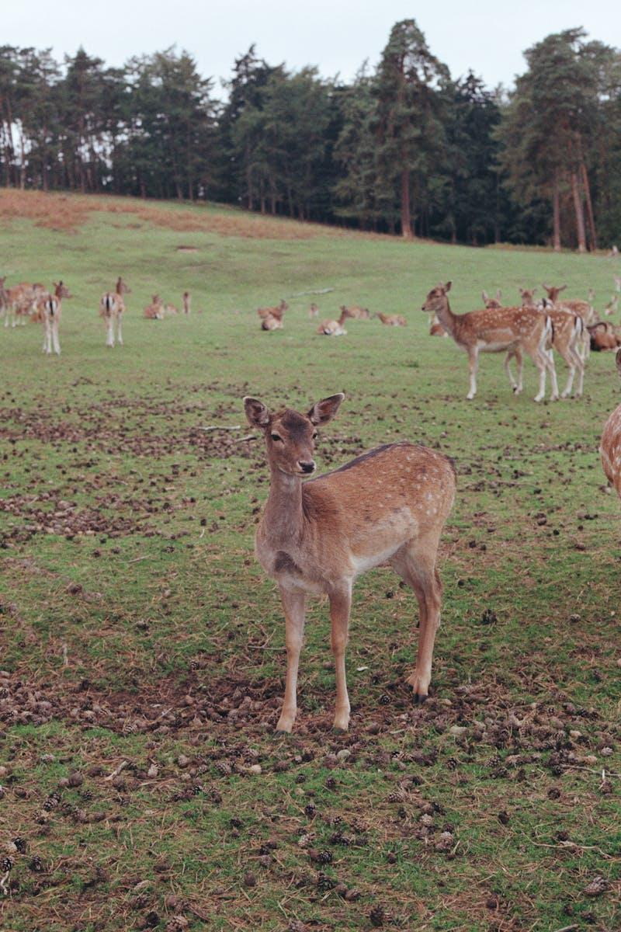
Carrying Capacity: Definition and Significance
Carrying capacity is the maximum number of individuals an environment can support sustainably.
It depends on resource availability, habitat space, and environmental conditions.
Exceeding carrying capacity leads to resource depletion and population decline.
Maintaining populations within carrying capacity ensures ecosystem stability.
Understanding carrying capacity helps in planning conservation and resource management.

Slide 9

Factors Influencing Population Dynamics
Birth rates, death rates, immigration, and emigration influence population size.
Environmental factors like climate and habitat availability affect population growth.
Predation, competition, and disease are biological factors controlling populations.
Human activities such as urbanization impact natural population balances.
Understanding these factors helps in managing and conserving species.

Slide 10

Conclusion and The Way Forward
Biodiversity is crucial for the health and stability of our planet.
Understanding adaptation, population growth, and carrying capacity is essential.
Protecting biodiversity requires collective efforts from individuals and governments.
Implementing sustainable practices helps preserve ecosystems for future generations.
Every individual can contribute to conservation through responsible actions.

