Slide 1
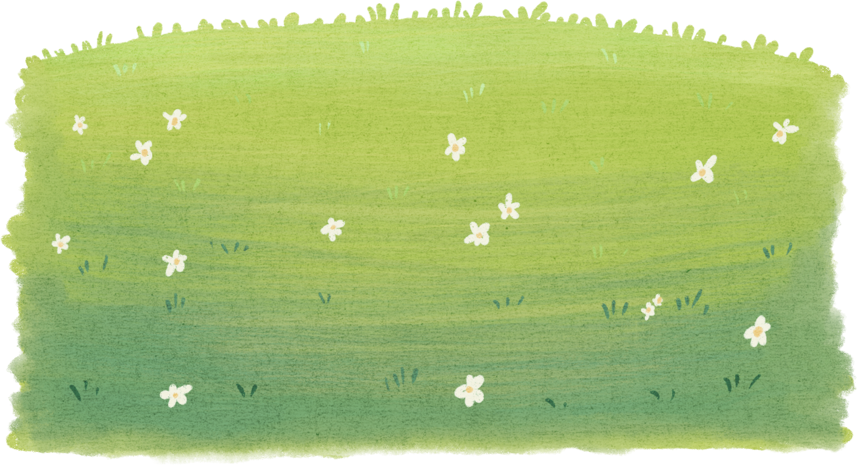

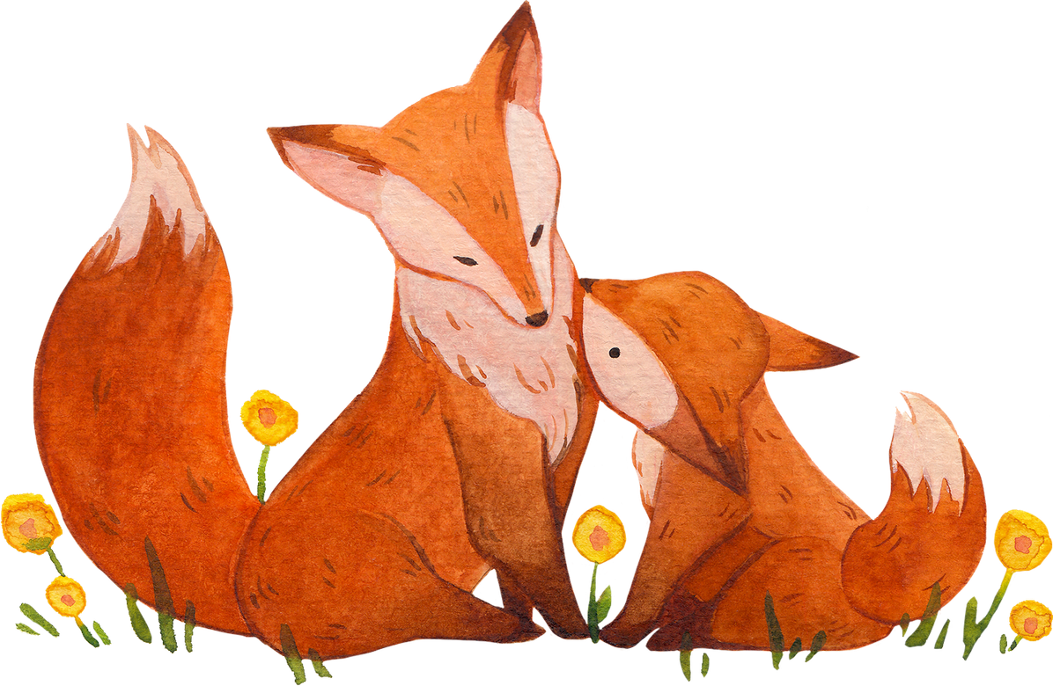
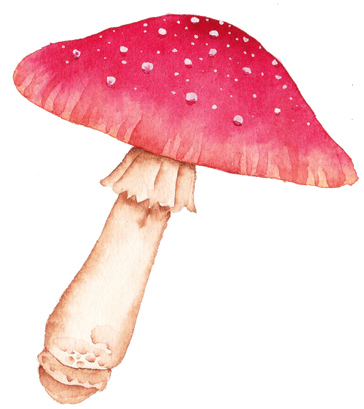
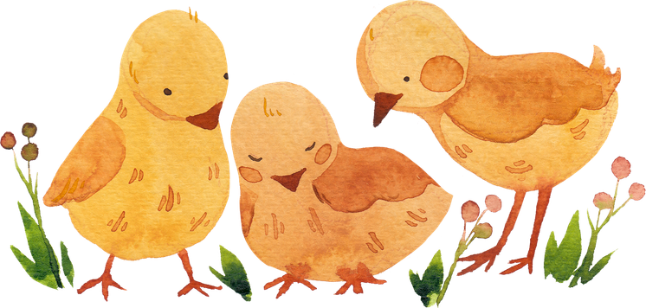
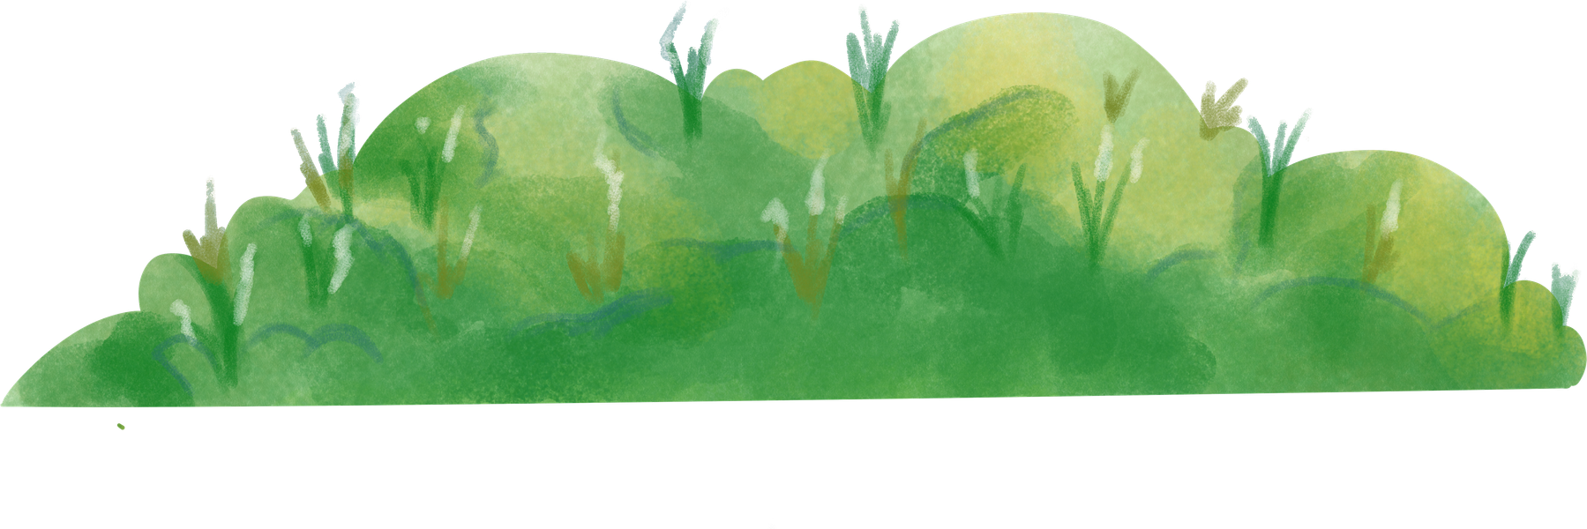
Creative Portfolio
Animation & Character Designer
Presented By:
Helene Paquet
www.reallygreatsite.com

Slide 2
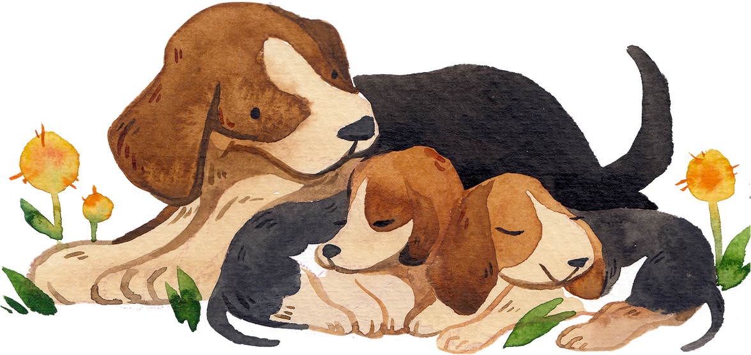

Table of Contents
01
Cover
03
Introduction
05
Signature Style
07
Project-1
09
Design Philosophy
02
Table of Contents
04
Creative Focus
06
Process Highlights
08
Project-2
10
Let’s Collaborate

Slide 3
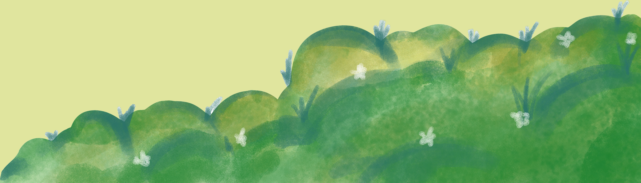

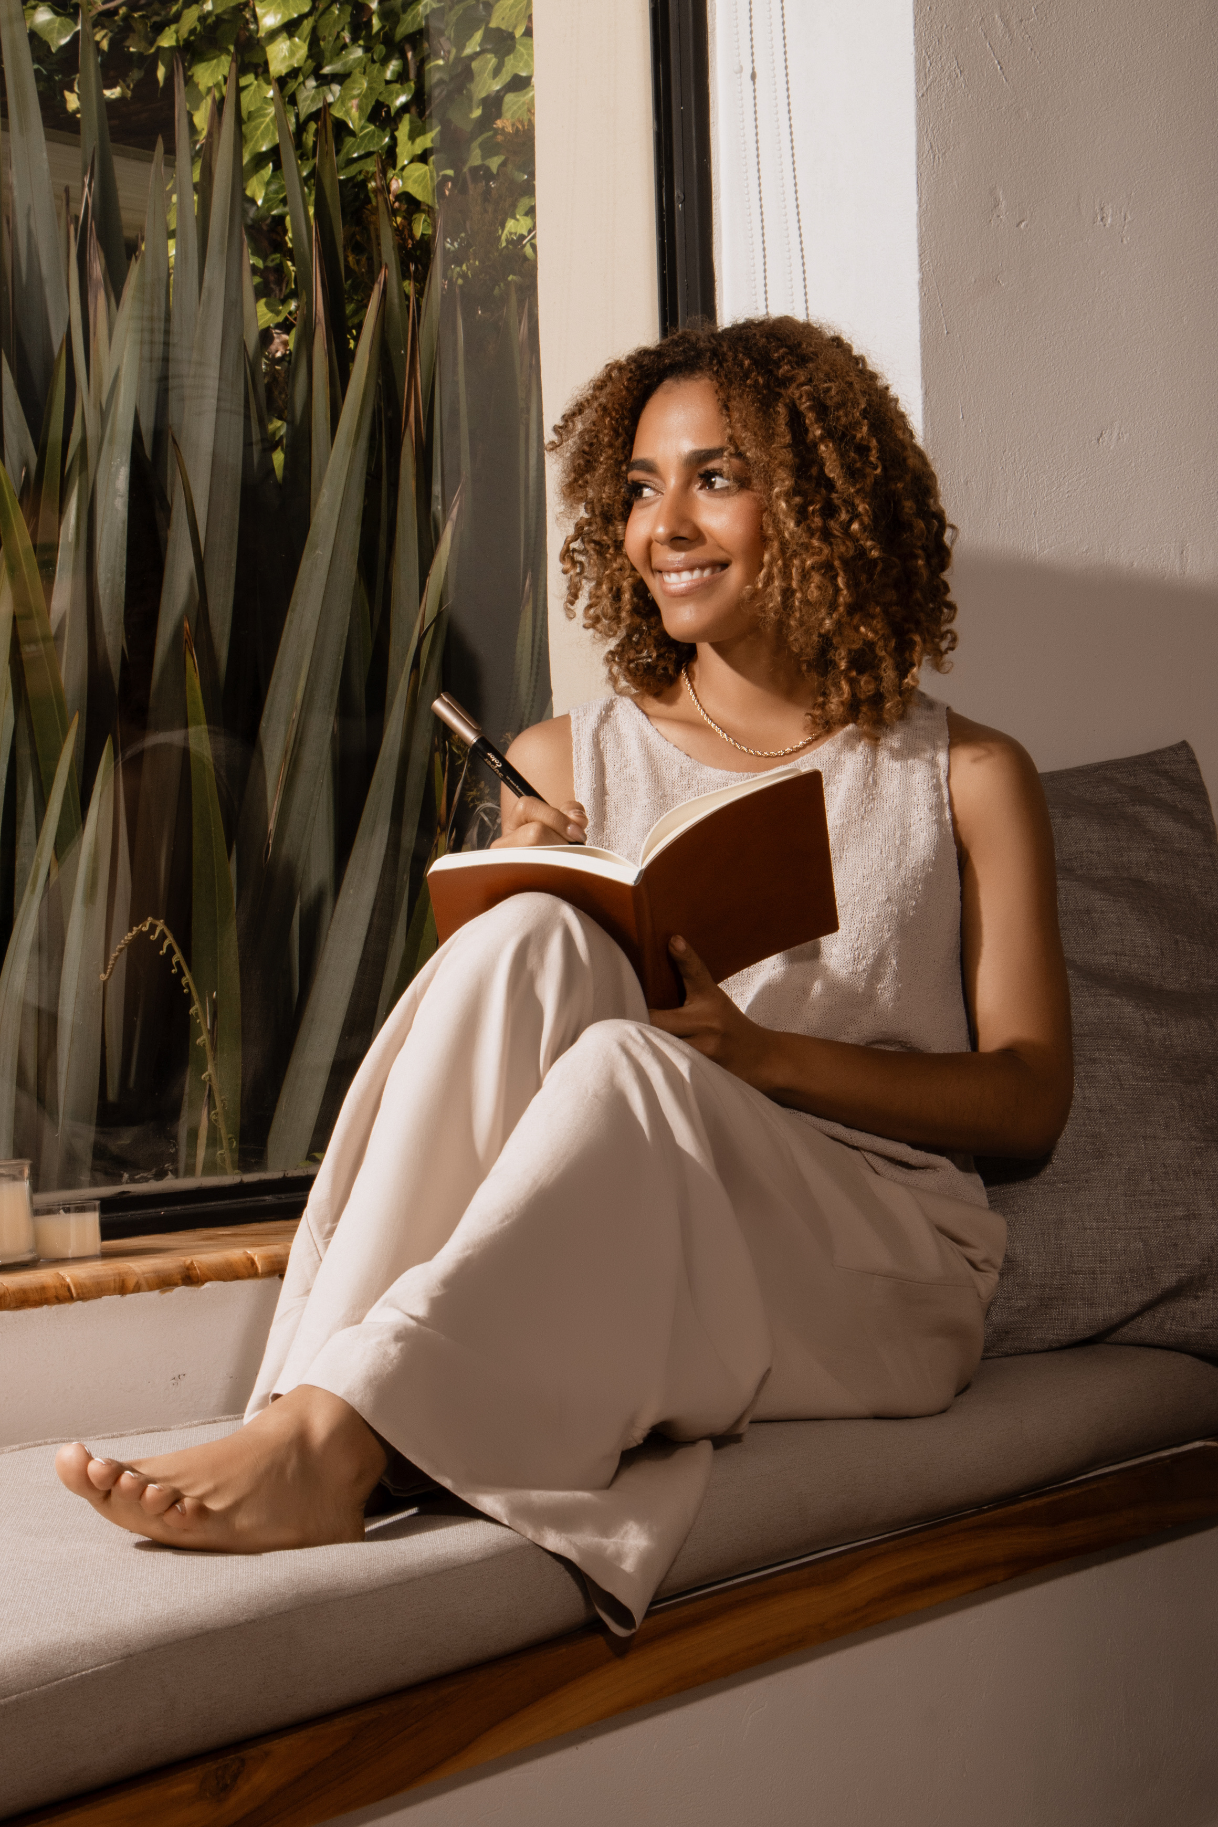
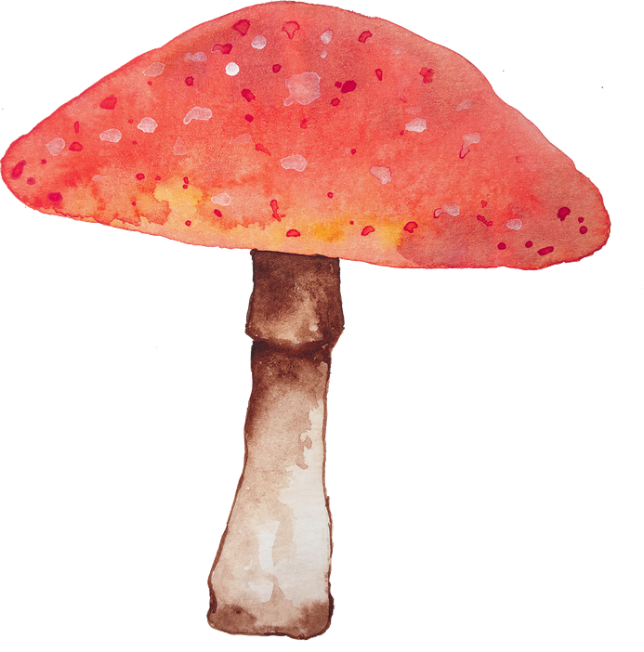
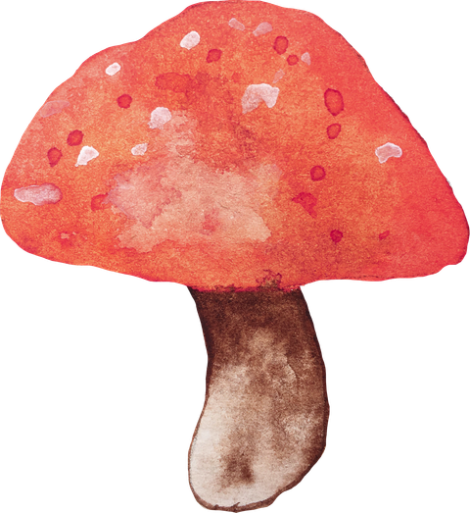
Animation & Character Designer
Introduction
Bonjour! I’m Helene. I bring characters to life through expressive, playful designs and hand-crafted 2D animation. My work blends European cartoon charm with vibrant storytelling.

Slide 4
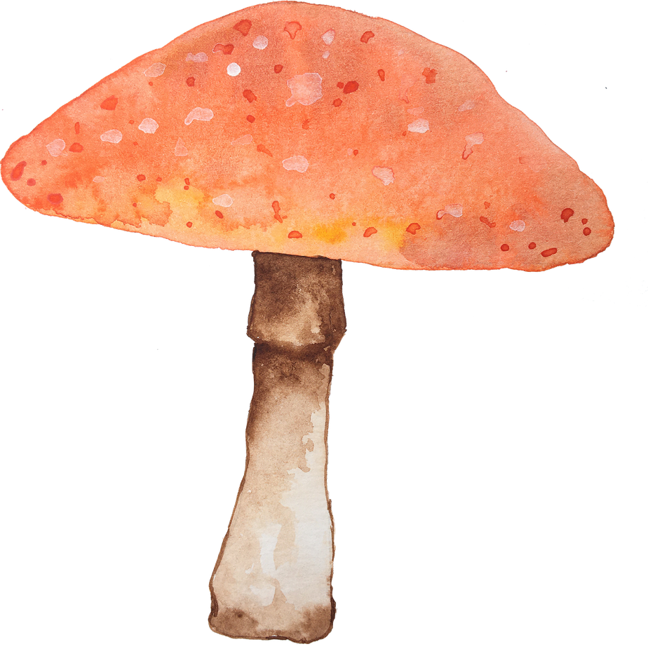
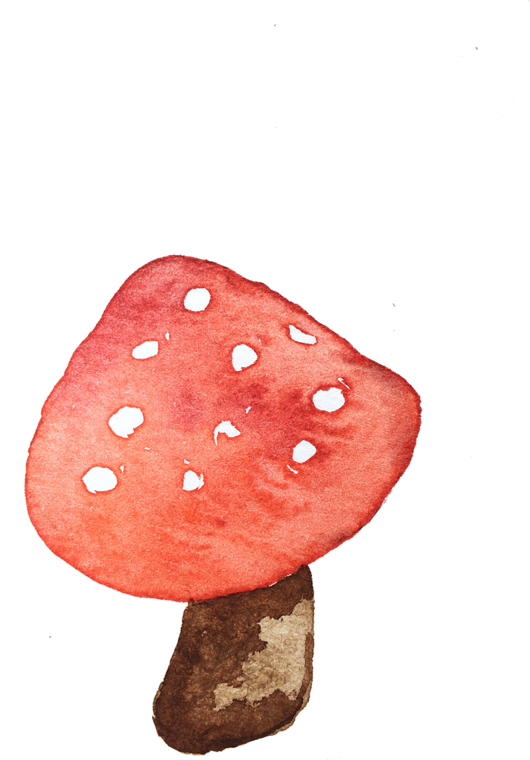
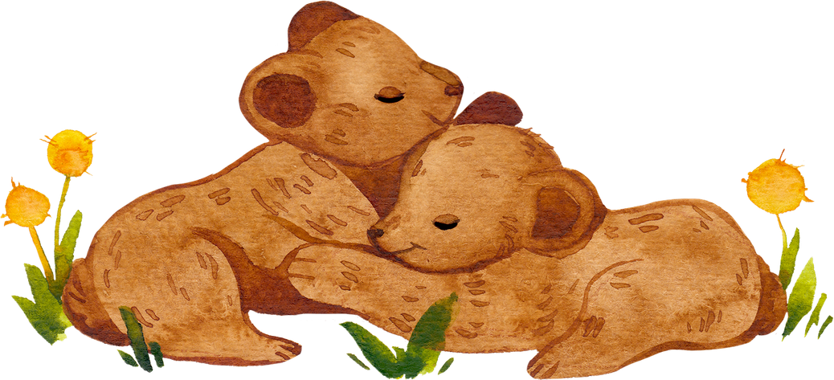
Creative Focus
Character design for animation and illustration
2D animation for series, short films, and digital content
Visual storytelling through pose, shape, and timing

Slide 5

Animation & Character Designer
www.reallygreatsite.com
Signature Style
Whimsical, expressive, and cartoon-European. I love crafting quirky, loveable characters with big personalities and emotional range. From sketches to full-motion

Slide 6
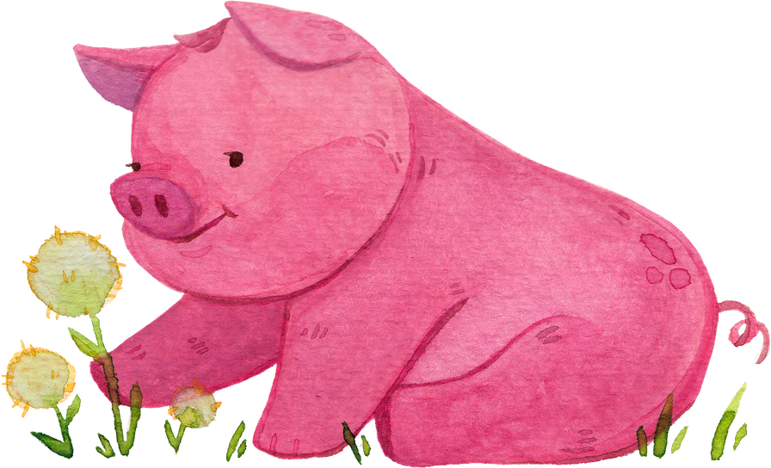
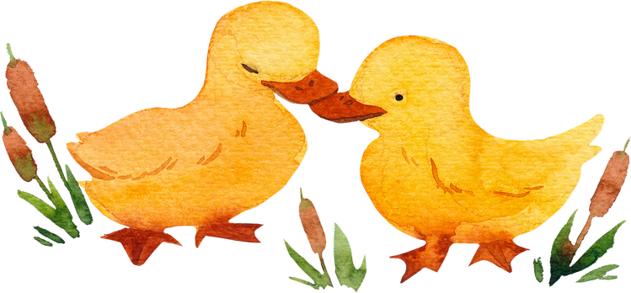
Visual research and style exploration
Turnarounds, rigs, and animation-ready designs
Sketches, shape language, and expression sheets
Final 2D animation with story-driven movement

Slide 7
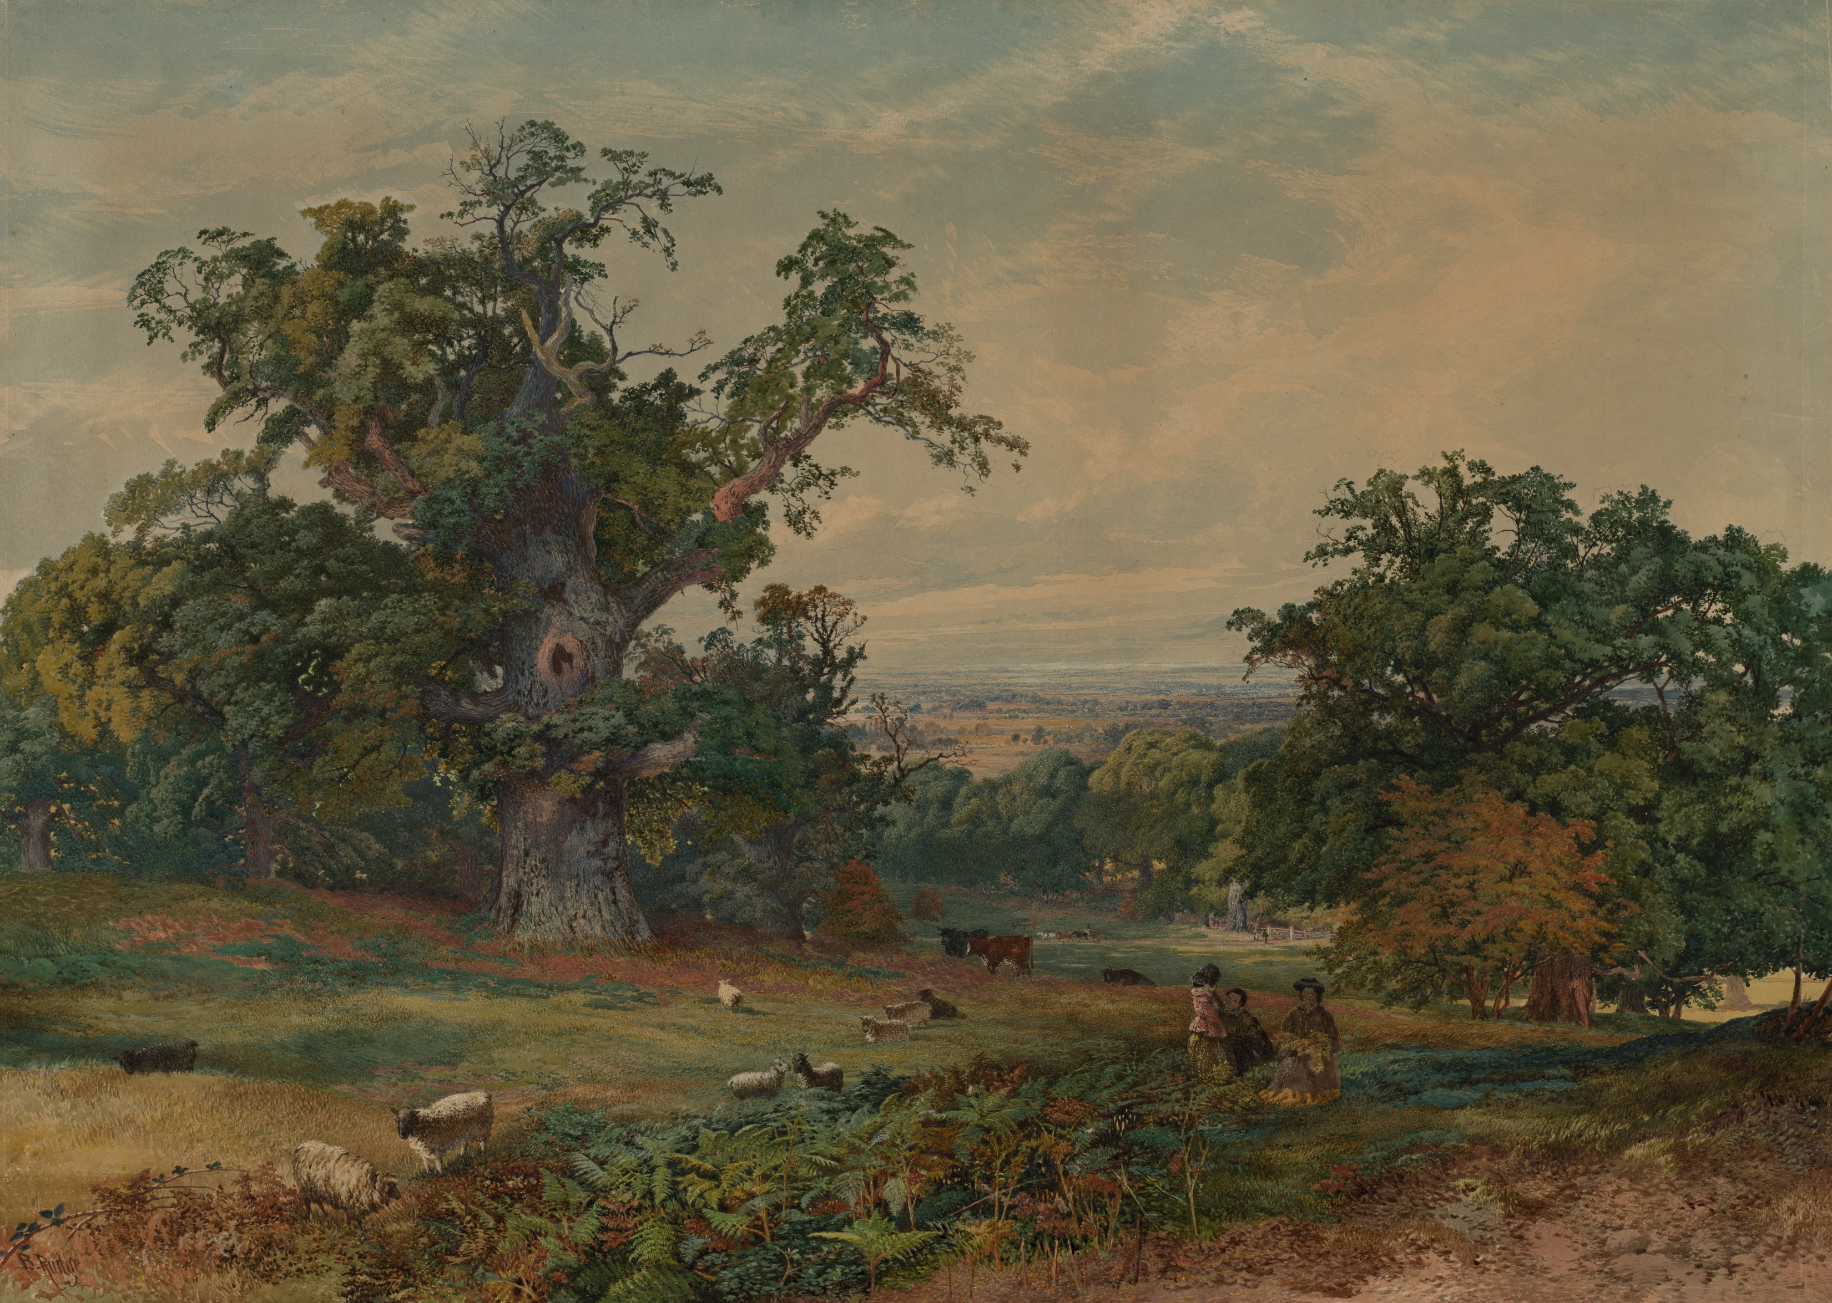
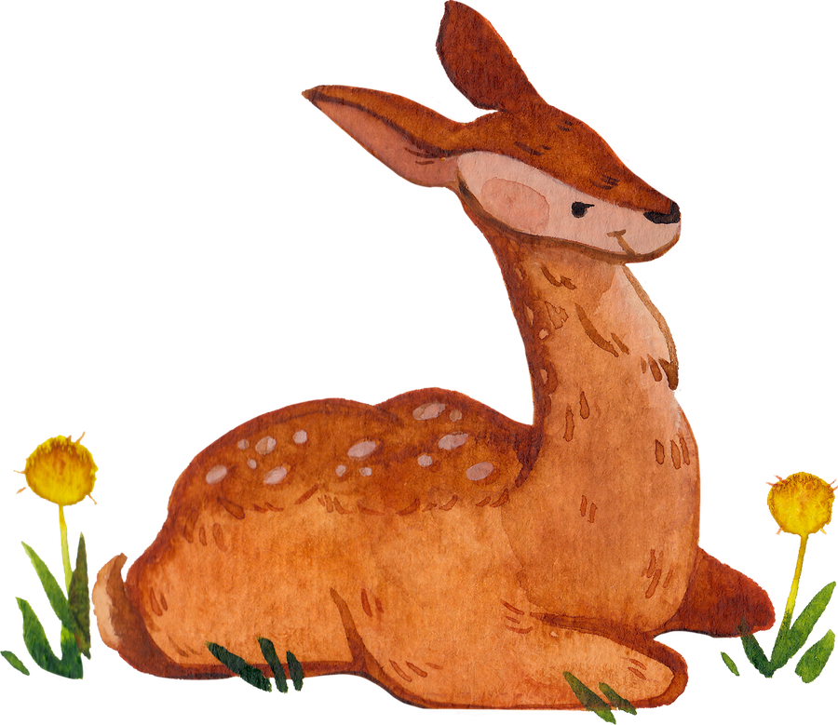
Animation & Character Designer
“Milo’s Wild Train” is an animated pilot about a curious raccoon explorer. I handled all character designs, key animations, and promotional visuals, developing a playful and dynamic motion language for young audiences.
Project – “Milo’s Wild Train”
www.reallygreatsite.com

Slide 8
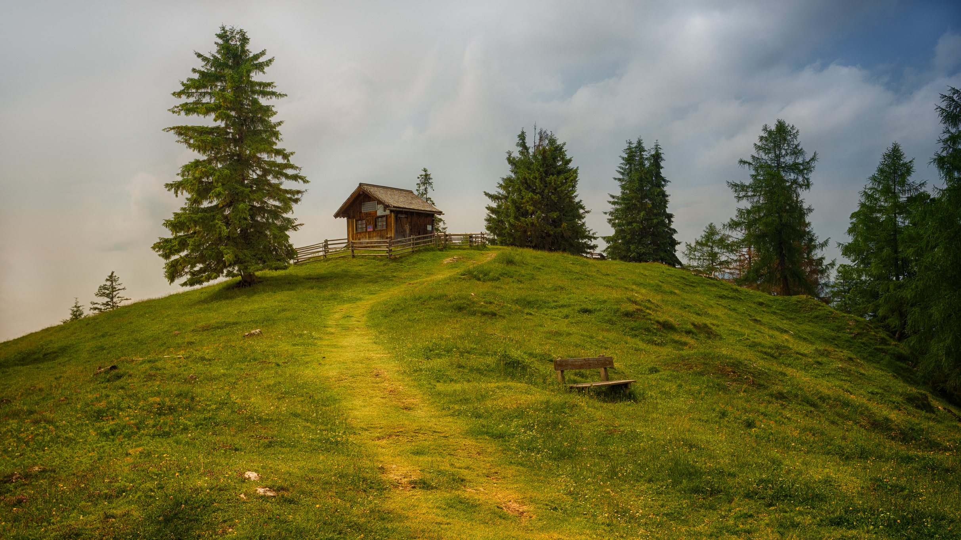


Animation & Character Designer
Project – “Little Soup Tales”
“Little Soup Tales” is a short animated web series with a cozy, heartwarming tone. I designed unique characters for each episode, creating subtle and emotional animations that connect with all ages
@reallygreatsite

Slide 9
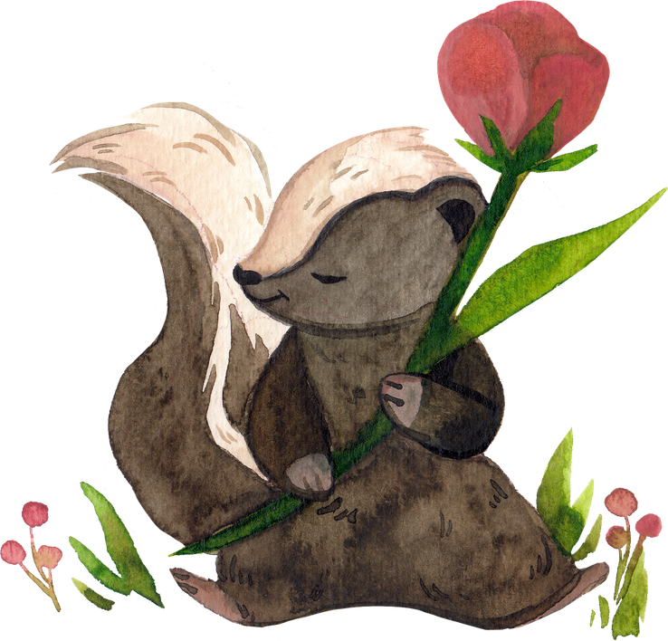
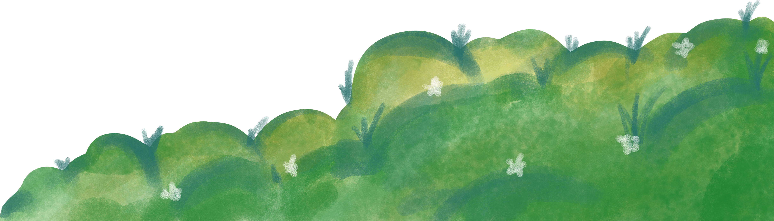
Animation & Character Designer
www.reallygreatsite.com
Design Philosophy
I believe in clarity-driven design. Good UX should feel invisible — it works when users don’t notice it. My role is to architect that flow with precision and empathy.

Slide 10
Howard Ong
I’m open to projects in product design, UX consultation, and interface systems. Let’s create digital experiences that simply make sense. Thank you.
Let’s Collaborate
@reallygreatsite

