Slide 1


Preparing for my financial future
This session is aimed at Senior Phase learners (recommended for S5 and S6)

Slide 2
Unit outline
Session 1 | Session 2 | Session 3 | Session 4 | Session 5 | Session 6
Managing Student Finance | Borrowing and Debt | Property - Renting and Buying | Cryptocurrency Risk and Reward | Money and Wellbeing | Financial literacy in the curriculum

Slide 3
Having a respectful learning environment
We will listen to each other respectfully
We will avoid making judgements or assumptions about others
We will comment on what has been said, not the person who has said it
We won’t put anyone on the spot and we have the right to pass
We will not share personal stories or ask personal questions
If there is a question that you do not wish to ask aloud, you can write it on a Post-it Note which will be collected throughout the session and answered at the end
Notes:
Teacher delivery
Students should be invited to ask questions and they should be provided with an opportunity to ask questions anonymously. It is useful to have a question box or allocated space on the whiteboard for students to share questions.
It is suggested that students are provided with post-its or slips to write their questions on and as the teacher circulates throughout the lesson these questions can be collected and answers throughout the session or using an allocated ‘question time’ at the end of the session.
Students can be invited to respond to questions asked by their peers. If responses to questions are based on personal preference or opinion, the teacher should be clear to preface any answers with this.

Slide 4
Session 1
Managing Student Finance

Slide 5
By the end of the session, I will be able to:
Describe what a student finance support is available and what costs are covered
Explain how an individual would pay back a student loan in the future
Identify steps needed to apply for a student finance application

Slide 6


Benefits and Drawbacks of University
Activity: Copy and fill in the table
What are the benefits and drawbacks of going to university?
Distinguish between immediate and long-term benefits and drawbacks.
 | Benefits | Drawbacks
Immediate
Long term
Notes:
Teacher delivery
Instruct students to draw up the table. Gather feedback until students have suggested the points in the expected feedback
Teacher Explanation
Expected Student Feedback
Benefits of university
Short term
In-depth learning of a subject
Opportunity to network and meet people
Opportunity to be independent/ learn how to budget (including through making mistakes)
Longer term
Increased earning potential
Widen job opportunities
Drawbacks
Costly - we’ll cover this in more detail
Could be gaining work experience instead; note students can also work part time while at university
Might be scary living away from home for first time and managing finances for yourself - whether paying bills or spending on nights out
Among other things, students are likely to cite the cost as an immediate drawback, and the increase earnings potential as a future benefit.
Teacher Script
Once students have mentioned this, guide the students to understand that many other students understand that gaining a university degree increases earning potential, but that the process can be costly. As such people apply for student loans to bridge this gap. It’s purpose is to ensure a wide range of people have access to higher education and are not limited by the immediate drawback of the cost.
Alternatives to University
A previous Y10 Flic session covers possible apprenticeship options. Consider mentioning to students that university is one of several possible post-18 options.

Slide 7
Benefits and Drawbacks of University
 | Benefits | Drawbacks
Immediate | In-depth learning of a subject Opportunity to network and meet people Opportunity to be independent/ learn how to budget (including through making mistakes) | Costly - we’ll cover this in more detail Could be gaining work experience instead; note students can also work part time while at university Might be scary living away from home for first time and managing finances for yourself - whether paying bills or spending on nights out
Long term | Increased earning potential Widen job opportunities Time for personal and social development, explore new hobbies and passions | Student debt repayments Possible stress and pressure of university study Missed opportunity to learn e.g. a trade. Instead, an apprenticeship could be a better option
Notes:
Teacher delivery
Instruct students to draw up the table. Gather feedback until students have suggested the points in the expected feedback
Teacher Explanation
Expected Student Feedback
Benefits of uni
Short term
In-depth learning of a subject
Opportunity to network and meet people
Opportunity to be independent/ learn how to budget (including through making mistakes)
Longer term
Increased earning potential
Widen job opportunities
Drawbacks
Costly - we’ll cover this in more detail
Could be gaining work experience instead; note students can also work part time while at university
Might be scary living away from home for first time and managing finances for yourself - whether paying bills or spending on nights out
Among other things, students are likely to cite the cost as an immediate drawback, and the increase earnings potential as a future benefit.
Teacher Script
Once students have mentioned this, guide the students to understand that many other students understand that gaining a university degree increases earning potential, but that the process can be costly. As such people apply for student loans to bridge this gap. It’s purpose is to ensure a wide range of people have access to higher education and are not limited by the immediate drawback of the cost.

Slide 8

Career decisions
This session explores how student finance works.
For some of you, this will be important information for the very near future.
For others, this session may be helpful to inform decisions that you haven’t made yet about higher education.
Remember that university is not the only option; many young people prefer to enter the workplace, as an employee or in an apprenticeship scheme.

Slide 9
True or false?
The higher your student loan, the more you pay back each month
FALSE

Slide 10
True or false?
If I haven’t paid off all of my student loan in 30 years, the rest gets written off
TRUE

Slide 11

Tuition fees loan: free for Scottish residents
Universities and higher education institutions in Scotland allocate their students a fee status for the purpose of charging tuition fees. There are three levels of fee status:
A ‘home’ fee for students who live in Scotland.
A ‘rest of UK’ (RUK) fee for students who live elsewhere in the UK or Ireland.
An ‘overseas’ fee for all other students.
Undergraduate home fees are capped by the Scottish Government at £1,820 for the 2025 to 2026 academic year. The RUK fee is capped at a middle rate equivalent to the ‘home’ fee charged in England (£9,535 for the 2025 to 2026 academic year). Overseas fees are set by institutions and can be much higher depending on the course and institution.
To receive publicly funded student support, including free tuition, loans, bursaries, and grants, students must generally also be allocated home status by Student Awards Agency Scotland (SAAS).
Tuition is free for Scottish residents attending a Scottish University.
Notes:
Update on Fees: https://www.saas.gov.uk/full-time/undergraduates/student-loan-bursary-tuition-fees

Slide 12
Living Costs
Expense | Cost per Month
Rent | £540
Groceries | £144
Household Bills | £76
Going Out | £51
Transport | £65
Takeaways | £48
Shopping | £32
Holidays/Events | £29
Health | £22
Other | £97
Total | £1,104
The table on the left shows the average living cost, ordered by expense, of university students in 2024.
With your partner, discuss what you think the missing values may be.
How do students afford their cost of living?
A maintenance loan covers living costs while at University
Source: https://www.savethestudent.org/money/student-budgeting/what-do-students-spend-their-money-on.html

Slide 13
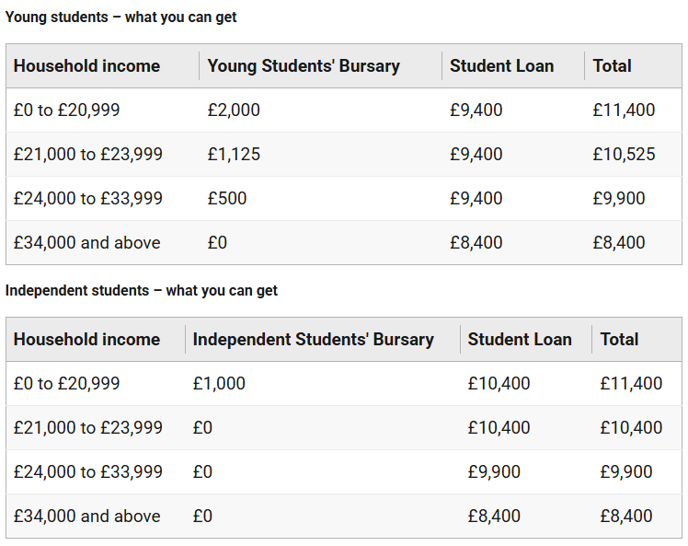
Maintenance Loan
A maintenance loan can be applied for to cover living costs while studying.
Living costs include accommodation, food, books and any equipment needed.
The amount received from a maintenance loan depends on a number of factors.
These include: household income, place of study, living location and the duration of the course.
Notes:
The maximum loan Scottish students can get for a Scottish university is £10,400 a year. You'll need to re-apply for it along with all your other student finance each year. But you'll only be able to get a loan of up to £8,400 if your household income is more than £34,000 a year.

Slide 14

Maintenance Loan (1)
The Maintenance Loan is a student loan provided by the government, and it's intended to help towards living costs while at university.
Students can give details of their household income and their course start date.
Students can use the student finance calculator to estimate how much they will get - it will also explain state eligibility for extra grants or allowances.
Source: https://www.studentinformation.gov.scot/
Notes:
Teacher explanation
By living costs we mean food, books, accommodation and travel.
Two student loan calculators:
https://www.student-loan-calculator.co.uk/
https://ukcalculator.com/student-finance-scotland-calculator.html
You might get a grant to cover some travel expenses if you normally live in England but study away from home.
If you’re a medical or dental student you might also qualify for help with the costs of attending clinical placements in the UK. You do not have to pay back a travel grant.
There are rules on eligibility and how much you’ll get.

Slide 15
Maintenance Loan (2)
Students may not get the full amount, so they may have to find other ways to fund the rest of their living costs.
  This could include part-time work, local authority assistance, bursaries, scholarships or family contributions.
The maintenance loan is paid directly into the student’s bank account at the start of each term. The loan must be paid back after their course is complete.
Source: https://www.studentinformation.gov.scot/
Notes:
Teacher explanation
‘Living costs’ may include food, books, clothing, accommodation and travel.
https://www.student-loan-calculator.co.uk/
https://www.studentcalc.co.uk/
You might get a grant to cover some travel expenses if you normally live in England but study away from home.
If you’re a medical or dental student you might also qualify for help with the costs of attending clinical placements in the UK. You do not have to pay back a travel grant.
There are rules on eligibility and how much you’ll get.

Slide 16

Recap
Scottish university tuition is free (paid for by the Scottish Government). Only international students need to take out tuition fee loans. However Scottish students will have to take out:
A maintenance loan:
  This is paid directly to students, to cover living costs (food, rent etc.)
Source: https://www.studentinformation.gov.scot/
Notes:
Teacher explanation
‘Living costs’ may include food, books, clothing, accommodation and travel.
https://www.student-loan-calculator.co.uk/
https://www.studentcalc.co.uk/
You might get a grant to cover some travel expenses if you normally live in England but study away from home.
If you’re a medical or dental student you might also qualify for help with the costs of attending clinical placements in the UK. You do not have to pay back a travel grant.
There are rules on eligibility and how much you’ll get.

Slide 17
By the end of the session, I will be able to:
Describe what a student finance support is available and what costs are covered
Explain how an individual would pay back a student loan in the future
Identify steps needed to apply for a student finance application

Slide 18

Starter | Repaying Student Loans
Activity
Watch the video → What are the three most important points?
Note, this video address repaying student loans in England, but the principles are the same. Specific details will be made clear on the next slide.
Stretch
Student loans have been described as working more like a ‘graduate tax’. Why this might be?
Video: Martin Lewis: Student Loans Decoded - Part 01 - How much does it cost to go to university
Notes:
Teacher Explanation
Student loans work much like a graduate tax, as you pay back a proportion of your income each month, in a similar way to which income tax works. The only real difference between the way that a graduate tax and the student loan system works, is that (some people) will eventually clear their debt and stop paying back the loan, whereas a graduate tax is likely to be spread over a person’s working life

Slide 19
Repaying Student Loans
Any student going to university has to repay their loan.
In Scotland students only repay the loan if their income is over £32,745 per year
Students repay 9% of anything they earn above this threshold
The debt is wiped after 30 years from the first repayment
Check here for up to date figures
Notes:
More information available here:
Repaying your student loan: Which repayment plan you're on - GOV.UK

Slide 20

How much interest will be charged?
Interest is charged on the loan from the day it is taken out
The amount of interest changes across the UK
Interest rate changes will occur, as they are fixed to either the retail price index (RPI) measure of inflation or the Bank of England Base Rate +1%, whichever is lower.
  In other words: interest will be added at the same rate as prices go up
How does interest affect loan repayments?
Interest will affect how long it takes to repay the loan completely BUT it doesn’t affect the amount paid back per year as we’ll find out soon.
Notes:
Key points
What we notice is that the price tag of university is mostly irrelevant
The amount paid back is based SOLELY on what you EARN after university (earliest will be April after you graduate)
Those who earn a lot - ie gain the most from going to university - will repay a lot
Those who don’t gain so much financially from going to university will repay little or nothing
If at any point someone earns less than the threshold, they don’t pay
Many people will never pay it back before the 30 years
The amount is calculated on pre-tax income

Slide 21

Case study 1: £30,000 salary
Meet Smita.
She earns £30,000 as a software engineer.
How much of her student loan will she contribute to over a year?
This is less than the salary threshold of £32,745, so Smita will not pay anything back.
Notes:
Key points
What we notice is that the price tag of university is mostly irrelevant
The amount paid back is based SOLELY on what you EARN after university (earliest will be April after you graduate)
Those who earn a lot - ie gain the most from going to university - will repay a lot
Those who don’t gain so much financially from going to university will repay little or nothing
If at any point earn less than the threshold, don’t pay
Many people will never pay it back before the 30 years
The amount is calculated on per-tax income

Slide 22

Case study 2: £42,000 salary
Meet David.
He earns £42,000 as a plumber.
How much of his student loan will he contribute to over a year?
He’ll be paying back 9% of £9,255 (£42,000 - £32,745) which is £832.95 a year.
That translates into £69.41 per month.
This amount will be deducted automatically from wages for employees and is paid directly to the Student Loans Company.
Notes:
Key points
What we notice is that the price tag of university is mostly irrelevant
The amount paid back is based SOLELY on what you EARN after university (earliest will be April after you graduate)
Those who earn a lot - ie gain the most from going to university - will repay a lot
Those who don’t gain so much financially from going to university will repay little or nothing
If at any point earn less than the threshold, don’t pay
Many people will never pay it back before the 30 years
The amount is calculated on per-tax income

Slide 23

Case study 3: £55,000 salary
Meet Lucy.
She earns £55,000 as a doctor.
How much of her student loan will she contribute to over a year?
She’ll be paying back 9% of £22,255 (£55,000 - £32,745) which is £2,002.95 a year.
That translates into £166.91 per month.
This amount will be deducted automatically from wages for employees and is paid directly to the Student Loans Company.
Notes:
Key points
What we notice is that the price tag of university is mostly irrelevant
The amount paid back is based SOLELY on what you EARN after university (earliest will be April after you graduate)
Those who earn a lot - ie gain the most from going to university - will repay a lot
Those who don’t gain so much financially from going to university will repay little or nothing
If at any point earn less than the threshold, don’t pay
Many people will never pay it back before the 30 years
The amount is calculated on per-tax income

Slide 24
Smita’s future decisions
Later in life, Smita decides that she wants to take a year out from work to travel to South America and volunteer at a school.
She also wants to save up to buy a home and take out a mortgage.
How will these decisions affect her student loan repayments?
If she’s not earning, she’s won’t have to contribute to her student loan
Student loans do not go on credit files
Notes:
Teacher explanation
2. The impact may be on affordability checks which establish whether you can afford to make repayments on a mortgage. Of course, if you have lower take home income with a student loan, means you’ll be assessed as being able to make smaller payments

Slide 25

Student loan and interest
Play around with the student loan repayment calculator and you’ll see the how the loan grows each year because of interest being added.
Notes:
Teacher explanation
Note that due to compound interest, the interest added each year goes up more and more each year.
https://www.moneysavingexpert.com/students/student-finance-calculator/
https://www.student-loan-calculator.co.uk/

Slide 26

Reflection
Dan is hoping to start at Edinburgh University in September 2026 and is planning to take out a student loan.
What are the key things he should consider when thinking about how much he will have pay back in the future?
Notes:
Teacher explanation
His future job salary; the interest on the loan; the total number of years until the loan is written off (i.e. 30 years); Whether he is taking out a maintenance loan as well as a tuition fee loans and, if so, the cost of the maintenance loan

Slide 27
By the end of the session, I will be able to:
Describe what a student finance support is available and what costs are covered
Explain how an individual would pay back a student loan in the future
Identify steps needed to apply for a student finance application

Slide 28

Preparing for a Student Finance Application
What details do you think are needed for an initial student finance eligibility check?

Slide 29
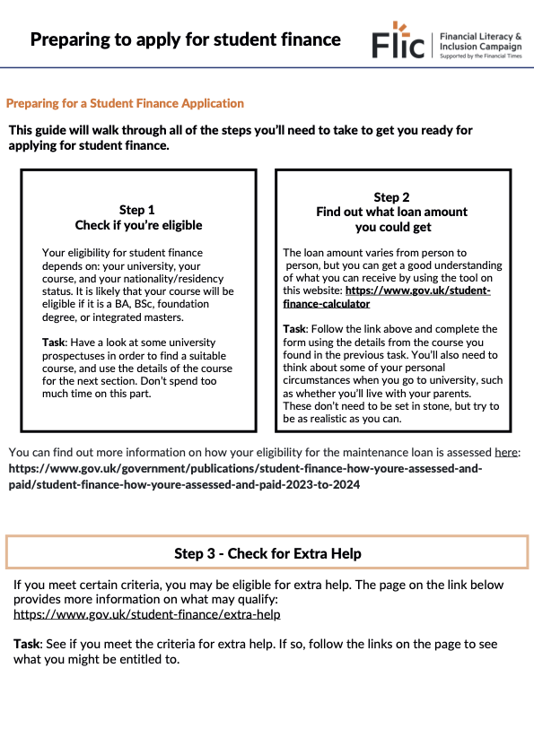
Preparing for a Student Finance Application
Activity
This task will walk you through what is needed leading up to applying for student finance.
Follow the instructions on the sheet and complete the tasks.
Resource 1: Preparing to Apply for Student Finance

Slide 30
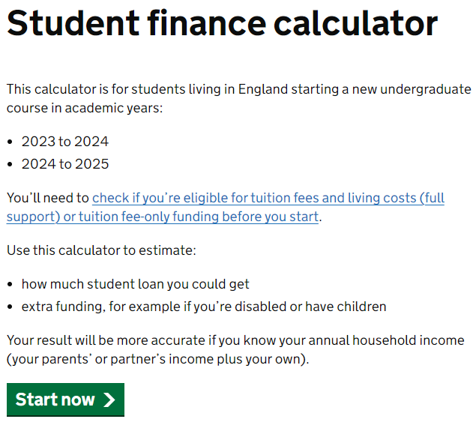
Preparing for a Student Finance Application
Let’s look through the questions asked to calculate the financial support that may be available to you, should you need to consider these.
Student finance calculator
Notes:
Link here: https://www.gov.uk/student-finance-calculator

Slide 31
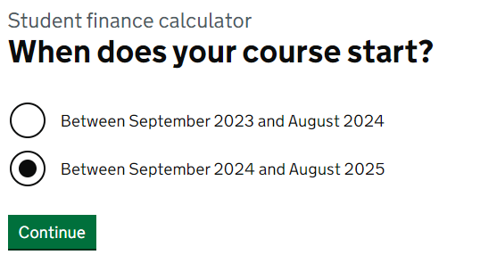
Preparing for a Student Finance Application
Why is the course start date needed?
The online application makes a calculation in line with current and expected changes to policy that could affect tuition fees and/or cost of living.

Slide 32
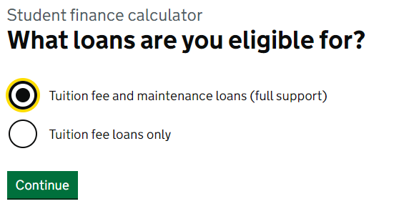
Preparing for a Student Finance Application
It is likely that you will be able to apply for full support if you live in England and have continuously lived in the UK, Channel Islands, or Isle of Man for 3 years before the first day of your first academic year.

Slide 33
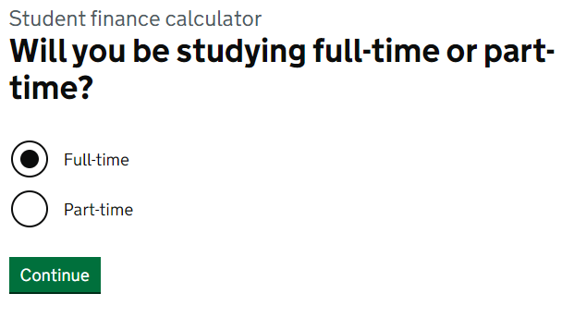
Preparing for a Student Finance Application
How might ‘type of student’ status affect the calculations ?
Part time students receive a lower tuition fee loan, as their tuition fees are usually lower each year.

Slide 34
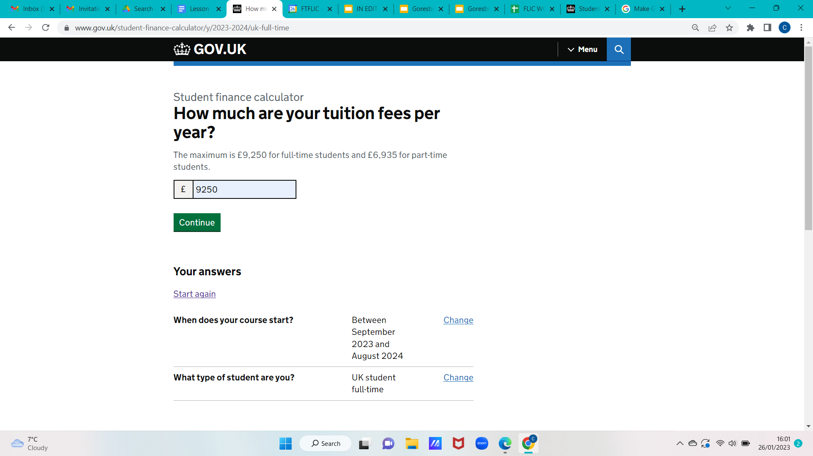
Preparing for a Student Finance Application
Tuition fees can vary based on the course and/or institution.
The student finance calculator considers how much money you actually need to cover costs.

Slide 35
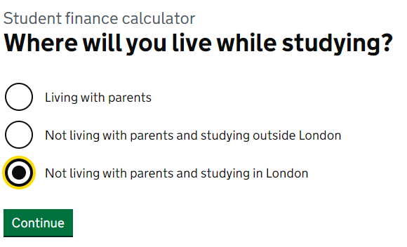
Preparing for a Student Finance Application
How might these three options affect the calculations?
Living with parents assumes that there is some financial support available, i.e. you would have a shared grocery budget for example. Living in London is more expensive than living in other regions in the UK.

Slide 36
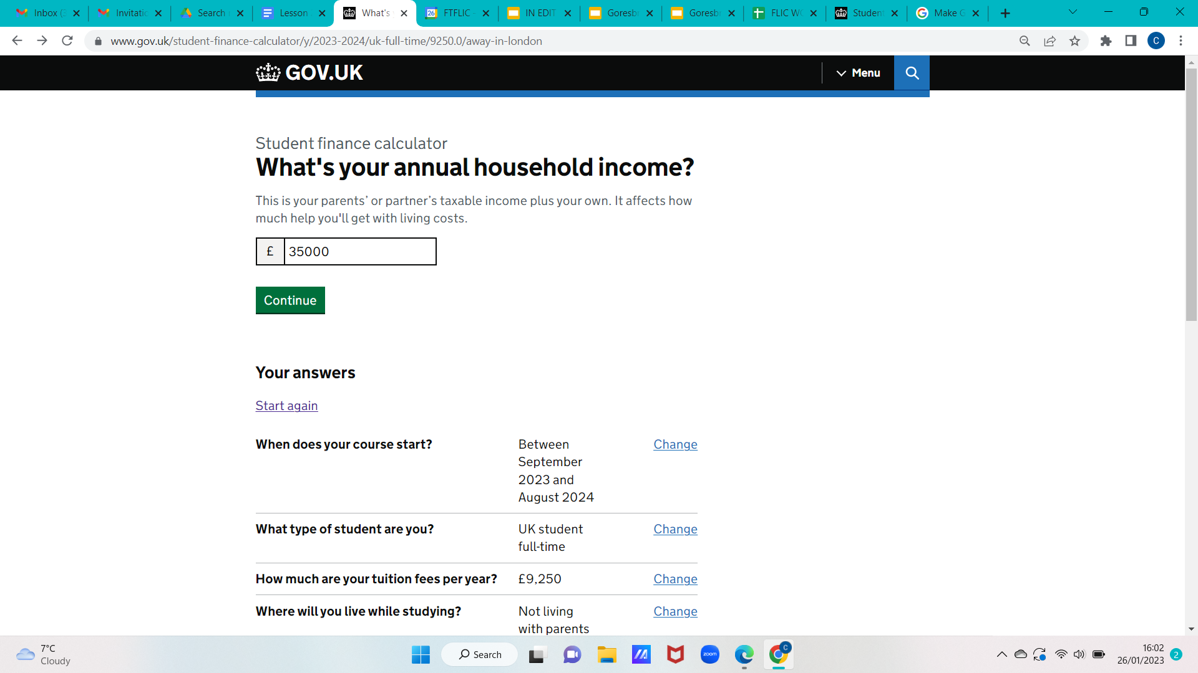
Preparing for a Student Finance Application
This is a great way to start a conversation about money at home.

Slide 37
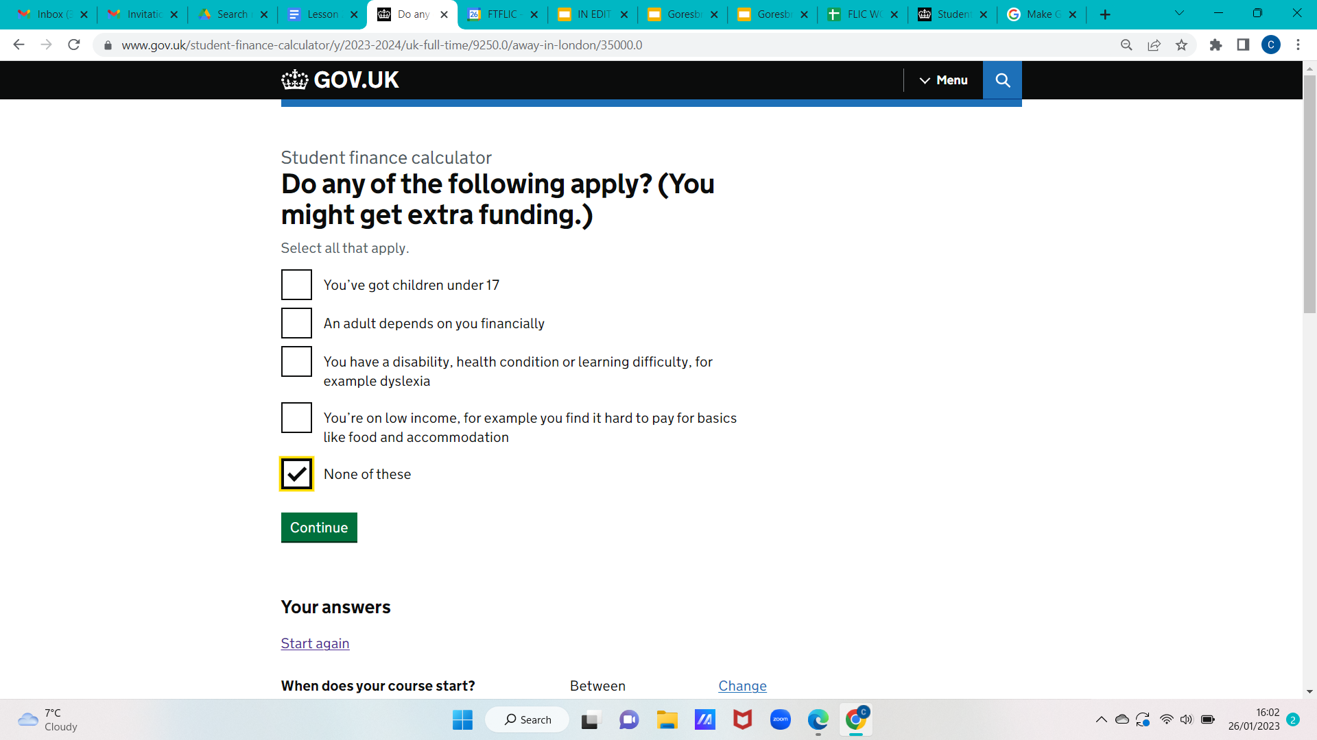
Preparing for a Student Finance Application
There may be other streams of funding available to you or anyone who depends on you if you are choosing to continue in Higher Education.
This could be a grant which does not need to be paid back.

Slide 38
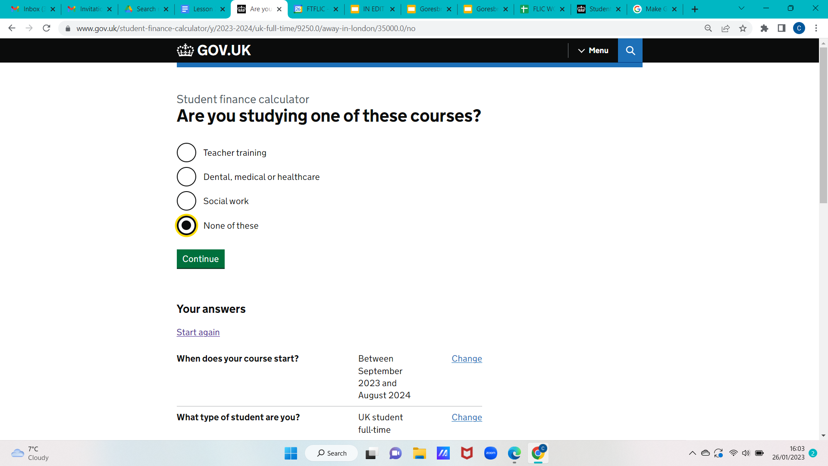
Preparing for a Student Finance Application
Why are these courses listed specifically?
There may be additional financial support to encourage and incentivise applications for course such as those listed.

Slide 39
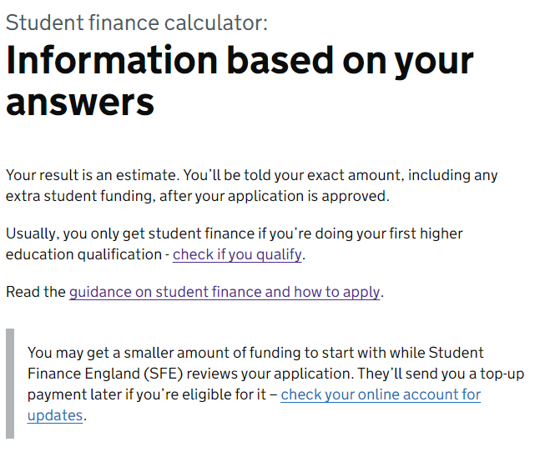
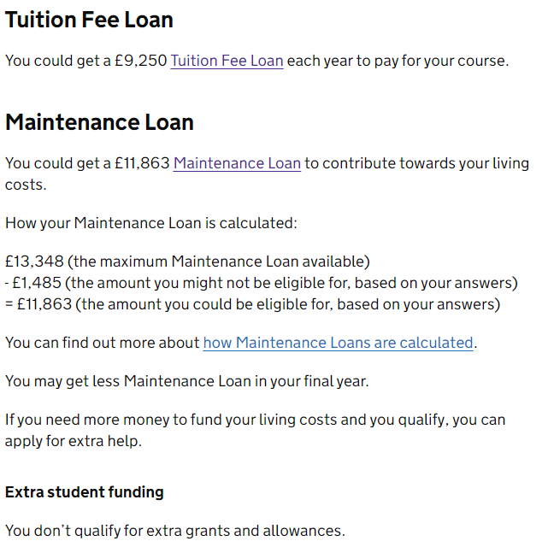
Preparing for a Student Finance Application
Based on the information given, it has been calculated that £11,863
could be available for a maintenance loan.

Slide 40
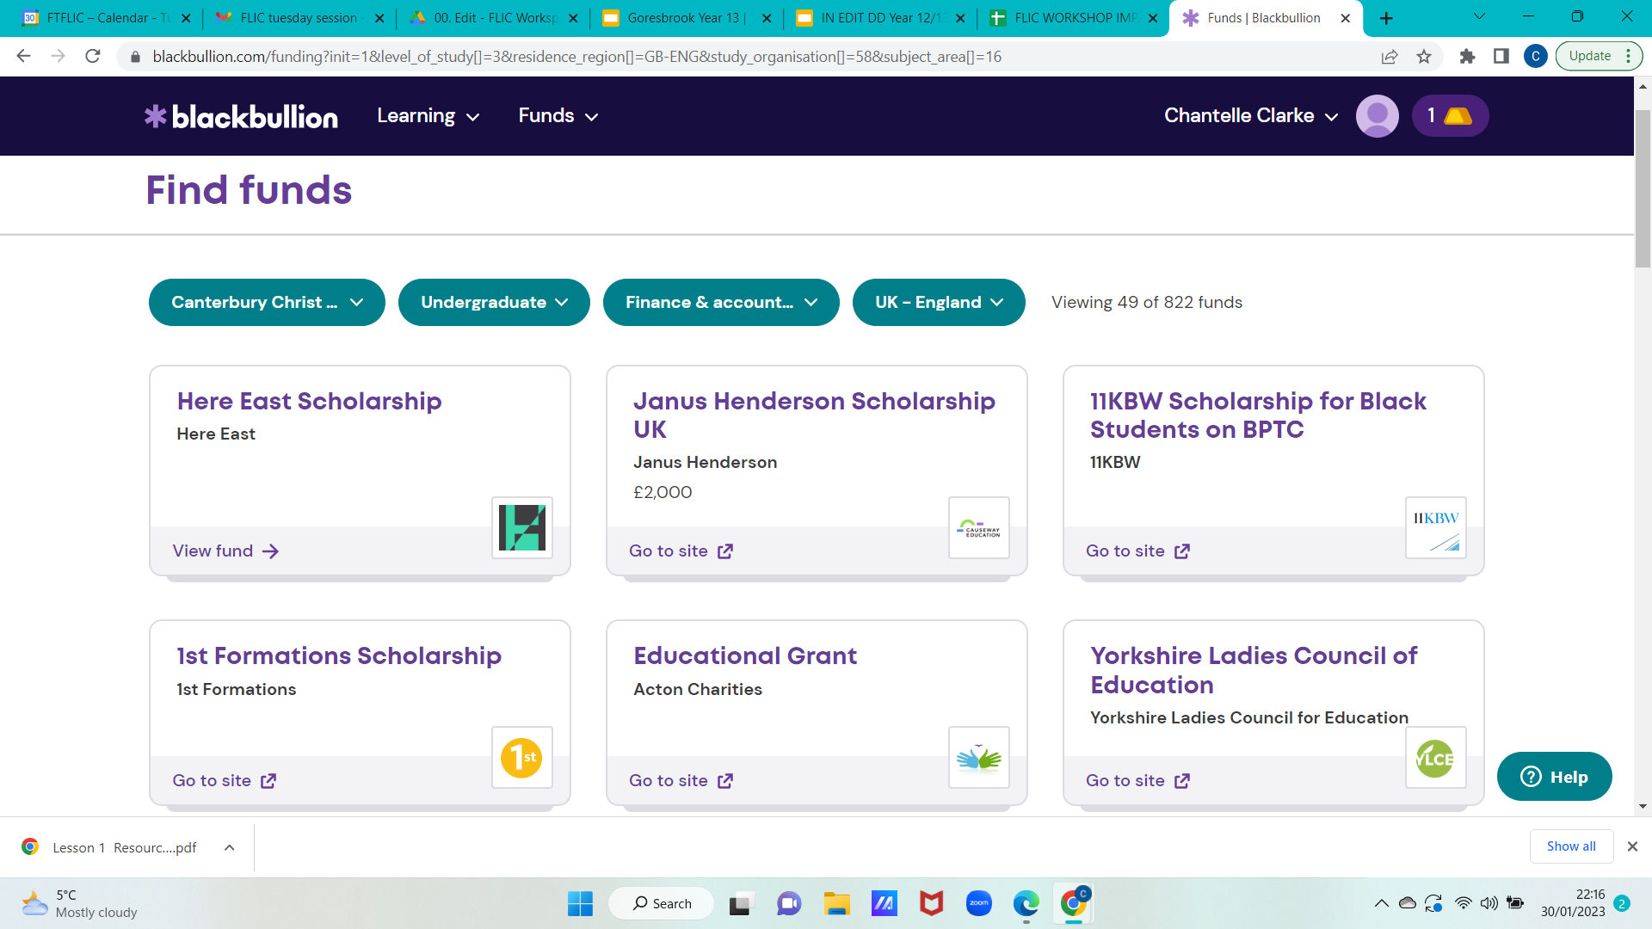
Other funding options
It’s your profile
University student support services and independent platforms for students will have a list of grant funding and scholarships that might be available to you.

Slide 41

Preparing for a Student Finance Application
Questions
In what circumstances may parents or carers be required to provide information?
What documentation is needed for a student finance application?
Why is it important to keep universities informed of finance applications once they are made?

Slide 42
Answers
1. In what circumstances may your parents be required to provide information?
If you are applying for funding based on your household income, as they will need to provide evidence of this
2. What documentation may you need to provide in your student finance application?
Passport and National Insurance Number
3. Why is it important to keep your university informed of your application?
They can support if the application is late, meaning you’ll still be able to access your course

Slide 43
True or false?
Student loans are paid back as soon as you leave university
Notes:
Teacher explanation
They are paid back the April after leaving university and only if somebody is earning more than the threshold which is £32,745 for Plan 4
The Govt may take into account household earnings (ie those of parents)
This affects taking out a mortgage
Another myth buster
You Should Save Up and Pay Off Your Student Debt as Soon as Possible.
Yet this doesn't mean you should pay them off early, just because it's allowed. While in general we encourage people to repay their debts as quickly as possible, student loans are one of the rare cases where that will be a bad decision for some people.
This is because under the new system many won't fully repay before the debt is wiped (after 30 years, use the Student Finance Calculator to see). Overpaying each month could actually be worthless – as the overpayment's not reducing the amount you'd need to pay back at all.
It can be tempting to pay off your student loan as soon as you graduate, particularly if you get a good job and are earning a decent income.
However, it’s not necessarily the smartest move for most people. Student loans come with low interest rates, and putting any extra cash you save at the end of the month into a separate savings account could be a much better long-term option for making your money go further.
It probably won’t be long until you need to take out a commercial loan at much higher interest (such as a mortgage), so just make the minimum student loan repayments to save borrowing later at a much higher cost.
Alternative:
Maintenance loan is calculated the same way across all UK universities

Slide 44
True or false?
Student loans are paid back as soon as you leave university
FALSE
Notes:
Teacher explanation
They are paid back the April after leaving university and only if somebody is earning more than the threshold which is £32,745 for Plan 4
The Govt may take into account household earnings (ie those of parents)
This affects taking out a mortgage
Another myth buster
You Should Save Up and Pay Off Your Student Debt as Soon as Possible.
Yet this doesn't mean you should pay them off early, just because it's allowed. While in general we encourage people to repay their debts as quickly as possible, student loans are one of the rare cases where that will be a bad decision for some people.
This is because under the new system many won't fully repay before the debt is wiped (after 30 years, use the Student Finance Calculator to see). Overpaying each month could actually be worthless – as the overpayment's not reducing the amount you'd need to pay back at all.
It can be tempting to pay off your student loan as soon as you graduate, particularly if you get a good job and are earning a decent income.
However, it’s not necessarily the smartest move for most people. Student loans come with low interest rates, and putting any extra cash you save at the end of the month into a separate savings account could be a much better long-term option for making your money go further.
It probably won’t be long until you need to take out a commercial loan at much higher interest (such as a mortgage), so just make the minimum student loan repayments to save borrowing later at a much higher cost.
Alternative:
Maintenance loan is calculated the same way across all UK universities

Slide 45
True or false?
I will repay 9% of my earnings when I earn over £20,000
Notes:
Teacher explanation
They are paid back the April after leaving university and only if somebody is earning more than the threshold which is £32,745 for Plan 4
The Govt may take into account household earnings (ie those of parents)
This affects taking out a mortgage
Another myth buster
You Should Save Up and Pay Off Your Student Debt as Soon as Possible.
Yet this doesn't mean you should pay them off early, just because it's allowed. While in general we encourage people to repay their debts as quickly as possible, student loans are one of the rare cases where that will be a bad decision for some people.
This is because under the new system many won't fully repay before the debt is wiped (after 30 years, use the Student Finance Calculator to see). Overpaying each month could actually be worthless – as the overpayment's not reducing the amount you'd need to pay back at all.
It can be tempting to pay off your student loan as soon as you graduate, particularly if you get a good job and are earning a decent income.
However, it’s not necessarily the smartest move for most people. Student loans come with low interest rates, and putting any extra cash you save at the end of the month into a separate savings account could be a much better long-term option for making your money go further.
It probably won’t be long until you need to take out a commercial loan at much higher interest (such as a mortgage), so just make the minimum student loan repayments to save borrowing later at a much higher cost.
Alternative:
Maintenance loan is calculated the same way across all UK universities

Slide 46
True or false?
I will repay 9% of my earnings when I earn over £20,000
FALSE
Notes:
Teacher explanation
They are paid back the April after leaving university and only if somebody is earning more than the threshold which is £32,745 for Plan 4
The Govt may take into account household earnings (ie those of parents)
This affects taking out a mortgage
Another myth buster
You Should Save Up and Pay Off Your Student Debt as Soon as Possible.
Yet this doesn't mean you should pay them off early, just because it's allowed. While in general we encourage people to repay their debts as quickly as possible, student loans are one of the rare cases where that will be a bad decision for some people.
This is because under the new system many won't fully repay before the debt is wiped (after 30 years, use the Student Finance Calculator to see). Overpaying each month could actually be worthless – as the overpayment's not reducing the amount you'd need to pay back at all.
It can be tempting to pay off your student loan as soon as you graduate, particularly if you get a good job and are earning a decent income.
However, it’s not necessarily the smartest move for most people. Student loans come with low interest rates, and putting any extra cash you save at the end of the month into a separate savings account could be a much better long-term option for making your money go further.
It probably won’t be long until you need to take out a commercial loan at much higher interest (such as a mortgage), so just make the minimum student loan repayments to save borrowing later at a much higher cost.
Alternative:
Maintenance loan is calculated the same way across all UK universities

Slide 47
True or false?
Student loans have no impact on your credit score*
*A credit score shows how reliable someone is at borrowing and repaying money. The higher the score, the more reliable someone is.
Notes:
Teacher explanation
They are paid back the April after leaving university and only if somebody is earning more than the threshold which is £32,745 for Plan 4
The Govt may take into account household earnings (ie those of parents)
This affects taking out a mortgage
Another myth buster
You Should Save Up and Pay Off Your Student Debt as Soon as Possible.
Yet this doesn't mean you should pay them off early, just because it's allowed. While in general we encourage people to repay their debts as quickly as possible, student loans are one of the rare cases where that will be a bad decision for some people.
This is because under the new system many won't fully repay before the debt is wiped (after 30 years, use the Student Finance Calculator to see). Overpaying each month could actually be worthless – as the overpayment's not reducing the amount you'd need to pay back at all.
It can be tempting to pay off your student loan as soon as you graduate, particularly if you get a good job and are earning a decent income.
However, it’s not necessarily the smartest move for most people. Student loans come with low interest rates, and putting any extra cash you save at the end of the month into a separate savings account could be a much better long-term option for making your money go further.
It probably won’t be long until you need to take out a commercial loan at much higher interest (such as a mortgage), so just make the minimum student loan repayments to save borrowing later at a much higher cost.
Alternative:
Maintenance loan is calculated the same way across all UK universities

Slide 48
True or false?
Student loans have no impact on your credit score*
TRUE
*A credit score shows how reliable someone is at borrowing and repaying money. The higher the score, the more reliable someone is.
Notes:
Teacher explanation
They are paid back the April after leaving university and only if somebody is earning more than the threshold which is £32,745 for Plan 4
The Govt may take into account household earnings (ie those of parents)
This affects taking out a mortgage
Another myth buster
You Should Save Up and Pay Off Your Student Debt as Soon as Possible.
Yet this doesn't mean you should pay them off early, just because it's allowed. While in general we encourage people to repay their debts as quickly as possible, student loans are one of the rare cases where that will be a bad decision for some people.
This is because under the new system many won't fully repay before the debt is wiped (after 30 years, use the Student Finance Calculator to see). Overpaying each month could actually be worthless – as the overpayment's not reducing the amount you'd need to pay back at all.
It can be tempting to pay off your student loan as soon as you graduate, particularly if you get a good job and are earning a decent income.
However, it’s not necessarily the smartest move for most people. Student loans come with low interest rates, and putting any extra cash you save at the end of the month into a separate savings account could be a much better long-term option for making your money go further.
It probably won’t be long until you need to take out a commercial loan at much higher interest (such as a mortgage), so just make the minimum student loan repayments to save borrowing later at a much higher cost.
Alternative:
Maintenance loan is calculated the same way across all UK universities

Slide 49
Student loan FAQs
Do I have to take out a student loan?
If I finish my course early, do I still have to repay the full amount?
Is it a good idea to repay my student loan early?
Can I choose to pay a bit more per month, e.g. 15% instead of 9%?
Can I get a refund it I’ve paid too much?
If I’m self-employed, do I still need to repay my student loan?
Notes:
Additional information: https://www.practitioners.slc.co.uk/media/1969/sfe_faq_plan5_feb2023.pdf

Slide 50
Student loan FAQs
1. Do I have to take out a student loan? No. Student loans are optional. You can fund university through savings, family contributions, part-time work, scholarships, or grants. However, most students need loans to cover costs.
2. If I finish my course early, do I still have to repay the full amount? You only repay what you've borrowed. If you finish early, you'll have borrowed less. Repayments are based on your income, not how long you studied.
3. Is it a good idea to repay my student loan early? Generally no. Student loans work like a graduate tax - you only pay 9% above £32,745. The debt is wiped after 30 years, and most people never repay it fully. Your money is usually better invested elsewhere (savings, pension, house deposit).
Notes:
Additional information: https://www.practitioners.slc.co.uk/media/1969/sfe_faq_plan5_feb2023.pdf

Slide 51
Student loan FAQs
4. Can I choose to pay a bit more per month, e.g. 15% instead of 9%? Yes, you can make voluntary overpayments at any time. However, this isn't usually recommended unless you're a very high earner who will definitely repay the full amount.
5. Can I get a refund if I've paid too much? Yes. If you've overpaid (e.g., through incorrect deductions), contact the Student Loans Company and they'll refund you.
6. If I'm self-employed, do I still need to repay my student loan? Yes. Self-employed people repay through their Self Assessment tax return. You'll pay 9% on income above £32,745, just like employees.
Notes:
Additional information: https://www.practitioners.slc.co.uk/media/1969/sfe_faq_plan5_feb2023.pdf

Slide 52
By the end of the session, I will be able to:
Describe what a student finance support is available and what costs are covered
Explain how an individual would pay back a student loan in the future
Identify steps needed to apply for a student finance application

Slide 53
3-2-1
Write down…
3
2
1
things you’ve learnt
skills you’ve practised
question you have about student finance

Slide 54
Any questions?
?

Slide 55



Services available for people who have concerns about their personal finances
Citizens Advice – Debt and Money – This resource contains links to advice on a number of topics, including financial difficulties, cost of living and communicating with creditors.
National Debtline – Debt and Money – a debt advice charity run by the Money Advice Trust, offering a free and confidential debt advice service.
Childline Helpline
0800 1111
At school, you can speak with an adult you trust.
This could be your form tutor, head of year or the school’s safeguarding officer.
Notes:
Read the moneysavingexpert debt problems guide
https://www.stepchange.org/
https://www.moneyhelper.org.uk/en/everyday-money/types-of-credit/overdrafts-explained

Slide 56
Links to learn more!
Articles to extend learning
Please visit the FLIC learning hub for further resources
Students hit by cost of living crunch (Financial Times, 2022)
The Budget Planner (MoneySavingExpert, October 2025)
How to stop spending (MoneySavingExpert, March 2022)
10 Best Budgeting & Money-Saving Apps in 2025 (International Business Times, 2025)
Student Loans Decoded (Money Saving Expert)
Budgeting apps:
BlackBullion
Emma

Slide 57
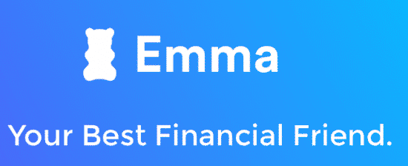


Some budgeting apps

